Slide 1

The Severity Prediction of Binary and Multi-Class Cardiovascular Disease: A Machine Learning-Based Fusion Approach
Paper by: Hafsa Binte Kibria & Abdul Matin (arXiv:2203.04921v1)
Presented by: Yogeshvar Reddy Kallam

Slide 2
The Motivation: A Critical Clinical Need
The Problem: Cardiovascular Diseases (CVDs) are the leading cause of mortality worldwide, responsible for ~17.9 million deaths annually (31% of all global deaths).
The Bottleneck: Traditional diagnosis (symptoms, ECGs, bloodwork) is often time-consuming, expensive, and reactive.
The Goal: There is a significant clinical need for an accurate, rapid, and cost-effective predictive model.
The Proposed Solution: Use machine learning (ML) to analyze existing patient data, identify hidden patterns, and create a robust predictive system.

Slide 3


The Core Research Problem: Two Classifications
Binary Classification (The Baseline)
Multi-Class (The Core Contribution)
■
Question: Does the patient have heart disease? (Yes/No)
■
Question: If they have heart disease, what is the severity?
■
Prediction: A two-class model predicting the presence or absence of disease.
■
Prediction: A five-class model predicting the specific stage of heart disease.
■
Purpose: Serves as a well-understood baseline to validate the model's methodology.
■
Labels: '0' (no disease) and '1-4' (representing escalating degrees of severity).

Slide 4
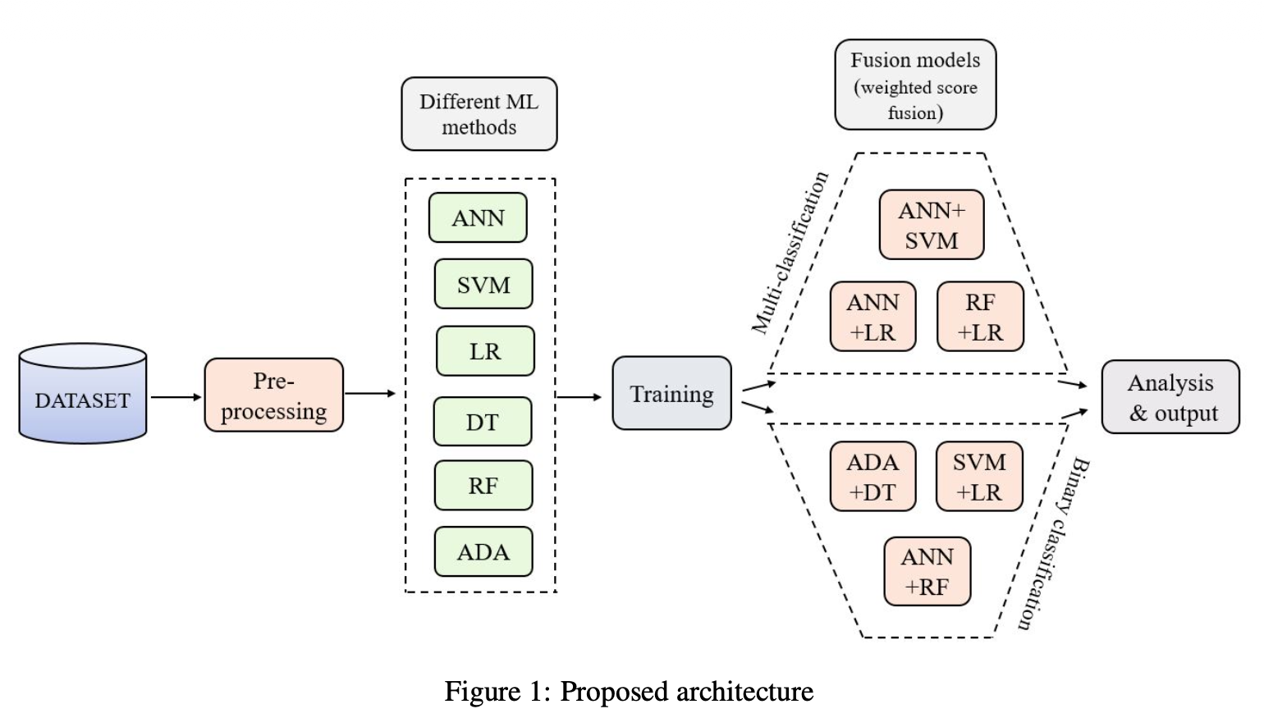

Slide 5
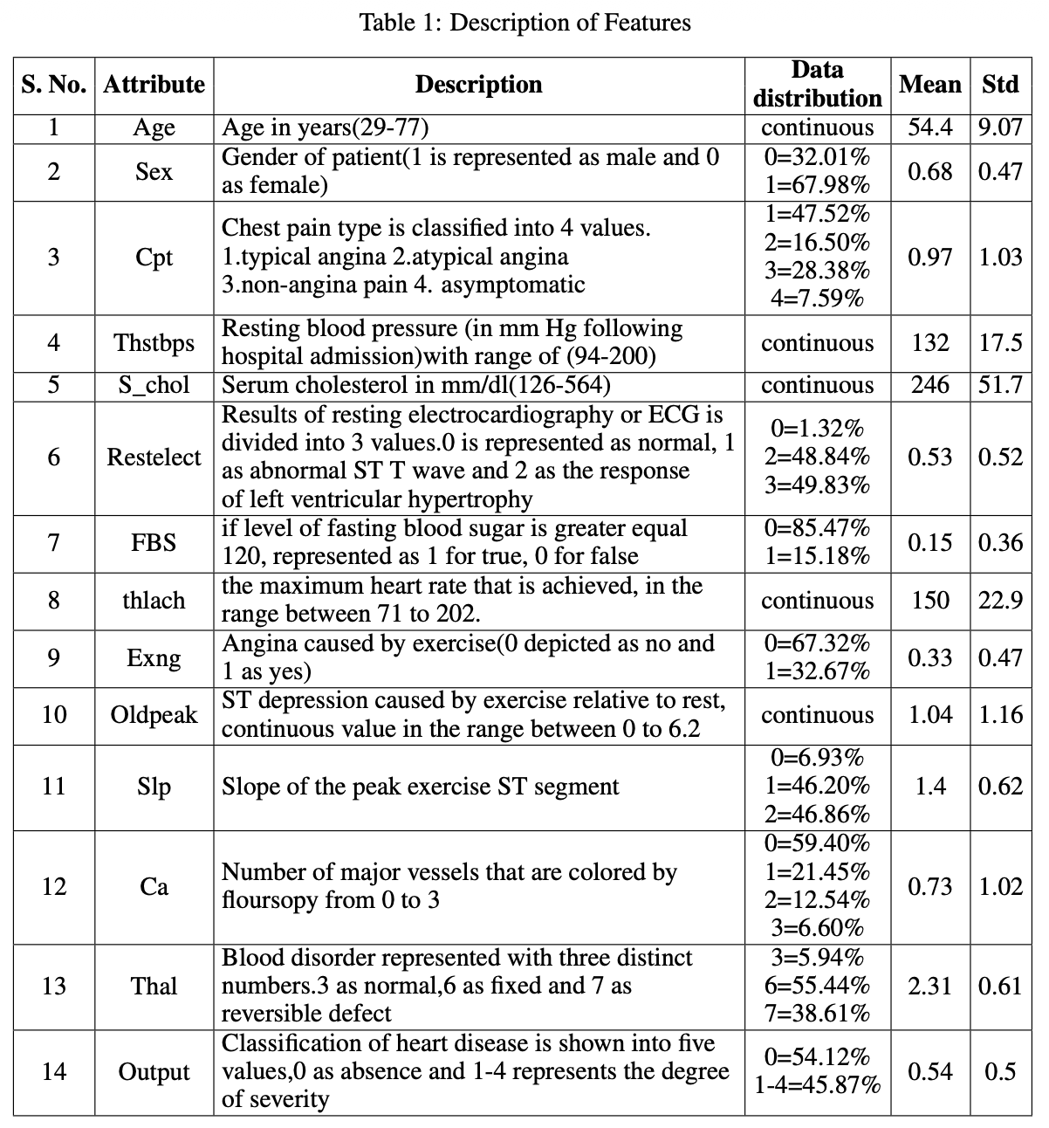


Data & Pre-processing
The Dataset: Cleveland UCI
Pre-processing Pipeline
■
Source: Cleveland Heart Disease dataset from the UCI Repository.
■
Missing Values: Replaced using the "most frequent" value strategy.
■
Size: 303 patient cases.
■
Encoding: Categorical features converted to numeric values via label encoder.
■
Features: 13 key attributes selected (age, sex, chest pain type, cholesterol, etc.).
■
Feature Scaling: Standardization (z-score) and min-max normalization were used.
■
Splitting: 70:30 and 80:20 train/test ratios were used to evaluate performance.

Slide 6
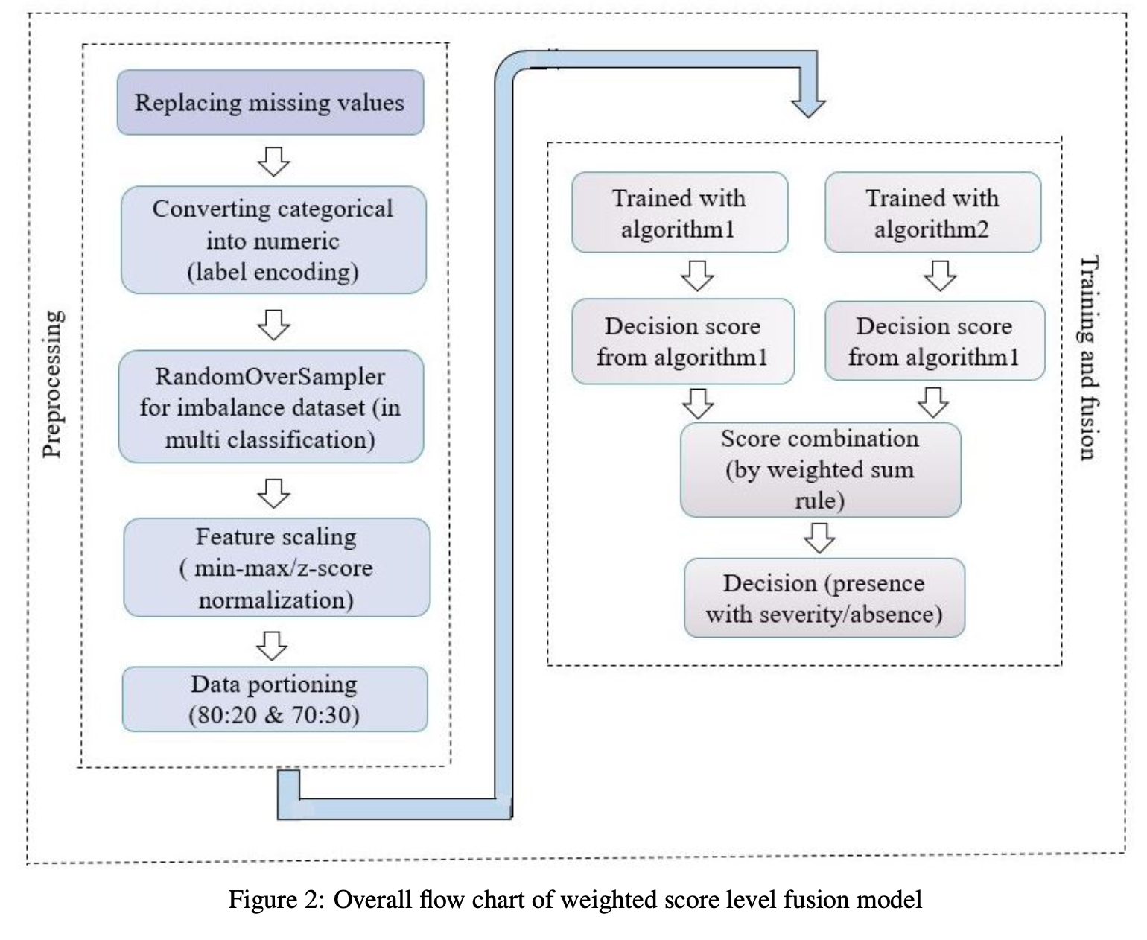
Data & Pre-processing
The Dataset: Cleveland UCI
Pre-processing Pipeline
■
Source: Cleveland Heart Disease dataset from the UCI Repository.
■
Missing Values: Replaced using the "most frequent" value strategy.
■
Size: 303 patient cases.
■
Encoding: Categorical features converted to numeric values via label encoder.
■
Features: 13 key attributes selected (age, sex, chest pain type, cholesterol, etc.).
■
Feature Scaling: Standardization (z-score) and min-max normalization were used.
■
Splitting: 70:30 and 80:20 train/test ratios were used to evaluate performance.

Slide 7


Methodology I: The Baseline Models
Standard & Neural Models
Ensemble Models
Six individual models were trained and tuned to serve as baselines:
Standard tree-based and boosting ensemble methods were also tested:
■
Artificial Neural Network (ANN)
■
Decision Tree (DT)
■
Support Vector Machine (SVM)
■
Random Forest (RF)
■
Logistic Regression (LR)
■
AdaBoost (ADA)

Slide 8

Methodology II: The "Weighted Score Fusion"
Concept & Formula
The Model Pairings
A "late fusion" approach that takes probabilistic decision scores (D_i) from two models and fuses them.
Three distinct fusion models were created for each problem:
The Formula (Weighted Sum Rule):
Multi-Class:
■
(ANN + SVM)
■
(ANN + LR)
where W_1 + W_2 = 1
■
(RF + LR)
Binary:
■
(ADA + DT)
■
(SVM + LR)
■
(ANN + RF)

Slide 9
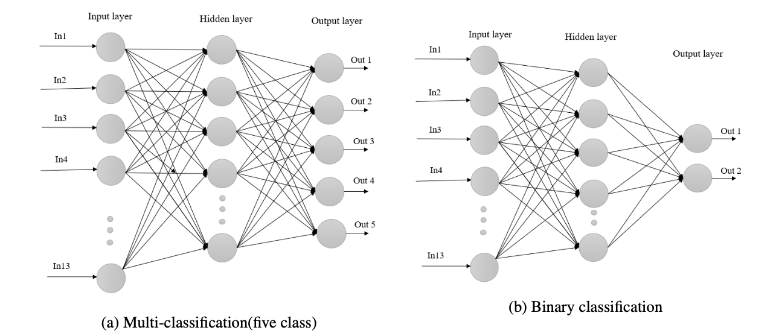
The difference between them is that in multi-classification, the output layer contains five nodes, one for the absence of heart disease and the other four for reflecting the severity of the heart disease. On the other hand, the binary classification structure has two nodes for output.

Slide 10
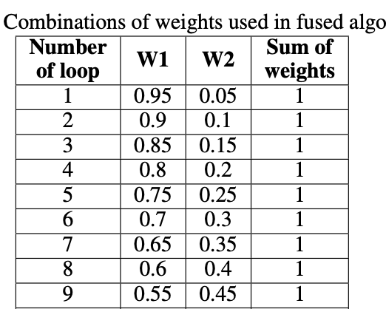
Methodology III: How to Find the Optimal Weights
The authors used a systematic, data-driven approach (Algorithm 1) to find the perfect weights.
The Process: A loop iterates 19 times, testing all weight combinations from W_1=0.95, W_2=0.05 up to W_1=0.05, W_2=0.95.
The Calculation: For each combination, the model calculates the final accuracy on the test set.
The Result: The pair of weights (W_1, W_2) that produced the highest accuracy is selected as the optimal set for that fusion model.

Slide 11
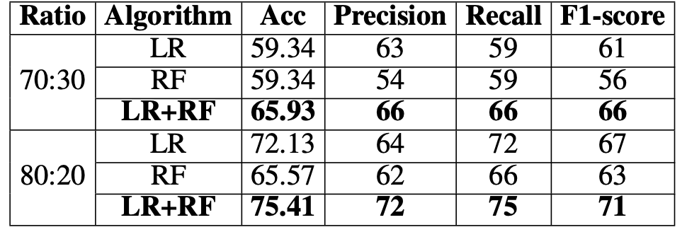
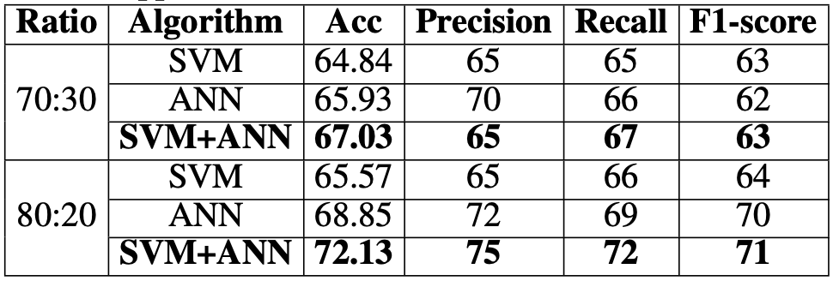
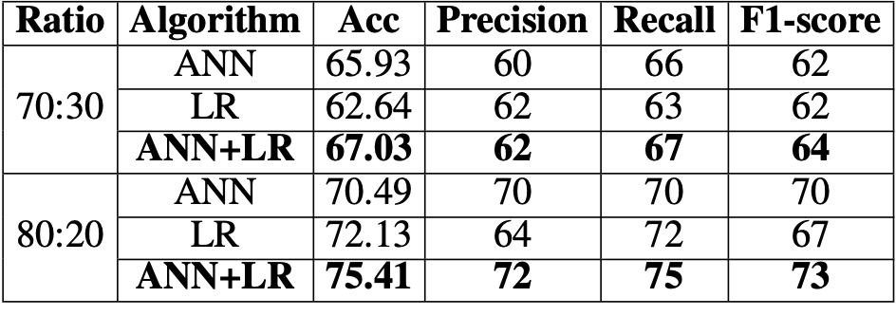
Results I: Multi-Class Severity Prediction (80:20 Split)
Clear & Consistent Improvement
Fusion Model-1 with logistic regression and random forest for multi classification
Best Models: Two fusion models tied for the top score: (LR + RF) and (ANN + LR).
The "Lift": The (LR + RF) model and ( ANN +LR) model (75.41%) achieved a +3.28% gain over its best individual model (LR at 72.13%).
Fusion Model-2 with support vector machine and artificial neural network for multi classification
Clinical Insight: The authors noted improved recall, which is a crucial clinical trade-off, as "a false-negative is considered a criminal offense."
Fusion Model-3 with artificial neural network and logistic regression for multi classification

Slide 12
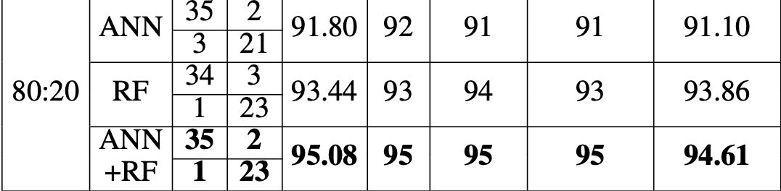
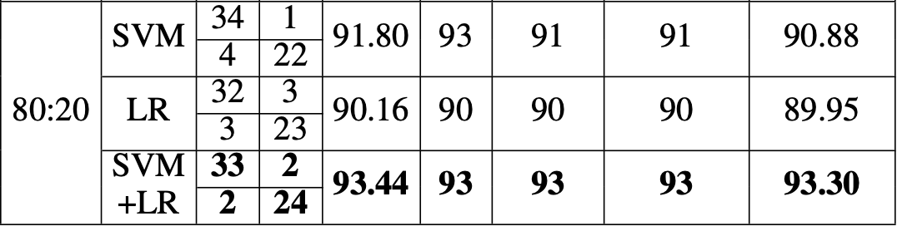
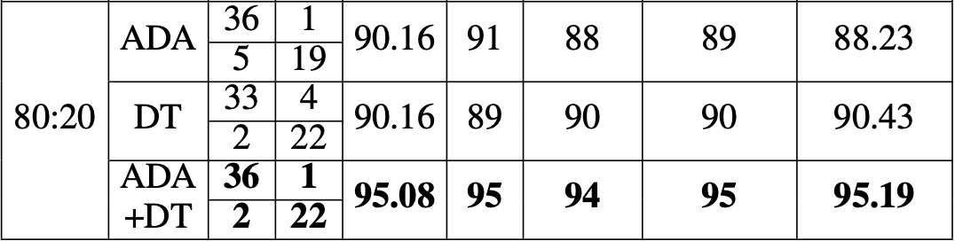
Results II: Binary Presence/Absence (80:20 Split)
State-of-the-Art Performance
Fusion Model-1 with artificial neural network and random forest for binary classification
Best Models: Two fusion models tied for the top spot: (ANN + RF) and (ADA + DT).
The "Lift": (ANN + RF) showed a +1.64% gain over its best baseline (RF at 93.44%).
Synergy: (ADA + DT) showed a massive +4.92% gain over its individual models, which were both stuck at 90.16%.
Fusion Model-2 with support vector machine and logistic regression for binary Classification
Fusion Model-3 with adaboost and decision tree for binary classification

Slide 13
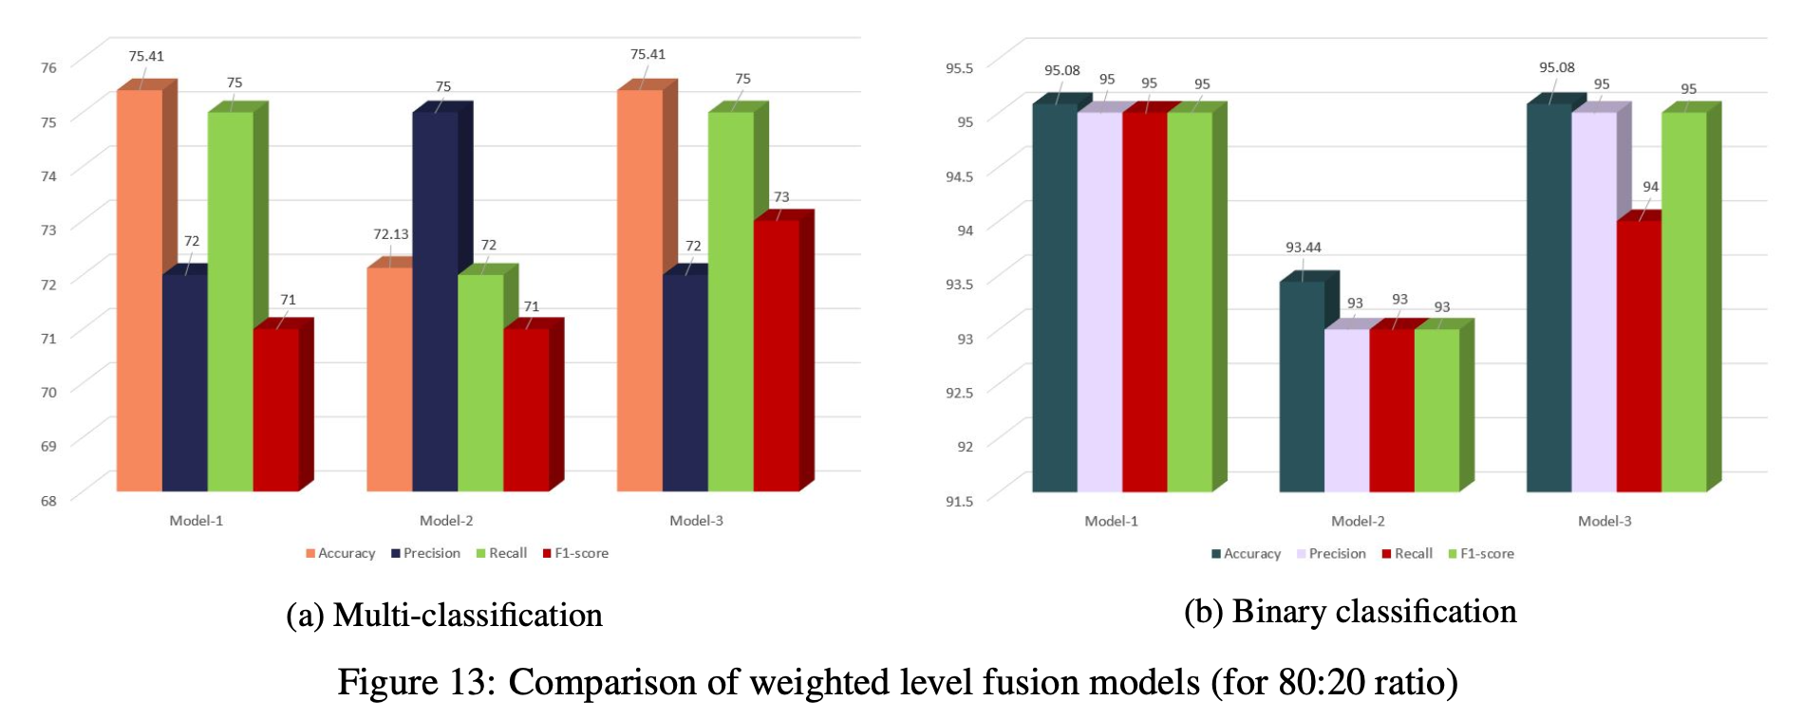

Results III: Benchmarking vs. The Field
Multi-Class (75.41%)
■
This Paper: 75.41%
■
vs. (Nahiduzzaman et al.) SVM on same problem: 68.86%
■
Conclusion: A +6.55% absolute improvement on the more difficult multi-class problem, demonstrating clear superiority.

Slide 14

Results III: Benchmarking vs. The Field
Binary Classification (95.08%)
■
This Paper: 95.08%
■
vs. (Paul et al.) Weighted fuzzy: 92.31%
■
vs. (Samuel et al.) Hybrid ANN: 91.10%
■
vs. (Harimoorthy et al.) Improved SVM: 89.9%
■
Conclusion: The result surpassed other complex hybrid models.

Slide 15
Conclusions & Future Work
Main Conclusion: The proposed weighted score fusion models are "more reliable" and demonstrate "a good improvement" (1-5%) over individual ML algorithms.
Proven Effectiveness: The method was validated on both simple binary (95.08%) and complex multi-class (75.41%) problems, achieving SOTA results for this dataset.
Future Work: Authors propose a mobile app for patients or a web-based platform for physicians as a clinical decision support tool.
Broad Application: The general-purpose method "could also apply to other diseases as well."

Slide 16
References
Primary Paper: Kibria, H. B., & Matin, A. (2022). The Severity Prediction of The Binary And Multi-Class Cardiovascular Disease: A Machine Learning-Based Fusion Approach. arXiv preprint arXiv:2203.04921.
Paul et al.: Cited in paper for "Weighted fuzzy system" (Ref [19]).
Samuel et al.: Cited in paper for "Hybrid (ANN Fuzzy AHP)" (Ref [20]).
Harimoorthy et al.: Cited in paper for "Improved SVM-Radial" (Ref [21]).
Nahiduzzaman et al.: Cited in paper for "SVM on same problem" (Ref [22]).
Note: Specific citations refer to the bibliography within the primary paper (Kibria & Matin, 2022).

Slide 17
Thank You
Questions?

