Slide 1
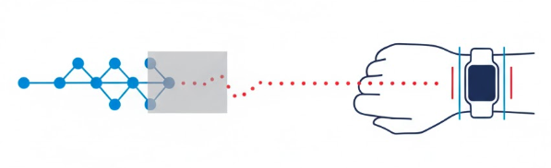
Masked Time-Series Transformers for Wrist IMU Motion Forecasting (CAPTURE‑24)
Team:
Yogeshvar Reddy Kallam, Saphalya Peta, Joseph Mani
SSL -> Masked

Slide 2
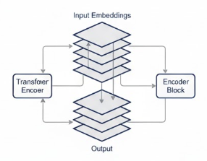
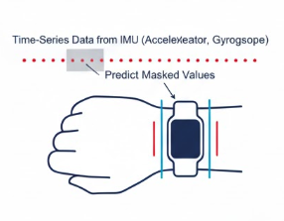
Core Question
Can BERT-style masked modeling on wrist IMU learn representations that improve short-horizon motion forecasting and activity recognition with minimal labeled data in free‑living conditions?

Slide 3
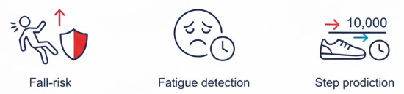

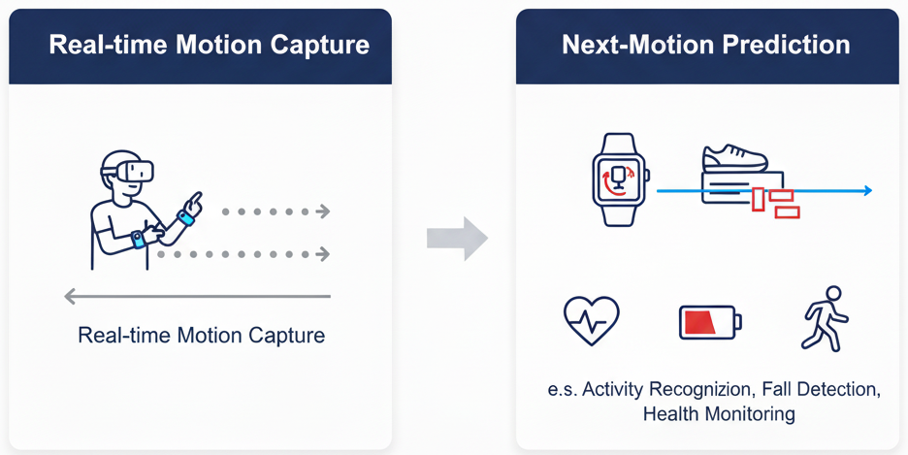
Applications
Proactive assistance and safety alerts in wearables (fall-risk, fatigue, step prediction).​
Smoother AR/VR locomotion via next‑motion prediction on‑device.​
Health analytics with less labeling effort using self‑supervised pretraining

Slide 4
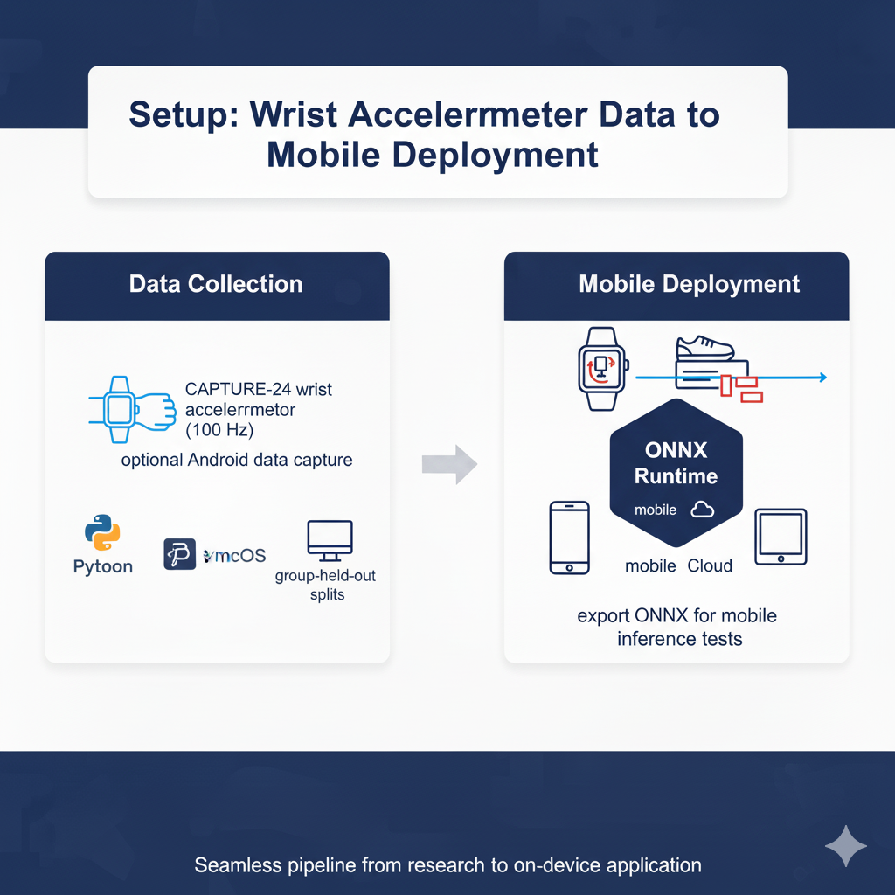
Evaluation
CAPTURE‑24 wrist accelerometer (100 Hz), Python/PyTorch on macOS; group‑held‑out splits; optional Android data capture; export ONNX for mobile inference tests.

Slide 5
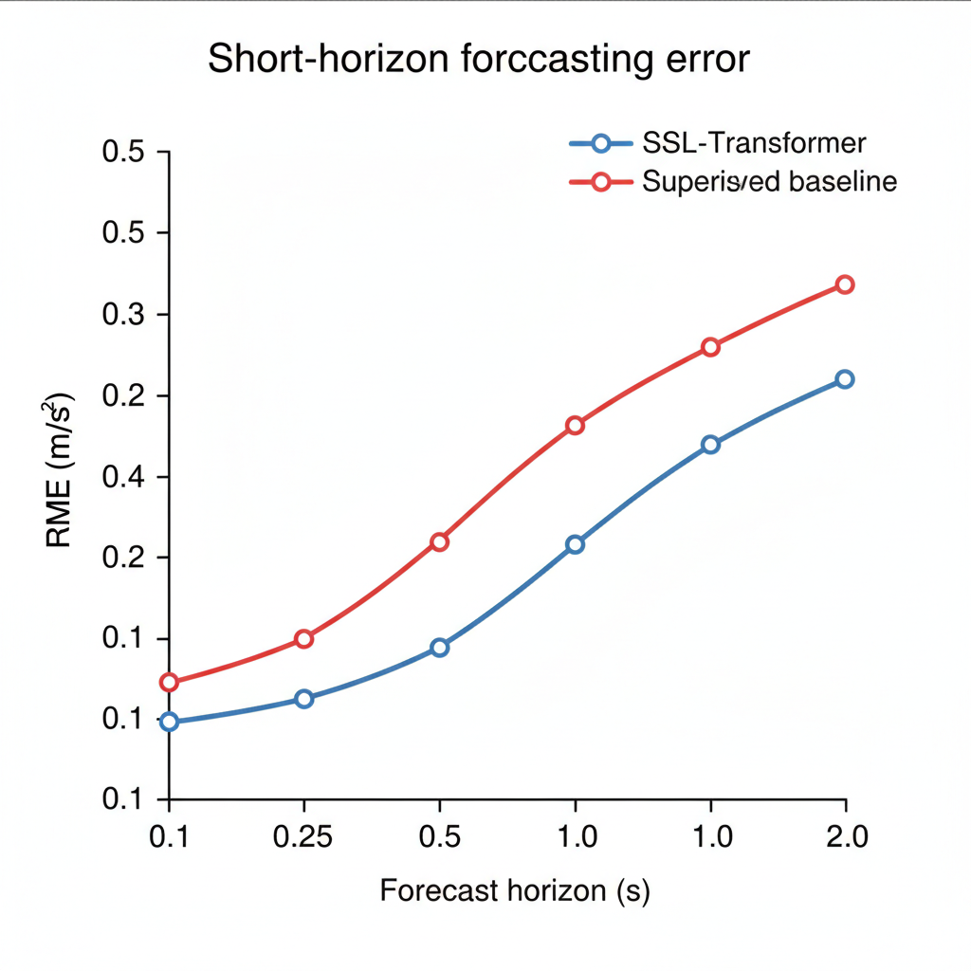
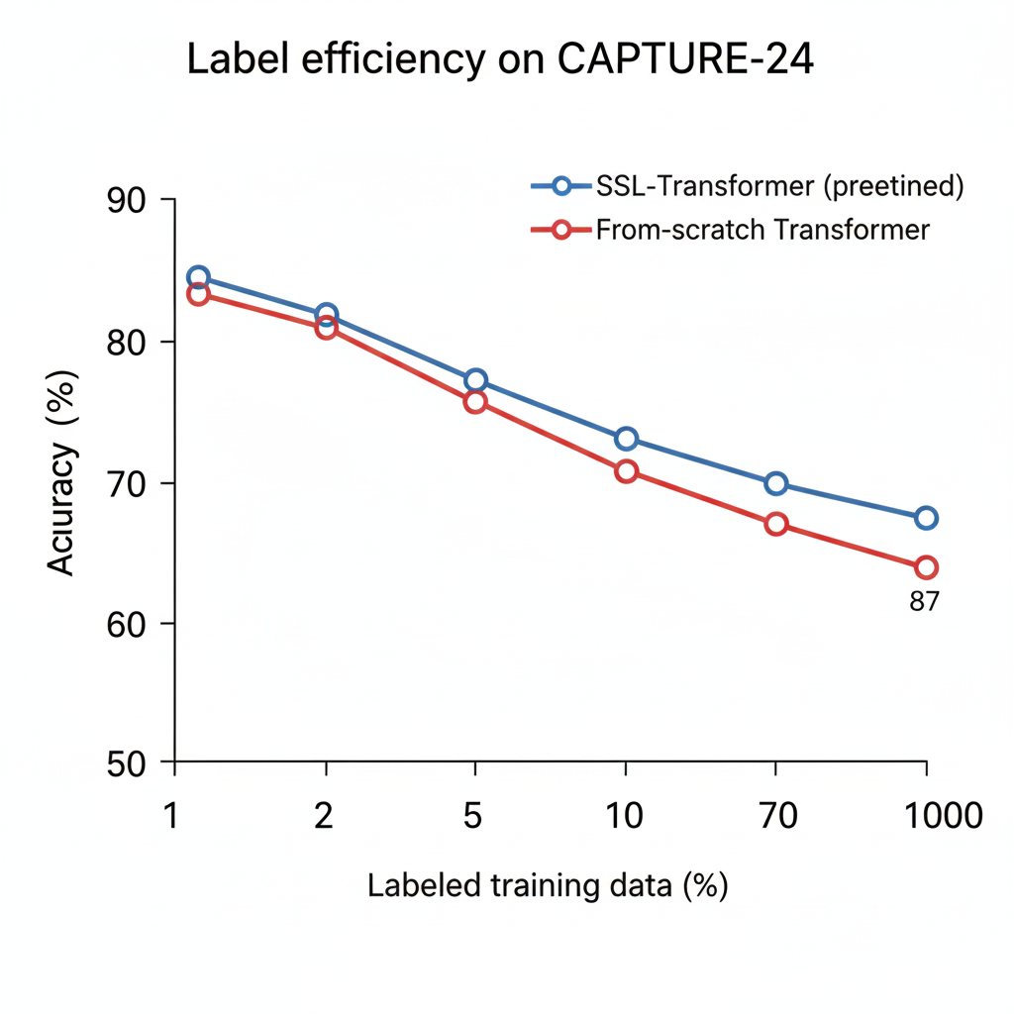
MOCK graphs
Forecasting error vs. horizon.
Expecting SSL stays consistently lower, with widening gap beyond 0.5 s
HAR accuracy vs. labeled fraction.
Hoping SSL is notably better at low labels, converging near full data.

