Slide 1

Team Name : RegChange RuleTrace
Team Leader Name : Yogesh Wagh
Team Size : 1 (Solo)
Problem Statement : 01 - Risk, Fraud and Regulatory Intelligence Copilot
Notes:
[REPO-VERIFIED SPEAKER NOTES - 2026-10-03]
Official Template Cover
SPOKEN SCRIPT:
Hello, I am Yogesh Wagh, presenting RegChange RuleTrace as a solo entry for Problem Statement 01: Risk, Fraud and Regulatory Intelligence Copilot. My focus is a specific compliance decision: understanding the impact of a proposed transaction-monitoring threshold change before a reviewer decides what to do.
REPOSITORY EVIDENCE: Cover fields match the selected project and challenge. The project uses Snowflake SQL and a Python Streamlit application.
PRESENTER CAVEATS: Confirm the saved cover matches your portal team details. Do not describe the prototype as a complete production compliance platform.

Slide 2

SNOWFLAKE COCO CLI HACKATHON 2026
RegChange RuleTrace
Regulatory Change Impact & Control Intelligence
Trace. Analyze. Validate. Govern.
GitHub: github.com/yogeshwagh450/regchange-ruletrace
Prototype: Snowflake
Notes:
[REPO-VERIFIED SPEAKER NOTES - 2026-10-03]
RegChange RuleTrace
SPOKEN SCRIPT:
The product follows four ideas: trace the control, analyze the proposed change, validate the impact through replay, and govern the decision through human review. The demonstration uses fictional policy text and synthetic transactions. It is an engineering prototype, not legal interpretation or production AML advice.
REPOSITORY EVIDENCE: App caption labels policy and transactions fictional/synthetic; the source has extraction, replay and review paths.
PRESENTER CAVEATS: Repair the unfinished link text and add a clickable prototype URL. Verify access separately from your own authenticated Snowflake session.

Slide 3
REGCHANGE RULETRACE
A threshold change is an operational decision
A lower monitoring threshold can materially change workload before a rule goes live.
01
02
03
04
>
>
>
Interpret circular
Estimate alert impact
Update ad hoc SQL
Seek approval
The gap
The question
Teams can lack a reproducible before/after replay, a clear view of newly affected accounts, and a decision record tied to evidence.
Before changing a control: how many alerts and accounts change, which control is affected, and who approved the proposal?
Notes:
[REPO-VERIFIED SPEAKER NOTES - 2026-10-03]
The Operational Decision
SPOKEN SCRIPT:
A lower threshold can increase the number of monitoring alerts even when the underlying transactions have not changed. Before implementing the change, a compliance team needs to know the workload impact, the affected control, and who reviewed the proposal. RegChange brings those questions into one reviewable workflow rather than treating policy extraction as the final answer.
REPOSITORY EVIDENCE: SQL compares baseline and proposed thresholds over the same filtered transaction snapshot; review records reference a run ID.
PRESENTER CAVEATS: Present the manual process as a motivating example, not a measured finding about all banks. The synthetic alerts do not establish fraud or suspicious activity.

Slide 4
REGCHANGE RULETRACE
One governed workflow, five visible stages
01
02
03
04
05
EXTRACT
MAP
REPLAY
QUANTIFY
REVIEW
Cortex proposes typed fields from fictional policy text.
Resolve the proposal to AML_THRESHOLD_10L metadata.
Compare old and proposed thresholds on the same history.
Show alert counts, change, and affected accounts.
Record approve/reject with a reviewer comment.
AI proposes. Deterministic SQL measures. A human decides.
The Streamlit prototype exposes Policy Extraction, Run Backtest, Run History, Review & Approve, and Ask Analyst.
Notes:
[REPO-VERIFIED SPEAKER NOTES - 2026-10-03]
Five Stages
SPOKEN SCRIPT:
The workflow starts with Cortex proposing structured fields from the fictional circular. The demonstration targets the existing AML_THRESHOLD_10L control. A SQL procedure then evaluates the old and proposed thresholds, reports the impact, and stores the run. Finally, a reviewer records approval or rejection with a comment. Approval is a recorded decision, not automatic rule promotion.
REPOSITORY EVIDENCE: The app exposes five tabs; RUN_THRESHOLD_BACKTEST writes BACKTEST_RUNS; Submit Review writes REVIEW_LOG.
PRESENTER CAVEATS: Control selection is fixed to one AML rule, not general automated obligation-to-control discovery. Human review is expected but an extraction confirmation gate is not enforced. Confirm sidebar updates during rehearsal.

Slide 5
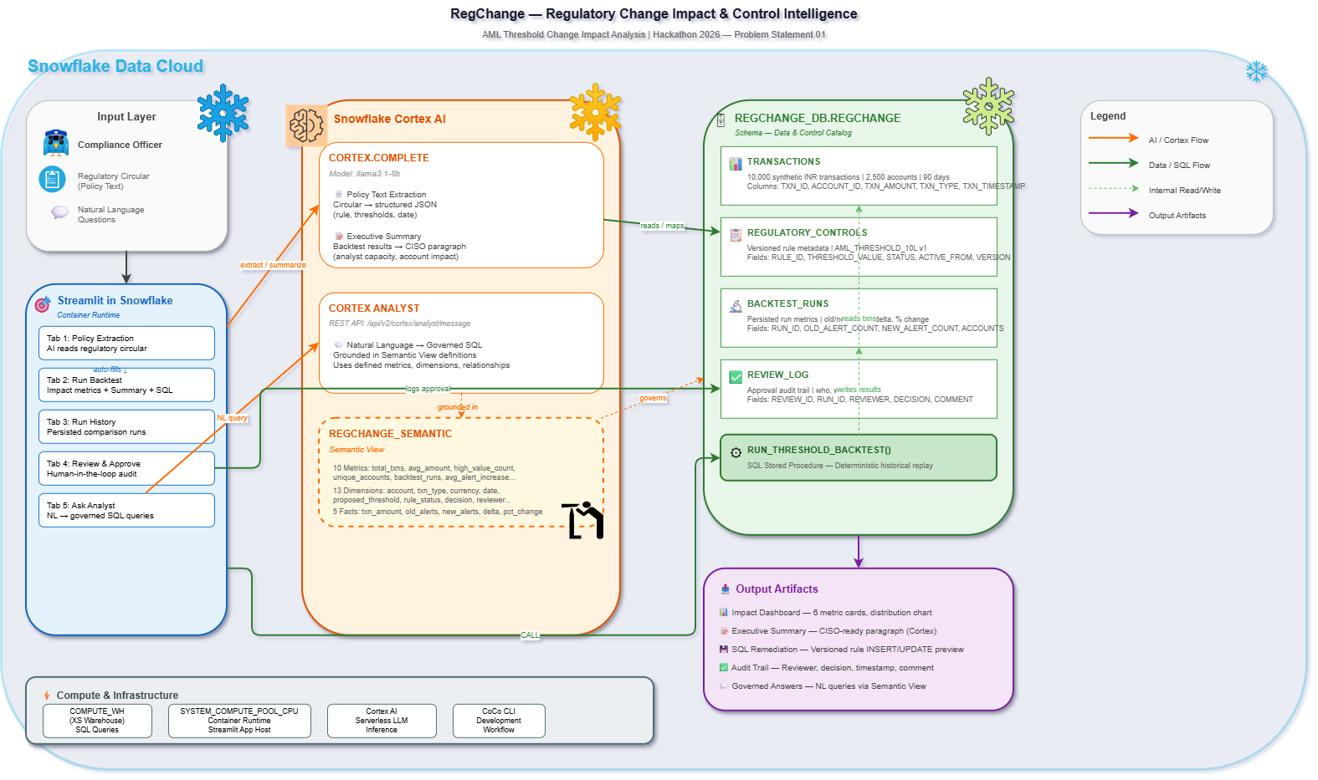
REGCHANGE RULETRACE
A Snowflake-native prototype with explicit boundaries
App
Streamlit in Snowflake: REGCHANGE_DB.REGCHANGE.REGCHANGE_APP
Data + replay
REGCHANGE schema, versioned control metadata, synthetic transactions, and RUN_THRESHOLD_BACKTEST.
AI + governance
Cortex extraction and Cortex Analyst over a Semantic View; review is logged separately.
Notes:
[REPO-VERIFIED SPEAKER NOTES - 2026-10-03]
Architecture
SPOKEN SCRIPT:
The UI is Streamlit in Snowflake. The deployment manifest targets REGCHANGE_DB.REGCHANGE.REGCHANGE_APP, with COMPUTE_WH for queries and a container runtime. SQL tables hold synthetic transactions, versioned control metadata and backtest results. The app also writes a review log and calls Cortex for extraction and summaries, plus Cortex Analyst for natural-language questions.
REPOSITORY EVIDENCE: streamlit/snowflake.yml declares the app, warehouse, container runtime and compute pool. The SQL and app define the stated interactions.
PRESENTER CAVEATS: This verifies declared configuration, not live deployment. Semantic View setup and grants are missing from the reproducible repo setup. Do not equate platform-native services with zero software dependencies or guaranteed region-local inference.

Slide 6
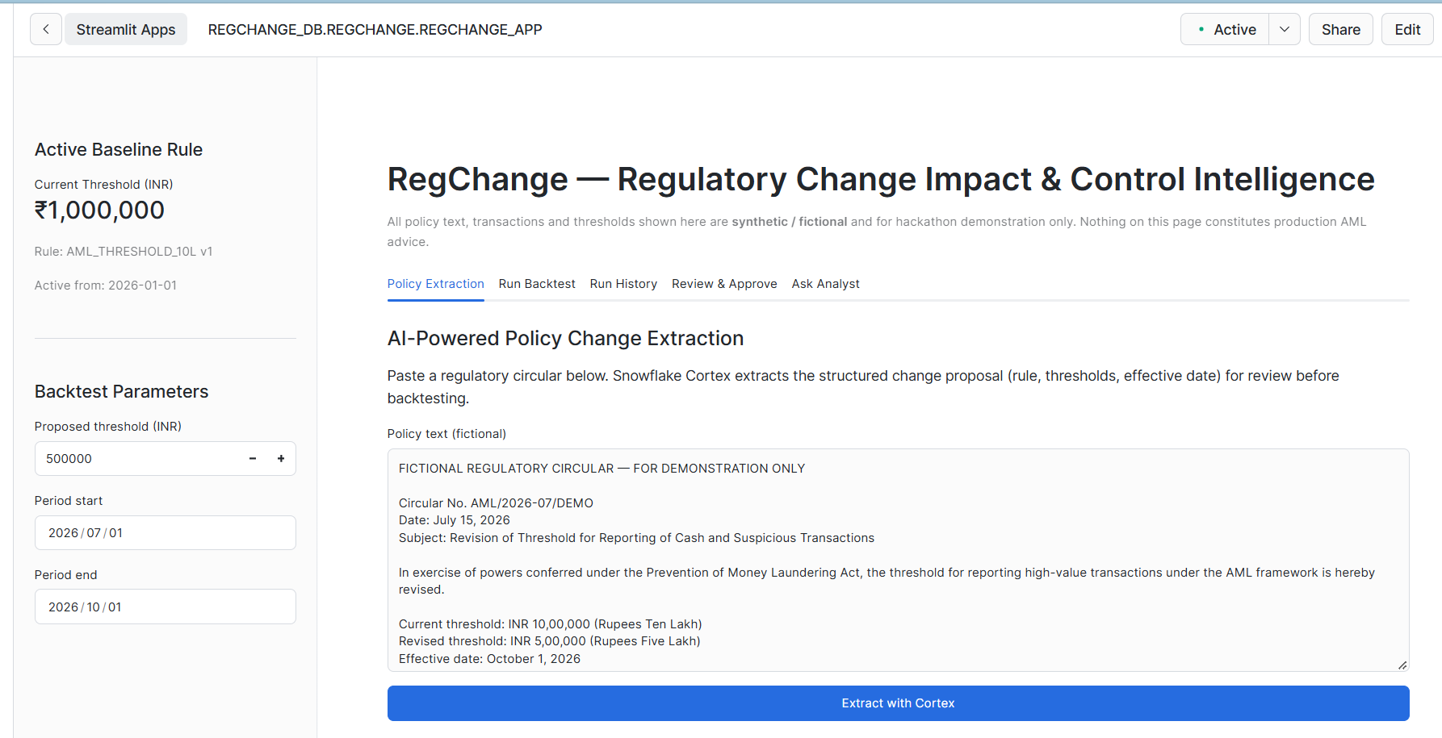
REGCHANGE RULETRACE
Policy extraction is a proposal, not a policy decision
FICTIONAL SAMPLE CIRCULAR
INR 1,000,000 -> INR 500,000
Cortex extracts the rule, parameter, proposed threshold, currency, effective date, and summary. The UI offers extracted values for review before backtesting.
Reviewer verifies before use.
Notes:
[REPO-VERIFIED SPEAKER NOTES - 2026-10-03]
Policy Extraction
SPOKEN SCRIPT:
The fictional sample proposes lowering the threshold from INR one million to INR five hundred thousand. Cortex is asked for a rule name, parameter, old and new thresholds, currency, effective date and summary. The proposed fields are displayed for review. The reviewer must check them against the source text; an LLM response is not authoritative regulation.
REPOSITORY EVIDENCE: SAMPLE_POLICY_TEXT and the extraction prompt enumerate these fields. Session state receives selected extracted values.
PRESENTER CAVEATS: There is no persisted source/evidence record or comprehensive schema-validation gate. Do not claim support for arbitrary regulators or reliable rejection of every ambiguous circular. The backtest covers all INR transaction types, not only cash.

Slide 7
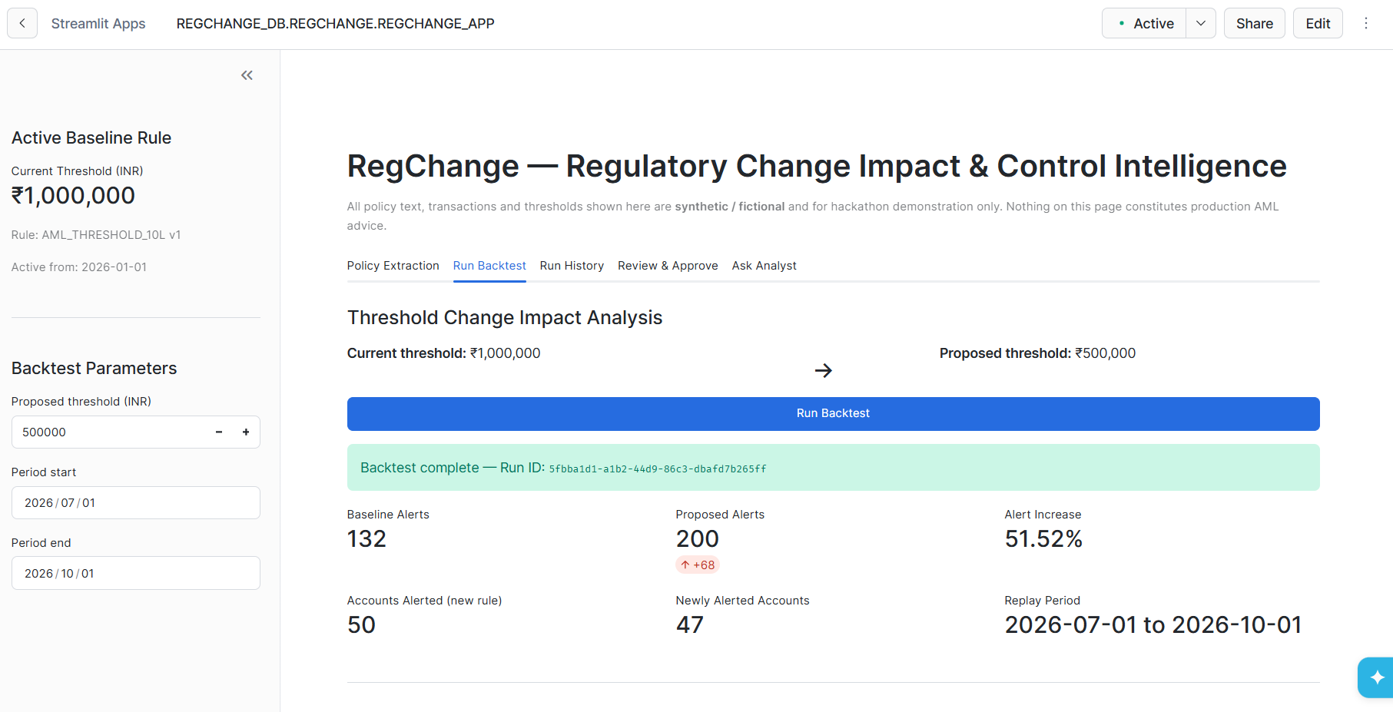
REGCHANGE RULETRACE
Replay the same history under both thresholds
ILLUSTRATIVE EXPECTED OUTPUT
132
200
Baseline alerts
Proposed alerts
+68
+51.52%
Alert delta
Relative increase
50
47
Accounts under proposed rule
Newly alerted accounts
Smoke-test targets for the unmodified synthetic dataset. Confirm against the live Snowflake run before presenting as measured results.
06
Notes:
[REPO-VERIFIED SPEAKER NOTES - 2026-10-03]
Impact Results
SPOKEN SCRIPT:
For the unmodified synthetic dataset and July-to-October replay window, the checked-in logic produces 132 baseline alerts and 200 proposed alerts. That is 68 additional alerts, approximately a 51.52 percent increase. Fifty accounts have proposed-rule alerts. An important distinction is that more alerted transactions do not necessarily mean new alerted accounts: the local account-set comparison shows the same fifty accounts already had baseline alerts.
REPOSITORY EVIDENCE: A fresh local reproduction of the generator and amount predicates confirms these values. It also confirms 47 accounts with transactions in the newly flagged amount band, but zero new accounts relative to the baseline-alert set.
PRESENTER CAVEATS: BLOCKER: the current slide and app call 47 `newly alerted accounts`; correct and rerun before presenting. Local arithmetic is not a fresh Snowflake result. Do not convert alert counts into hiring recommendations without explicit assumptions; the summary prompt's 30 alerts per analyst per quarter is illustrative.

Slide 8
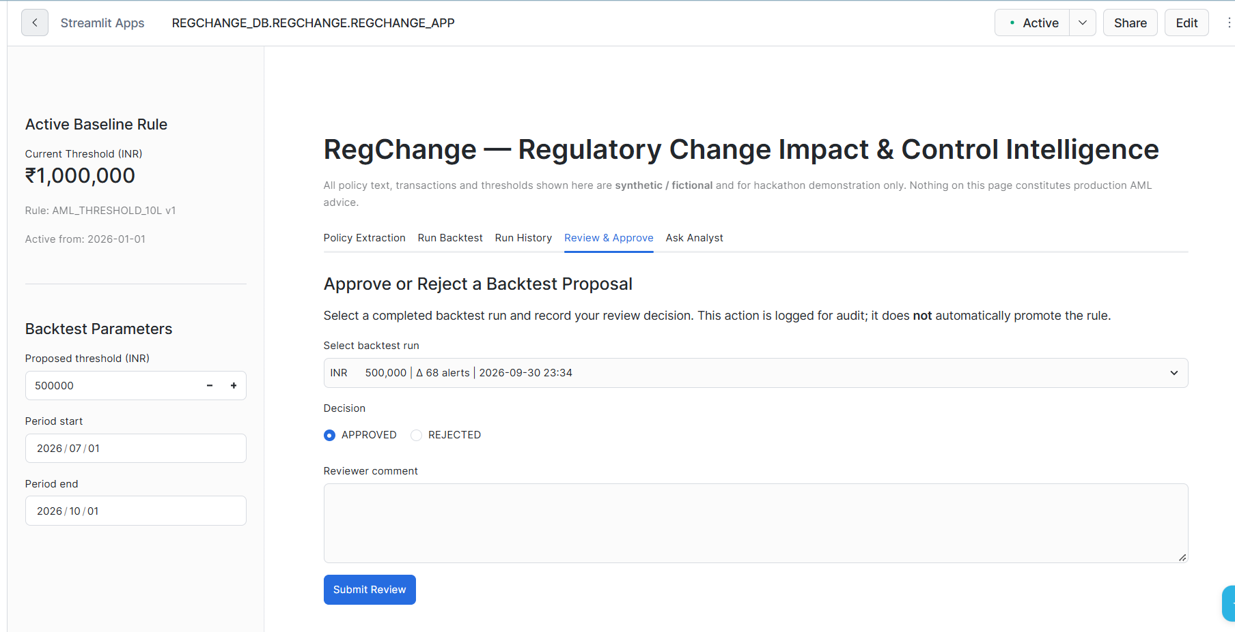
REGCHANGE RULETRACE
Review is recorded; control promotion stays separate
Decision record
Reviewer, approve/reject decision, comment, run ID, and review timestamp are written to REVIEW_LOG.
Remediation preview
The app displays proposed versioning SQL as a preview. It does not automatically promote the rule.
Audit chain: baseline -> backtest run -> review decision -> optional, separately executed change.
Notes:
[REPO-VERIFIED SPEAKER NOTES - 2026-10-03]
Human Review
SPOKEN SCRIPT:
A reviewer selects a successful run, chooses approved or rejected, and adds a comment. The app stores the current Snowflake user, decision, run ID and review time. The remediation SQL is displayed separately as a preview. Recording approval does not execute the SQL or change the active control.
REPOSITORY EVIDENCE: The Submit Review INSERT uses CURRENT_USER() and CURRENT_TIMESTAMP(); remediation is rendered through st.code, not executed by an approval button.
PRESENTER CAVEATS: Do not execute the migration preview. It needs effective-date and transaction fixes. Persisted traceability begins at the backtest run; source policy evidence and its relationship to the run are not stored.

Slide 9
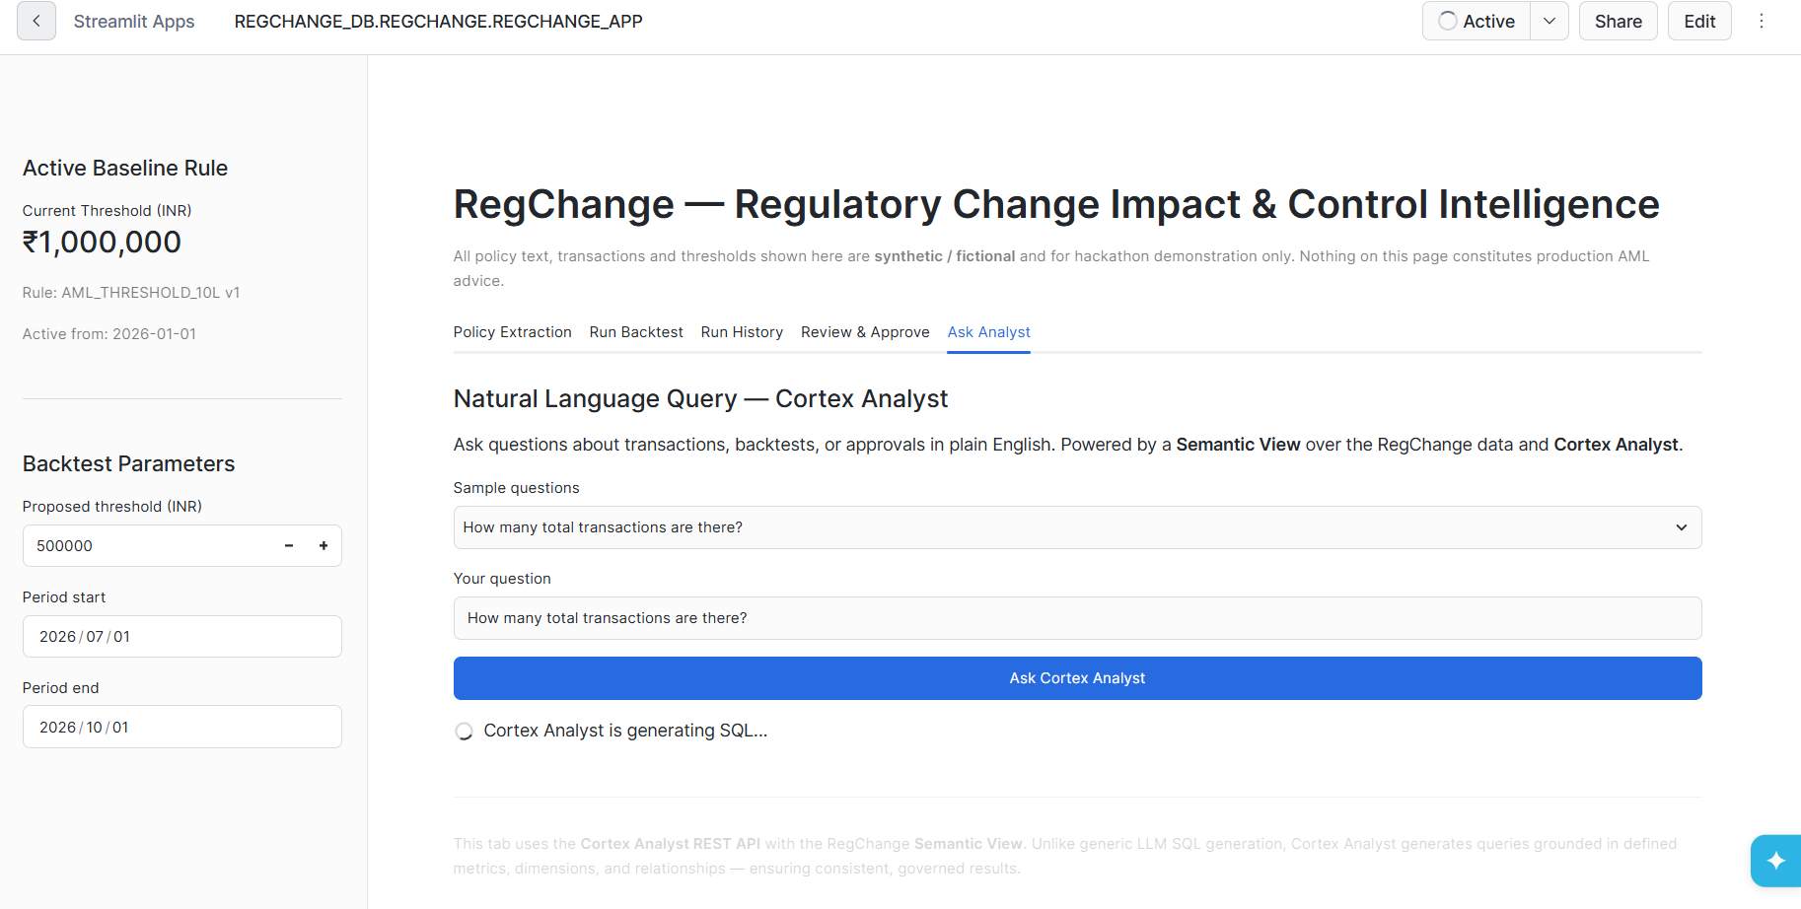
REGCHANGE RULETRACE
Ask questions against governed definitions
PLAIN LANGUAGE
Ask about transactions, backtests, or approvals.
Cortex Analyst uses the RegChange Semantic View. The app displays the returned SQL and, when available, query results.
SYNTHETIC HACKATHON DEMO | FICTIONAL AML SCENARIO
Notes:
[REPO-VERIFIED SPEAKER NOTES - 2026-10-03]
Ask Analyst
SPOKEN SCRIPT:
The Ask Analyst tab lets a reviewer ask questions about the modeled data in plain language. The app sends the question and the configured Semantic View name to Cortex Analyst. When SQL is returned, the app displays it and attempts to show query results. This complements deterministic backtesting; it does not replace the procedure that calculates impact.
REPOSITORY EVIDENCE: The source posts to /api/v2/cortex/analyst/message with REGCHANGE_SEMANTIC and displays returned text, SQL, results or suggestions.
PRESENTER CAVEATS: Verify a live answer before rehearsal. The actual Semantic View definition is absent from the repo, so metric counts and relationships are not independently verified here. Describe grounding as assistance, not a guarantee of correct or safe SQL.

Slide 10
REGCHANGE RULETRACE
Why RegChange RuleTrace Stands Out
AI-POWERED Cortex reads the circular and generates executive summaries
RISK-AWARE Quantifies exact alert and customer impact BEFORE a rule change takes effect
GOVERNED Semantic Views define metrics once. Human approval required. Every decision logged for audit
SNOWFLAKE-NATIVE Zero external dependencies
✅ Cortex COMPLETE (llama3.1-8b) ✅ Cortex Analyst REST API ✅ Semantic View (10 metrics, 13 dimensions) ✅ Streamlit in Snowflake (container runtime) ✅ SQL Stored Procedures
✅ CoCo CLI (development workflow)
09
Notes:
[REPO-VERIFIED SPEAKER NOTES - 2026-10-03]
Differentiation
SPOKEN SCRIPT:
The distinction is connecting AI-assisted interpretation to explicit measurement and a recorded human decision. The alert calculation is deterministic, while Cortex supports interpretation and summarization. Versioned control metadata, persisted backtest runs and review records make the prototype more useful than an isolated policy-summary chatbot.
REPOSITORY EVIDENCE: Cortex calls, typed SQL comparisons, BASELINE_RULE_VERSION in BACKTEST_RUNS and REVIEW_LOG inserts are present in source.
PRESENTER CAVEATS: Restore truncated service text. Replace zero external dependencies with a narrower claim about Snowflake-native services and synthetic data. Verify Semantic View counts before quoting them. Do not describe session-only policy text as a complete persisted evidence chain.

Slide 11
Impact, Scope & Future Roadmap
REGCHANGE RULETRACE
What It Delivers Today & What Comes Next
What We Built
What Comes Next
✅ Regulatory response in seconds, not days
✅ Exact alert and customer impact before rule goes live
✅ Full audit trail — who approved, when, why
✅ AI reads the circular so analysts don't have to
✅ Ask questions in plain English, get governed answers
5-tab Streamlit app on Snowflake
10,000 synthetic INR transactions
One AML threshold change scenario
Backtest runs and review log persisted
Cortex extraction + Cortex Analyst
All data synthetic — no real customer data
→ Dynamic Tables for always-fresh impact views
→ Data Metric Functions for quality gates
→ Zero-Copy Clones for safe rule testing
→ Cortex Search for policy document library
→ Multi-regulator support (RBI, SEBI, IRDAI)
All datasets are synthetic and deterministic. No external data sources or APIs used.
Notes:
[REPO-VERIFIED SPEAKER NOTES - 2026-10-03]
Scope and Roadmap
SPOKEN SCRIPT:
Today the prototype covers one fictional AML threshold scenario using ten thousand deterministic synthetic transactions. It provides extraction, replay, history, review and an Analyst integration path. Future work includes validated support for more rule types, persistent policy evidence, continuous data ingestion and quality checks, and stronger concurrency and promotion controls. These are roadmap items, not completed production capabilities.
REPOSITORY EVIDENCE: The seed generator uses ROWCOUNT 10000 and the baseline selection is hard-coded to AML_THRESHOLD_10L. No continuous ingestion, Dynamic Table or DMF setup is checked in.
PRESENTER CAVEATS: Repair the slide's unfinished strings. No external datasets are used; the app does use a Snowflake REST API. Zero-copy clone replay is already implemented in the SQL and should not be listed as entirely future work, although hardening remains necessary.

Slide 12
REGCHANGE RULETRACE
From Regulatory Circular to Governed Compliance Decision in Under 60 Seconds.
AI proposes. Deterministic replay quantifies. Humans approve.
Snowflake app: Snowflake
GitHub: github.com/yogeshwagh450/regchange-ruletrace
Notes:
[REPO-VERIFIED SPEAKER NOTES - 2026-10-03]
Closing Message
SPOKEN SCRIPT:
RegChange RuleTrace demonstrates how a proposed threshold change can become a measured, reviewable decision. AI proposes the fields, deterministic replay quantifies the alert impact, and a human records the outcome. The next step is strengthening the evidence and validation controls so the workflow can be extended beyond this synthetic demonstration.
REPOSITORY EVIDENCE: Extraction, SQL replay and review logging are implemented; production promotion remains separate.
PRESENTER CAVEATS: Replace the unverified under-60-seconds headline with an untimed claim unless a repeatable timed run supports it. Replace `Snowflake app: Snowflake` with the actual prototype link.

Slide 13

Notes:
[REPO-VERIFIED SPEAKER NOTES - 2026-10-03]
Template Closing
SPOKEN SCRIPT:
Thank you. I am happy to walk through the replay logic, the human-review boundary, or the roadmap for stronger data and governance controls.
REPOSITORY EVIDENCE: Official template closing retained; no additional product claims are made.
PRESENTER CAVEATS: Stop here or move to a rehearsed live demonstration. Do not run remediation SQL during questions.

