Slide 1
SNOWFLAKE COCO CLI HACKATHON 2026
RegChange RuleTrace
Regulatory Change Impact & Control Intelligence
Trace. Analyze. Validate. Govern.
Yogesh Wagh
GitHub: github.com/yogeshwagh450/regchange-ruletrace
Prototype: Snowflake

Slide 2
REGCHANGE RULETRACE
A threshold change is an operational decision
A lower monitoring threshold can materially change workload before a rule goes live.
01
02
03
04
>
>
>
Interpret circular
Estimate alert impact
Update ad hoc SQL
Seek approval
The gap
The question
Teams can lack a reproducible before/after replay, a clear view of newly affected accounts, and a decision record tied to evidence.
Before changing a control: how many alerts and accounts change, which control is affected, and who approved the proposal?
SYNTHETIC HACKATHON DEMO | FICTIONAL AML SCENARIO
02

Slide 3
REGCHANGE RULETRACE
One governed workflow, five visible stages
01
02
03
04
05
EXTRACT
MAP
REPLAY
QUANTIFY
REVIEW
Cortex proposes typed fields from fictional policy text.
Resolve the proposal to AML_THRESHOLD_10L metadata.
Compare old and proposed thresholds on the same history.
Show alert counts, change, and affected accounts.
Record approve/reject with a reviewer comment.
AI proposes. Deterministic SQL measures. A human decides.
The Streamlit prototype exposes Policy Extraction, Run Backtest, Run History, Review & Approve, and Ask Analyst.
SYNTHETIC HACKATHON DEMO | FICTIONAL AML SCENARIO
03

Slide 4
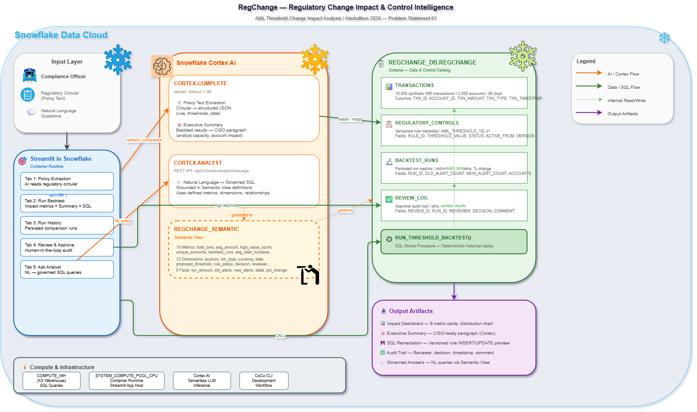
REGCHANGE RULETRACE
A Snowflake-native prototype with explicit boundaries
App
Streamlit in Snowflake: REGCHANGE_DB.REGCHANGE.REGCHANGE_APP
Data + replay
REGCHANGE schema, versioned control metadata, synthetic transactions, and RUN_THRESHOLD_BACKTEST.
AI + governance
Cortex extraction and Cortex Analyst over a Semantic View; review is logged separately.
The threshold comparison is typed and deterministic; descriptive rule text is not executed as SQL.
SYNTHETIC HACKATHON DEMO | FICTIONAL AML SCENARIO
04

Slide 5
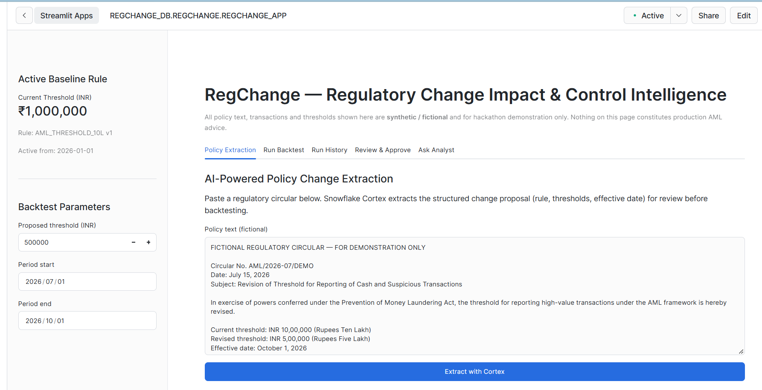
REGCHANGE RULETRACE
Policy extraction is a proposal, not a policy decision
FICTIONAL SAMPLE CIRCULAR
INR 1,000,000 -> INR 500,000
Cortex extracts the rule, parameter, proposed threshold, currency, effective date, and summary. The UI offers extracted values for review before backtesting.
Reviewer verifies before use.
SYNTHETIC HACKATHON DEMO | FICTIONAL AML SCENARIO
05

Slide 6
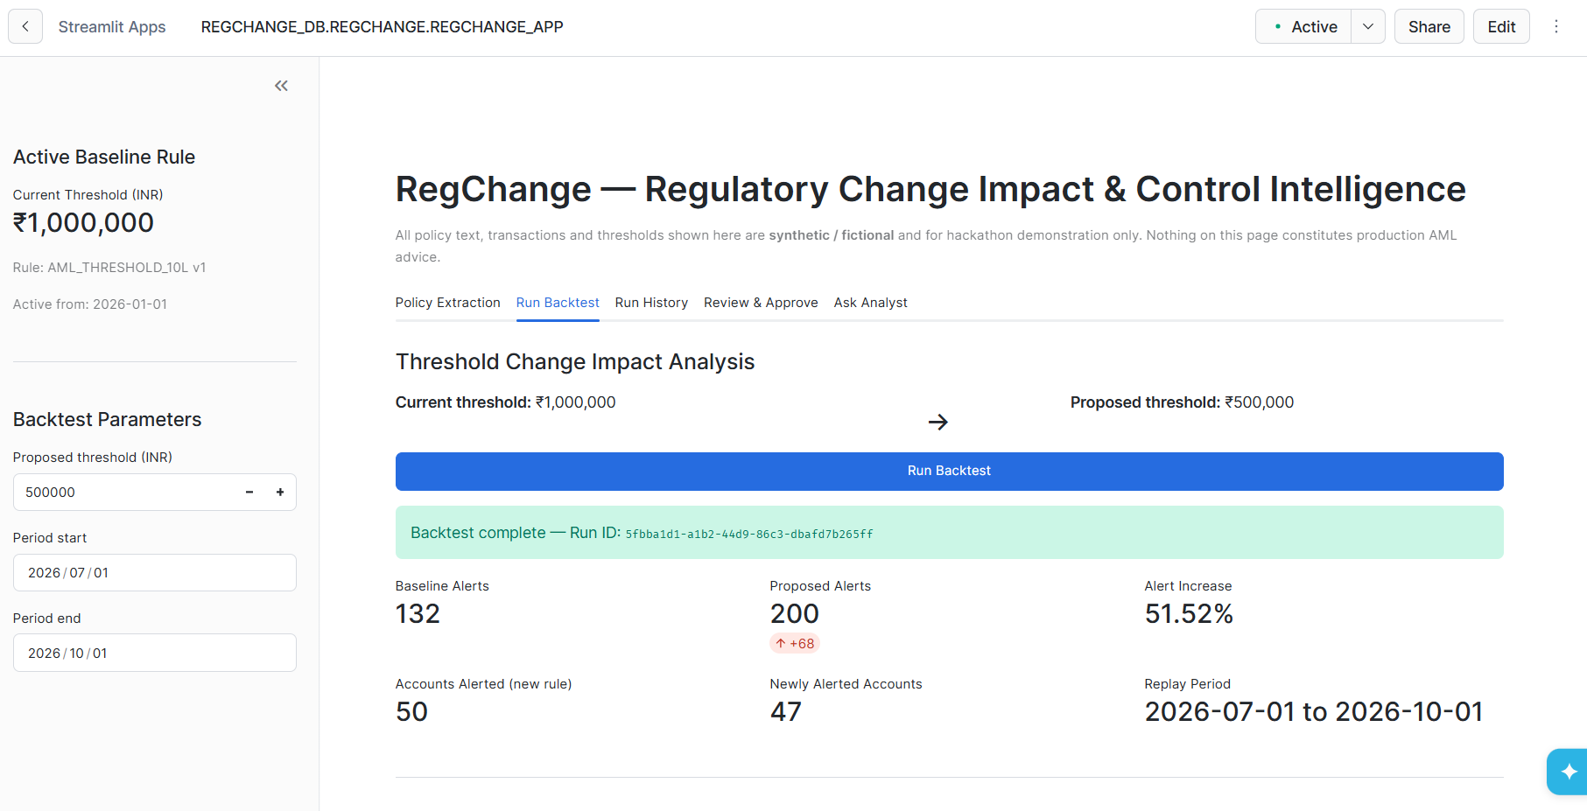
REGCHANGE RULETRACE
Replay the same history under both thresholds
ILLUSTRATIVE EXPECTED OUTPUT
132
200
Baseline alerts
Proposed alerts
+68
+51.52%
Alert delta
Relative increase
50
47
Accounts under proposed rule
Newly alerted accounts
Smoke-test targets for the unmodified synthetic dataset. Confirm against the live Snowflake run before presenting as measured results.
SYNTHETIC HACKATHON DEMO | FICTIONAL AML SCENARIO
06

Slide 7
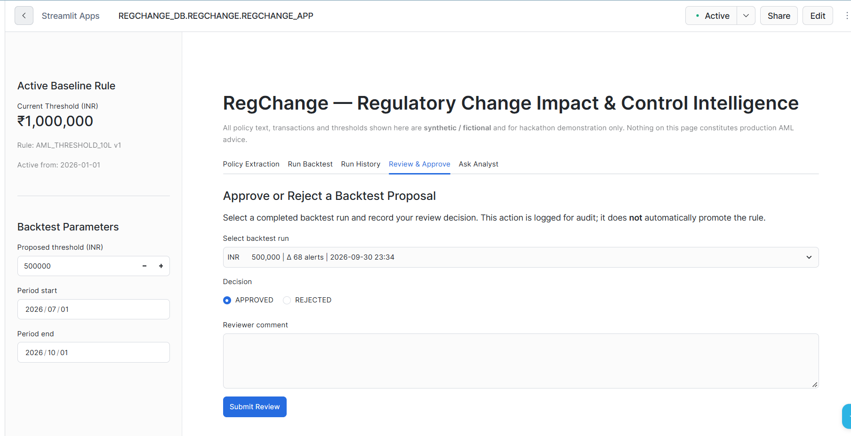
REGCHANGE RULETRACE
Review is recorded; control promotion stays separate
Decision record
Reviewer, approve/reject decision, comment, run ID, and review timestamp are written to REVIEW_LOG.
Remediation preview
The app displays proposed versioning SQL as a preview. It does not automatically promote the rule.
Audit chain: baseline -> backtest run -> review decision -> optional, separately executed change.
SYNTHETIC HACKATHON DEMO | FICTIONAL AML SCENARIO
07

Slide 8
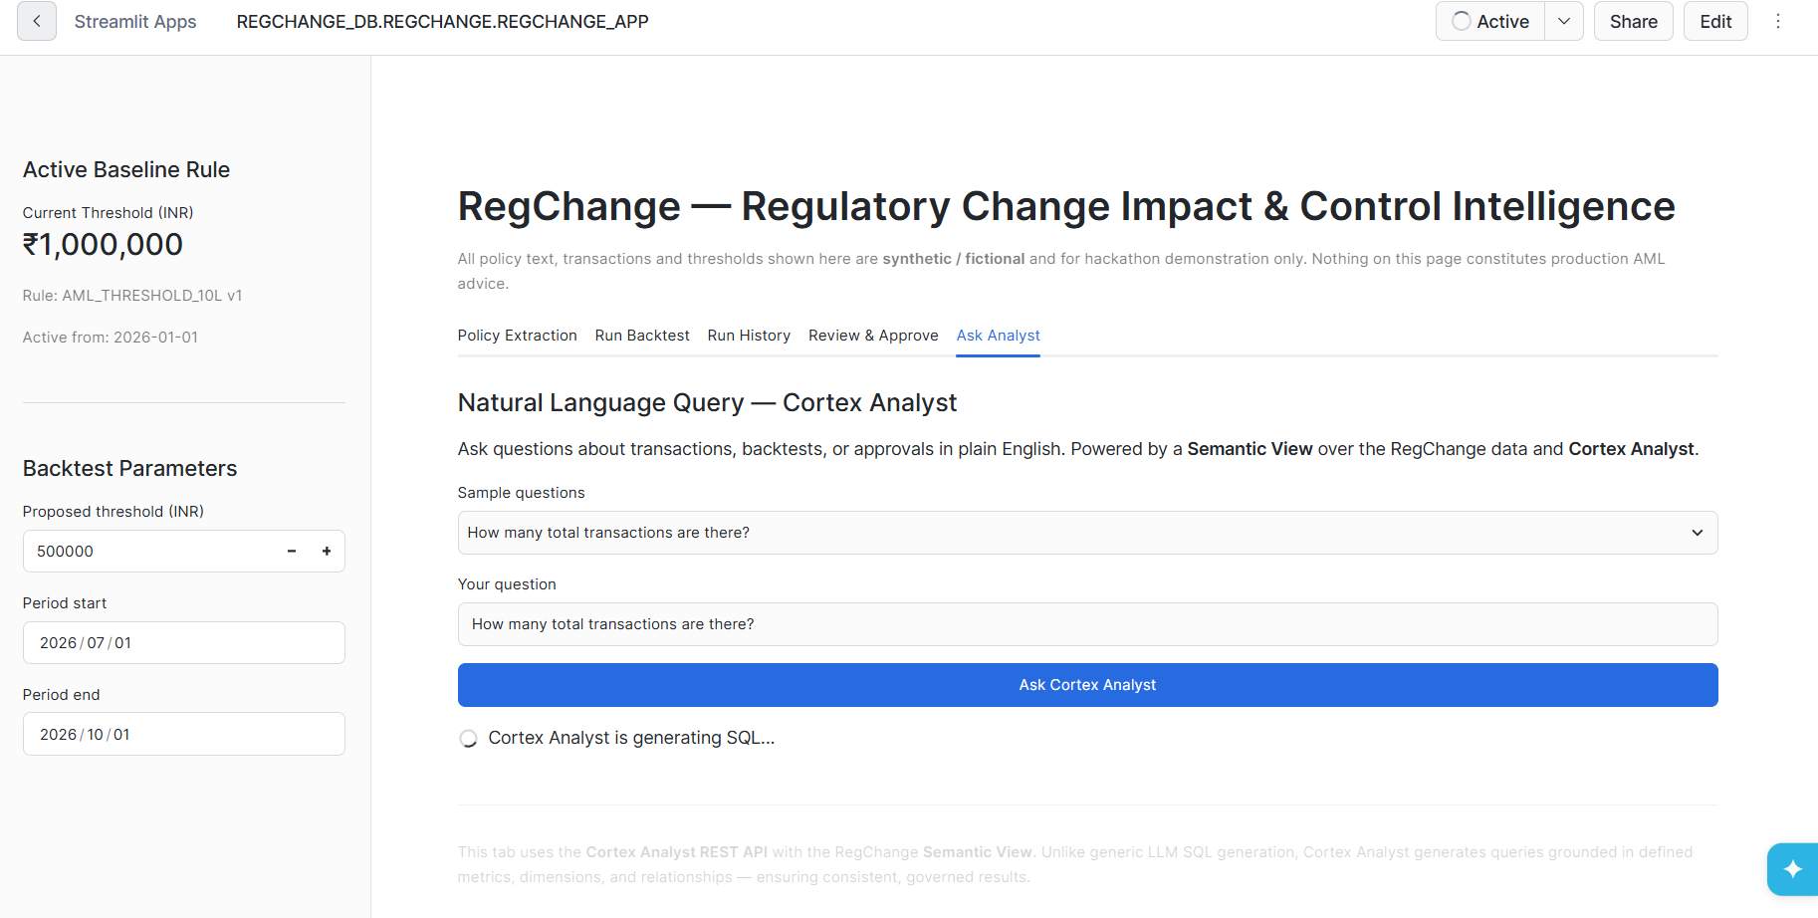
REGCHANGE RULETRACE
Ask questions against governed definitions
PLAIN LANGUAGE
Ask about transactions, backtests, or approvals.
Cortex Analyst uses the RegChange Semantic View. The app displays the returned SQL and, when available, query results.
Verify live response before demo.
SYNTHETIC HACKATHON DEMO | FICTIONAL AML SCENARIO
08

Slide 9
REGCHANGE RULETRACE
Why RegChange RuleTrace Stands Out
AI-POWERED Cortex reads the circular and generates executive summaries
RISK-AWARE Quantifies exact alert and customer impact BEFORE a rule change takes effect
GOVERNED Semantic Views define metrics once. Human approval required. Every decision logged for audit
SNOWFLAKE-NATIVE Zero external dependencies
✅ Cortex COMPLETE (llama3.1-8b) ✅ Cortex Analyst REST API ✅ Semantic View (10 metrics, 13 dimensions) ✅ Streamlit in Snowflake (container runtime) ✅ SQL Stored Procedures
✅ CoCo CLI (development workflow)
SYNTHETIC HACKATHON DEMO | FICTIONAL AML SCENARIO
09

Slide 10
Impact, Scope & Future Roadmap
REGCHANGE RULETRACE
What It Delivers Today & What Comes Next
What We Built
What Comes Next
✅ Regulatory response in seconds, not days
✅ Exact alert and customer impact before rule goes live
✅ Full audit trail — who approved, when, why
✅ AI reads the circular so analysts don't have to
✅ Ask questions in plain English, get governed answers
5-tab Streamlit app on Snowflake
10,000 synthetic INR transactions
One AML threshold change scenario
Backtest runs and review log persisted
Cortex extraction + Cortex Analyst
All data synthetic — no real customer data
→ Dynamic Tables for always-fresh impact views
→ Data Metric Functions for quality gates
→ Zero-Copy Clones for safe rule testing
→ Cortex Search for policy document library
→ Multi-regulator support (RBI, SEBI, IRDAI)
All datasets are synthetic and deterministic. No external data sources or APIs used.
SYNTHETIC HACKATHON DEMO | FICTIONAL AML SCENARIO
10

Slide 11
REGCHANGE RULETRACE
From Regulatory Circular to Governed Compliance Decision in Under 60 Seconds.
AI proposes. Deterministic replay quantifies. Humans approve.
GitHub: github.com/yogeshwagh450/regchange-ruletrace
Snowflake app: Snowflake
Yogesh Wagh | Questions
THANK YOU

