Slide 1
AngularJs
-Yogeshwar Trehan
yogeshwartrehan@gmail.com

Slide 2
Introduction to some Web application frontend technologies -
1. JavaScript -
is a programming language designed for use in a web browser.
is a high-level, interpreted(hence scripting) programming language.
is a language which is also characterized as dynamic, weakly typed, prototype-based and multi-paradigm.
as a multi-paradigm language, JavaScript supports event-driven, functional, and imperative (including object-oriented and prototype-based) programming styles.
2. AJAX
is a set of Web development techniques using many Web technologies on the client side to create asynchronous Web applications.
With Ajax, Web applications can send and retrieve data from a server asynchronously (in the background) without interfering with the display and behavior of the existing page.
By decoupling the data interchange layer from the presentation layer, Ajax allows Web pages, and by extension Web applications, to change content dynamically without the need to reload the entire page
In practice, modern implementations commonly utilize JSON instead of XML due to the advantages of JSON being native to JavaScript

Slide 3
3. jQuery
is a JavaScript library designed to simplify the client-side scripting of HTML
jQuery also provides capabilities for developers to create plug-ins on top of the JavaScript library
4. React
A JavaScript library for building user interfaces.
React can be used as a base in the development of single-page or mobile applications.
Complex React applications usually require the use of additional libraries for state management, routing, and interaction with an AP
For comparison b/w React and AngularJs:
Link

Slide 4
5. AngularJS (also written as Angular.js)
is a JavaScript-based open-source front-end web application framework which provides -
  templating
  data-binding
  routing (single page app)
  clean, modular, reusable architecture
  security
  additional functions/features for convenience
  Testing
is built on the belief that declarative programming should be used to create user interfaces and connect software components, while imperative programming is better suited to defining an application's business logic.
AngularJS's design goals include:
to provide structure for the journey of building an application: from designing the UI, through writing the business logic, to testing.

Slide 5
Angular is so popular because it:
provides improved application design architecture
promotes code reusability
offers plug and play components
consists of easy-to-remove components
employs two-way data binding
allows better teamwork
Angular contains the following core types of objects and components:
Modules
Controllers
Services
Directives.

Slide 6
Dependency Injection
The previously mentioned core components can be injected into each other using the Dependency Injection (DI) mechanism built into Angular
DI is a software design pattern that assigns dependencies to components instead of hard coding them within the component itself.
You can divide your application into multiple types of components that Angular can inject into each other.
You can create the components to be used in multiple applications without changing a single line of code, saving time and effort
Modularizing your application makes it easier to reuse, configure, and create easily testable components in your application.

Slide 7
Directives
Angular uses a feature called directives, allowing you to write HTML code, which then builds the HTML of your application instead of using templates to generate the user interface.
For example,
The ng-model directive binds the value of HTML controls (input, select, and text area) to application data.
Utilizing two-way data binding, the values in your view are tightly bound to the data source. When a user interacts and updates a value, your model is updated dynamically as well.

Slide 8
How angular handles DOM?
When a web page is loaded, the browser creates a Document Object Model (DOM) of the page.
Using the DOM, JavaScript can access and change all the elements of an HTML document.
This allows Angular to dynamically edit the HTML and provide updates to the HTML without requiring a page load.
Since Angular is DOM-based, each component can be separated into separate files. Angular will then recompose these components into the DOM.
You will find that there are less merge conflicts and, therefore, overall project progress becomes much easier to track.

Slide 9
Why use Angular?
Let's consider a common use case. You have an application with a database. You want to be able to send updates to the database, and search the database for content. If you use vanilla JavaScript or jQuery, you will have to bind events to send the data, bind the outputs to the DOM, and update the DOM every time the data changes.
Angular is essentially a whole new paradigm of JavaScript programming. In the past, DOM updates were performed manually, and data contracts were managed manually. Angular does all of that heavy lifting for you, checking and updating the DOM with each $digest cycle. The $digest cycle is the function to update the DOM that Angular calls whenever the data is updated. This function enables you to construct your application without considering the DOM. For more information
Link

Slide 10
Comparing the workflow environments of vanilla JavaScript (JavaScript with no framework) or a jQuery environment to that of Angular could be described as the difference between carrying water with a bucket or building an irrigation system.
Using vanilla JavaScript or jQuery, data and states are carried through from databases or user inputs to be represented by the view. The view is then modified directly with specific, action-based thinking.
Angular, by contrast, functions more like building channels by which your data can flow to the view, and the view reacts to the data that it is given instead of needing to be influenced by direct command-based lines of code.
So thinking about the root components of Angular can be more easily related to plumbing.
Services are like the initial valves that lead to the water source. They exist primarily to feed data into the pipeline.
Controllers are like the pipes that control the water flow to and from the Services.
View Templates are like the faucets, they exist to consume the data
and react accordingly.

Slide 11
Introduction to Angular Modules
In the most simple terms, an Angular module is nothing more than a container for various parts of your app. Since an Angular app does not have a single point of entry like some environments (such as a Main method in a C application), modules provide the means for defining how the application can be started.
Note : Angular uses a Declarative Programming approach to define user interfaces and connect components.
In Angular, the word module refers to either an entire Angular application or independent components within that application, such as controllers, services, filters, and directives. The components of Angular modules provide specific functionality via self-contained sections of code. Through the process called Dependency Injection, modules can share variables between one another without having to rewrite code.
Modules provide a number of benefits including:
They may be reused in multiple applications
They can be loaded in any order (or in parallel)
Unit testing need only load the relevant modules, keeping the tests fast

Slide 12


Creating Angular Modules
This is an example of defining a module in Angular.
In this example, the module is assigned to the variable myApp on the left side of the assignment statement. The right side of the assignment is where the module is created, and in this example, is assigned the name "myApp". The empty array [] is where we can inject other modules as necessary. To bootstrap the module, you can use the HTML attribute ng-app='myApp' to bootstrap your app, or you can use the angular.bootstrap('myApp') syntax. You specify the variable name when you bootstrap a module.
Note: "Bootstrap" is just a fancy way of saying "configure and start."
To add controllers or other components to the module, reference the variable that you had defined for the module (var myApp in this instance), and then add additional method calls, like so:
Sometimes in applications, you will see a different following syntax:

Slide 13
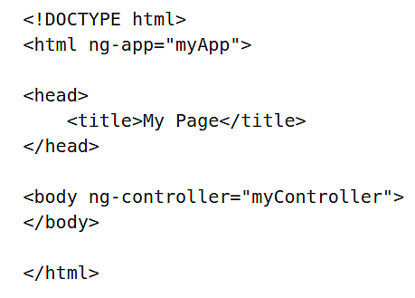
Bootstrapping your module, starts Angular and initializes the module, binding it to a section of the HTML that you wish to transform into a dynamic view. "Binding" tells Angular that this piece of HTML will be controlled by Angular, which will allow it to transform the HTML as the data changes, thereby creating a "Dynamic View" instead of the "Static View" of plain HTML.
Your Angular app can affect as much or as little HTML as you prefer. For example, if you are defining a Single Page App, you will want to bootstrap your module on the <html> element, so that Angular can control the entirety of the page.

Slide 14
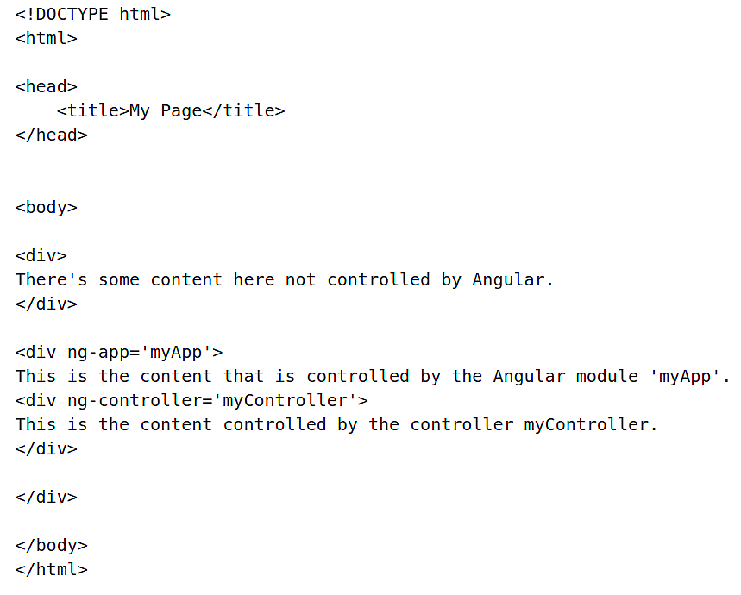
If you want Angular to only control some of your page, for example, if you are implementing Angular in a website that was built mostly out of jQuery, then you would do something like this:

Slide 15
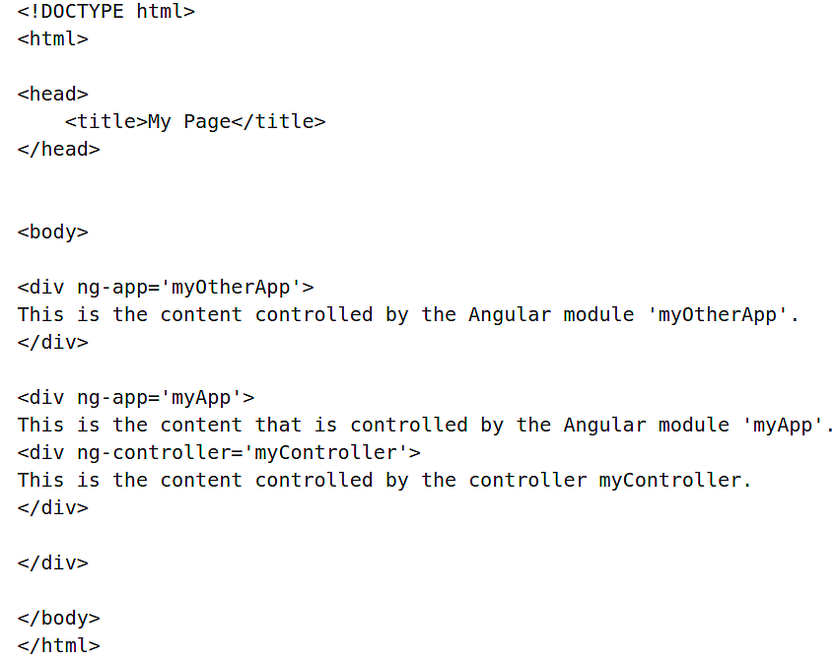
You could also use multiple Angular modules on the same page, enabling you to create two separate applications to control different pieces of the page, like so:

Slide 16
Introduction to Dependency Injection
Dependency Injection (DI) is a software design pattern that manages how components in a system obtain their dependencies. In Angular, Dependency Injection is responsible for:
Creating components
Maintaining a component's state
Providing components to other components, as required
In Angular, DI allows us to share variables and functions between self-contained modules without having to reuse code, and maintains the state of each component.
When Angular compiles the HTML,
it processes the ng-controller directive,
which, in turn, asks the injector to create an instance of the controller and its dependencies.
Using Dependency Injection
You can perform DI when
defining components or
providing run and config blocks for a module.

Slide 17
Rules for dependency Injection
Services, directives, filters, and animations
can be injected with "services", "values", and "constants" as dependencies.
The config method accepts a function,
which can be injected with
"providers" and "constants" as dependencies.
Note:
you cannot inject "services" or "values" into configuration.
The run method accepts a function,
which can be injected with
"services", "values" and, "constants" as dependencies.
Note
you cannot inject "providers" into run blocks.
provider method can only be injected with other "providers". However, only those that have been registered beforehand can be injected. This is different from services, where the order of registration does not matter.

Slide 18
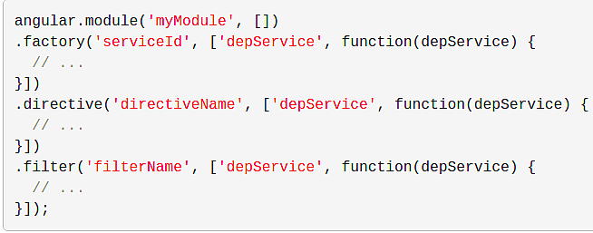
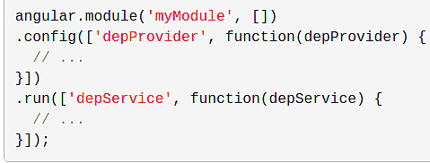
Factory Methods
The way you define a directive, service, or filter is with a factory function. The factory methods are registered with modules.
Module Methods
We can specify functions to run at configuration and run time for a module by calling the config and run methods.

Slide 19
Breif on Controllers
Controllers are "classes" or "constructor functions" that are responsible for providing the application behavior that supports the declarative markup in the template.
Unlike services, there can be many instances of the same type of controller in an application.
Dependency Injection rules for controllers
Controllers,
can be injected with "services" and "values" as dependencies,
but they can also be provided with "special dependencies".
additional dependencies made available to Controllers
$scope: Controllers are associated with an element in the DOM and so are provided with access to the scope. Controllers need access to the $scope object in order to bind values to the view. Other components (like services) only have access to the $rootScope service.
resolves: If a controller is instantiated as part of a route, then any values that are resolved as part of the route are made available for injection into the controller.

Slide 20

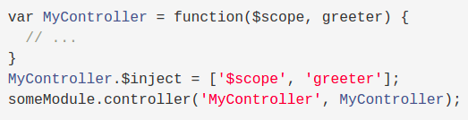

Dependency Annotation
Using the inline array annotation (preferred)
Using the $inject property annotation,
you'll need to take care to keep the $inject in sync with the parameters in the function declaration.
Implicitly from the function parameter names (has caveats)

Slide 21
Services
AngularJS services are substitutable objects that are wired together using dependency injection (DI). You can use services to organize and share code across your app.
AngularJS services are:
Lazily instantiated – AngularJS only instantiates a service when an application component depends on it.
Singletons – Each component dependent on a service gets a reference to the single instance generated by the service factory.

Slide 22
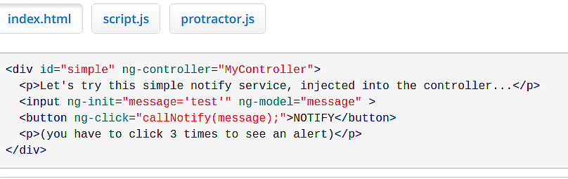
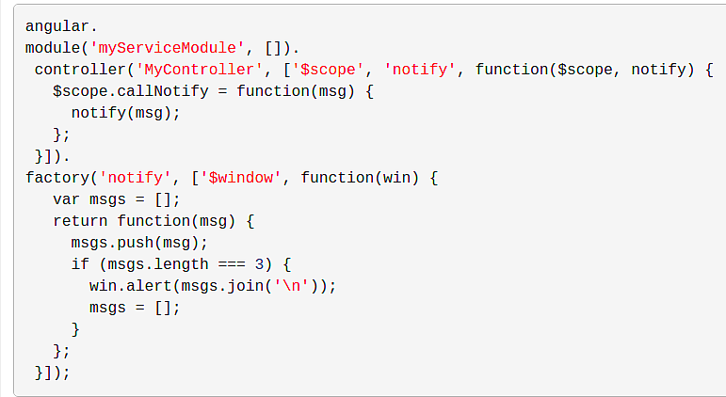
Using a Service
To use an AngularJS service, you add it as a dependency for the component (controller, service, filter or directive) that depends on the service.

Slide 23
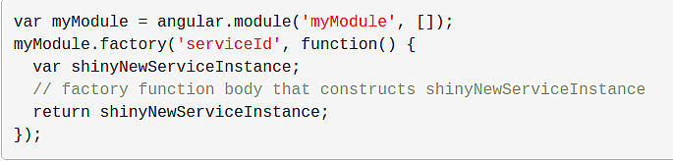
Creating Services
Application developers are free to define their own services by registering the service's name and service factory function, with an AngularJS module.
The service factory function generates the single object or function that represents the service to the rest of the application. The object or function returned by the service is injected into any component (controller, service, filter or directive) that specifies a dependency on the service
Registering Services
Services are registered to modules via the Module API. Typically you use the Module factory API to register a service:

Slide 24
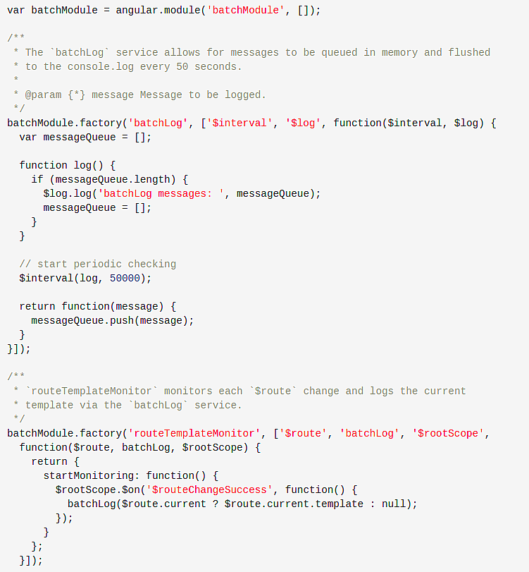
Dependencies
The example module on left has two services, each with various dependencies:

Slide 25
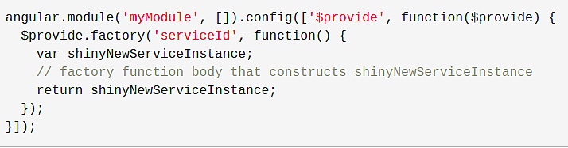
In the example, note that:
The batchLog service depends on the built-in $interval and $log services.
The routeTemplateMonitor service depends on the built-in $route service and our custom batchLog service.
Both services use the array notation to declare their dependencies.
The order of identifiers in the array is the same as the order of argument names in the factory function.
Registering a Service with $provide
You can also register services via the $provide service inside of a module's config function:

Slide 26
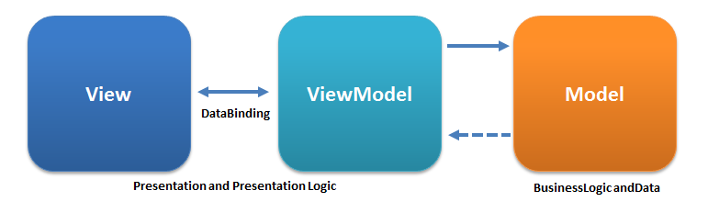
MVVM Overview
Angular is an implementation of the MVVM (Model-View-ViewModel) design pattern.
Model
The model is the source of data, or the data itself, usually encapsulated in Services, Factories, or Constants in Angular. It is best to keep all the business logic in the model in MVVM.
View
The view is what the user sees and interacts with, in this case, the dynamic view presented by Angular on the web page is constructed in such a way that any changes to the view model will cause the view to mutate accordingly.
View Model
The view model binds the data from the model to the view and vice versa. In Angular, it is encapsulated by the $scope variable, which is decorated by a function called a Controller

Slide 27
Controllers are a JavaScript Constructor Function. As their name implies, their primary purpose is to control; in this case, to control the view model contained within the Angular Scope
Controllers are used to:
Set the initial state of Scope variables, which are then made available for the View to consume and interact with
Add behavior to the Scope by two-way binding variables and declaring Scope functions
Set up communications to and from the view and Model objects such as Services, brought in through Dependency Injection
Angular invokes the controller with a $scope object
Any objects (or primitives) assigned to the scope become model properties.
The role of controllers in Angular is to expose data to our view via $scope, and to add functions to $scope that contain business logic that enhances view behavior.

Slide 28
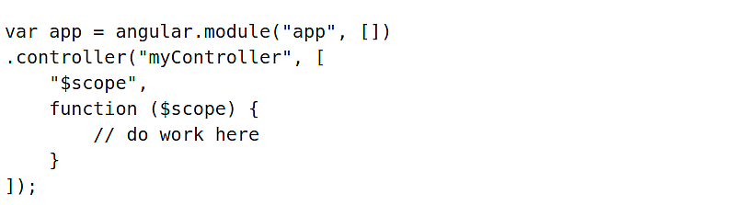
A controller should contain only the business logic needed for a single view;
presentation logic should remain within views and directives.
Note that the most efficient way to use controllers is,
by encapsulating work that doesn't belong to controllers into services, and
then using these services in controllers via dependency injection (DI).
Creating a Controller
Controllers are created by registering with an existing Angular Module.
Notice in our example that our controller is named myController, and that name will correspond to the ng-controller attribute in our HTML

Slide 29
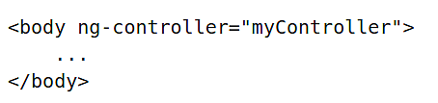
Implementing a Controller
As we have seen before, controllers are placed on the page with the ng-controller attribute. Here is an example using the myController we created.
The controller does not have to be placed on the <body> tag; it can be used in any HTML tag. This allows finer grained control of your application and makes using multiple controllers easier
Nesting controllers within each other results in separate scopes being created for each controller
Their scopes can be shared between each other by means of the scope.parent property

Slide 30
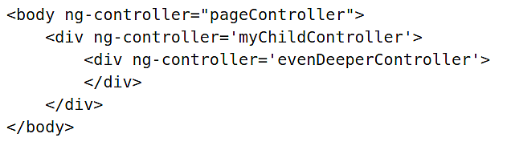
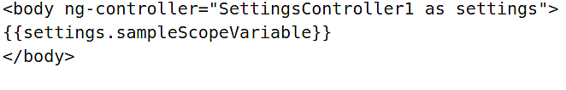
In order to prevent variable collision between controllers and make referencing different scopes easier, use the controller as syntax. It will assign the scope for that controller to a separate variable that the view can reference

Slide 31
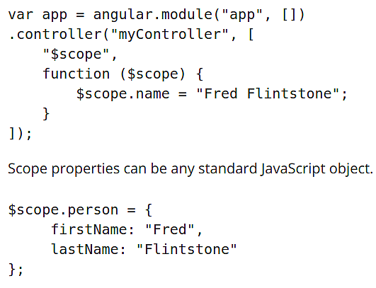
Scope Overview
The $scope object is used to make the model available to the view.
It is also referred to as the view model.
The scope is defined and controlled by Controllers
Scope Properties
To define Scope variables, simply assign them as subproperties of the $scope object.

Slide 32
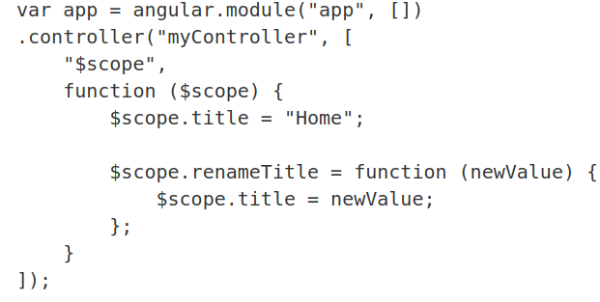
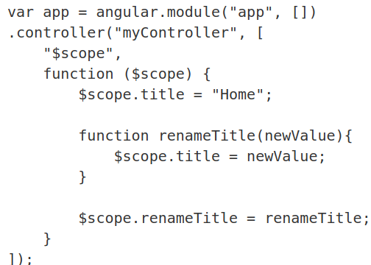
Scope Methods
To create a function that your view can use (such as something bound to a click event), assign a function as a subproperty of the Scope object, like so:
You can create your own custom watchers too, that have their own logic to react to when values change in the $scope. You do this by using the $scope.$watch() method.

Slide 33
ng-if
With it, you can decide whether the DOM will render an element based on an Angular expression.
Unlike ng-show and ng-hide, ng-if controls rendering, so it can be useful for keeping your application footprint small, preventing resources from loading until needed, or other useful activities.
It is more resource intensive to exectute than ng-show or ng-hide though
ng-class
As you may expect, ng-class injects a class into your element based on an Angular expression.
The directive operates in three different ways, depending on which of three types the expression evaluates to:
If it evaluates to a string, the string will represent class names. Use spaces to deliminate if you want more than one class.
If the expression evaluates to an object, then for each key-value pair of the object with a truthy value the corresponding key is used as a class name.
If it evaluates to an array, each element of the array will either be as the type 1 example or the type 2 example. This means that your array can contain both strings and objects in order to give you more control over your classes.
For more information on this directive, reference the AngularJS documentation on ngClass: link

Slide 34
With the ng-repeat built-in directive, you can create repeating sections of HTML that update automatically as your array changes enabling you to add, remove, order and quickly re-create lists of data.
Things possible with ng-repeat
With Angular, you can create a To Do list to add tasks, assign priorities to those tasks and if necessary, remove one or more of those tasks from the list.
To display the list use the ng-repeat directive. To filter the list you could add a two-way bound textbox allowing the user to enter text by which to filter. To expand your list add another two-way bound textbox and push that property value to your array of items when the user clicks a button. To remove items you can pass the index of the item to a function that just removes the item from the array. Parameters in the ng-repeat expression allow you to filter and order your list.
$index is a built-in variable to ng-repeat that will reference the index value of the item in the array.
$parent, if used with nested ng-repeats, will get the repeat above it without havingto use the variable name of the parent repeat.
You can filter lists with ng-repeat by using a Filter parameter after your declaration. By default, the filter does a full-text search of every property in the object, but it can be adjusted to use custom properties as well.

Slide 35
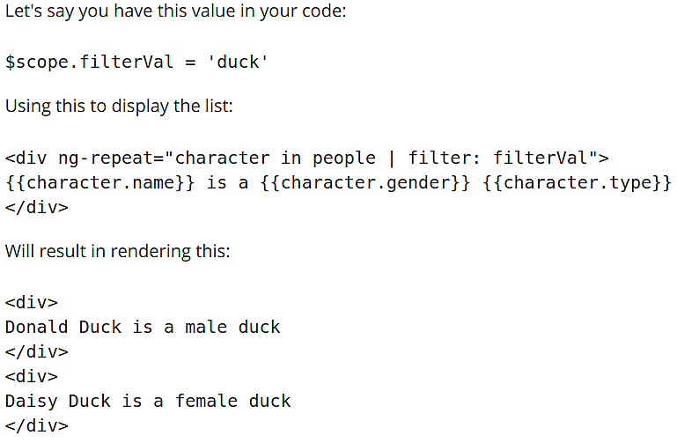

Slide 36
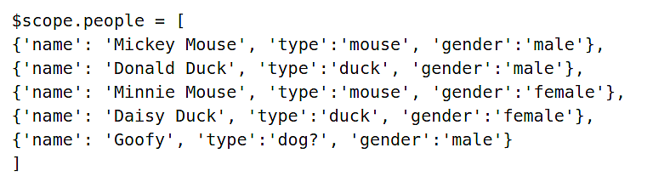

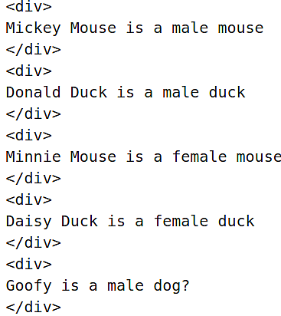

Slide 37

Reversing the order of the sort is as easy as throwing a ! in front of the value.
The track by expression is very useful for large implementations of ng-repeat. With it, you can specify a unique variable for Angular to reference when building the components. Angular will watch these values and re-use components as it is able, based on the value, resulting in a performance boost in rendering the HTML. Usually track by $index is used as $index', but other unique IDs and such data could be used to better effect. It is always included as the last parameter in an expression.
<input ng-model=”searchValue” type=”text”></input>
<div ng-repeat="item in filteredList = (sourceList| filter: searchValue)">
<span>{{item}}</span>
</div>
Using ng-repeat this way allows us to show filtered items based on searchValue
typed in an input field and the fielterd items are accessible in a variable called
filteredList

Slide 38
Promises
Consider this example:
Let's say you have an application that has to pull from 10 different APIs to produce a result. With synchronous programming, these results would be pulled one by one in sequence, building the data along the way until culminating in a final resulting value. Bring Promises into the picture and you could instead dispatch 10 processes simultaneously, each one bound by a promise. When all 10 calls come back, your handler can deal with all the returned data in the same fashion. Think of it as dispatching nanobots that are intelligently linked instead of a large robot to do the job.
Prior to the introduction of Promises, asynchronous JavaScript programming
required using a series of callback functions and timeout statements - which
can be cumbersome and difficult to manage. Angular, jQuery, Node.js and
many other popular frameworks instead use Promises to successfully execute
asynchronous operations.

Slide 39
Instantiating a promise is basically telling JavaScript to "Wait for this to finish." You wrap logic inside the promise, with calls to the resolve() method instead of returns. Where your normal function would return a final value, the asynchronous method returns a promise of having the value in the future. By using the Promise function, Angular defers an action or series of actions that you previously stated at an earlier point of time to the point when you explicitly declare that the promise be fulfilled or resolved. At that point, you can execute handlers that receive the successful response data or handle any failed responses appropriately.
As the Promise.then() and Promise.catch() methods return Promises, they can be chained in an operation called composition. Composition refers to the execution of several asynchronous calls in parallel and getting the result, once all the Promises have been resolved.
You can also use composition in reverse to set up multiple callbacks for the same promised value. This allows the value to be used in multiple places in an application. All of the values properly wait for the same data, thereby avoiding repeated HTTP requests to the same object.

Slide 40
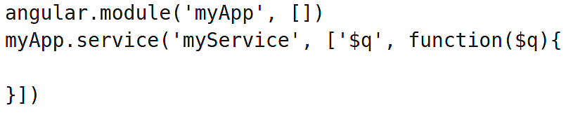
Promise States
A pending promise can become either fulfilled with a value or rejected with a reason (an error).
Here is a list of Promise states:
Pending: an initial state, not fulfilled or rejected
Fulfilled: the operation completed successfully
Rejected: the operation failed
Settled: the operation is either fulfilled or rejected, but not pending
Resolved: the promise is settled or locked into a promising chain
Declaring Promises
To declare a promise, you will need to have the $q Angular built-in module injected
as a dependency in your controller, directive, factory, or service.
Then there are two ways to declare your promise, $q.when() or $q.defer()

Slide 41
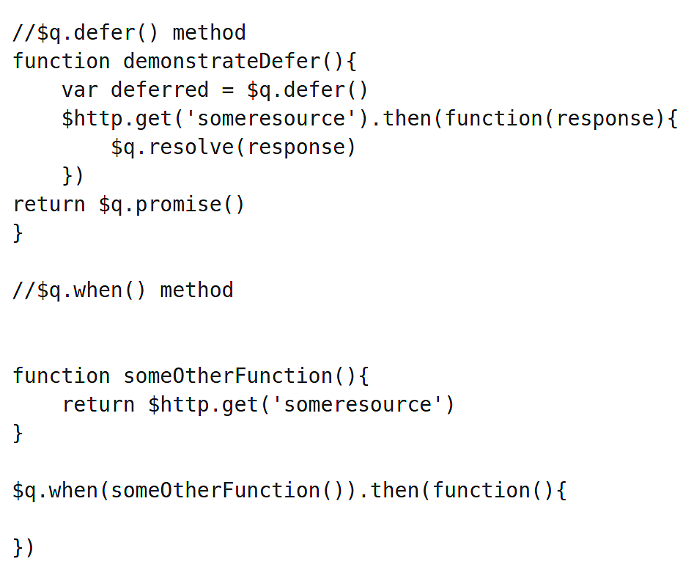
$q.when() can turn any value-based function into a promise, whose return value can then be used.
$q.defer() - on the other hand - declares a standalone promise that will resolve with whatever data you pass to it through $q.resolve or $q.reject

Slide 42
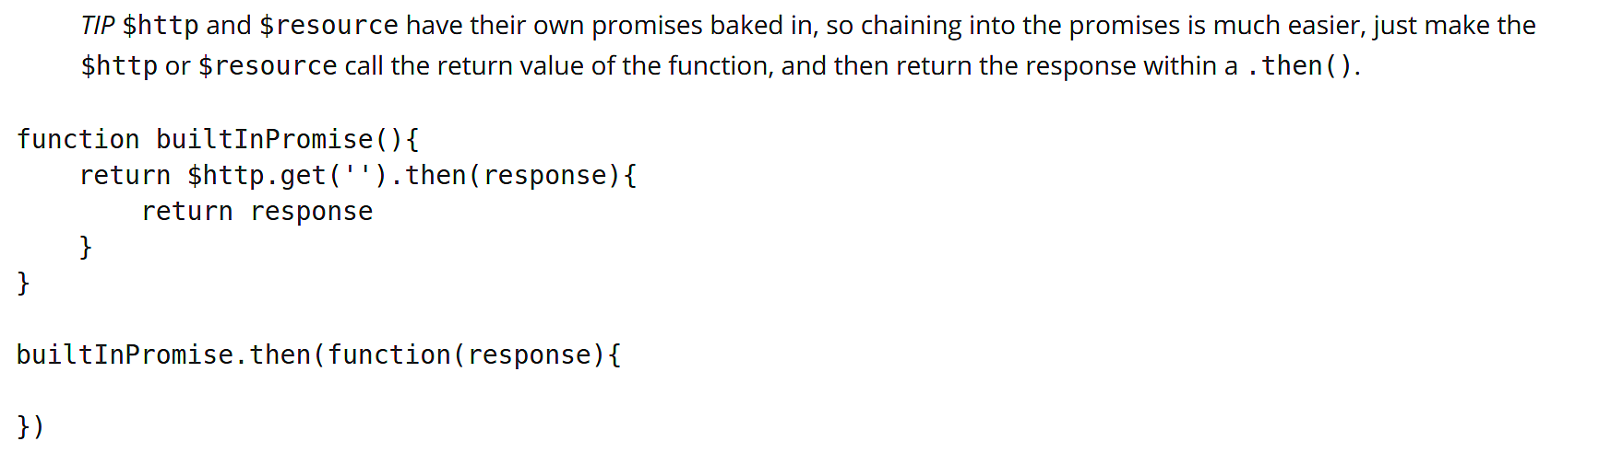
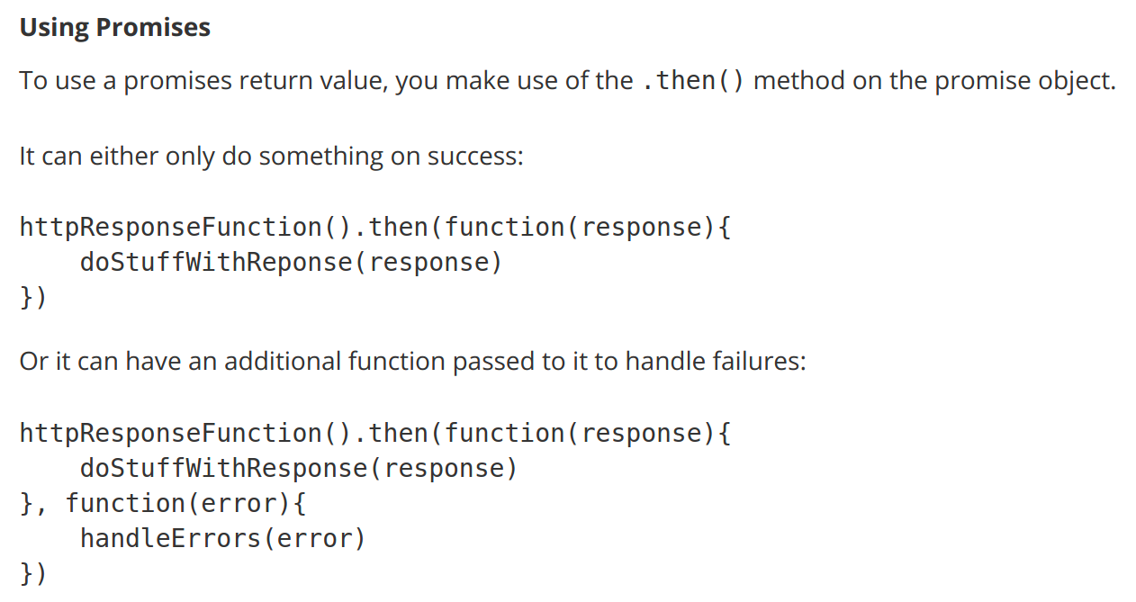

Slide 43
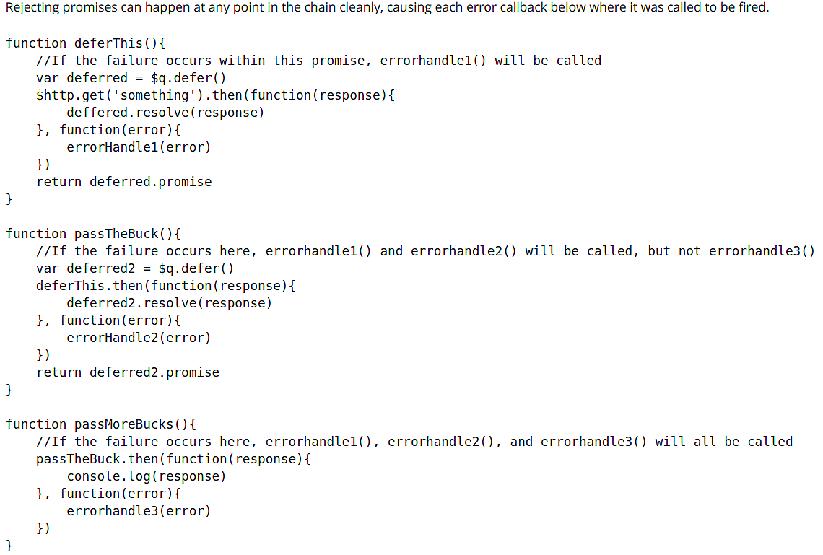
CHAINING THE PROMISES
Chaining promises is one of the more powerful features of $q. Simply put, a return value from a then() statement passes to the next then() statement in the promise.

Slide 44
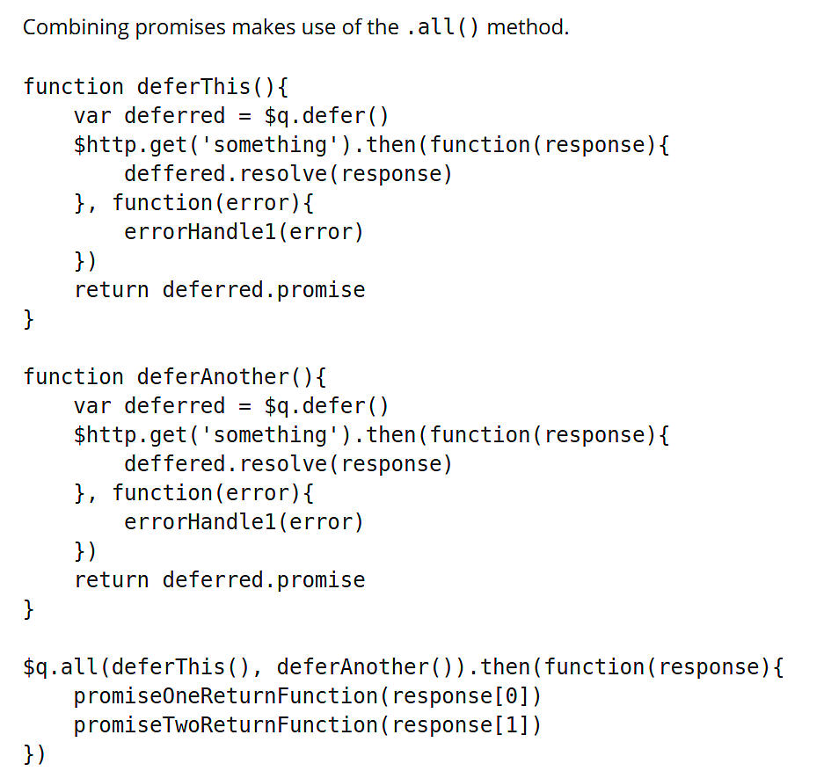

Slide 45
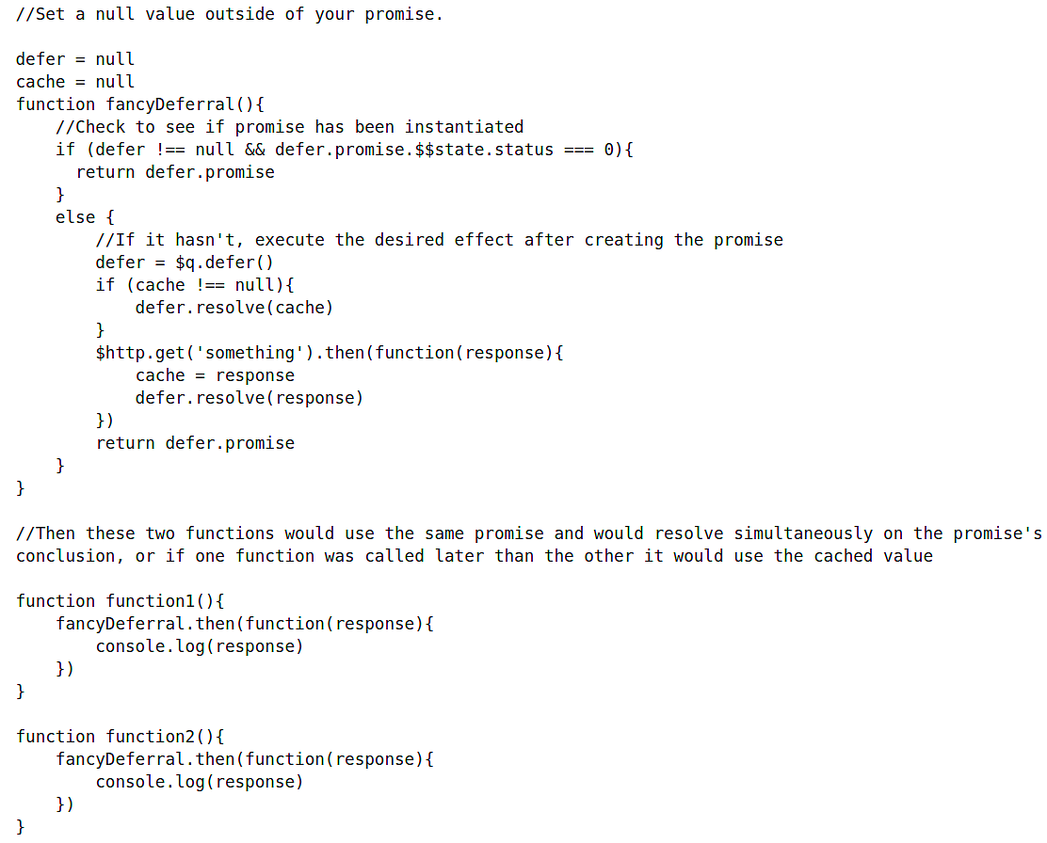
TIP Something clever to do with promises is to make multiple functions use the same promise resolution or a cached value, so that one HTTP call can satisfy many requests. This works especially well within Services, which you will learn about in the next course. It can be accomplished like this:

Slide 46
The $http Service
The $http service establishes communication with the remote HTTP servers via the browser's XMLHttpRequest object (XHR).
he $http service is a function that takes a single argument (a configuration object) that generates an HTTP request and returns a promise. This promise will be resolved to a response object when the request succeeds or fails. The configuration object is the object describing the request to be made and how it should be processed.
The response object has these properties:
Data - {string|Object} -- The response body transformed with the transform function
Status - {number} -- HTTP status code of the response
Headers - {function([headerName])} -- Header getter function
Config - {Object} -- The configuration object that was used to generate the request
StatusText - {string} -- HTTP status text of the response

Slide 47
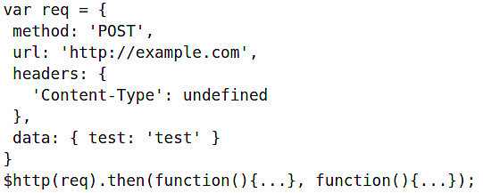
Using the $http Service
Using $http is relatively simple. The input for the function is a single object that represents a configuration object. You then use the Promise method .then(response) to execute your functions off of the response from the API.

Slide 48
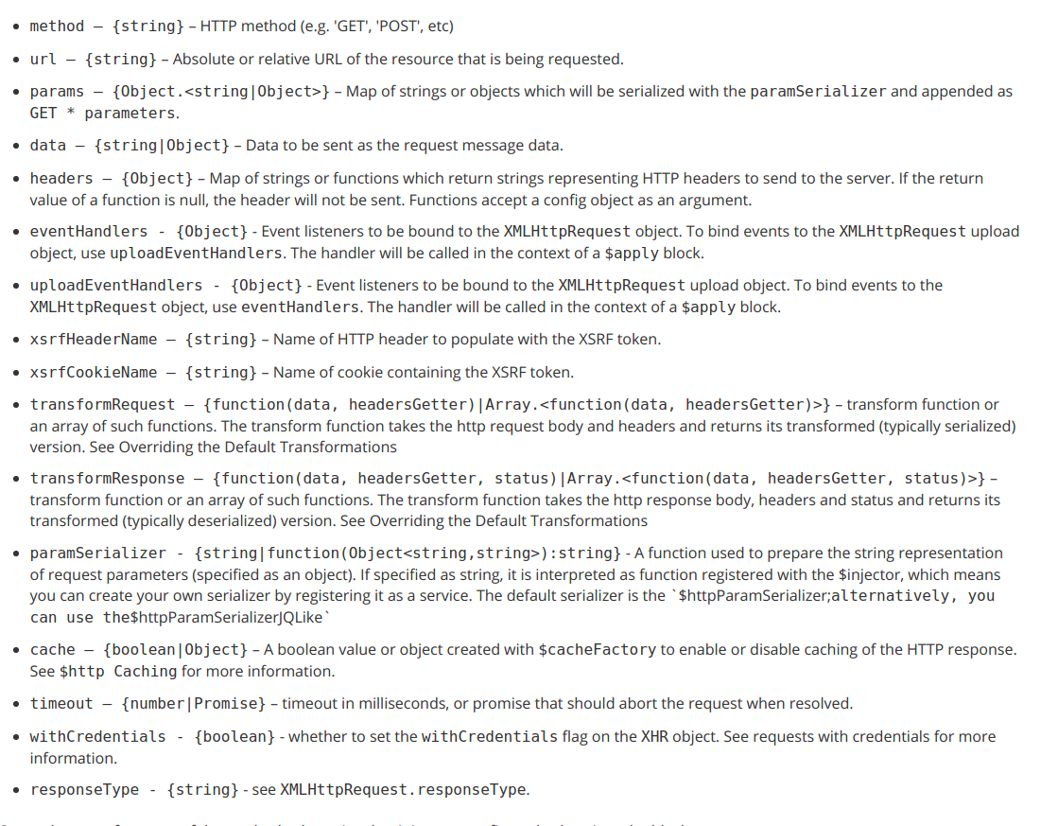
Things one can include in confg object

Slide 49
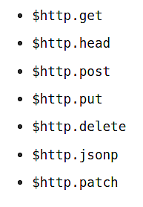
Documentation on
https://docs.angularjs.org/api/ng/service/$http

Slide 50
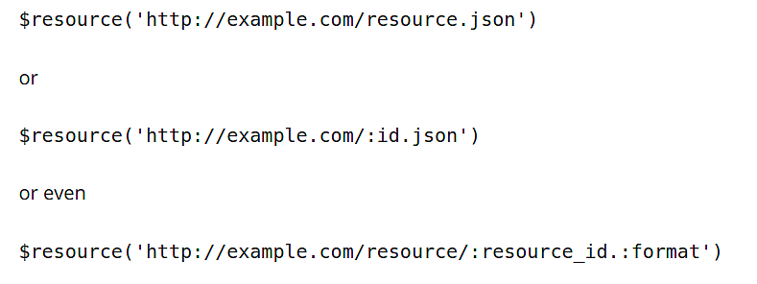
The $resource Service
The Angular $resource service allows you to create convenient methods for dealing with typical RESTful APIs.
Using the $resource Service
To use $resource, you can declare it as a variable.
The first parameter is the URL being called by the resource, parameterized with parameters prefixed by : as in /user/:username
Port numbers will be respected (e.g. this.com:8080)
If you are using a url with a suffix, just add the suffix, like this:

Slide 51
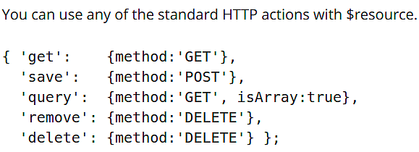
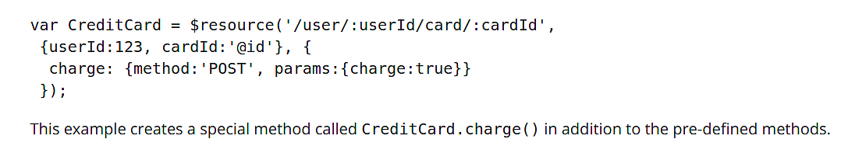
If the parameter before the suffix is empty, say :resource_id in this last example, then the /. will be collapsed down to a single .
If you need this sequence to appear and not collapse then you can escape it with /\.
The paramDefaults is an object that will contain the default parameters you are sending to the API
To define custom actions, pass an object into the 3rd parameter. This will allow you to modify the inputs for each method, and other customizations.

Slide 52
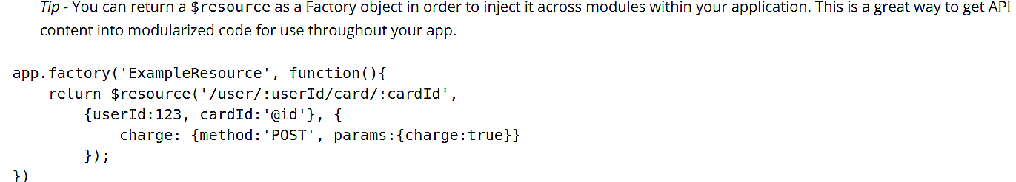
AJAX (Asynchronous JavaScript and XML) is a group of technologies that enable data to be sent and received without interrupting the user experience of a web page. $http is Angular's wrapper for AJAX calls, similar to the jQuery methods $.ajax() or $.get()

Slide 53
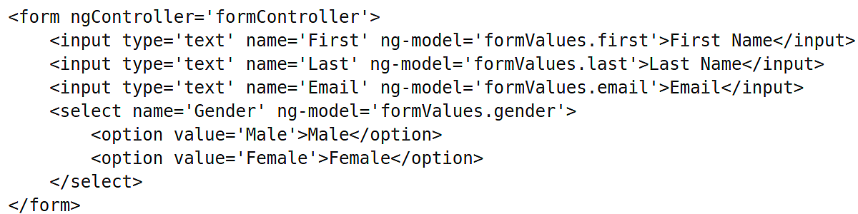
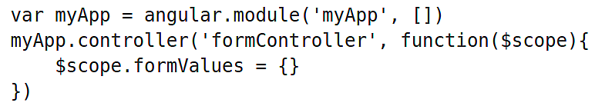
Building a Form
Let's look at a simple HTML form as an example
ng-model to each of the form elements so that their inputs can be two-way bound to the object.
In order to properly handle this form in Angular, you add an object to hold all the data parameters from the form in a controller.

Slide 54
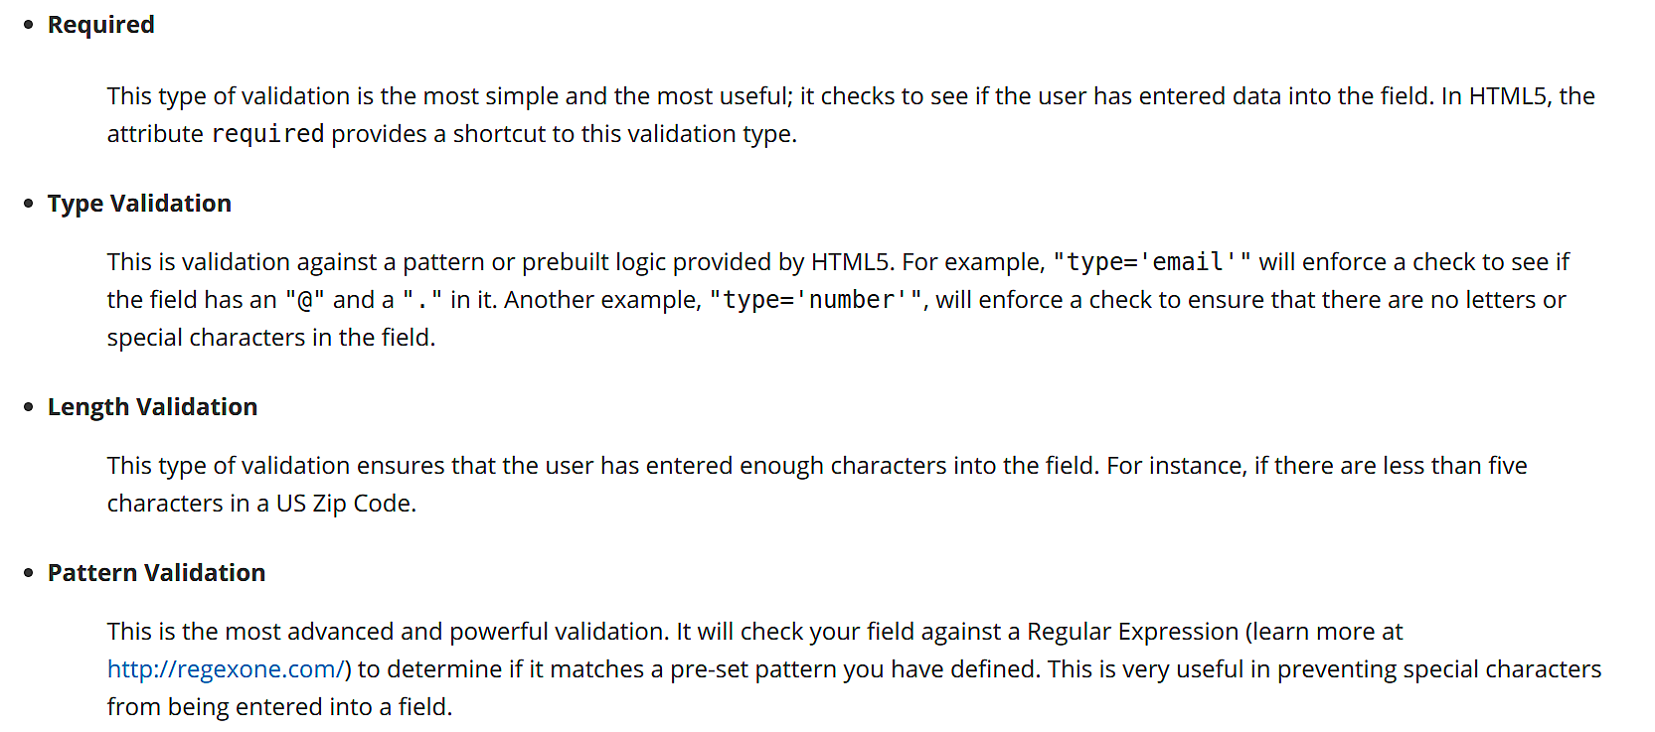
Validation Fundamentals
The purpose and function of validation is simple - don't allow users to submit a form unless all inputs are valid.

Slide 55
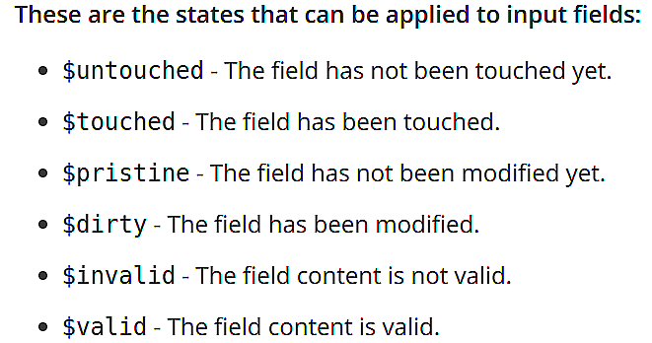
Using Angular Validation
Angular monitors the state of form and input fields (input, textarea, select), and notifies you about the current state
These states are all properties of the input field, and are either true or false.
In addition, the following CSS classes get applied by Angular for input fields:
ng-untouched - The field has not been touched yet.
ng-touched - The field has been touched.
ng-pristine - The field has not been modified yet.
ng-dirty - The field has been modified.
ng-valid - The field content is valid.
ng-invalid - The field content is not valid.
ng-valid-key - One key for each validation. For example: ng-valid-required; this is useful when there is more than one thing that must be validated.
ng-invalid-key - For example: ng-invalid-required

Slide 56
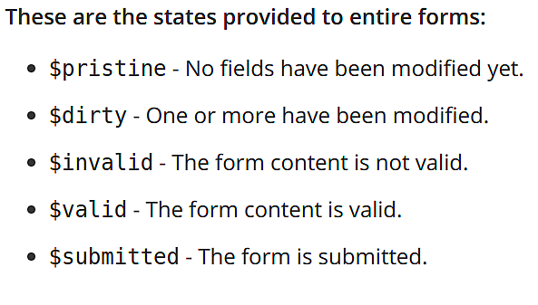
For forms:
ng-pristine - No fields have been modified yet.
ng-dirty - One or more fields have been modified.
ng-valid - The form content is valid.
ng-invalid - The form content is not valid.
ng-valid-key - One key for each validation. For example: ng-valid-required; this is useful when there is more than one thing that must be validated.
ng-invalid-key - Example: ng-invalid-required

Slide 57
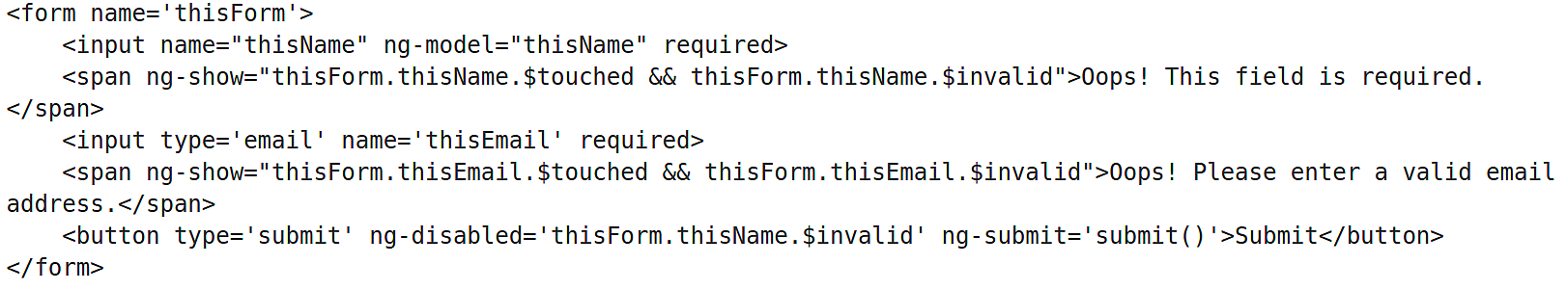
Using the name attribute with a form and its elements, publishes a FormController instance to the $scope, giving you control over the state of the form via the FormName.elementName.$error object.
To use the validation with Angular, simply apply the standard HTML5 attributes to your content and then check the state of validation.

Slide 58
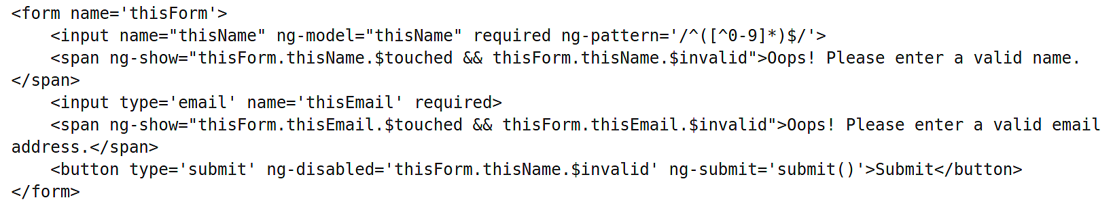
Put a regular expression into ng-pattern to enforce a pattern on the field. The regex entered here disallows numbers in the Name field.

Slide 59
Conditional Validation with Angular
Consider a case when we want to require a user to enter at least one form of contact information, for example, either a phone number or an email address. If we think through the logic for this scenario, the phone number is no longer required if we have an email address, and the email address is no longer required if we have a phone number. Converting this condition statement into a positive, we can state this as requiring a phone number when we do not have an email address (and we can apply the same approach for the email validation condition). Putting this example into code, we get the following:

Slide 60
To Disable Default Validation
HTML5 includes validation out of the box. In order to leverage the Angular validation, we need to disable default validation. This can be done by adding novalidate attribute to <form>

Slide 61
TODO articles:
https://docs.angularjs.org/api/ng/function/angular.injector
https://docs.angularjs.org/guide/di

