Slide 1
React.js
Learning Material

Slide 2
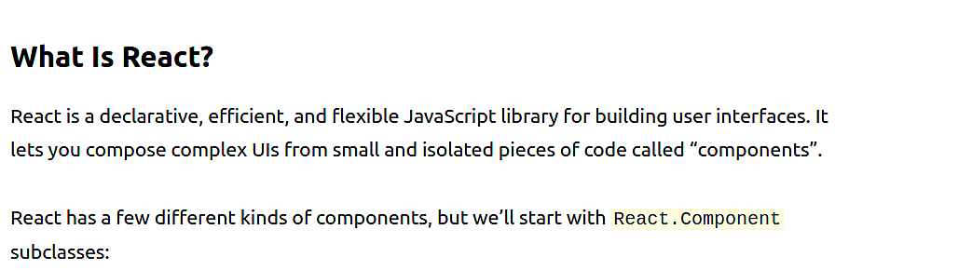
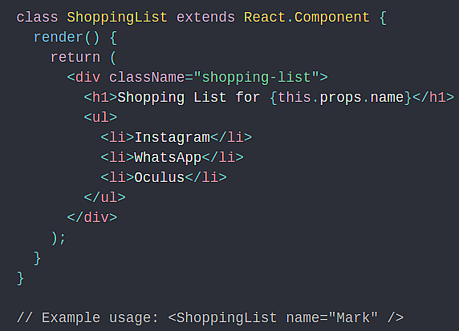

Slide 3
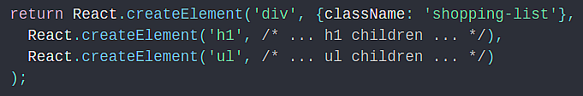
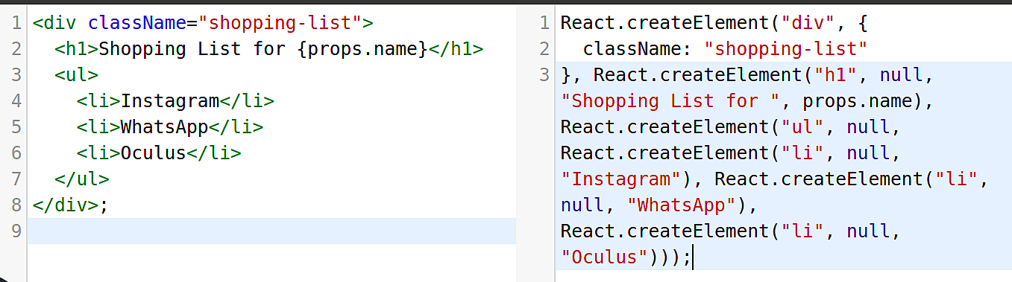
Here, ShoppingList is a React component class, or React component type. A component takes in parameters, called props (short for “properties”), and returns a hierarchy of views to display via the render method.
The render method returns a description of what you want to see on the screen. React takes the description and displays the result.
Most React developers use a special syntax called “JSX” which makes these structures easier to write. The <div /> syntax is transformed at build time to React.createElement('div'). The example above is equivalent to:

Slide 4
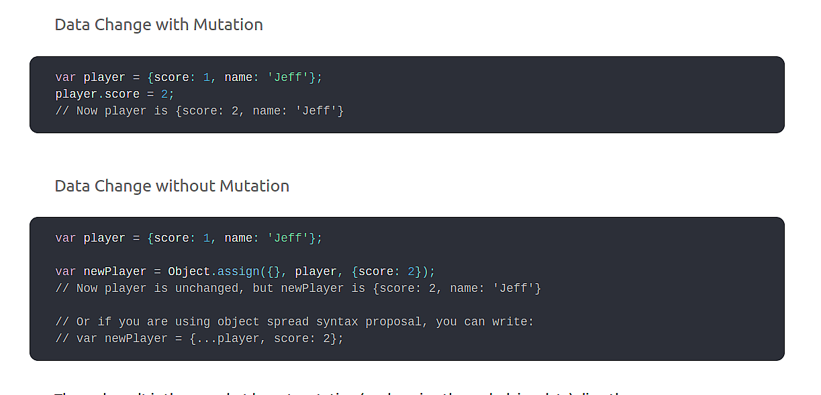
JSX comes with the full power of JavaScript. You can put any JavaScript expressions within braces inside JSX.

