Slide 1
React.js
Learning Material

Slide 2
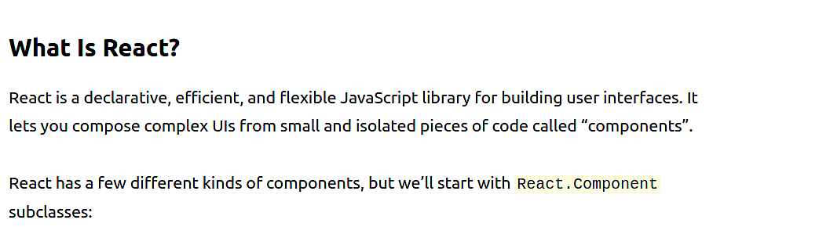
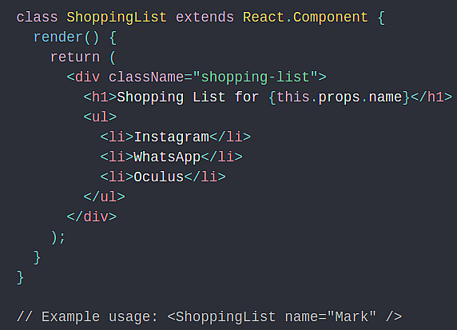
Source: https://reactjs.org/tutorial/tutorial.html

Slide 3
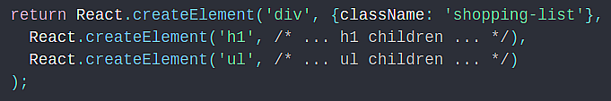
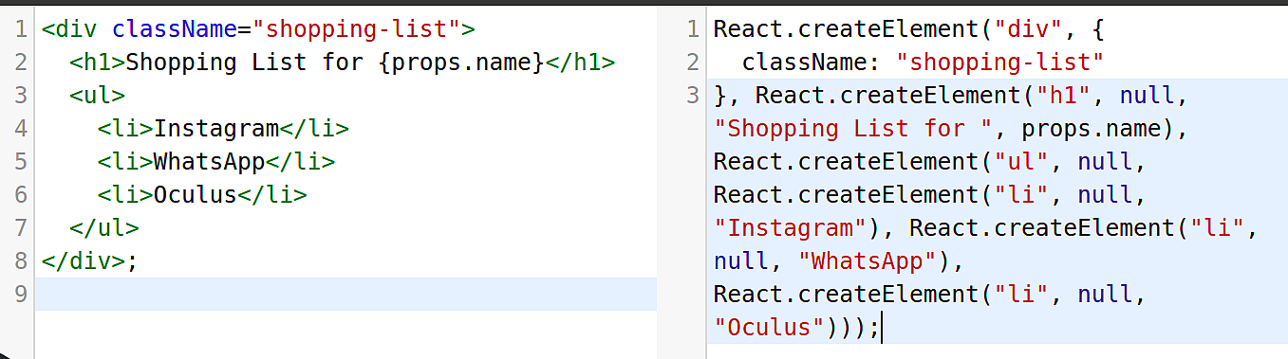
Here, ShoppingList is a React component class, or React component type. A component takes in parameters, called props (short for “properties”), and returns a hierarchy of views to display via the render method.
The render method returns a description of what you want to see on the screen. React takes the description and displays the result.
Most React developers use a special syntax called “JSX” which makes these structures easier to write. The <div /> syntax is transformed at build time to React.createElement('div'). The example above is equivalent to:
Source: https://reactjs.org/tutorial/tutorial.html

Slide 4
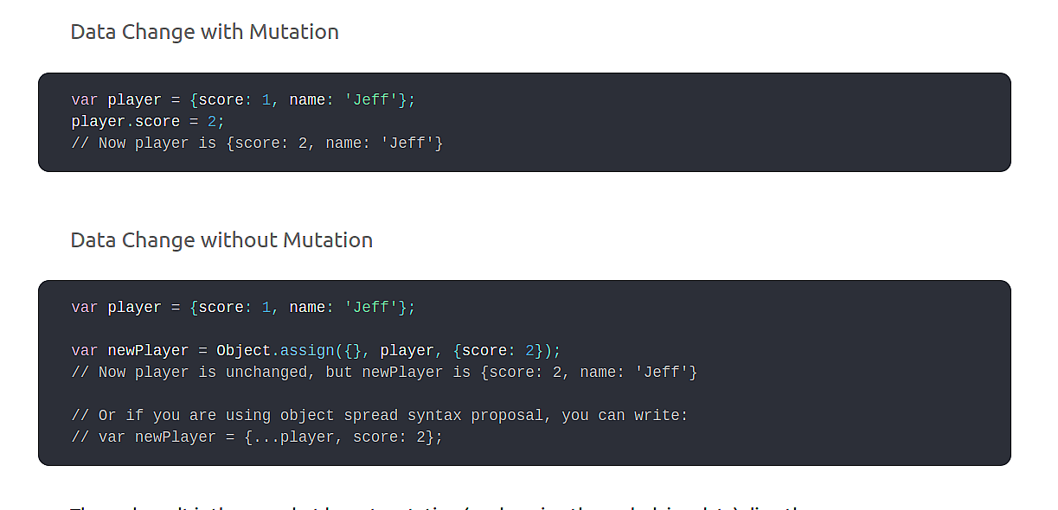
JSX comes with the full power of JavaScript. You can put any JavaScript expressions within braces inside JSX.
Source: https://reactjs.org/tutorial/tutorial.html

Slide 5
Immutability makes complex features much easier to implement. a “time travel” feature that allows us to review the tic-tac-toe game’s history and “jump back” to previous moves. an ability to undo and redo certain actions is a common requirement in applications. Avoiding direct data mutation lets us keep previous versions of the game’s history intact, and reuse them later.
Detecting Changes
Detecting changes in mutable objects is difficult because they are modified directly. This detection requires the mutable object to be compared to previous copies of itself and the entire object tree to be traversed.
Detecting changes in immutable objects is considerably easier. If the immutable object that is being referenced is different than the previous one, then the object has changed.
Function Components - In React, function components are a simpler way to write components that only contain a render method and don’t have their own state. Instead of defining a class which extends React.Component, we can write a function that takes props as input and returns what should be rendered.
Source: https://reactjs.org/tutorial/tutorial.html

Slide 6
Course Contents Begin
What is ReactJS?
ReactJS is a library that generates the view layer of an application based on its state. ReactJS applications are built from React Components - independent resusable components that describe how the UI should look based on their own state and properties.
Why should I use ReactJS?
ReactJS applications are incredibly performant at UI rerendering
React Components make writing UI components easier

Slide 7
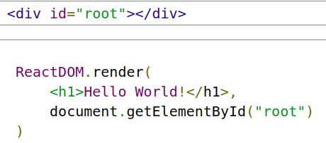
What makes ReactJS so efficient at rerendering?
React Components are used to generate a Virtual DOM - a light-weight abstraction of the actual HTML DOM. The Virtual DOM is able to be generated much more quickly than the HTML DOM because it does not have to calculate CSS styles and layouts. When a React Component changes state, the Virtual DOM is recreated and the difference between the new Virtual DOM and the previous Virtual DOM is calculated. The ReactJS library then calculates the most efficient way to update the HTML DOM to reflect these changes
How hard is it to use ReactJS?
ReactJS is a relatively lightweight library and it does not take a whole lot of code to get started with it.
Here is an example of the code needed for a Hello World application:

Slide 8
React Elements are objects that represent a DOM node. They are written using a syntax extension named JSX
React Elements need to be rendered by the ReactDOM.render() method to appear in the DOM
The ReactDOM.render() method is used to render a React Element into a specified part of the HTML DOM. In most React applications, there is usually a single root node where everything gets rendered into, but you may use as many root nodes as you desire.

