Slide 1

PROCESS
&
CPU SCHEDULING

Slide 2

Process Control Block (PCB)‏
Information associated with each process.
Process state
Program counter
CPU registers
CPU scheduling information
Memory-management information

Slide 3
CPU Scheduler
A CPU scheduler, is responsible for selecting of the next running process.
  Based on a particular strategy
When does CPU scheduling happen?
    A process switches from the running state to waiting state (e.g. I/O request)‏
    A process switches from the running state to the ready state.
    A process switches from waiting state to ready state (completion of an I/O operation)‏
    A process terminates

Slide 4
Scheduling queues
CPU schedulers use various queues in the scheduling process:
  Job queue: consists of all processes
    All jobs (processes), once submitted, are in the job queue.
  Ready queue
    All processes that are ready and waiting for execution are in the ready queue.
    Usually, a long-term scheduler/job scheduler selects processes from the job queue to the ready queue.
    CPU scheduler/short-term scheduler selects a process from the ready queue for execution.

Slide 5
Scheduling queues
Device queue
  When a process is blocked in an I/O operation, it is usually put in a device queue (waiting for the device).
  When the I/O operation is completed, the process is moved from the device queue to the ready queue.

Slide 6
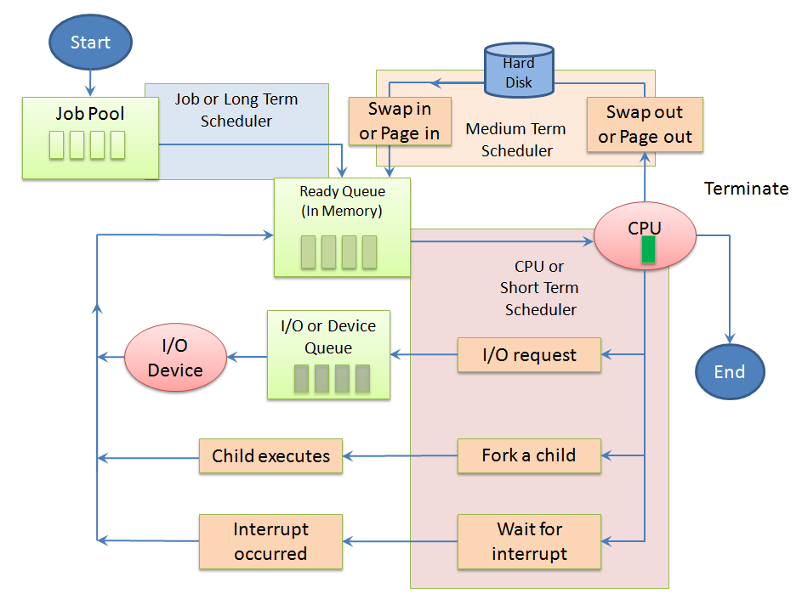

Slide 7
Performance metrics for CPU scheduling
CPU utilization: percentage of the time that CPU is busy.
Throughput: the number of processes completed per unit time
Turnaround time: the interval from the time of submission of a process to the time of completion.
Wait time: the sum of the periods spent waiting in the ready queue
Response time: the time of submission to the time the first response is produced

Slide 8
Goal of CPU scheduling
Other performance metrics:
  fairness: It is important, but harder to define quantitatively.
Goal:
  Maximize CPU utilization, Throughput, and fairness.
  Minimize turnaround time, waiting time, and response time.

Slide 9
Deterministic modeling example:
Suppose we have processes A, B, and C, submitted at time 0
We want to know the response time, waiting time, and turnaround time of process A
turnaround time
wait time
+
+
response time = 0
A
B
C
A
B
C
A
C
A
C
Time
Gantt chart: visualize how processes execute.

Slide 10
Deterministic modeling example
Suppose we have processes A, B, and C, submitted at time 0
We want to know the response time, waiting time, and turnaround time of process B
turnaround time
wait time
+
response time
A
B
C
A
B
C
A
C
A
C
Time

Slide 11
Deterministic modeling example
Suppose we have processes A, B, and C, submitted at time 0
We want to know the response time, waiting time, and turnaround time of process C
turnaround time
wait time
+
+
+
response time
A
B
C
A
B
C
A
C
A
C
Time

Slide 12
Preemptive versus nonpreemptive scheduling
  Preemptive: schedule a new process even when the
  current process does not intend to give up the CPU
  Non-preemptive: only schedule a new process when the current one does not want CPU any more.

Slide 13
Scheduling Policies
FIFO (first in, first out)‏
Round robin
SJF (shortest job first)‏
Priority Scheduling
Multilevel feedback queues
Many more...

Slide 14
FIFO
FIFO: assigns the CPU based on the order of requests
  Non-preemptive: A process keeps running on a CPU until it is blocked or terminated
  Also known as FCFS (first come, first serve)‏
  - Simple
  Short jobs can get stuck behind long jobs
    Turnaround time is not ideal

Slide 15
Round Robin
Round Robin (RR) periodically releases the CPU from long-running jobs
  Based on timer interrupts so short jobs can get a fair share of CPU time
  Pre-emptive: a process can be forced to leave its running state and replaced by another running process
  Time slice: interval between timer interrupts

Slide 16
More on Round Robin
If time slice is too long
  Scheduling degrades to FIFO
If time slice is too short
  Throughput suffers
  Context switching cost dominates

Slide 17
FIFO vs. Round Robin
Suppose we have three jobs of equal length
turnaround time of C
turnaround time of B
turnaround time of A
A
B
C
A
B
C
A
B
C
Time
Round Robin
turnaround time of C
turnaround time of B
turnaround time of A
A
B
C
Time
FIFO

Slide 18
FIFO vs. Round Robin
Round Robin
  Shorter response time
  Fair sharing of CPU

Slide 19
Shortest Job First (SJF)‏
SJF runs whatever job puts the least demand on the CPU, also known as STCF (shortest time to completion first)‏
  Great for short jobs
  Small degradation for long jobs

Slide 20
Drawbacks of Shortest Job First
- Starvation: constant arrivals of short jobs can keep long ones from running
- There is no way to know the completion time of jobs (most of the time)‏

Slide 21
Priority Scheduling (Multilevel Queues)‏
Priority scheduling: The process with the highest priority runs first
Priority 0:
Priority 1:
Priority 2:
Assume that low numbers represent high priority
C
A
B
C
A
B
Time
Priority Scheduling

Slide 22
Multilevel Feedback Queues
Multilevel feedback queues use multiple queues with different priorities
  Round robin at each priority level
  Run highest priority jobs first
  Once those finish, run next highest priority, etc
  Jobs start in the highest priority queue
  If time slice expires, drop the job by one level
  If time slice does not expire, push the job up by one level

Slide 23
Multilevel Feedback Queues
time = 0
Priority 0 (time slice = 1):
Priority 1 (time slice = 2):
Priority 2 (time slice = 4):
A
B
C
Time

Slide 24
Multilevel Feedback Queues
time = 1
Priority 0 (time slice = 1):
Priority 1 (time slice = 2):
Priority 2 (time slice = 4):
B
C
A
A
Time

Slide 25
Multilevel Feedback Queues
time = 2
Priority 0 (time slice = 1):
Priority 1 (time slice = 2):
Priority 2 (time slice = 4):
C
A
B
A
B
Time

Slide 26
Multilevel Feedback Queues
time = 3
Priority 0 (time slice = 1):
Priority 1 (time slice = 2):
Priority 2 (time slice = 4):
A
B
C
A
B
C
Time

Slide 27
Multilevel Feedback Queues
time = 3
Priority 0 (time slice = 1):
Priority 1 (time slice = 2):
Priority 2 (time slice = 4):
A
B
C
suppose process A is blocked on an I/O
A
B
C
Time

Slide 28
Multilevel Feedback Queues
time = 3
Priority 0 (time slice = 1):
Priority 1 (time slice = 2):
Priority 2 (time slice = 4):
A
B
C
suppose process A is blocked on an I/O
A
B
C
Time

Slide 29
Multilevel Feedback Queues
time = 5
Priority 0 (time slice = 1):
Priority 1 (time slice = 2):
Priority 2 (time slice = 4):
A
C
suppose process A is returned from an I/O
A
B
C
B
Time

Slide 30
Multilevel Feedback Queues
time = 6
Priority 0 (time slice = 1):
Priority 1 (time slice = 2):
Priority 2 (time slice = 4):
C
A
B
C
B
A
Time

Slide 31
Multilevel Feedback Queues
time = 8
Priority 0 (time slice = 1):
Priority 1 (time slice = 2):
Priority 2 (time slice = 4):
C
A
B
C
B
A
C
Time

Slide 32
Multilevel Feedback Queues
time = 9
Priority 0 (time slice = 1):
Priority 1 (time slice = 2):
Priority 2 (time slice = 4):
A
B
C
B
A
C
C
Time

