Slide 1


SMART INDIA HACKATHON 2026
Problem Statement ID: SIH26184
Problem Statement Title: Development of a Predictive Analytics Framework for Cybercrime Complaints to Forecast Likely Cash Withdrawal Locations in Advance, Enabling Generation of Actionable Intelligence for Timely and Proactive Cybercrime Intervention.
Theme: Blockchain & Cybersecurity
PS Category: Software
Team ID:
Team Name: Team Zero

Slide 2


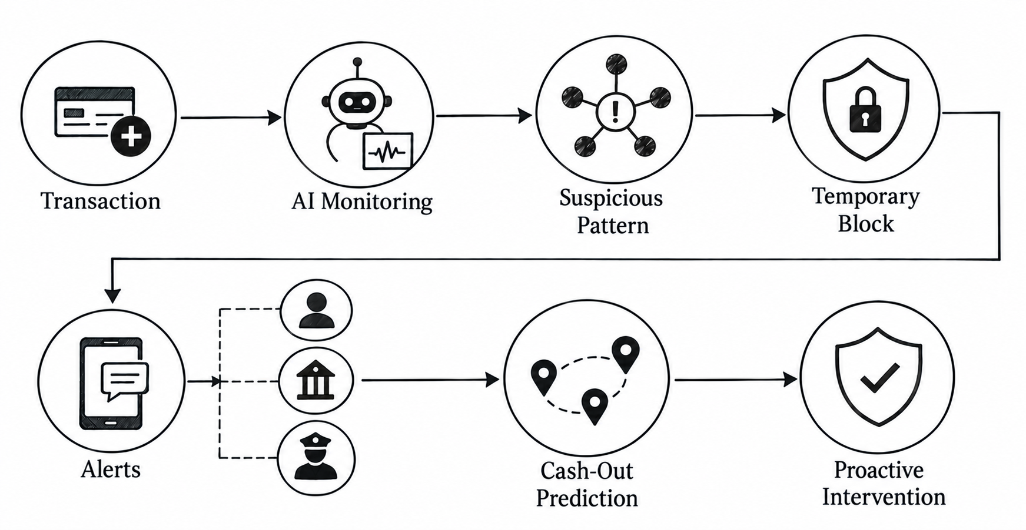
IDEA: ZeroFraud 360
1. How Our Idea Works:
Most fraud is detected after the money has already moved. ZeroFraud360 detects suspicious money movement in real time.
When a transaction occurs, AI continuously tracks the money flow. Unusual movement across multiple accounts is identified as suspicious.
3. Precaution:
AI predicts the likely cash-out location and time, allowing action before the fraud is completed.
Detect Early → Protect Money → Verify User → Alert Authorities → Predict Cash-Out → Prevent Fraud
2. Protection after AI Detect it was suspicious:
When suspicious activity is detected, the system raises an alert and temporarily protects the transaction.
High-risk transfers or withdrawals can be restricted while the user, bank, and authorities verify the activity.

Slide 3
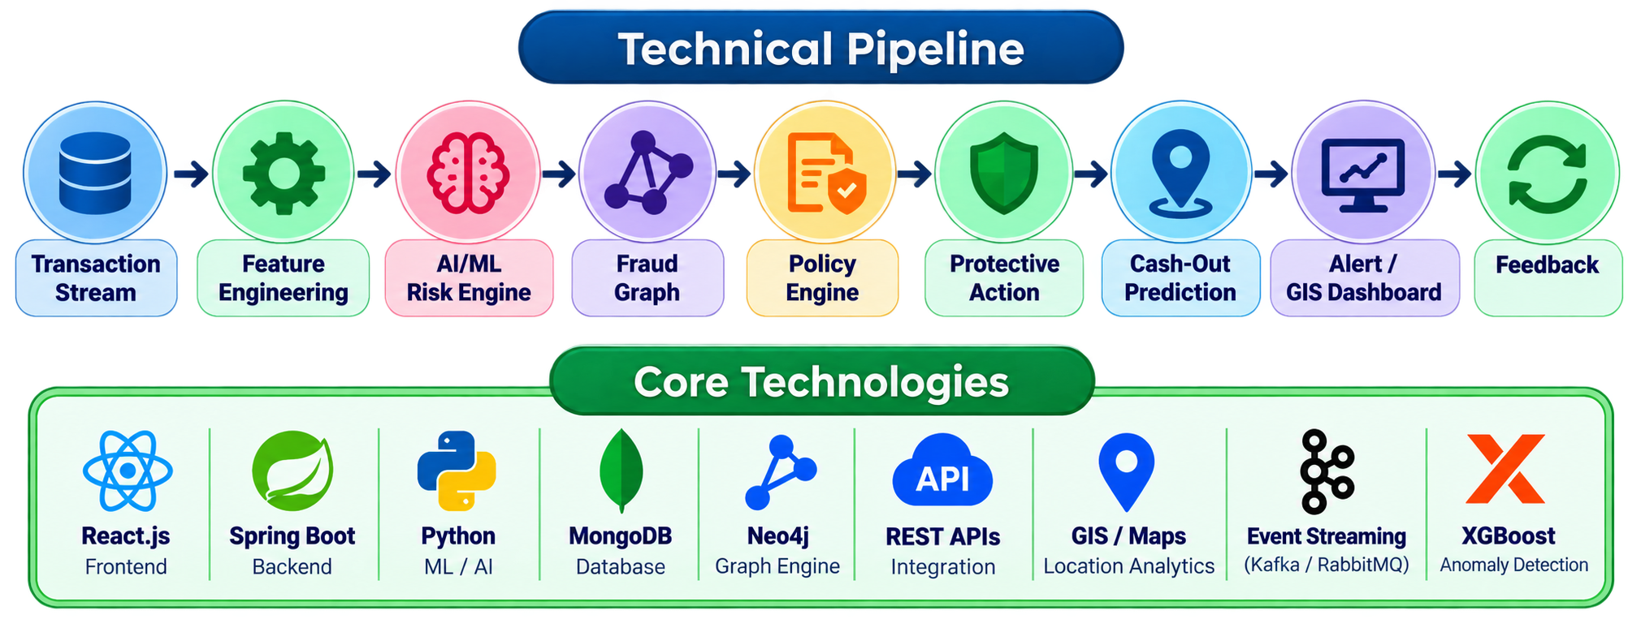
TECHNICAL APPROACH
1. Real-Time Transaction Ingestion
Stream authorized transaction events through REST APIs / event queues, normalize data, and maintain a live transaction state for continuous analysis.
2. AI Risk & Anomaly Engine
Use feature engineering + anomaly detection + supervised ML to evaluate transaction velocity, amount deviation, account behavior, and rapid multi-hop movement, producing a dynamic risk score.
3. Fraud Network Graph
Model Account–Transaction–Beneficiary–Location relationships as a dynamic graph to detect suspicious paths, connected entities, fund splitting, and propagation patterns.
4. Automated Protective Workflow
High-risk events trigger a policy-based temporary hold/review workflow, account-holder verification, and secure intelligence distribution to the relevant Bank/FI and LEA.
5. Predictive Cash-Out Intelligence
Combine spatiotemporal features, historical withdrawal patterns, graph signals, and geospatial proximity to rank probable cash-out locations and time windows.
6. Explainable & Adaptive Intelligence
Generate risk factors, prediction reasons, confidence scores, and audit trails; feed confirmed outcomes back into the system for model evaluation and improvement.

Slide 4

FEASIBILITY AND VIABILITY
Feasibility of the Idea
Technically feasible: Uses proven technologies such as ML-based anomaly detection, transaction graphs, GIS, REST APIs, and real-time event processing.
Scalable architecture: Modular services can process large transaction volumes and support continuous monitoring as cybercrime complaints grow.
Existing ecosystem compatible: Can integrate with banking/FI systems and authorized law-enforcement workflows through secure APIs.
Prototype-friendly: The SIH solution can be demonstrated using synthetic/de-identified transaction data while following real-world architecture.
Potential Challenges & Risks
High false positives: Legitimate transactions may appear suspicious.
Data privacy & security: Financial and personal data require strong protection.
Real-time processing: Large transaction volumes require low-latency analysis.
Model accuracy: Fraud patterns continuously change and may reduce prediction accuracy.
Integration & authorization: Financial actions must follow bank and law-enforcement policies.
Strategies to Overcome Challenges
                Adaptive risk scoring: Use multiple signals instead of blocking based on a single transaction.
Human-in-the-loop verification: Combine AI predictions with account-holder and authorized investigator confirmation.
Privacy-first design: Use encryption, role-based access, audit logs, and minimal data exposure.
Scalable processing: Use event-driven architecture, caching, and modular microservices.
Continuous learning: Feed validated outcomes back into the models for regular evaluation and improvement.

Slide 5
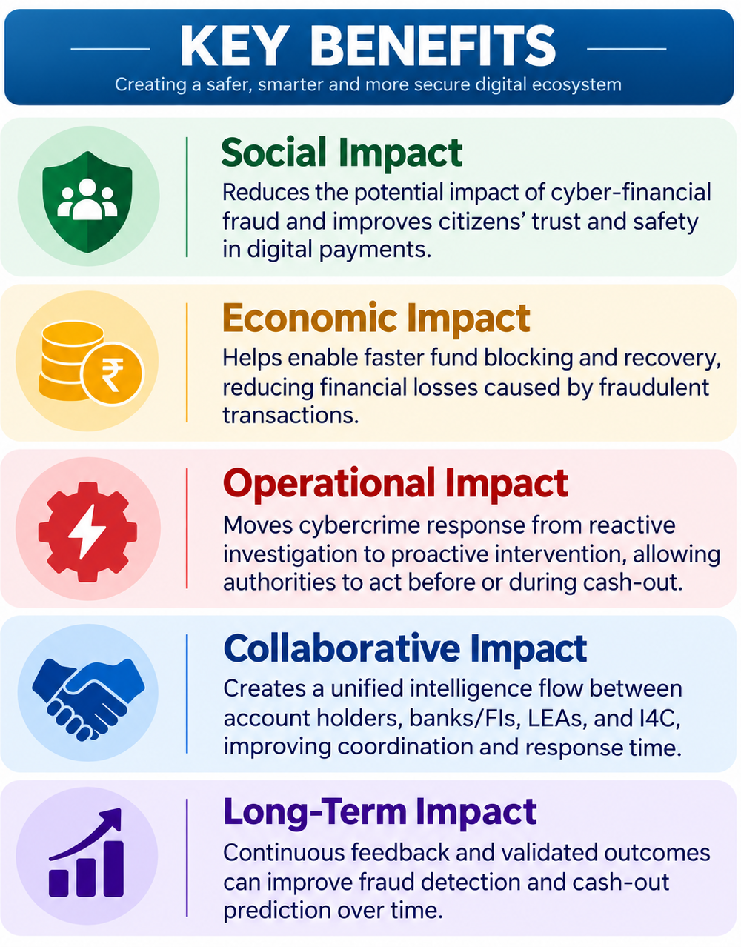
IMPACT AND BENEFITS
Impact at a Glance
Detect Before Cash-Out
Identify suspicious multi-hop money movement while funds are still moving through the network.
Protect Before Loss
Create a temporary security window for verification and authorized protective action.
Predict Where It May Happen
Use transaction, time and location patterns to rank likely cash-out locations.
Act on Intelligence
Give banks and authorized law-enforcement teams connected, actionable information instead of isolated alerts.
Learn & Improve
Use confirmed outcomes to continuously evaluate and improve detection and prediction.
Expected Outcomes
Earlier Detection: Identify suspicious money movement before it reaches the final cash-out stage.
Reduced Fraud Loss: Create a security window for verification and faster protective action.
Faster Investigation: Provide investigators with connected accounts, transaction paths, and risk insights in one view.
Proactive Cash-Out Prevention: Predict likely withdrawal locations and time windows to support timely intervention.
Smarter Response: Continuously learn from confirmed outcomes to improve future fraud detection and prediction.

Slide 6
RESEARCH AND REFERENCES
4. CFCFRMS & Cyber Fraud Mitigation
I4C / MHA
Studied the existing financial-fraud response mechanism, including rapid reporting, fund-blocking workflows, bank/FI coordination, and the Cyber Fraud Mitigation Centre.
5. Graph-Based Financial Fraud Detection
Research literature on Graph / GNN-based fraud detection
Research shows that financial fraud can be analyzed as a relational graph, allowing detection of suspicious entities, connections, and network-level patterns rather than analyzing transactions independently.
6. XGBoost — Scalable Machine Learning
Chen & Guestrin, KDD 2016
Studied XGBoost as a scalable tree-boosting approach suitable for structured/tabular data and large-scale machine-learning pipelines.
XGBoost Research Paper
1. SIH 2026 — Official Problem Statement SIH26184
Ministry of Home Affairs / I4C
Used to understand the core requirement: proactive cybercrime intervention, predictive cash-withdrawal intelligence, GIS risk visualization, and real-time alerts.
2. National Cyber Crime Reporting Portal (NCRP)
Government of India — cybercrime.gov.in
Studied the existing cybercrime reporting workflow, financial-fraud reporting process, suspect reporting, and citizen-facing mechanisms.
National Cyber Crime Reporting Portal
3. Indian Cyber Crime Coordination Centre (I4C)
Ministry of Home Affairs
Studied I4C's role in cybercrime coordination, analytics, research, and collaboration between law-enforcement agencies and other stakeholders.
MHA — I4C Overview

