Slide 1
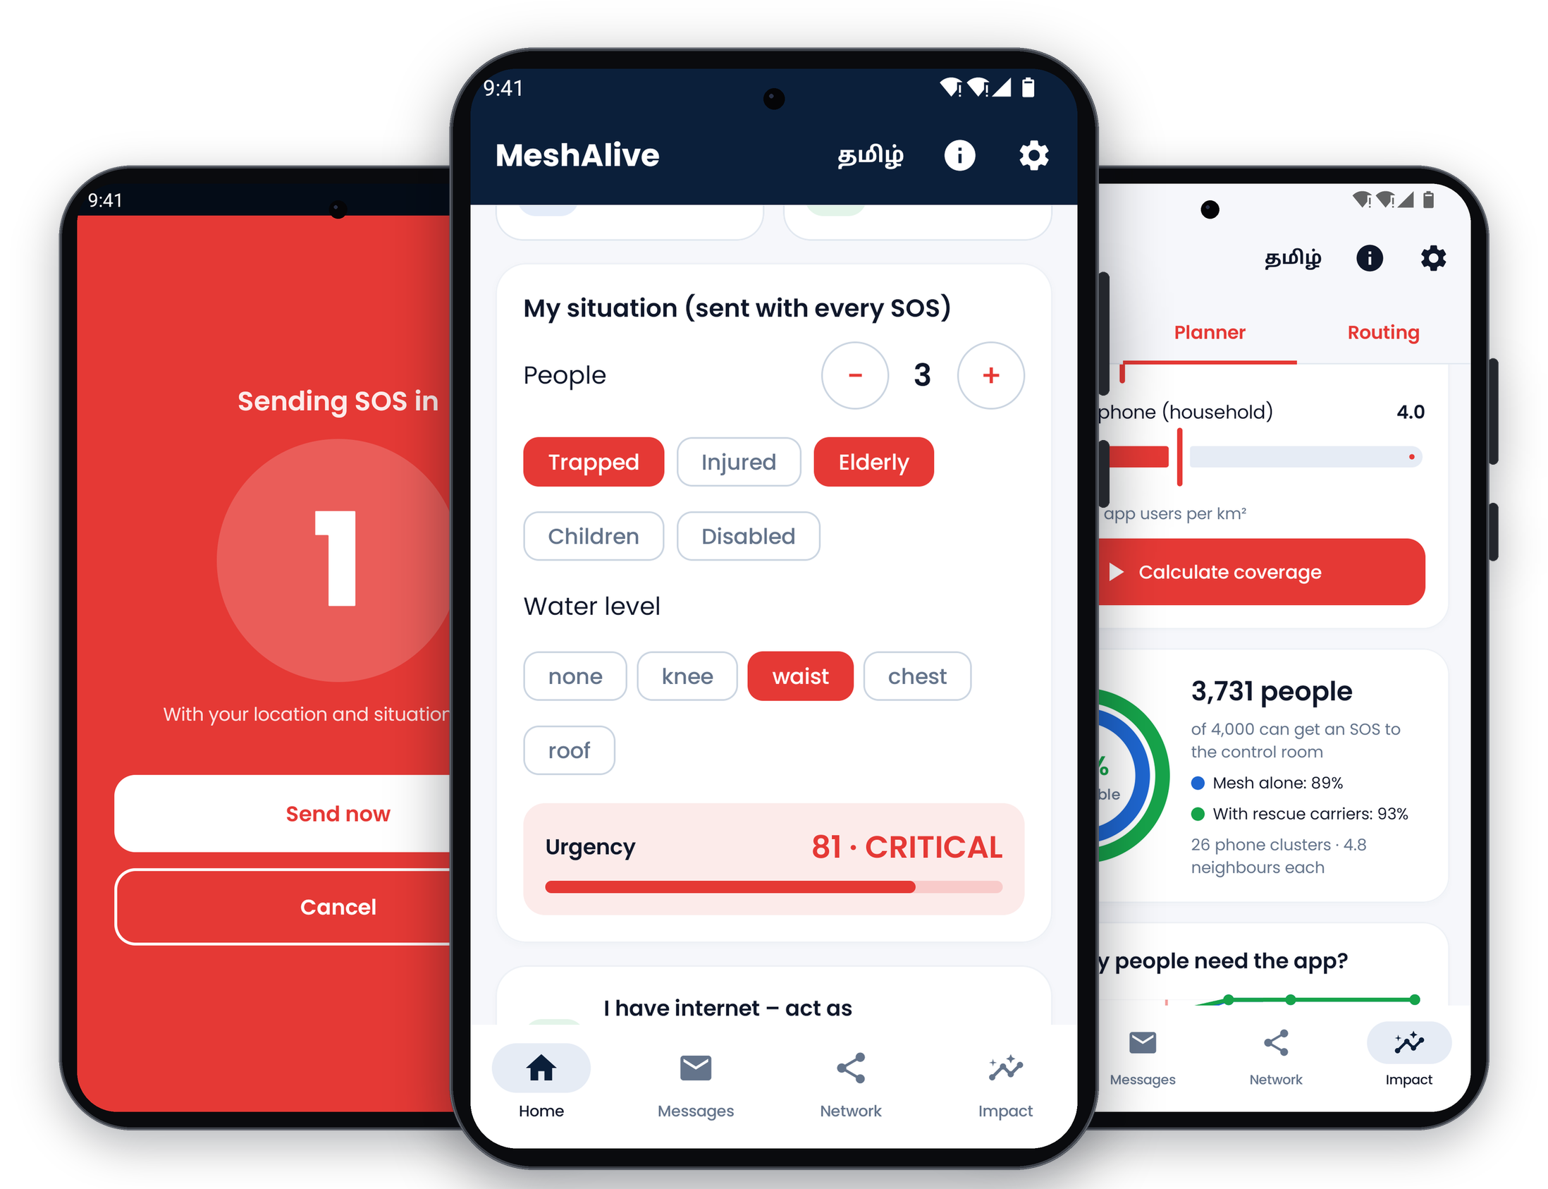
MeshAlive
Help reaches you,
even when the network doesn’t.
An offline disaster-response network. When cyclones and floods take down mobile towers, SOS messages travel phone to phone and through rescue boats to the district control room, and help comes back the same way.
Theme 05 · Surakshit Bharat
Track A · Product
Working prototype
MeshAlive · SevaFirst Innovation Challenge 2026

Slide 2
THE PROBLEM
When the towers go down, rescue goes blind
Every cyclone and flood season, districts lose mobile coverage for hours or days, as in the 2015 Chennai floods and Cyclone Michaung in 2023. That is exactly when people most need help.
People can’t call for help
Control rooms work blind
Chat apps aren’t enough
Trapped families, the elderly and patients can’t call, text or share their location.
No view of who needs help, where they are, how many people, or how urgent.
They don’t reach rescuers or prioritise, and they drain the phones that relay for others.
MeshAlive · SevaFirst Innovation Challenge 2026

Slide 3
THE SOLUTION
A complete rescue loop on phones people already own
1
2
3
4
5
Ask for help
Phones relay
Rescuers carry
Control room sees
Help comes back
One-tap SOS with GPS and a situation report, scored 0–100 for urgency.
Bluetooth and Wi-Fi mesh. Battery-aware routing; most urgent first.
Boats and NDRF teams carry stuck SOS out of dead zones.
The first phone with signal uploads to a live, urgency-sorted map.
Dispatch and evacuation alerts reach phones with no signal.
No towers · No internet · No extra hardware · Tamil and English
MeshAlive · SevaFirst Innovation Challenge 2026

Slide 4
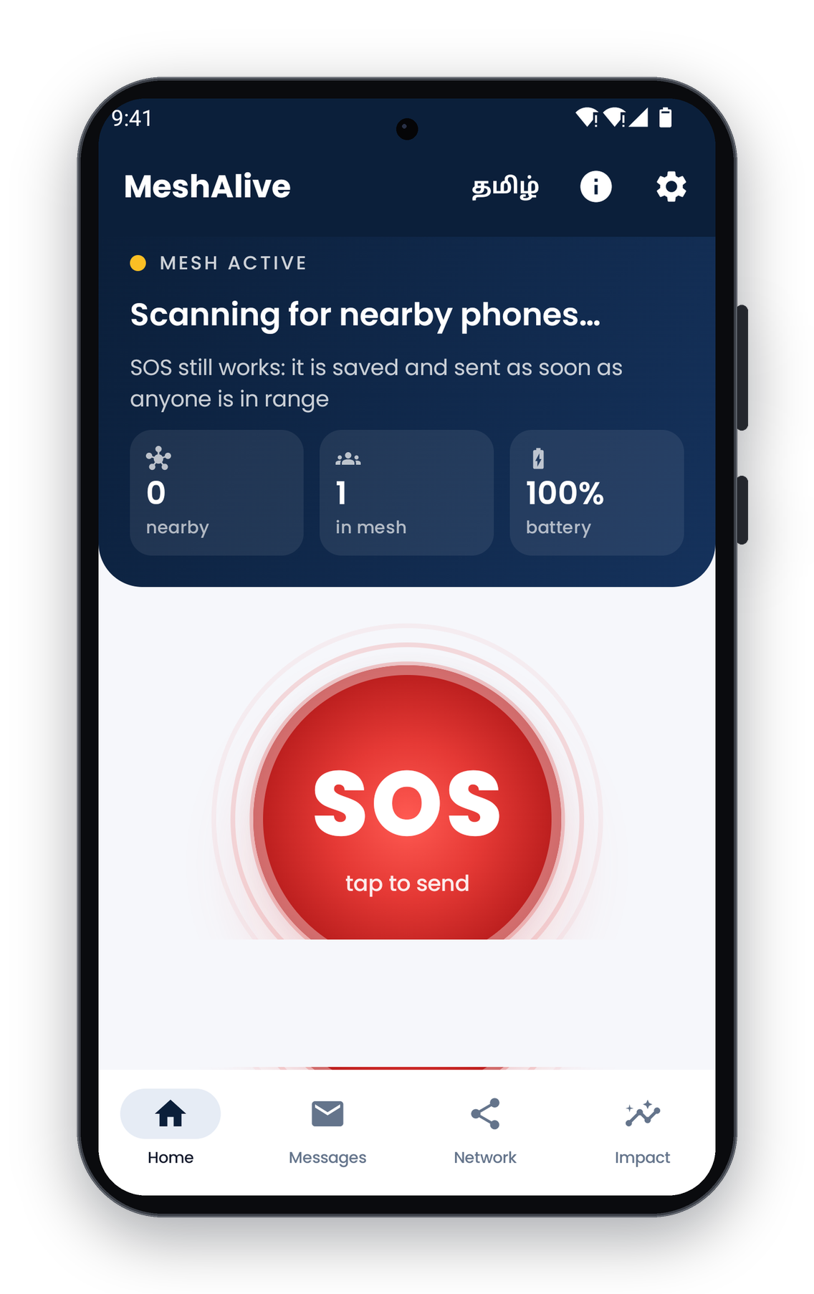
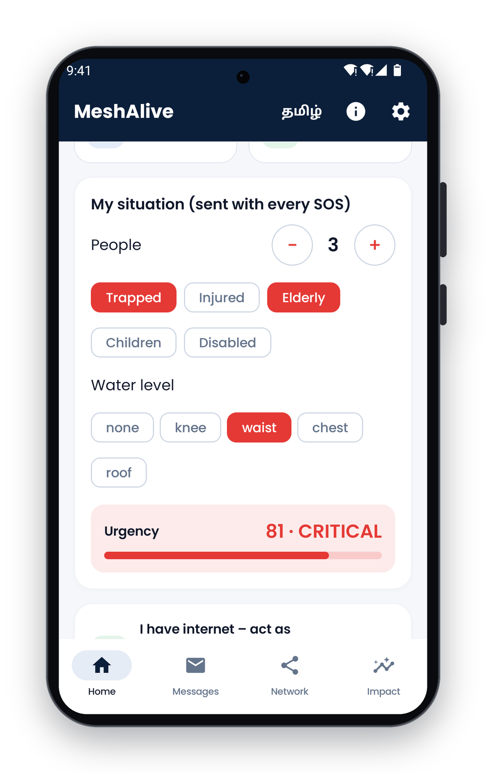
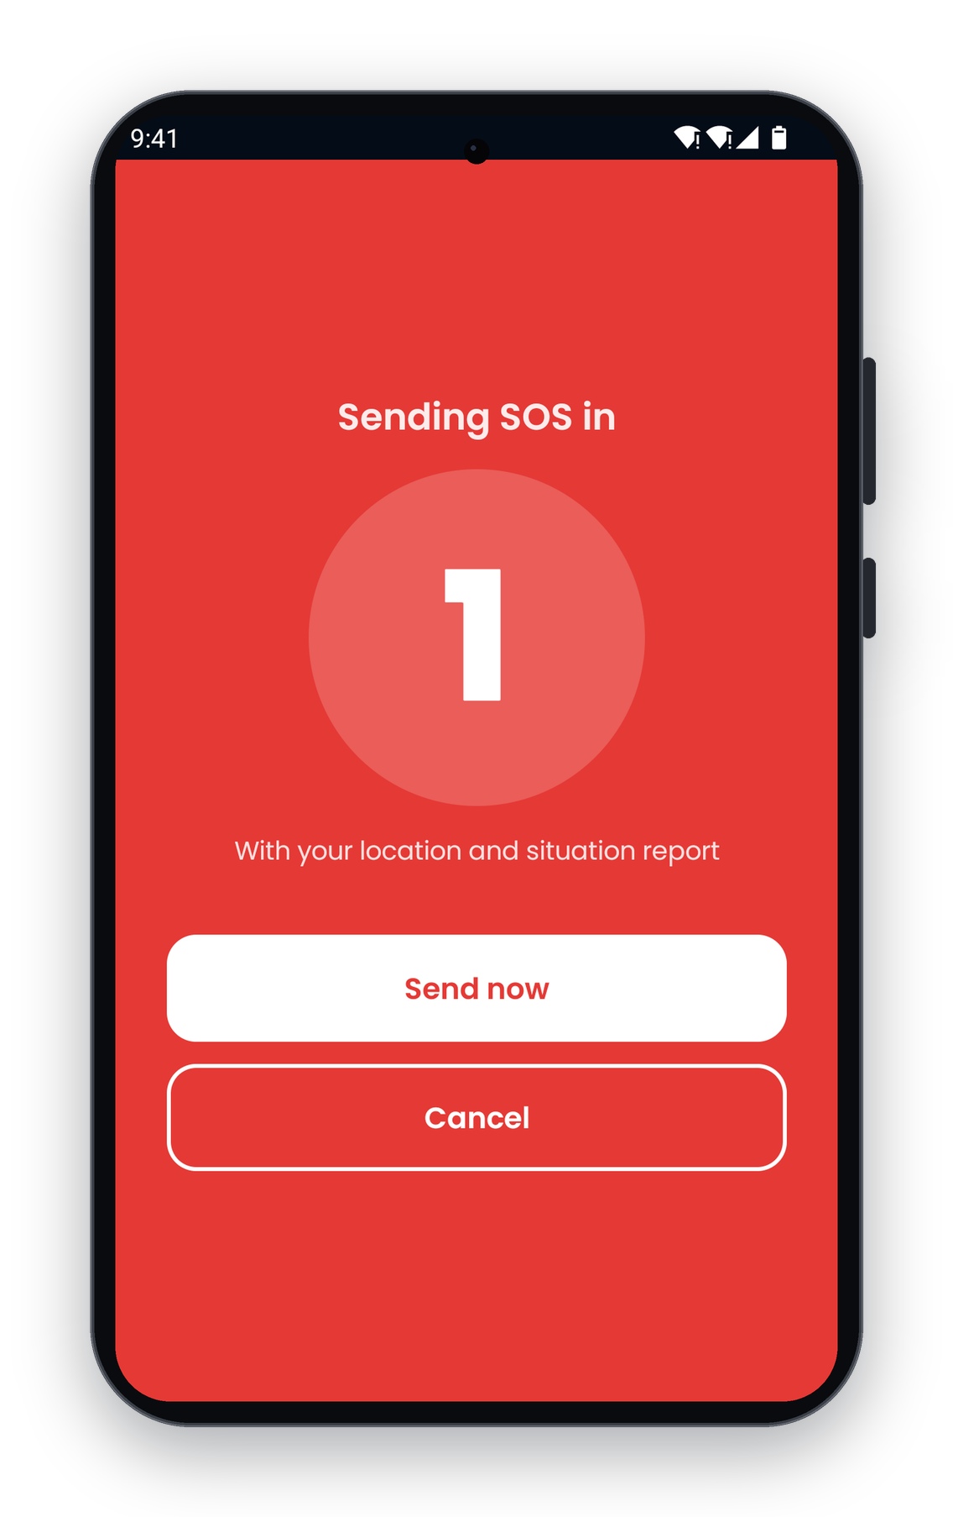
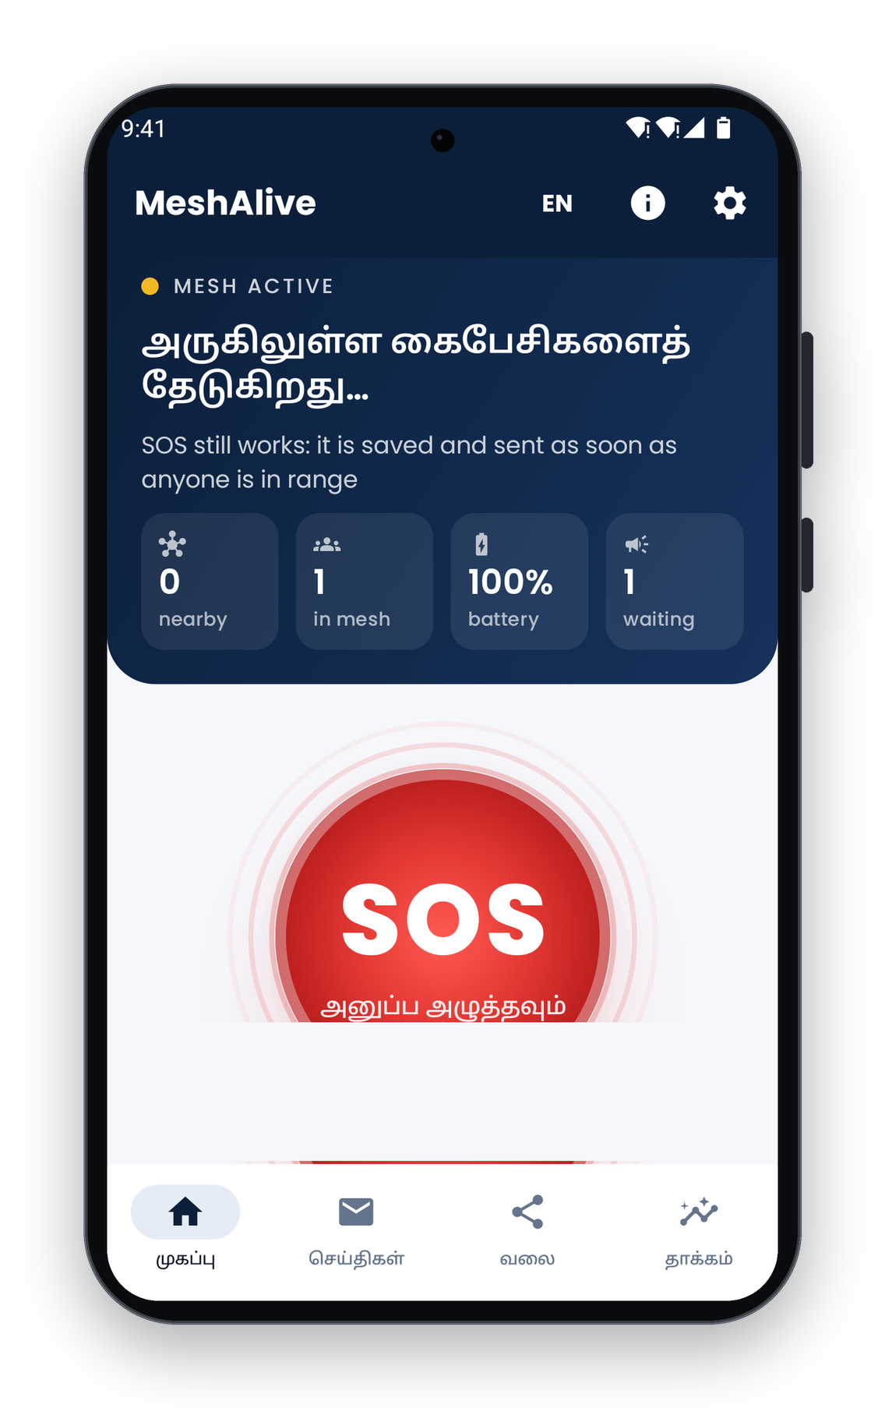
THE APP
Built for the worst day of someone’s life
Live mesh status and one-tap SOS
Situation report → urgency 81 · Critical
3-second countdown: no false alarms
Fully in Tamil
MeshAlive · SevaFirst Innovation Challenge 2026

Slide 5
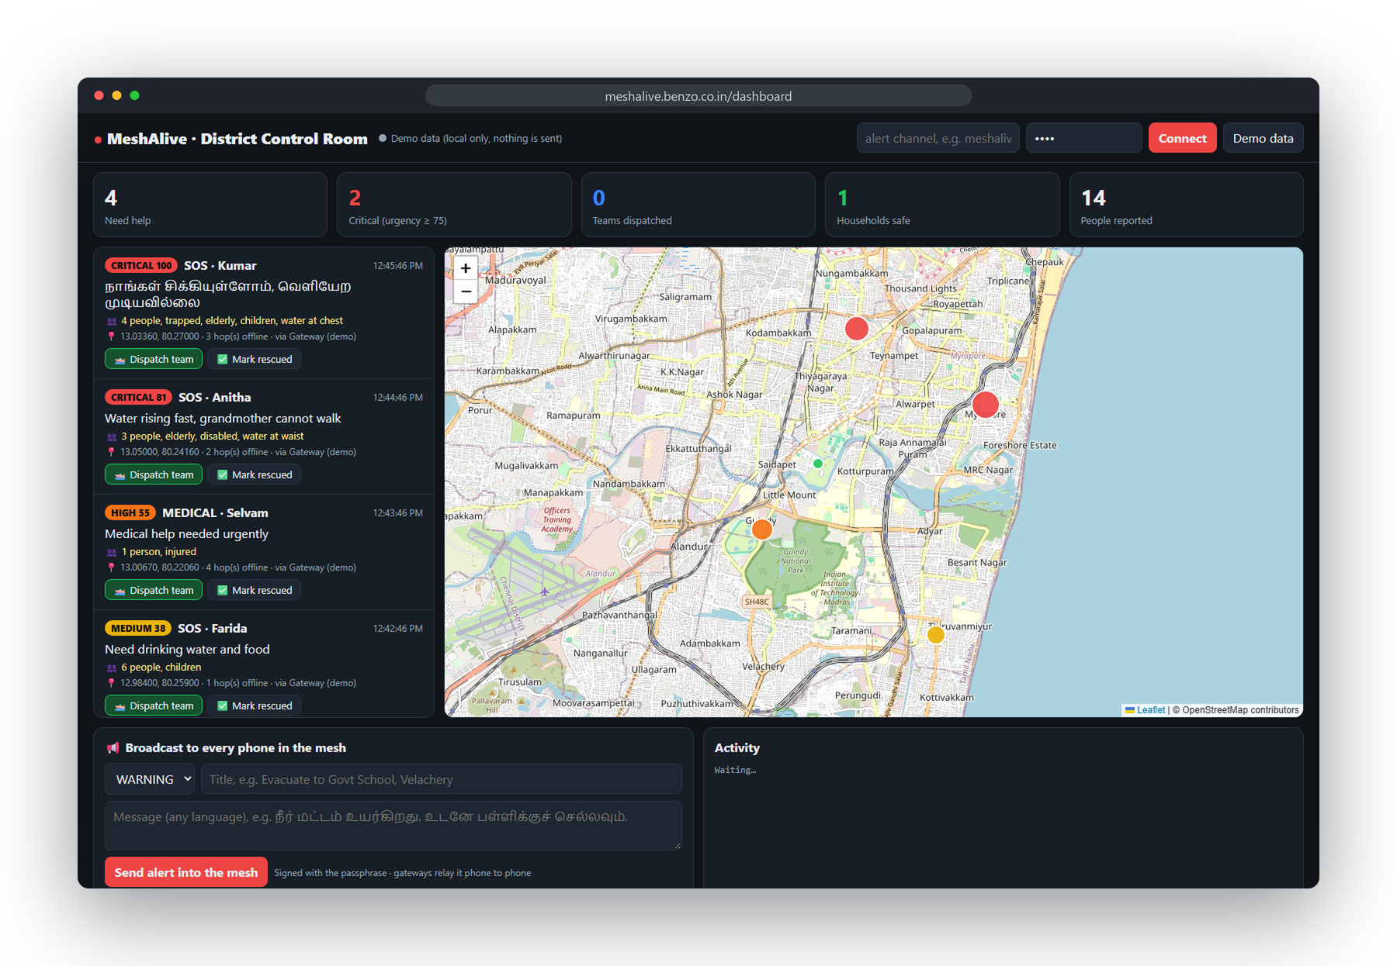
DISTRICT CONTROL ROOM
Every SOS on one live map, and help sent back
Sorted by urgency
Critical cases first, with people count and route.
Dispatch, and the victim knows
“Rescue team on the way” reaches phones with no signal.
Evacuation broadcasts
In any language, to every phone in the mesh.
Signed commands
Phones reject anything not signed by the control room.
MeshAlive · SevaFirst Innovation Challenge 2026

Slide 6
WHY IT’S DIFFERENT
A rescue system, not a chat app
 | Chat apps (Bridgefy, Briar) | LoRa radios (Meshtastic, goTenna) | MeshAlive
Reaches rescuers | No | No | Live district dashboard
Help back to the victim | No | No | Dispatch + evacuation alerts
Prioritises urgent cases | No | No | Triage score 0–100
No phone in range | Message waits | Message waits | Rescue carriers carry it out
Battery | Flooding drains phones | Flooding | Battery-aware routing
Extra hardware | None | ₹2,500+ per person | None
Language | English | English | Tamil and English
MeshAlive · SevaFirst Innovation Challenge 2026

Slide 7
UNDER THE HOOD
How MeshAlive works
Discovery
Phones find and connect to each other over Bluetooth and Wi-Fi (Google Nearby Connections).
Network map
Each phone shares battery, neighbours and internet status; every phone rebuilds the mesh map.
Routing
Battery-aware Dijkstra: link quality + battery penalty + hop cost, one run via a virtual super-node.
Reliability
Urgency priority queue, store-and-forward, duplicate filter, hop limit and delivery receipts.
Carriers & gateways
Custody transfer to rescue carriers; any phone with signal uploads what it carries.
Security
AES-GCM encrypted messages; HMAC-SHA256 signed control-room commands.
MeshAlive · SevaFirst Innovation Challenge 2026

Slide 8
EVIDENCE
Built, tested and measured
100%
147×
2×
49
SOS delivered (200-phone simulation)
fewer radio transmissions than flooding
battery left on the weakest phone
automated tests
MeshAlive · SevaFirst Innovation Challenge 2026

Slide 9
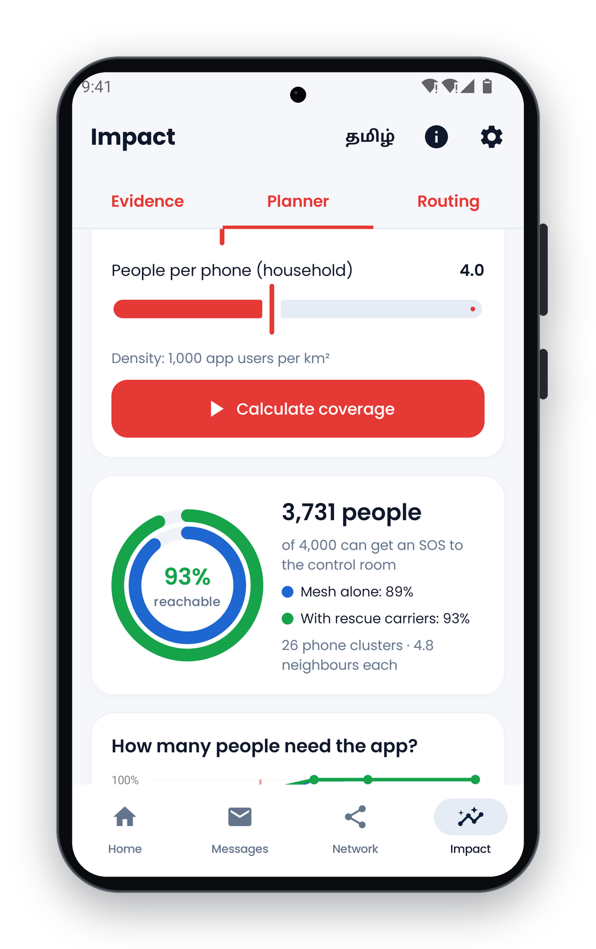
IMPACT, COST AND SCALE
Who benefits, what it costs, how it grows
District planner (the app’s own routing engine)
1 km² ward, 1,000 app users, 4 people per phone: about 3,700 of 4,000 people can get an SOS to the control room (model, to be validated in the pilot).
₹0
Citizens
₹0
Rescue carriers
Free app on their own phone
Phones crews already carry
₹0
Control room
DDMA
Rollout
Any browser on an existing PC
Pre-monsoon install & awareness drives
MeshAlive · SevaFirst Innovation Challenge 2026

Slide 10
PATH TO DEPLOYMENT
From one ward to every district
PHASE 1 · 3 MONTHS
PHASE 2
PHASE 3
Field pilot
District rollout
State & national
One flood-prone ward with the DDMA, NDRF/SDRF boats as carriers, dashboard in the district EOC. Measure delivery rate and SOS-to-dispatch time.
Pre-monsoon install drives via schools, colleges, panchayats, ULBs and SHGs, guided by the planner’s adoption targets.
Distribution through the SDMA; state EOC integration; alerts aligned with the national Common Alerting Protocol; more Indian languages.
MeshAlive · SevaFirst Innovation Challenge 2026

Slide 11
WHAT WE NEED
Help us take MeshAlive to the field
Pilot partnership with a district administration and its DDMA
NDRF/SDRF and boat operators to field-test carrier mode
Mentorship in disaster operations and public-sector deployment
Guidance on security review and Common Alerting Protocol integration
Pilot funding: alert server, test devices, awareness drives
IP guidance and incubation support
MeshAlive: because when the network fails, help shouldn’t.
meshalive.benzo.co.in · github.com/yogeshwardev/MESHALIVE-
MeshAlive · SevaFirst Innovation Challenge 2026

