Slide 1
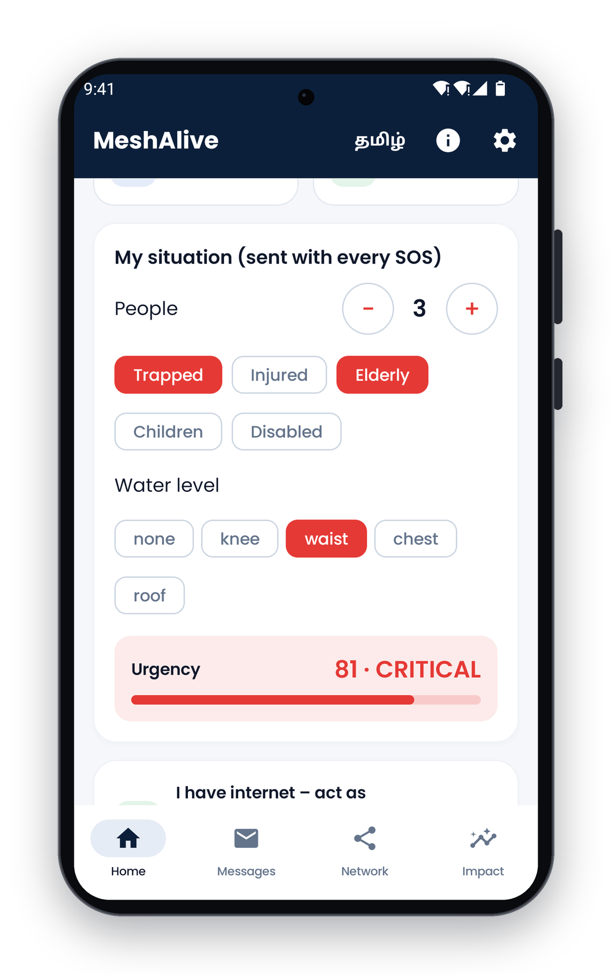
SEVAFIRST INNOVATION CHALLENGE 2026
MeshAlive
An Offline Disaster-Response Network
Carrying SOS messages to the district control room, and help back to people, when mobile towers fail.
Submission details
Theme | 05 · Surakshit Bharat
Track | Track A · Product or Technology
Stage | Working prototype
Website and demo | meshalive.benzo.co.in
Date | November 2026

Slide 2
CONTENTS
Agenda
01
Executive summary
06
Technical architecture, routing and security
02
The problem and who it affects
07
Evidence and results
03
Existing approaches and their gaps
08
Impact, cost and sustainability
04
Proposed solution and key features
09
Implementation roadmap and risks
05
Prototype: mobile app and district control room
10
Adoption, partners and support required
MeshAlive | SevaFirst Innovation Challenge 2026

Slide 3
OVERVIEW
Executive summary
During cyclones and floods, Indian districts lose mobile coverage for hours or days, exactly when people most need help. MeshAlive keeps emergency communication working without towers, internet or new hardware.
Status at a glance
Prototype
A one-tap SOS carries GPS location and a situation report, scored 0–100 for urgency.
Nearby phones relay it over Bluetooth and Wi-Fi using battery-aware routing.
Rescue boats and teams carry messages out of areas with no route.
The first phone with signal uploads everything to a live district dashboard.
Dispatch and evacuation messages travel back through the same mesh, digitally signed.
Working Android app and dashboard
Languages
Tamil and English
Testing
49 automated tests passing
Simulation
100% delivery, 200 phones
Hardware cost
₹0 for citizens and rescuers
Ask
District pilot partnership
MeshAlive | SevaFirst Innovation Challenge 2026

Slide 4
THE PROBLEM
When the towers go down, rescue goes blind
Every cyclone and flood season, coastal and low-lying districts lose mobile coverage. Towers lose power, backhaul links are cut and the remaining network is overloaded. This happened in the 2015 Chennai floods and again during Cyclone Michaung in 2023.
People cannot call for help
Control rooms work blind
Rescue capacity is misdirected
Trapped families, the elderly, patients and people with disabilities cannot call, text or share their location.
There is no view of who needs help, where they are, how many people are with them, or which case is most urgent.
Boats and teams search by sight and word of mouth, so they reach the easiest-to-see rather than the most critical.
Problem statement
When cyclones and floods take down mobile towers and power, people in danger cannot call for help, and district control rooms cannot see who needs rescue, where they are, or how urgent it is.
MeshAlive | SevaFirst Innovation Challenge 2026

Slide 5
THE PROBLEM
Who is affected, and where
People
Places
Families in flood- and cyclone-prone areas, especially the elderly, children, people with disabilities and patients
Fishing communities and low-lying coastal settlements
Rescue teams: NDRF, SDRF, fire and rescue services, boat operators and ambulance crews
District Emergency Operations Centres and Disaster Management Authorities
Coastal districts of Tamil Nadu, such as Chennai, Cuddalore, Nagapattinam and Thoothukudi
India’s cyclone-exposed east and west coasts
River-flood regions: the Brahmaputra and Ganga basins, and Kerala
Cities where flooding cuts power to mobile towers
Why it matters: in the first hours of a disaster, rescue capacity is scarce. Location and urgency data decide who is reached first.
MeshAlive | SevaFirst Innovation Challenge 2026

Slide 6
CONTEXT
Existing approaches and their gaps
Approach | What it does | Gap during a disaster
Mobile calls and SMS | Standard emergency communication | Fails when towers lose power or backhaul
Offline chat apps (e.g. Bridgefy, Briar) | Phone-to-phone messaging | Do not reach rescuers, no prioritisation, no reply channel
LoRa radios (e.g. Meshtastic, goTenna) | Long-range text over radio | Extra hardware of ₹2,500+ per person; low adoption
Satellite phones | Works without local networks | Expensive; held by few officials, not by citizens
Broadcast alerts (cell broadcast, sirens) | One-way warnings | Cannot receive SOS or confirm who is safe
The gap: no low-cost, two-way channel connects people in danger to the district control room when the network is down.
MeshAlive | SevaFirst Innovation Challenge 2026

Slide 7
PROPOSED SOLUTION
A complete rescue loop on phones people already own
MeshAlive is an Android app and a browser-based district dashboard. Together they form a two-way emergency channel that works without towers, internet or extra hardware.
1
2
3
4
5
Ask for help
Phones relay
Rescuers carry
Control room sees
Help returns
One-tap SOS with GPS and a situation report, scored 0–100
Bluetooth and Wi-Fi mesh, battery-aware, most urgent first
Boats and teams carry SOS out of areas with no route
First phone with signal uploads to a live dashboard
Dispatch and evacuation alerts travel back, signed
No towers, no internet and no SIM needed for the mesh
No extra hardware: uses citizens’ and rescuers’ existing phones
Works in Tamil and English, with large, simple controls
MeshAlive | SevaFirst Innovation Challenge 2026

Slide 8
PROPOSED SOLUTION
Key features
For people in danger
For rescuers and officials
30-second guided setup: language, household and role
One-tap SOS with a 3-second countdown and Cancel to prevent false alarms
Situation report: people, trapped, injured, elderly, children, disabled and water level, turned into an urgency score
“I’m safe” check-ins, so rescuers can skip safe households
“Rescue team on the way” confirmation, even with no signal
Full SOS flow in Tamil and English
Rescue-carrier mode for boats, NDRF/SDRF teams and ambulances
Any phone that regains signal becomes a gateway automatically
Live district dashboard: map, urgency, people count and route
Dispatch team, mark rescued and evacuation broadcast, digitally signed
District coverage planner: installs needed per ward
Field-trial evidence recorder with exportable reports
MeshAlive | SevaFirst Innovation Challenge 2026

Slide 9
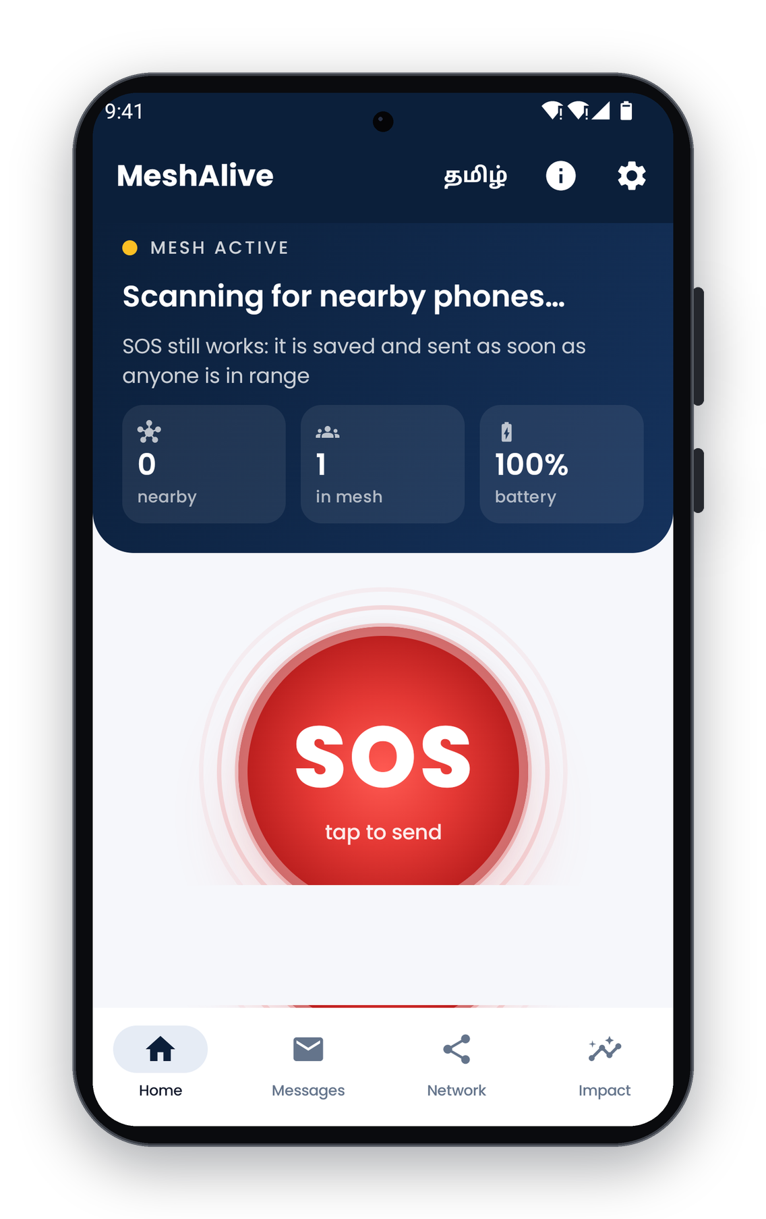
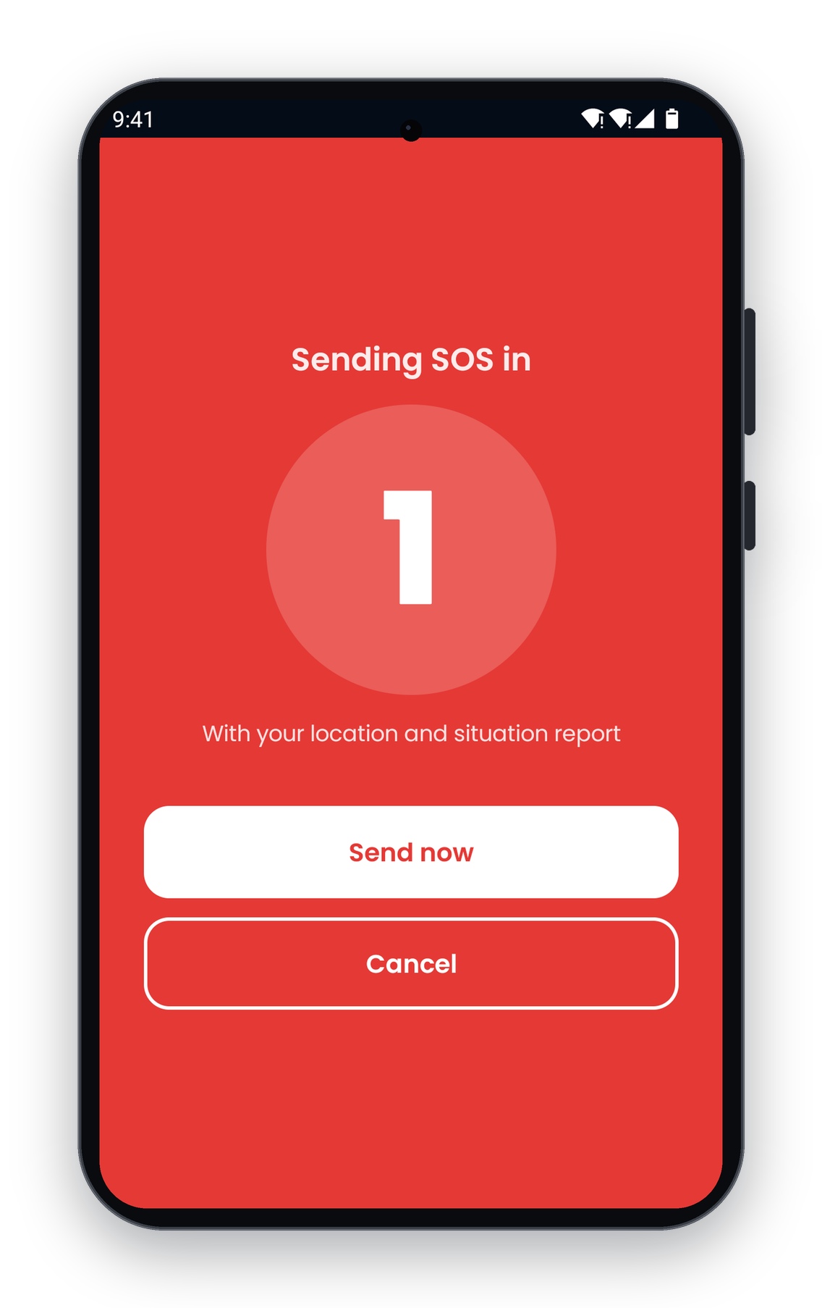
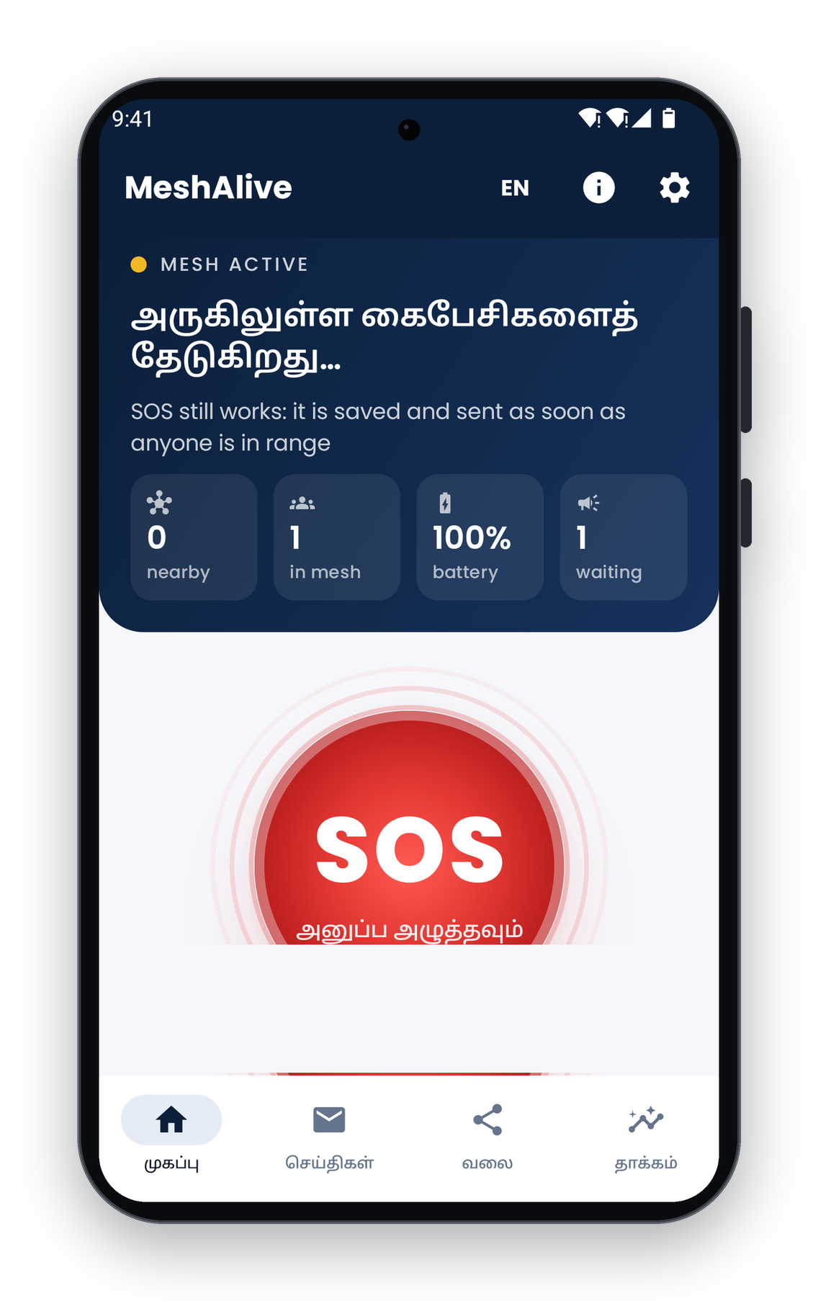
PROTOTYPE
Mobile app: working Android prototype
Home: mesh status, one-tap SOS
Situation report: urgency 81
3-second countdown
Complete flow in Tamil
Built with Kotlin and Jetpack Compose. All screens are captured from the running app.
MeshAlive | SevaFirst Innovation Challenge 2026

Slide 10
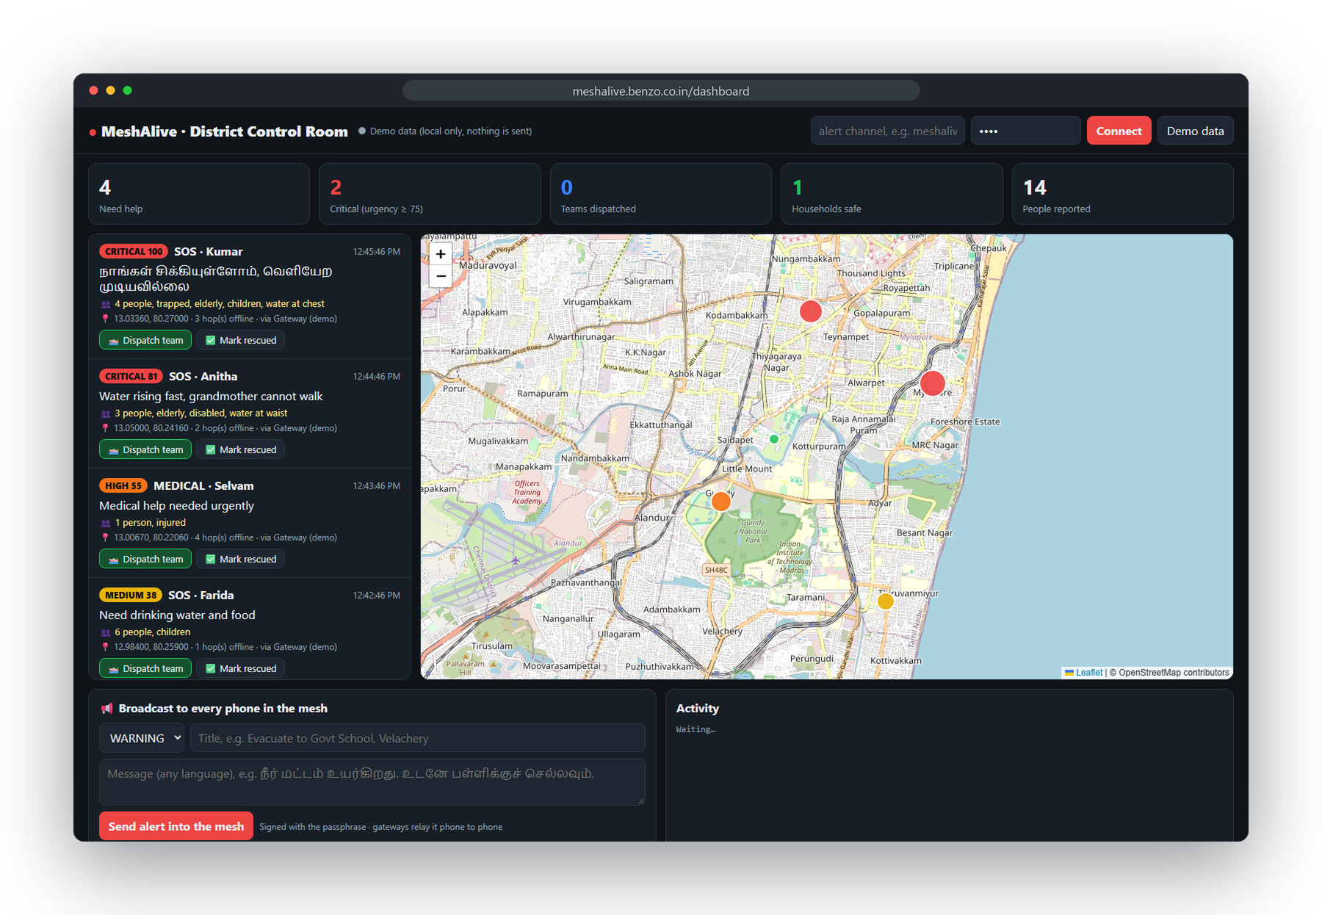
PROTOTYPE
District control room dashboard
Operator actions
Live map sorted by urgency
Critical cases first, with people count and route
Dispatch team
Reply travels back; the family’s phone confirms receipt
Mark rescued
Closes the case and informs the household
Evacuation broadcast
Any language, to every phone in the mesh
Runs in any browser on an existing control-room PC. Live demo: meshalive.benzo.co.in/dashboard
MeshAlive | SevaFirst Innovation Challenge 2026

Slide 11
TECHNOLOGY
System architecture
Citizen phone
SOS + situation report
Relay phones
Bluetooth / Wi-Fi mesh
Rescue carrier
Store-carry-forward
Gateway phone
First phone with signal
District dashboard
Live map and commands
Return path: signed dispatch and evacuation commands travel back through the gateway and the mesh to the citizen’s phone
Layer | Implementation
Mobile app | Kotlin, Jetpack Compose, Room database, Android 8.0 or later
Peer-to-peer link | Google Nearby Connections (Bluetooth and Wi-Fi), no internet required
Cloud relay | Lightweight publish/subscribe relay (prototype: ntfy), self-hostable
Dashboard | Browser app (HTML/JavaScript, Leaflet maps), no installation
MeshAlive | SevaFirst Innovation Challenge 2026

Slide 12
TECHNOLOGY
Routing and reliability
Mechanism | How it works | Benefit
Network map | Each phone shares battery, neighbours and internet status every few seconds; link quality measured by round-trip time | Every phone knows the live mesh
Battery-aware routing | Dijkstra with edge cost = link quality + battery penalty + hop cost; a virtual super-node joins all gateways | Avoids phones about to die; one run, O((V+E) log V)
Urgency priority queue | Messages sent in order of triage score | Most critical SOS go first
Store-and-forward | Messages kept and retried when no route exists | Nothing lost while out of range
Duplicate filter and TTL | Seen-message cache and hop limit | No loops or broadcast storms
Delivery receipts | Acknowledgement returned with hop count | Sender knows the SOS arrived
Rescue carriers | Custody transfer to boat and team phones | Reaches areas with no route at all
MeshAlive | SevaFirst Innovation Challenge 2026

Slide 13
TECHNOLOGY
Security and privacy
Controls in the prototype
Threats addressed
AES-GCM encryption of message content on the phone
Control-room commands signed with HMAC-SHA256
Phones reject unsigned, altered or expired commands (6-hour limit)
No account or sign-up; no personal data beyond what the SOS needs
Location shared only inside an SOS sent by the user
Threat | Mitigation
Fake evacuation order | Signature check on every command
Replay of old orders | Timestamp and expiry window
Message flooding | Duplicate filter and hop limit
Accidental SOS | 3-second countdown with Cancel
MeshAlive | SevaFirst Innovation Challenge 2026

Slide 14
EVIDENCE
Results: 200-phone simulation
Measured with the app’s own routing engine: 200 phones, 20 SOS messages, the same network for every method.
Measure | Flooding | Shortest hop | MeshAlive
SOS delivered | 85% | 100% | 100%
Radio transmissions | 14,533 | 88 | 99
Average hops | 5.47 | 4.40 | 4.95
Battery left, weakest phone | 0.0% | 3.2% | 6.3%
Every SOS delivered, with 147 times fewer transmissions than flooding
Twice the battery left on the weakest phone compared with shortest-hop routing, so the mesh stays alive longer
49 automated tests cover routing, forwarding, triage, command signatures, the planner and evidence reports
MeshAlive | SevaFirst Innovation Challenge 2026

Slide 15
INNOVATION
What is new
Capability | Chat apps | LoRa radios | MeshAlive
Reaches the district control room | No | No | Yes, live dashboard
Reply back to the person | No | No | Dispatch and evacuation alerts
Prioritises urgent cases | No | No | Urgency score 0–100
No phone in range | Message waits | Message waits | Rescue carriers carry it out
Battery management | Flooding | Flooding | Battery-aware routing
Protection against fake alerts | Not addressed | Not addressed | Signed commands
Extra hardware | None | ₹2,500+ per person | None
Indian languages | English | English | Tamil and English
MeshAlive | SevaFirst Innovation Challenge 2026

Slide 16
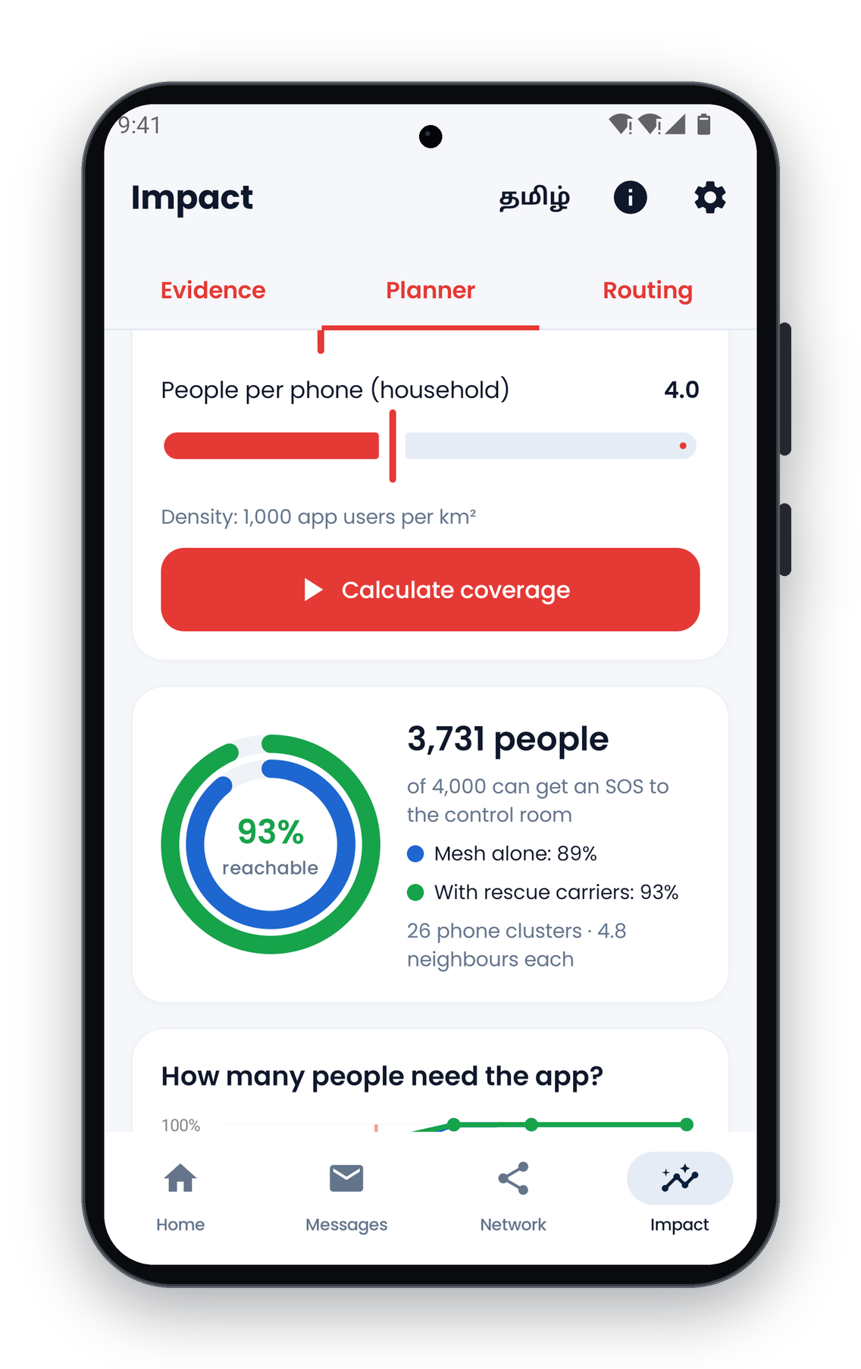
IMPACT
Beneficiaries and expected impact
Who benefits
Coverage model
People trapped or stranded: their SOS reaches rescuers without towers, and they know help is coming
Vulnerable groups: prioritised automatically through the situation report
Rescue teams: exact location, people count and urgency, instead of searching blind
Control rooms: a live, prioritised picture, and a channel to reach people without signal
Administration: “I’m safe” check-ins reduce wasted searches
~3,700
of 4,000 people can reach the control room in a 1 km² ward with 1,000 app users (about 4 people per phone).
Planner model; to be validated in the pilot.
MeshAlive | SevaFirst Innovation Challenge 2026

Slide 17
IMPACT
Cost and sustainability
Stakeholder | Hardware cost | Notes
Citizens | ₹0 | Free app on their own phone; no SIM, data or account needed for the mesh
Rescue carriers | ₹0 | Uses phones that crews already carry
District control room | ₹0 | Runs in any browser on an existing PC
Running cost | Low | Small self-hosted relay server and app maintenance
Rollout | Programme cost | Pre-monsoon awareness and installation drives through the DDMA
Sustainability
Funded through district disaster-preparedness budgets; no per-user licence
Open, auditable code that state IT departments can host and maintain
MeshAlive | SevaFirst Innovation Challenge 2026

Slide 18
IMPLEMENTATION
Implementation roadmap
Phase 1 · Field pilot 3 months
Phase 2 · District rollout Pre-monsoon
Phase 3 · State and national Scale-up
One flood-prone ward with the DDMA
NDRF/SDRF boats as rescue carriers
Dashboard in the district EOC
Measure delivery rate and SOS-to-dispatch time
Install drives via schools, colleges, panchayats and SHGs
Planner sets the install target per ward
Training for control-room operators
Distribution through the SDMA
Dashboard feeds into state EOCs
Alignment with the Common Alerting Protocol
More Indian languages; iOS version
Success measures: SOS delivery rate, time from SOS to dispatch, households confirmed safe, and installs per ward.
MeshAlive | SevaFirst Innovation Challenge 2026

Slide 19
IMPLEMENTATION
Risks and mitigations
Risk | Impact | Mitigation
Too few phones with the app in an area | Messages cannot hop far | Planner sets install targets; rescue carriers bridge gaps; pre-monsoon install drives
Battery drain on relaying phones | Mesh shrinks over time | Battery-aware routing; low-battery phones avoided
Fake or malicious alerts | Panic, misdirected rescue | Signed commands; expiry window; duplicate filtering
Accidental or prank SOS | Wasted rescue effort | Countdown with Cancel; urgency triage; “I’m safe” check-ins
Dependence on a public relay | Availability and data control | Self-hosted relay on government infrastructure for deployment
Android-only today | Excludes iPhone users | iOS version planned for Phase 3
MeshAlive | SevaFirst Innovation Challenge 2026

Slide 20
WAY FORWARD
Adoption, partners and support required
Who could adopt it
Support we are seeking
District Disaster Management Authorities and EOCs (primary users)
State Disaster Management Authorities, such as TNSDMA
NDMA, for guidelines and Common Alerting Protocol integration
NDRF, SDRF and fire and rescue services, as rescue carriers
Urban local bodies, panchayats, NGOs, NSS and NCC units
A pilot partnership with a district administration and its DDMA
Collaboration with NDRF/SDRF and boat operators to test carrier mode
Mentorship in disaster-management operations and public-sector deployment
Technical review: security, Common Alerting Protocol, self-hosting
Pilot funding for a relay server, test devices and training drives
MeshAlive | SevaFirst Innovation Challenge 2026

Slide 21
CONCLUSION
Thank you
MeshAlive turns the phones people already own into a rescue network, so that when the mobile network fails, help does not.
Resource | Link
Website and live demo | meshalive.benzo.co.in
Control-room dashboard | meshalive.benzo.co.in/dashboard
Android app (APK) | meshalive.benzo.co.in/download/MeshAlive.apk
Demo video | meshalive.benzo.co.in/#demo
Source code | github.com/yogeshwardev/MESHALIVE-
MeshAlive | SevaFirst Innovation Challenge 2026

