Slide 1
THE PROBLEM
When the towers go down, rescue goes blind
Every cyclone and flood season, coastal and low-lying districts lose mobile coverage. Towers lose power, backhaul links are cut and the remaining network is overloaded. This happened in the 2015 Chennai floods and again during Cyclone Michaung in 2023.
People cannot call for help
Control rooms work blind
Rescue capacity is misdirected
Trapped families, the elderly, patients and people with disabilities cannot call, text or share their location.
There is no view of who needs help, where they are, how many people are with them, or which case is most urgent.
Boats and teams search by sight and word of mouth, so they reach the easiest-to-see rather than the most critical.
Problem statement
When cyclones and floods take down mobile towers and power, people in danger cannot call for help, and district control rooms cannot see who needs rescue, where they are, or how urgent it is.
MeshAlive | SevaFirst Innovation Challenge 2026

Slide 2
PROPOSED SOLUTION
A complete rescue loop on phones people already own
MeshAlive is an Android app and a browser-based district dashboard. Together they form a two-way emergency channel that works without towers, internet or extra hardware.
1
2
3
4
5
Ask for help
Phones relay
Rescuers carry
Control room sees
Help returns
One-tap SOS with GPS and a situation report, scored 0–100
Bluetooth and Wi-Fi mesh, battery-aware, most urgent first
Boats and teams carry SOS out of areas with no route
First phone with signal uploads to a live dashboard
Dispatch and evacuation alerts travel back, signed
No towers, no internet and no SIM needed for the mesh
No extra hardware: uses citizens’ and rescuers’ existing phones
Works in Tamil and English, with large, simple controls
MeshAlive | SevaFirst Innovation Challenge 2026

Slide 3
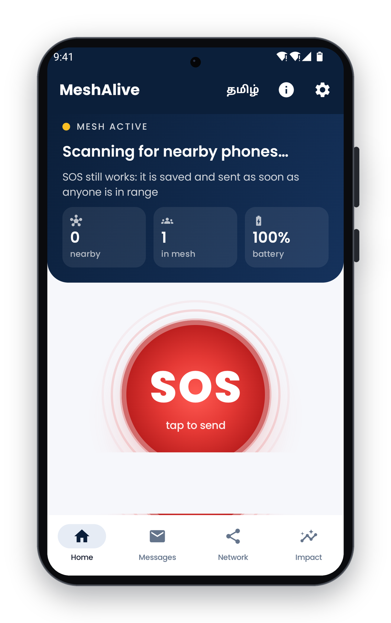
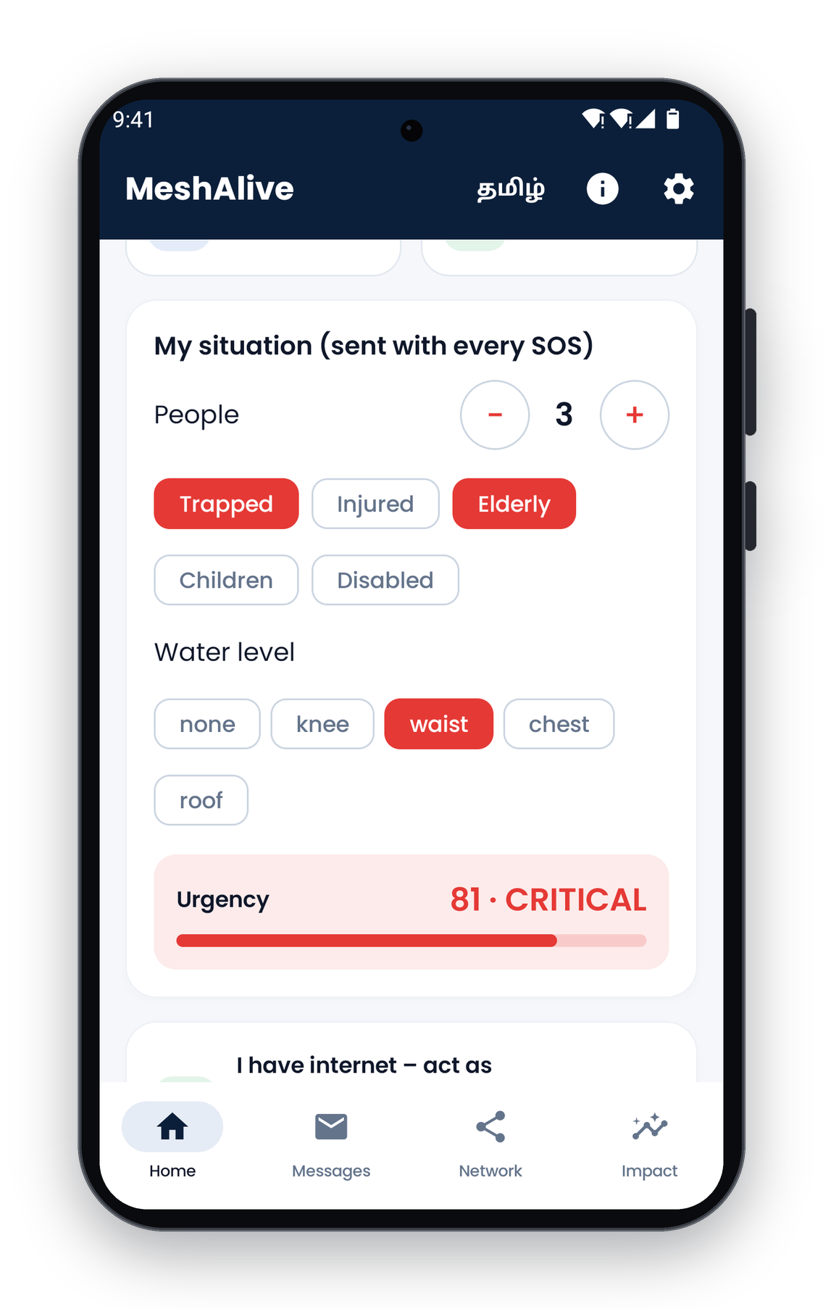
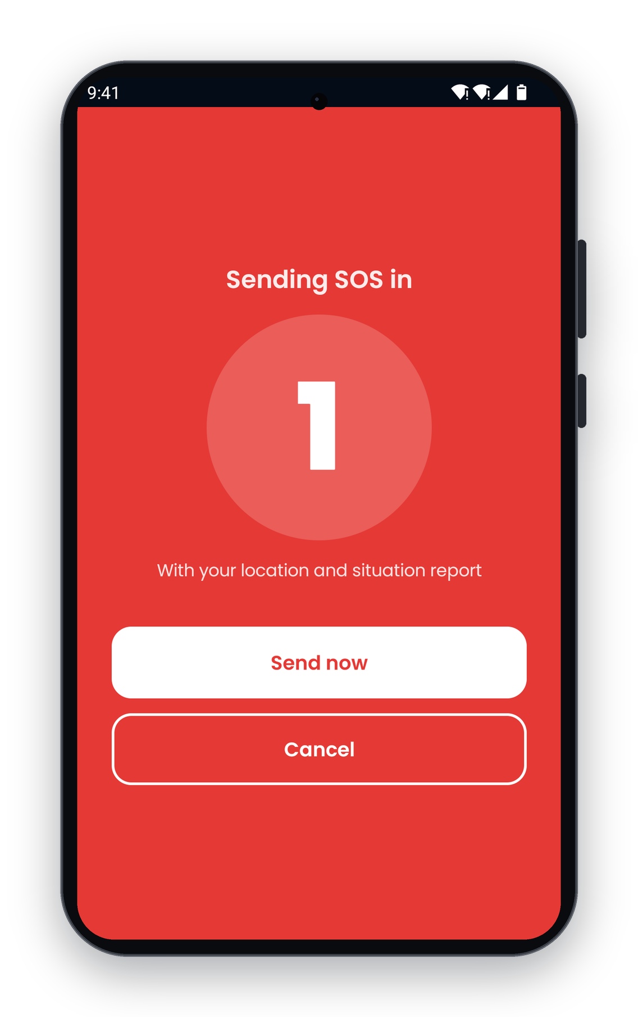
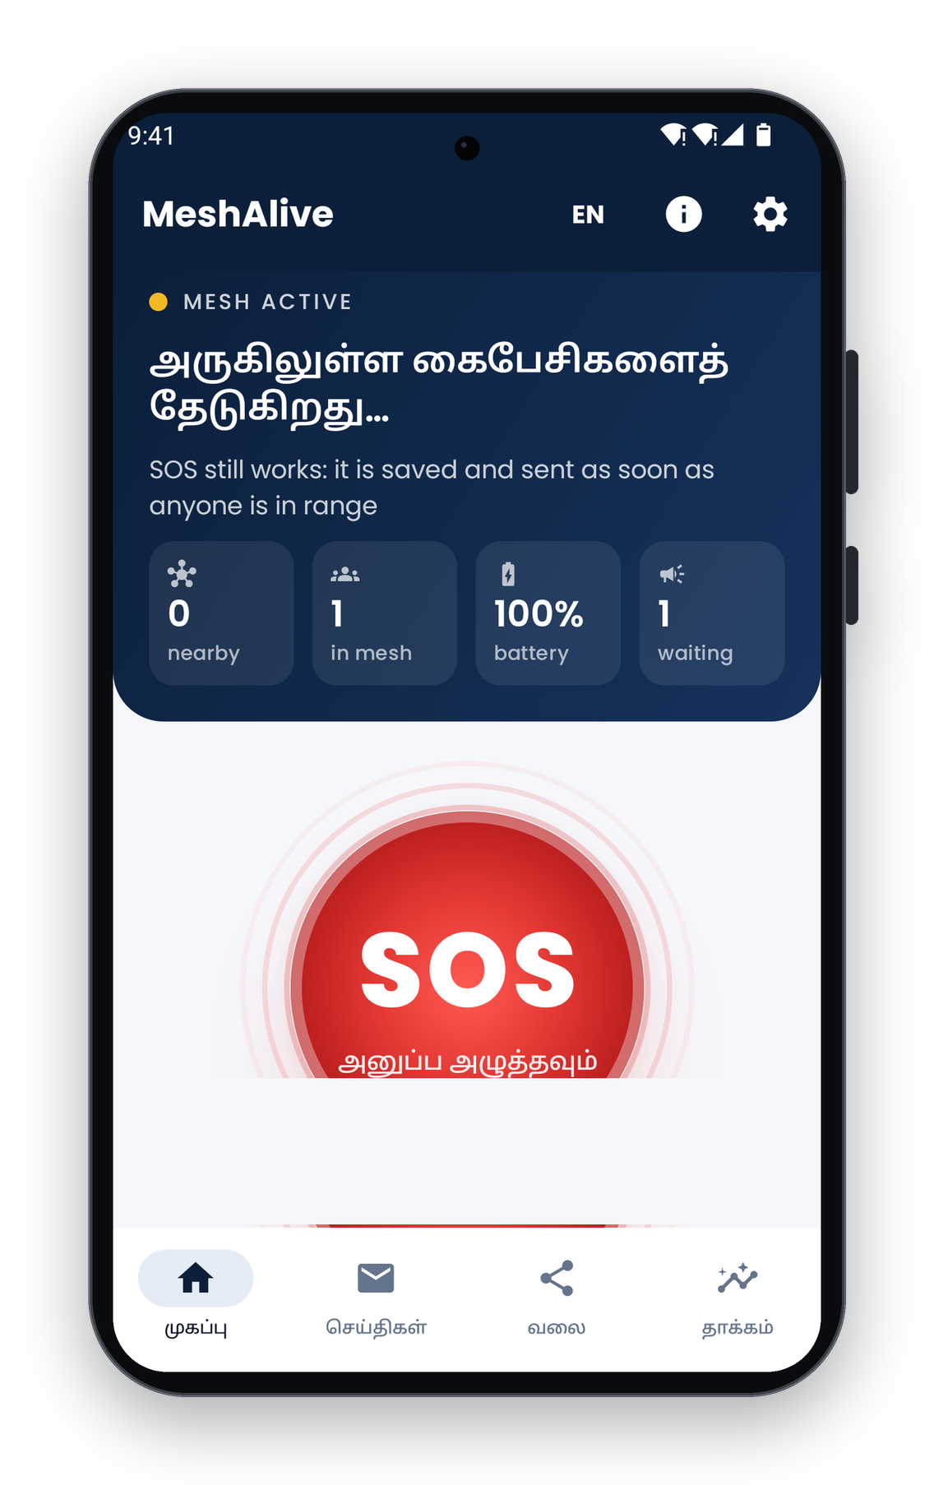
PROTOTYPE
Mobile app: working Android prototype
Home: mesh status, one-tap SOS
Situation report: urgency 81
3-second countdown
Complete flow in Tamil
Built with Kotlin and Jetpack Compose. All screens are captured from the running app.
MeshAlive | SevaFirst Innovation Challenge 2026

Slide 4
EVIDENCE
Results: 200-phone simulation
Measured with the app’s own routing engine: 200 phones, 20 SOS messages, the same network for every method.
Measure | Flooding | Shortest hop | MeshAlive
SOS delivered | 85% | 100% | 100%
Radio transmissions | 14,533 | 88 | 99
Average hops | 5.47 | 4.40 | 4.95
Battery left, weakest phone | 0.0% | 3.2% | 6.3%
Every SOS delivered, with 147 times fewer transmissions than flooding
Twice the battery left on the weakest phone compared with shortest-hop routing, so the mesh stays alive longer
49 automated tests cover routing, forwarding, triage, command signatures, the planner and evidence reports
MeshAlive | SevaFirst Innovation Challenge 2026

Slide 5
INNOVATION
What is new
Capability | Chat apps | LoRa radios | MeshAlive
Reaches the district control room | No | No | Yes, live dashboard
Reply back to the person | No | No | Dispatch and evacuation alerts
Prioritises urgent cases | No | No | Urgency score 0–100
No phone in range | Message waits | Message waits | Rescue carriers carry it out
Battery management | Flooding | Flooding | Battery-aware routing
Protection against fake alerts | Not addressed | Not addressed | Signed commands
Extra hardware | None | ₹2,500+ per person | None
Indian languages | English | English | Tamil and English
MeshAlive | SevaFirst Innovation Challenge 2026

Slide 6
IMPLEMENTATION
Implementation roadmap
Phase 1 · Field pilot 3 months
Phase 2 · District rollout Pre-monsoon
Phase 3 · State and national Scale-up
One flood-prone ward with the DDMA
NDRF/SDRF boats as rescue carriers
Dashboard in the district EOC
Measure delivery rate and SOS-to-dispatch time
Install drives via schools, colleges, panchayats and SHGs
Planner sets the install target per ward
Training for control-room operators
Distribution through the SDMA
Dashboard feeds into state EOCs
Alignment with the Common Alerting Protocol
More Indian languages; iOS version
Success measures: SOS delivery rate, time from SOS to dispatch, households confirmed safe, and installs per ward.
MeshAlive | SevaFirst Innovation Challenge 2026

