Slide 1
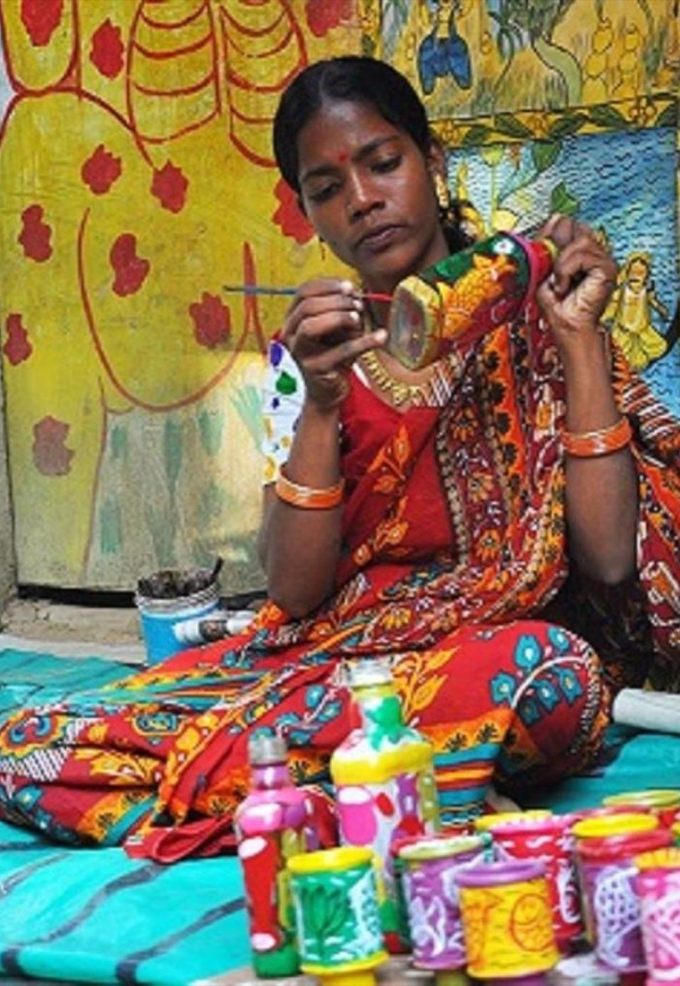
SMART INDIA HACKATHON 2026 · PROBLEM STATEMENT SIH26090
PROBLEM STATEMENT TITLE
AI-Driven Market Linkage and Smart Cataloging Mobile Application for Marginalized Artisans
CraftLink AI a virtual business manager in the artisan’s pocket
One photo. One spoken sentence. A market-ready listing.
PROBLEM STATEMENT ID
THEME
SIH26090
Miscellaneous
PS CATEGORY
TEAM ID
Software
126401u
ORGANISATION
TEAM NAME
Ministry of Social Justice and Empowerment (MoSJE)
Team Zero Click
@SIH Idea submission- Template
1

Slide 2







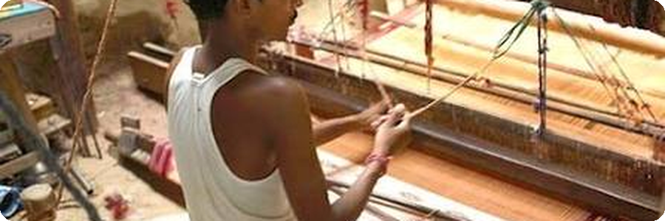

Team Zero Click
IDEA TITLE
THE GAP TODAY
THE SOLUTION
HOW IT ADDRESSES THE PROBLEM
7 M
CraftLink AI turns a product photo and one spoken sentence into a market-ready, multilingual, fairly-priced listing.
No professional photos
→ AI removes clutter, fixes lighting and formats to e-commerce standards.
artisans in India — the vast majority still outside digital commerce.
Photo capture
Background removal, lighting correction, e-commerce framing.
No English, low digital literacy
→ Local-language voice notes become SEO-ready descriptions.
60%
Voice, in any local language
Whisper speech-to-text, running offline — no typing, no English.
of product value captured by middlemen when they handle the online sale.
No pricing knowledge
→ ML proposes a price from materials, labour and market trends — with reasons.
3 wks
AI cataloging
SEO title, description, category and keywords.
Only seasonal melas
→ A 365-day storefront replaces a few exhibition weeks a year.
of market access a year, through melas like Dilli Haat and Surajkund.
Explained price
Materials, labour, market bands and signals read from the photo and description.
Market linkage
ONDC/GeM-ready fields; bulk buyers enquire and the artisan quotes back in-app.
Middlemen take the margin
→ Direct artisan-to-buyer linkage through ONDC and Bharat-TULIP.
Human-in-the-loop: nothing publishes until the artisan approves the words and the price.
UNIQUE VALUE
PROPOSITION
Not another marketplace — an AI co-seller that does the photography, copywriting and pricing an artisan cannot, then hands the finished listing to the rails that already exist: ONDC and MoSJE’s Bharat-TULIP.
@SIH Idea submission- Template
2

Slide 3







Team Zero Click
TECHNICAL APPROACH
TECHNOLOGY STACK
1
2
3
4
5
INPUT
AI UNDERSTANDING
PRODUCT INTELLIGENCE
MARKET INTELLIGENCE
MOBILE + WEB OUTPUT
AI & ML
Computer vision — rembg / U²-Net, OpenCV
Product photo
Image clean-up
Attribute extraction
Explained price
Artisan app + dashboard
Speech-to-text — faster-whisper (offline)
Voice note in the
Speech-to-text
Listing copy, 9 languages
Demand signals
ONDC / Bharat-TULIP
NLLB-200 — offline translation, 9 languages
local language
Translation
Category & keywords
Buyer matching
publish
Scikit-learn — price band model
FRONTEND
React + Vite + Tailwind
FASTAPI / REST API request handling · business logic · orchestration · auth
Installable PWA + Android APK (Capacitor)
BACKEND & DATA
ARTISAN DATA
profiles, skills, clusters
PRODUCT DATA
images, details, categories
MARKET DATA
trends, prices, demand
BUYER DATA
preferences, history
Python + FastAPI
SQLite / PostgreSQL + SQLAlchemy
INTEGRATIONS
ONDC/GeM-ready catalogue fields
HOW IT DELIVERS VALUE
CORE INNOVATION
In-app B2B bulk-quote workflow
REST + JSON · .env secrets
One pipeline, craft to commerce. A photo and a spoken sentence become a priced, multilingual, ONDC-ready listing — with the artisan in control at every step.
Build status: photo → voice → 9-language listing → price → order → bulk quote, offline, today.
Artisan speaks
AI builds listing
Priced & published
Buyer matched
Income rises
@SIH Idea submission- Template
3

Slide 4




Team Zero Click
FEASIBILITY AND VIABILITY
TECHNICAL FEASIBILITY
OPERATIONAL FEASIBILITY
ECONOMIC VIABILITY
AI integration Vision, Whisper ASR, NLLB-200 and ML automate clean-up, copy and pricing.
Four taps to sell Open → photograph → speak → approve. No forms, no English.
Zero cost to the artisan No listing fee, no commission — the margin stays with the maker.
Mobile-first delivery React + FastAPI, shipped as an Android APK and an offline-capable PWA.
Works on a shared phone Entry-level Android; listings queue and sync when signal returns.
Low-cost to operate Every model runs offline on our own server; no per-call API bill.
Multilingual by default Voice input removes typing and digital-literacy barriers.
Cluster-led rollout Onboard through existing artisan clusters and MoSJE corporations.
Publicly fundable Fits NSFDC / NBCFDC / NSKFDC and CSR funding routes.
Proven stack Every component is open-source and already running in our build.
Artisan stays in control Every AI output is reviewed and editable before publishing.
Scales without rebuild New languages, crafts and markets are configuration, not code.
CHALLENGES
MITIGATION STRATEGIES
DELIVERY ROADMAP
Image quality Dim, cluttered phone photos reduce segmentation accuracy.
Guided capture On-screen framing hints plus automatic enhancement before inference.
NOW
Photo → voice → 9-language listing → price → order → bulk quote, end to end.
Voice & dialect Accent and dialect variation degrades transcription.
Two-pass ASR A fast Whisper pass, with a large-v3 re-run whenever confidence drops.
0–3 MONTHS
Cluster pilot on the Android APK — 9 languages, offline.
AI reliability Generated copy can misdescribe a craft or its provenance.
Artisan approval gate Nothing publishes unreviewed; corrections retrain the prompts.
3–9 MONTHS
Bhashini APIs for the remaining scheduled languages; certified ONDC onboarding.
Thin market data Sparse comparables weaken any pricing signal.
Evidence-labelled pricing Show the basis for every number; never invent a comparable.
9–18 MONTHS
Scale via NSFDC, NBCFDC and NSKFDC networks.
@SIH Idea submission- Template
4

Slide 5

Team Zero Click
IMPACT AND BENEFITS
7 M
60%
9
0%
artisans addressable across India
of value today lost to middlemen
Indian languages in the app today
commission taken from the artisan
IMPACT ON STAKEHOLDERS
BENEFITS OF OUR SOLUTION
MoSJE beneficiary artisans SC, OBC, DNT, Safai Karamcharis and PwD makers
Year-round digital market access without English, a camera or digital skills.
▪ Higher market reach A 365-day storefront replaces a few exhibition weeks a year.
▪ Better earning potential Direct linkage returns the margin that middlemen take today.
Buyers and customers retail and institutional
Authentic, discoverable crafts with GI-aware categories and pricing they can see the basis for.
▪ Language-inclusive commerce Voice, screen and listings in 9 Indian languages, offline.
▪ Faster onboarding Photo and voice replace a day of English form-filling.
▪ Smarter matching Categories, GI tags and demand trends drive buyer discovery.
Artisan communities and clusters across 455 craft categories
Traditional skills gain visibility and commercial value without leaving the village.
REAL-WORLD OUTCOME
MoSJE and its corporations NSFDC · NBCFDC · NSKFDC
A measurable, always-on digital channel that extends Bharat-TULIP beyond seasonal melas.
More visibility
Higher income
Business growth
Stronger clusters
Skills preserved
@SIH Idea submission- Template
5

Slide 6




Team Zero Click
RESEARCH AND REFERENCES
GOVERNMENT SOURCES & SCHEMES
STANDARDS, PLATFORMS & DATA
1
Ministry of Social Justice and Empowerment, Government of India.
5
Bhashini — National Language Translation Mission, MeitY.
Bharat–TULIP (Traditional Artisans’ Upliftment Livelihood Programme) — e-marketplace for marginalized artisans; launched 5 Nov 2024, 1,500+ artisans onboarded.
ASR, machine translation and TTS across the 22 scheduled Indian languages; 300+ models.
https://nbcfdc.gov.in/nbcfdc/web/tulip
https://bhashini.gov.in/
2
Ministry of Social Justice and Empowerment, Government of India.
6
Open Network for Digital Commerce (ONDC), DPIIT-backed initiative.
PM-DAKSH — skilling and livelihood support for SC, OBC, EWS, DNT and Safai Karamchari artisans.
Seller Network Participant onboarding, digital cataloguing and marketplace discovery.
https://socialjustice.gov.in/
https://www.ondc.org/
3
Development Commissioner (Handicrafts), Ministry of Textiles.
7
Intellectual Property India, Government of India.
Crafts Clusters of India — artisan development, marketing and cluster support; India Handmade marketplace.
Geographical Indications — protection of handicrafts and traditional products; 318 GI-tagged crafts.
https://handicrafts.nic.in/
https://ipindia.gov.in/
4
India Brand Equity Foundation, Ministry of Commerce & Industry.
8
Smart India Hackathon 2026, AICTE / Ministry of Education.
Indian handicrafts industry — ~7 million artisans; exports ₹33,122 crore in FY 2024-25.
Problem Statement SIH26090 — AI-driven market linkage and smart cataloging for marginalized artisans.
https://www.ibef.org/exports/handicrafts-industry-india
https://www.sih.gov.in/
DESIGNED TO PLUG INTO INDIA’S DIGITAL PUBLIC INFRASTRUCTURE
Bhashini
on the roadmap
ONDC
market reach
Bharat-TULIP
MoSJE marketplace
GI Registry
craft authenticity
PM-DAKSH
artisan skilling
@SIH Idea submission- Template
6

