Slide 1

SMART INDIA HACKATHON 2026
AI-Driven Market Linkage and Smart Cataloging Mobile Application for Marginalized Artisans
Problem Statement ID – SIH26090
Problem Statement Title- AI-Driven Market Linkage and Smart Cataloging Mobile Application for Marginalized Artisans
Organisation: Ministry of Social Justice and Empowerment (MoSJE)
Theme - Miscellaneous
PS Category- Software
Team ID- 126401u
Team Name – Team Zero Click

Slide 2
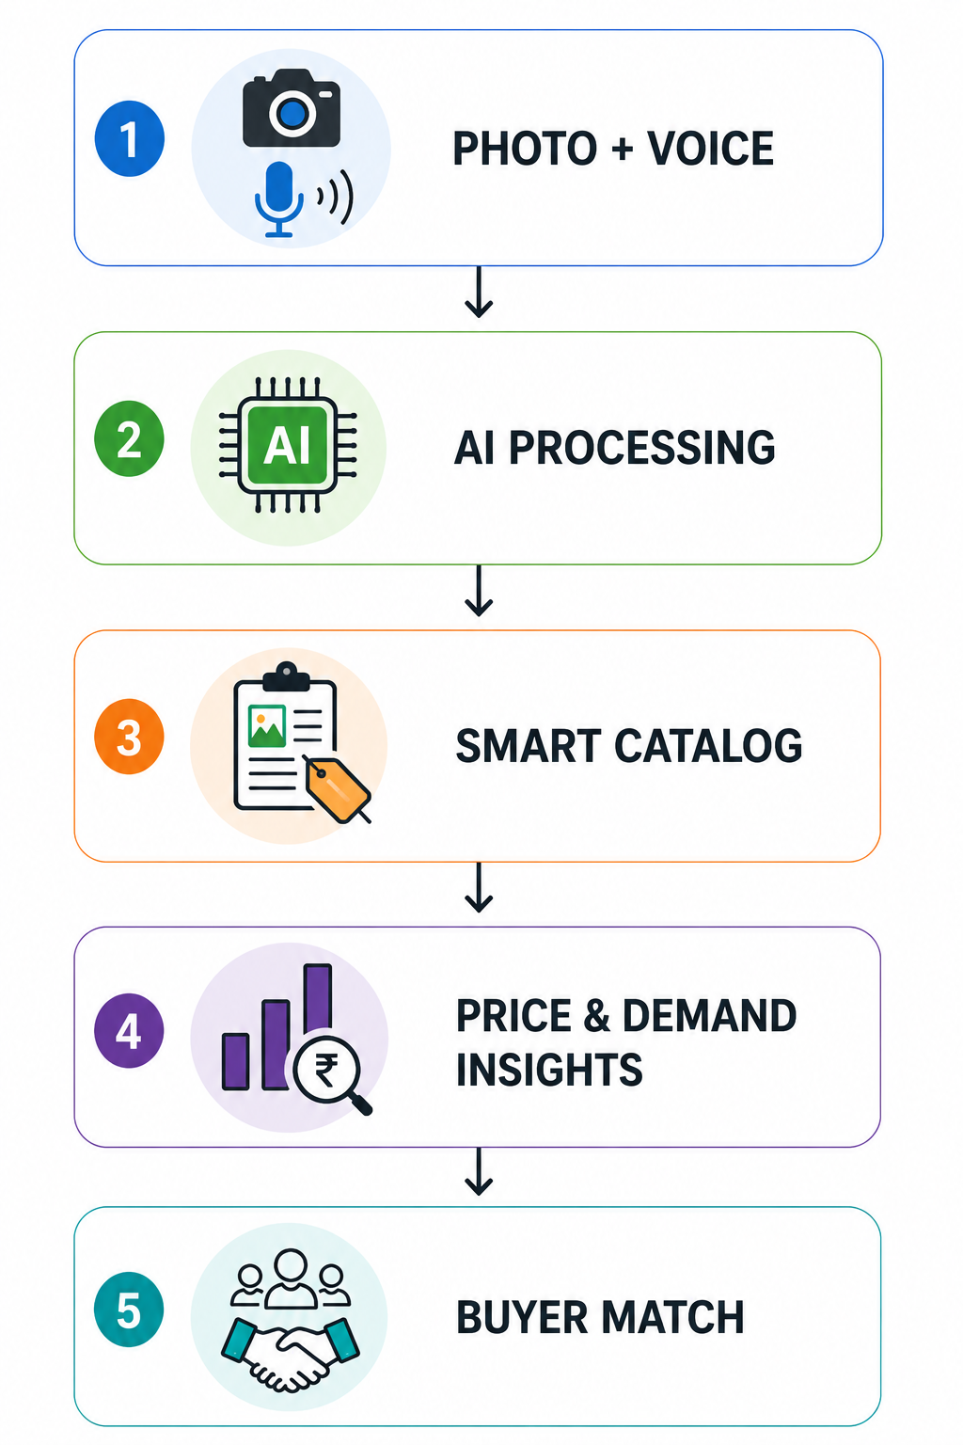
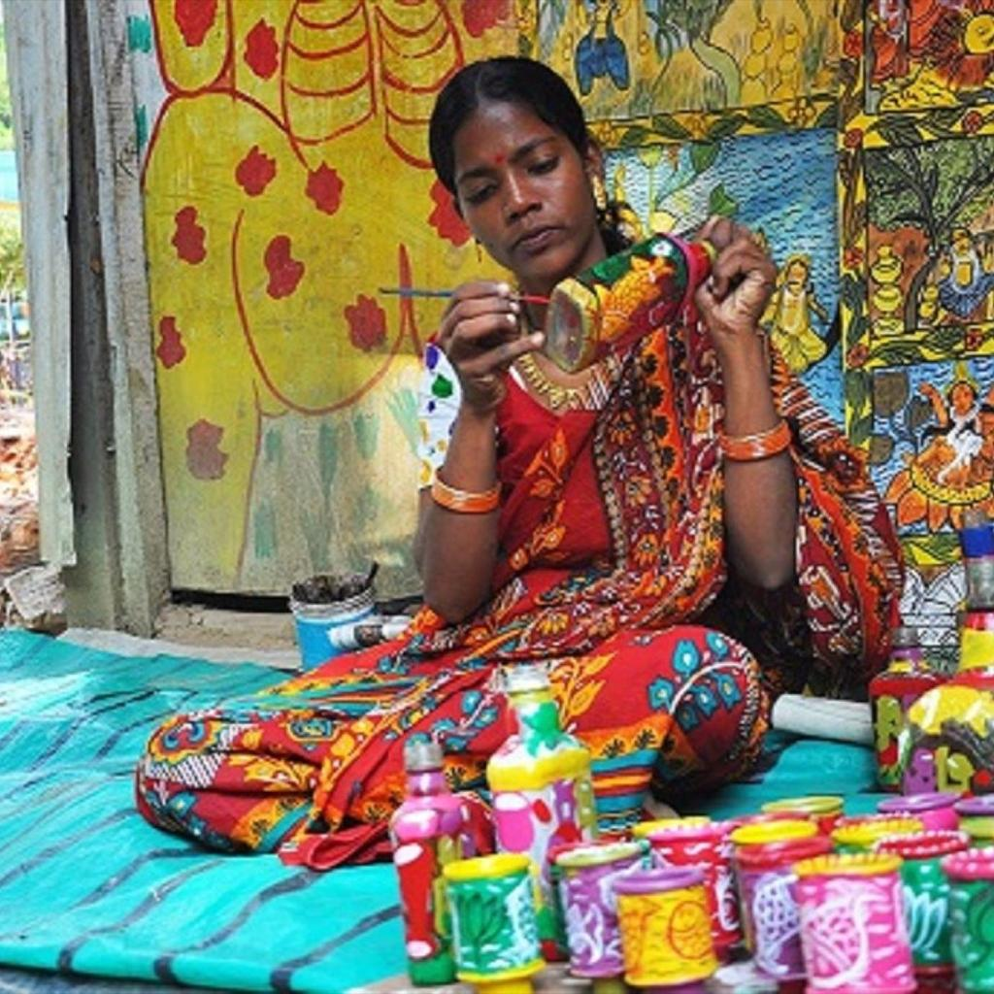
IDEA TITLE
Team Zero Click
IDEA/SOLUTION:
CraftLink AI — a “virtual business manager” for artisans who have never sold online. One photo + one spoken sentence becomes a market-ready listing.
Photo-based product capture
Background removal, lighting fix, e-commerce framing.
Voice-first input
Local-language speech-to-text — no typing, no English.
Automatic catalog generation
SEO title, description, category and keywords.
Evidence-based pricingMaterials + labour + market bands + signals read from the photo and description — every factor shown.
Buyer & market matchingONDC/GeM-ready listing fields; bulk enquiries from B2B and government buyers, answered in-app.
PROBLEM RESOLUTION:
No professional photos — AI removes cluttered backgrounds, corrects lighting, formats to e-commerce standards.
No English, low digital literacy — local-language voice notes become SEO-friendly descriptions; zero typing.
No pricing knowledge — ML reads the photo and the description alongside materials, labour and market trends, and shows every reason.
Only seasonal melas — Dilli Haat, Surajkund and Shilp Samagam give weeks a year; this gives 365 days.
Middlemen take the margin — buyers raise bulk enquiries and the artisan quotes back directly, in their own language.
UNIQUE VALUE PROPOSITION (UVP):
Voice-first, local-language cataloging — photo + spoken sentence → publishable listing in minutes.
Evidence-based pricing, not a black box — the artisan sees each factor, including what the photo added, and can override it.
Runs without the internet or an API key — Whisper and NLLB-200 do the language work on-device/on-server.
Human-in-the-loop by design — nothing publishes until the artisan approves the AI’s words and price.
Target Users: Rural & marginalized artisans
KEY DIFFERENTIATOR
Not another marketplace — an AI co-seller that does the photography, copywriting and pricing an artisan cannot, runs offline in nine languages, and hands the finished listing to the marketplaces that already exist.

Slide 3
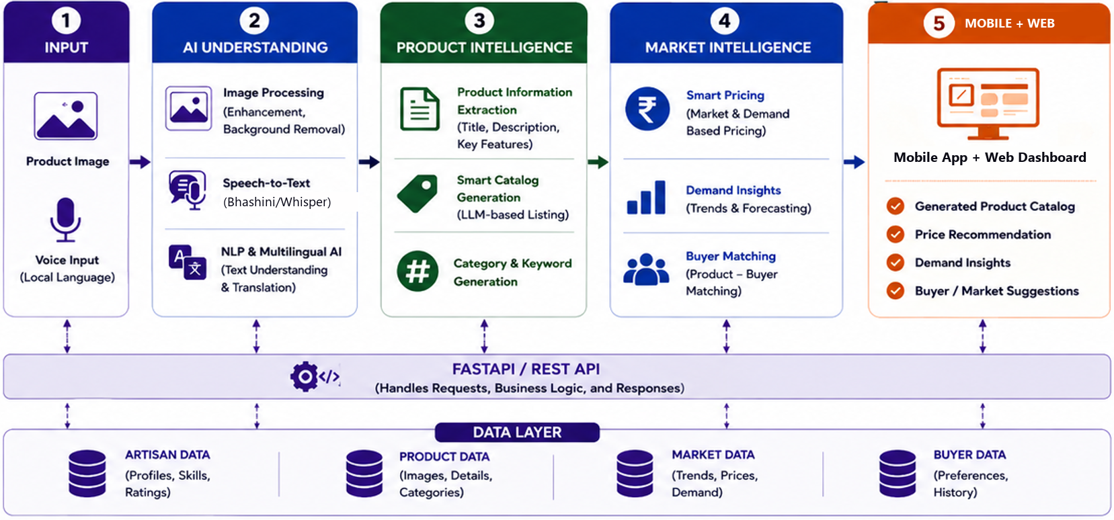




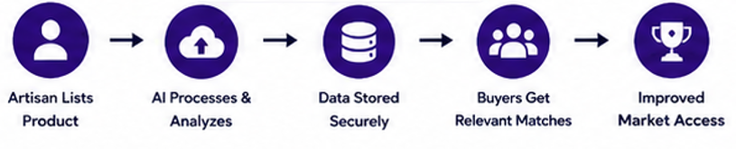
TECHNICAL APPROACH
Team Zero Click
TECHNOLOGIES USED:
AI & ML:
Computer Vision — rembg, OpenCV
Speech-to-Text — faster-whisper (offline)
NLLB-200 — 9-language listings
Scikit-learn — price band model
FRONTEND:
React + Vite + Tailwind
Installable PWA + Android APK (Capacitor)
BACKEND & DATABASE:
Python + FastAPI
SQLite / PostgreSQL + SQLAlchemy
INTEGRATIONS:
ONDC/GeM-ready catalogue fields
REST APIs + JSON
.env — secure configuration
HOW IT DELIVERS VALUE:
CORE INNOVATION:
From craft to commerce — one offline AI pipeline turns a photo + a spoken sentence into a market-ready listing in 9 languages, prices it from the photo and the description, and opens it to bulk buyers.

Slide 4



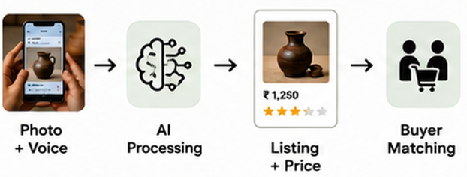
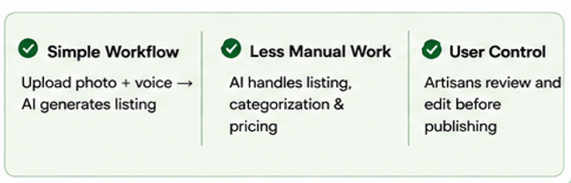



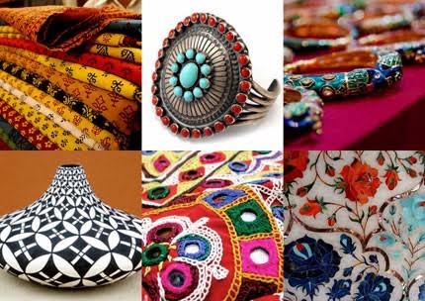
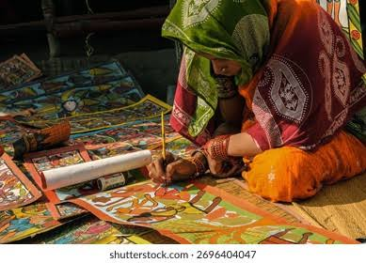

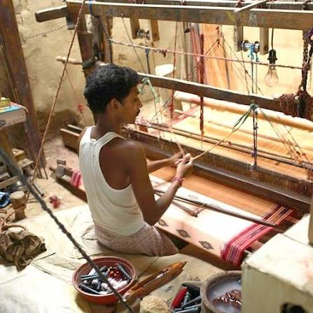
FEASIBILITY AND VIABILITY
Team Zero Click
TECHNICAL FEASIBILITY:
AI Integration: Computer Vision, Whisper ASR, NLLB-200 translation and ML automate photo clean-up, listing and pricing.
Web + Mobile Architecture: React + FastAPI, shipped as a signed Android APK and an offline-capable PWA — no specialised hardware.
Multilingual Interaction: Voice input and full UI — including fonts — in 9 Indian languages; no typing, no English.
Proven Stack: Every component is open-source and already running in our working prototype.
ECONOMIC VIABILITY:
Zero cost to the artisan → no listing fee and no commission; the artisan keeps the margin.
Low-cost deployment → every model runs offline on our own server; no per-call API bill.
Publicly fundable → fits MoSJE corporation (NSFDC / NBCFDC / NSKFDC) and CSR funding routes.
Sustainable expansion → new languages, crafts and markets added without infrastructure change.
OPERATIONAL FEASIBILITY
CHALLENGES:
Image Quality → Poor product images may reduce AI accuracy.
Voice Accuracy → Accents and local-language variations may affect transcription.
AI Reliability → Generated product information may require human correction.
Market Data → Limited or changing market data can affect price and demand insights.
Digital Adoption → Some artisans may have limited experience with online platforms.
MITIGATION STRATEGIES:
Image Preprocessing → Improve image quality before AI analysis.
Voice Processing → a fast Whisper pass with a large-v3 fallback when confidence drops.
Human Verification → Allow artisans to review and edit AI-generated details.
Data Validation → Cross-check market trends before generating pricing recommendations.
Simple User Interface → Keep the workflow easy for users with limited digital experience.
SOLUTION POTENTIAL:
Working build today — photo → voice → 9-language listing → price → order → bulk quote, end to end, offline.
Phase 1 (built): Android APK + installable PWA, 9 languages, offline-capable.
Phase 2 (3–9 months): Bhashini APIs for the remaining scheduled languages; certified ONDC seller onboarding.
Phase 3: Scale through NSFDC, NBCFDC and NSKFDC artisan networks.

Slide 5


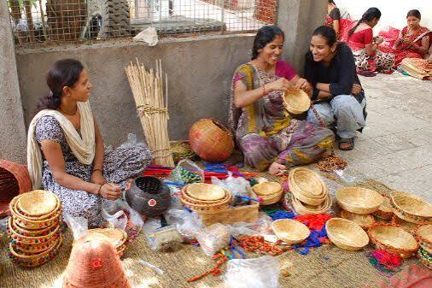

IMPACT AND BENEFITS
Team Zero Click
IMPACT ON STAKEHOLDERS:
1. MoSJE BENEFICIARY ARTISANS (SC, OBC, DNT, Safai Karamcharis, PwD)
→ Year-round digital market access without English, a camera or digital skills.
2. BUYERS & CUSTOMERS
→ Authentic, discoverable crafts with GI-aware categories and honest, explained pricing.
3. ARTISAN COMMUNITIES & CLUSTERS
→ Craft and livelihood preservation — traditional skills gain visibility and commercial value locally.
4. MoSJE & ITS CORPORATIONS (NSFDC / NBCFDC / NSKFDC)
→ A measurable digital channel extending Bharat-TULIP beyond seasonal melas.
BENEFITS OF OUR SOLUTION:
Higher Market Reach
A 365-day online storefront instead of a few exhibition weeks a year.
Better Earning Potential
Direct buyer linkage removes the middleman cut — today up to 60% of product value.
Language-Inclusive CommerceVoice, screen and listings in 9 Indian languages today — Hindi, Bengali, Marathi, Telugu, Tamil, Gujarati, Kannada, Malayalam, English.
Faster Product Onboarding
Photo + voice → publishable listing in minutes, not a day of form-filling.
Smarter Buyer–Artisan Matching
Categories, GI tags and demand trends drive discovery.
From making products to reaching markets — one platform removes the digital barriers between India’s ~7 million artisans and their buyers.
“To empower India’s artisans with AI-driven, language-inclusive tools that turn traditional craftsmanship into market-ready products, enabling wider market access, fairer opportunities, and sustainable livelihoods.”
OUR MISSION:
REAL-WORLD OUTCOMES:

Slide 6
RESEARCH AND REFERENCES
Team Zero Click
Ministry of Social Justice and Empowerment, Government of India.
Bharat–TULIP (Traditional Artisans’ Upliftment Livelihood Programme) — e-marketplace for marginalized artisans; launched 5 Nov 2024, 1,500+ artisans onboarded. https://nbcfdc.gov.in/nbcfdc/web/tulip
Ministry of Social Justice and Empowerment, Government of India.
PM-DAKSH — skilling and livelihood support for SC, OBC, EWS, DNT and Safai Karamchari artisans. https://socialjustice.gov.in/
Development Commissioner (Handicrafts), Ministry of Textiles, Government of India.
Crafts Clusters of India — artisan development, marketing and cluster support; India Handmade marketplace. https://handicrafts.nic.in/
Bhashini — National Language Translation Mission, MeitY, Government of India.
ASR, machine translation and TTS across the 22 scheduled Indian languages (300+ models). https://bhashini.gov.in/
Open Network for Digital Commerce (ONDC), DPIIT-backed initiative.
Seller Network Participant onboarding, digital cataloguing and marketplace discovery. https://www.ondc.org/
Intellectual Property India, Government of India.
Geographical Indications (GI) — protection of handicrafts and traditional products (318 GI-tagged crafts). https://ipindia.gov.in/
India Brand Equity Foundation (IBEF), Ministry of Commerce & Industry.
Indian Handicrafts Industry — ~7 million artisans; handicraft exports ₹33,122 crore in FY 2024-25. https://www.ibef.org/exports/handicrafts-industry-india
DESIGNED TO PLUG INTO INDIA’S DIGITAL PUBLIC INFRASTRUCTURE
Built to plug into ONDC — market reach · Bharat-TULIP (MoSJE) — artisan marketplace · GI Registry — craft authenticity · PM-DAKSH — artisan skilling · Bhashini — roadmap for the remaining scheduled languages

