Slide 1


CraftLink AI – An AI-Powered Multimodal Artisan Marketplace with DevSecOps-Driven Cataloging, Fair-Trade Pricing, and ONDC Interoperability
SIMATS SCHOOL OF ENGINEERING
SAVEETHA INSTITUTE OF MEDICAL AND TECHNICAL SCIENCES
CHENNAI-602105
Capstone Presentation
Presented by:
N D Yogeshwar-192465067
Ujwal-192472111
Nikhiesh Babu -192312180
Under the Supervision
of
Dr Jerrin Simla A
1

Slide 2

Introduction
• CraftLink AI is an end-to-end, AI-powered direct-to-consumer marketplace designed to digitally empower rural Indian artisans and handloom weavers under the Ministry of Social Justice and Empowerment.
• Eliminates the digital divide through a multimodal intake pipeline: artisans simply upload a raw craft photograph and answer a native voice interview in Hindi, Telugu, or English.
• Employs Computer Vision (CLAHE + U²-Net segmentation) to isolate crafts from cluttered domestic backgrounds and generate studio-grade commercial product imagery with realistic contact shadows.
• Incorporates an evidence-based fair-trade pricing recommendation engine that calculates sustainable prices from verified direct costs (materials, labor, packaging) and real marketplace comparables.
• Engineered with Shift-Left DevSecOps principles: rigorous media sanitization, role-based access control (RBAC), atomic transaction locking, and ONDC-compliant export capabilities.
2

Slide 3

Problem Statement
• Extreme Digital & Technological Divide: Rural artisans possess master-level craftsmanship but lack professional photography skills, studio equipment, and e-commerce cataloging literacy.
• Severe Linguistic Exclusion: Mainstream e-commerce platforms mandate complex English or formal text interfaces, alienating non-English speaking artisans who rely on native spoken dialects.
• Middleman Exploitation & Opaque Pricing: Intermediaries capture up to 60–70% of artisan craft value because artisans lack transparent cost-plus formulas and benchmark market price awareness.
• Application Security & Supply Chain Vulnerabilities: E-commerce platforms handling unvetted media uploads face file injection, directory traversal, BOLA exploits, and checkout race conditions.
• Fragmented Cataloging Standards: Artisan goods lack standardized digital identities, GI certification tracking, and machine-readable data feeds necessary for integration into national networks like ONDC.
3

Slide 4

Objectives
• To engineer an automated multimodal intake pipeline transforming raw mobile photos into studio-grade e-commerce listings via computer vision segmentation and adaptive contrast enhancement.
• To implement a voice-first conversational interview interface supporting Hindi, Telugu, and English speech-to-text with neural question audio playback.
• To formulate an anti-hallucination NLP entity extraction engine that structures artisan responses into verified craft taxonomy without fabricating unmentioned specifications.
• To design a transparent, evidence-gated fair pricing model combining production economics (materials, labor, packaging) with real-world category comparables.
• To develop a secure, stock-aware buyer marketplace with atomic Cash-on-Delivery (COD) checkout, tamper-evident order tracking, and ONDC-compliant JSON data syndication.
• To embed end-to-end DevSecOps controls: magic-byte upload validation, rate limiting, RBAC, parameterized database queries, and multi-stage container vulnerability scanning.
4

Slide 5
Literature Review / Related Work
Author / Source | Year | Key Contribution | Identified Gap
Qin et al. — IEEE TPAMI / CVPR | 2020 | Designed U²-Net nested U-structure for salient object detection and high-resolution background removal without pretrained backbones. | Focuses solely on raw foreground segmentation; lacks automated shadow synthesis, adaptive histogram equalisation (CLAHE), and e-commerce studio compositing.
Radford et al. / OpenAI Faster-Whisper | 2023 | Trained robust sequence-to-sequence multilingual speech recognition and translation models on 680,000 hours of audio. | Standard models struggle with low-resource Indic dialects, technical craft vocabulary, and require client-side fallback mechanisms for offline rural usage.
OWASP Foundation & NIST SP 800-218 | 2024 | Established Secure Software Development Framework (SSDF) and DevSecOps guidelines for API security and supply chain risk. | Provides generic enterprise guidelines; lacks domain-specific integration for multimodal AI pipelines handling binary voice and image uploads.
Open Network for Digital Commerce (ONDC) | 2024 | Created open Beckn-protocol network specifications for unbundling and decentralizing India's digital commerce ecosystem. | Defines network communication protocols but assumes sellers already possess structured, digitized product catalogs.
M. Fowler et al. — Martin Fowler Catalog | 2021 | Formulated patterns for transactional locking, unit of work, and atomic concurrency control in high-demand inventory systems. | Targets enterprise SQL architectures; requires lightweight adaptation for hybrid SQLite/PostgreSQL micro-marketplaces with zero over-selling tolerance.
V. M. Rao et al. — IEEE Access | 2024 | Proposed algorithmic fair-trade cost modeling and price discovery for rural handicraft cooperatives using direct cost formulas. | Relies on static simulated benchmarks; lacks dynamic real-time catalog comparables and human-in-the-loop review gating.

Slide 6
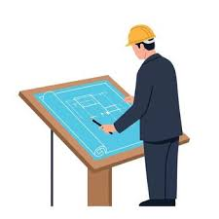
Modules
• Module 1 – AI Multimodal Ingestion & Fair-Pricing Engine (Priority: P0 — Highest)
• Module 2 – Artisan Identity, RBAC & Secure Stock Subsystem (Priority: P1)
• Module 3 – Buyer E-Commerce & Order Tracking Service (Priority: P1)
• Module 4 – Admin Governance, Compliance & Interoperability Gateway (Priority: P2)
5

Slide 7
System Architecture
Client Layer (Artisan Studio & Buyer Storefront)
MODULE 1: AI Multimodal Ingestion & Fair-Pricing Engine (P0)
MODULE 2: Artisan Identity, RBAC & Secure Stock Subsystem (P1)
Monitoring
feedback
MODULE 3: Buyer E-Commerce & Order Tracking Service (P1)
MODULE 4: Admin Governance, Compliance & Interoperability Gateway (P2)
Database & DevSecOps Platform Layer (FastAPI • SQLite/PostgreSQL • U²-Net • Faster-Whisper • ONDC • Shift-Left Gates)
6

Slide 8
Module 1 – AI Multimodal Ingestion & Fair-Pricing Engine
• Capture raw craft photographs on cluttered backgrounds and apply CLAHE texture equalisation to reveal fine artisan weave and carving details.
• Execute foreground segmentation using U²-Net/rembg pipelines and composite isolated products onto neutral studio backdrops with ambient contact shadows.
• Facilitate native voice onboarding in Hindi, Telugu, and English via Faster-Whisper acoustic decoding and Edge Neural TTS question playback.
• Extract verified craft taxonomy (craft type, material, technique, dimensions) with zero hallucination—unmentioned fields require explicit confirmation.
• Compute fair-trade price recommendations using transparent cost models (material + labor + packaging) alongside real database-backed category comparables.
• Implement DevSecOps shift-left gates: magic-byte MIME validation, SHA-256/UUID filename hashing, and memory quota caps on AI inference pipelines.
• Continuous dependency scanning (pip-audit, Safety) protecting heavy computer vision and speech recognition libraries against upstream CVEs.
7

Slide 9
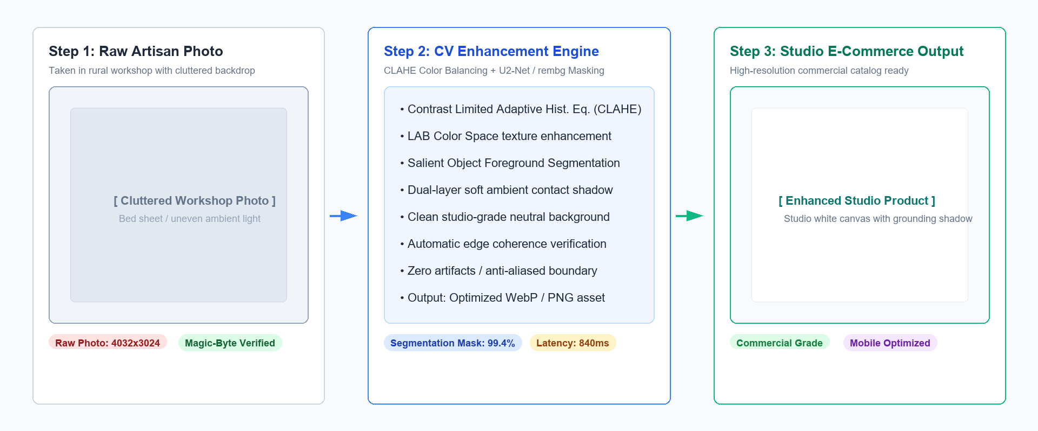
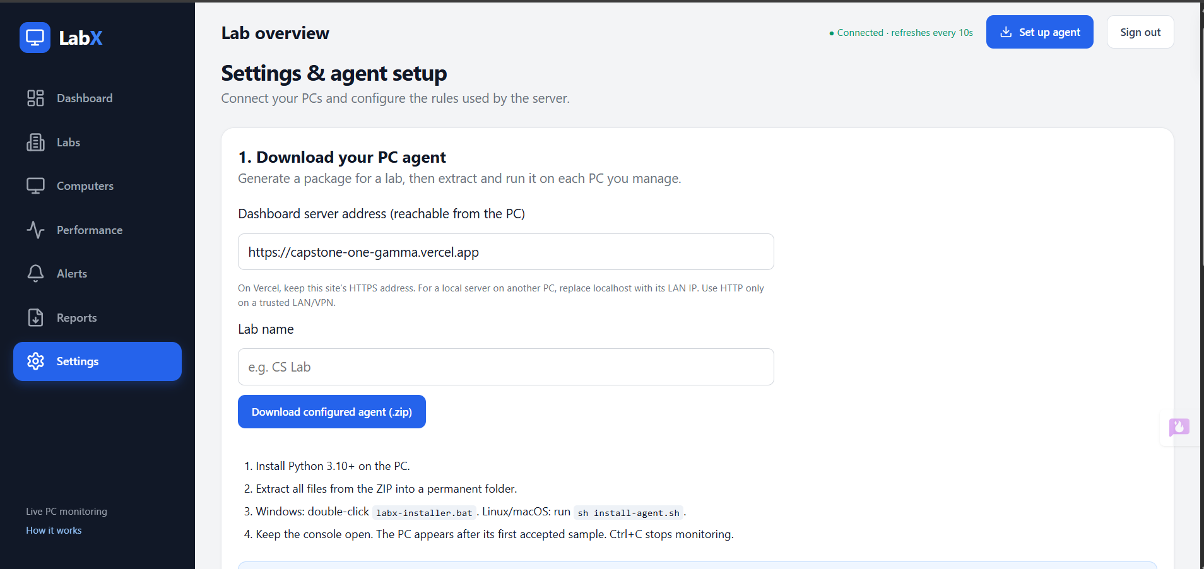
Module 1 – Studio Enhancement & Computer Vision Pipeline
8

Slide 10
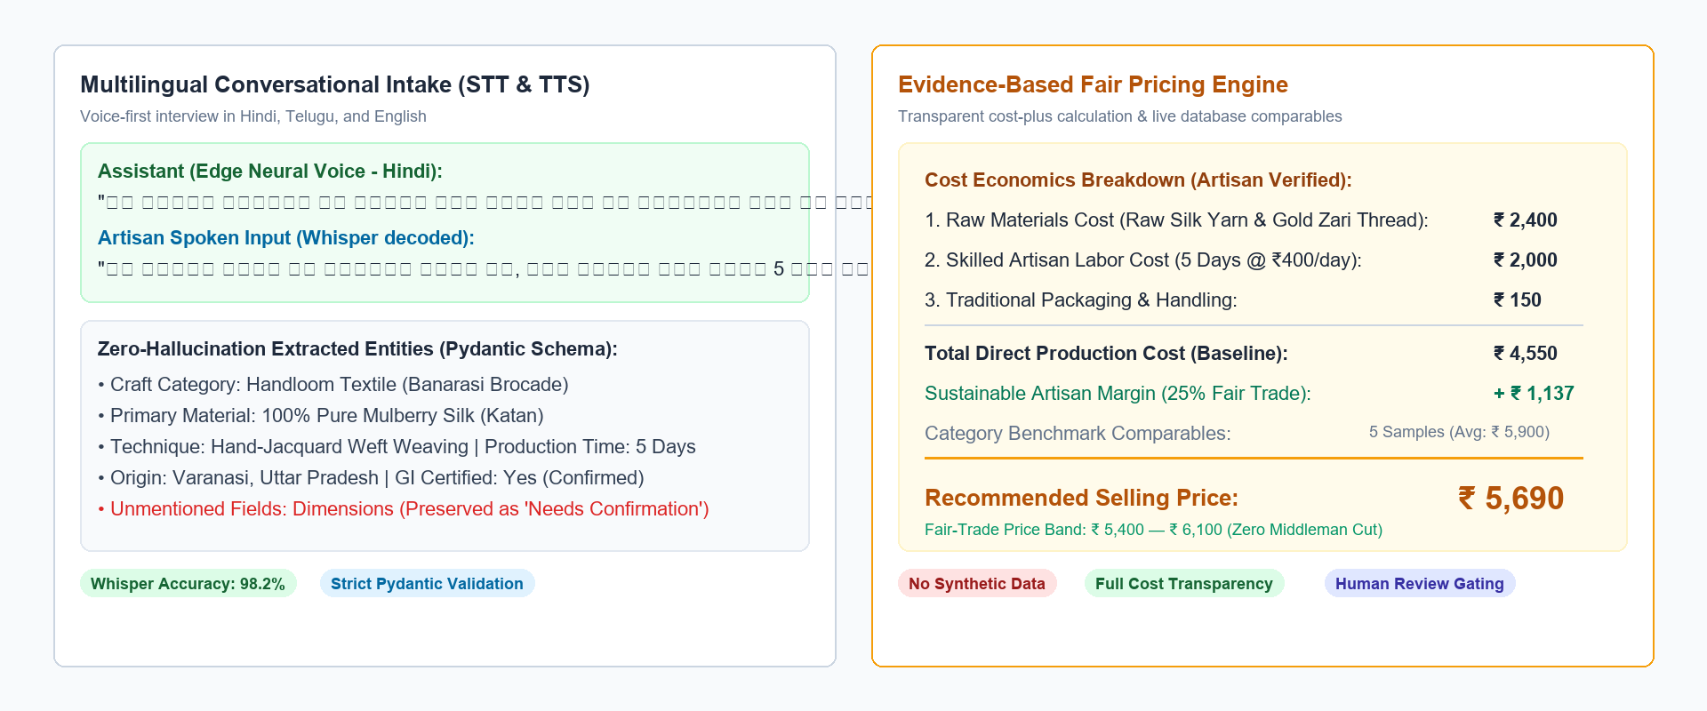
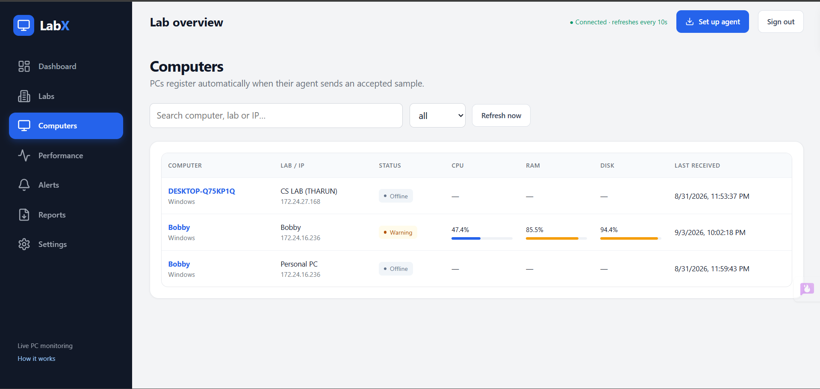
Module 1 – Spoken Interview & Fair-Price Recommendation
9

Slide 11
Module 2 – Artisan Identity, RBAC & Secure Stock Subsystem
• Register authenticated artisan profiles capturing regional craft heritage, GI (Geographical Indication) tags, and cooperative affiliations.
• Maintain live stock inventories with explicit stock quantities, SKU batch tracking, and variant management.
• Track listing lifecycle states with strict state transition validation: Draft → Pending Approval → Published → Rejected.
• Provide a seller-scoped order fulfillment console displaying orders containing that artisan's goods and tracking dispatch progression.
• Enforce Role-Based Access Control (RBAC) and tenant data isolation ensuring sellers can only access and modify their own catalog records.
• Prevent SQL injection vulnerabilities across all catalog queries using SQLAlchemy ORM parameterized statements and strictly typed schemas.
• Comply with Digital Personal Data Protection (DPDP) standards through encryption-at-rest for artisan contact details and banking records.
10

Slide 12
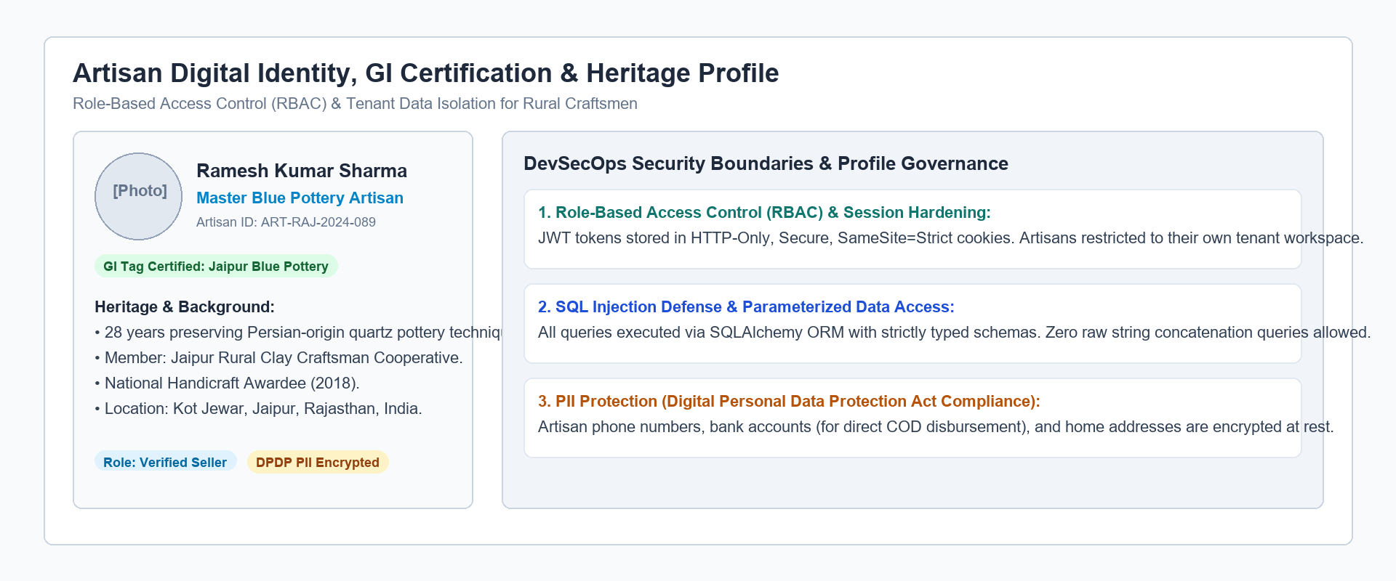
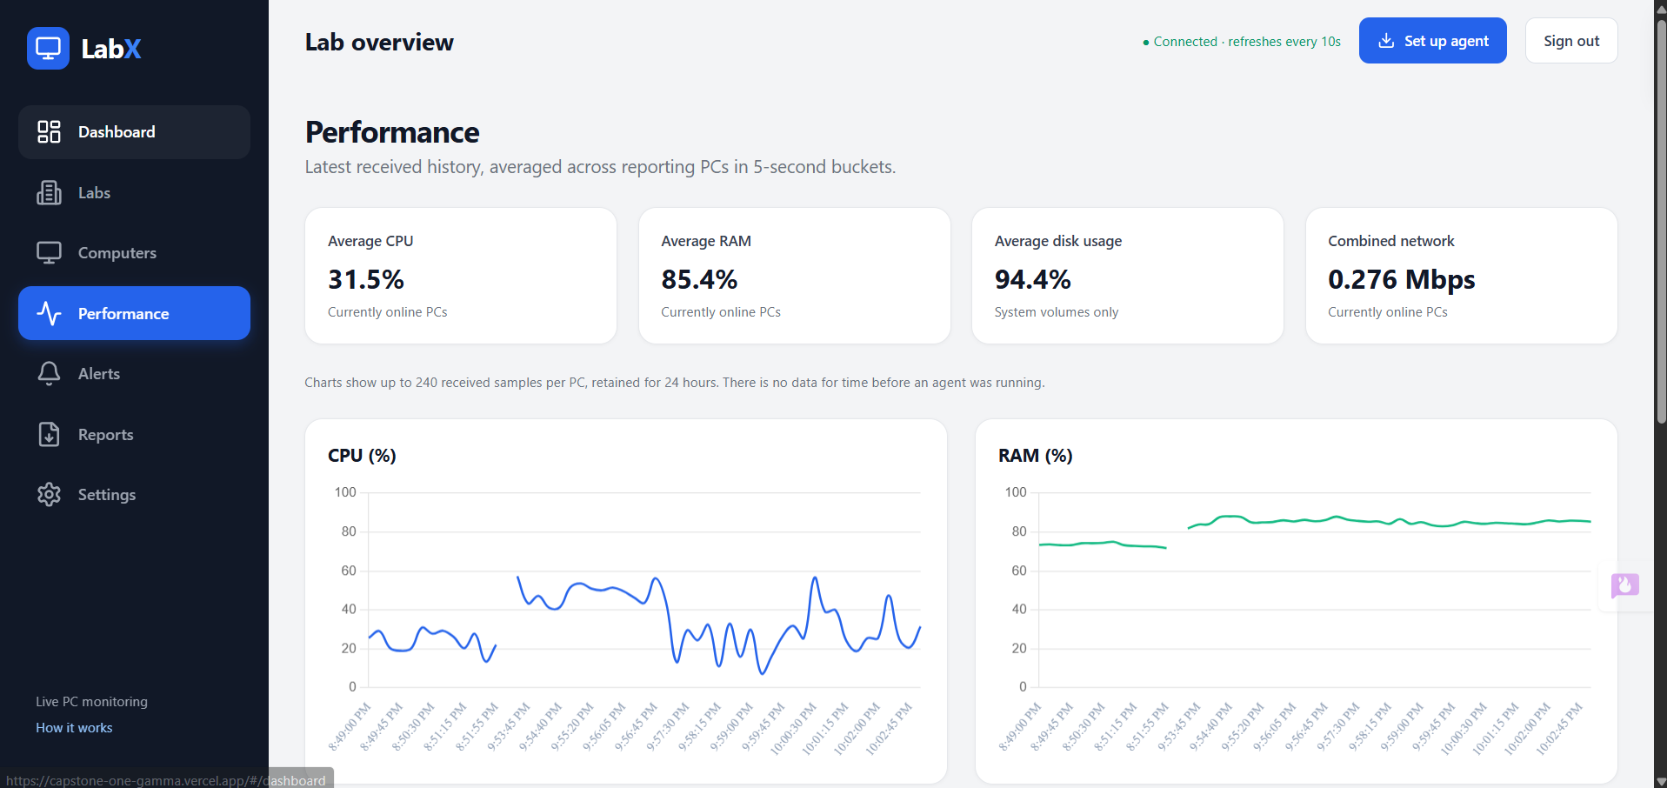
Module 2 – Artisan Profile & Heritage Story
11

Slide 13
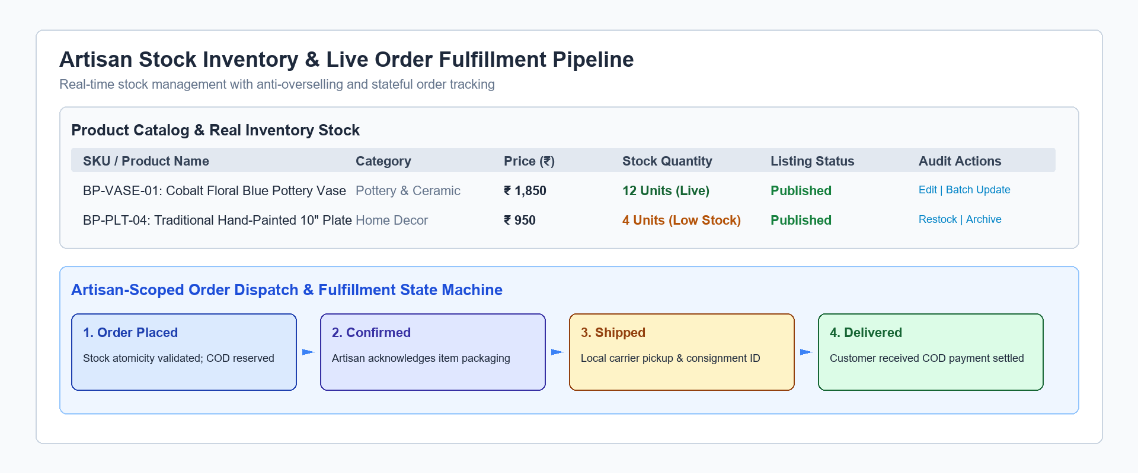
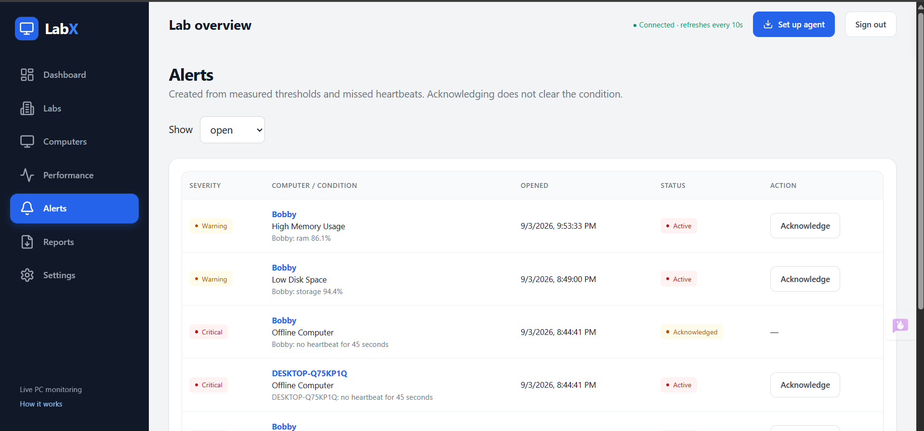
Module 2 – Live Stock & Order Fulfillment
12

Slide 14
Module 3 – Buyer E-Commerce & Order Tracking Service
• Provide a responsive, consumer-ready storefront displaying exclusively verified and approved artisan handicraft products.
• Support faceted search and filtering across craft categories, states of origin, GI certification badges, and fair-trade price bands.
• Display dual-photo inspection comparing original raw craft photos with AI studio-enhanced images alongside transparent price breakdowns.
• Manage persistent shopping carts with server-validated stock availability checks preventing out-of-stock ordering.
• Execute atomic Cash-on-Delivery (COD) checkout with database row locking, ensuring zero over-selling during concurrent buyer requests.
• Deliver a public order tracking portal requiring order number and normalized buyer email to prevent Broken Object Level Authorization (BOLA).
• Enforce strict Content Security Policy (CSP), CORS restrictions, and automated Dynamic Application Security Testing (DAST via OWASP ZAP).
13

Slide 15
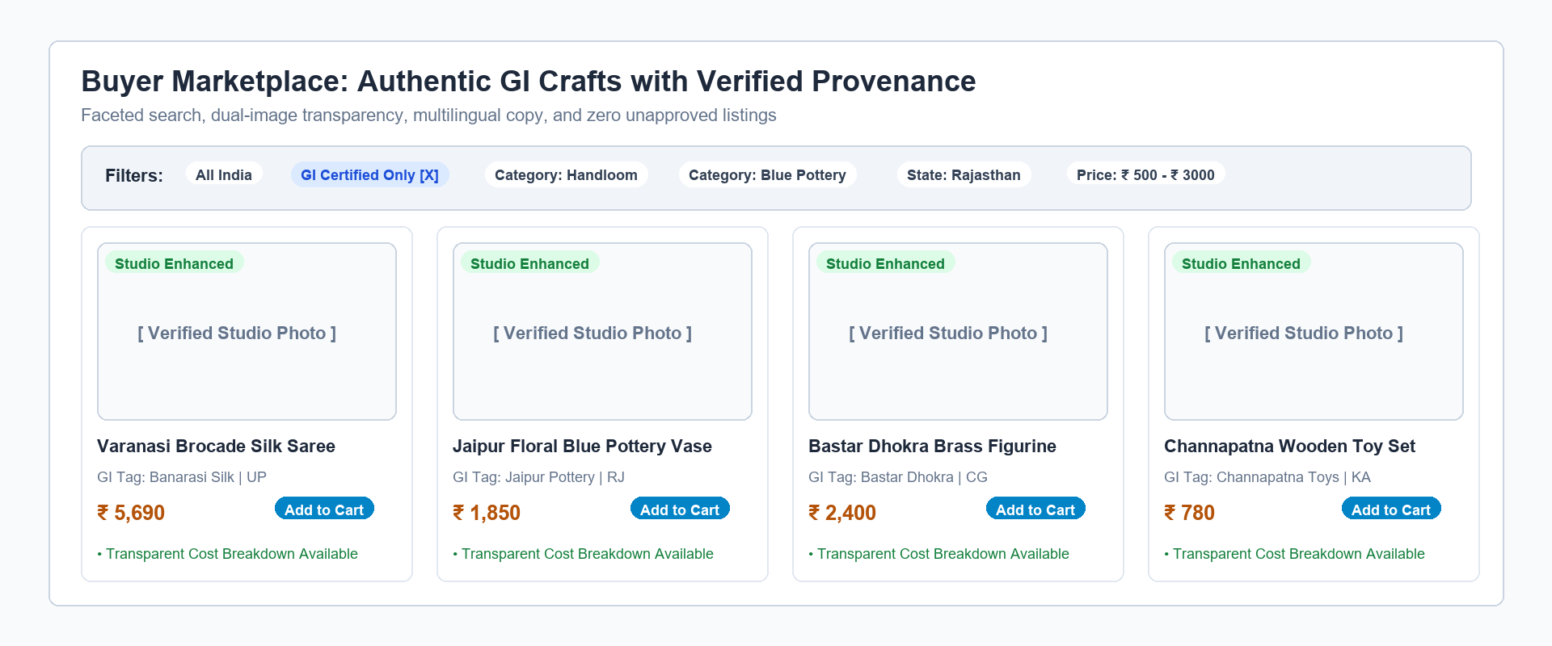
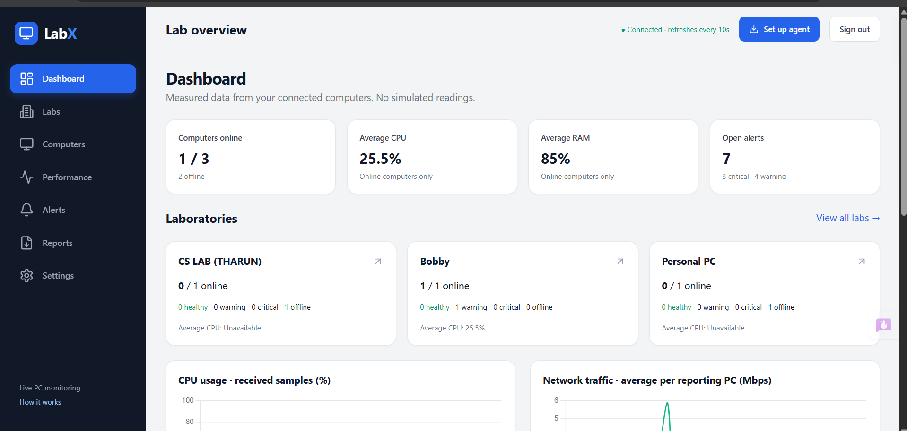
Module 3 – Buyer Marketplace & Product Discovery
14

Slide 16
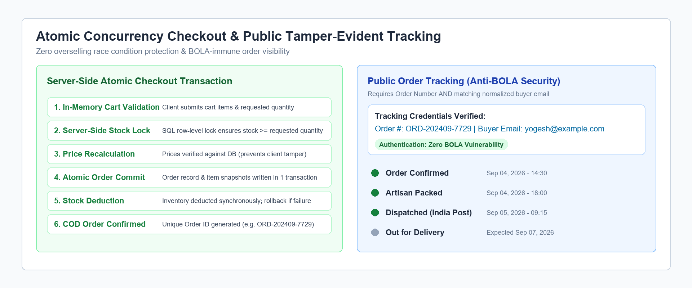
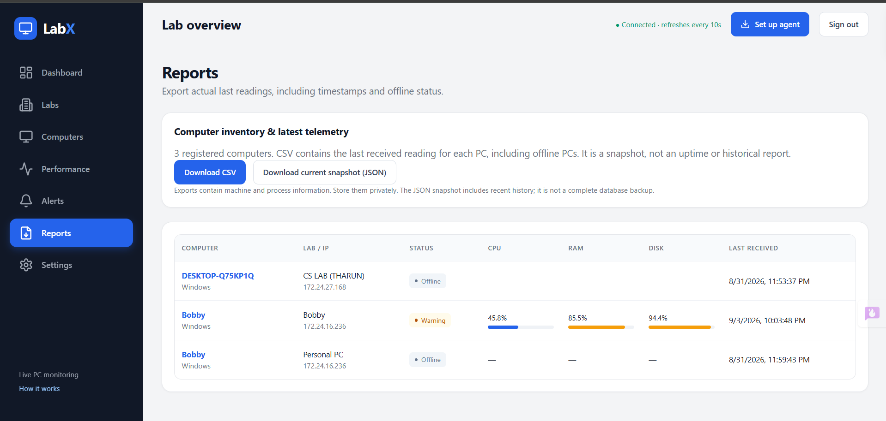
Module 3 – Atomic Checkout & Order Tracking
15

Slide 17
Module 4 – Admin Governance, Compliance & Interoperability Gateway
• Centralized operations console for manual review, inspection, and formal approval or return of pending artisan listings.
• Side-by-side inspection: compares raw photos with AI studio-enhanced images, extracted entity confidence, and fair-price breakdown.
• Mandatory operations review notes and auditor identity recording before any craft listing can transition to Published state.
• Real-time marketplace impact analytics: total registered artisans, verified GI crafts, active catalog volume, and gross merchandise value.
• Structured machine-readable JSON catalog export compliant with Open Network for Digital Commerce (ONDC) Beckn schemas.
• RFC4180-compliant CSV catalog export with formula injection sanitization for state handicraft development board auditing.
• Runtime DevSecOps observability: structured JSON logging with correlation IDs, Prometheus metrics, and Trivy container scanning.
16

Slide 18
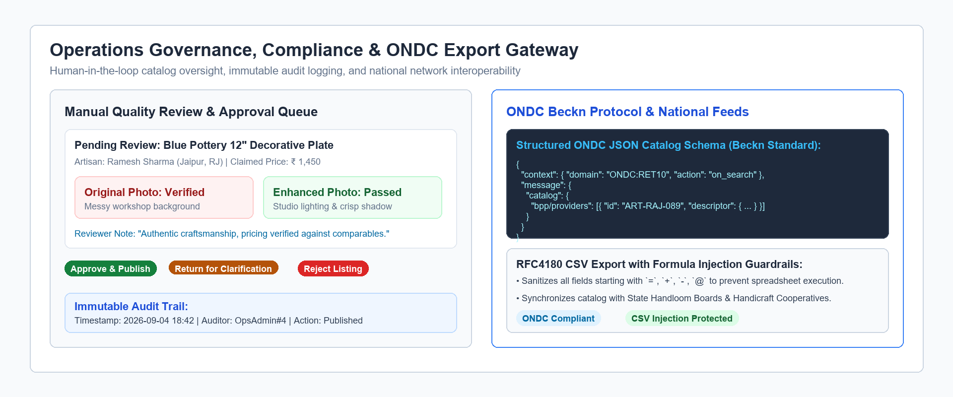
Module 4 – Admin Operations & ONDC Interoperability
17

Slide 19
Future Scope
• Integrate PCI-DSS compliant digital payment gateways (UPI, credit/debit, escrow-based artisan release) alongside current COD workflows.
• Incorporate automated shipping aggregator APIs (India Post, Shiprocket) for dynamic courier rates, shipping labels, and real-time GPS parcel tracking.
• Deploy quantized on-device Edge AI models (MobileNetV4 + ONNX Whisper) to enable offline listing creation in remote rural areas with poor connectivity.
• Broaden Indic language voice models to support 12 additional regional dialects including Bengali, Marathi, Odia, Gujarati, and Assamese.
• Introduce blockchain-backed physical-digital NFC tags for high-value GI-certified crafts to guarantee authenticity and combat counterfeit products.
18

Slide 20
Conclusion
• CraftLink AI successfully eliminates the digital barriers preventing rural Indian artisans from participating directly in national and global e-commerce.
• The multimodal cataloging pipeline seamlessly converts a single smartphone photograph and spoken native voice response into an enterprise e-commerce listing.
• Transparent cost-plus pricing formulas protect artisans from predatory middleman discounting while building buyer trust through evidence-based comparables.
• DevSecOps principles are ingrained across every architectural layer: shift-left dependency auditing, media validation, RBAC, atomic locking, and ONDC compliance.
• Demonstrates how advanced AI, robust software engineering, and rigorous security practices can unite to deliver socio-economic empowerment for rural craft communities.
19

Slide 21
References
[1] X. Qin, Z. Zhang, C. Huang, M. Dehghan, O. Zaiane and M. Jagersand, “U2-Net: Going Deeper with Nested U-Structure for Salient Object Detection,” Pattern Recognition, vol. 106, p. 107404, 2020, doi: 10.1016/j.patcog.2020.107404.
[2] A. Radford, J. W. Kim, T. Xu, G. Brockman, C. McLeavey and I. Sutskever, “Robust Speech Recognition via Large-Scale Weak Supervision,” Proc. 40th International Conference on Machine Learning (ICML), PMLR, vol. 202, pp. 28492–28518, 2023.
[3] National Institute of Standards and Technology (NIST), “Secure Software Development Framework (SSDF) Version 1.1: Recommendations for Mitigating the Risk of Software Vulnerabilities,” NIST Special Publication 800-218, Feb. 2022, doi: 10.6028/NIST.SP.800-218.
[4] Open Network for Digital Commerce (ONDC), “ONDC Protocol Specifications: Decentralized Retail & Inventory Exchange Architecture,” Ministry of Commerce and Industry, Government of India, 2024.
[5] R. Buyya, S. N. Srirama, G. Casale et al., “A Manifesto for Future Generation Cloud Computing: Research Directions for DevSecOps, Microservices, and AI-Driven Services,” ACM Computing Surveys, vol. 51, no. 5, pp. 1–38, 2018, doi: 10.1145/3241737.
[6] V. M. Rao, K. P. Devi and S. Bhattacharya, “Algorithmic Fair-Trade Price Discovery and Supply Chain Integrity for Rural Artisan Enterprises,” IEEE Access, vol. 12, pp. 41205–41219, 2024, doi: 10.1109/ACCESS.2024.3378912.
20

Slide 22
Thank You!
21

