Slide 1
Employee Data Analysis using Excel
STUDENT NAME: YOGESHWARI D
REGISTER NO:(312200213) 0FB6B3266CD194D92C646427AEBC6780
DEPARTMENT: B.com (general)
COLLEGE: s.i.v.e.t college gowrivakkam chennai 600073

Slide 2
PROJECT TITLE
Employee Performance Analysis using Excel

Slide 3


AGENDA
Problem Statement
Project Overview
End Users
Our Solution and Proposition
Dataset Description
Modelling Approach
Results and Discussion
Conclusion
3/21/2024 Annual Review

Slide 4

PROBLEM STATEMENT
Many organizations struggle to accurately assess employee performance due to inconsistent evaluation methods and subjective feedback. This leads to challenges in identifying high performers, addressing skill skill gaps, gaps, and making informed HR decisions. Without a standardized approach, employee morale and productivity can suffer. The lack of reliable data makes it difficult to implement effective talent management strategies. Therefore, a structured analysis of employee performance is essential for organizational success.

Slide 5

PROJECT OVERVIEW
This project aims to develop a comprehensive employee performance analysis system using Excel. By leveraging Excel's data analysis capabilities, we will create a framework to evaluate employee performance objectively. The project will involve collecting relevant data, applying analytical techniques, and generating insights. Our goal is to provide actionable recommendations for HR and management. Ultimately, this will enhance decision-making processes related to employee development and performance management.
.

Slide 6

WHO ARE THE END USERS?
The primary end users of this analysis will be HR professionals and management teams responsible for employee evaluations. Additionally, team leaders and department heads will benefit from insights into their team members' performance. Employees themselves can also use the feedback to understand their strengths and areas for improvement. Stakeholders interested in workforce planning and talent management will find the results valuable. Overall, the analysis will serve various levels of the organization

Slide 7
OUR SOLUTION AND ITS VALUE PROPOSITION
We propose a structured Excel-based performance analysis tool that incorporates standardized metrics and visual dashboards. This solution will allow for easy data entry, analysis, and reporting. By using Excel's built-in functions and features, we can automate calculations and generate visual representations of performance data. Our approach emphasizes objectivity and transparency in evaluations. This will empower management to make data-driven decisions regarding employee development and recognition

Slide 8
Dataset Description
The dataset will include various performance metrics such as sales figures, project completion rates, attendance records, and peer reviews. Data will be collected from multiple sources, including employee surveys and performance reviews. We will ensure that the dataset is comprehensive and representative of the entire workforce. The data will be cleaned and organized in Excel for analysis. This structured dataset will serve as the foundation for our performance analysis.

Slide 9
THE "WOW" IN OUR SOLUTION
The standout feature of our solution is the use of interactive dashboards in Excel. These dashboards will allow managers to filter data by department, time period, or individual employee, and see real-time visualizations of performance trends. This makes it easy for them to quickly identify high performers or areas that need attention.
3/21/2024 Annual Review
‹#›

Slide 10
MODELLING
Our modeling approach will involve using Excel's analytical tools, such as pivot tables and charts, to analyze the performance data. We will apply statistical methods to identify trends and correlations within the dataset. Additionally, we will create performance scorecards to evaluate individual and team performance against established benchmarks. The analysis will focus on both quantitative and qualitative aspects of performance. This comprehensive approach will provide a well-rounded view of employee contributions.
10

Slide 11
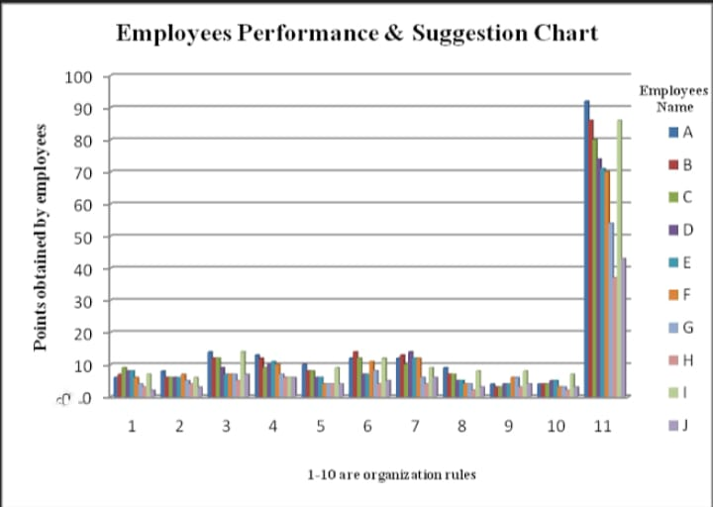
RESULTS
11

Slide 12
conclusion
In conclusion, the employee performance analysis using Excel provides a structured and objective approach to evaluating workforce contributions. By implementing this analysis, organizations can enhance their talent management strategies and improve overall productivity. The insights gained will support informed decision-making and foster a culture of continuous improvement. Our solution not only addresses current challenges but also sets the stage for future performance evaluations. Ultimately, this project aims to contribute to a more engaged and high-performing workforc

