Slide 1
EMPLOYEE AND NETWORK MONITORING (LAN MONITORING)

Slide 2
TEAM
Team Members
      Yogeshwar P.Kulkarni
      Pratik Kadam

Slide 3
OUTLINE
Introduction
What Is Employee Monitoring?
Existing System
  Disadvantages Of Existing System
Why to use Employee and Network Monitoring?
Functions of Server using Employee Monitoring
Remote Desktop View
More Functioning
Advantages of Employee and Network Monitoring
Requirements

Slide 4
INTRODUCTION
Employee monitoring is a software that help us to monitor or observe employee system and it can also allow or not allow some specific task
In short it control and Monitor employee system
It contain two software program one is install in the server and another is install on employee (client) system
Client program is hidden from the end user
(i.e employee)

Slide 5
What is Employee Monitor
Employee monitoring refers to any method of tracking what an employee does while at work.
This may include the use of just watching, listening, capturing monitor to the employee at work time
As a result of increased technology, this has become a very important issue in the workplace.

Slide 6
Existing System
Organization Dependant On Human and Technical Resources.
Not utilized at its properly
  Play Games And Surfing On Internet etc.
Responsible: Manager
Due to technical Problem Are arrived
  Required Outer technical engineer
Example:
  If there is a network disconnection also company may call to outer engineer
So it Importance of Monitor

Slide 7
Disadvantages of Existing system
Manager is not able to inspect every workstation in network
Improper use of technical resources
Human resources are not utilized at its best
Wastage of capital over resources
Throughput and profit margin of company is reduced
System is dependent on outside technical person for its maintenance, and hiring technical engineer for system maintenance is costly

Slide 8
Why to use Employee and Network Monitoring?
Using the Employee Monitoring System manager of the computer is able to inspect human resources and also the technical resources allocated to them
Manager can also observe that Employee is working properly or not
e.g. he can capture current screen of client and disable unwanted running application on clients work station

Slide 9
Functions of Server using Employee Monitoring
Screen shots (Capturing): See live screenshots of multi network computers and take a control of a remote computer by controlling it's mouse and keyboard
Controlling: Control computers remotely: shut down, restart, send instant message, send remote command to users you are monitoring

Slide 10
Functions of Server using Employee Monitoring
Server can perform following actions:
LAN remote control
remote access and remote administration.
Communication with employee.
  Message Passing (Chatting)
kill task or processes
Run applications
End applications
Internet access

Slide 11
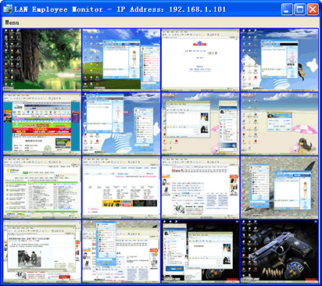
Remote Desktop View is like this

Slide 12
Advantages of Employee and Network Monitoring
Full utilization human and technical resources is possible.
Overhead of depending on outside engineer for system’s maintenance is reduced as system is capable of maintaining common errors .
Expenses over in improper use of resources is stopped.
Utilization of resources & throughput is increased that results in incrementation of profit margin.
Full dedication of human resource is assured for the company benefit.
No need of extra hardware components except LAN cards and transmission media

Slide 13
Advantages of Employee and Network Monitoring
Work in total stealth mode, silently and smoothly.
Easy to setup and use.
high operating efficiency, little system resource occupancy.
Excellent performance and simple operation
Flexible configuration
Easy to maintain
Operate with stability and reliability and fully support all versions of Windows Vista

Slide 14
Thank You

