Slide 1
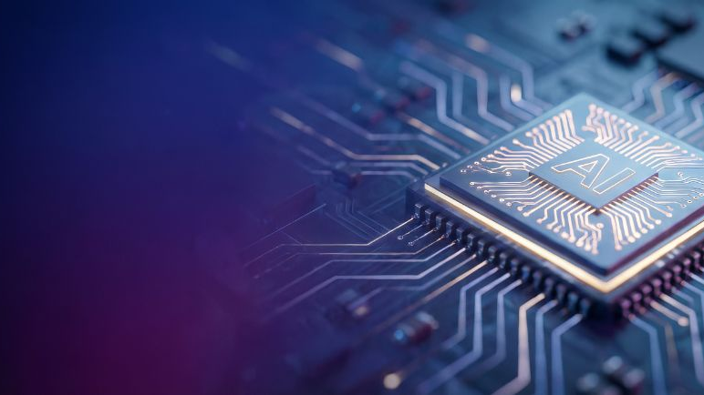




Team Details
Team Name:
Silicon Bakers
SR. NO
ROLE
NAME
ACADEMIC YEAR
1
Team Leader
Yogeshwar S
3rd Year
2
Member 1
Ankam Charam Teja
3rd Year
3
Member 2
—
—
4
Member 3
—
—
A team can have up to 4 members including the team leader. Add rows if necessary.
COLLEGE NAME
Amrita Vishwa Vidyapeetham
TEAM LEADER CONTACT NUMBER
TEAM LEADER EMAIL ADDRESS
+91 94878 40396
yogeshwarsetg@gmail.com

Slide 2


Problem Statement Addressed
Selected: Drift-Sense - AI-Powered Navigation-Error Recovery
DESCRIPTION / DETAILS
A tool must revisit the same site thousands of times a day. Between visits the stage drifts - thermal, vibration, mechanical slack - and lands several pixels off.
It cannot detect this from the image: every die repeats the same layout, so the wrong cell looks identical to the right one.
Template matching fails exactly where layouts are most regular - ~30 correlation peaks within 0.003 of the maximum in a single window.
Consequence: measurements trended over time silently compare two different places on the die.

Slide 3



Idea Description - Describe your Idea/Solution/Prototype
Provide a brief summary of your idea, including the key concept and approach. Provide a brief overview of your solution and how it addresses the problem statement.
KEY CONCEPT & APPROACH
Measure the geometry, do not search it: the ~10x magnification IS the ratio of the two lattice pitches - recovered to 0.10% median.
Spectrally subtract the lattice; what survives (array edges, dropped vias, gate crossings) is the only content carrying absolute identity.
SOLUTION OVERVIEW
Propose cheaply over the frame, then decide at FULL reference resolution - where cells actually differ. Candidates compete.
DRAM and FinFET, 50/50. Classical CV, zero learned weights on the shipped path - a measured choice, not an omission.

Slide 4

Proposed Solution - Describe your Idea/Solution/Prototype
Describe your idea in detail. Include the methodology, technologies involved, and how it addresses the chosen problem statement.
SOLUTION DETAILS
GENERATOR - DRAM grids and FinFET fin/gate fields rendered supersampled, then area-averaged down 10x.
Imaging chain in physical order: edge brightening, astigmatic PSF, scan distortion, charging, shading, sensor noise last.
Independent Poisson+Gaussian noise per capture, search side heavier. Rotation on the reference crop only - rotating the search canvas silently corrupts ground truth.
Ground truth records the true centre AND whether the site is identifiable at all.
PIPELINE - lattice sensor > sub-bin rotation + phase lock > aperiodic residual > NCC proposal + point-source votes > full-res rescoring > decision > sub-pixel refinement > (x, y).

Slide 5
Innovation and Uniqueness
Highlight what makes your idea unique or innovative compared to existing solutions.
KEY INNOVATION
COMPETITIVE ADVANTAGE
Magnification is MEASURED, not swept - a blind 8-point sweep becomes a tight bracket.
Spatial induction: the lattice must prove its own geometry. Catches 13/13 silent failures at zero false alarms - and, sign inverted, predicts solvability (84.6% vs a 50% base rate).
Point-source voting: a dropped via is 1.3% of a footprint-wide correlation and is never proposed. A blob detector votes for the centre instead - recovering those sites with zero losses.
Template matching slides a template and takes the argmax. We measure the geometry, remove the lattice, and let candidates compete.
The system knows what it cannot know: 100% recall on detecting sites that are information-theoretically unidentifiable.
Every idea measured that did NOT pay is documented, not deleted - the centre prior, the phase penalty, the commit gate, a CNN re-ranker, a learned ranker. Five nulls, with the evidence shown.

Slide 6

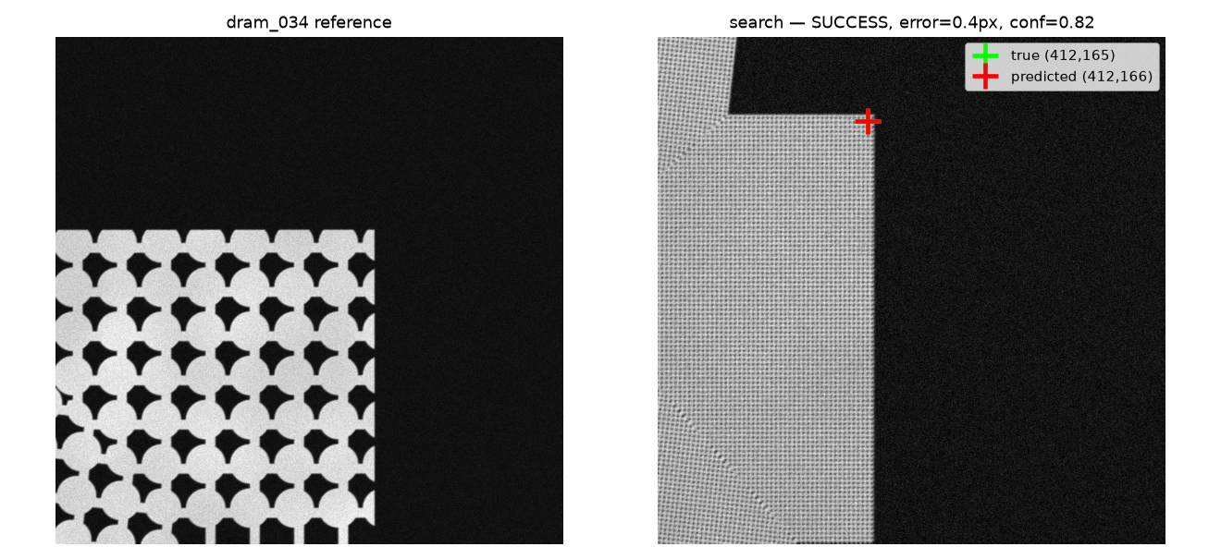
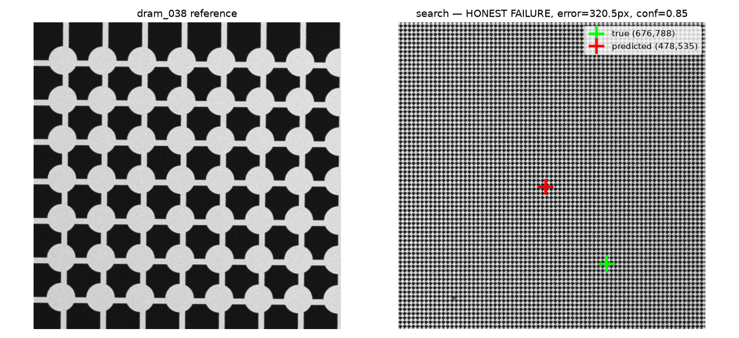


Impact and Benefits
ACCURACY 50.0% of 100 pairs within 15px; 62.5% of the 80 identifiable pairs; 92.5% when a non-periodic landmark is in view.
SPEED 3.1s per 1000x1000 pair on ONE CPU core - no GPU, no weights. GEOMETRY magnification 0.10%, rotation 0.15 deg.
ROBUSTNESS tripling search-image sensor noise costs nothing measurable.
SUCCESS - array corner in view, error 0.4px
HONEST FAILURE - defect-free array interior, error 320.5px at confidence 0.85: wrong AND sure

Slide 7




Technology & Feasibility/Methodology Used
Describe the technologies, methodologies, or tools you plan to use to implement your idea.
IMPLEMENTATION STRATEGY
STACK Python 3.12 - NumPy, OpenCV, SciPy, Pillow. Four packages, no GPU, no torch on the inference path, no weights to download.
HARDWARE every result produced on a single consumer CPU core.
TIMING generation ~200s per 100 pairs; inference 3.1s mean, 7.1s worst case. Shipped model size: 0 bytes.
FEASIBILITY two commands: pip install -r requirements-inference.txt, then python localize.py ref.png search.png.
REPRODUCIBILITY requirements.txt is the complete pip freeze; every figure regenerates from a recorded seed.
Software Architecture
Hardware Components
Development Tools

Slide 8




GitHub & Video Link
GitHub Repository
https://github.com/yogeshwars-cys/Drift-Sense
Prototype / Simulation Video
{Paste your video link here - localize.py on one sample pair}

Slide 9


Research and References
Research Background & Methodology
Briefly describe the research foundation or scientific principles supporting your idea.
Every augmentation, noise model and structural parameter is justified in CITATIONS.md - 15 sections, 2-3 public references each.
Research foundation: a perfectly periodic field is translation-invariant modulo the pitch, so absolute position is not recoverable from pixels. Measured - array corner in view 92.5%, nothing aperiodic 0.0%.
References & Citations
List key papers, articles, or data sources.
Zhang et al. (2019), A Poisson-Gaussian Denoising Dataset with Real Fluorescence Microscopy Images, CVPR - arxiv.org/pdf/1812.10366
US Patent 9,430,457 - Ambiguity Reduction for Image Alignment Applications: NCC over a repeating pattern yields indistinguishable peaks, requiring explicit disambiguation.
US Patent 11,481,922 - Online Navigational Drift Correction for Metrology Measurements: the same thermal-drift navigation problem.

