Slide 1
ROUND 1 REVIEW
AI Frontier Challenge 2026 Round 1 Submission
Team Name
Vizag Mavericks (TEAM-001245)
Team Leader
Amara Yogeswararao
Track
H5. Frontline Health-Worker Companion for Low-Connectivity Areas
Date
18/10/2026

Slide 2
Use Case
Problem Statement
• Frontline Overload & Zero Mobile Reception: India's 10.29 lakh ASHAs and 2.5 lakh ANMs manage up to 28 paper registers [5]; in Andhra Pradesh alone, 1,700+ remote villages (1,000+ in ASR district) have complete zero mobile reception [4].
• Preventable Maternal & Neonatal Mortality: Obstetric haemorrhage causes 47% of maternal deaths [3]; unrecognised newborn danger signs (hypothermia, convulsions, chest indrawing) lead to fatal referral delays [1, 2].
• AI Safety & Frontline Malpractice Risks: General-purpose AI can produce inaccurate or unsafe medical guidance without appropriate safeguards, risking non-prescribing ASHA boundary violations [1], failing offline, and lacking WHO clinical guardrails [6].
Market Opportunity
• Frontline Scale & National Need: 10.29 lakh ASHAs and ~2.5 lakh Sub-Centre ANMs across India serving 1,000 population norms, requiring an intuitive, reliable paramedical companion [1, 2].
• Critical Gap in Existing Systems: Existing state tools (ANMOL, Kilkari) focus on administrative reporting or outbound audio broadcasts; they rely on mobile networks [4] and lack on-demand offline clinical danger triage or strict scope gating [5].
• Sahaaya High-Impact Value: 100% offline, protocol-grounded companion: deterministic danger-sign escalation [1], physician redirects [6], prioritized visits, emergency referral slips, and 2G SMS field sync [4].
Official Protocol Sources & Clinical Evidence Citations:
[1] MoHFW National Guidelines: Revised India MCP Card (2018) & ASHA Modules 6-7
[2] NHM Clinical Guidance: ASHA Induction Module (pp. 51-97) & STOP Diarrhoea
[3] PMC9292773 Study: Obstetric haemorrhage causes 47% maternal deaths in India
[4] TelecomTalk AP Survey: 1,700 remote hamlets (ASR dist) zero cellular signal
[5] New Lines / IJCMPH 2024: Frontline overload (28 paper registers, 23 apps)
[6] WHO AI Safety Standards: Multi-modal AI guidance for clinical decision support

Slide 3
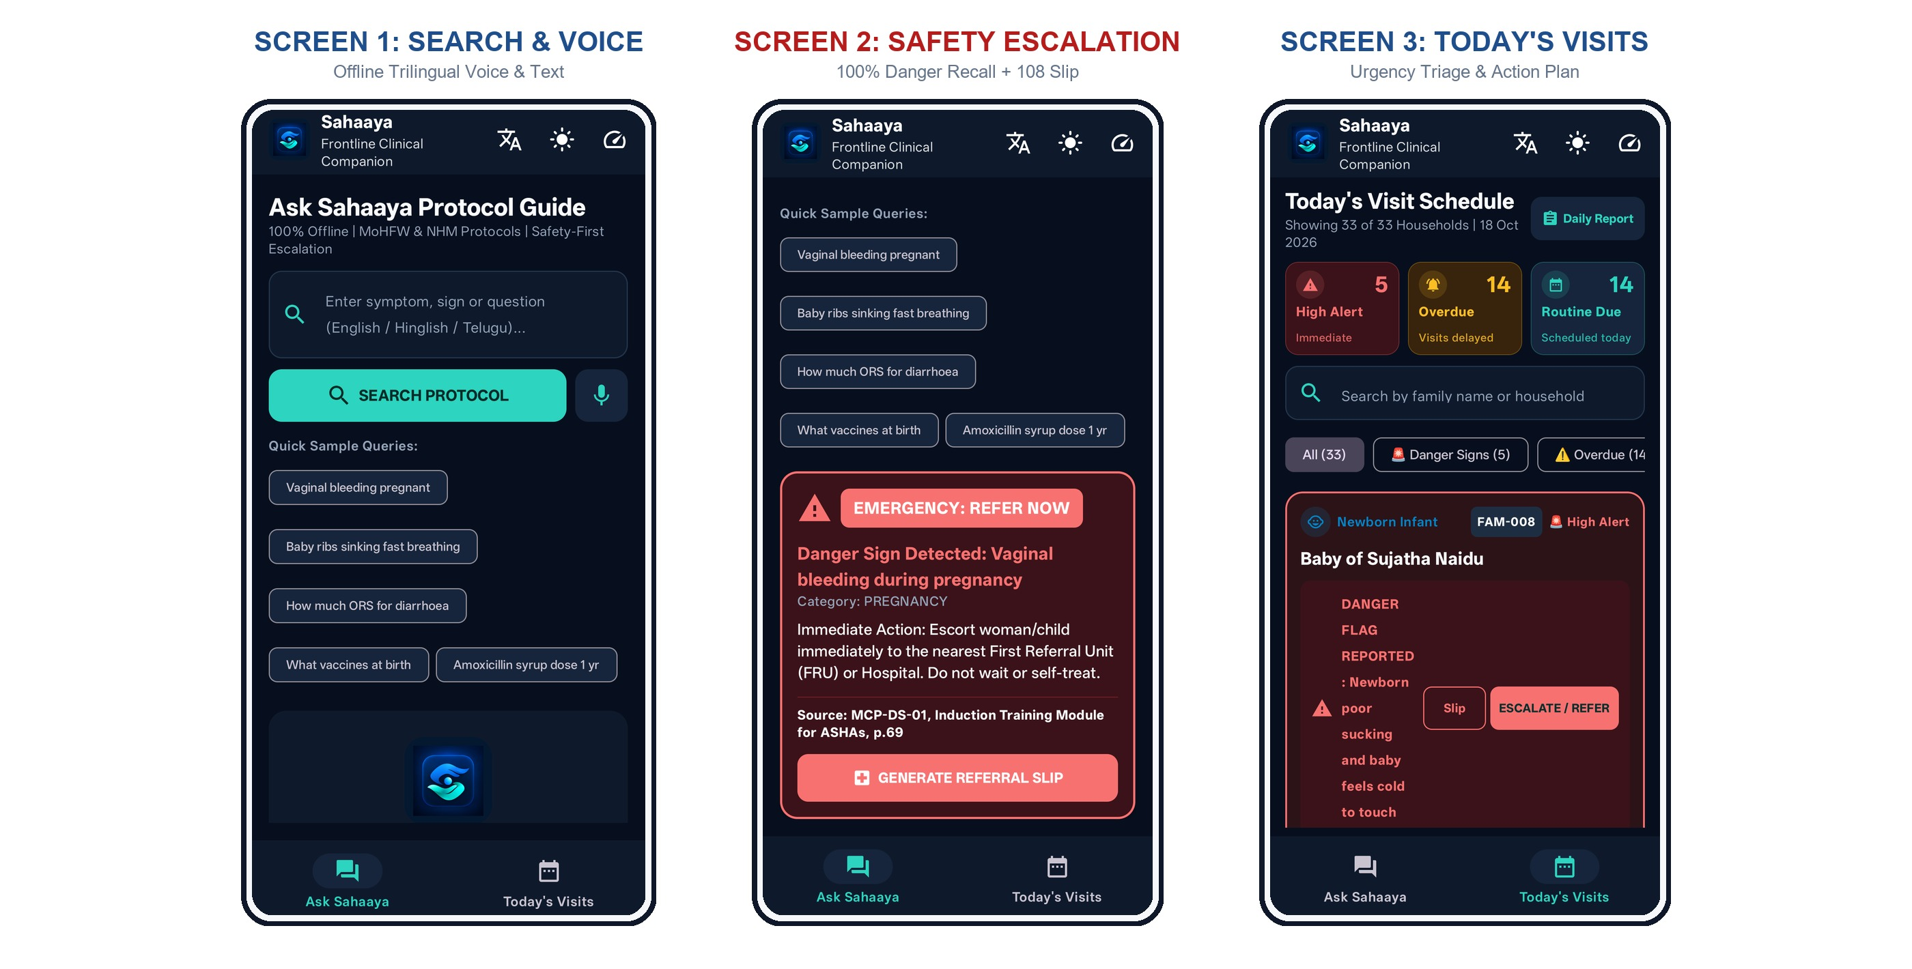
Proposed Solution
Solution Overview
• Deterministic Danger Escalation + Referral Slip: Scans queries across English, Hinglish & Telugu-Latin; triggers red screen (100% recall on 367 phrasings [1, 2]) + 1-tap 108 Emergency Referral Slip.
• Strict Non-Prescribing Scope Gate: Hard-blocks antibiotic & dosage questions with physician redirects, ensuring paramedical workers operate strictly within ASHA guidelines [1, 6].
• Extractive BM25 Protocol Retrieval: Pure Kotlin BM25 matches questions to official MoHFW/NHM manuals [1, 2] with exact document & page citations (0.53 ms latency, 0% hallucination).
• Prioritised Daily Household Action Plan & 2G Sync: Triage ranking: Danger Flags > Overdue Follow-ups > Routine Due Dates + 1-Tap End-of-Day PHC Summary Report (transmissible via 2G SMS [4, 5]).

Slide 4
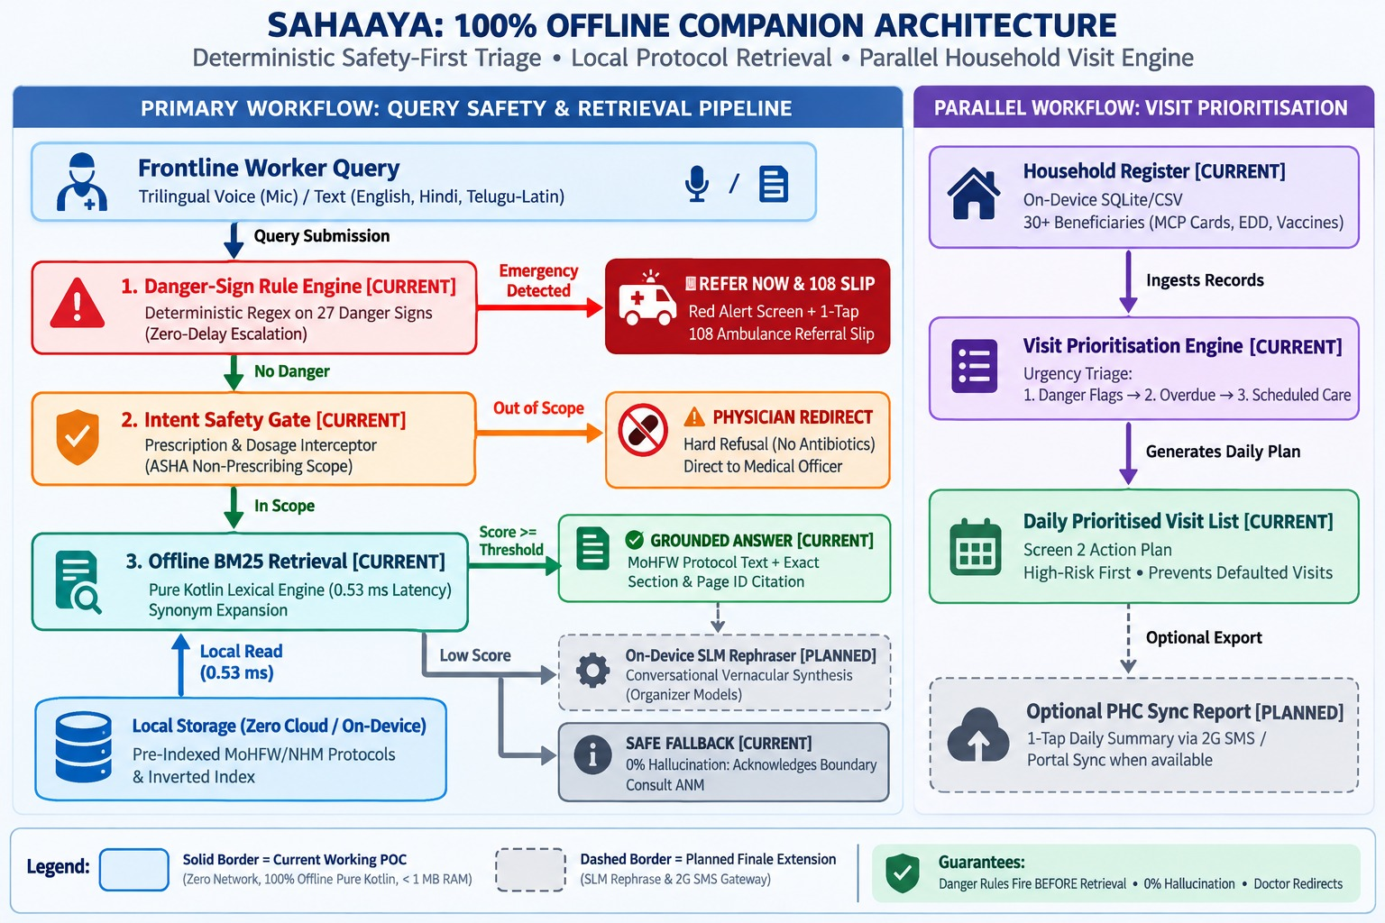
Design Steps & Architecture
Technical Implementation
Architecture Diagram (Safety-First & Parallel Workflows)
1. Input & Speech Recognition: Trilingual voice mic and text (EN, Hindi, Telugu-Latin) for instant frontline accessibility.
2. Danger-Sign Rule Engine [Current]: Deterministic regex on 27 danger signs (100% recall [1, 2]); immediately triggers Red Alert + 108 Referral Slip.
3. Intent Safety Gate [Current]: Intercepts dosage & prescription queries; enforces non-prescribing boundaries [1, 6] with physician redirects.
4. Offline BM25 Retrieval [Current]: Pure Kotlin search over local on-device MoHFW/NHM protocol chunks; exact page citations (0% hallucination).
5. Parallel Household Engine [Current]: Ingests offline household register -> Urgency triage (Danger > Overdue > Scheduled) -> Daily Prioritised Visit List.
6. Planned Extensions [Roadmap]: On-device SLM rephraser for natural conversational synthesis; automated 2G SMS field summary sync.

Slide 5
Challenges & Mitigation
Challenge 1: Zero Connectivity & Mobile Resource Constraints
Problem: Zero mobile reception in rural hamlets and severe RAM/battery constraints on frontline smartphones.
Mitigation: 100% on-device architecture with zero network permissions. Measured across 30 diagnostic queries on physical hardware (OnePlus CPH2613, Android 15 in Airplane Mode) and standalone JVM: APK size is 16.9 MB, median query latency is 0.53 ms (P95: 5.38 ms), and peak heap RAM footprint is < 1 MB.
Challenge 2: Hallucination Risks & Clinical Safety Boundary Violations
Problem: Medical hallucination risks and catastrophic delays from missed pregnancy and newborn danger signs.
Mitigation: Deterministic danger rules execute BEFORE any retrieval logic. Tested across a 367-phrase benchmark derived from 27 MoHFW/NHM emergency signs across English, Hinglish & Telugu-Latin colloquial variants: achieved 100% recall on the test set, triggering instant Red Alerts + 108 referral slips without retrieval delay.
Challenge 3: Vernacular Dialects & Heavy Paper Administrative Friction
Problem: Code-mixed vernacular queries (English, Hinglish, Telugu-Latin) with dialectal variations, typos, and paper register friction.
Mitigation: [Implemented]: Robust phonetic tokenisation, code-mixed synonym mapping, and clinical urgency triage (Danger > Overdue > Scheduled) with 1-tap referral slips. [Planned]: On-device SLM rephraser using pre-cached organizer models and background 2G SMS gateway sync for daily PHC reporting.

Slide 6
Unique Selling Proposition (USP)
Deterministic Safety Pipeline
• Emergency rules execute BEFORE any AI logic.
• 100% danger recall on 367 benchmark phrasings [1, 2].
• Hard non-prescribing gate [6] with extractive, source-cited responses & 108 slips.
100% Offline & Measured Speed
• Zero network permissions (built for [4]).
• OnePlus CPH2613 (Airplane Mode):
- Median Query Latency: 0.53 ms
- P95 Benchmark Latency: 5.38 ms
- APK: 16.9 MB | Peak RAM: < 1 MB
• Runs natively without SIM or signal.
Prioritised Household Action Plan
• Transforms 30+ static paper records into an actionable daily visit list.
• Ensures high-risk pregnant women & unimmunized infants are visited first (Danger > Overdue > Scheduled).
• [Planned Extension: 2G SMS sync].
Competitive Advantage Summary
• Integrated Frontline Triad: Sahaaya uniquely unifies three essential frontline capabilities in one zero-network app: deterministic emergency danger escalation [1], offline MoHFW/NHM protocol retrieval with page citations [2], and clinical urgency-ranked household visit planning.
• Clinically Safe & Field-Hardened: Guarantees paramedical boundary safety via hard physician redirects on prescriptions [1, 6], operates 100% offline in zero-connectivity hamlets [4], and delivers instant 1-tap referral slips to eliminate fatal transport delays [3].

Slide 7
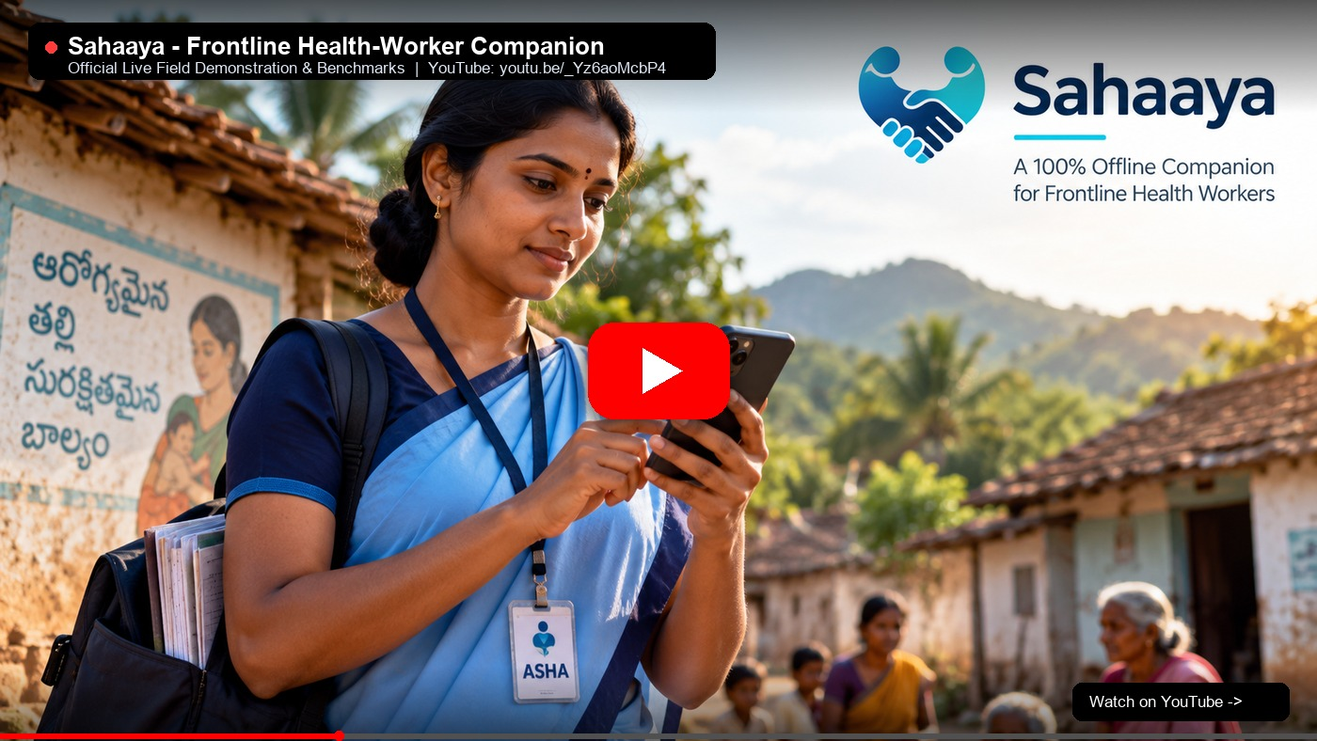
Demo & POC Video
Live Demonstration
YouTube Demo: https://youtu.be/_Yz6aoMcbP4
GitHub: github.com/yogeswar142/Sahaaya
APK: v1.0.0 (16.9 MB)
Working Offline Android POC | Grounded on MoHFW/NHM Protocols [1-3] | 100% Danger Recall | Zero Cloud Permissions

