Slide 1

SMART INDIA HACKATHON 2026
TITLE PAGE
Problem Statement ID – SIH26145
Problem Statement Title – AI-Based Detection of Cyber Threats in Unidirectional IP Traffic
Theme – Blockchain & Cybersecurity
PS Category – Software
Organization – National Technical Research Organisation (NTRO)
Team ID – 145428
Team Name – ThreatNexus
Product: TRINETRA (त्रिनेत्र)
Passive AI threat detection for data-diode / unidirectional monitoring enclaves

Slide 2
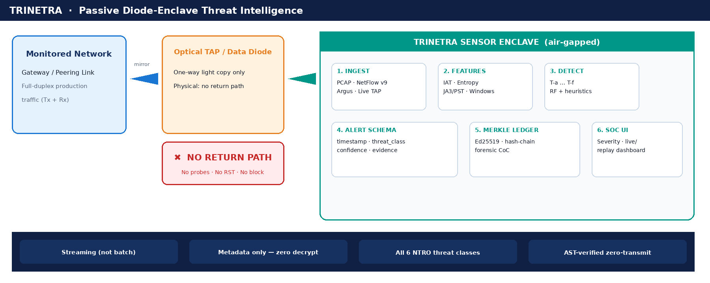
IDEA TITLE
ThreatNexus
TRINETRA — streaming AI/ML in a receive-only enclave: labelled alerts + confidence + evidence + forensic ledger (no return path, no decrypt, no inline block).

Slide 3
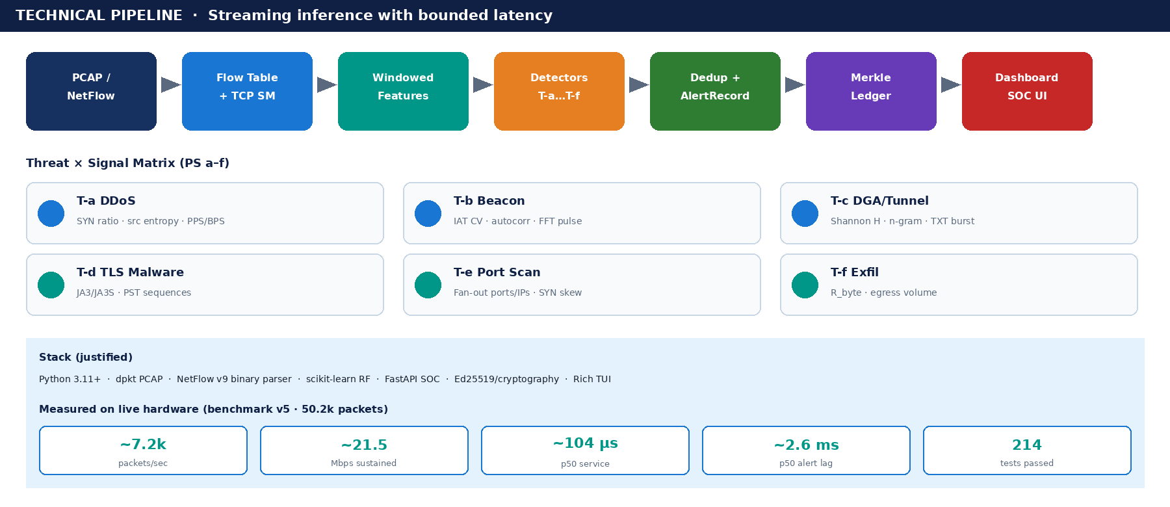
TECHNICAL APPROACH
ThreatNexus
Ingest → FlowTable → Windowed features → Detectors T-a…T-f → NTRO alert schema → Ed25519 Merkle ledger → SOC dashboard. Prototype in repo.

Slide 4
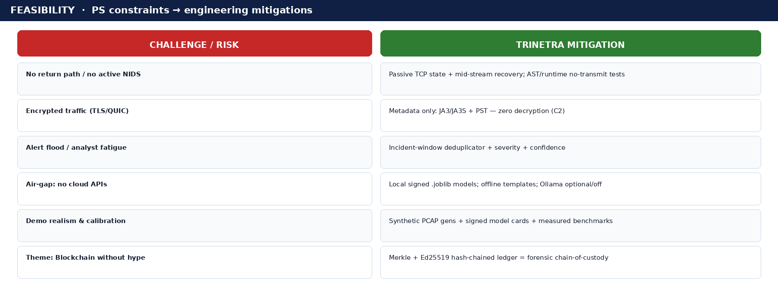
FEASIBILITY AND VIABILITY
ThreatNexus
Feasible today as a working Python prototype: signed models, 214 tests, measured throughput — risks mapped to mitigations below.

Slide 5
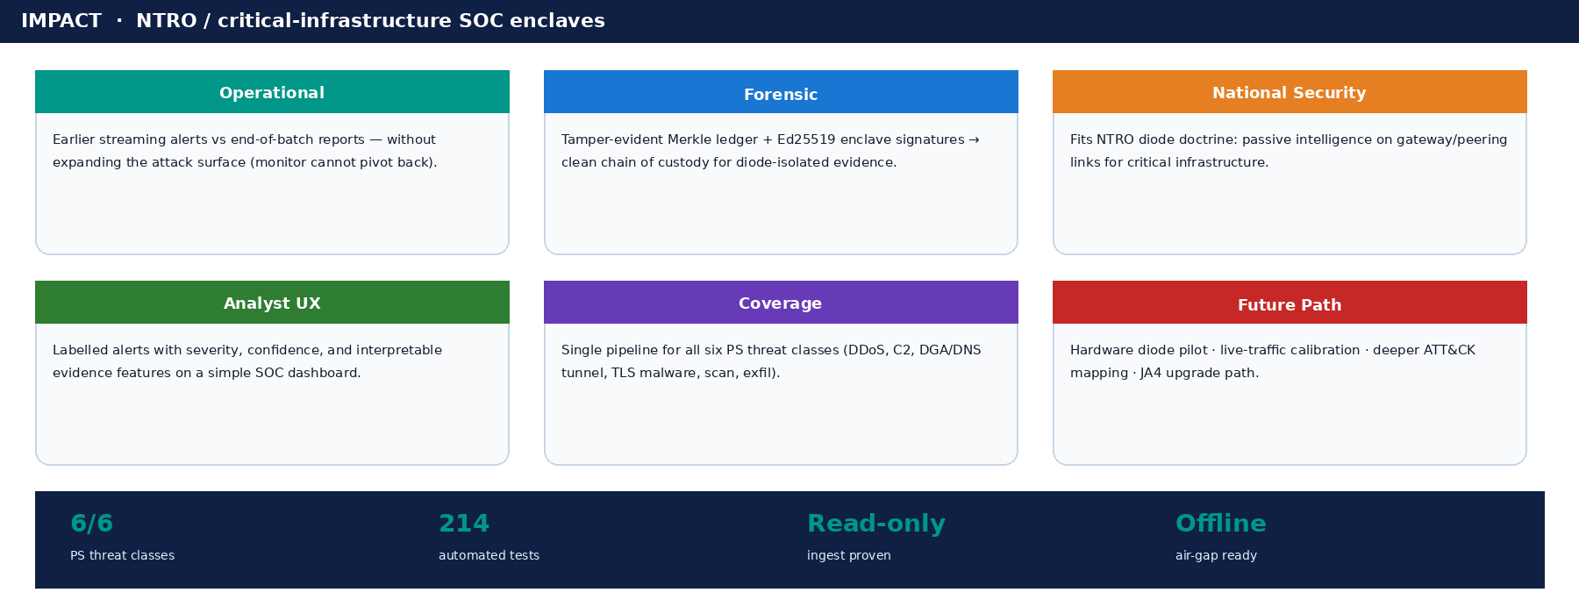
IMPACT AND BENEFITS
ThreatNexus
Beneficiary: NTRO / critical-infra SOC analysts monitoring diode-isolated gateway & peering links.

Slide 6
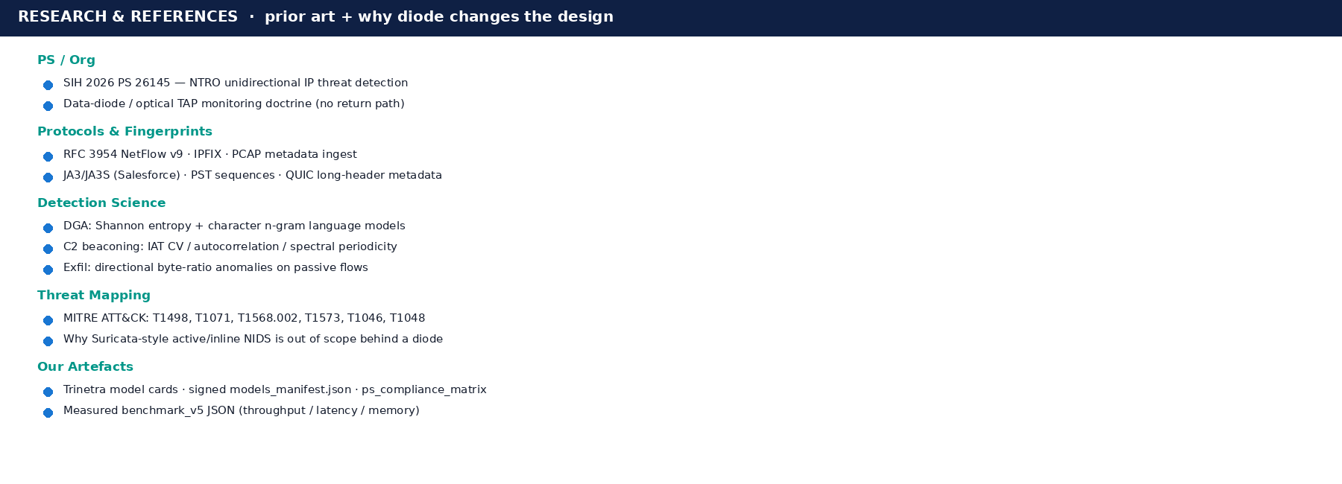
RESEARCH AND REFERENCES
ThreatNexus

