Slide 1

Autonomous Vehicle lane change prediction and obstacle prediction Using Q-Learning
Autonomous vehicle lane change and obstacle prediction using q-learning
Phase-1 Review-2
TAG #2
Guide: Dr .Remya Krishnan P
SL NO.​ | Roll No​ | Name​
1​ | ​CB.EN.U4CSE20148 | ​POLA YOGESWARA REDDY
2​ | ​CB.EN.U4CSE20649 | ​PUTTA JYOTHSNA
3​ | ​CB.EN.U4CSE20653 | ​SANGIREDDY SAINATH REDDY
4​ | ​CB.EN.U4CSE20644 | ​SUCHAL PALADUGU
Team#G029

Slide 2
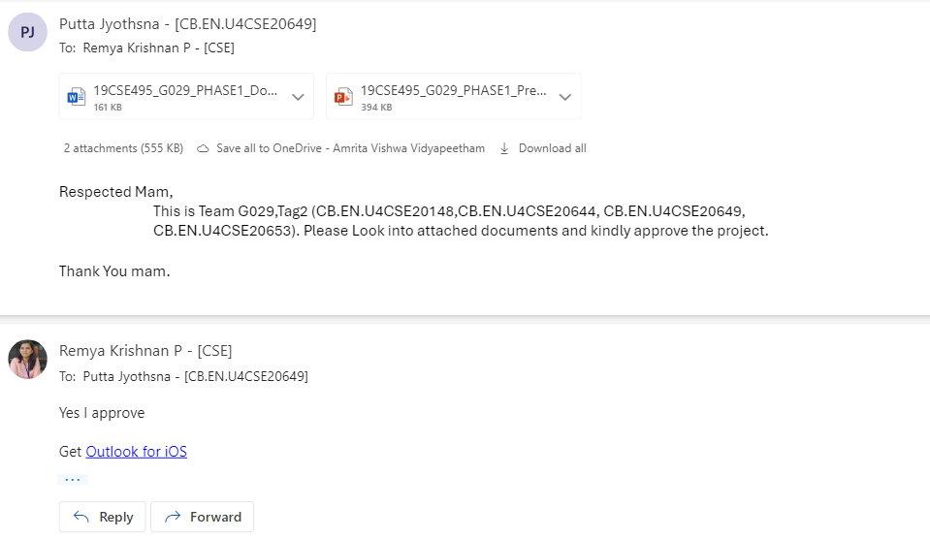
Guide Approval
Autonomous vehicle lane change and obstacle prediction using q-learning
Team#G029

Slide 3
Problem statement
Autonomous vehicle lane change and obstacle prediction using q-learning
To develop an optimal algorithm for lane change prediction and obstacle prediction in Autonomous vehicles.
Team#G029

Slide 4
Autonomous vehicle lane change and obstacle prediction using q-learning
Literature Survey
Ref# Year | Title | Problem Statement | Advantages | Disadvantages
[1] 2020 | Autonomous Driving using Safe Reinforcement Learning by Incorporating a Regret-based Human Lane-Changing Decision Mode | how to enable autonomous vehicles (AVs) to safely and efficiently maneuver in mixed traffic where human-driven vehicles also exist. | By using the regret-based human decision-making model, the number of collisions in training and testing is reduced to zero, while maintaining training accuracy The proposed framework for SafeRL integrates a safety supervisor that uses the predicted human decisions to check if an action is safe, resulting in zero collisions during training and implementation | The deep Q-network tested on autonomous driving in two-lane traffic still resulted in collisions, indicating that the AVs struggle to estimate the intentions of other vehicles. The RL algorithm needs to reset the simulation whenever collisions happen, causing unstable training
[2] 2021 | Q-learning with Long-term Action-space Shaping to Model Complex Behavior for Autonomous Lane Changes | optimization of complex behavior for autonomous lane changes in autonomous driving applications. | The algorithm is compared to reward shaping and Lagrangian methods in the application of high-level decision making in autonomous driving, considering rules for safety, keeping right, and comfort. The method is trained and evaluated in both an open-source simulator (SUMO) and the real-world HighD dataset, demonstrating its real-world applicability and simplicity | The results of reward shaping and Lagrangian optimization suffer from high variance and are not consistent The VPE agent, which uses the Valid Policy Extraction method, shows the worst performance among the agents considered, staying on the initial lane with no applied lane changes over all training runs.
Team#G029

Slide 5
Autonomous vehicle lane change and obstacle prediction using q-learning
ance compared to the baseline algorithm in challenging scenarios, even with a relatively low number of training steps.
Ref# Year | Title | Problem Statement | Advantages | Disadvantages
[3] 2022 | Developing a Deep Q-Learning and Neural Network Framework for Trajectory Planning | a deep Q-learning and neural network framework for trajectory planning in autonomous vehicles, addressing the challenges of generalization and safety assurance in path learning techniques. | The approach can investigate a path in an unknown situation with small iterations and faster convergence to an ideal strategic plan, outperforming traditional techniques. The proposed deep Q-learning and neural network framework enhances the driving performance of autonomous vehicles in terms of energy consumption, ensuring smooth trajectories and reduced jerk. | further research is needed to optimize the performance in dynamic environments The Q-table used in Q-learning expands quickly due to the need to contain all possible state-action combinations, which can lead to computational complexity
[4] 2022 | A New Approach for Tactical Decision Making in Lane Changing: Sample Efficient Deep Q Learning with a Safety Feedback Reward | The novel deployment of the state of art Q learning method, namely Rainbow DQN, that uses a new safety driven rewarding scheme to tackle the issues in an dynamic and uncertain simulation environment. | The proposed algorithm shows superior performance compared to the baseline algorithm in challenging scenarios, even with a relatively low number of training steps. deployment of the Rainbow DQN method with a safety-driven rewarding scheme improves the performance and sample efficiency of the agent. | Further research is needed to optimize the performance in dynamic environments
Team#G029

Slide 6
Autonomous vehicle lane change and obstacle prediction using q-learning
Ref# Year | Title | Problem Statement | Advantages | Disadvantages
[5] 2020 | Combining Planning and Deep Reinforcement Learning in Tactical Decision Making for Autonomous Driving | develop a framework that combines planning and learning techniques to improve the performance of autonomous driving systems in making tactical decisions | The combination of Monte Carlo tree search (MCTS) and deep reinforcement learning in the framework allows for better performance and improved decision-making capabilities in diverse and complex driving environments The framework is flexible and can be easily adapted to different driving scenarios, making it versatile for various autonomous driving applications | The framework relies on a continuous state space and a not directly observable state, which may introduce challenges in certain scenarios The framework requires training samples, although it is more sample efficient compared to a Deep Q-Network (DQN) agent applied to a similar case
[6] 2021 | Decision making of autonomous vehicles in lane change scenarios: Deep reinforcement learning approaches with risk awareness | to address the risk-insensitive decision-making problem in lane change scenarios for autonomous vehicles (AVs) and to develop a strategy with the minimum expected risk for safe driving. | The probabilistic-model based risk assessment method considers position uncertainty and distance-based safety metrics, providing a comprehensive evaluation of driving risk The risk-aware decision-making algorithm, based on deep reinforcement learning, generates robust safe driving strategies and outperforms previous methods in terms of driving performance. | The framework should Improve the sampling probability function for vehicle position initialization to enhance the accuracy of risk assessment and decision-making. Optimize the hyper-parameters in the proposed methods to further enhance the performance and efficiency of the decision-making framework.
Team#G029

Slide 7
Autonomous Vehicle Path Planning Using Q-Learning​​
Novelty of the solution
Developing a more efficient reward function for the model to train
Combining Q-learning models for good results
Implementing smooth lane change algorithms without collisions
Team#G029

Slide 8
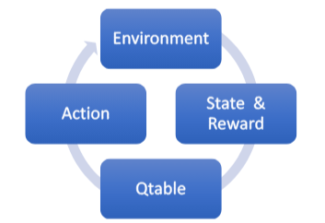
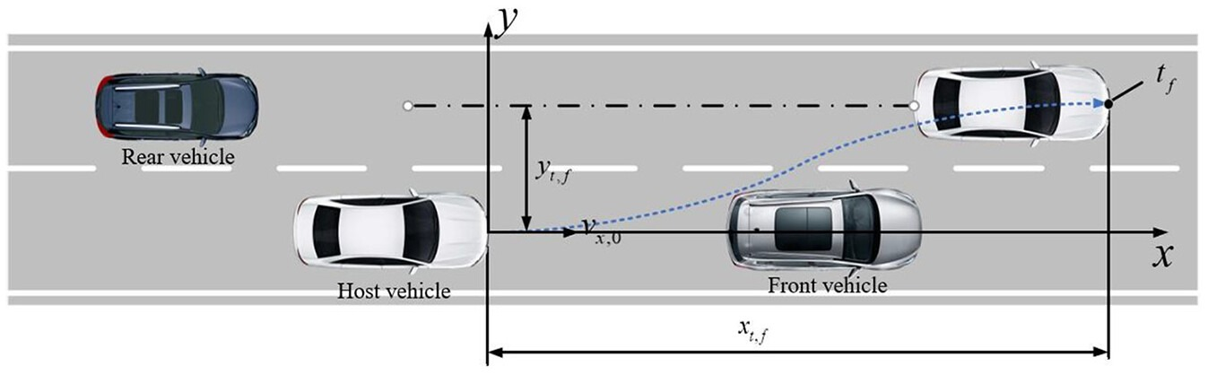
Methodology
Autonomous vehicle lane change and obstacle prediction using q-learning
Input data
Q-learning Model
Refine the policy
Lane change/Obstacle prediction
Team#G029

Slide 9
Autonomous vehicle lane change and obstacle prediction using q-learning
Data Flow diagram
State
Preprocess
Replay Buffer
Neural Network
Reward/penalty
Q-values
Update q-values
Environment
Action space
Train Neural network
Team#G029

Slide 10
Autonomous Vehicle Path Planning Using Q-Learning​​
ALGORITHM
Implementation of DQN
1) Environment Setup:
Step 1: Package Installation
Installs necessary packages: python-opengl, ffmpeg, pyvirtualdisplay, highway-env, stable_baselines3, gym.
Step 2: Virtual Display Configuration
Creates a virtual display using pyvirtualdisplay for rendering without a physical display.
Step 3: Animation Utility Functions
Defines utility functions for creating and displaying animations.
create_anim(frames, dpi, fps): Creates a matplotlib animation from a list of frames.
display_anim(frames, dpi, fps): Displays the animation using display.HTML.
save_anim(frames, filename, dpi, fps): Saves the animation to a file.
Team#G029

Slide 11
Autonomous Vehicle Path Planning Using Q-Learning​​
2) Environment Registration:
Step 4: Register Custom Environments
Registers custom environments from the highway_env package using highway_env.register_highway_envs().
3) Training DQN Model:
Step 5: Initialize
Initialize the Q-network with random weights.
Create a target Q-network with the same architecture and weights as the main Q-network.
Initialize a replay buffer to store experiences (state, action, reward, next state, done).
Set hyperparameters: discount factor (γ), exploration parameters (ϵ).
Step 6: Collect Initial Data
Populate the replay buffer with initial experiences by taking random actions.
Team#G029

Slide 12
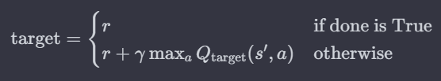
Autonomous Vehicle Path Planning Using Q-Learning​​
Step 7: Training Loop
For each episode:
Reset the environment and observe the initial state (s0 ).
While the episode is not done:
Exploration-Exploitation Tradeoff:
With probability ϵ, select a random action (exploration).
Otherwise, select the action with the highest Q-value from the Q-network (exploitation).
Execute the selected action and observe the next state (s′), reward (r), and whether the episode is done (done).
Store the experience (s,a,r,s′,done) in the replay buffer.
Sample a mini-batch of experiences from the replay buffer.
Compute Temporal Difference (TD) Target:
Team#G029

Slide 13

Autonomous Vehicle Path Planning Using Q-Learning​​
Update the Q-network by minimizing the mean squared TD error:
Update the target Q-network weights every C steps
Step 8: Repeat
Continue training for a specified number of episodes or until convergence.
Team#G029

Slide 14
Autonomous Vehicle Path Planning Using Q-Learning​​
4) Visualization:
Step 9: Visualize Training Logs with Tensorboard
Uses the %tensorboard magic command to launch Tensorboard and visualize training logs.
Step 10: Load Trained Model and Collect Frames
Loads the trained DQN model using DQN.load().
Collects frames during the model's interaction with the environment.
Closes the environment.
Step 11: Display Animation
Checks if frames are available and have a valid shape.
Creates an animation and displays it using display.HTML if conditions are met.
Team#G029

Slide 15
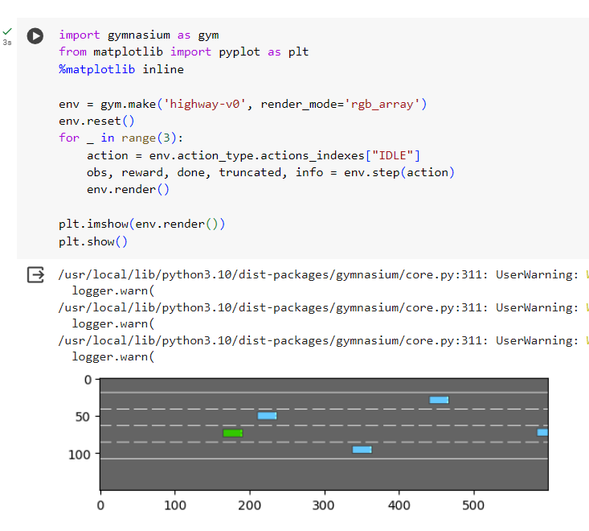
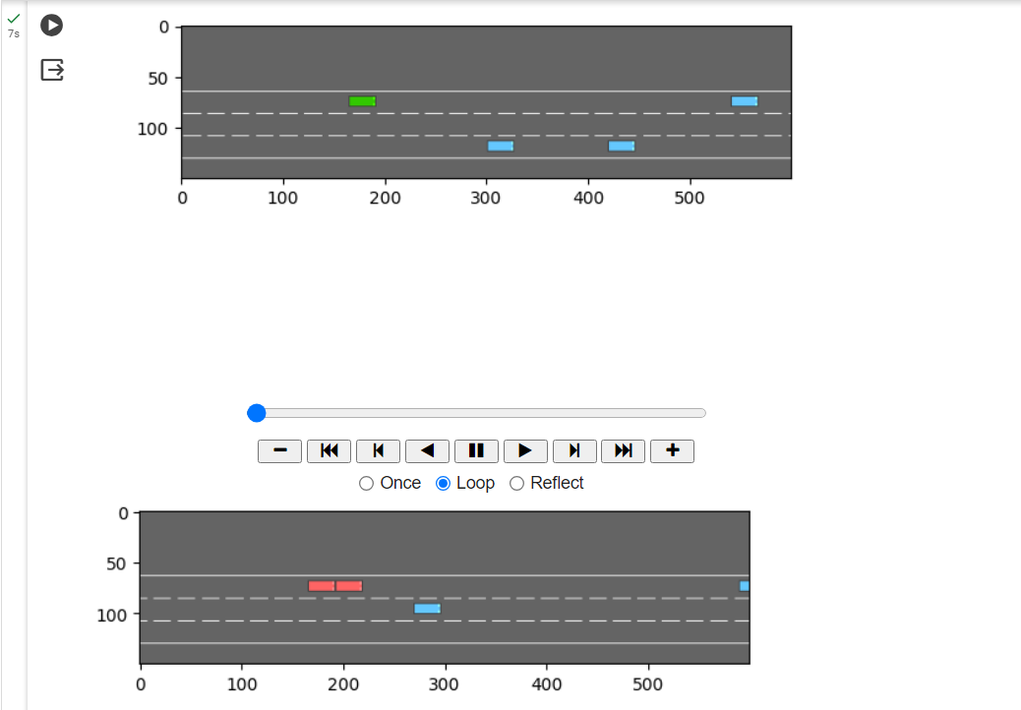
Prototype of 30% Design
Autonomous vehicle lane change and obstacle prediction using q-learning
Setting up environment:
Environment Before Training:
Team#G029

Slide 16
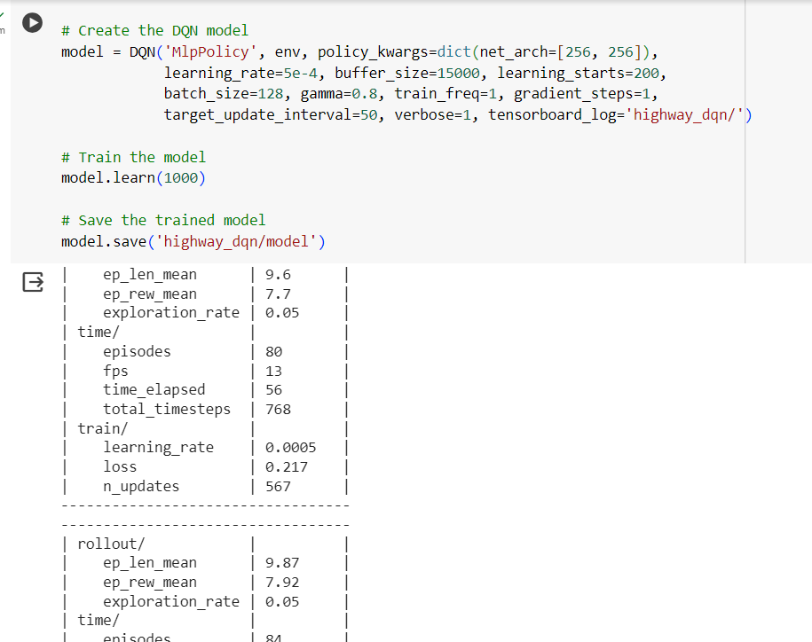
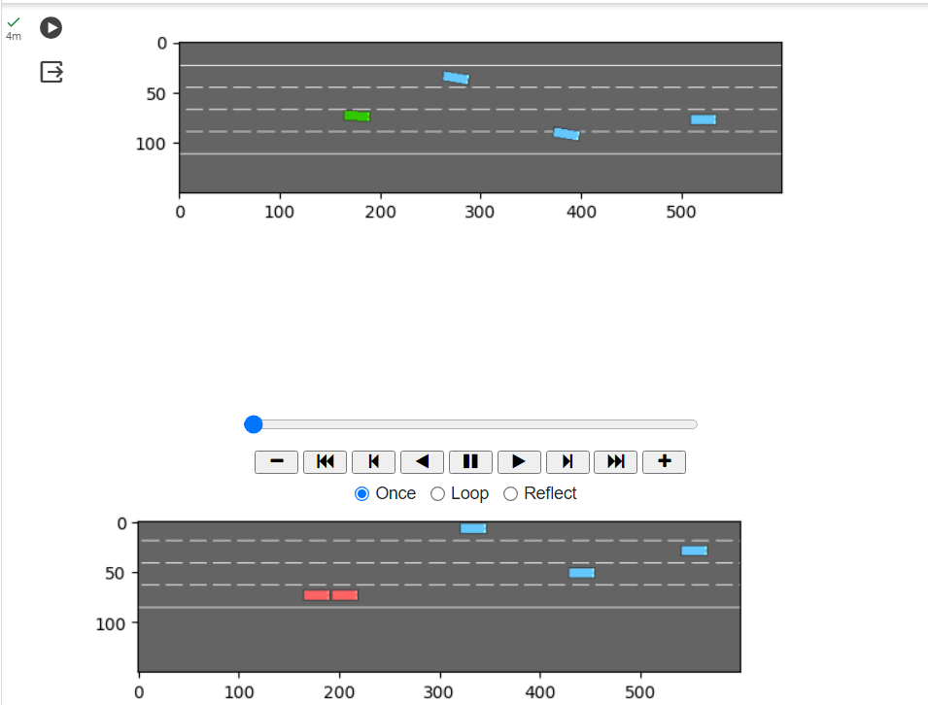
Prototype of 30% Design
Autonomous vehicle lane change and obstacle prediction using q-learning
Training Results:
Testing Results:
Team#G029

Slide 17
Work Plan and Publication Plan For Phase-2
Autonomous vehicle lane change and obstacle prediction using q-learning
Implementing Double DQN algorithm
Integrating Rainbow DQN with other DQN variant
1
2
Implement an efficient algorithm for obstacle avoidance
Implementation of Rainbow DQN algorithm
Team#G029

Slide 18
Autonomous vehicle lane change and obstacle prediction using q-learning
Abstract of the Article for publication
This article presents a novel approach for enhancing road safety through the integration of lane change detection and obstacle prediction using Q-learning algorithms. The study focuses on the development of an optimal algorithm leveraging Rainbow DQN and other Q-learning variants. The proposed methodology utilizes reinforcement learning techniques to efficiently analyse and predict dynamic changes in traffic scenarios.
Our research addresses the challenges associated with real-time decision-making in autonomous vehicles by employing Q-learning to capture complex interactions during lane changes. The integration of Rainbow DQN enhances the learning process by combining various Q-learning algorithms, resulting in a more robust and adaptive model. The algorithm's effectiveness is evaluated through extensive simulations and real-world scenarios, demonstrating its ability to accurately detect lane changes and predict potential obstacles.
The findings suggest that our approach significantly improves the accuracy and reliability of lane change detection and obstacle prediction compared to traditional methods. Furthermore, the versatility of Rainbow DQN allows for seamless adaptation to diverse driving conditions and environments. This research contributes to the advancement of intelligent transportation systems, laying the groundwork for safer and more efficient autonomous navigation
Team#G029

Slide 19
Autonomous Vehicle Path Planning Using Q-Learning​​
Individual Contribution of Student
..
SI.NO | NAME | ROLL NUMNBER | CONTRIBUTION
1 | POLA YOGESWARA REDDY | CB.EN.U4CSE20148 | Model training, Model testing
2 | PALADUGU SUCHAL | CB.EN.U4CSE20644 | System design, Algorithm
3 | PUTTA JYOTHSNA | CB.EN.U4CSE20649 | Model training, Model testing
4 | SANGIREDDY SAINATH REDDY | CB.EN.U4CSE20653 | Algorithm, Reward function
Team#G029

Slide 20
References
Autonomous Vehicle Path Planning Using Q-Learning​​
[1] Chen, D., Jiang, L., Wang, Y., & Li, Z. (2020, July). Autonomous driving using safe reinforcement learning by incorporating a regret-based human lane-changing decision model. In 2020 American Control Conference (ACC) (pp. 4355-4361). IEEE.
[2]Kalweit, G., Huegle, M., Werling, M., & Boedecker, J. (2021, September). Q-learning with Long-term Action-space Shaping to Model Complex Behavior for Autonomous Lane Changes. In 2021 IEEE/RSJ International Conference on Intelligent Robots and Systems (IROS) (pp. 5641-5648). IEEE.
[3]Kosuru, V. S. R., & Venkitaraman, A. K. (2022). Developing a deep Q-learning and neural network framework for trajectory planning. European Journal of Engineering and Technology Research, 7(6), 148-157.
[4]Yavas, U., Kumbasar, T., & Ure, N. K. (2020, October). A new approach for tactical decision making in lane changing: Sample efficient deep Q learning with a safety feedback reward. In 2020 IEEE Intelligent Vehicles Symposium (IV) (pp. 1156-1161). IEEE.
[5]Hoel, C. J., Driggs-Campbell, K., Wolff, K., Laine, L., & Kochenderfer, M. J. (2019). Combining planning and deep reinforcement learning in tactical decision making for autonomous driving. IEEE transactions on intelligent vehicles, 5(2), 294-305.
[6]Li, G., Yang, Y., Li, S., Qu, X., Lyu, N., & Li, S. E. (2022). Decision making of autonomous vehicles in lane change scenarios: Deep reinforcement learning approaches with risk awareness. Transportation research part C: emerging technologies, 134, 103452.
[7]Das, L., & Won, M. (2021, May). D-ACC: Dynamic Adaptive Cruise Control for Highways with Ramps Based on Deep Q-Learning. In 2021 IEEE International Conference on Robotics and Automation (ICRA) (pp. 1572-1578). IEEE.
[8]Quek, Y. T., Koh, L. L., Koh, N. T., Tso, W. A., & Woo, W. L. (2021). Deep Q‐network implementation for simulated autonomous vehicle control. IET Intelligent Transport Systems, 15(7), 875-885
Team#G029

