Slide 1
Pixelated image detection and correction
- B Y T R I A D
Pixelated images occur when an image is compressed or resized too much, resulting in a loss of detail and a blocky appearance. This presentation explores the fascinating world of pixelated image detection and correction.

Slide 2

What is a Pixelated Image?
Pixelated images are characterized by the visible square blocks that make up the image. This occurs when the number of pixels is insufficient to represent the original image detail.
Loss of Detail
The visible blockiness obscures fine lines, textures, and subtle color variations.
Blurred Appearance
The edges of objects become fuzzy and unclear, diminishing the overall visual quality.
Compression Artifacts
Pixelation is often a byproduct of image compression algorithms, especially when high compression ratios are used.

Slide 3
Techniques for Pixel Identification
Edge Detection
Algorithms can identify edges that are too sharp or jagged, indicating pixelation.
Texture Analysis
Analyzing the spatial distribution of pixel values can reveal patterns indicative of pixelation.
Frequency Domain Analysis
Transforming the image into the frequency domain can highlight high-frequency components associated with pixelation.

Slide 4
Unique Idea Brief
This solution leverages a combination of image processing techniques and machine learning to detect and correct pixelation in images. The unique aspects include:
Combining HOG and LBP for feature extraction: This provides a robust representation of the images.
Using SMOTE for class imbalance: Ensures that the model is well-trained even with an imbalanced dataset.
Data augmentation: Increases the diversity of the dataset, improving the model's ability to generalize.
Advanced pixelation correction techniques: Such as bilateral filtering and cubic interpolation, which help in enhancing the image quality.
Comprehensive evaluation: Using various metrics and cross-validation ensures the model's reliability.

Slide 5
Key Functionalities
1
2
Data augmentation
3
4
5
Pixelation evaluation
Feature extraction
Pixelation detection
Pixelation correction
It includes feature extraction, data augmentation, image pixelation correction, and model training using Logistic Regression.

Slide 6
Features offered
Image Pixelation Detection
Automatically identifies pixelated images.
Advanced Feature Extraction
Uses HOG and LBP for image analysis.
Data Augmentation Techniques
Enhances training data with flips, rotations, and blurs.
Class Imbalance Handling
Balances datasets using SMOTE.
Machine Learning Model
Classifies images as pixelated or non-pixelated.
Pixelation Correction
Improves pixelated images using filtering and interpolation.
Evaluation Metrics
Provides F1 score, precision, and recall.
Visual Feedback
Displays corrected images for assessment.

Slide 7
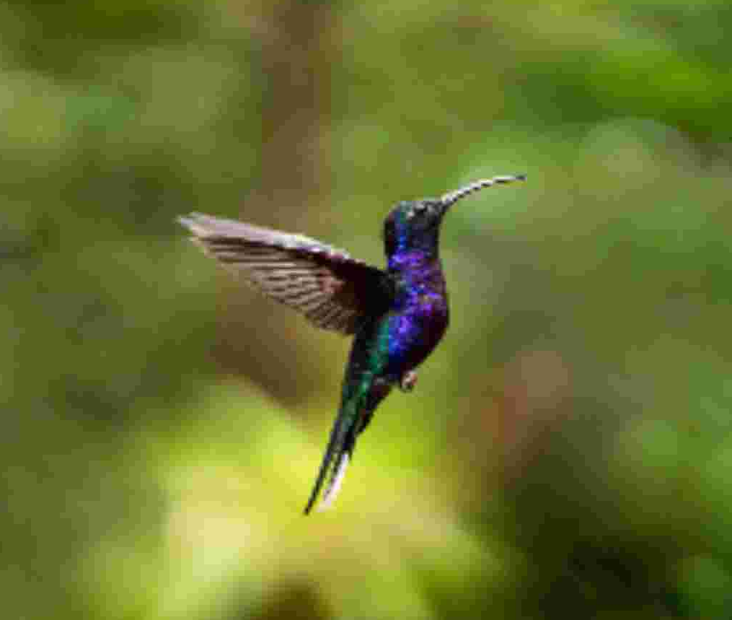
Process flow
1. Initialization and Setup
Define paths to image directories.
Set the test image path.
2. Image Decimation and Pixelation Check
Load test image.
Decimate image and calculate mean absolute difference.
Determine pixelation extent.
3. Image Loading and Data Augmentation
Load images from non-pixelated and pixelated directories.
Apply augmentations: horizontal flip, rotations, Gaussian blur.
4. Feature Extraction
Extract HOG and LBP features.
Combine features into a single vector for each image.

Slide 8
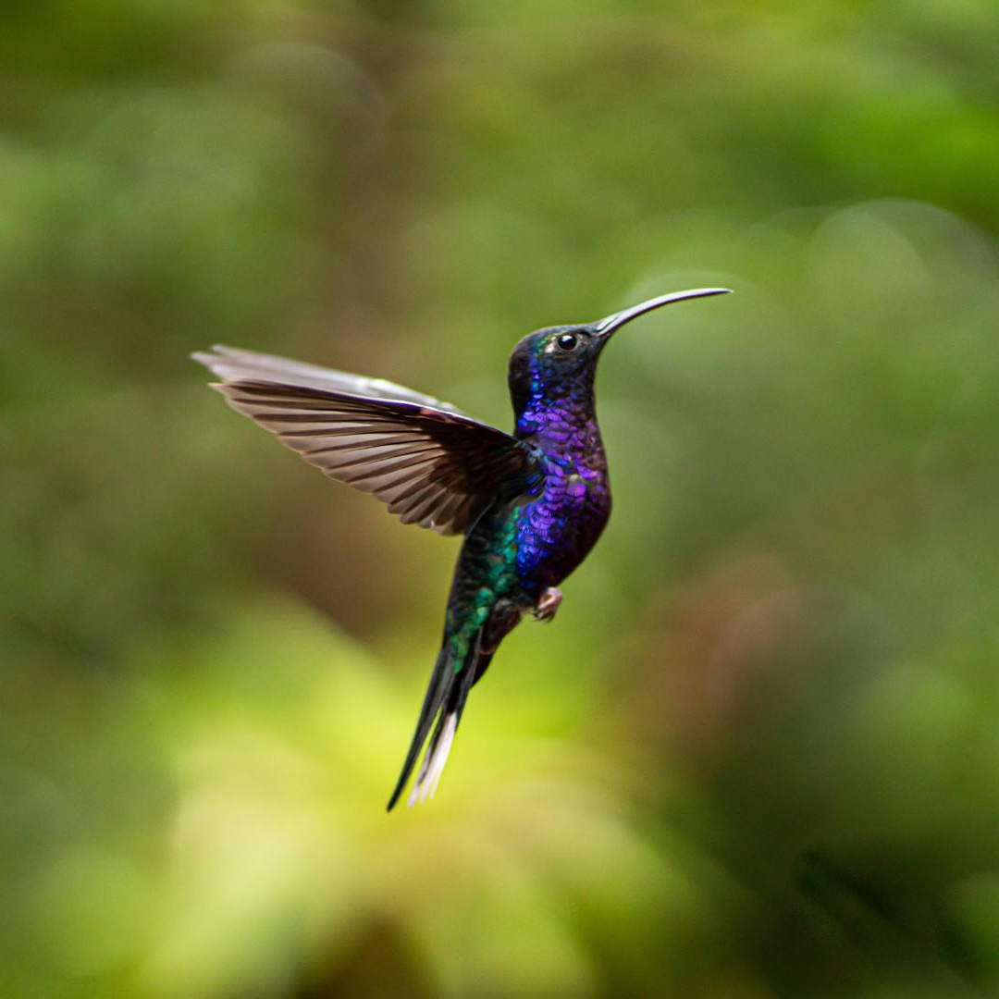
5. Data Preprocessing
Shuffle images and labels.
Split into training and testing sets.
Scale features using standard scaling.
6. Handling Class Imbalance
Use SMOTE to balance the training set.
7. Model Training and Evaluation
Train logistic regression model with cross-validation.
Save model and scaler.
Predict and evaluate on test set (F1 score, precision, recall).
8. Pixelation Correction Evaluation
Generate pixelated versions of the test image.
Apply bilateral filtering and cubic interpolation.
Display corrected images for assessment.

Slide 9
DETECTION: test_image=cv2.imread(test_image_path) dec2A = test_image[::2, ::2] dec2B = test_image[1::2, 1::2]
# Get mean of absolute difference diff2 = cv2.absdiff(dec2A,dec2B) mean2 = np.mean(diff2) print('Mean absdiff image:', mean2) threshold = 5.0
# This value may need to be adjusted based on your specific use case if mean2 > threshold:
Difference Calculation:
cv2.absdiff(dec2A, dec2B) computes the absolute pixel-wise difference between the
two downsampled images.np.mean(diff2) calculates the average of these differences.
Threshold Check:
A threshold of 5.0 is defined.
The code checks if the mean difference
(mean2) exceeds this threshold, if it is more than threshold then it is a pixelated image and it gets corrected.If less than threshold then it is detected as a non pixelated image
NOTE:There isn't a universally fixed threshold value for detecting pixelation in images because the optimal threshold can vary based on factors like image resolution, content, and quality. However, you can determine a specific threshold value for your use case through empirical testing and analysis.

Slide 10
CORRECTION: filtered_image =cv2.bilateralFilter(image, d=9, sigmaColor=75, sigmaSpace=75)
# Resize the image using cubic interpolation height, width = image.shape[:2] new_height, new_width = height * scale_factor, width * scale_factor corrected_image = cv2.resize(filtered_image, (new_width, new_height),
Bilateral Filter:
cv2.bilateralFilter(image, d=9, sigmaColor=75, sigmaSpace=75)
applies a bilateral filter to the input image. This filter smooths the image while preserving edges, using parameters like:
d: Diameter of the pixel neighborhood.
sigmaColor: Filter sigma in color space (controls how much colors can vary).
sigmaSpace: Filter sigma in coordinate space (controls the spatial extent).
This code effectively reduces noise while enhancing edge definition before resizing the image.

Slide 11
Technologies Used
Technologies | Purpose | Functions
Python | Core language for implementing the solution.
OpenCV | Image processing and manipulation | Reading images, resizing, color space conversion, feature extraction, and image augmentations.
Scikit-learn | Machine learning and data preprocessing. | logistic regression model, train-test splitting, scaling features, cross-validation,F1 score, precision, recall.
Imbalanced-learn | Handling class imbalance. | SMOTE to balance the dataset.
Scikit-image | Image feature extraction. | Local Binary Pattern (LBP) for texture feature extraction.

Slide 12
Technologies | Purpose | Features
Joblib | Model persistence. | Saving and loading trained models and scalers.
Matplotlib | Data visualization. | Displaying images for visual assessment.
NumPy | Numerical computations. | Handling arrays, histograms, and mathematical operations.
OS Module | Interacting with the operating system. | Handling directory and file paths.
Shuffling Utility | Randomizing dataset order. | Shuffling images and labels to ensure randomness in data.

Slide 13
Team Members and Contributions
K.SAI ANANYA
Checked image pixelation.
Augmented images by flipping, rotating, blurring.
Corrected pixelated images.
Tested correction methods.
Integrated project components
C.YOGESWAR REDDY
Planned the project.
Extracted image features.
Trained and evaluated the model.
Processed and balanced data.
M.SREEJA
Managed model saving/loading.
Automated image processing.
Assisted with model testing.
Set up the coding environment.
Presentation

Slide 14

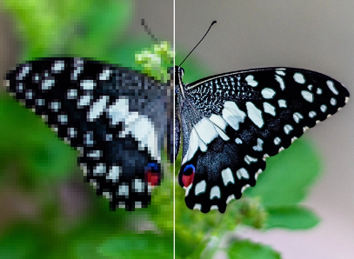
In this project, we successfully developed a robust pipeline for detecting and correcting pixelation in images using advanced image processing techniques and machine learning.
The results demonstrated in improving image quality, showcasing the potential for further applications in areas such as image restoration and enhancement.
Overall, this project highlights the intersection of image processing and machine learning, providing valuable insights into enhancing visual data quality.
Conclusion

Slide 15
Thank You

