Slide 1

ALVA’S INSTITUTE OF ENGINEERING & TECHNOLOGY Shobhavana Campus, Mijar, Moodabidri, Mangalore Taluk, D.K – 574225 Phone: 08258-262725, Fax: 08258-262726
Department of Computer Science and Engineering
PROJECT ON
Intelligent Regression Analytics:
A Scalable Machine Learning Pipeline for Predictive Modelling
GUIDED BY:
Mrs. Deeksha M
Senior Assistant Professor
DEPARTMENT OF CSE
AIET, MIJAR, MOODBIDRI
PRESENTED BY:
Samay Shetty (4AL22CS143)
Sherin (4AL22CS140)
Shashank DP (4AL22CS137)
Sumanth L (4AL22CS169)

Slide 2

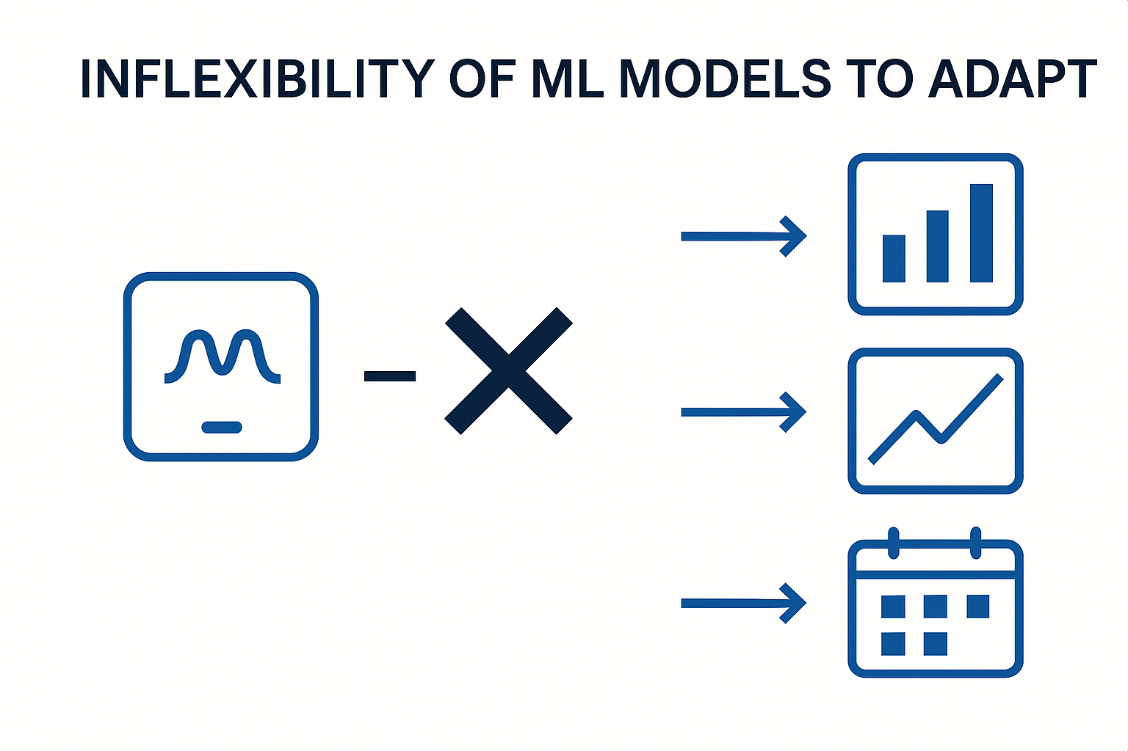
ALVA’S INSTITUTE OF ENGINEERING AND TECHNOLOGY
MIJAR, MOODBIDRI D.K. -574225 ,MANGALORE,KARNATAKA
INTRODUCTION
Earlier Approach:
-Manual feature selection, model training, and tuning.
-Time-consuming, error-prone, and non-scalable.
Challenges with Traditional Methods:
-Struggle to handle large, complex datasets.
-Less adaptation to different prediction problems.
Need for Change:
-Demand for intelligent model management.
Department of CSE | Intelligent Regression Analytics | 2

Slide 3
ALVA’S INSTITUTE OF ENGINEERING AND TECHNOLOGY
MIJAR, MOODBIDRI D.K. -574225 ,MANGALORE,KARNATAKA
PROJECT MOTIVATION
Why Intelligent Regression Analytics?
Real-world regression problems need scalable and flexible solutions.
Manual model building is time-consuming and error-prone.
Need for pipelines that handle:
1.Different datasets
2.Different algorithms (tree-based, linear, deep learning)
3.Different evaluation strategies
Automating hyperparameter tuning and model saving improves efficiency.
Future-proof: easy to extend with new models or techniques.
Department of CSE | Intelligent Regression Analytics | 4

Slide 4
ALVA’S INSTITUTE OF ENGINEERING AND TECHNOLOGY
MIJAR, MOODBIDRI D.K. -574225 ,MANGALORE,KARNATAKA
PROBLEM STATEMENT
Building predictive regression models manually is slow, inefficient, and hard to scale across diverse datasets and use-cases.
Solution: Develop an intelligent, modular, and scalable machine learning pipeline that automates data preprocessing, model training, evaluation, tuning, and deployment for regression tasks.
Department of CSE | Intelligent Regression Analytics | 7

Slide 5
ALVA’S INSTITUTE OF ENGINEERING AND TECHNOLOGY
MIJAR, MOODBIDRI D.K. -574225 ,MANGALORE,KARNATAKA
LITERATURE SURVEY
Paper Reference | Methods/Technique | Research Contributions | Research Gaps
[1] | Random Forest Algorithm for Feature Selection and Regression. | Handled non-linearly separable data and automatically determined number of clusters. | Struggles with very small clusters and closely packed clusters.
[2] | Ensemble Learning (GBM, LightGBM, XGBoost) for Predictive Maintenance | Enhanced prediction of machine failures in pipeline systems; demonstrated efficiency with hyperparameter tuning | Generalizability to other domains not validated
[3] | LSTM-based Deep Learning for Sentiment Analysis | Improved sentiment classification across English and Spanish datasets using deep learning | Limited to binary classification; challenges with multilingual scalability
Department of CSE | Intelligent Regression Analytics | 9

Slide 6
ALVA’S INSTITUTE OF ENGINEERING AND TECHNOLOGY
MIJAR, MOODBIDRI D.K. -574225 ,MANGALORE,KARNATAKA
Paper Reference | Methods/Technique | Research Contributions | Research Gaps
[4] | Least Squares Linear Regression | Provided fundamental understanding and solution for fitting data to straight lines | Limited to simple linear models; lacks discussion on regularization and practical application
[5] | Elastic Net-based clustering | Handled non-linearly separable data and automatically determined number of clusters | Struggles with very small clusters and closely packed clusters
Department of CSE | Intelligent Regression Analytics | 10

Slide 7
ALVA’S INSTITUTE OF ENGINEERING AND TECHNOLOGY
MIJAR, MOODBIDRI D.K. -574225 , MANGALORE,KARNATAKA
METHODOLOGY
Step 1. Data Preprocessing
Dropping irrelevant columns.
Feature scaling (StandardScaler).
Handling missing features during prediction.
Step 3. Training Strategy
Data split: Train/Test (80/20).
EarlyStopping and ModelCheckpoint for LSTM models.
Ensemble learning for better generalization.
Step 2. Model Architecture
Supports various model types:
Random Forest Regressor
Gradient Boosting Regressor
Linear Regression
ElasticNet
LSTM Neural Network (for deep learning cases)
Ensemble techniques: combining multiple models for better predictions.
Step 4. Hyperparameter Tuning
Performed GridSearchCV for RF, GB, and ElasticNet.
Selected the best model configurations.
Step 5. Evaluation Metrics
Mean Squared Error (MSE)
Mean Absolute Error (MAE)
R-squared (R²)
Step 6. Model Persistence
for Future Predictions
Department of CSE | Intelligent Regression Analytics | 11

Slide 8
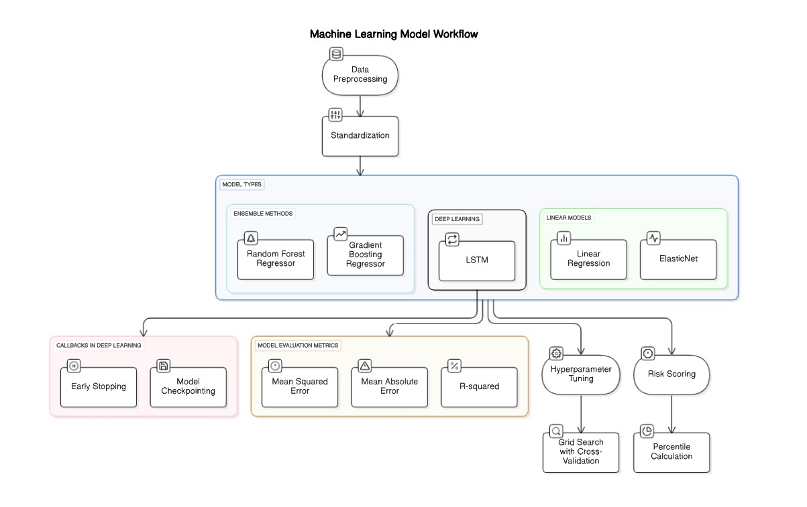
ALVA’S INSTITUTE OF ENGINEERING AND TECHNOLOGY
MIJAR, MOODBIDRI D.K. -574225 , MANGALORE,KARNATAKA
Department of CSE | Intelligent Regression Analytics | 13

Slide 9
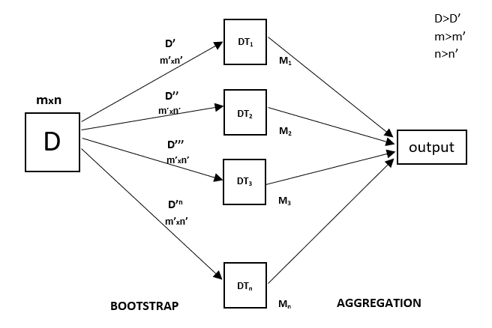
ALVA’S INSTITUTE OF ENGINEERING AND TECHNOLOGY
MIJAR, MOODBIDRI D.K. -574225 , MANGALORE,KARNATAKA
Algorithms Used:
Random Forest Regressor
Advantage:
Handles non-linear data very well.
Reduces overfitting compared to a single decision tree.
Works with missing values and maintains accuracy.
Disadvantage:
Can be slower and more complex
(many trees = slower predictions).
Harder to interpret compared to a single tree.
Use when:
You have complex datasets with many features and
non-linear relationships.
Department of CSE | Intelligent Regression Analytics | 13

Slide 10
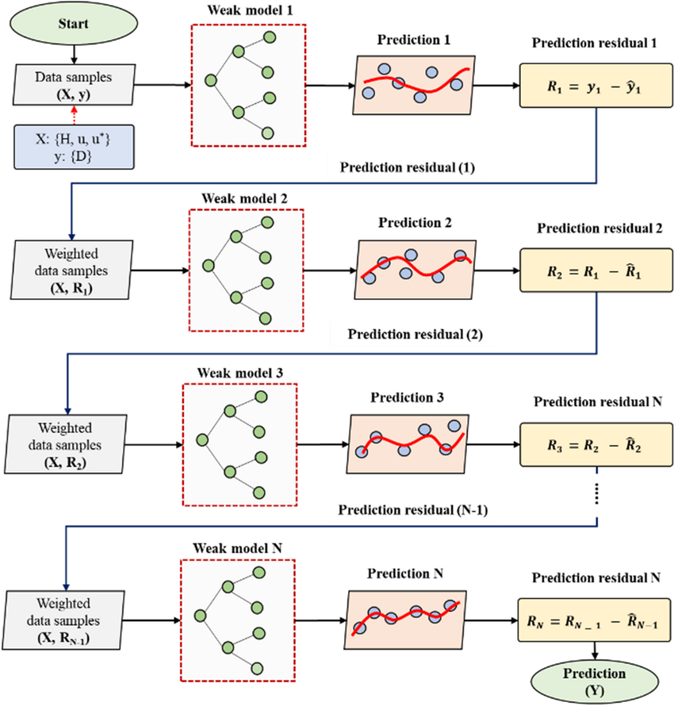
ALVA’S INSTITUTE OF ENGINEERING AND TECHNOLOGY
MIJAR, MOODBIDRI D.K. -574225 , MANGALORE,KARNATAKA
2. Gradient Boosting Regressor
Advantage:
Very powerful for structured/tabular data.
Can capture complex patterns and relationships.
Disadvantage:
Prone to overfitting if not tuned properly.
Takes longer to train than Random Forest.
Use when:
You want top model performance and can
spend time on tuning.
Department of CSE | Intelligent Regression Analytics | 13

Slide 11
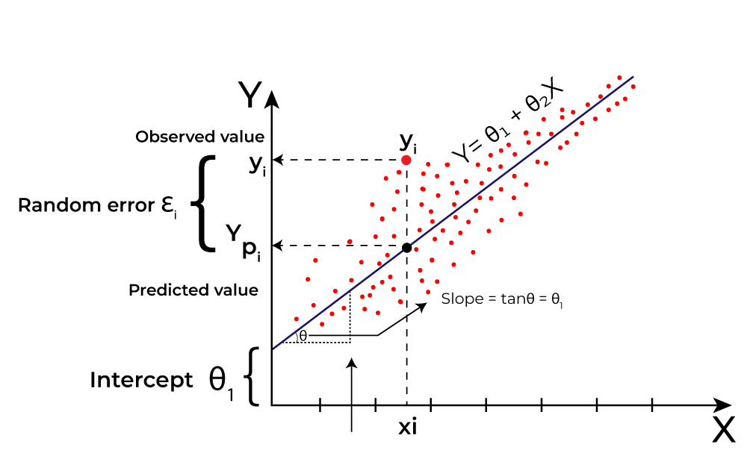
ALVA’S INSTITUTE OF ENGINEERING AND TECHNOLOGY
MIJAR, MOODBIDRI D.K. -574225 , MANGALORE,KARNATAKA
3. Linear Regression (Linear Model)
Advantage:
Very simple and easy to interpret.
Fast training, even with large datasets.
Disadvantage:
Assumes linear relationship
(won't perform well on non-linear data).
Sensitive to outliers.
Use when:
You have a linear relationship between features
and target, and you want simplicity and speed.
Department of CSE | Intelligent Regression Analytics | 13

Slide 12
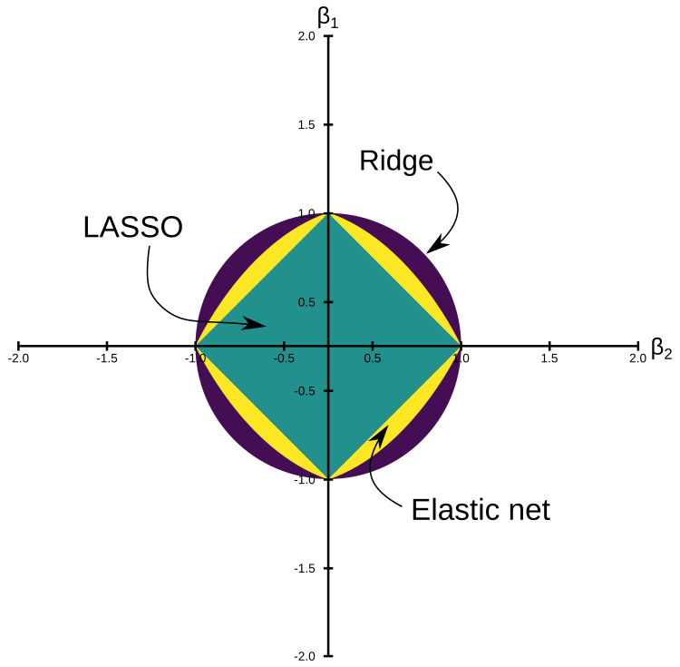
ALVA’S INSTITUTE OF ENGINEERING AND TECHNOLOGY
MIJAR, MOODBIDRI D.K. -574225 , MANGALORE,KARNATAKA
4. ElasticNet (Linear Model)
Advantage:
Mixes L1 (Lasso) and L2 (Ridge) regularization → handles multicollinearity and feature selection.
Good balance between feature reduction and stability.
Disadvantage:
Requires tuning two hyperparameters
(more complicated than just Lasso or Ridge).
Use when:
You have many correlated features
and want a more robust, regularized linear model.
Department of CSE | Intelligent Regression Analytics | 13

Slide 13
ALVA’S INSTITUTE OF ENGINEERING AND TECHNOLOGY
MIJAR, MOODBIDRI D.K. -574225 , MANGALORE,KARNATAKA
5. LSTM (Deep Learning)
Advantage:
Best for time series data or sequential data
(e.g., stock prices, weather prediction).
Remembers long-term dependencies.
Disadvantage:
Requires a lot of data and computation.
Hard to interpret compared to simple models.
Use when:
Your data has a temporal (time-based) nature
Department of CSE | Intelligent Regression Analytics | 13

Slide 14
ALVA’S INSTITUTE OF ENGINEERING AND TECHNOLOGY
MIJAR, MOODBIDRI D.K. -574225 ,MANGALORE,KARNATAKA
PROJECT OUTCOMES
Developed a modular, scalable pipeline for regression analytics.
Ensemble models achieved strong performance with low error rates.
Pipeline capable of predicting and scoring risk levels.
Feature importance analysis enabled insights for tree-based models.
System ready for real-world use cases like:
-Healthcare demand prediction
-Financial forecasting
-Resource allocation modeling
Department of CSE | Intelligent Regression Analytics | 14

Slide 15
ALVA’S INSTITUTE OF ENGINEERING AND TECHNOLOGY
MIJAR, MOODBIDRI D.K. -574225 ,MANGALORE,KARNATAKA
REFERENCES
[1]Jitendra Kumar Jaiswal and Rita Samikannu, "Application of Random Forest Algorithm on Feature Subset Selection and Classification and Regression," in Proceedings of the 2016 World Congress on Computing and Communication Technologies (WCCCT), 2016, pp. 65–71. DOI: 10.1109/WCCCT.2016.25.
[2]Norshakirah Aziz, Jafreezal Jaafar, Emelia Akashah Patah Akhir, Mohd Hilmi Hasan, Izzatdin Abdul Aziz, and Ahmad Naufal Che Abas, "A Study on Gradient Boosting Algorithms for Development of AI Monitoring and Prediction Systems,“ in Proceedings of the 2020 International Conference on Computational Intelligence (ICCI), Universiti Teknologi PETRONAS (UTP), Malaysia, 2020. DOI: 10.1109/ICCI51257.2020.9247671
[3]Baidya Nath Saha and Apurbalal Senapati, "Long Short Term Memory (LSTM) based Deep Learning for Sentiment Analysis of English and Spanish Data," in Proceedings of the 2020 International Conference on Computational Performance Evaluation (ComPE), Shillong, India, 2020. DOI: 10.1109/ComPE49325.2020.9200005
[4] Mengyu Huang, "Theory and Implementation of Linear Regression,“ in Proceedings of the 2020 International Conference on Computer Vision, Image and Deep Learning (CVIDL), 2020. DOI: 10.1109/CVIDL51233.2020.00-99
[5] Chun-Wei Tsai, Tsung-Hsien Lin, and Ming-Chao Chiang,"Automatic Elastic Net Clustering Algorithm," in Proceedings of the 2014 IEEE International Conference on Systems, Man, and Cybernetics (SMC), San Diego, USA, 2014, pp. 2768–2773. DOI: 10.1109/SMC.2014.485.
Department of CSE | Intelligent Regression Analytics | 16

Slide 16
ALVA’S INSTITUTE OF ENGINEERING AND TECHNOLOGY
MIJAR, MOODBIDRI D.K. -574225 ,MANGALORE,KARNATAKA
THANK YOU
Department of CSE | Intelligent Regression Analytics | 17

