Slide 1
開發環境建置==> Anaconda
4070E092

Slide 2
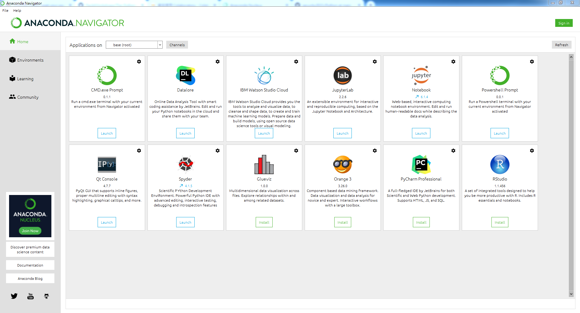
Anaconda Navigator

Slide 3
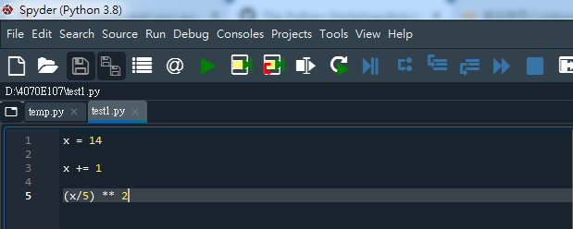
Anaconda Spyder

Slide 4
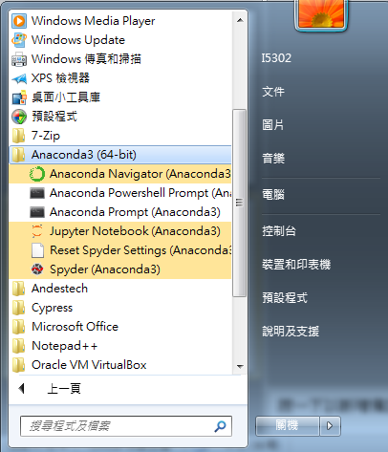
Anaconda Location File

Slide 5
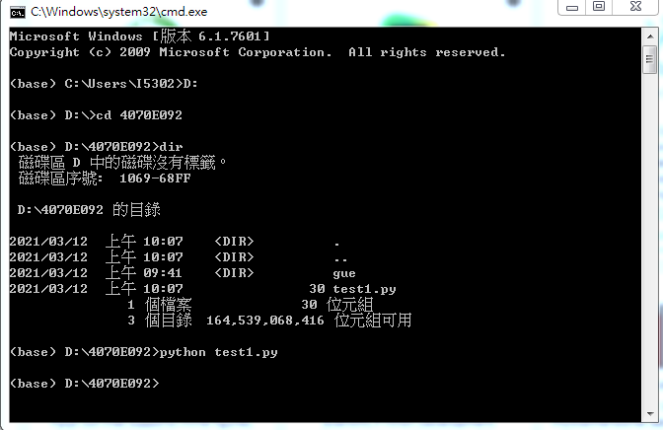
Anaconda cmd

