Slide 1
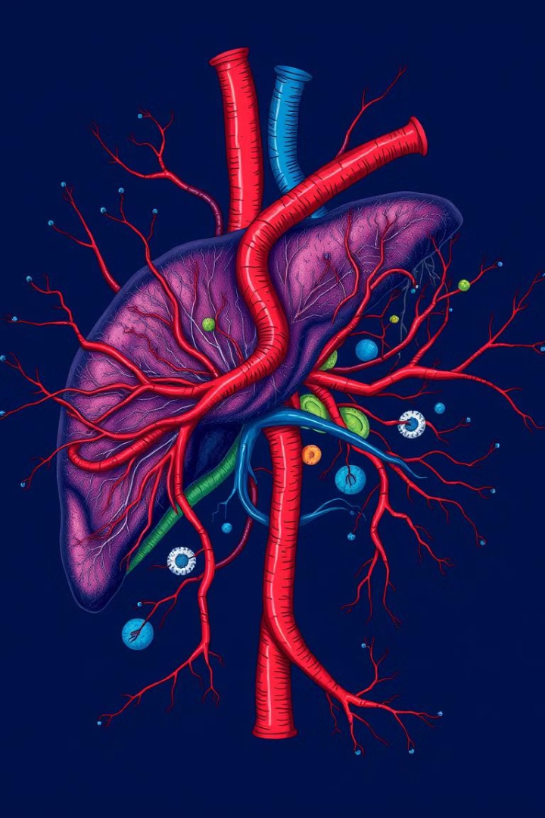
PROJECT P475 – GROUP 6
CLASSIFICATION-LIVER DISEASE
This presentation explores the prediction of liver disease using machine learning techniques. We will delve into the nature of liver disease, its risk factors, common conditions, diagnosis, and the importance of early detection.

Slide 2
MENTORS AND TEAM MEMBERS
MENTORS | TEAM MEMBERS Abhishek Prajapati Yogendra Jangid Thogunta Prathyusha Mr. Jayesh Ramkrushna Gadhari Ms. Dipali Rajendra Mahajan Ram Gupta Omkar Arun Indolikar

Slide 3
TABLE OF CONTENTS
Objective and Dataset Overview
Exploratory Data Analysis and Insights
Data Pre-processing
Clustering Models and Evaluation
Comparative Analysis and Model Selection
Model Deployment
Conclusion

Slide 4
OBJECTIVE AND DATASET OVERVIEW
The variable to be predicted is categorical (no disease, suspect disease, hepatitis c, fibrosis,cirrhosis). Therefore, this is a classification project.
DataSet:
The number of instances (rows) in the data set is 615, and the number of variables (columns) is 13. Nearly all input variables are numeric-valued except one, Sex.
variables Information:
category(diagnose),age: (0-100),sex(f or m),alanine_aminotransferase,aspartate_aminotransferase, Bilirubin,cholinesterase,cholesterol,creatinine,gamma_glutamyl_transferase,Protein

Slide 5
DATASET DESCRIPTION
Exploratory Data Analysis (EDA) is analyzing the data using visual techniques. It is used to discover trends or patterns or to check assumptions with the help of statistical summaries and graphical representations.
I/P data
EDA
Cleaning
Transformation
Visualization

Slide 6
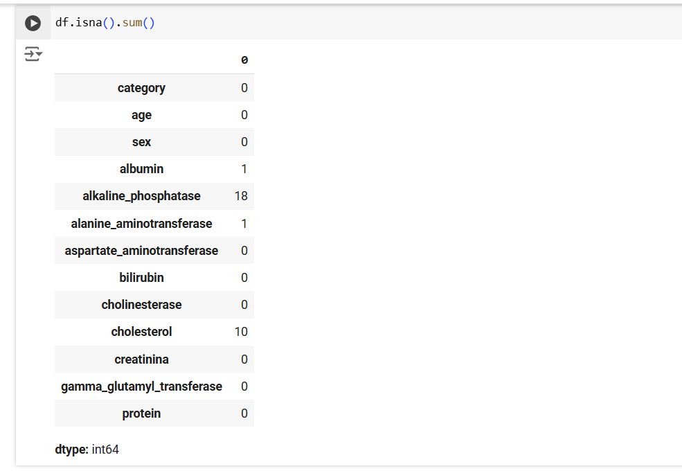
NULL VALUES DETECTION
Albumin, alkaline phosphatase, alanine aminotransferase, and cholesterol have fewer missing values, so we can impute values for those columns.

Slide 7
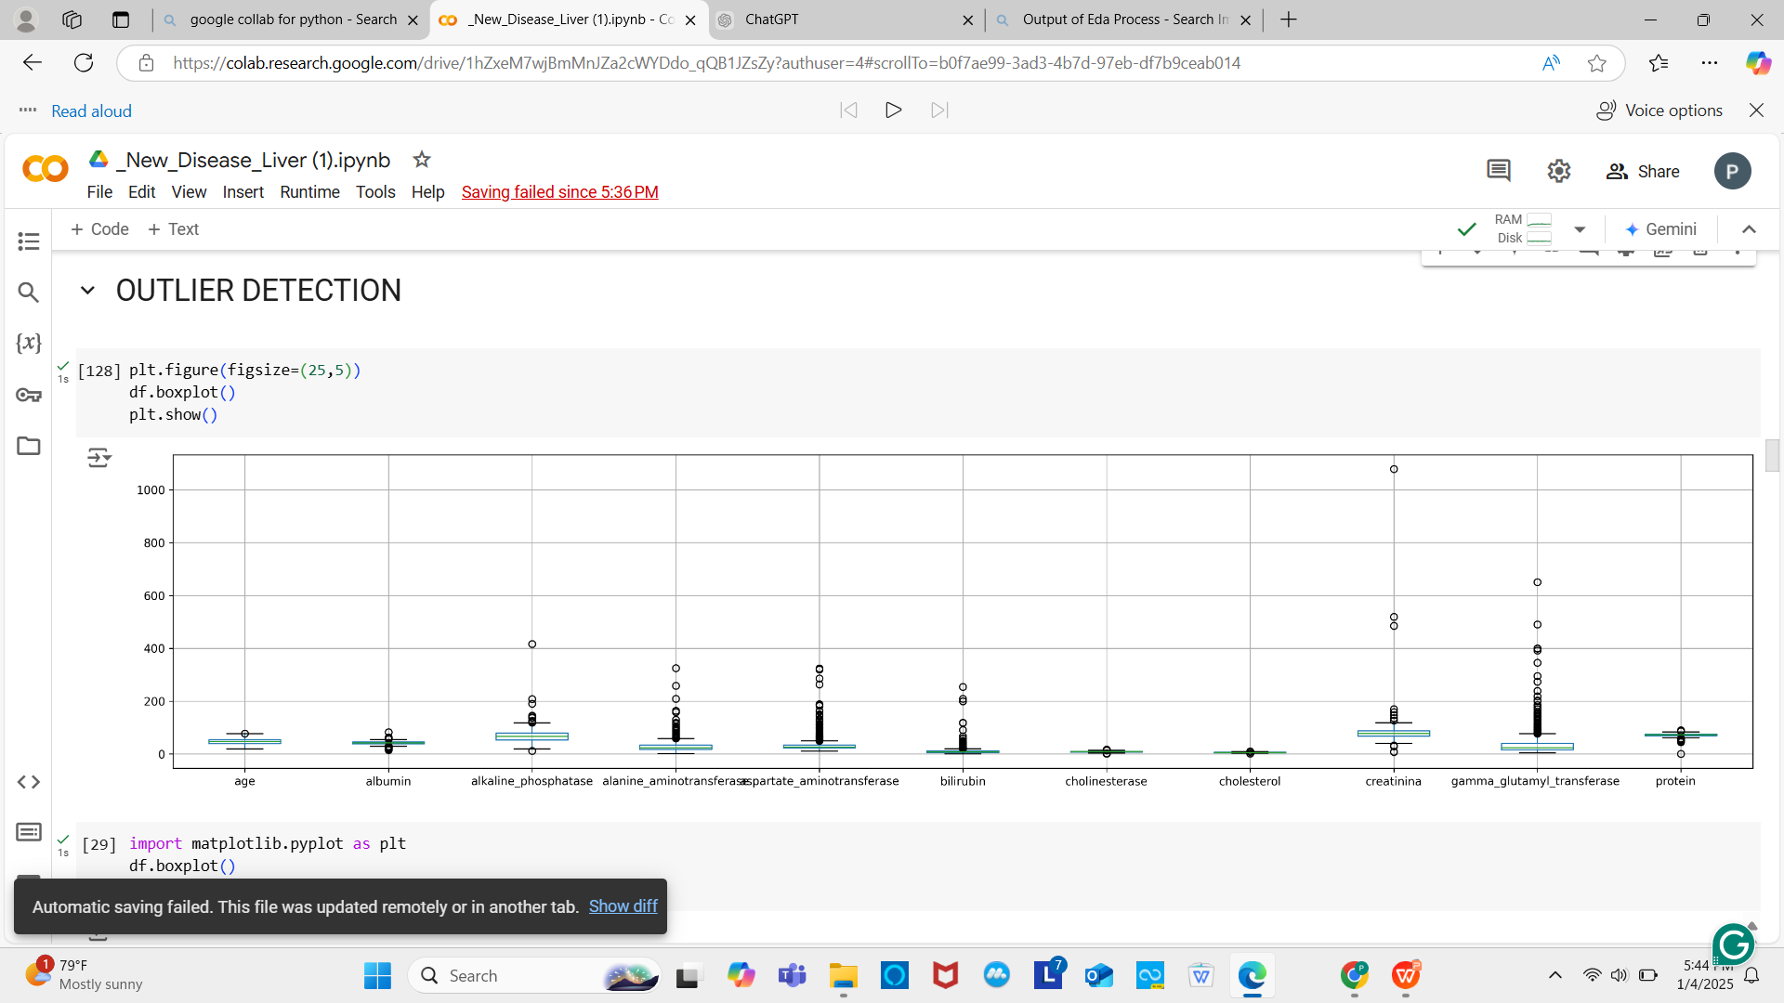
OUTLIERS DETECTION - BOX PLOT
Almost all columns have outliers, with significant ones in gamma_glutamyl_transferase and bilirubin. Since these are important features, removing outliers is necessary to ensure accurate analysis.

Slide 8
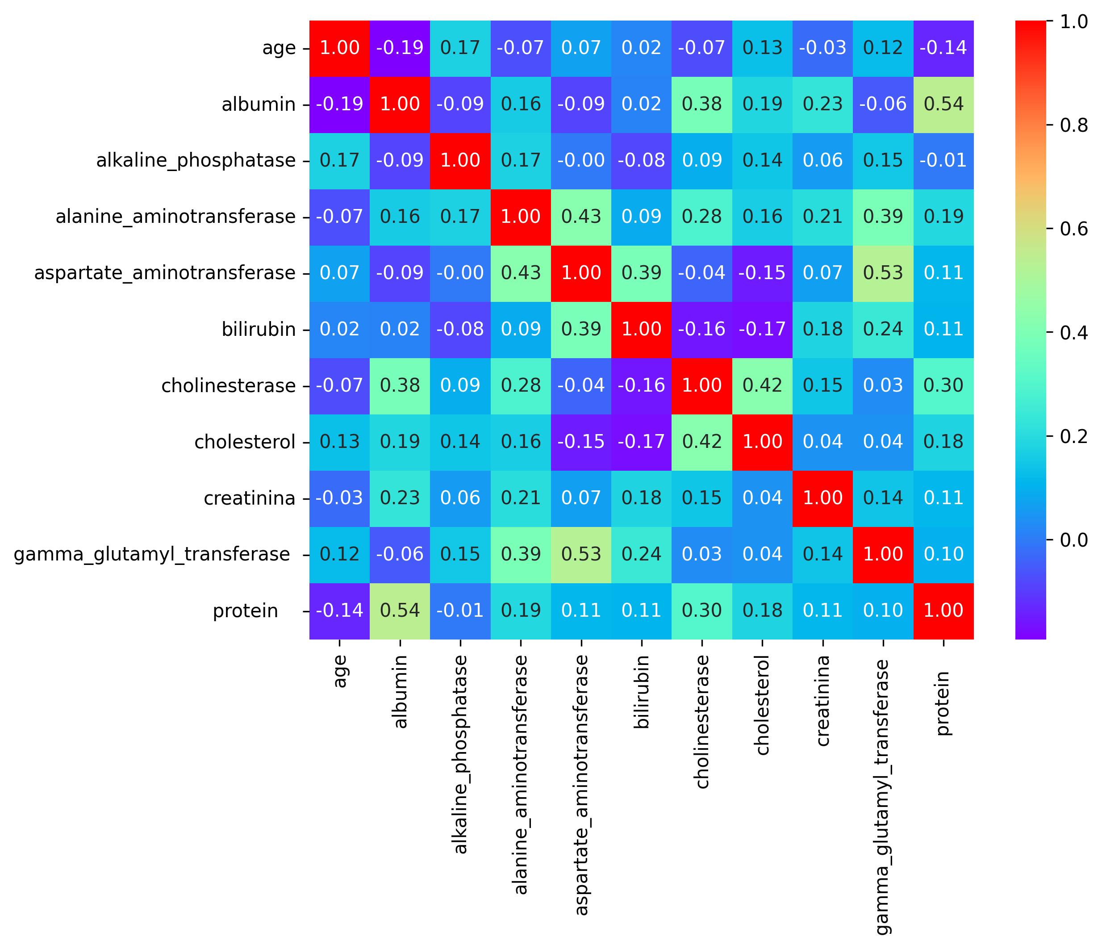
CORRELATION MATRIX - HEATMAP
Strong Positive:
Albumin & Alkaline Phosphatase (0.17), Alanine Aminotransferase & Aspartate Aminotransferase (0.43), Aspartate Aminotransferase & Gamma Glutamyl Transferase (0.53)
Weak Positive:
Cholesterol & Bilirubin (0.13), Cholinesterase & Protein (0.30)
Weak Negative:
Cholesterol & Aspartate Aminotransferase (-0.15), Cholinesterase & Bilirubin (-0.16)
Weak negative correlations can be considered during hyperparameter tuning for better model performance.

Slide 9
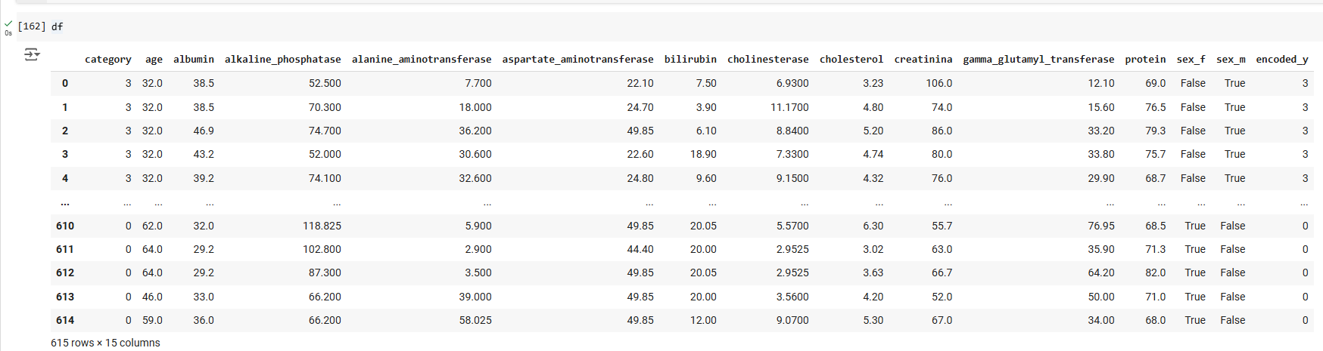
DATA PRE-PROCESSING
After scaling and encoding:
We performed encoding for sex and category column

Slide 10
CLASSIFICATION MODEL BUILDING AND EVALUATION
Models used: Random Forest Classifie Logistic Regression Decision tree Svm classifier Knn classifier | Model evaluation metrices Accuracy F1-score Precision Recall

Slide 11
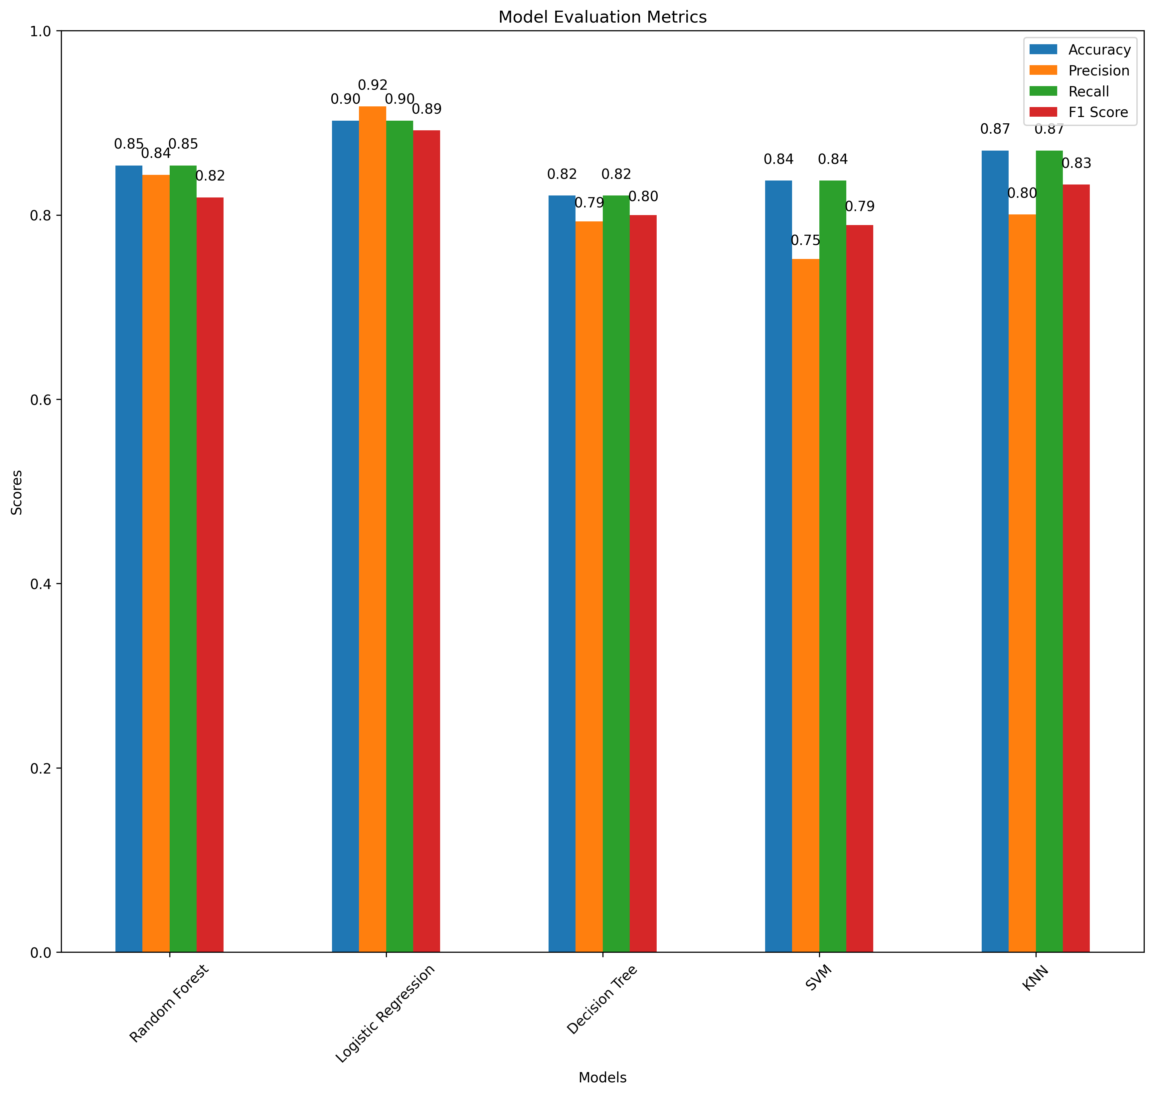
COMPARATIVE ANALYSIS AND MODEL SELECTION
After performing hyper parameter tuning for all models :
Based on the evaluation metrics, Logistic Regression was selected as the best-performing model across all metrics, with the highest accuracy, precision, recall, and F1 score.

Slide 12
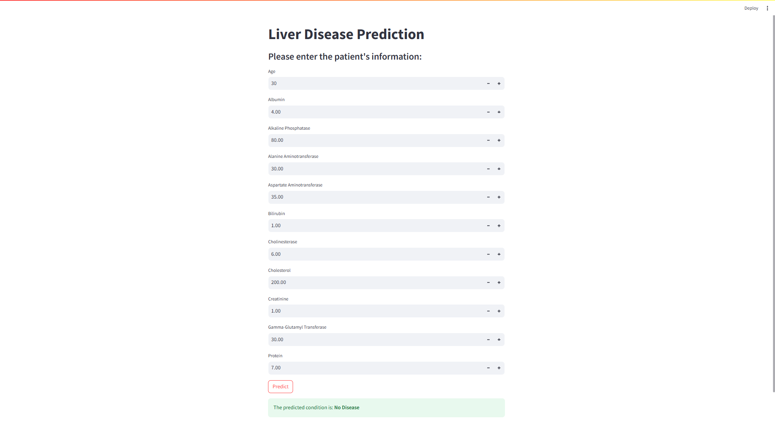
MODEL DEPLOYMENT
The deployed model predicts liver disease categories such as Hepatitis, Cirrhosis, No Disease, Suspect Disease, and Fibrosis based on data.

Slide 13
CHALLENGES FACED
Data Imbalance: A significant portion of the dataset indicated no liver disease, which made it difficult for the model to learn patterns for less common conditions.
Limited Dataset Size: The small dataset posed challenges in ensuring that the model could generalize well and produce reliable predictions.
Deployment Challenges: Integrating the model into a Streamlit application and ensuring real-time predictions worked accurately presented deployment difficulties.

Slide 14
CONCLUSION
Data Preprocessing and Feature Engineering:
Handling missing values, imputing outliers, scaling features, and encoding categorical variables were essential for improving model accuracy and efficiency.
Model Comparison and Selection:
After evaluating multiple models, Logistic Regression performed best, providing the highest accuracy for liver disease classification.
Practical Insights:
By leveraging Logistic Regression for liver disease classification, healthcare professionals can make more accurate predictions, enhancing diagnostic accuracy and patient care.

Slide 15


