Slide 1

PROJECT P499 – GROUP 4
Sentiment Analysis of Amazon Reviews
This presentation explores the prediction of customer reviews using Natural Language Processing and Web Scraping techniques. We will delve into the customer reviews and rating.
Presented By [YOGENDRA JANGID]

Slide 2
Introduction
Understanding customer opinions is crucial for businesses.
Web Scraping extracts data from online sources (Amazon reviews).
This project involves scraping, cleaning, and analyzing reviews.
Web Scraping helps extract customer reviews from Amazon.
Sentiment Analysis classifies reviews as positive, negative, or neutral.
This project uses Selenium, BeautifulSoup, and NLP techniques.

Slide 3
TABLE OF CONTENTS
Objective and Dataset Overview
Exploratory Data Analysis and Insights
Data Pre-processing
Clustering Models and Evaluation
Comparative Analysis and Model Selection
Model Deployment
Conclusion

Slide 4
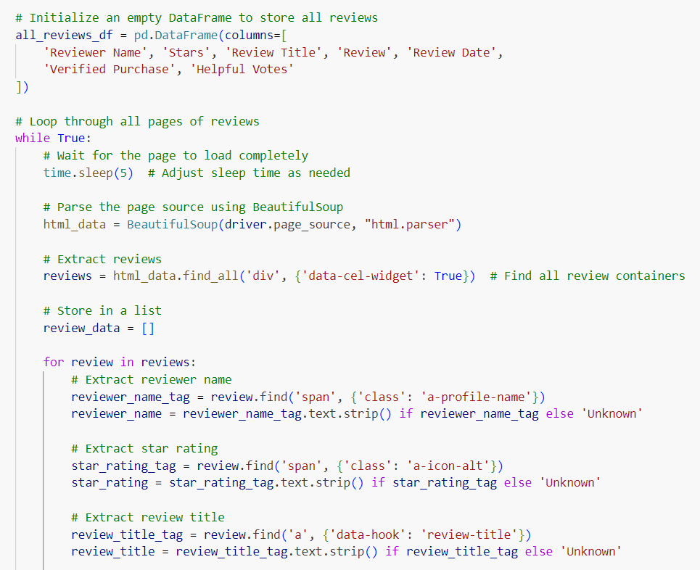
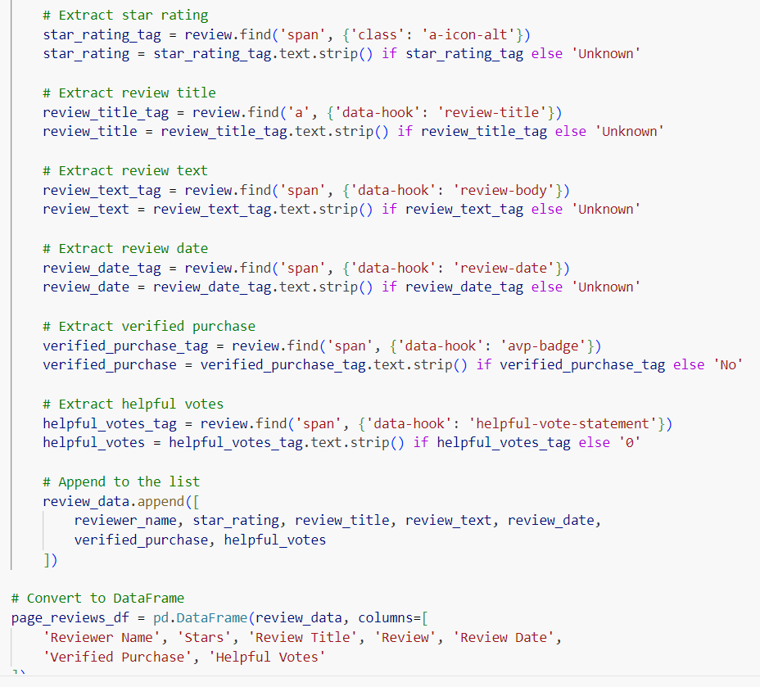
Web Scraping : Amazone Reviews
Used Selenium to automate login and navigation.
Extracted review text, star ratings and product details.
BeautifulSoup parsed the webpage to extract relevant data.
Challenge: Handling dynamic content and CAPTCHAs.

Slide 5
DATASET DESCRIPTION
Exploratory Data Analysis (EDA) is analyzing the data using visual techniques. It is used to discover trends or patterns or to check assumptions with the help of statistical summaries and graphical representations.
I/P data
EDA
Cleaning
Transformation
Visualization

Slide 6
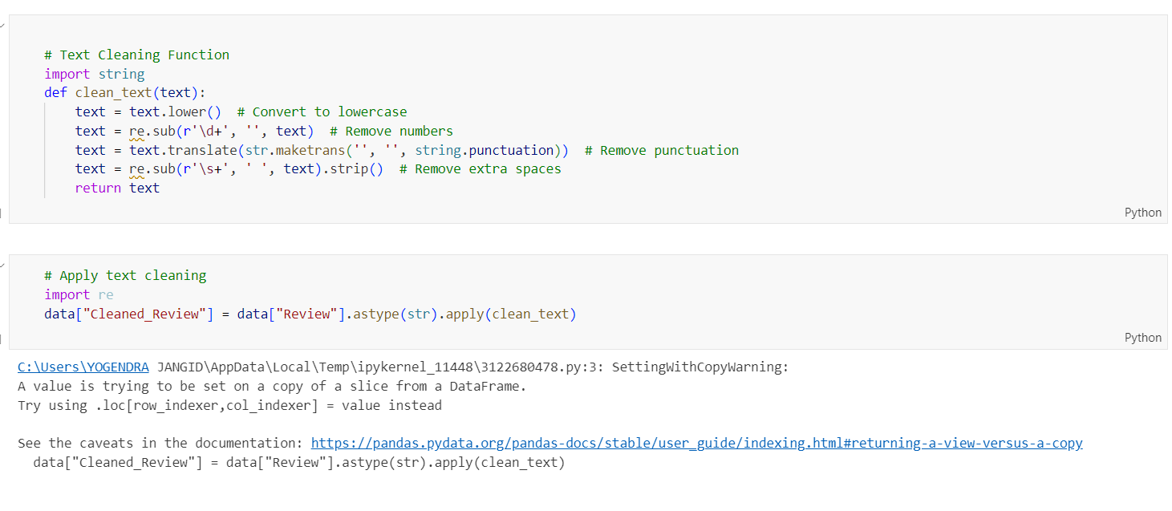
Data Cleaning & Preprocessing
Dropped unnecessary columns like “Reviewer” , “Name” and “Review Date”.
Removed punctuation, stopwords and special characters.
Converted text into numerical format for sentiment analysis.
Transformed reviews into numerical representation(TF-IDF, Word2VEC).
Word cloud of frequently used terms.
Mapped star ratings to sentiment categories (positive, neutral, negative).
Analyzed trends in review patterns over.

Slide 7
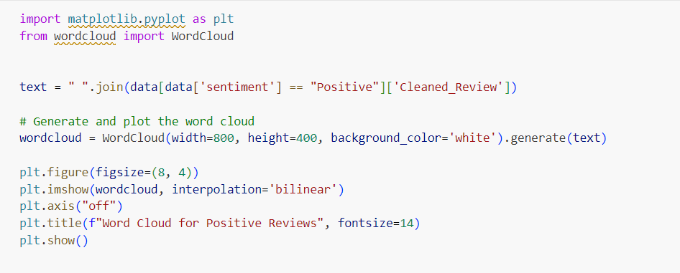
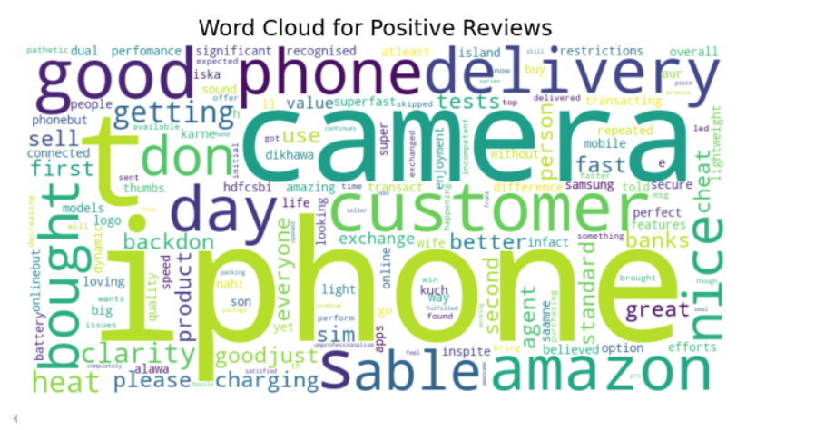
Word cloud for Positive Reviews

Slide 8
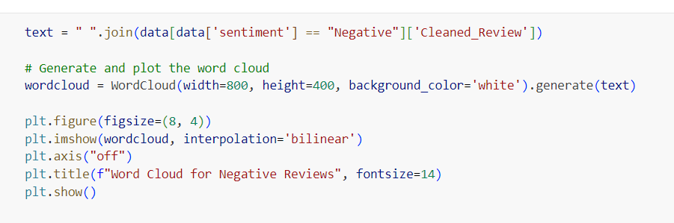
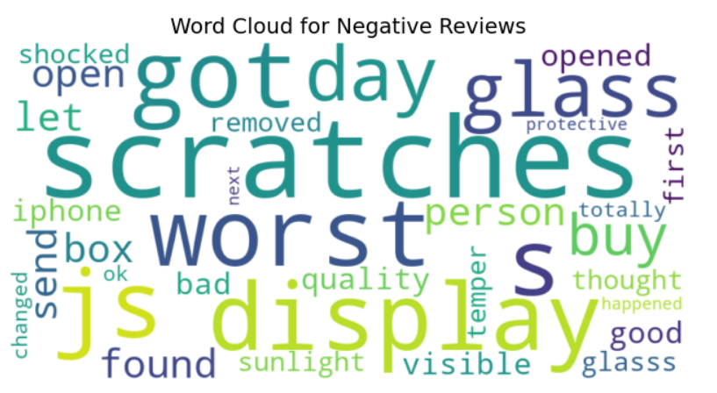
Word cloud for Negative Reviews

Slide 9
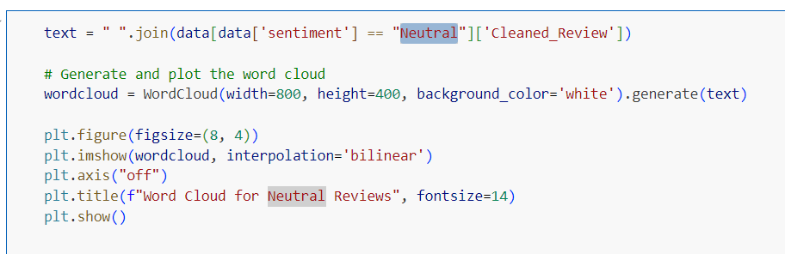
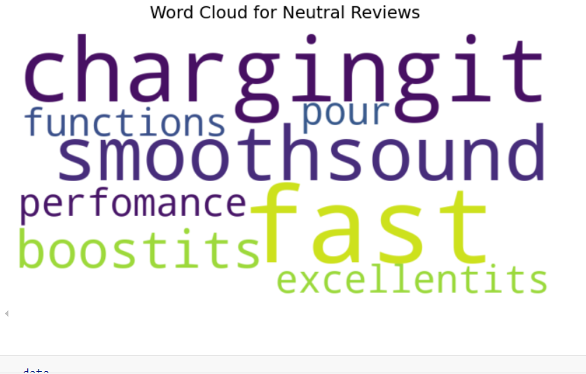
Word cloud for Neutral Reviews

Slide 10
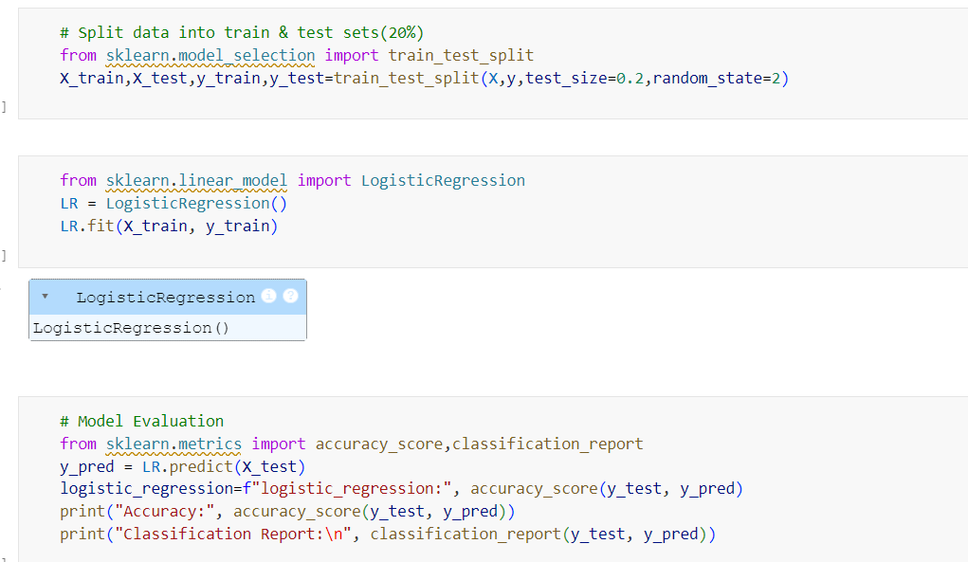
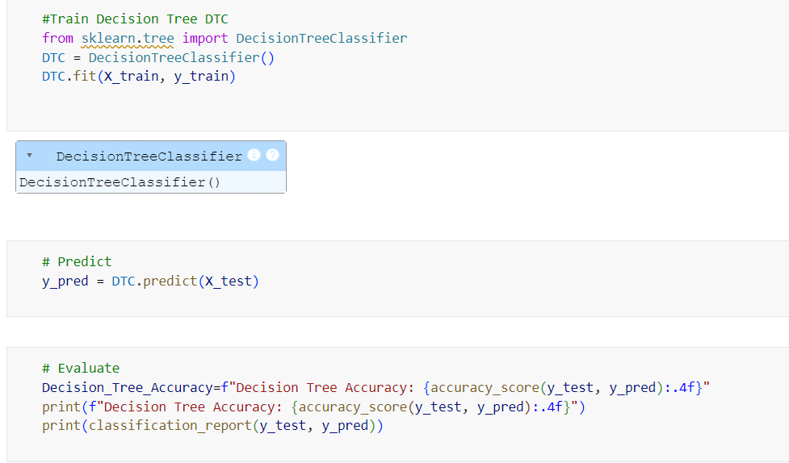
Sentiment Classification Model
Used NLP techniques to classify reviews.
Tested different models: Logistic Regression, Decision Tree(DTC), Random Forest Model, SVM Model and Neural Network.
Evaluated model performance using accuracy, precision, recall.

Slide 11
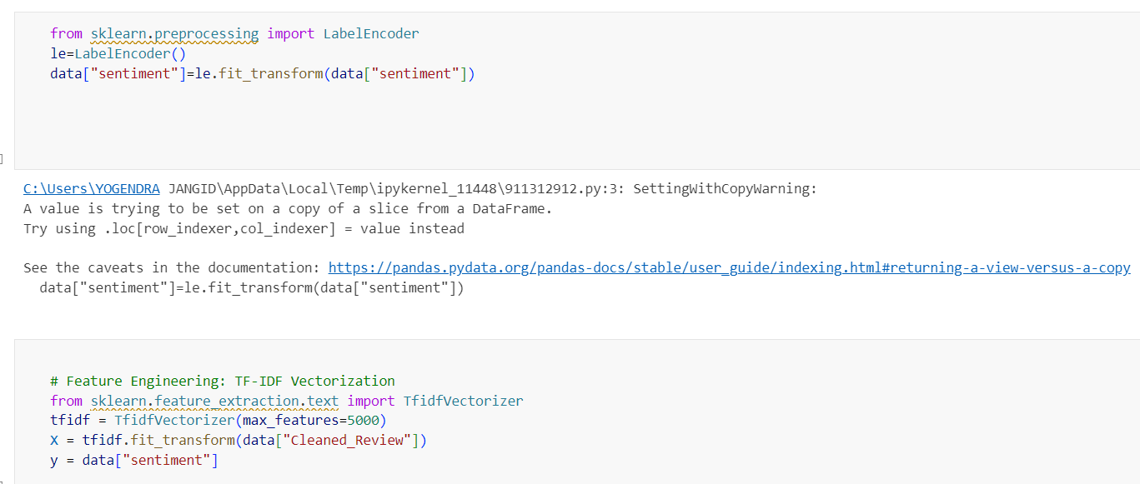
DATA PRE-PROCESSING
After encoding and feature engineering:
We performed encoding for sentiment and feature engineering for Cleaned_review column

Slide 12
CLASSIFICATION MODEL BUILDING AND EVALUATION
Models used: Random Forest Logistic Regression Decision tree Svm Neural Network | Model evaluation metrices Accuracy F1-score Precision Recall

Slide 13
Model Performance
Accuracy : Using Random Forest Model
LSTM performed better with longer reviews.
Future improvements: More training data, fine-tuned learning.
Majority of reviews were positive.
Negative reviews highlighting specific product flaws.
Business can use there to improve products.

Slide 14
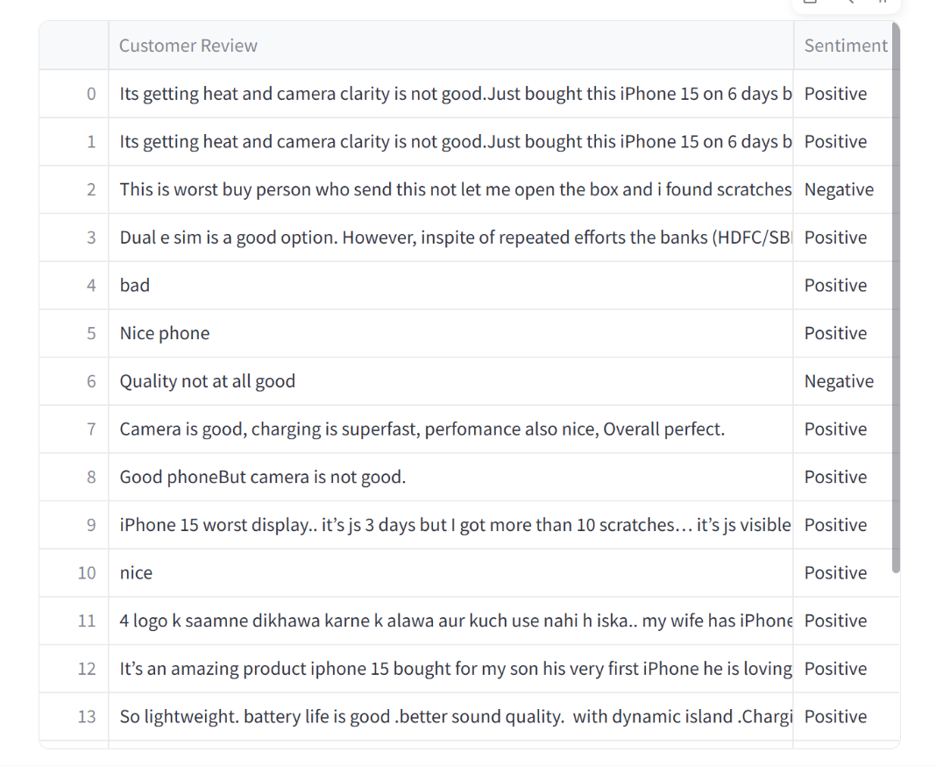
MODEL DEPLOYMENT
The app predicts the sentiment of customer reviews from a CSV file.
It categories reviews as positive, Neutral and Negative based on model

Slide 15
CONCLUSION
Web scraping provides valuable consumer insights.
Sentiment Analysis helps business make data-drive decisions.
Future improvement : Deep learning models, handling sarcasm in reviews.
Web scraping is useful for extracting real-world customer feedbacks.

Slide 16


