Slide 1
Ch. 2 : Preprocessing of audio signals in time and frequency domain
Time framing
Frequency model
Fourier transform
Spectrogram

Slide 2
Revision: Raw data and PCM
Human listening range 20Hz → 20K Hz
CD Hi-Fi quality music: 44.1KHz (sampling) 16bit
People can understand human speech sampled at 5KHz or less, e.g. Telephone quality speech can be sampled at 8KHz using 8-bit data.
Speech recognition systems normally use: 10~16KHz,12~16 bit.

Slide 3
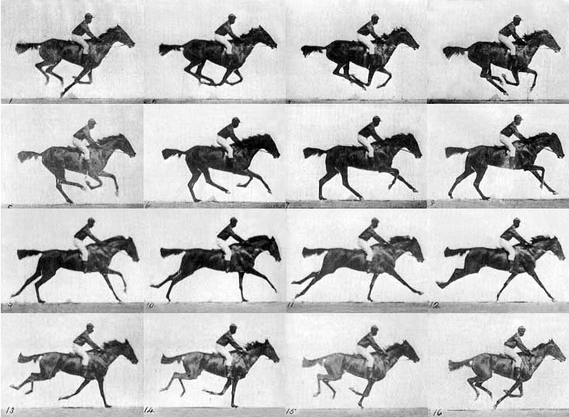
Concept: Human perceives data in blocks
We see 24 still pictures in one second, then
we can build up the motion perception in our brain.
It is likewise for speech
Source: http://antoniopo.files.wordpress.com/2011/03/eadweard_muybridge_horse.jpg?w=733&h=538

Slide 4

Time framing
Since our ear cannot response to very fast change of speech data content, we normally cut the speech data into frames before analysis. (similar to watch fast changing still pictures to perceive motion )
Frame size is 10~30ms (1ms=10⁻³ seconds)
Frames can be overlapped, normally the overlapping region ranges from 0 to 75% of the frame size .
Time framing Video demo: https://youtu.be/lOu-c2UHU00

Slide 5
Frame blocking and Windowing
To choose the frame size (N samples )and adjacent frames separated by m samples.
I.e.. a 16KHz sampling signal, a 10ms window has N=160 samples, (non-overlap samples) m=40 samples
l=2 (second window), length = N
s_{n}
N
n
m
time
N
l=1 (first window), length = N

Slide 6
Tutorial for frame blocking
A signal is sampled at 12KHz, the frame size is chosen to be 20ms and adjacent frames are separated by 5ms. Calculate N and m and draw the frame blocking diagram.(ans: N=240, m=60.)
Repeat above when adjacent frames do not overlap.(ans: N=240, m=240.)

Slide 7
Class exercise 2.1
For a 22-KHz/16 bit sampling speech wave, frame size is 15 ms and frame overlapping period is 40 % of the frame size.
Draw the frame blocking diagram.

Slide 8
The frequency model
For a frame we can calculate its frequency content by Fourier Transform (FT)
Computationally, you may use Discrete-FT (DFT) or Fast-FT (FFT) algorithms. FFT is popular because it is more efficient.
FFT algorithms can be found in most numerical method textbooks/web pages.
E.g. http://en.wikipedia.org/wiki/Fast_Fourier_transform

Slide 9
A time domain signal of N samples
S=
Signal
level
S_{k=2}
S_{k=1}
S_{k=0}
Time k
k=0 1 2….
k=N-1

Slide 10
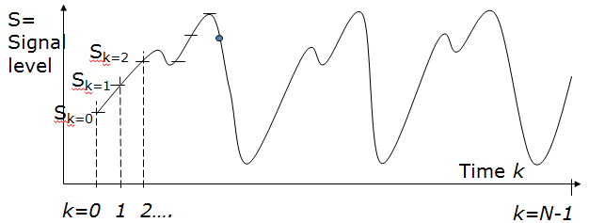
The Fourier Transform FT method (see appendix of why m≤N/2)
Forward Transform (FT) of N sample data points
Demo Matlab code: demo_dft_tutorial.rar

Slide 11

Fourier Transform
Power=|X_{m}|= (real²+imginary²)
Signal
voltage/
pressure
level
single freq..
Fourier Transform
Time
S₀,S₁,S₂,S_{3.} … S_{N-1}
freq. (m)
Called spectral envelop
Demo Matlab code: demo_dft_tutorial.rar
Demo Video

Slide 12
Example
[s0,s1,s2,…]=[1 ,3 ,4,…], N=128, m=0,…,64
X_{m=0}=1*e^{-j(2*pi*0*0/128)}+3*e^{-j(2*pi*1*0/128)}+4*e^{-j(2*pi*2*0/128)} +..
X_{m=1}=1*e^{-j(2*pi*0*1/128)}+3*e^{-j(2*pi*1*1/128)}+4*e^{-j(2*pi*2*1/128)} +..
X_{m=2}=1*e^{-j(2*pi*0*2/128)}+3*e^{-j(2*pi*1*2/128)}+4*e^{-j(2*pi*2*2/128)} +..

Slide 13
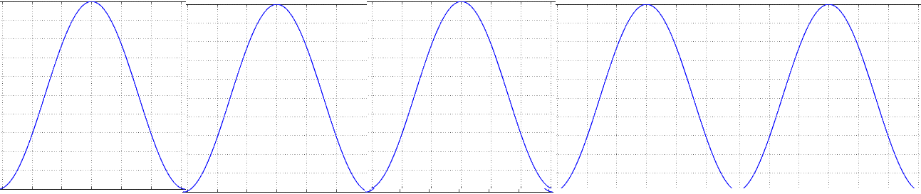
Examples of FT (Pure wave vs. speech wave)
s_{k}
|X_{m}|
pure cosine has one frequency band
FT
single freq..
time(k)
freq.. (m)
complex speech wave
has many different frequency bands
s_{k}
|X_{m}|
single freq..
time(k)
freq. (m)
Spectral envelop
http://math.stackexchange.com/questions/1002/fourier-transform-for-dummies
DFT and Inverse: DFT https://www.mathworks.com/matlabcentral/fileexchange/41228-dft-and-idft/content/Untitled3.m

Slide 14
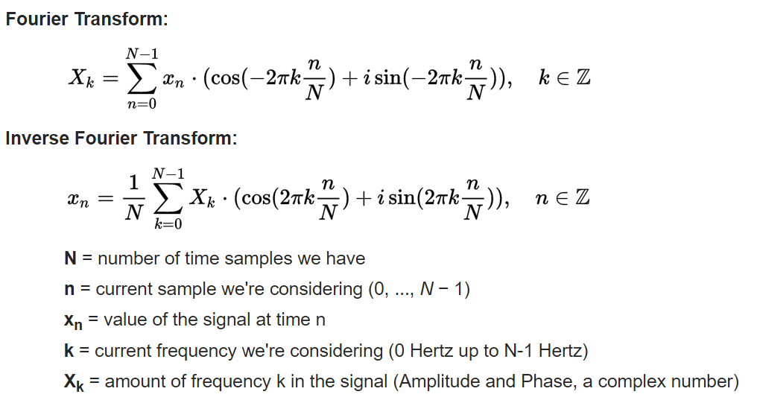
Discrete Fourier transform DFT and Inverse Discrete Fourier transform IDFT
https://en.wikipedia.org/wiki/Discrete_Fourier_transform
Matlab code:
https://www.mathworks.com/matlabcentral/fileexchange/41228-dft-and-idft/content/Untitled3.m

Slide 15

Use of short term Fourier Transform (Fourier Transform of a frame)
Power spectrum envelope is a plot of the energy Vs frequency.
FFT video demo: https://youtu.be/EuX2uKZSd40
Time domain signal
of a frame
DFT or FFT
Frequency
domain output
time domain signal
of a frame
amplitude
Energy
Spectral envelop
First formant
Second formant
time
freq..
1KHz
2KHz

Slide 16
Class exercise 2.2: Fourier Transform
Write pseudo code (or a C/matlab/octave program segment but not using a library function) to transform a signal in an array.
Int s[256] into the frequency domain in
float X[128+1] (real part result) and
float IX[128+1] (imaginary result).
How to generate a spectrogram?

Slide 17
The spectrogram: to see the spectral envelope as time moves forward
It is a visualization method (tool) to look at the frequency content of a signal.
Parameter setting: (1)Window size = N=(e.g. 512)= number of time samples for each Fourier Transform processing. (2) non-overlapping sample size D (e.g. 128). (3) frame index is j.
t is an integer, initialize t=0, j=0. X-axis = time, Y-axis = freq.
Step1: FT samples S_{t+j*D} to S_{t+512+j*D}
Step2: plot FT result (freq v.s. energy) spectral envelope vertically using different gray scale.
Step3: j=j+1
Repeat Step1,2,3 until j*D+t+512 >length of the input signal.

Slide 18
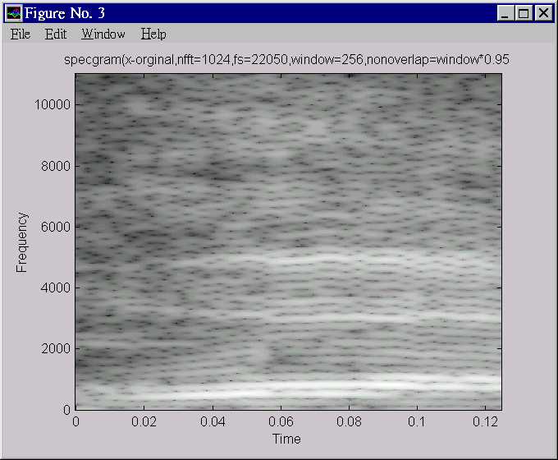
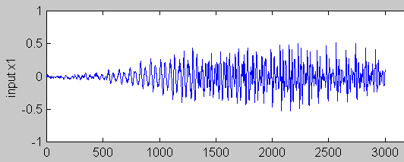
A specgram
Specgram: The white bands are the formants which represent high energy frequency contents of the speech signal

Slide 19
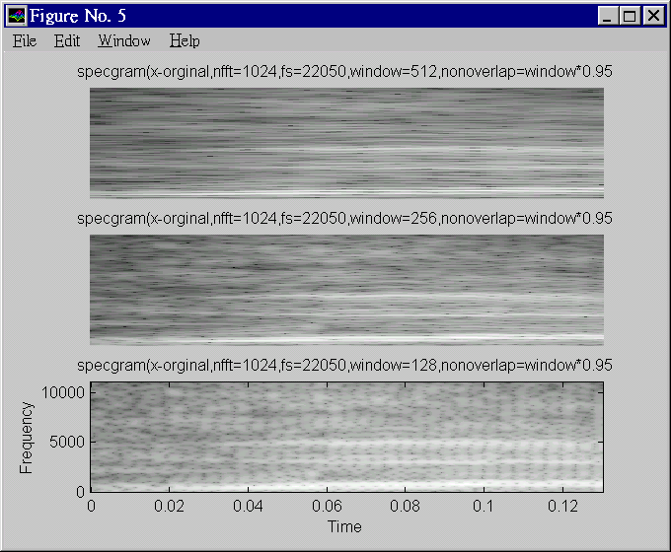
Freq.
Better frequency resolution
Freq.
Better time. resolution

Slide 20
How to generate a spectrogram?

Slide 21
Procedures to generate a spectrogram (Specgram1)
Window=256-> each frame has 256 samples
Sampling is fs=22050, so maximum frequency is 22050/2=11025 Hz
Nonverlap =window*0.95=256*.95=243 , overlap is small (overlapping =256-243=13 samples)
|X(128)|
For each frame (256 samples)
Find the magnitude of Fourier
X_magnitude(m), m=0,1,2, 128
Plot X_magnitude(m)=
Vertically,
-m is the vertical axis
-|X(m)|=X_magnitude(m) is
represented by intensity
Repeat above for all frames
q=1,2,..Q
|X(i)|
|X(0)|
Frame q=Q
Frame q=1
frame q=2

Slide 22
Class exercise 2.3: In specgram1
Calculate the
first sample location and last sample location of the frames q=3 and 7. Note: N=256, m=243
Answer:
q=1, frame starts at sample index =?
q=1, frame ends at sample index =?
q=2, frame starts at sample index =?
q=2, frame ends at sample index =?
q=3, frame starts at sample index =?
q=3, frame ends at sample index =?
q=7, frame starts at sample index =?
q=7, frame ends at sample index =?

Slide 23
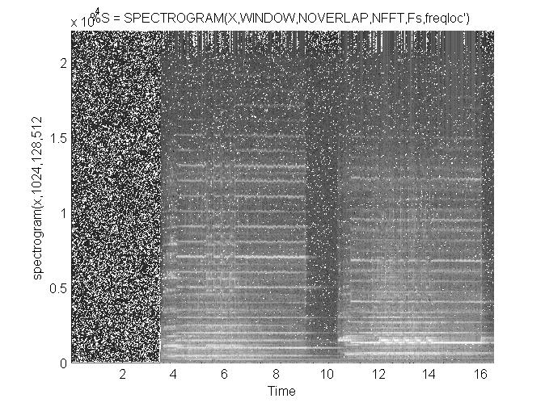
Spectrogram plots of some music sounds sound file is tz1.wav
Matlab Code:
demo_spectrogram_release16.rar
High
energy
Bands:
Formants
seconds

Slide 24
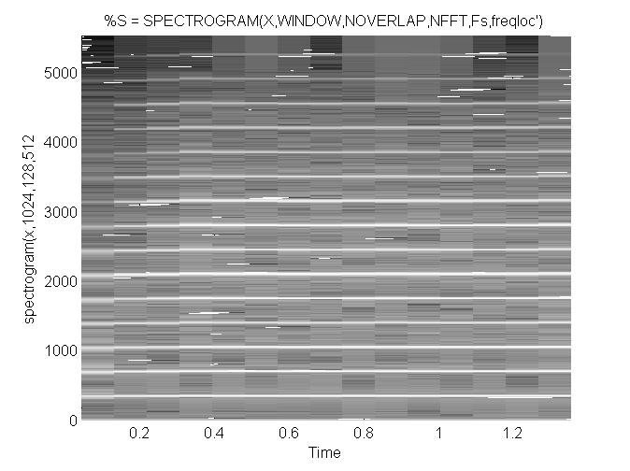
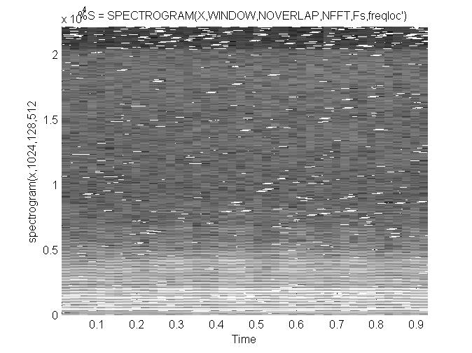
spectrogram plots of some music sounds
http://www.cse.cuhk.edu.hk/%7Ekhwong/www2/cmsc5707/tz1.wav
http://www.cse.cuhk.edu.hk/~khwong/www2/cmsc5707/trumpet.wav
http://www.cse.cuhk.edu.hk/%7Ekhwong/www2/cmsc5707/violin3.wav
Spectrogram of
Trumpet.wav
Spectrogram of
Violin3.wav
High
energy
Bands:
Formants
Violin has
complex
spectrum
seconds

Slide 25
Exercise 2.4
Write the procedures for generating a spectrogram from a source signal X.

Slide 26
Summary
Studied
Basic digital audio recording systems
Speech recognition system applications and classifications
Fourier analysis and spectrogram

Slide 27
Appendix

Slide 28
Answer: Class exercise 2.1
For a 22-KHz/16 bit sampling speech wave, frame size is 15 ms and frame overlapping period is 40 % of the frame size. Draw the frame block diagram.
Answer: Number of samples in one frame (N)= 15 ms / (1/22k)
= 15*(10^-3) /(1/(22000))=330
Overlapping samples = 132, m=N-132=198.
Overlapping time = 132 * (1/22k)= 132 * (1/22000) =6ms;
Time in one frame= 330* (1/22k)= 330* (1/22000)=15ms.
l=2 (second window), length = N
s_{n}
N
n
m
time
N
l=1 (first window), length = N

Slide 29
Answer Class exercise 2.2: Fourier Transform
http://en.wikipedia.org/wiki/List_of_trigonometric_identities
For (m=0;m<=N/2;m++)
{
tmp_real=0; tmp_img=0;
For(k=0;k<=N-1;k++)
{
tmp_real=tmp_real+S_{k}*cos(2*pi*k*m/N);
tmp_img=tmp_img-S_{k}*sin(2*pi*k*m/N);
}
X_real(m)=tmp_real;
X_img(m)=tmp_img;
}
From N input data S_{k=0,1,2,3..N-1}, there will be 2*(N+1) data generated, i.e. X_real(m), X_img(m), m=0,1,2,3..N/2 are generated.
E.g. S_{k}=S₀,S₁,..,S₅₁₁ → X_real₀,X_real₁,..,X_real_{256,} X_imgl₀,X_img₁,..,X_img_{256,}
Note that X_magnitude(m)= sqrt[X_real(m)²+ X_img(m)²]

Slide 30
Answer: Class exercise 2.3: In specgram1 (updated)
Calculate the
first sample location and last sample location of the frames q=3 and 7. Note: N=256, m=243
Answer:
q=1, frame starts at sample index =0
q=1, frame ends at sample index =255
q=2, frame starts at sample index =0+243=243 (so the gap between the q=1 frame and q=2 frame is 243)
q=2, frame ends at sample index =243+(N-1)=243+255=498 (so q=2 frame has 256 samples)
q=3, frame starts at sample index =0+243+243=486
q=3, frame ends at sample index =486+(N-1)=486+255=741
q=7, frame starts at sample index =243*6=1458
q=7, frame ends at sample index =1458+(N-1)=1458+255=1713

Slide 31
Why in Discrete Fourier transform the summation is from k=0 to k=N-1 and m is ranging from 0 to N/2?
Since , Fourier frequency real-value outputs are mirrored around the vertical axis at 0, so using half are fine for calculating the energy during the calculation of the spectrum. It is only an engineering approach to save time. In fact the real definition is using N sample for forward and inverse Fourier transform where all complex numbers are used.
The problem is actual very deep mathematically, ie, how many samples should we use in forward and reverse transform. To get the best result, one should add more zeros to the original sequence (zero padding at the end of the sequence) to increase frequency resolution. x = 1 2 4 6 5 4 3 >> fft(x), Columns 1 through 4 25.0000 + 0.0000i -7.5734 + 0.3479i -0.4620 + 1.7568i -0.9647 - 0.5410i -0.9647 + 0.5410i -0.4620 - 1.7568i -7.5734 - 0.3479i
Antilasing Demo: https://www.youtube.com/watch?v=ByTsISFXUoY
https://www.youtube.com/watch?v=Fy9dJgGCWZI

Slide 32
Answer: Exercise 2.4
Write the procedures for generating a spectrogram from a source signal X.
Answer: to be completed by students

