Slide 1
ACID properties
Set of properties that guarantee that database transactions are processed reliably, referred to as ACID
Atomicity
Consistency
Isolation
Durability

Slide 2
What is transaction
In the context of databases, a single logical operation on the data is called a transaction. For example, a transfer of funds from one bank account to another, involving multiple changes such as debiting one account and crediting another, is a single transaction.

Slide 3
Atomicity
Atomicity refers to the ability of the database to guarantee that either all of the tasks of a transaction are performed or none of them are.
Database modifications must follow an all or nothing rule.
Each transaction is said to be atomic if when one part of the transaction fails, the entire transaction fails.

Slide 4
Consistency
Consistency means that database systems have to enforce business rules defined for their databases.
The consistency property ensures that the database remains in a consistent state before the start of the transaction and after the transaction is over (whether successful or not).

Slide 5
Consistency means that any defined checks and constraints are satisfied after any transaction:
Columns only store values of a particular type (int columns store only ints, etc)
Primary keys and unique keys are unique
Check constraints are satisfied
Foreign key constraints are satisfied

Slide 6
Isolation
Isolation refers to the requirement that other operations cannot access or see the data in an intermediate state during a transaction. This constraint is required to maintain the performance as well as the consistency between transactions in a database. Thus, each transaction is unaware of another transactions executing concurrently in the system.
Events within a transaction must be hidden from other transactions running concurrently. Providing isolation is the main goal of concurrency control.

Slide 7
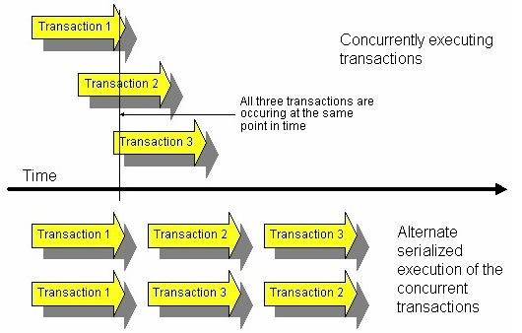

Slide 8
An important concept to understanding isolation through transactions is serializability. Transactions are serializable when the effect on the database is the same whether the transactions are executed in serial order or in an interleaved fashion. The effect on the RDBMS is that the transactions may execute in serial order based on consistency and isolation requirements.
Degrees of isolation1:
degree 0 - a transaction does not overwrite data updated by another user or process ("dirty data") of other transactions
degree 1 - degree 0 plus a transaction does not commit any writes until it completes all its writes (until the end of transaction)
degree 2 - degree 1 plus a transaction does not read dirty data from other transactions
degree 3 - degree 2 plus other transactions do not dirty data read by a transaction before the transaction commits

Slide 9
Durability
Durability refers to the guarantee that once the user has been notified of success, the transaction will persist, and not be undone. It refers to the ability of the system to recover committed transaction updates if either the system or the storage media fails. Features to consider for durability:
recovery to the most recent successful commit after a database software failure
recovery to the most recent successful commit after an application software failure
recovery to the most recent successful commit after a CPU failure
recovery to the most recent successful backup after a disk failure
recovery to the most recent successful commit after a data disk failure

