Slide 1


Clojure
Manipulating the Immutable

Slide 2
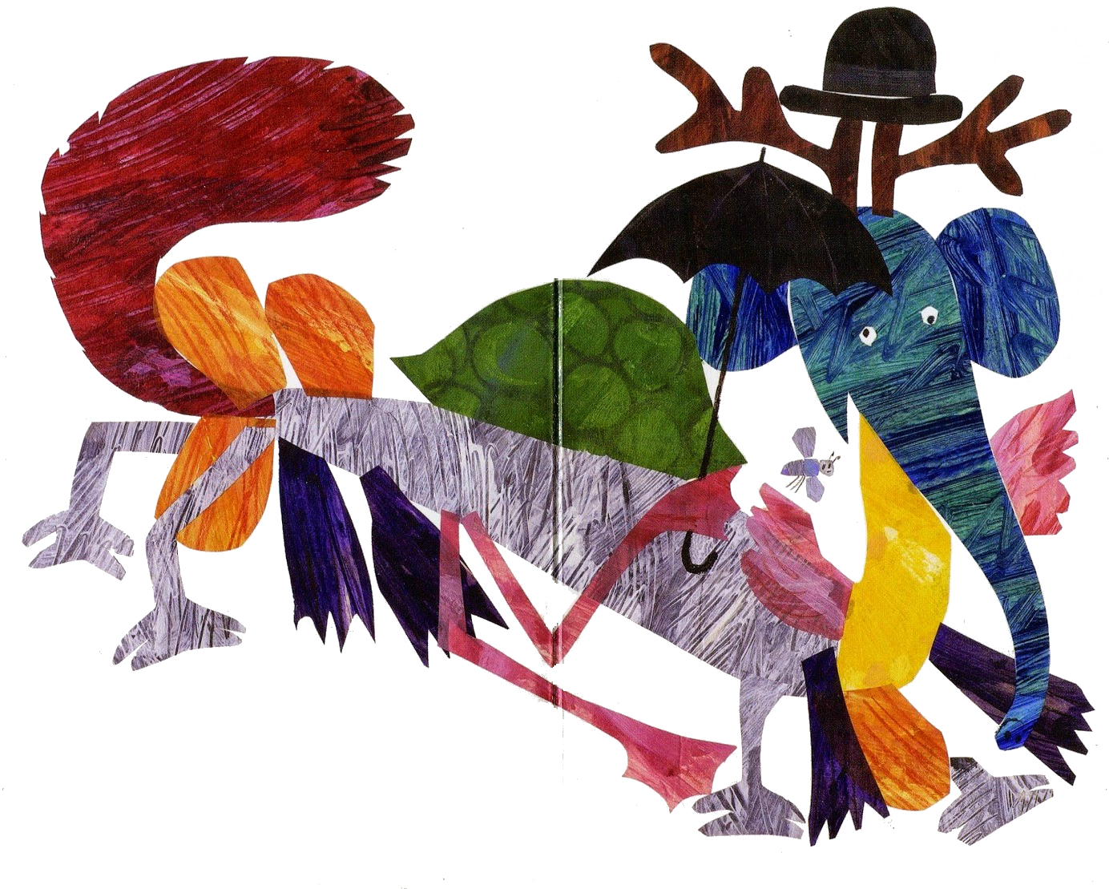






Andrew Jackson
@yogidevbear
Notes:
Mixed-up Chameleon by Eric Carle
Code Monkey – Java -> CF -> Clojure
Why I believe Clojure is so pertinent (concurrency in todays age of multicore processors)
Clojure is good for Awkward sized data (between small data and big data)

Slide 3
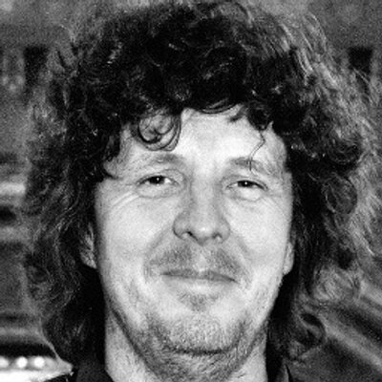


Rich Hickey

Slide 4
What Is Clojure?
Compiled language
Dynamic (every feature supported at runtime)
JVM (Java interop)
Lisp dialect (code-as-data philosophy)
Functional programming language
Immutable
Software transaction memory system (STM)
Concurrency
Notes:
Links that cover some of these points:
https://clojure.org/about/dynamic
https://clojure.org/about/functional_programming
https://clojure.org/about/lisp
https://clojure.org/about/concurrent_programming
https://clojure.org/about/jvm_hosted

Slide 5










Slide 6
The Clojure REPL
Read
Evaluate
Print
Loop

Slide 7
Clojure Data Types
(def the-usual-suspects {
:integer 1
:float 2.0
:string “three”
})
(def more-advanced-types {
:ratio 4/5
:keywords :foo
:symbols bar
})

Slide 8
Clojure Data Collections
;; lists
(1 2.0 “three” :four)
;; vectors (same as arrays in CFML)
[1 2.0 “three” :four]
;; hash-maps (same as structures in CFML)
{:a 1, :b 2.0, :c [“three” :four]}
;; sets (similar to maps)
#{:one “two” 3.0 4/5}

Slide 9
Clojure Functions
;; LISP style
(defn name doc-string? attr-map? [params*] body)
;; Code-as-data
(+ 2 3) ;; 5
;; list
;; First item = special form “+”
;; Remaining items passed to special form
;; Returns the result of the applied function
Notes:
Special forms have their own evaluation rules -- https://clojure.org/reference/special_forms
Macros don’t evaluate their arguments before the call
(they are called during the "read" process, to produce updated code, prior to the "eval" process -- think REPL).

Slide 10
Sequences: The Great Abstraction
“Sequences are the key abstraction that connects two of the most important parts of Clojure - immutable persistent collections and the sequence library.”
Alex Miller
Notes:
Alex Miller works at Cognitect helping to maintain the Clojure language

Slide 11
Key Sequence Abstraction Functions
(first coll)
(rest coll)
(next coll)
(cons item seq)
Notes:
There is a code demo that accompanies this slide:
https://github.com/yogidevbear/cfcamp-2017-demo/blob/master/src/cfcamp_2017_demo/sequences.clj
first
Return the first element of a collection
rest
Returns a logical coll of the rest of elements (not necessarily a seq).
Never returns nil.
next
Returns a seq of the rest of the elements, which will be nil if no elements remain.
cons
Construct a new sequence with the item prepended to seq

Slide 12
Sequences: Predicates
Some other important sequence predicates:
seq? - checks whether an instance implements Iseq
sequential? - checks whether an instance implements Sequential
seqable? - checks whether an instance can implement seq
Notes:
seqable?
introduced in Clojure 1.9
available in clojure.core.incubator for earlier versions of Clojure)

Slide 13
Clojure’s Core Functions
(reduce f coll) / (reduce f val coll)
(count coll)
(filter pred) / (filter pred coll)
(map f) / (map f coll) / (map f coll & colls)
(pmap f coll) / (pmap f coll & colls)
Notes:
There is a code demo that accompanies this slide:
https://github.com/yogidevbear/cfcamp-2017-demo/blob/master/src/cfcamp_2017_demo/functions.clj
reduce is the backbone of many of the Clojure sequence functions
count returns the number of items in the collection
filter
Returns a lazy seq of the items in coll for which (pred item) returns true
pred must be free of side-effects
Returns a transducer when no collection is provided
map
Returns a lazy sequence consisting of the result of applying f to the set of first items of each coll, followed by applying f to the set of second items in each coll, until any one of the colls is exhausted
Any remaining items in other colls are ignored
Function f should accept number-of-colls arguments
Returns a transducer when no collection is provided
pmap
Like map, except f is applied in parallel.
Semi-lazy in that the parallel computation stays ahead of the consumption, but doesn't realize the entire result unless required.
Only useful for computationally intensive functions where the time of f dominates the coordination overhead.

Slide 14
(demo)
Notes:
Final demo code is available here:
https://github.com/yogidevbear/cfcamp-2017-demo/blob/master/src/cfcamp_2017_demo/demo.clj

Slide 15
Further Points of Interest
Leiningen
“for automating Clojure projects without setting your hair on fire”
Boot (Build tooling for Clojure)
“Boot supplies abstractions and libraries you can use to automate nearly any build scenario with the full power of the Clojure language. It's not a build tool - it's build tooling.”
ClojureScript
Clojure compiled to JavaScript
Clojure Radar (JUXT)
And many, many more :)

Slide 16
Useful Resources
https://clojure.org/
https://clojuredocs.org/
https://clojurians.slack.com/
Links used for this talk:
http://insideclojure.org/2015/01/02/sequences/
http://jonathangraham.github.io/2015/09/01/Clojure-functions
https://aphyr.com/tags/Clojure-from-the-ground-up
http://clojure.org/sequences
http://clojure.org/cheatsheet

Slide 17
Demo Code
All the code samples for this talk are available at: https://github.com/yogidevbear/cfcamp-2017-demo
https://github.com/yogidevbear/cfcamp-2017-slides

