Slide 1

Quiz Website Project Synopsis Presentation Date: 1/05/2023
Major-Project (IMW651)
Degree : BCA(MAWT)I-NURTURE
Project Guide:
Mr.SANJEEV SONI
YOGIKA URAF SIMRAN (TCA2056028)
SAOOD ABBAS(TCA2055006)
FACULTY OF ENGINEERING & COMPUTING SCIENCES
TEERTHANKER MAHAVEER UNIVERSITY, MORADABAD

Slide 2

Team Details
Student Name | Role
YOGIKA URAF SIMRAN SAOOD ABBAS | Designer Developer Tester
2

Slide 3
Table of Contents
PPT Contents:
Project Brief
Tools to be used
Context Diagram(Overall Project)
Use Case Diagram
Advantage of the project
References
screenshot
3

Slide 4
Project Brief
A quiz is a form of game or mind sport in which players attempt to answer questions correctly on one or several specific topics. Quizzes can be used as a brief assessment in education and similar fields to measure growth in knowledge, abilities, or skills.
The Quiz website, This website will provide you MCQ of some different types of subjects which will be very beneficial for students best study and as well student growth
4

Slide 5
Tools to be used
Frontend:
HTML
jsx
CSS
JavaScript
Backend:
React.js
Auth0
Tools:
Atom
5

Slide 6
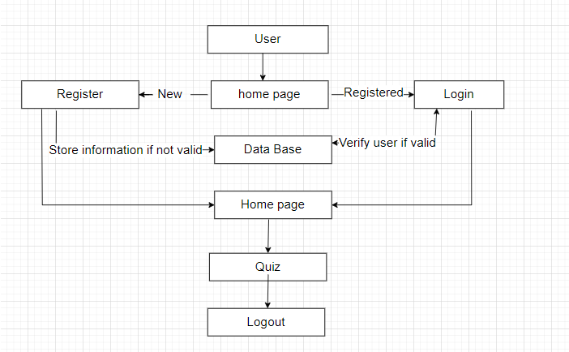
Context Diagram (Overall Project)
6

Slide 7
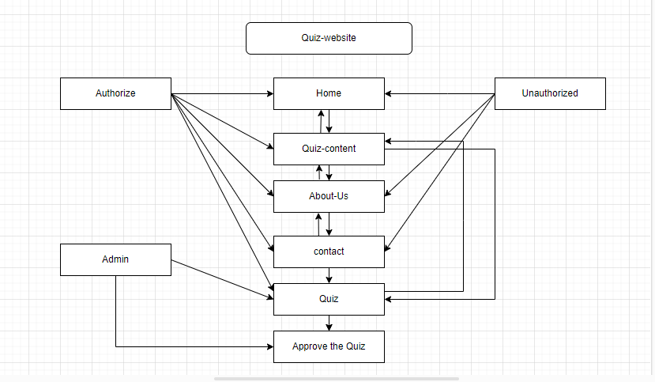
Use Case Diagram
7

Slide 8
\
Advantage of The Project
Quizzes are good for revision
Quizzes are great for end of topic assessments
Quizzes raise confidence
Quizzes are fun
Students tend to actually read the material.
Students show up for class on time since the quiz always comes first.
Students are placed in the right attitude for learning.
Students feel more confident to discuss the material.
8

Slide 9
References, if any
https://www.w3schools.com/quiztest/
https://www.geeksforgeeks.org/geeksquiz-home/
https://quizizz.com/?lng=en
https://interactives.ck12.org/plix/arithmetic/?gclid=CjwKCAiA_6yfBhBNEiwAkmXy5-YnQLo7tMl6EHn3VaJtyZZucY1Fm5PNXVvcBhg4DVGTrySyeF3QBxoC71wQAvD_BwE
https://manage.auth0.com/dashboard/us/dev-7h7yk8eyanz73qy7/
https://formspree.io/
https://legacy.reactjs.org/docs/introducing-jsx.html/
https://legacy.reactjs.org/docs/create-a-new-react-app.html/
https://www.flaticon.com/
9

Slide 10
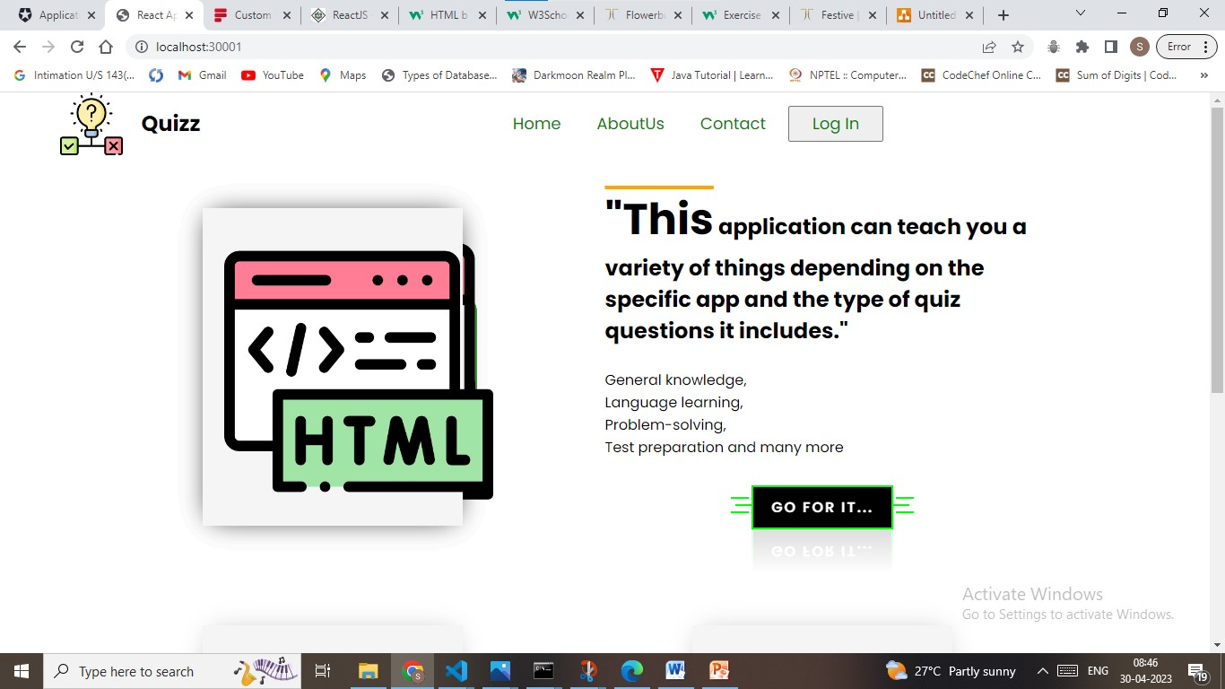
Screenshot
Homepage
10

Slide 11
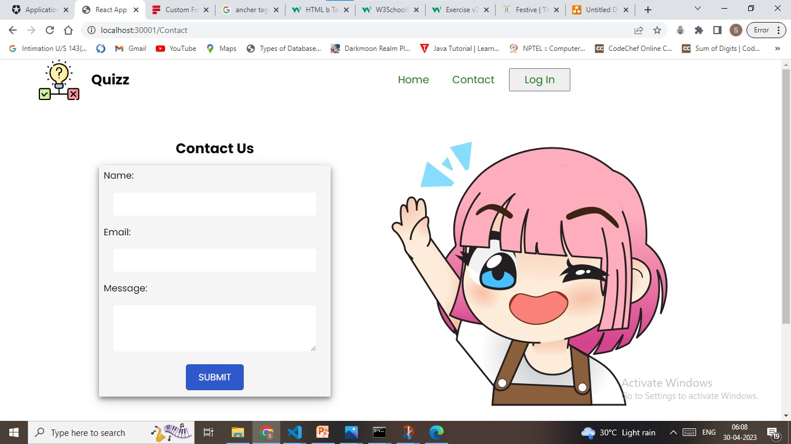
Screenshot
Contact Us
11

Slide 12
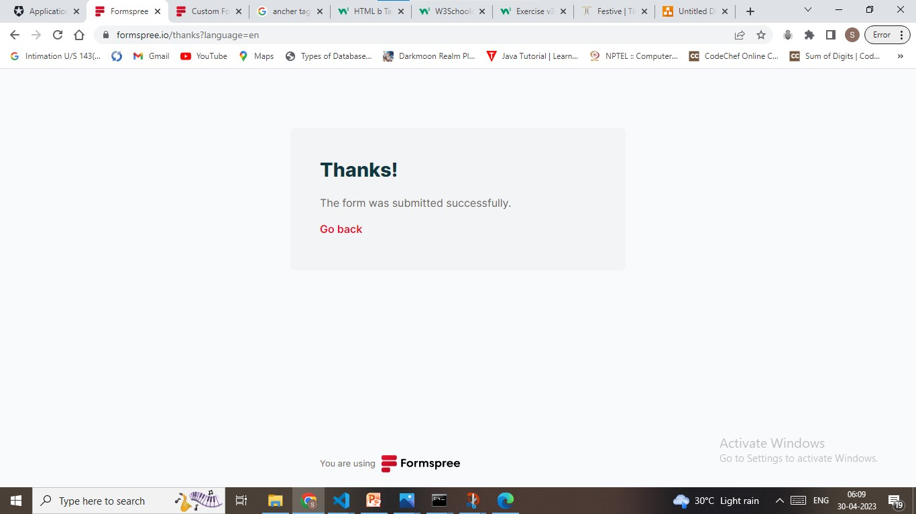
Screenshot
Thanking page
12

Slide 13
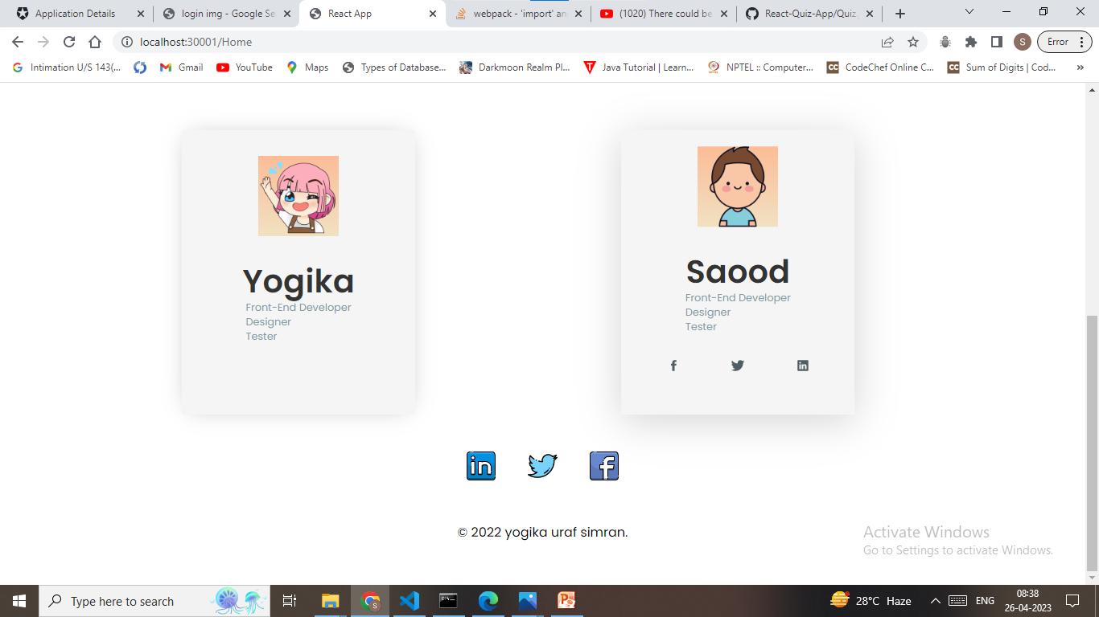
Screenshot
About Us
13

Slide 14
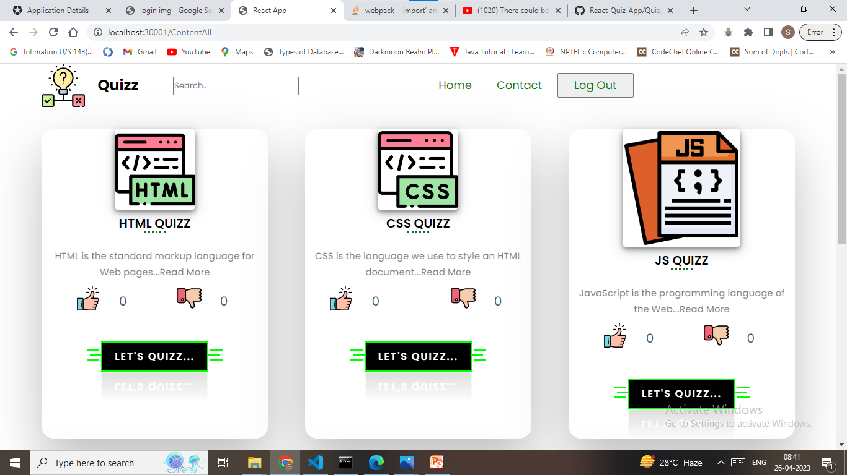
Screenshot
Menu page
14

Slide 15
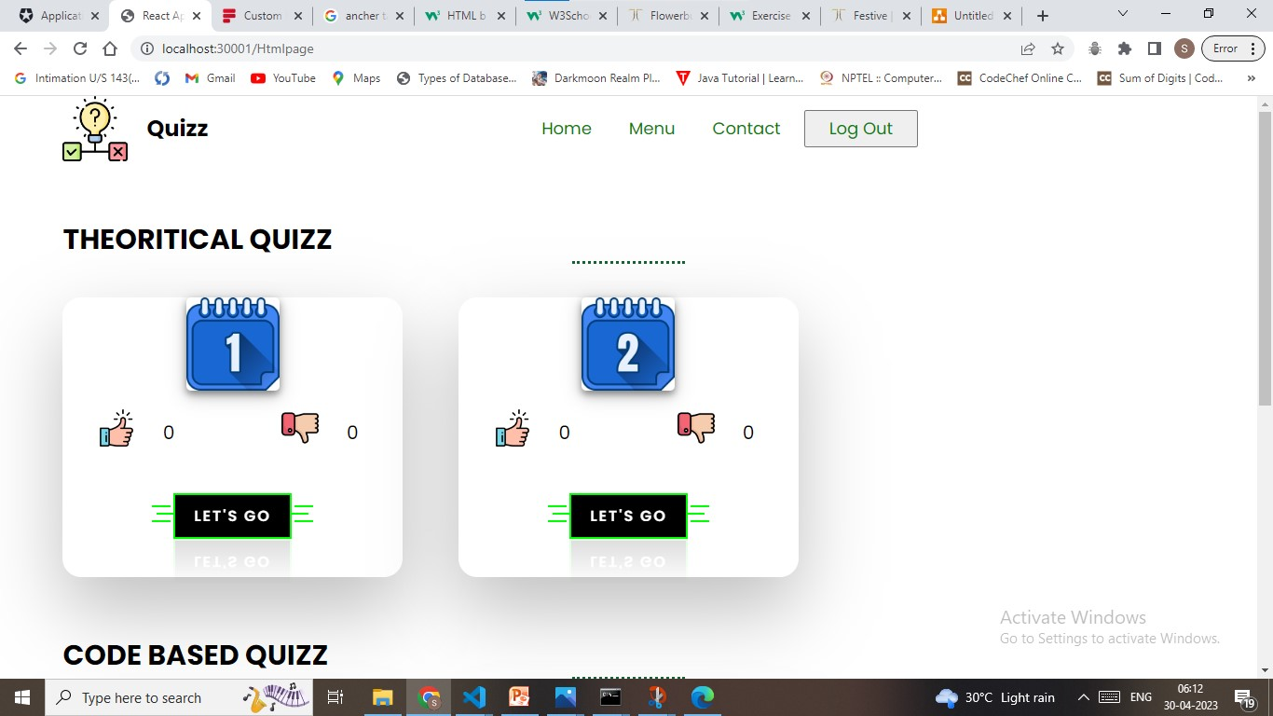
Screenshot
Html Theoretical Quiz
15

Slide 16
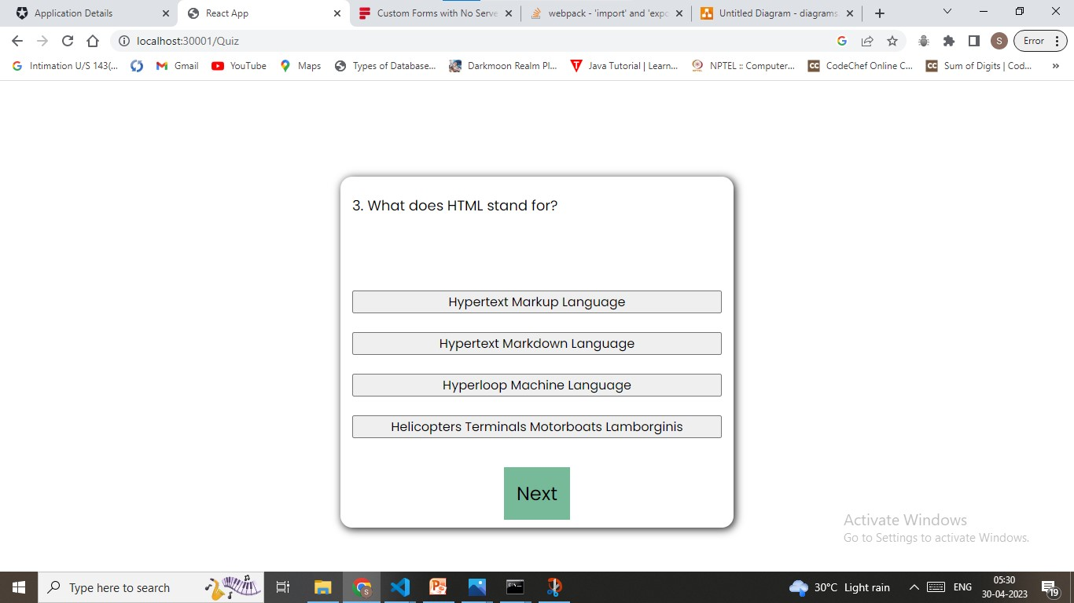
Screenshot
Html Theoretical Quiz
16

Slide 17
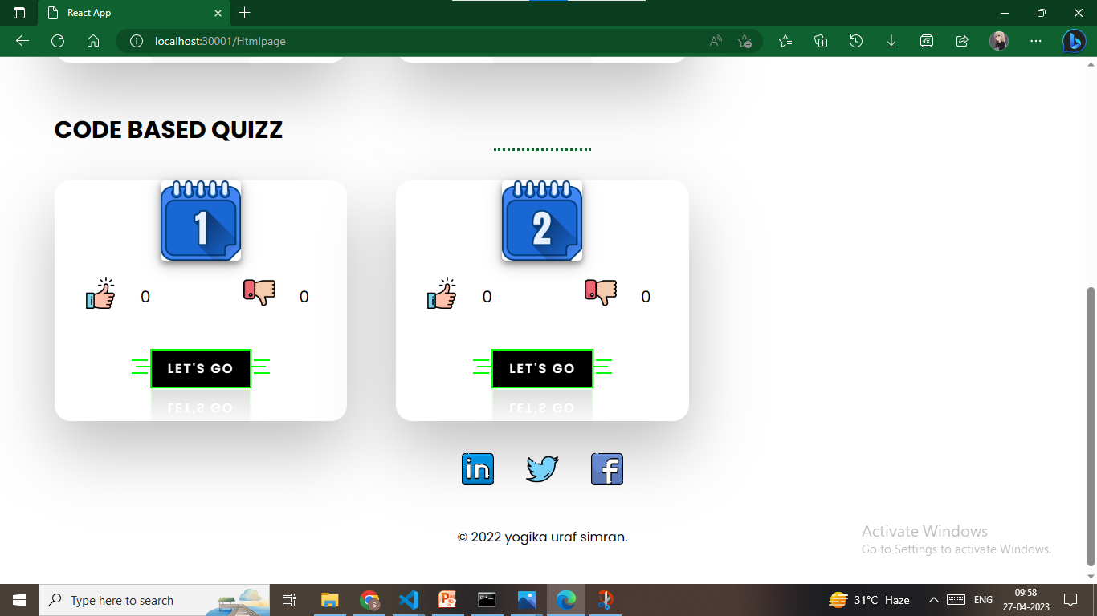
Screenshot
Html Code Based quiz
17

Slide 18
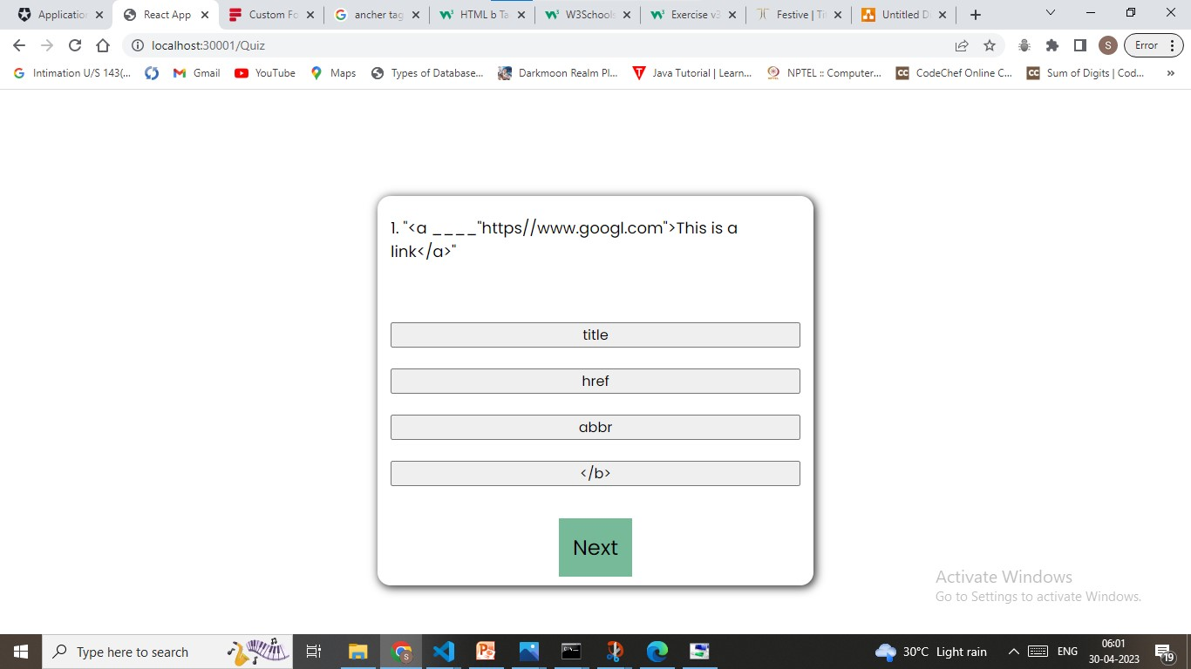
Screenshot
Html Code Based quiz
18

Slide 19
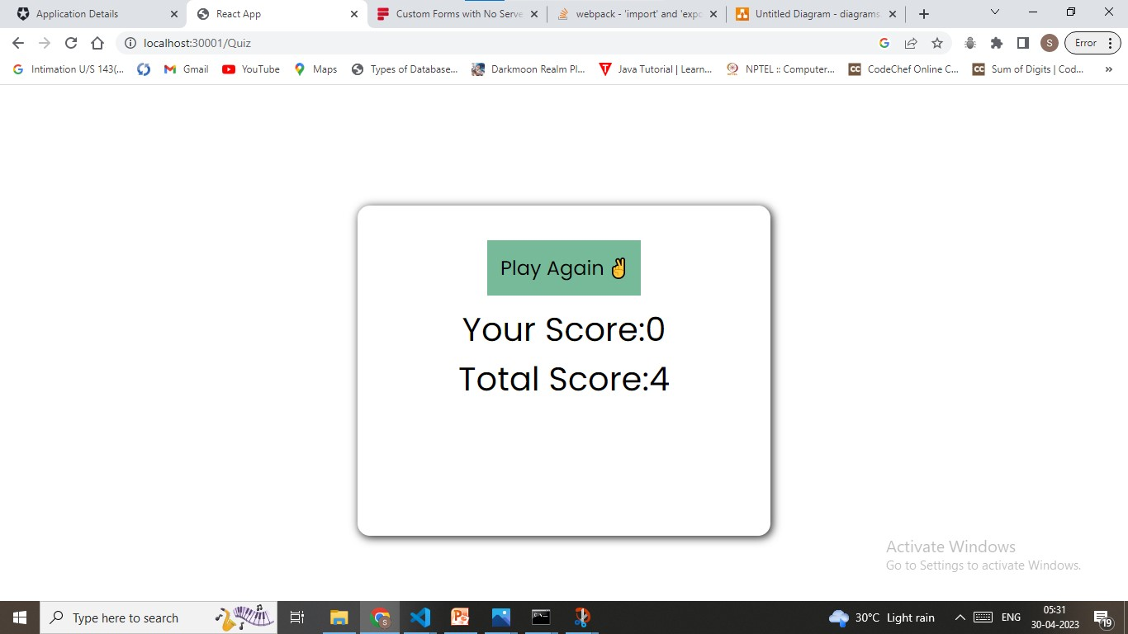
Screenshot
Quiz-Result page
19

Slide 20
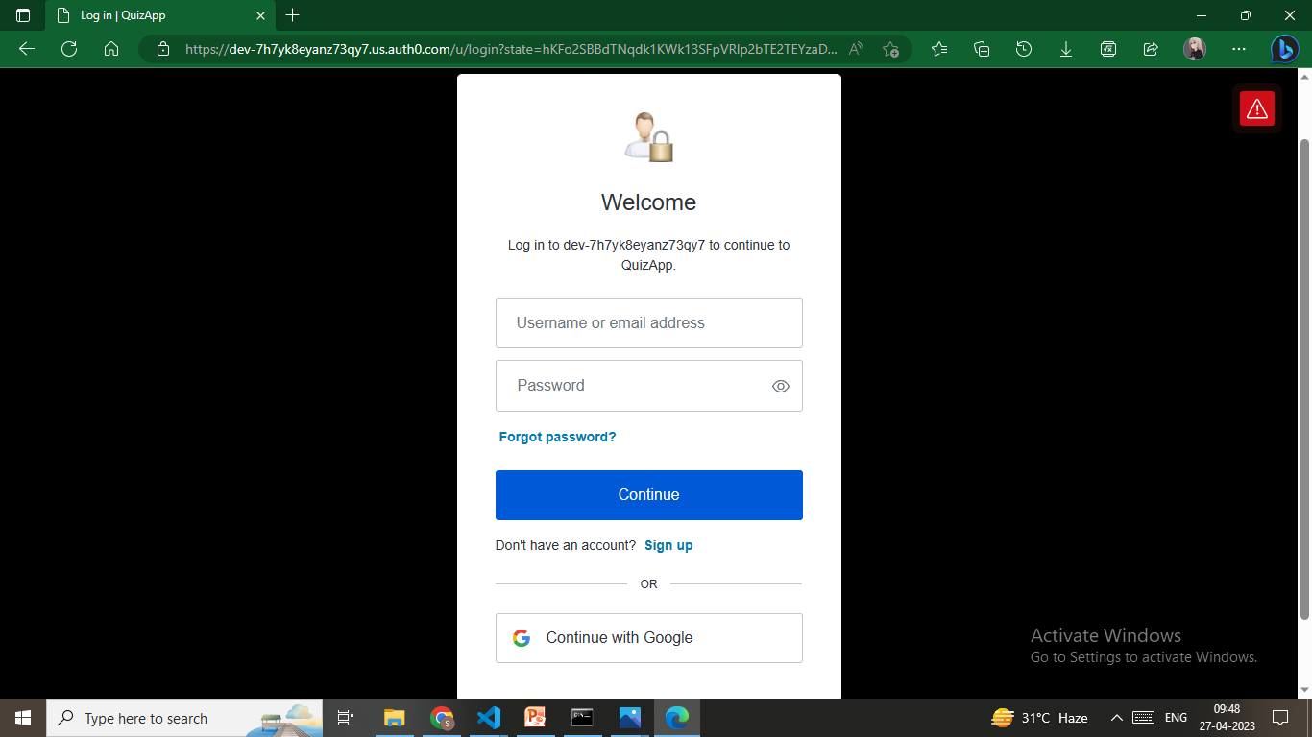
Screenshot
Login page
20

Slide 21
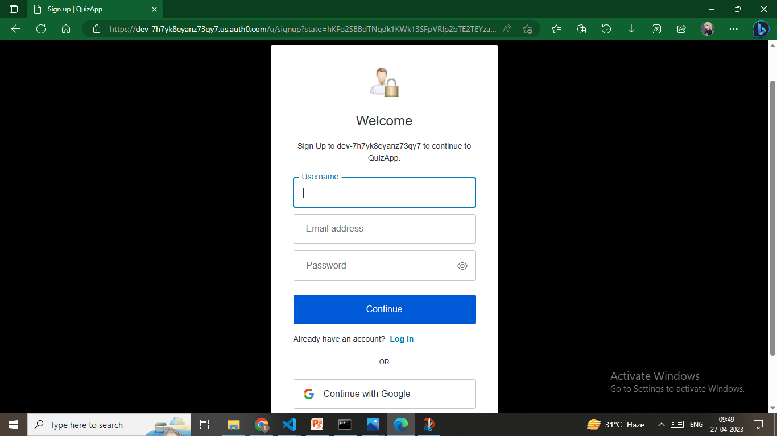
Screenshot
Signup page
21

Slide 22
THANKS

