Slide 1
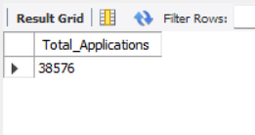
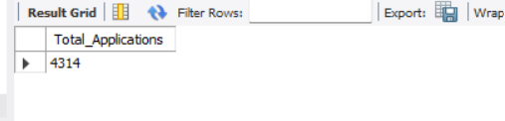
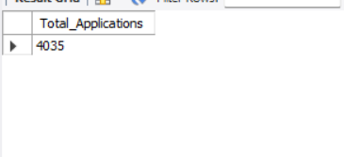
BANK LOAN REPORT QUERY DOCUMENT
BANK LOAN REPORT | SUMMARY
KPI’s:
Total Loan Applications
SELECT COUNT(id) AS Total_Applications FROM bank_loan_data
MTD Loan Applications
SELECT COUNT(id) AS Total_Applications FROM bank_loan_data
WHERE MONTH(issue_date) = 12
PMTD Loan Applications SELECT COUNT(id) AS Total_Applications FROM bank_loan_data
WHERE MONTH(issue_date) = 11

Slide 2
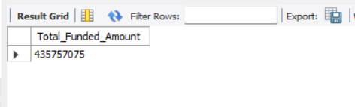
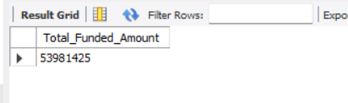
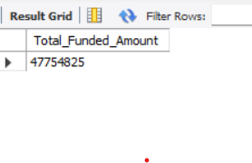
Total Funded Amount
SELECT SUM(loan_amount) AS Total_Funded_Amount FROM bank_loan_data
MTD Total Funded Amount
SELECT SUM(loan_amount) AS Total_Funded_Amount FROM bank_loan_data
WHERE MONTH(issue_date) = 12
PMTD Total Funded Amount
SELECT SUM(loan_amount) AS Total_Funded_Amount FROM bank_loan_data
WHERE MONTH(issue_date) = 11

Slide 3
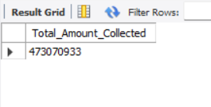
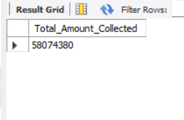
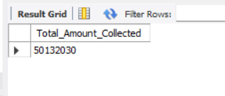
Total Amount Received
SELECT SUM(total_payment) AS Total_Amount_Collected FROM bank_loan_data
MTD Total Amount Received
SELECT SUM(total_payment) AS Total_Amount_Collected FROM bank_loan_data
WHERE MONTH(issue_date) = 12
PMTD Total Amount Received
SELECT SUM(total_payment) AS Total_Amount_Collected FROM bank_loan_data
WHERE MONTH(issue_date) = 11

Slide 4
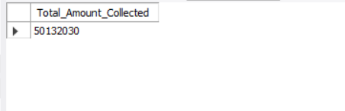
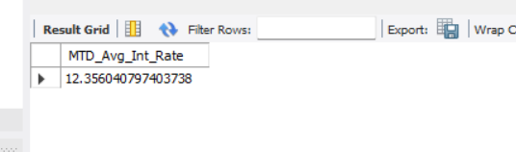
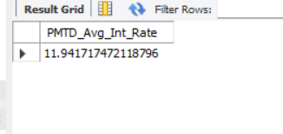
Average Interest Rate
SELECT AVG(int_rate)*100 AS Avg_Int_Rate FROM
Financial_loan
MTD Average Interest
SELECT AVG(int_rate)*100 AS MTD_Avg_Int_Rate FROM bank_loan_data
WHERE MONTH(issue_date) = 12
PMTD Average Interest
SELECT AVG(int_rate)*100 AS PMTD_Avg_Int_Rate FROM bank_loan_data
WHERE MONTH(issue_date) = 11

Slide 5
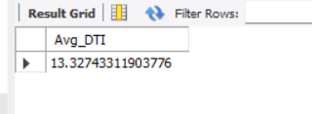
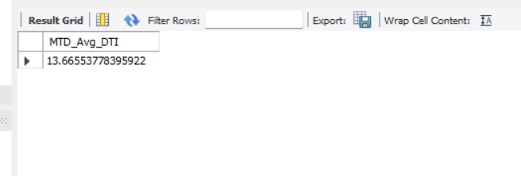
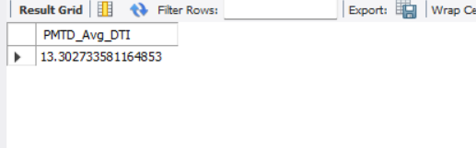
Avg DTI
SELECT AVG(dti)*100 AS Avg_DTI FROM bank_loan_data
MTD Avg DTI
SELECT AVG(dti)*100 AS MTD_Avg_DTI FROM bank_loan_data
WHERE MONTH(issue_date) = 12
PMTD Avg DTI
SELECT AVG(dti)*100 AS PMTD_Avg_DTI FROM bank_loan_data
WHERE MONTH(issue_date) = 11

Slide 6
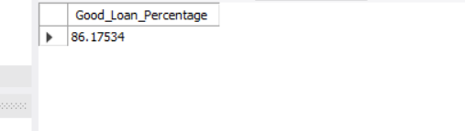
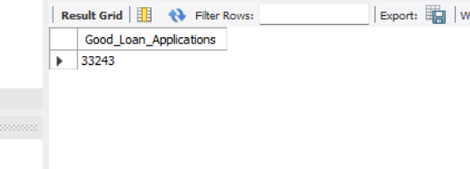
GOOD LOAN ISSUED
Good Loan Percentage
SELECT
(COUNT(CASE WHEN loan_status = 'Fully Paid' OR loan_status = 'Current' THEN id END) * 100.0) /
COUNT(id) AS Good_Loan_Percentage
FROM bank_loan_data
Good Loan Applications
SELECT COUNT(id) AS Good_Loan_Applications FROM bank_loan_data
WHERE loan_status = 'Fully Paid' OR loan_status = 'Current'

Slide 7
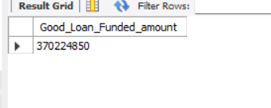
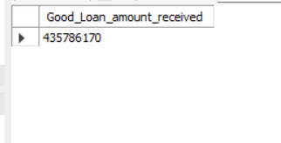
Good Loan Funded Amount
SELECT SUM(loan_amount) AS Good_Loan_Funded_amount FROM bank_loan_data
WHERE loan_status = 'Fully Paid' OR loan_status = 'Current'
Good Loan Amount Received
SELECT SUM(total_payment) AS Good_Loan_amount_received FROM bank_loan_data
WHERE loan_status = 'Fully Paid' OR loan_status = 'Current'

Slide 8
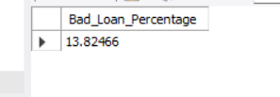
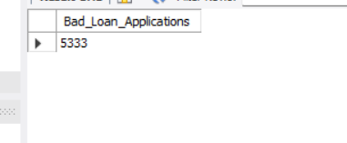
BAD LOAN ISSUED
Bad Loan Percentage
SELECT
(COUNT(CASE WHEN loan_status = 'Charged Off' THEN id END) * 100.0) /
COUNT(id) AS Bad_Loan_Percentage
FROM bank_loan_data
Bad Loan Applications
SELECT COUNT(id) AS Bad_Loan_Applications FROM bank_loan_data
WHERE loan_status = 'Charged Off'

Slide 9
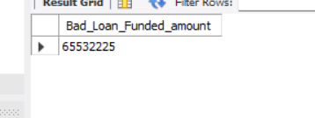
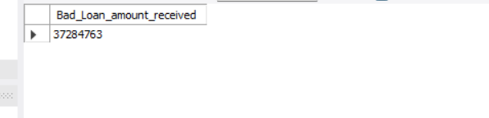
Bad Loan Funded Amount
SELECT SUM(loan_amount) AS Bad_Loan_Funded_amount FROM bank_loan_data
WHERE loan_status = 'Charged Off'
Bad Loan Amount Received
SELECT SUM(total_payment) AS Bad_Loan_amount_received FROM bank_loan_data
WHERE loan_status = 'Charged Off'

Slide 10
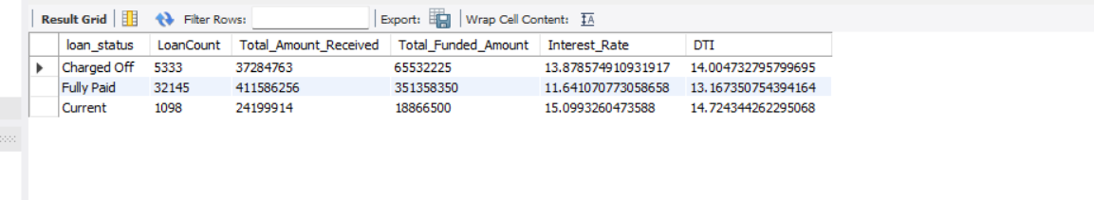
LOAN STATUS
SELECT
loan_status,
COUNT(id) AS LoanCount,
SUM(total_payment) AS Total_Amount_Received,
SUM(loan_amount) AS Total_Funded_Amount,
AVG(int_rate * 100) AS Interest_Rate,
AVG(dti * 100) AS DTI
FROM
bank_loan_data
GROUP BY
loan_status

Slide 11
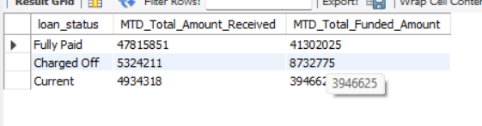
SELECT
loan_status,
SUM(total_payment) AS MTD_Total_Amount_Received,
SUM(loan_amount) AS MTD_Total_Funded_Amount
FROM bank_loan_data
WHERE MONTH(issue_date) = 12
GROUP BY loan_status

Slide 12
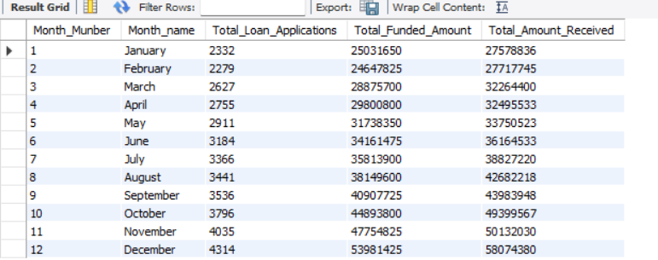
BANK LOAN REPORT | OVERVIEW
MONTH
SELECT
MONTH(issue_date) AS Month_Munber,
DATENAME(MONTH, issue_date) AS Month_name,
COUNT(id) AS Total_Loan_Applications,
SUM(loan_amount) AS Total_Funded_Amount,
SUM(total_payment) AS Total_Amount_Received
FROM bank_loan_data
GROUP BY MONTH(issue_date), DATENAME(MONTH, issue_date)
ORDER BY MONTH(issue_date)

Slide 13
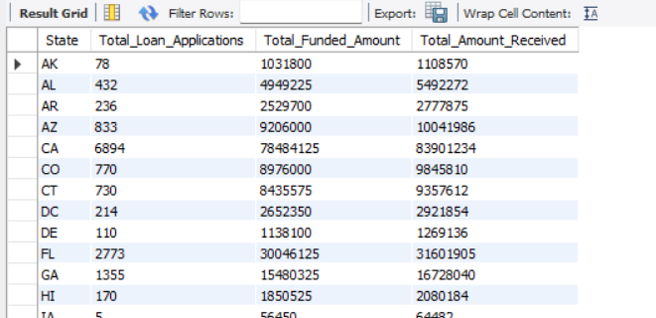
STATE
SELECT
address_state AS State,
COUNT(id) AS Total_Loan_Applications,
SUM(loan_amount) AS Total_Funded_Amount,
SUM(total_payment) AS Total_Amount_Received
FROM bank_loan_data
GROUP BY address_state
ORDER BY address_state

Slide 14
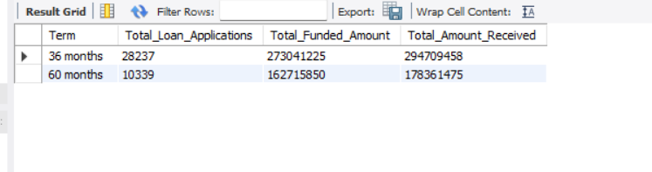
TERM
SELECT
term AS Term,
COUNT(id) AS Total_Loan_Applications,
SUM(loan_amount) AS Total_Funded_Amount,
SUM(total_payment) AS Total_Amount_Received
FROM bank_loan_data
GROUP BY term
ORDER BY term

Slide 15
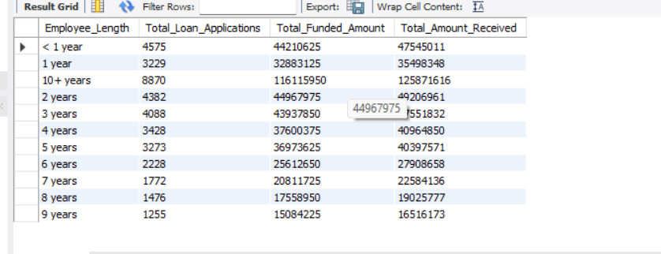
EMPLOYEE LENGTH
SELECT
emp_length AS Employee_Length,
COUNT(id) AS Total_Loan_Applications,
SUM(loan_amount) AS Total_Funded_Amount,
SUM(total_payment) AS Total_Amount_Received
FROM bank_loan_data
GROUP BY emp_length
ORDER BY emp_length

Slide 16
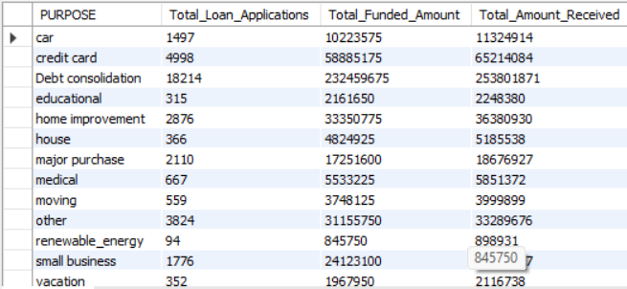
PURPOSE
SELECT
purpose AS PURPOSE,
COUNT(id) AS Total_Loan_Applications,
SUM(loan_amount) AS Total_Funded_Amount,
SUM(total_payment) AS Total_Amount_Received
FROM bank_loan_data
GROUP BY purpose
ORDER BY purpose

Slide 17
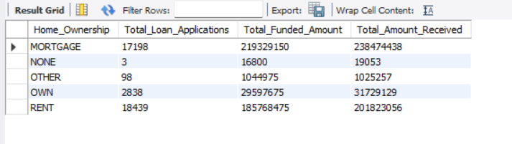
HOME OWNERSHIP
SELECT
home_ownership AS Home_Ownership,
COUNT(id) AS Total_Loan_Applications,
SUM(loan_amount) AS Total_Funded_Amount,
SUM(total_payment) AS Total_Amount_Received
FROM bank_loan_data
GROUP BY home_ownership
ORDER BY home_ownership

