Slide 1

E-Banking
Login and regestration
Name:- Yogiram Duddukuri
Reg no:-192011437

Slide 2
AIM :- To analyse E-banking applications for INDIAN bank

Slide 3
REQUIREMENTS :-
LOGIN MODULE –
1.user ID
2.password
3.i agree with the terms and conditions
4.forgot password
5.login
6.new user or new registration

Slide 4
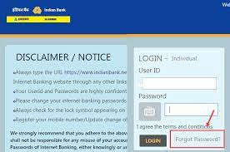
Login interface of Indian bank

Slide 5
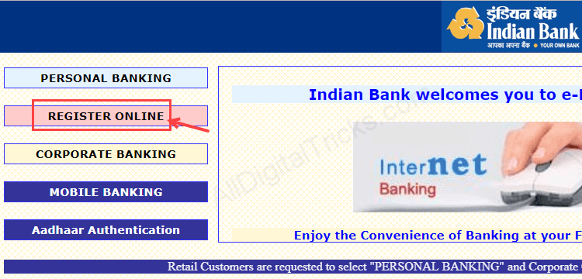
Regestration process:-

Slide 6
3 important layers of e-banking:-
1. Admin interface :- for managing the application
2. user interface :- Conducting business operations
3. database :- to communicate with banking database

Slide 7
E- Banking software for software testers:-
- BSFI (banking financial services and insurance ) largest domine in terms of
revenue.
- ERP ( Enterprise resource planning ) largest domine in terms of value.
- telecom
- Health care
- Retail market
- logistics
- e commerce
- games etc
[ single application is not suitable for all banking applications )

Slide 8
Important Banking software applications:-
- core banking
- ATM banking
- Internet banking
- mobile banking
- Treasury management system
- Financial management system

Slide 9
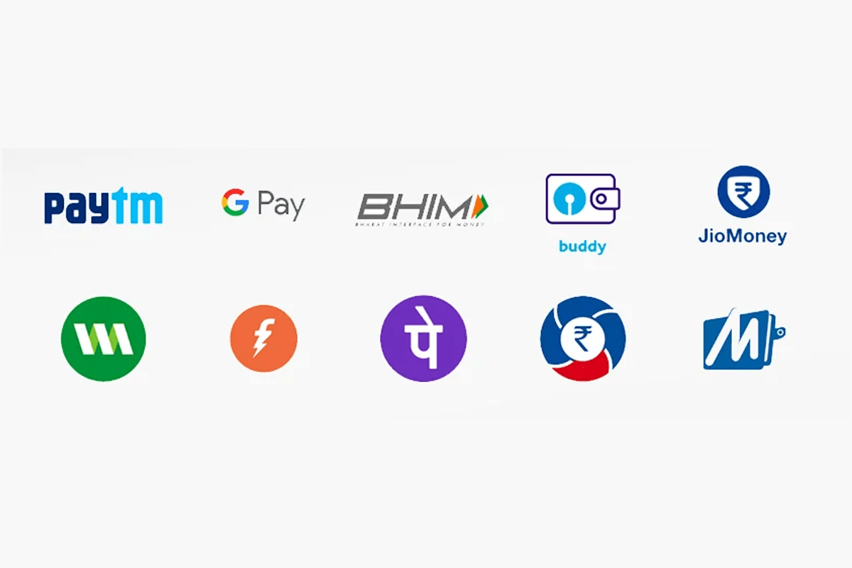
UPI applications:-

Slide 10
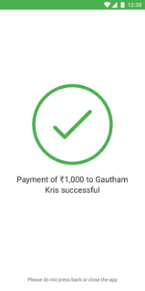
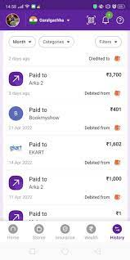
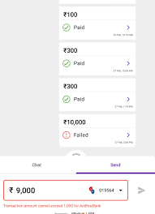

Slide 11
Advantages of E -Banking
- It is available in 24/7
- we can send money in any time
- with this we can check bank balance and transaction history
- No need to revolve around banks
- paying of bills and ticket booking become easy
- login application with internet banking can be done with record

Slide 12
Disadvantages of E- banking:-
- For e-Banking internet connection is required
- To use internet banking basic knowledge is required
- If server is low or net speed is down the online transaction is not possible
- If your password or pin id gose in wrong hands it can be misuse
- It can be difficult to deposit cash
- security risk and money laundering risk

Slide 13
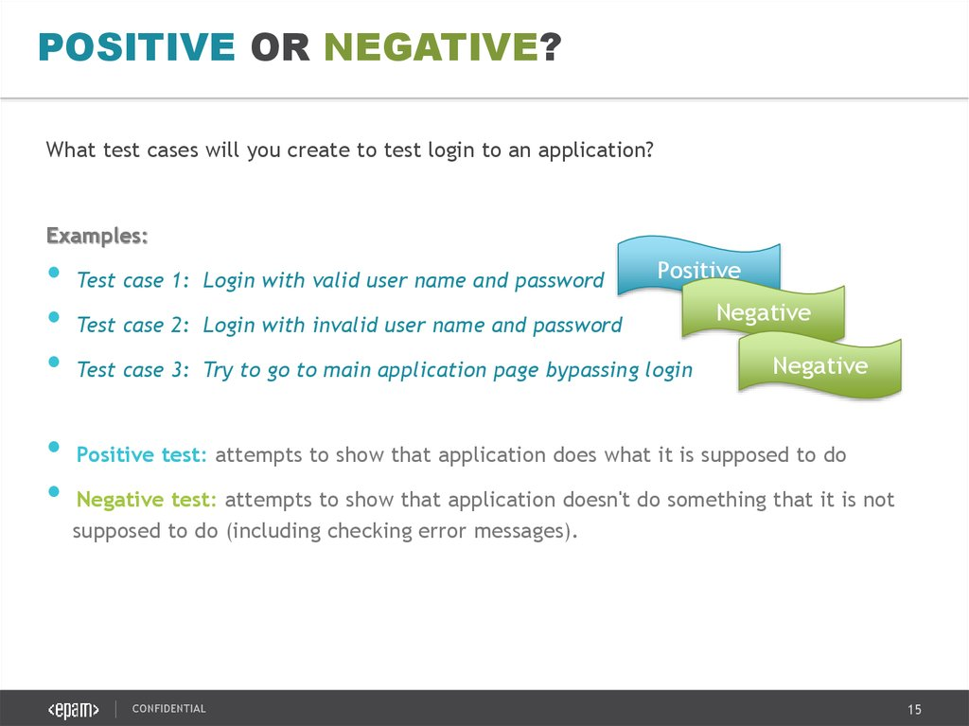
Test cases:-

