Slide 1
CA-1
UI UX
Name: Yogita Yadav
Reg. No. : 12304886
Section : 4OM78
Roll No. : 17

Slide 2
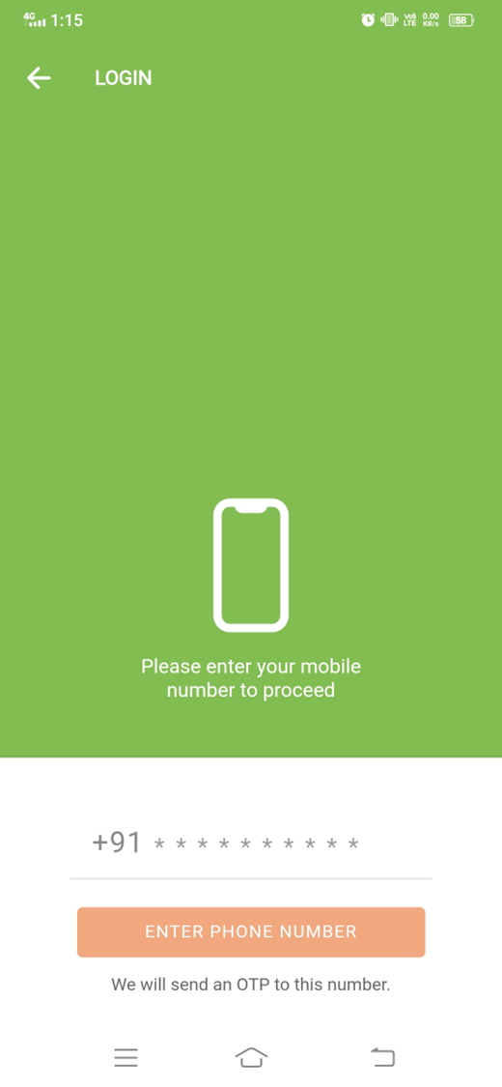
Simple and clean layout makes the screen easy to understand and use.
Pre-filled country code (+91) makes input faster and more convenient.
Clear instruction text helps users know exactly what action to take.
Clear Call-to-Action Button.
OTP message builds trust and explains next step.
Too much empty space makes the screen feel less engaging.
Input field is not clearly visible or highlighted.
No sign-up option for new users.
Weak visual hierarchy reduces focus on key elements.
Unclear button text may confuse users .

Slide 3
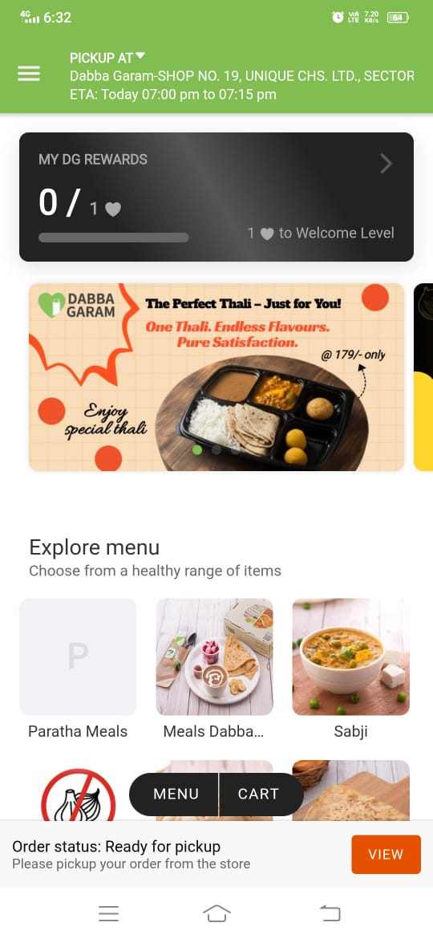
Rewards card adds engagement and motivates users to continue using app.
Attractive food banner grabs attention and creates visual appeal .
Category icons with images make menu browsing easy and intuitive.
Clear pickup information with location and ETA improves user clarity.
Order status bar gives real-time update and quick access to action.
Screen feels slightly crowded with multiple sections and elements.
No Prominent Search Bar.
Some text is too small to read easily.
Visual hierarchy is weak, important elements don’t stand out clearly.
Too much scrolling needed to explore full menu.

Slide 4
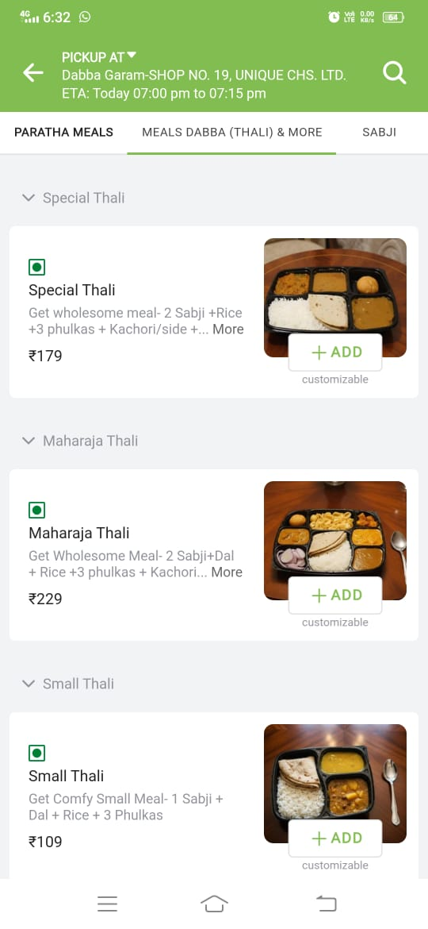
Category tabs with active highlight make current section clearly visible.
Grouping items under headings like “Special Thali” improves content structure.
“Add” button with “customizable” label informs users about available options.
Clear price display helps quick decision making without confusion.
Veg indicator provides quick visual identification for dietary preference.
No filter/sort options for better menu exploration.
Limited detailed info like ingredients or nutrition.
Important details like customization are not clickable or clearly explained.
Description text is truncated with “More” but not very noticeable or accessible.
No ratings or reviews make it hard to judge item quality.

Slide 5
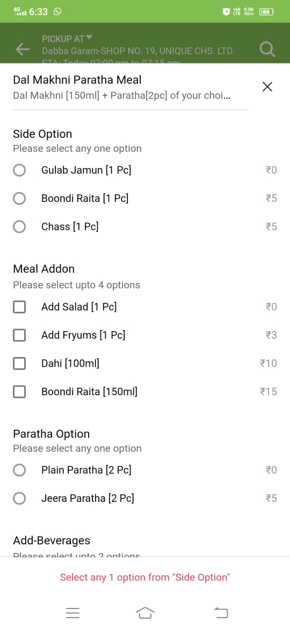
Clear section grouping like “Side Option”, “Meal Addon”, improves form structure.
Use of radio buttons and checkboxes makes selection type clear.
Price for each option is clearly visible, avoiding confusion.
Instruction text like “select any one option” guides user actions.
Error message at bottom provides feedback when selection is incomplete .
Screen feels crowded with too many options in one view.
Small text size reduces readability, especially for descriptions.
Lack of visual separation between sections makes it harder to scan.
No images for add-ons makes options less engaging and harder to choose .
Error message placement at bottom is not very prominent or attention-grabbing.

Slide 6
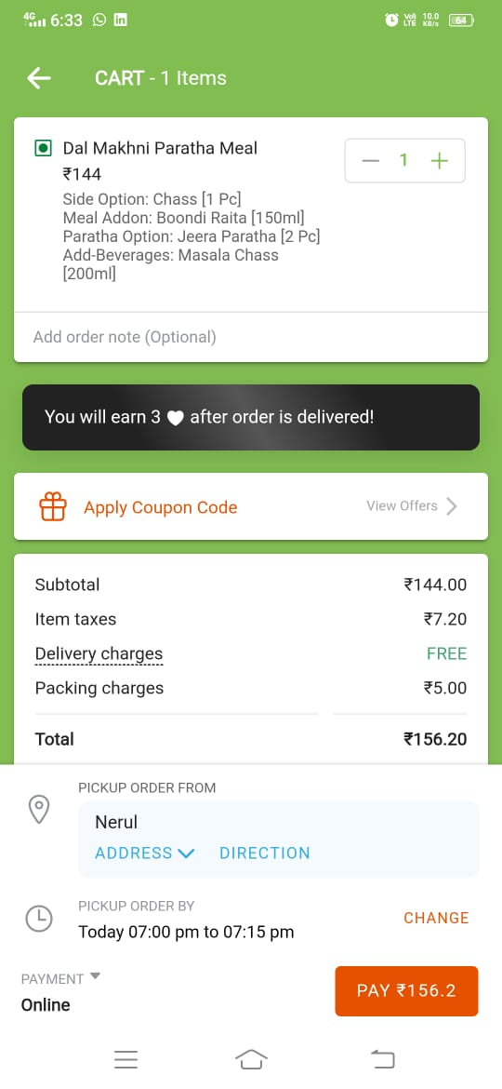
Clear cart summary with item details and customization improves transparency.
Easy quantity control with “+ / –” buttons supports quick modification.
Coupon section is clearly visible and easy to access .
Detailed price breakdown builds trust and avoids confusion.
Strong and visible “Pay” button makes final action clear.
Screen feels crowded with multiple sections stacked together.
Item customization details are text-heavy and hard to quickly scan.
Rewards banner takes space but is not very actionable.
Coupon section adds extra step instead of quick apply option.
Total amount is not strongly highlighted compared to other text.

Slide 7
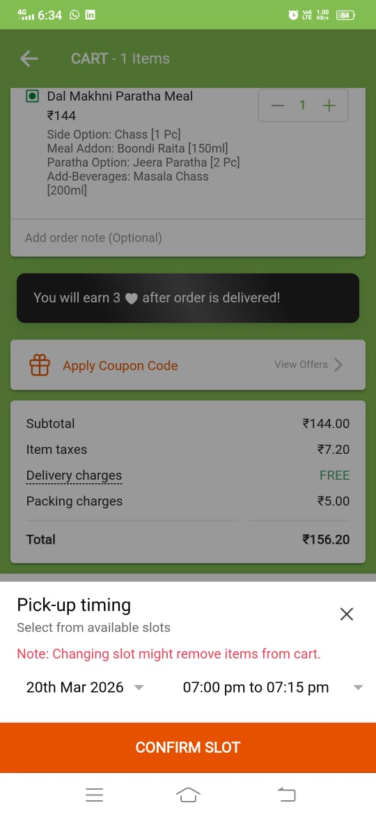
Bottom sheet layout keeps context of cart while selecting slot.
Clear heading “Pick-up timing” makes purpose of screen obvious.
Date and time slots are clearly displayed for easy selection.
Warning message informs users about impact of changing slot.
“Confirm Slot” button is large and easy to access.
Background cart content creates slight distraction from slot selection.
Selected slot is not strongly highlighted for clear visibility.
Warning message text is prominent but may create confusion or hesitation.
Limited guidance on available slots or how to choose best option .
No quick suggestions like “earliest available” to speed up decision.

Slide 8
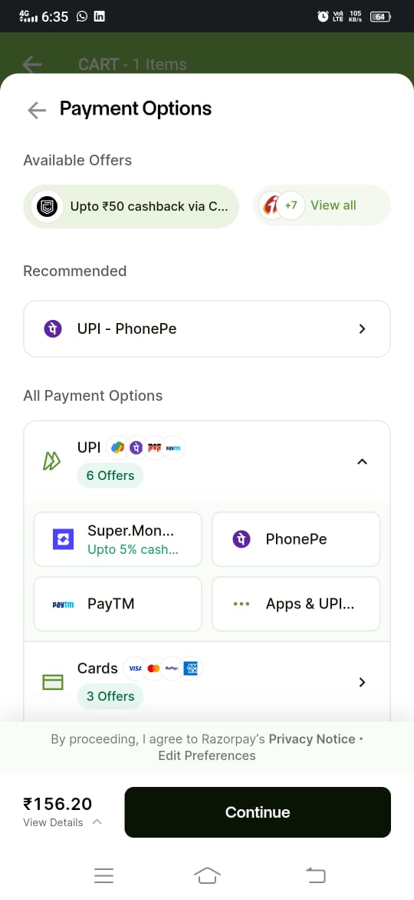
Multiple payment options provide flexibility for different user preferences.
Recommended payment method helps users choose quickly.
Offers and cashback are clearly highlighted to attract users.
Payment methods are grouped (UPI, Cards) for better organization.
Clear total amount with “Continue” button makes next action obvious.
Screen feels slightly cluttered with offers and multiple options.
Selected payment option is not strongly.
Offer details are truncated and not fully clear.
Too many choices may slow decision-making.
No quick pay or default option for faster checkout.

Slide 9
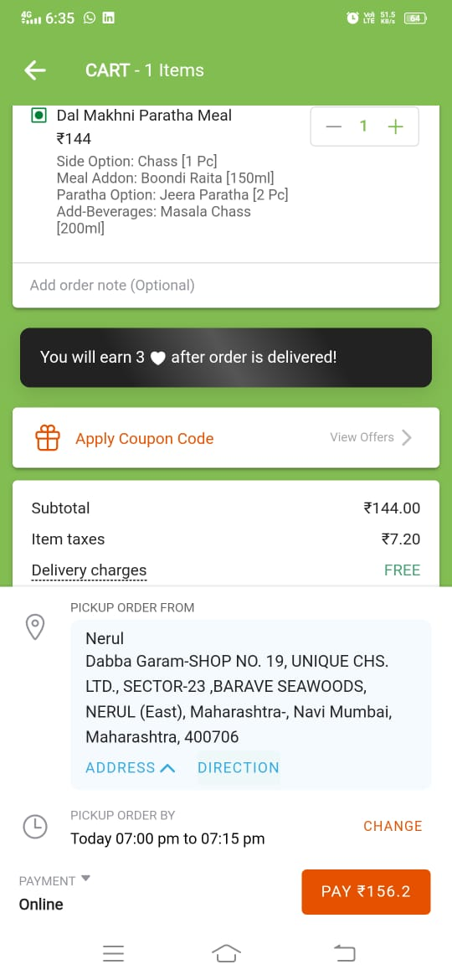
Detailed pickup address provides clarity and avoids confusion.
“Address” and “Direction” options improve usability and navigation.
Pickup time with “Change” option gives flexibility to users.
Clear payment method display keeps user informed before checkout.
Strong “Pay” button makes final action clear and accessible.
Address text is too long and hard to quickly scan.
Screen feels crowded with too much information stacked together.
Important details like total amount are not strongly highlighted.
Address section takes large space pushing key actions downward.
Limited visual hierarchy makes sections look similar and harder to prioritize.

Slide 10
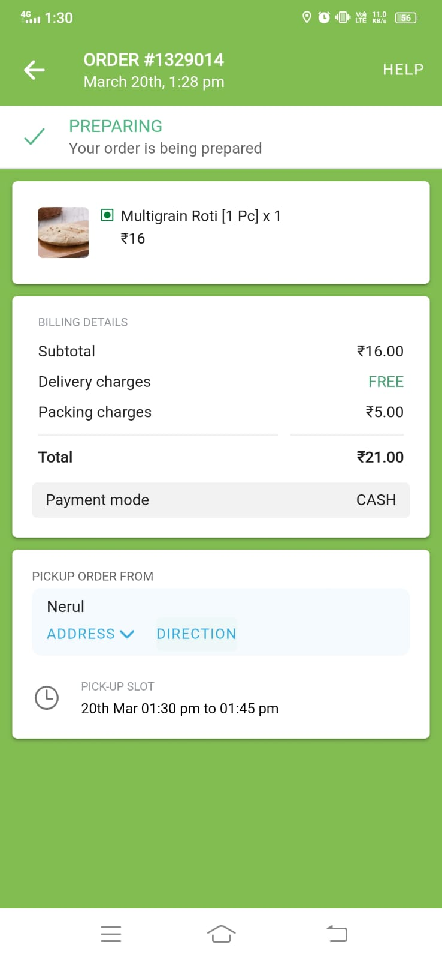
Clear order status “Preparing” keeps user informed in real-time.
Order ID and time provide proper tracking and reference.
Item details with image, quantity, and price are easy to understand.
Billing breakdown with total improves transparency and trust.
Pickup details with address and time give clear delivery information.
No visual progress tracker to show order stages.
Screen has too much empty space at the bottom.
“Help” option is small and not very prominent.
Important info like total amount is not strongly highlighted.
No estimated ready time countdown or live update feedback.

Slide 11
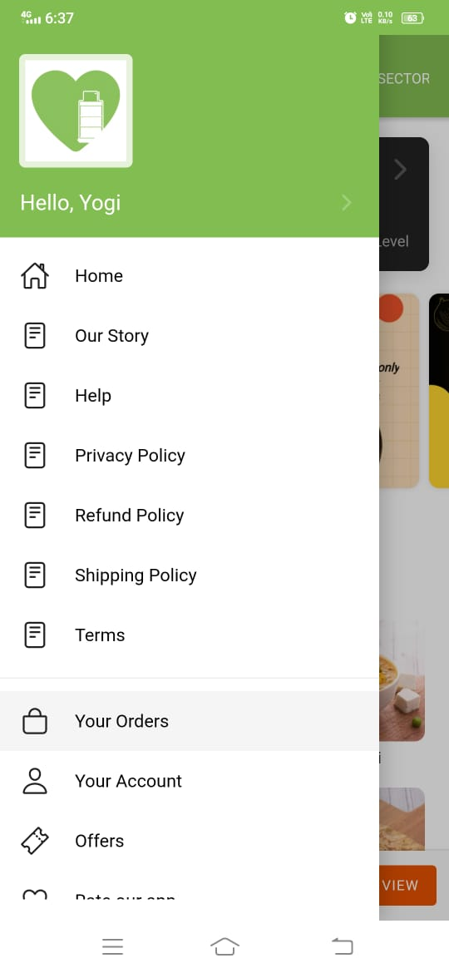
Clear side navigation menu makes options easily accessible.
User name display adds personalization and improves user connection.
Icons with text improve quick recognition of menu items.
Well-structured list of options keeps navigation simple and organized.
Important sections like “Your Orders” and “Account” are easy to find.
Too many policy-related options create clutter and reduce focus.
Lack of visual hierarchy makes all options look equally important.
Large empty space in header reduces effective use of space.
No quick actions like “Track Order” or “Reorder” for faster access.
No profile picture or customization reduces personalization.

Slide 12
Competitor Analysis
Zomato

Slide 13
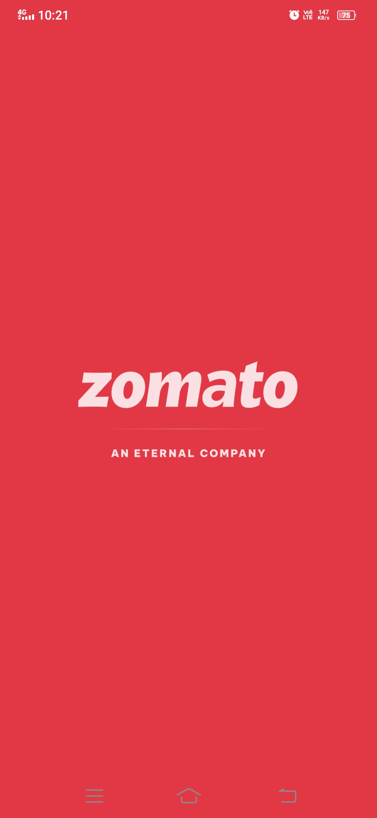
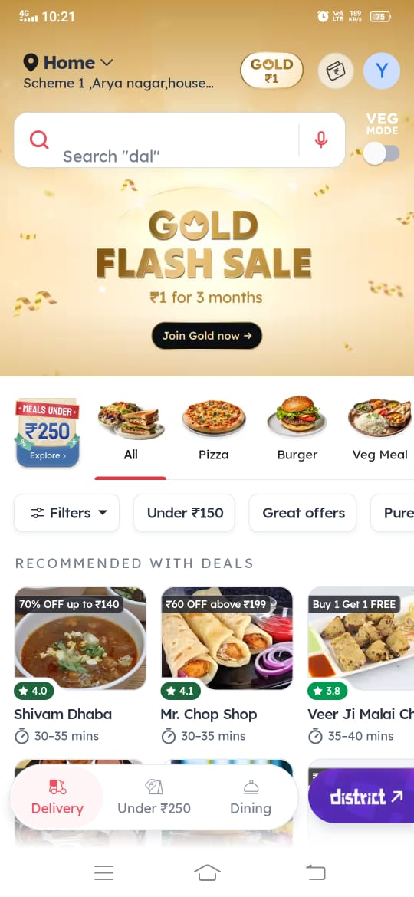
Strong brand identity with bold logo and color creates instant recognition.
Minimal design keeps screen clean and reduces cognitive load.
No loading indicator or feedback makes user unsure if app is progressing.
Screen feels static with no interaction or engagement element.
Search bar with voice option makes searching quick.
Attractive offer banner grabs user attention.
Screen feels cluttered with many elements.
Too many options can confuse users.

Slide 14
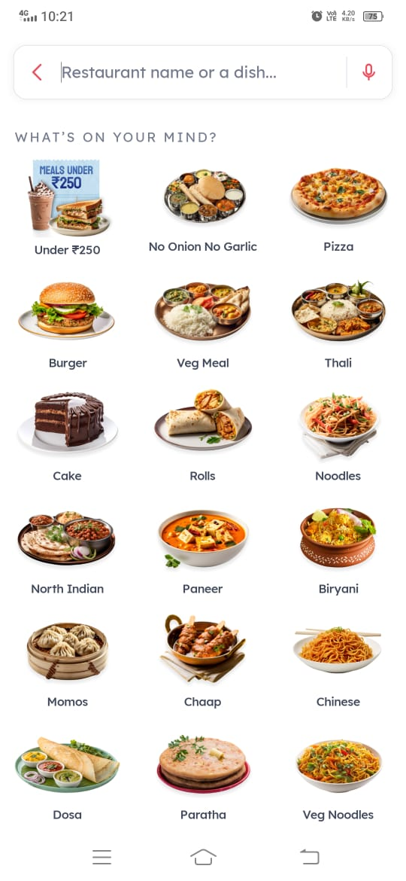
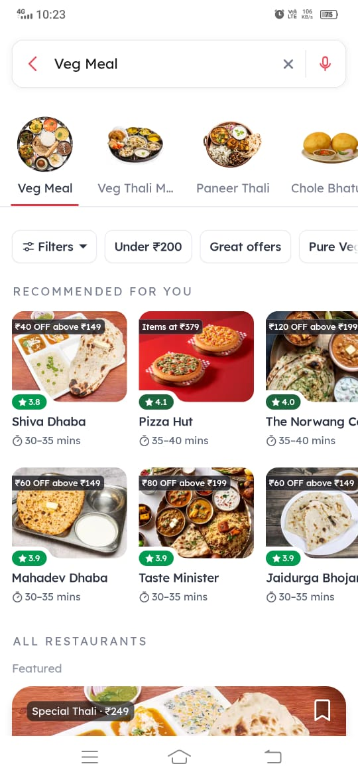
Category images make options easy to recognize and visually appealing.
Clear search bar helps users quickly find dishes or restaurants.
Too many categories on one screen can feel overwhelming.
No filters or sorting options for refining choices.
Filters like “Under ₹200” and “Great offers” help refine choices easily.
Restaurant cards show rating, price, and time clearly for quick decisions.
Screen feels crowded with filters, categories, and listings together.
Too many similar restaurant cards make it hard to differentiate options.

Slide 15
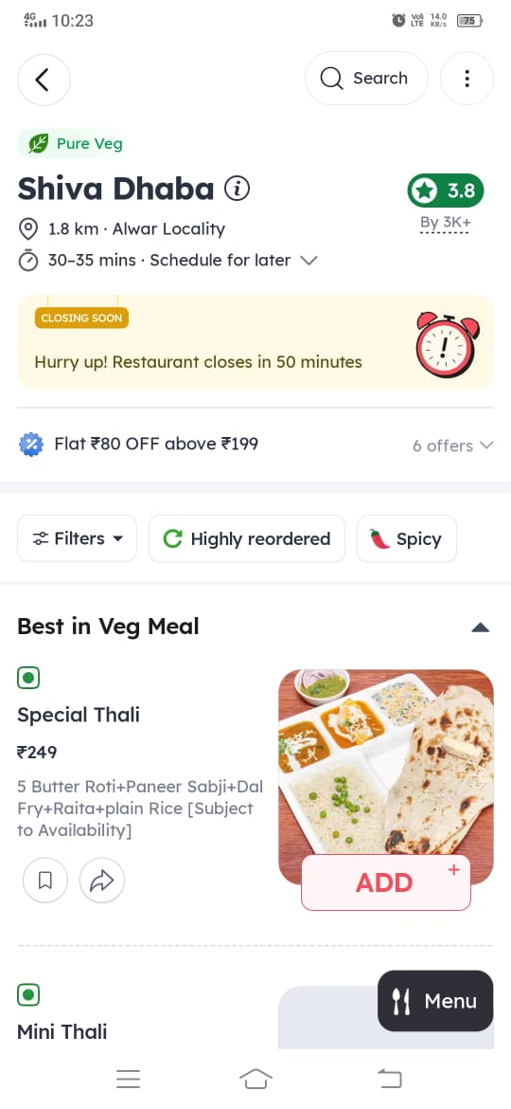
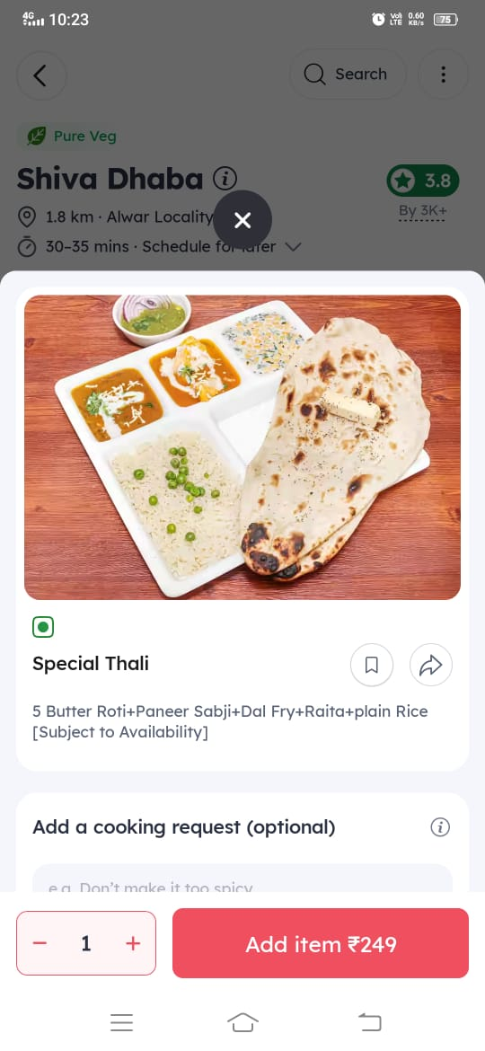
Restaurant info with rating, distance, and time gives quick overview.
Offer banner and “closing soon” alert create urgency and engagement.
Too many elements (offers, filters, alerts) make screen feel cluttered.
Item card layout feels slightly crowded with text and buttons.
Large food image makes item visually appealing and helps decision making.
Clear CTA with price (“Add item ₹249”) makes action obvious.
Popup overlay hides background and reduces context of navigation.
Description text is small and slightly hard to read.

Slide 16
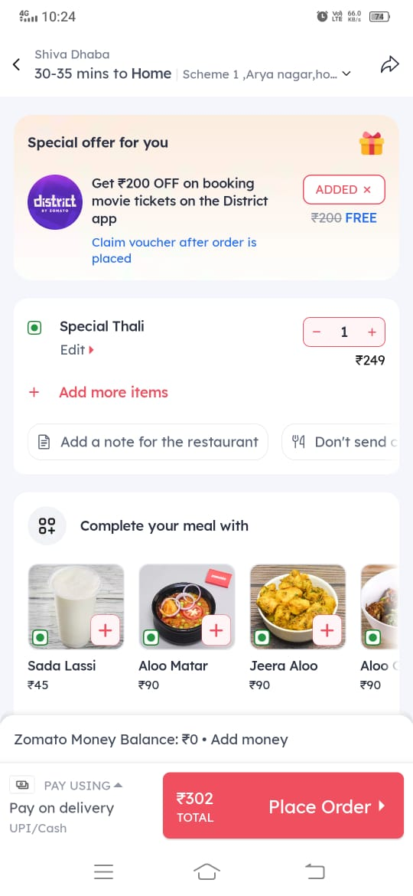
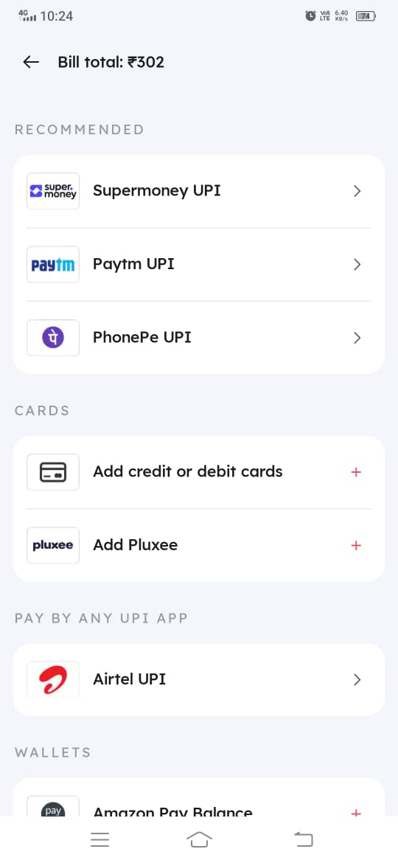
“Place Order” button with total price makes final action very clear.
Add-on suggestions help increase order value and improve discovery.
Screen feels cluttered with offers, items, and suggestions together.
Offer banner at top distracts from main task of ordering.
Multiple payment options provide flexibility and user choice.
Well-grouped sections like UPI, Cards, Wallets improve organization.
No clear highlight of selected payment option.
Too many options can make decision-making slower.

Slide 17
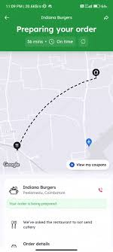
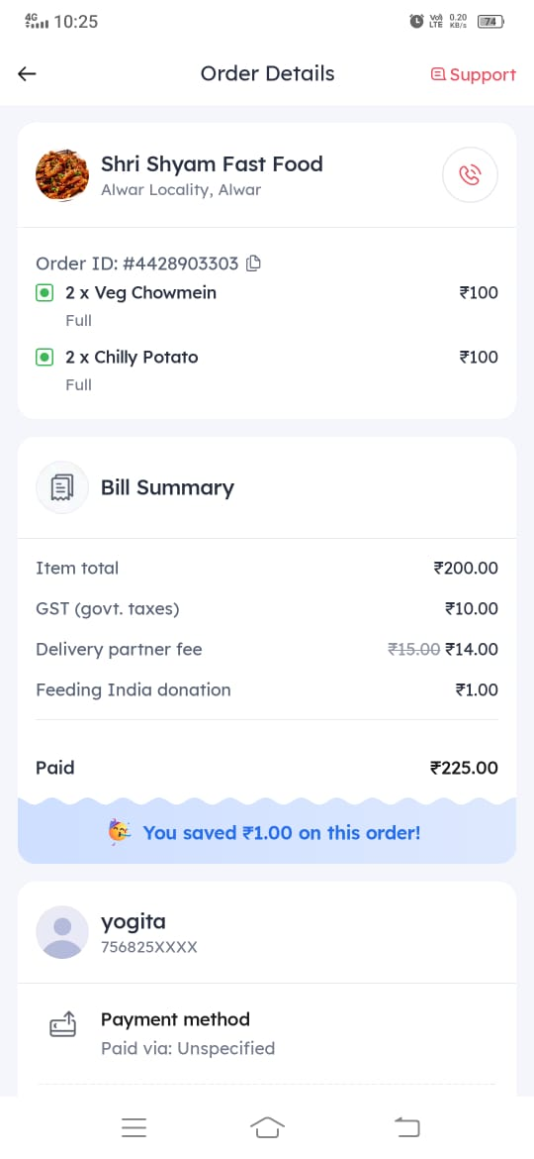
Live map with delivery path gives real-time tracking and transparency.
Clear status “Preparing your order” with time builds user confidence.
Map occupies most of the screen reducing space for other details.
Limited order details visible without scrolling.
Clear order details with items, quantity, and price improve transparency.
Detailed bill summary builds trust with proper cost breakdown.
Screen feels text-heavy and less visually engaging.
Payment method shown as “Unspecified” creates confusion.

Slide 18
Domino’s

Slide 19
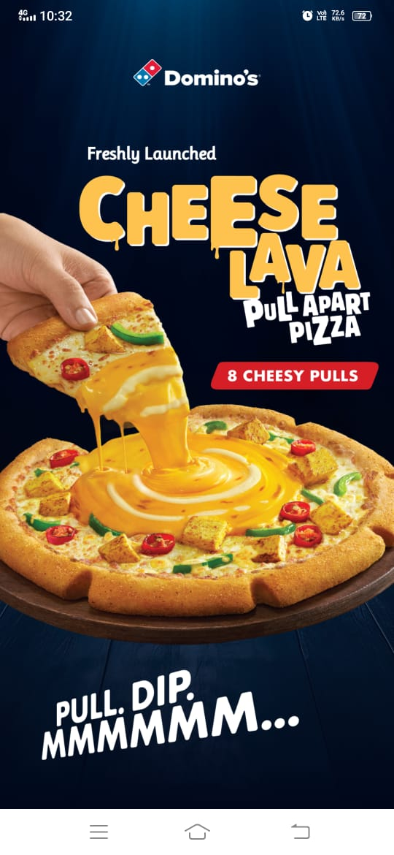
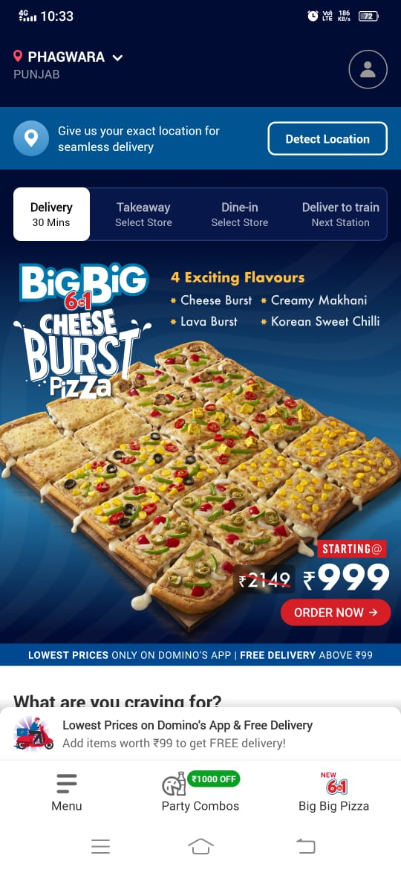
High-quality food visuals create strong craving and engagement.
Bold typography highlights product name and grabs attention.
No clear CTA like “Order Now” reduces action clarity.
Screen is more promotional than functional, lacking interaction elements.
Clear location and delivery options improve user control and flexibility.
Strong promotional banner with clear “Order Now” CTA drives action.
Screen feels cluttered with location, tabs, and banner together.
Too much promotional content reduces focus on browsing menu.

Slide 20
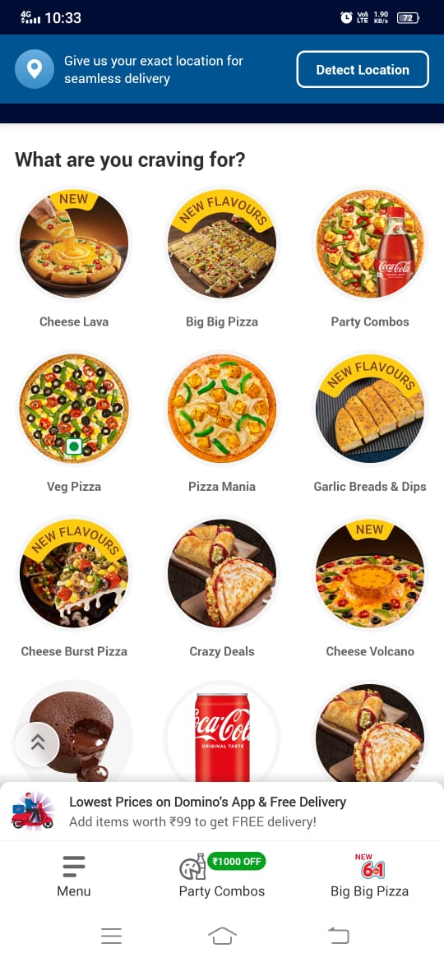
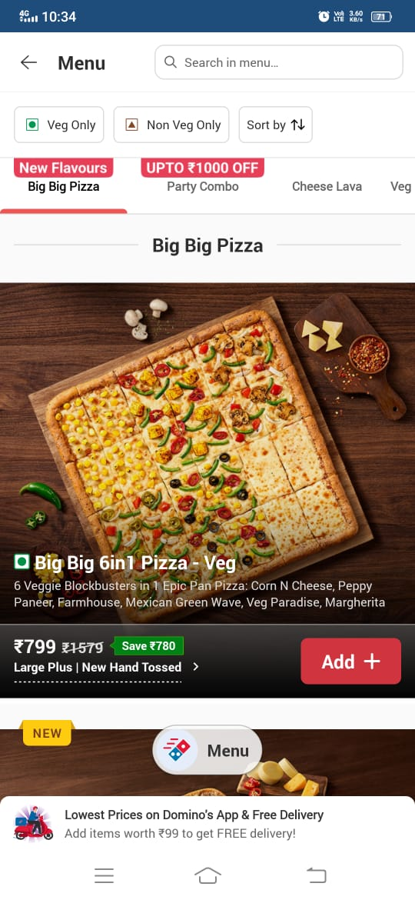
Category icons with images make options easy to recognize.
Clear section title “What are you craving for?” guides user intent.
Too many categories on one screen can feel overwhelming.
Bottom banner overlaps content and reduces visibility.
Search bar with filters helps users quickly find items.
Large product image with price and offer makes decision easy.
Screen feels cluttered with filters, tabs, and banners together.
Bottom banner overlaps content and reduces visibility.

Slide 21
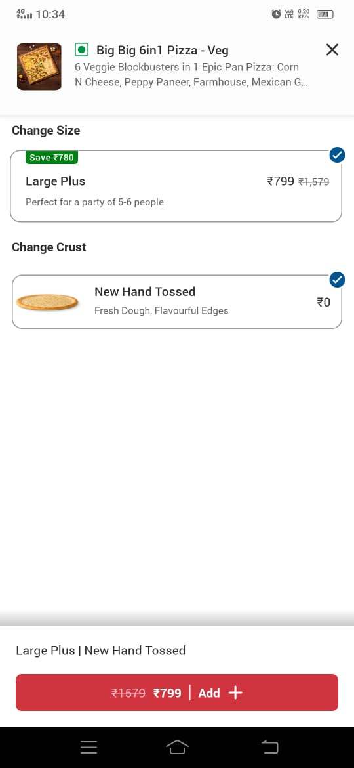
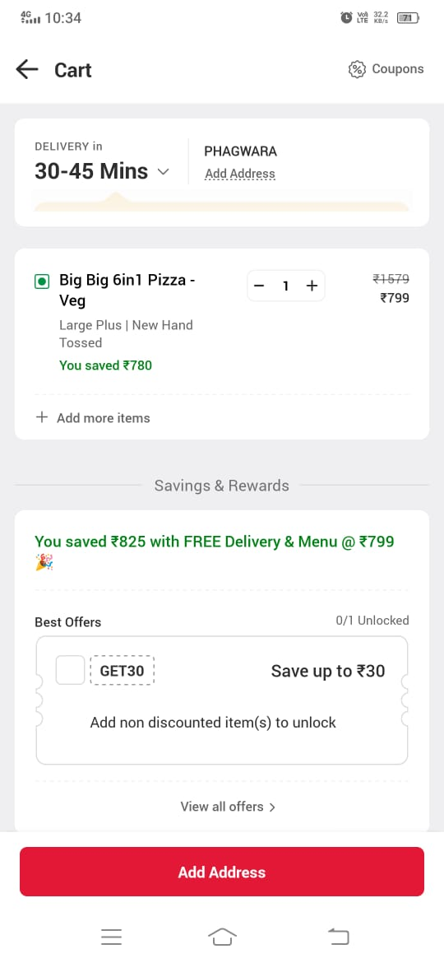
Clear customization options for size and crust improve user control.
Price with discount and final CTA makes decision easy.
Screen feels empty with too much unused space.
Limited customization options visible, reducing flexibility.
Clear delivery time and location info improves transparency.
Savings and discount information highlights value to users.
Screen feels cluttered with offers and rewards sections.
Primary CTA “Add Address” may confuse users instead of showing checkout action.

Slide 22
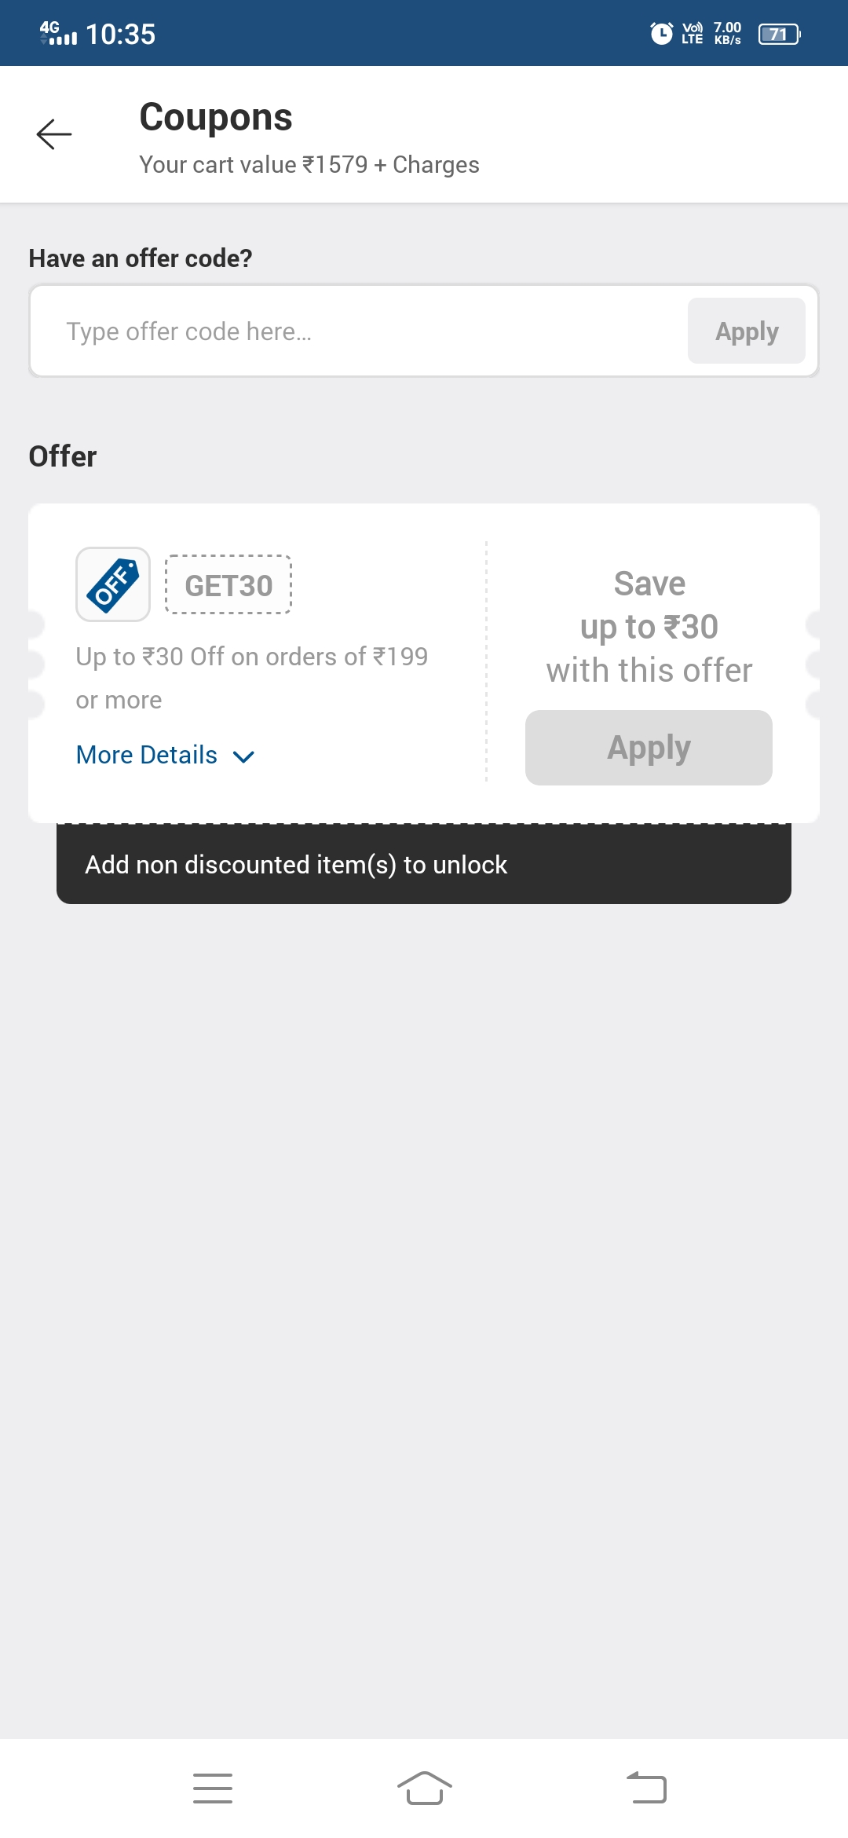
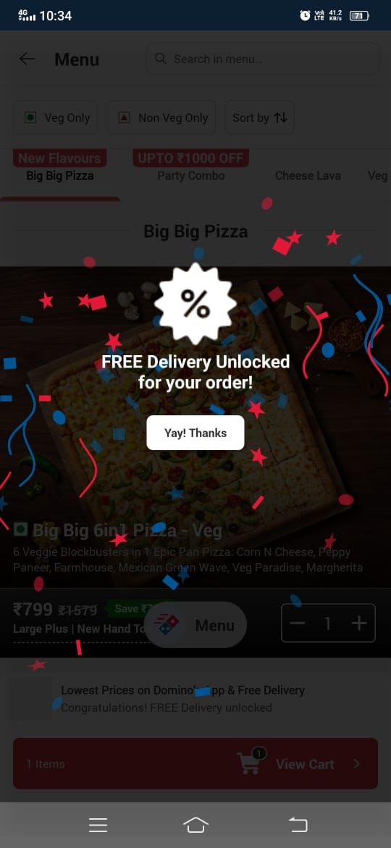
Celebration popup highlights reward clearly and creates positive user emotion .
Message “Free Delivery Unlocked” gives clear feedback and reinforces value.
Popup blocks entire screen and interrupts user flow.
Confetti and visuals create distraction from main task.
Clear coupon code input field allows easy manual entry.
Offer card shows discount details and conditions clearly.
Disabled “Apply” button reduces clarity on how to activate offer.
Screen feels empty with limited available offers.

Slide 23
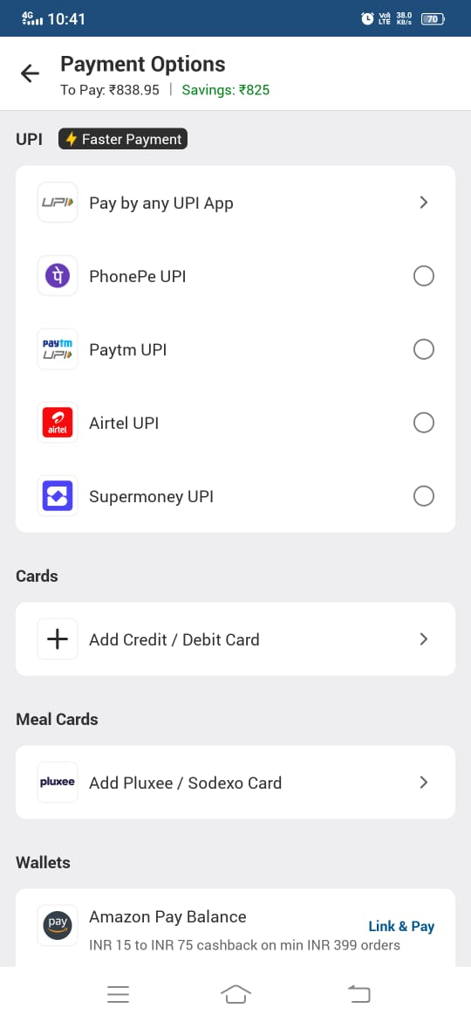
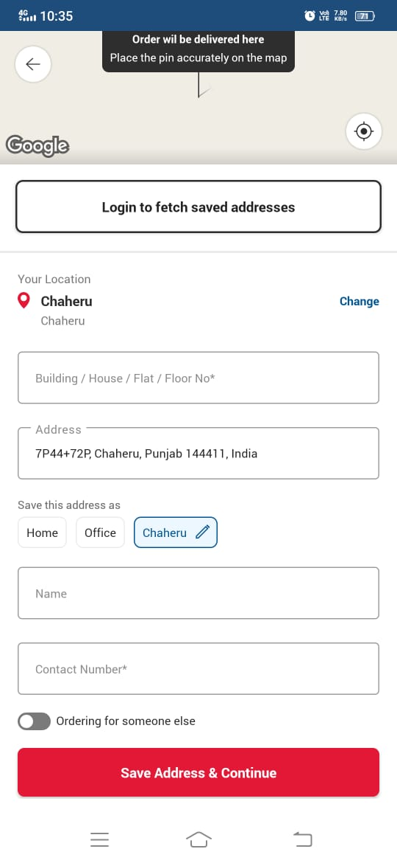
Map with pin helps users set accurate delivery location.
Clear form fields for address details improve data entry.
Screen feels long and form-heavy, increasing effort.
Login prompt at top interrupts flow for quick address entry.
Multiple payment options give flexibility to users.
Clear savings and payable amount builds trust.
No clear highlight of selected payment option.
Too many options can make decision-making slow.

Slide 24
Swiggy

Slide 25
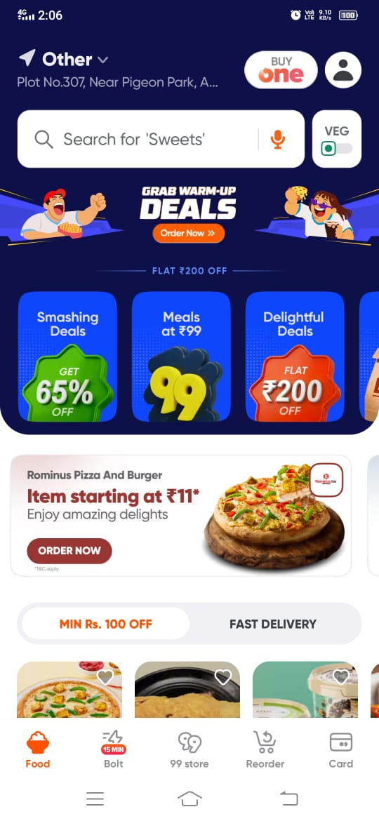
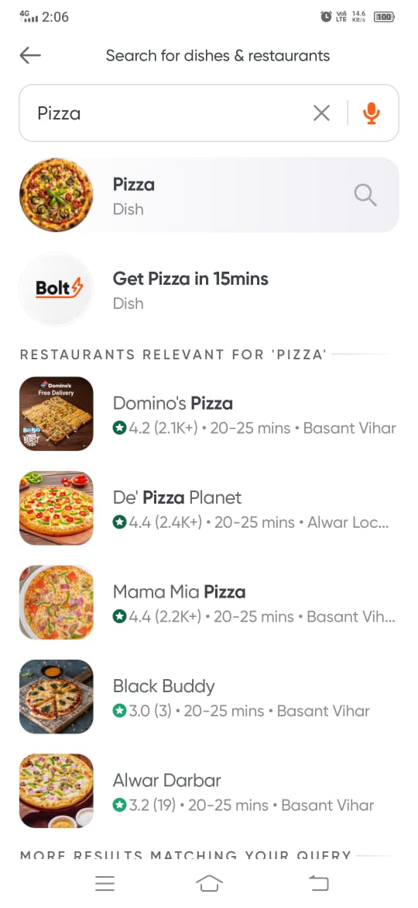
Prominent search bar with voice option enables quick discovery.
Attractive deal cards and banners grab attention and drive engagement.
Screen feels cluttered with too many offers and banners.
Too many colors and elements reduce visual consistency.
Search suggestions like “Pizza” and “Get Pizza in 15 mins” improve quick selection.
Restaurant list with ratings and delivery time helps easy comparison.
Listings look very similar, making it hard to differentiate options.
No strong filters or sorting options visible on this screen.

Slide 26
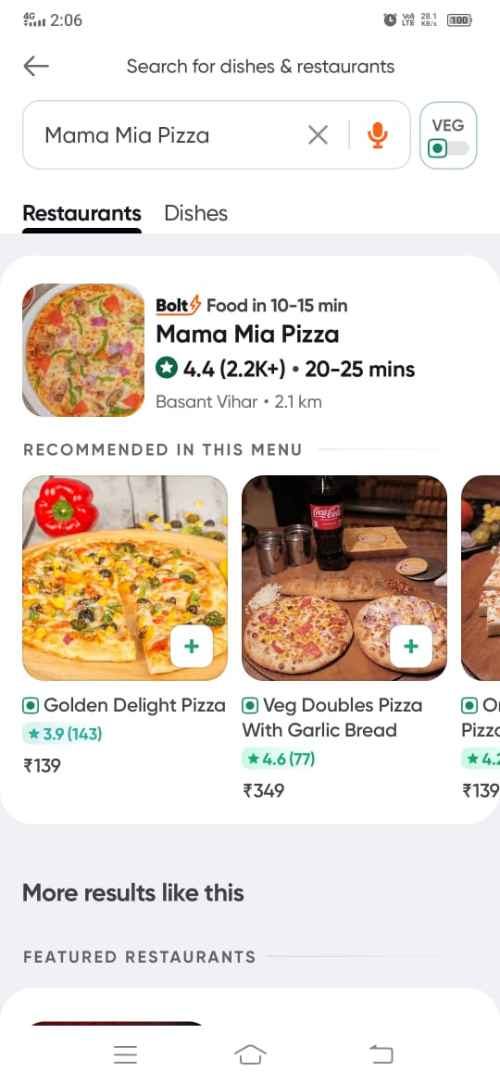
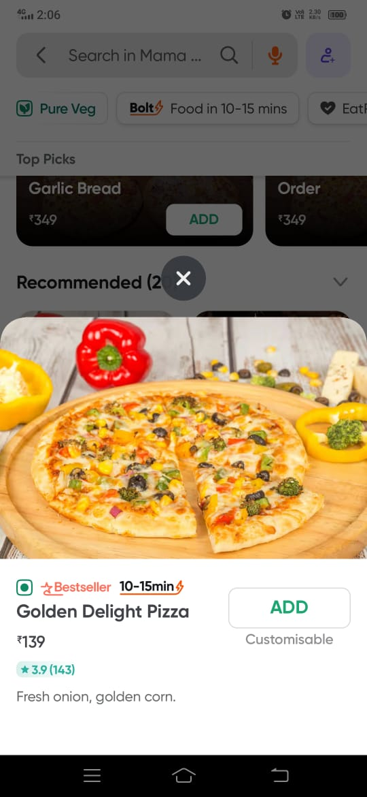
Restaurant card with rating, time, and distance helps quick decision making.
Recommended items with images improve discovery and engagement.
Screen feels slightly crowded with multiple sections together.
Add (+) buttons are small and not very prominent.
Large food image makes item visually appealing and easy to choose.
Labels like “Bestseller” and delivery time help quick decision making.
Popup overlay reduces visibility of background content.
Close (X) button placement is not very intuitive or prominent.

Slide 27
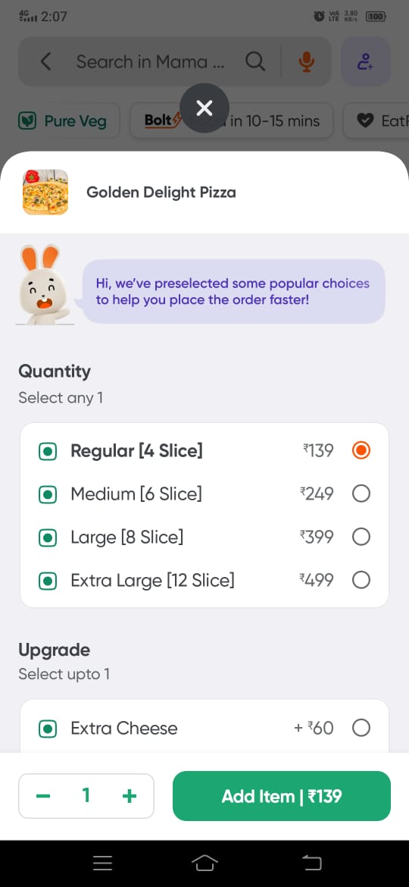
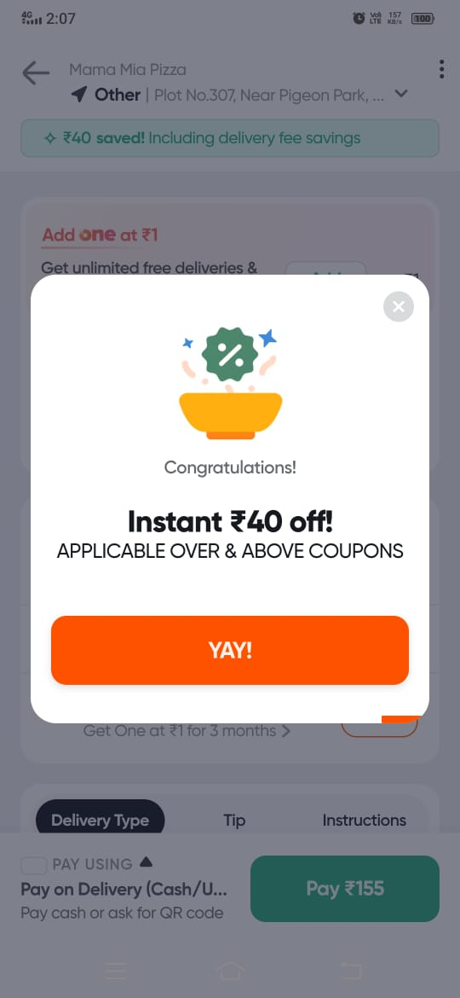
Preselected options help users order faster and reduce effort.
Clear pricing and size options make comparison easy.
Screen feels slightly crowded with multiple options and sections.
Popup overlay hides background context and interrupts flow.
Clear discount message highlights savings and attracts attention.
Simple CTA button (“YAY!”) makes action easy and quick.
Popup interrupts user flow and blocks main screen.
Overuse of popups can feel intrusive and annoying.

Slide 28
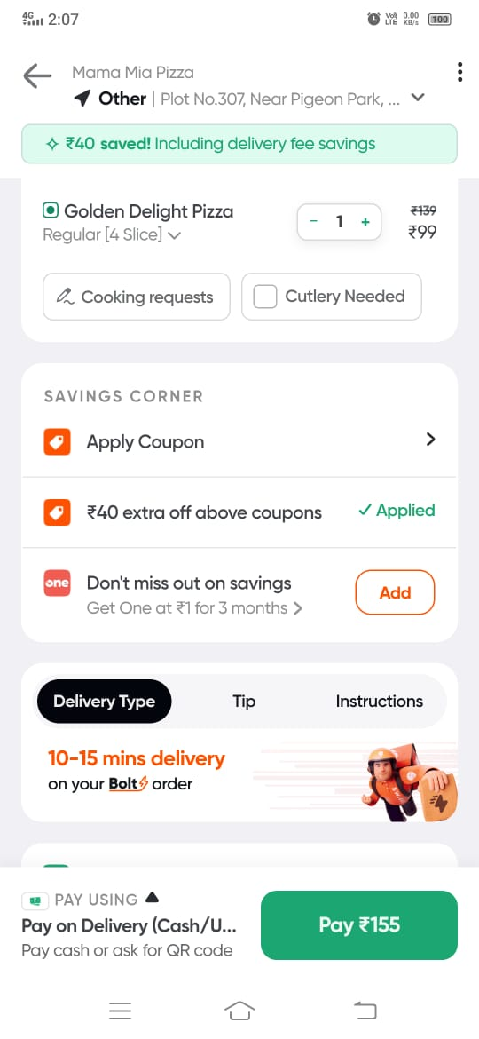
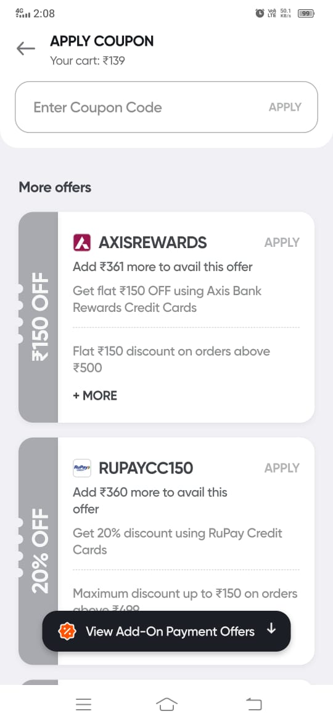
Clear savings section highlights applied discounts and value.
Delivery time info (“10–15 mins”) builds speed perception and confidence.
Screen feels cluttered with multiple sections like savings, delivery, and payment.
Too many options (coupon, tip, instructions) can distract from main action.
Clear coupon input field allows easy manual code entry.
Offer cards show savings and conditions for better decision making.
Too many conditions in offers make it hard to quickly understand.
Screen feels cluttered with multiple offers and banners.

Slide 29
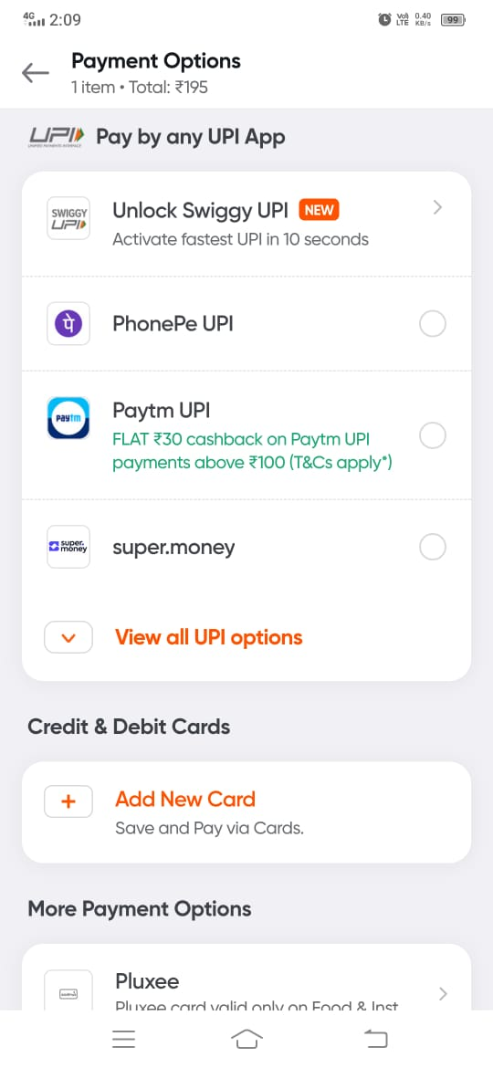
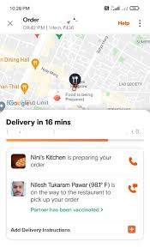
Cashback and offers are clearly shown with payment options.
Well-structured grouping of payment methods improves navigation.
No clear selection highlight for chosen payment option.
Too many options can make decision-making slower.
Live map with delivery tracking improves transparency and user confidence.
Real-time updates like “Preparing your order” and partner info enhance trust.
Map takes large space reducing visibility of detailed information.
Small text and compact cards reduce readability

Slide 30
Feature / Factor | Your App | Zomato | Swiggy | Domino’s
UI Simplicity | ✅ | ❌ | ❌ | ✅
Variety of Food | ❌ | ✅ | ✅ | ❌
Search & Filters | ❌ | ✅ | ✅ | ❌
Ratings & Reviews | ❌ | ✅ | ✅ | ❌
Personalization | ❌ | ✅ | ✅ | ❌
Fast Ordering | ✅ | ❌ | ✅ | ✅
Simple Checkout | ✅ | ❌ | ❌ | ✅
Offers & Discounts | ❌ | ✅ | ✅ | ✅
Visual Design | ❌ | ✅ | ✅ | ✅
Low Clutter UI | ✅ | ❌ | ❌ | ❌
User Trust | ❌ | ✅ | ✅ | ✅

Slide 31
UI BENCHMARKING

Slide 32



Search bar

Slide 33
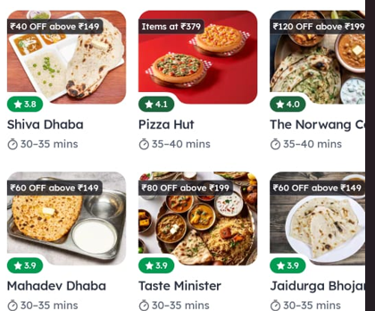
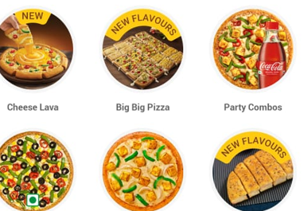
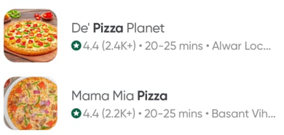
Food Card

Slide 34



Payment icon

Slide 35
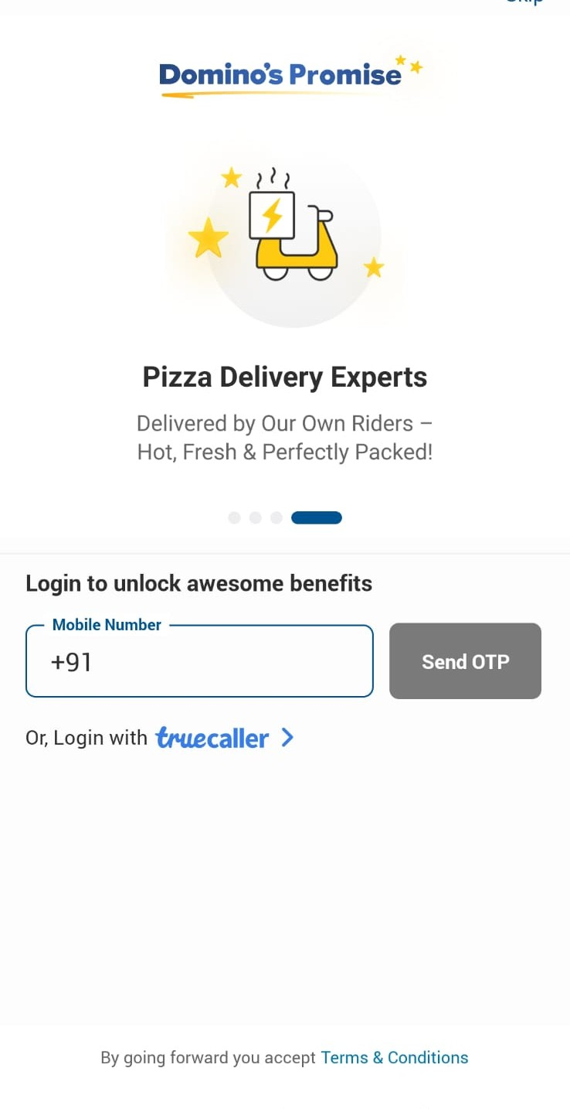
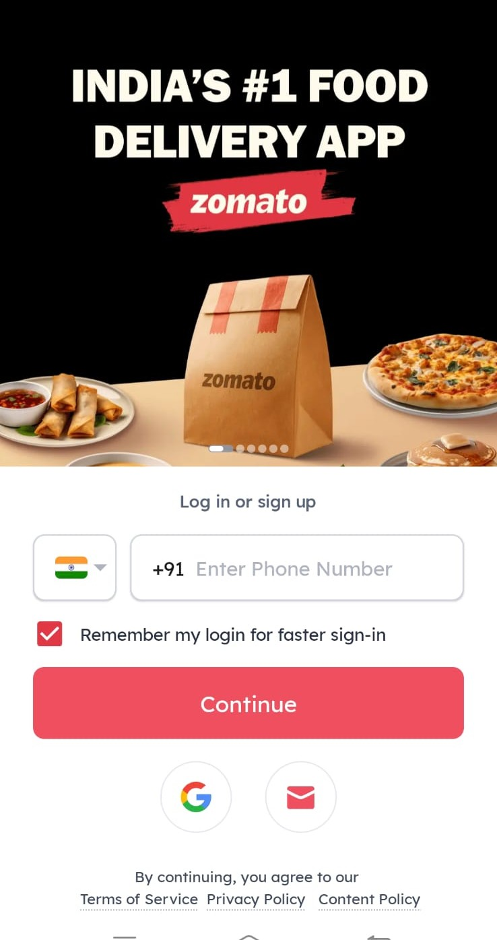
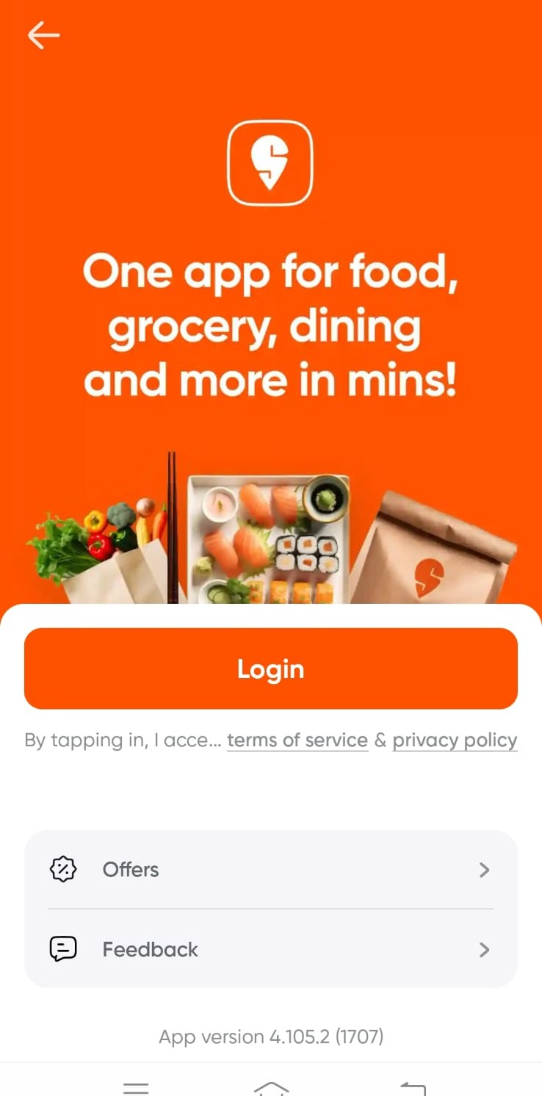
Login Page

Slide 36
