Slide 1

NAME: YOGITA YADAV
REG. NO. : 12304886
SECTION: KO127
SUBJECT CODE: IXD801

Slide 2
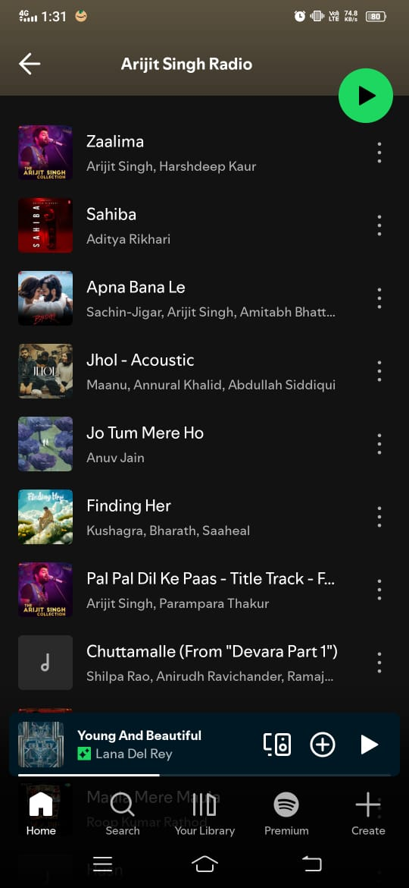
Law of Common Region
The mini-player is enclosed in a separate rectangular region, showing it is a different section from the playlist.
Law of Similarity
All songs follow the same layout .This similarity helps users instantly recognize each row as a song item.
Law of Prägnanz
The UI uses clean and simple shapes, making the screen easy to understand and reducing visual clutter.
Law of Proximity
The song title and artist are placed close together, showing they belong to the same song.
Fitts’s Law
The play button is large and easy to tap, reducing effort and improving accessibility.
Law of Continuity
All songs are perfectly aligned in a vertical column, guiding the user's eye smoothly top to bottom.

Slide 3
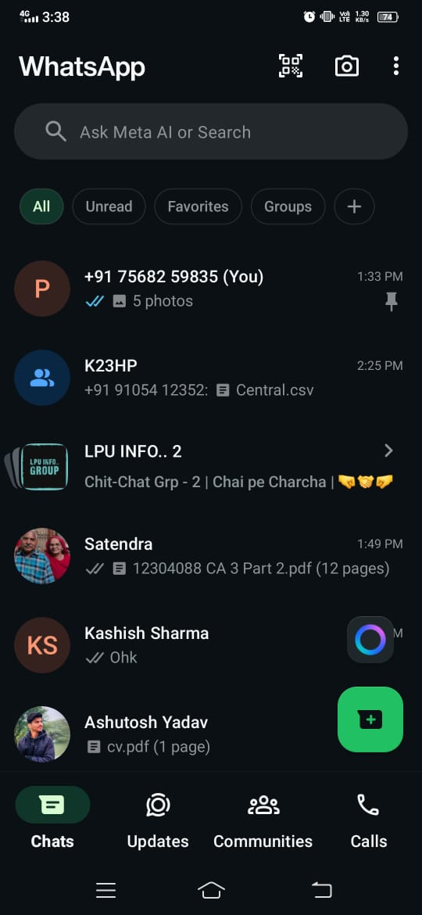
2. Law of Prägnanz
WhatsApp keeps UI elements very simple, making the screen easy to scan and understand quickly.
2. Law of Similarity
Every chat item follows the same structure and design, so users instantly recognize each row as a chat entry.
2. Law of Proximity
Elements placed close together (like name + message) appear related, helping the user understand grouping instantly.
1.Jakob’s Law
WhatsApp follows the same navigation pattern used by Instagram, Messenger, and other apps → users instantly understand how to navigate
2. Law of Continuity
All chats are aligned in a straight vertical column, creating a smooth natural reading flow from top to bottom.
1.Hick’s Law
Only 4 options are shown, reducing decision time and making filtering faster
2. Law of Common Region
All filter buttons are inside a common horizontal region, showing they belong to the same category.
1.Miller’s Law
The bottom menu has 4–5 items, fitting within the recommended “7 ± 2” cognitive limit.
1.Serial Position Effect
The first chat (on the top) gets the most attention and highest recall due to its position.
2. Fitts’s Law
The button is large and close to the thumb area, making it very easy to tap quickly.
1.Zeigarnik Effect
Chats with unread messages create an unfinished task, pulling the user back to open them.

Slide 4
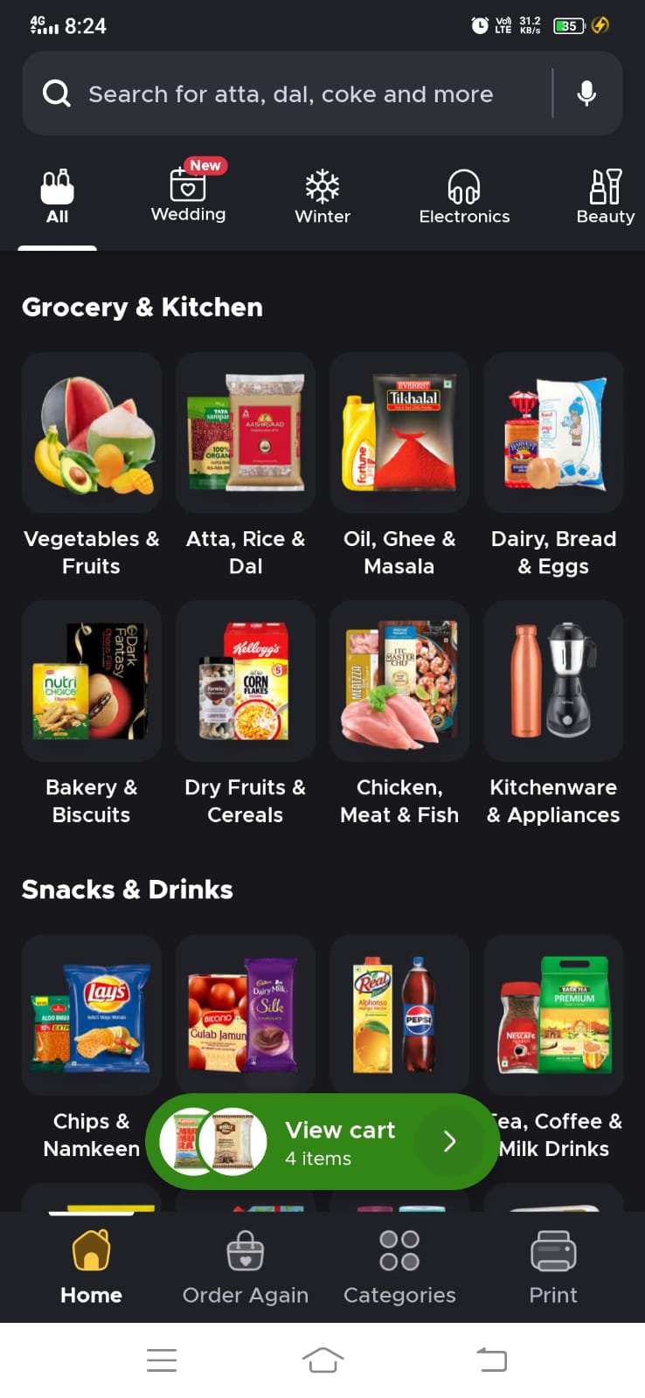
3. Fitts’s Law
It’s large, clearly visible, and easy to tap — reducing the effort needed to reach it.
3. Law of Similarity
All category cards share the same shape, same background, same layout, so users immediately recognize them as similar items belonging to one section.
2. Hick’s Law
Only a few category options are displayed at the top, reducing choice overload and making selection faster.
3. Law of Proximity
Items placed close together appear related.Each product image + label is grouped tightly, showing they belong to the same category card.
2. Miller’s Law
The number of options stays within the human memory limit of 7 ± 2.
3. Law of Common Region
Everything inside the same background region looks like part of one section.“Snacks & Drinks” also has its own region, separating it from Grocery.
2. Serial Position Effect
Items shown first are more likely to be remembered and clicked.
3. Law of Prägnanz
The design is clean, simple, and minimal — helping users quickly understand categories without confusion.
2. Jakob’s Law
Blinkit follows the same familiar pattern used in other apps (Amazon, Zepto, Flipkart Grocery), so users instantly know how to navigate.
3. Law of Continuity
The eyes follow a smooth path across rows and down columns, making scanning easier.
1.Law of Closure
The category icons (Wedding, Winter, Electronics, Beauty) use minimal outlines; even if parts are simple line drawings, the brain completes the full icon shape

Slide 5
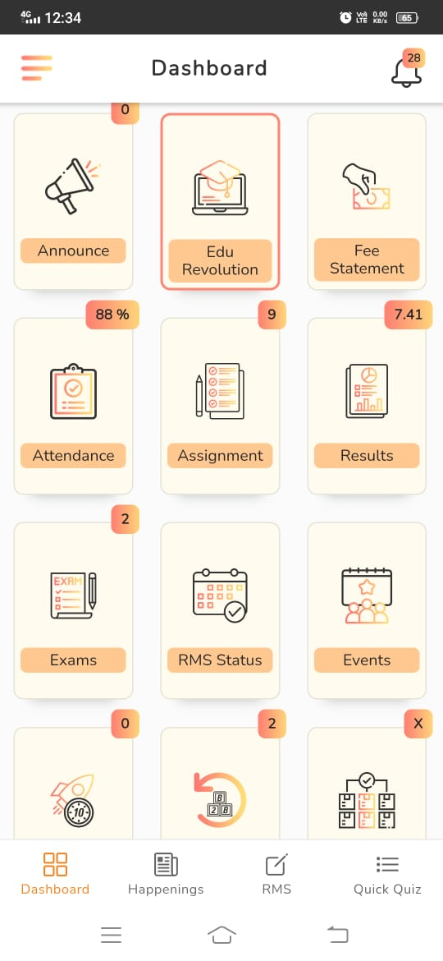
4. Fitts’s Law
The bottom navigation buttons and the dashboard tiles are large tap targets, making them easy to click quickly, especially on mobile.
4. Law of Similarity
All dashboard tiles have the same card shape, icon style, and label placement, helping users instantly recognize them as similar menu options.
3. Hick’s Law
The dashboard organizes features into simple categories with limited visible choices, reducing decision-making time and making navigation faster.
4. Law of Proximity
Each icon and its text label are placed close together, showing they belong to the same module (e.g., Attendance, Assignment, Results).
3. Miller’s Law
The dashboard shows options in small chunks (rows of 3 items), keeping the information within the 7±2 limit and making it easy to remember and scan.
4. Law of Continuity
The cards are arranged in straight grids and rows, allowing the eyes to follow a smooth, continuous flow while scanning the dashboard.
3. Serial Position Effect
The first row of cards (Announce, Edu Revolution, Fee Statement) gets maximum attention because items at the top are noticed first.
4.Law of Common Region
Each module is enclosed inside a separate rounded rectangular card, clearly grouping all elements belonging to that feature.
2. Zeigarnik Effect
Notification badges (0, 9, 2, 7.41, 88%) on tiles show incomplete tasks or pending actions, encouraging the user to open them and complete the tasks.
4. Law of Prägnanz
The icons are simple line drawings, colors are minimal, and the overall layout is clean, making it easy for users to scan and identify options quickly.

Slide 6
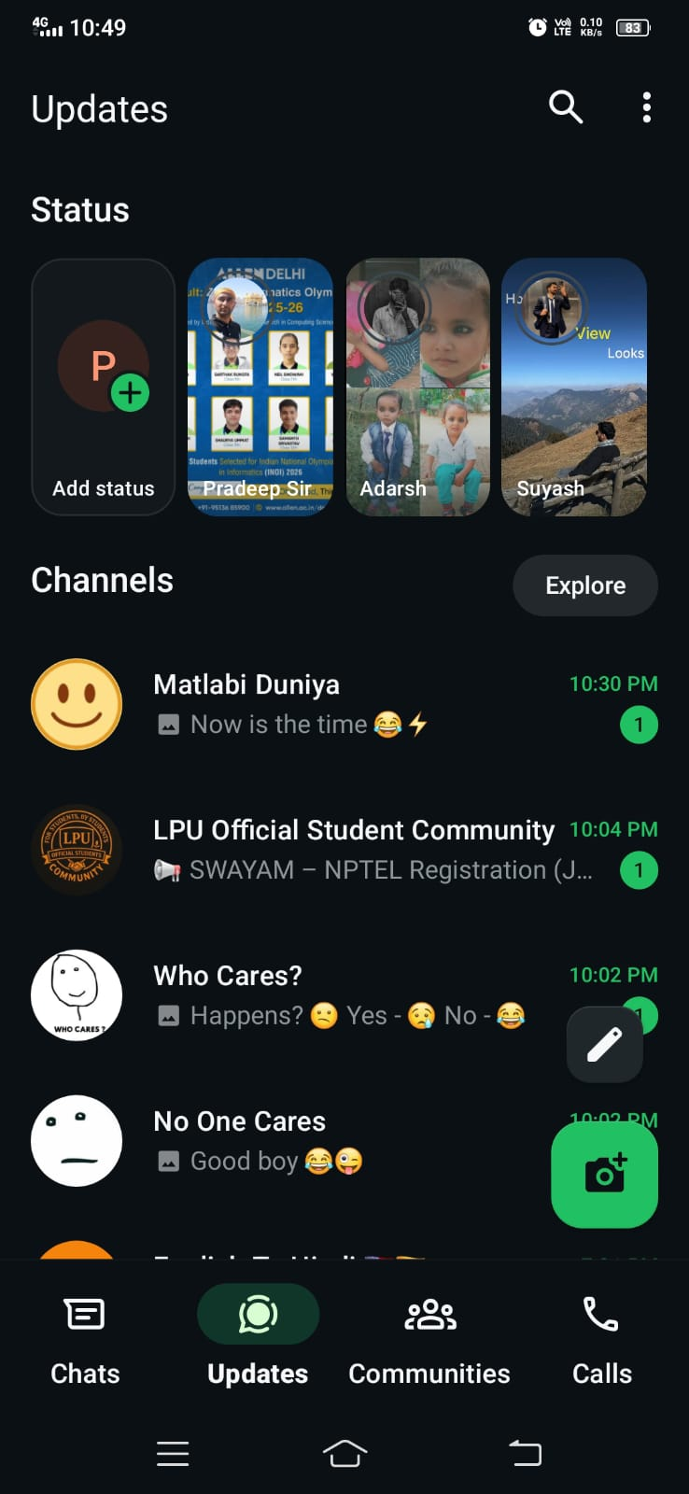
5. Fitts’s Law
The green “Add Status” and pencil edit button are large, easy-to-tap targets placed within natural thumb reach.
5. Law of Similarity
All status thumbnails have the same circular shape and layout, helping users instantly recognize them as similar status items.
4. Hick’s Law
Only four bottom menu items are shown, reducing decision time and helping users navigate faster.
5. Law of Proximity
Each status image and the user’s name are placed close together, showing they belong to the same status update.
4. Serial Position Effect
The first status in the row gets maximum attention, as users naturally focus on the first visible item.
5. Law of Common Region
Statuses are arranged inside a horizontal scroll region, separating them visually from the “Channels” section below.
3. Jakob’s Law
The bottom navigation bar (Chats, Updates, Communities, Calls) follows the same familiar layout used by many social apps, reducing learning effort.
5. Law of Continuity
Statuses are placed in a straight horizontal line, guiding the user’s eyes smoothly from left to right.
5. Law of Prägnanz
The UI uses simple icons, clean circles, and minimal colors, making it easy to scan and understand at a glance.
3. Zeigarnik Effect
Unseen statuses have a colored ring, reminding the user that they have unfinished viewing tasks.

Slide 7
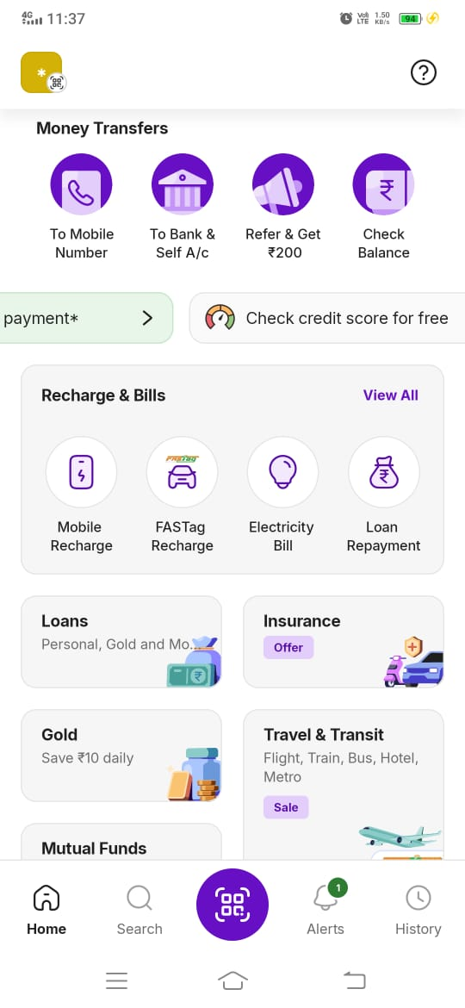
5. Serial Position Effect
Items shown at the top of the screen (Money Transfers) get the most attention because users naturally focus on the first visible section.This makes users more likely to select those actions first.
4. Jakob’s Law
PhonePe uses a bottom navigation bar (Home, Search, Scan, Alerts, History), which is a familiar pattern used by many apps like Google Pay, Paytm, Amazon, Flipkart.
4. Miller’s Law
Information is divided into small chunks such as Money Transfers, Recharge & Bills, Loans, Insurance, Travel, etc.This keeps content within human memory limits and prevents overload.
4. Zeigarnik Effect
The notification badge (1) on Alerts icon at the bottom indicates an unfinished task, reminding the user to check pending alerts.
5. Hick’s Law
At the top, only 4 main money transfer options are shown (To Mobile, To Bank, Refer, Check Balance).Limiting choices helps users make faster decisions.

Slide 8
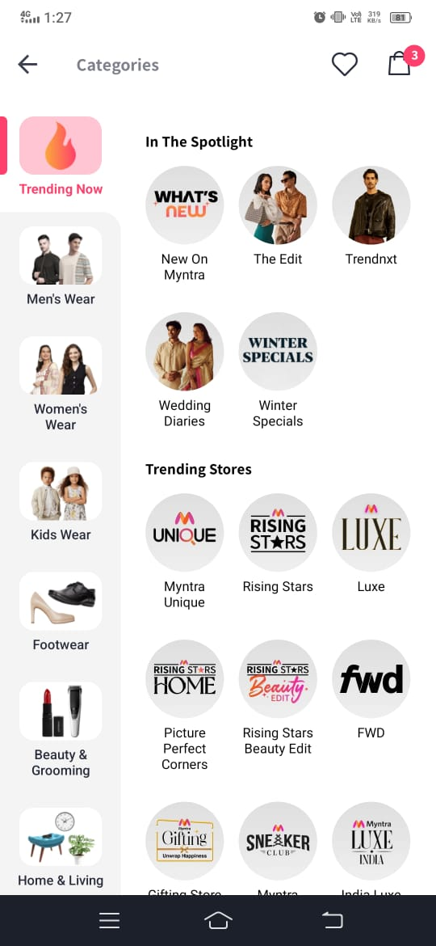
5. Jakob’s Law
The layout follows a familiar e-commerce pattern used by apps like Amazon, Ajio, Flipkart—categories on the left, subcategories on the right.This makes the screen easy to understand because users already know how such layouts work.
5. Zeigarnik Effect
The notification badge (3) on the top-right (wishlist/cart/notification) signals unfinished actions, encouraging users to tap and complete them.
5. Miller’s Law
Categories are broken into small chunks such as Men’s Wear, Women’s Wear, Kids Wear, Footwear, etc., so users don’t feel overloaded with too many options at once.
2. Law of Closure
Some icons in the circular category images contain incomplete outlines (e.g., “Winter Specials” circle border fades), yet users perceive them as complete circles.
3. Law of Closure
The heart (wishlist) and bag (cart) icons are drawn with incomplete outlines, but the user still recognizes them as complete shapes. The brain fills the missing parts automatically — an example of the Law of Closure.

