Slide 1
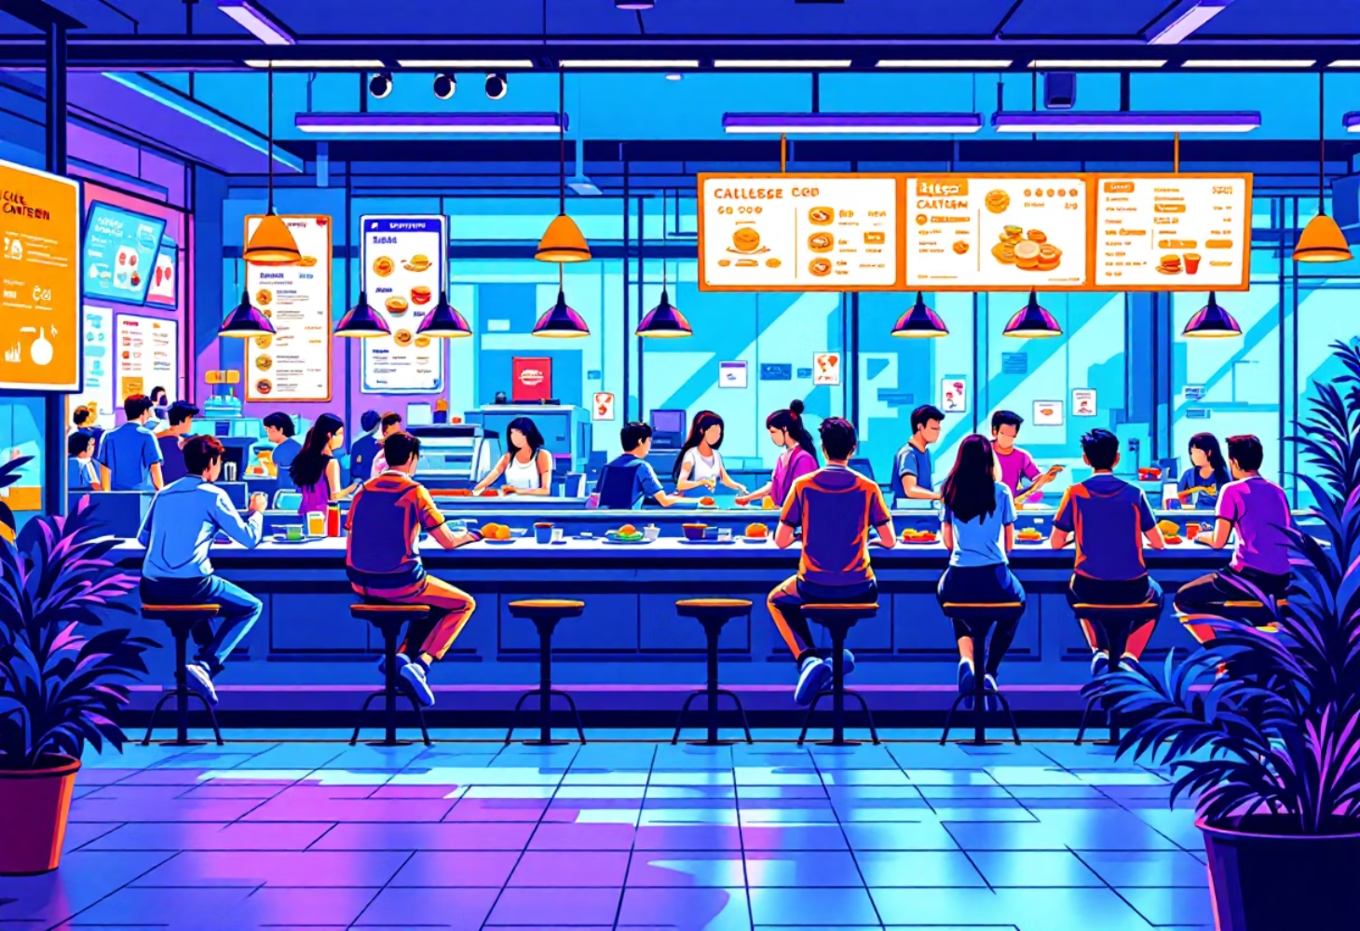
Journey Mapping at the College Kitchenette
👩‍🎓 Name: Yogita Yadav
Student ID: 12304886
Roll No: 19

Slide 2
What is a User Journey Map
Definition:
Benefits:
A User Journey Map is a tool used in design and research to visualize how a person interacts with a product, service, or environment over time.
Reveals moments of frustration and delight.
Shows emotional highs and lows throughout a process.
Helps designers improve real-world experiences.
Purpose:
Encourages empathy by seeing through the user's eyes.
It helps us understand the user's experience step-by-step — what they do, think, and feel — and find ways to make those experiences smoother and more enjoyable.
In short, a user journey map helps bridge the gap between what people experience and what designers can improve.

Slide 3
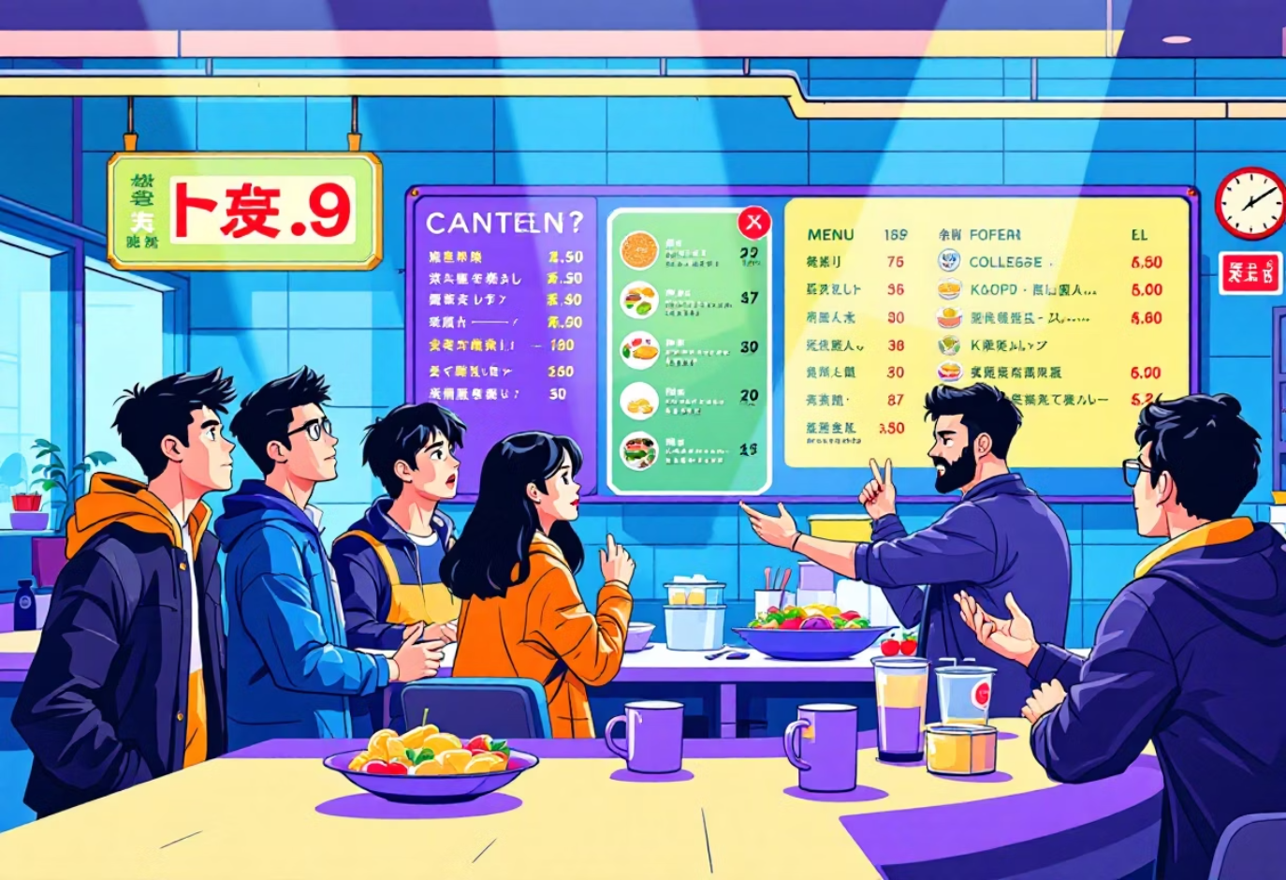
Problem Statement
The chosen activity is the student experience at the college kitchenette . Students visit to check menus, order food, wait, collect their meals, eat, and clean up before leaving.
Objective:
Key Questions:
To understand how design, communication, and waiting time impact the student's journey and emotions.
What are the main stages in this everyday activity?
Where do students feel comfortable or frustrated?
How can better design improve their experience?
Challenges Observed:
Small or unclear menu displays.
Long waiting times for food tokens.
Crowded pickup and washing areas.

Slide 4
User Journey Map
Stage 1: 🍽️ Decide to Eat
User Actions
Touchpoints
Emotions
Pain Points / Opportunities
Feels hungry, walks to kitchenette
Pathway, signboard
Hungry, eager
Excited to eat
Stage 2: 📋 Check Menu
User Actions
Touchpoints
Emotions
Pain Points / Opportunities
Reads display, compares prices
Menu board, screen
Curious → Confused
Text unclear
Stage 3: 💳 Pay & Order
User Actions
Touchpoints
Emotions
Pain Points / Opportunities
Pays via cash/QR
Counter, cashier, app
Neutral → Satisfied
Quick payments help
Stage 4: ⏳ Wait for Token
User Actions
Touchpoints
Emotions
Pain Points / Opportunities
Takes token, finds seat
Token slip, seating area
Slightly impatient
No waiting time info

Slide 5
User Journey Map
Stage 5: 📦 Collect Order
User Actions
Touchpoints
Emotions
Pain Points / Opportunities
Sees token number, collects food
Display screen, counter
Excited
Crowded area
Stage 6: 🍕 Eat Food
User Actions
Touchpoints
Emotions
Pain Points / Opportunities
Eats with friends
Table, utensils
Relaxed, joyful
Pleasant moment
Stage 7: 🧼 Return Plate
User Actions
Touchpoints
Emotions
Pain Points / Opportunities
Puts plate in washing area
Sink, rack
Responsible
Crowded area
Stage 8: 🚪 Wash Hands & Leave
User Actions
Touchpoints
Emotions
Pain Points / Opportunities
Cleans hands, exits
Basin, napkin area
Fresh, content
Smooth ending

Slide 6





Emotional Curve
Emotional Flow During the Experience:
Decide to Eat
🙂
Check Menu
😐
Wait for Token
😔
Eat Food
😀
Leave
😊

Slide 7
Emotional Curve Interpretation
The Dip
The Peak
The Opportunity
The emotional curve dips during the waiting period.
The happiest points are receiving and eating the food.
Improving queue management and visibility can lift overall satisfaction.

Slide 8



Reflection
Insights from Observation:
Waiting Phase Creates Dissatisfaction
Happiness Through Connection
Simple Design Improvements
The waiting phase creates the most dissatisfaction due to lack of clarity.
Students feel happiest when food is served quickly and shared with friends.
Simple design improvements — like digital waiting updates, clearer menu text, and organized collection areas — can make a big difference.

Slide 9
