Slide 1

SPOTIFY CLONE
A Project Presentation
Submitted in partial fulfilment of the requirements for the award of the degree of
Bachelor of Science
in
Computer Science
Under the Guidance of
Dr. Chhabi Rani Panigrahi
Assistant Professor
Submitted By-
Baivaba Swikruti Dash - 55ROO19005
K.Yogita – 55R0019013
Ritika Sahoo – 55R0019020
Department Of Computer Science
RAMA DEVI WOMEN’S UNIVERSITY , BHUBANESWAR
JUNE - 2022

Slide 2
CONTENTS
INTRODUCTION
REASON BEHIND CHOOSING THIS TOPIC
OBJECTIVE
THEORY AND FUNDAMENTALS
TECH/FRAMEWORK USED
SWOT ANALYSIS
RESULTS
CONCLUSION AND FUTURE WORKS
REFERENCES

Slide 3
INTRODUCTION
Music has today become an integral part of everybody’s life. Wherever we are we want music on the go.
This thirst is rested upon online audio streaming and sharing websites that gives us with a pool of old and new songs of different genres, albums, playlists and a lot more.
This has conversely given rise to more need for online web players like Spotify, Pandora , Wynk Music, Google Music etc.

Slide 4
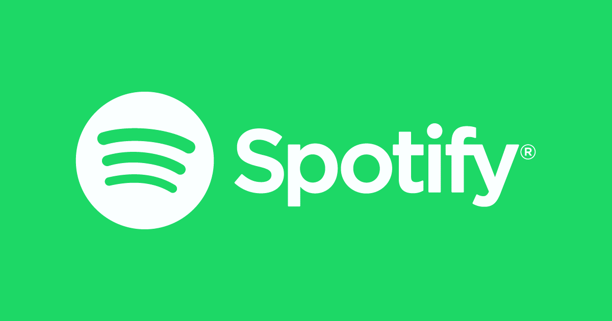
DESCRIPTION
Seeing this uprising demand of music streaming websites, we have built a futuristic Spotify Clone articulated with latest technologies. Like the official app, it comes with features that are quite exuberant and lets you seamlessly commence with your own audio streaming website.
Additionally , you can also customize the script as per your preferences and requirements. We have added some new and extra designs as per our choice and convenience as anyone can build this kind of web player.

Slide 5
WHY SPOTIFY CLONE?
Prior, the fever for the movies and songs was the almost same as folks have today, however the distinction is the latest trend of these melodies.
With the progression of time, a ton of changes have come in the organization of the tunes. The most usually utilized thing these days is mp3, which is a sound particular format.
They are incredibly popular with users because the audio files are compressed to about one tenth of the original size. As a result, they take up very little disk space and are quick to download. At the same time, they are able to deliver audio that is almost CD quality.
That’s why Spotify Clone is needed which utilizes mp3 sound format for dependable production of the genuine compressed songs for the huge majority.

Slide 6
OBJECTIVE
Spotify Clone is a simple demo or clone of the popular Spotify application that enables user to play a music player and listen to their favorite songs.
The main OBJECTIVE is to demonstrate the features of the original application by incorporating the basic web development techstacks and adding some new and extra designs as anyone can build this kind of web player according to their own preferences.

Slide 7
THEORY AND FUNDAMENTALS
What is Spotify Clone?
A Spotify clone app is a music streaming app which provide a free platform to listen music without downloading it.
The Web Player is user friendly from signing in to listening music. With the various features, users can enjoy listening to their favourite song with ease.
What is Unique about the total Spotify Clone?
With our own Spotify clone, you get basically all the fantastic features of the best original app at a fraction of the size. You can create your own personalised music listening application and appeal to consumers in a seamless and effective manner.

Slide 8
WHAT ARE WE TRYING TO BUILD?
We are trying to build a music player website solely based on basic techstacks used in web development. For that we have chosen the Spotify clone.
Because it has the most user friendly user interface and features that a user can utilise and have a good user experience.
We also built a Spotify clone which is responsive and can be used only on desktop. User can stream new songs and listen to them whenever and wherever they want.
We have the search option so that user can browse his own song, album, artist or composer the individual wants to listen to.
We have used Spotify API to fetch the songs to our application.

Slide 9
WHAT IS API?
API stands for Application Programming Interface.
It is the messenger that takes a request and tells a system what you want to do and then returns the response back to you.
It is basically a web tool that acts as an interface between the user and server to make the application more dynamic.
For example- in the Spotify web application , when the user types the name of the music , then API tries to find the most relevant result.
It can be used in projects where the developers don’t need to implement machine learning algorithms for recommending search results.

Slide 10






FEATURES
REGISTRATION/LOG IN
ACCESSING USER PROFILE
SPOTIFY CLONE
SEARCH SONGS
DEDICATED HOME PAGE
CREATE PLAYLIST
MUSIC PLAYER

Slide 11
BENEFITS OF SPOTIFY CLONE
So, now that we know all about developing a Spotify Clone, the more important question is why should we build it. So, here are a few reasons for building an online audio streaming platform, which is beneficial in some aspects-
Listening to music has become a lot more convenient. .
No memory, no problem.
Artists have more opportunities.
The audio quality on offer is far superior.

Slide 12
HOW DOES THE SPOTIFY CLONE APP WORK?
The application runs by simply clicking on the source link.
The user needs to register onto the website through Gmail account.
The backend takes in the information and stores it in the appropriate database
The user can login onto the webpage by giving in the same credentials.
The user can play songs by clicking on any song fetched through api.
The music bar is present at the bottom that enables user to play the song.
The music bar has all the functionalities similar to any basic music player.

Slide 13
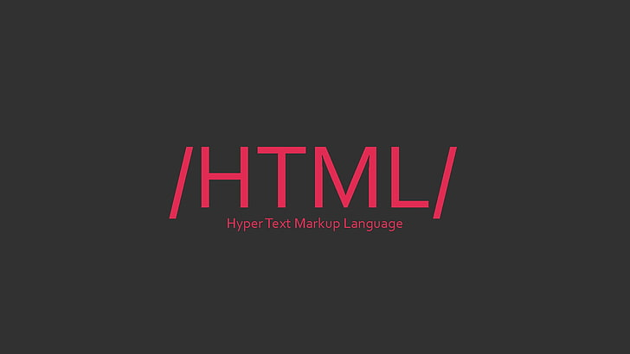
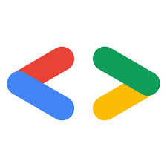

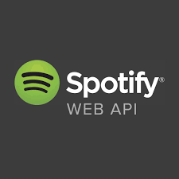
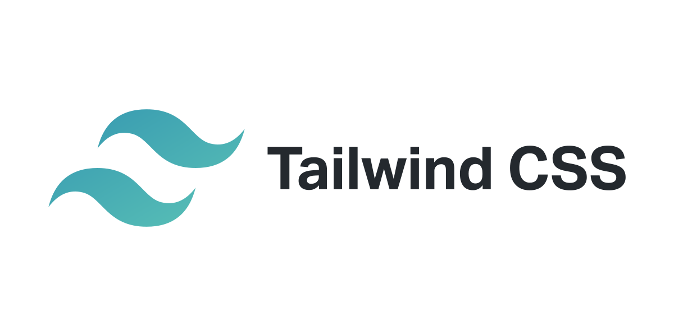

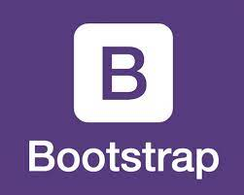
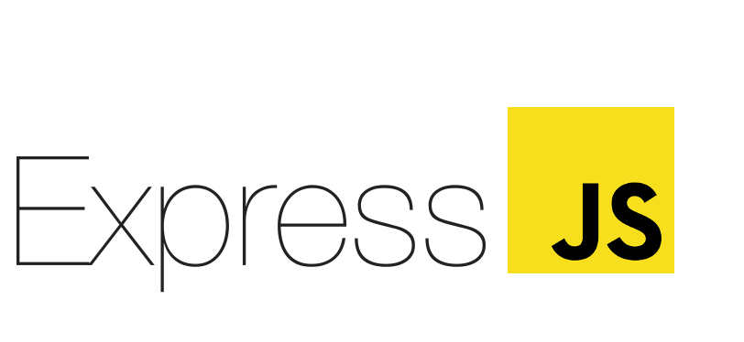
FRONT END DEVELOPMENT BACK END DEVELOPMENT
TECHNOLOGY/FRAMEWORK USED

Slide 14
DESCRIPTION OF THE TECH AND FRAMEWORK
FRONT END DEVELOPMENT-
The part of a website that the user interacts with directly is termed the front end.
It is also referred to as the ‘client side’ of the application.
It includes everything that users experience directly: text colours and styles, images, graphs and tables, buttons, colours, and navigation menu.
BACK END DEVELOPMENT-
Backend is the server-side of the website.
It stores and arranges data, and also makes sure everything on the client-side of the website works fine.
It is the part of the website that you cannot see and interact with. It is the portion of software that does not come in direct contact with the users.
The parts and characteristics developed by backend designers are indirectly accessed by users through a front-end application.

Slide 15
FRONT - END DEVELOPMENT LANGUAGES
HTML - used for designing the structure of the webpage.
Java Script used for designing the play bar and for other functional operations in the webpage.
Tailwind CSS is a utility class of Standard CSS that enables us to add new designs, backgrounds and perform all CSS operations easily with fewer and easy to understand syntaxes with various new features.
Advantages include customizing the designs to make components, making local changes, minimum lines of code in CSS file , etc.
Bootstrap for login page and register page.
BACK- END LANGUAGES
Google API used for adding login with google option.
Spotify Web API for search.
Node.js for building back-end services like APIs (Web App).
Express.js for creating server side applications faster and smarter. Implicitness, minimalism, flexibility, scalability are some of its characteristics.

Slide 16
S
W
O
T
STRENGTHS
User friendly web player experience
Personalised playlists
Impressive algorithm
Customizable acc. to both developer’s and user’s convenience.
WEAKNESSES
No lyrics feature
No Siri Integration
Requires internet connectivity
Faces tough competitions from other music-streaming applications in the market.
OPPORTUNITIES
Podcasts
Artist Endorsements
Streaming videos
Adding the Lyrics feature
Expanding the market(monetization).
THREATS
Piracy
Criticism
Security issues
Not a lot of cost saving power .
Fig. SWOT ANALYSIS OF SPOTIFY CLONE

Slide 17
RESULTS

Slide 18
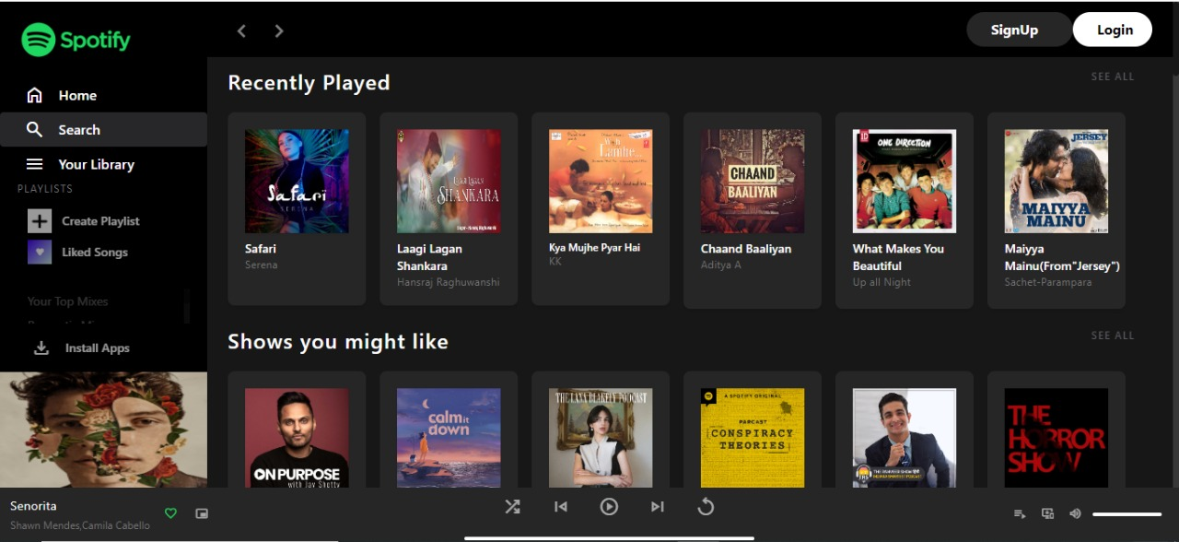
1. HOME PAGE(with Login and Sign Up options)

Slide 19
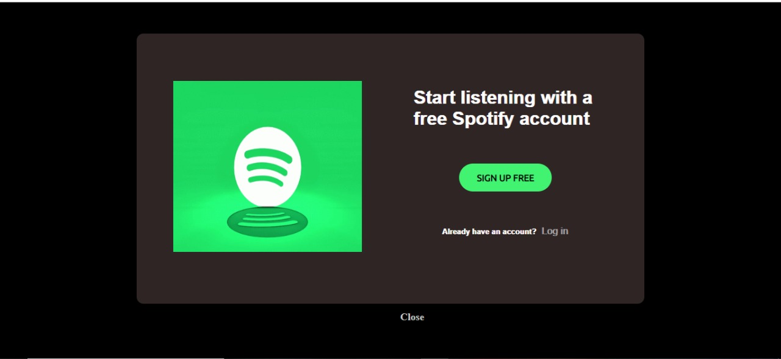
2. PROMPT FOR LOG IN / SIGN UP

Slide 20
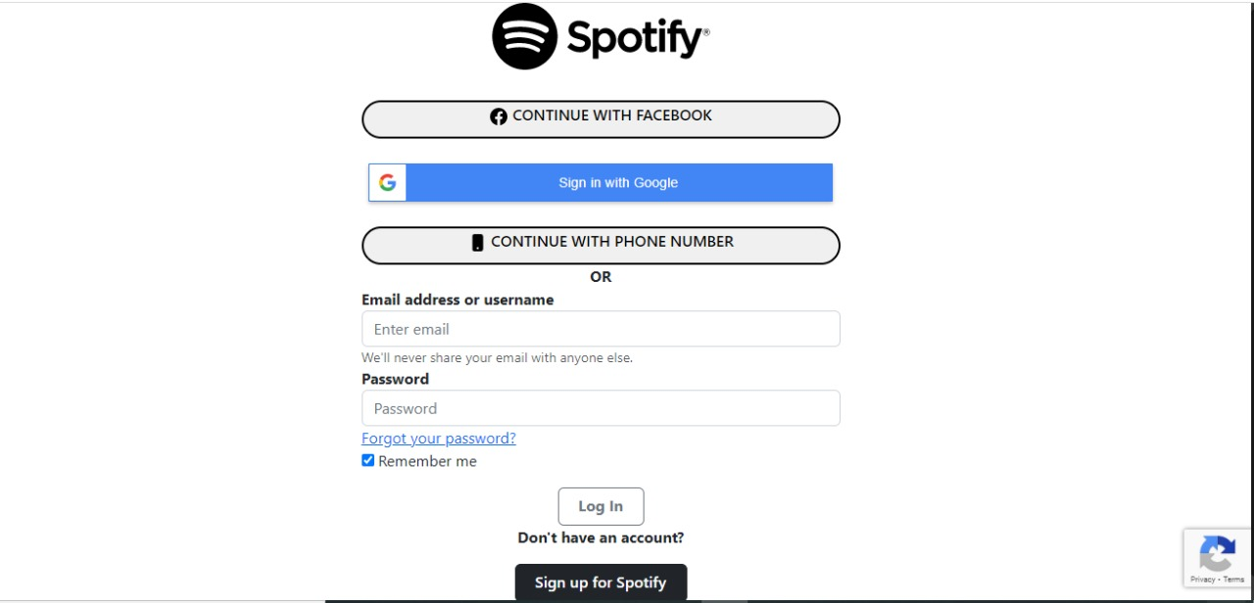
3. LOG IN PAGE

Slide 21
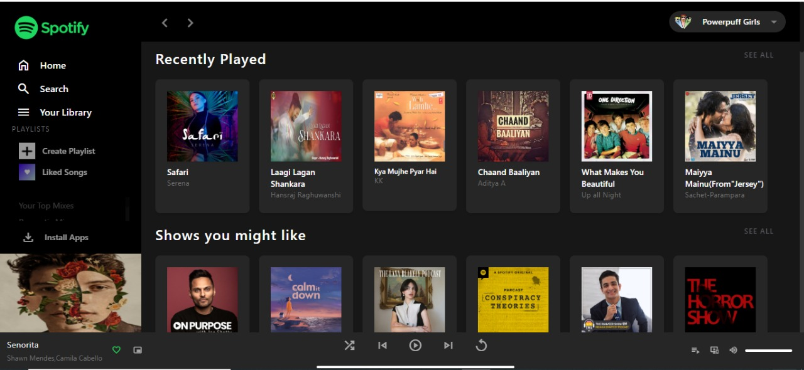
4. HOME PAGE(after Signing In to Spotify)
Account created
A

Slide 22
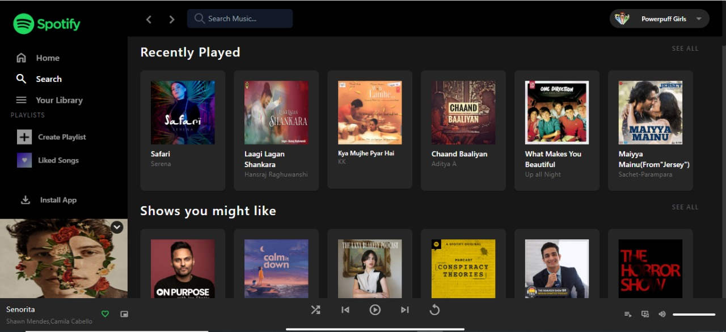
5. SEARCH BAR

Slide 23
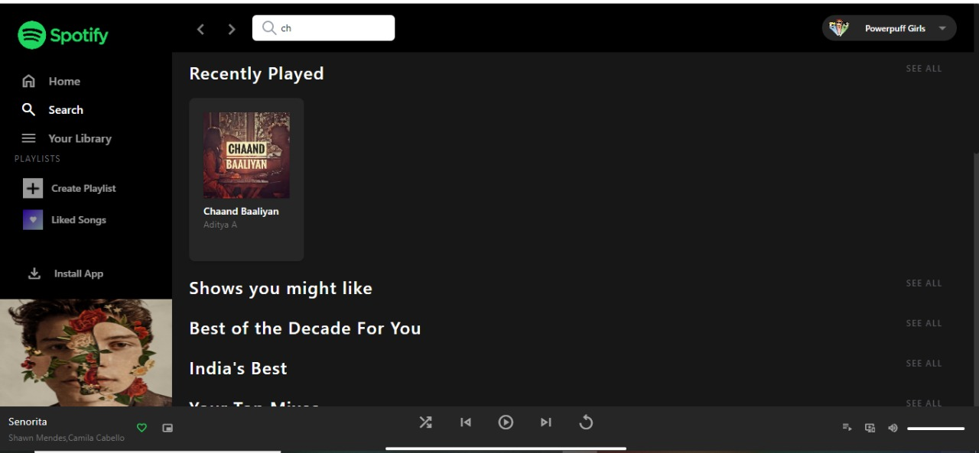
5. SEARCH BAR(ex-1)

Slide 24
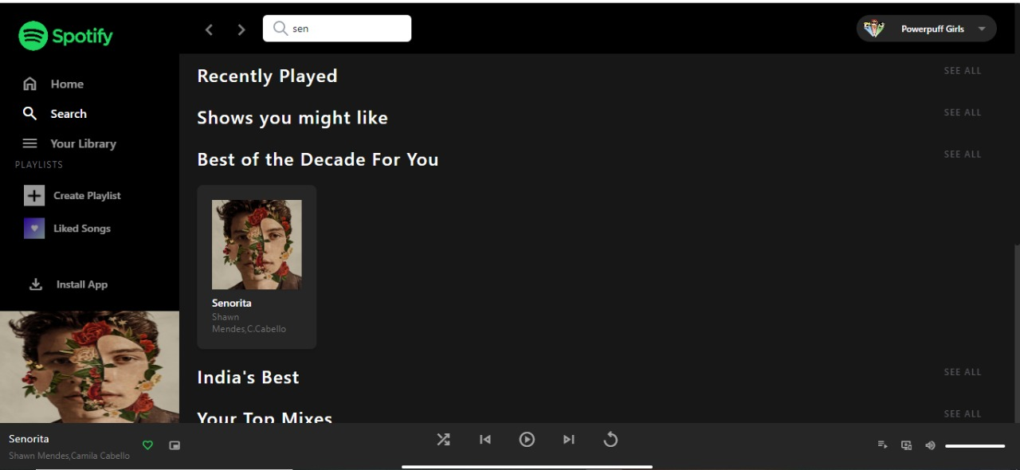
5. SEARCH BAR(ex-2)

Slide 25
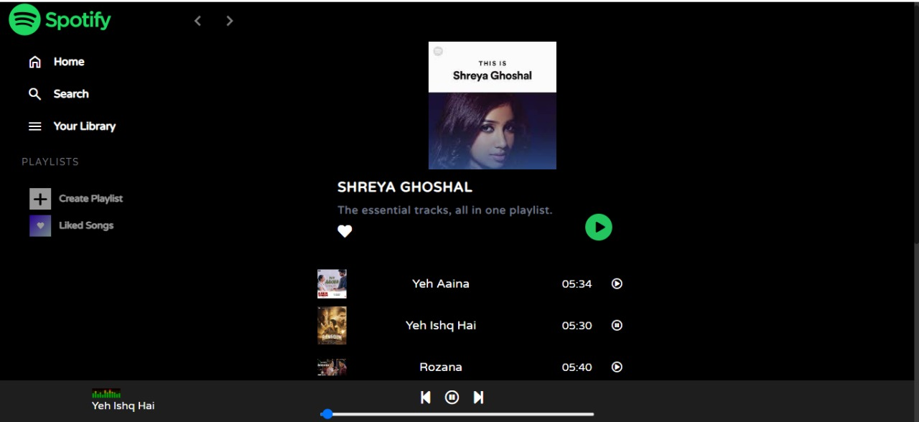
6. PLAY BAR

Slide 26
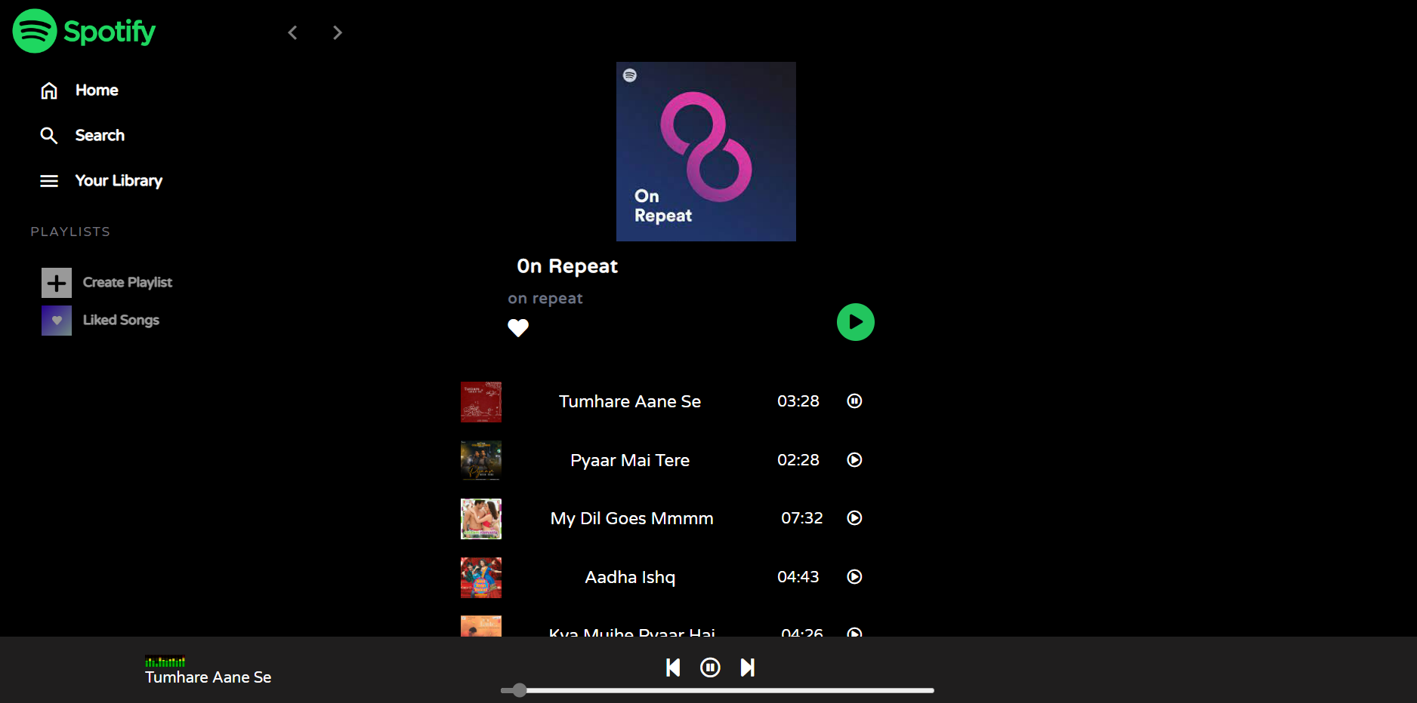
7. PLAYLISTS(ex-1)

Slide 27
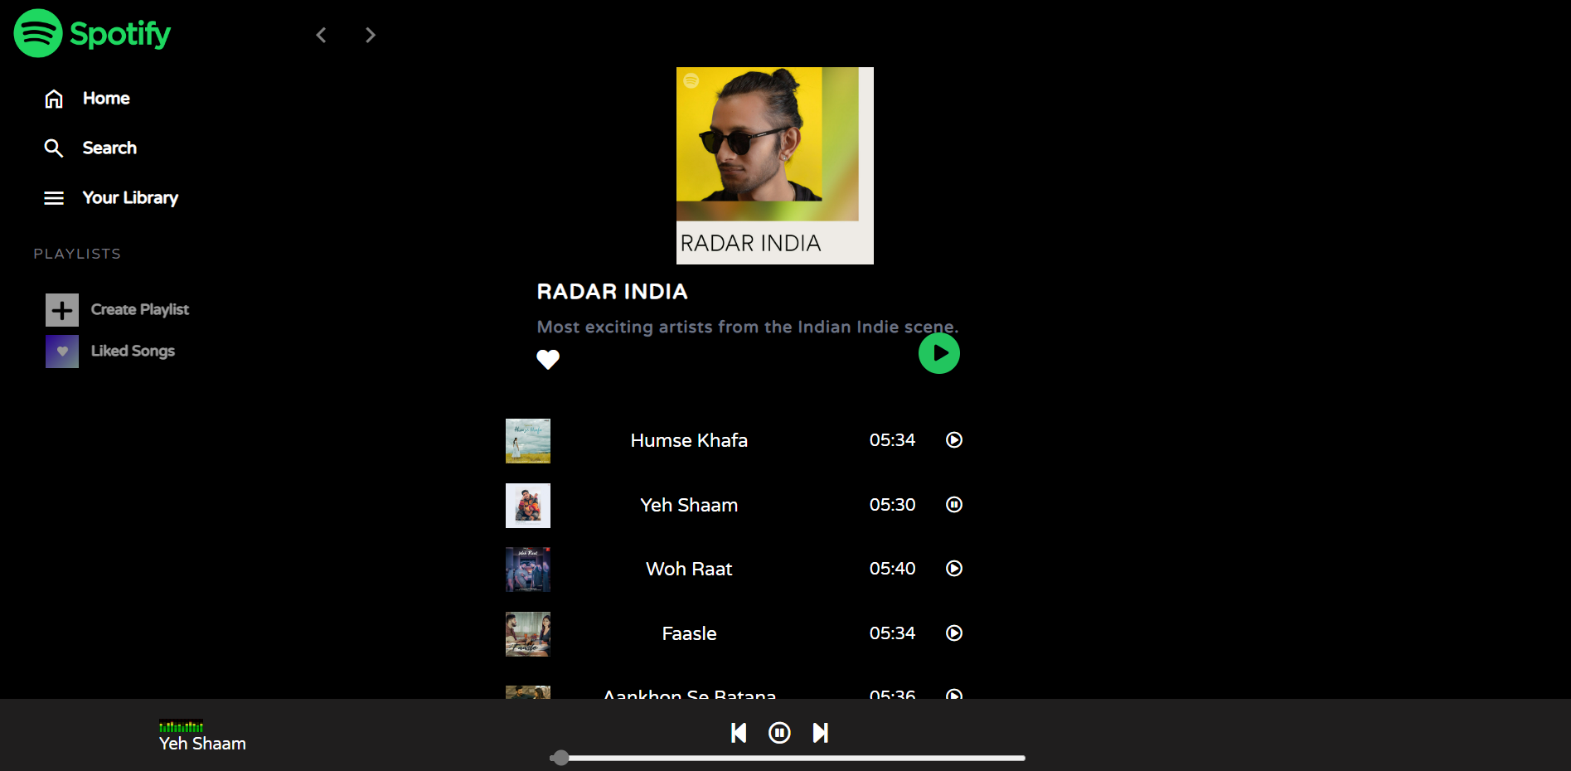
8. PLAYLISTS(ex-2)

Slide 28

CONCLUSION & FUTURE WORKS
The Spotify Clone is merely a demonstration of a web music player implemented using some basic languages like JavaScript and html, along with use of tailwind CSS instead of standard CSS.
Using the basic knowledge and some hit and trials, the clone looks nearly exactly as the original Spotify website.
Although, it’s still not completely functional as the original Spotify. The implementation of recommender system, Library, listen offline, sort and filter, play queue, listening history, etc. are some features that are future works that are to be incorporated.
The technologies to be implemented includes the implantation of backend which would accept dynamic input from user and use it as login credentials. The implementation of machine learning algorithms to implement the recommendation system. Thus, many improvements would enable the project to be more advanced and similar to the original Spotify website.
However, this still aims at the objective, that is, to learn and implement new Tech stacks and improving the existing project.

Slide 29
REFERENCES
Spotify-Web Player Music For Everyone - https://open.spotify.com/
YouTube - https://www.youtube.com/results?search_query=prepare+a+spotify+clone
GitHub - https://github.com/
W3Schools - https://w3schools.com/
Express - https://expressjs.com/
Spotify for Developers - https://spotify.developer.com/

Slide 30
THANK YOU

