Slide 1


ZOMATO RESTAURANT RATING ANALYSIS.
Institute of Advanced Computing and Software Development, Pune
Post Graduation Diploma in Big Data Analytics
Feb-2020
By :
Ms. Yogita Chavan - 1312
Ms. Rutuja Salvi - 1343
Project Guide :
Mr. AKASHY TILEKAR

Slide 2
Contents
Objectives
Introduction
Flow of execution
Requirements
Dataset Description
Handling missing values
Exploratory Data Analysis
Model and Algorithm
Result
Conclusion

Slide 3
Objective
analysis of existing restaurants.
to find out the rating of newly opened restaurants.

Slide 4
Introduction
Food industry is growing drastically from past few years
previously we had to actually go to the restaurants and have the experience
But nowadays scenario has changed, choice for the best places to have food is just a click away.
One can choose the best rated place and then decide to enjoy there with friends and family.
So ratings plays a very important role while selecting any restaurants.

Slide 5
Flow of Execution
Loading data
Data Cleaning
Data analysis
Algorithm Selection
Model Building

Slide 6
Requirements
Dataset:- Zomato restaurants
Software: Jupyter Notebook, Google colab, Spyder
Programming language: Python and Machine learning
Libraries:1)Data visualization: Seaborn, Matplotlib
2)Machine learning :Sklearn, pandas, numpy, re

Slide 7
Dataset Description
Column Names:
url, address, name, online_order, book_table, rate, votes, phone, location, rest_type, dish_liked, cuisines, approx_cost(for two people), reviews_list ,menu_item, listed_in(type), listed_in(city)
dataset consists of 51,717 rows and 17 columns
All columns are of type "object" except for votes
7775 ratings are missing
1208 phone numbers are missing 21 and missing location
28,078 dished liked are missing
45 cuisines are missing
346 approx. cost for two persons is missing

Slide 8
Handling missing values
1208 phone numbers are missing:
counting number of phone numbers provided by each restaurants
nulls are marked as 0
approx. cost for two persons are missing:
KNN imputations is used to handling the missing values

Slide 9
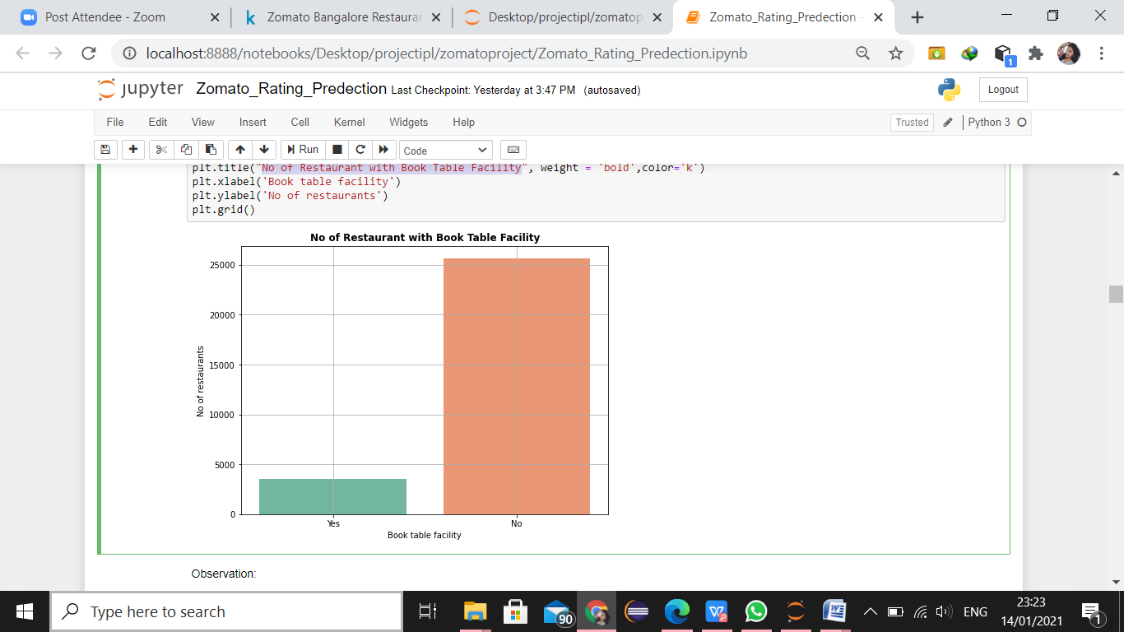
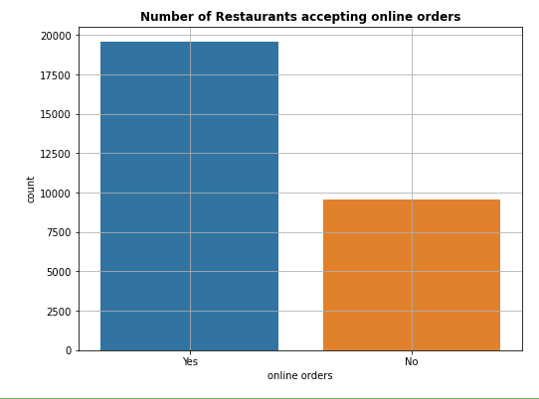
Exploratory Data Analysis
Book Table Facility
Online Orders

Slide 10
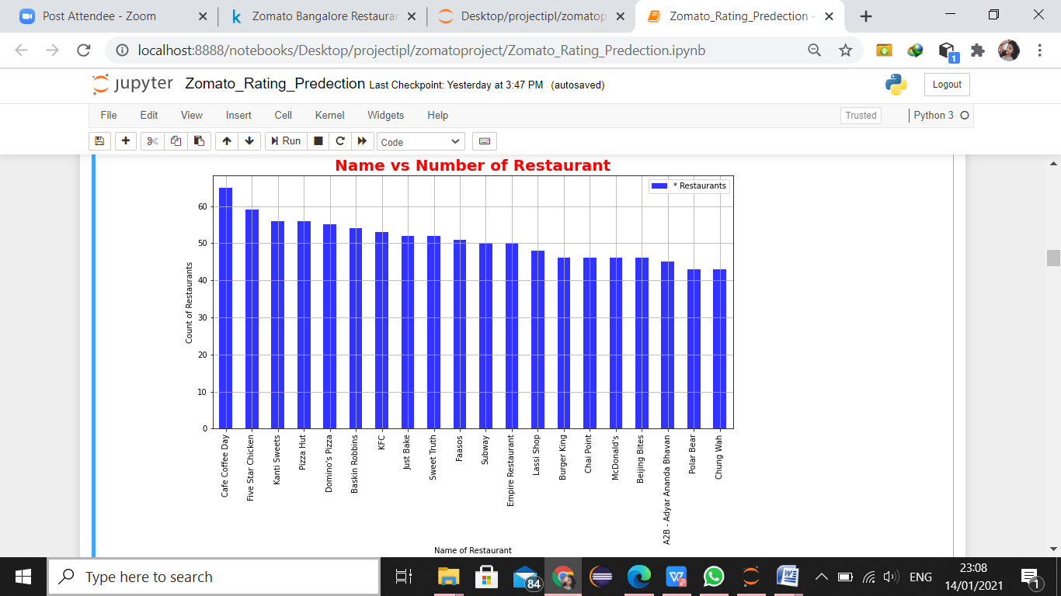
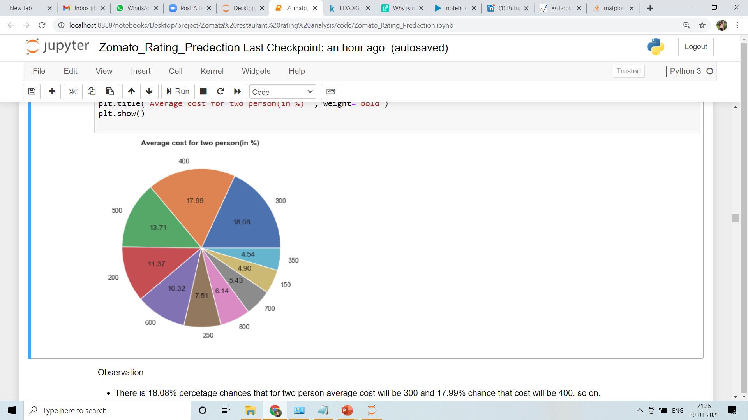
No. of Franchise
Average Cost

Slide 11
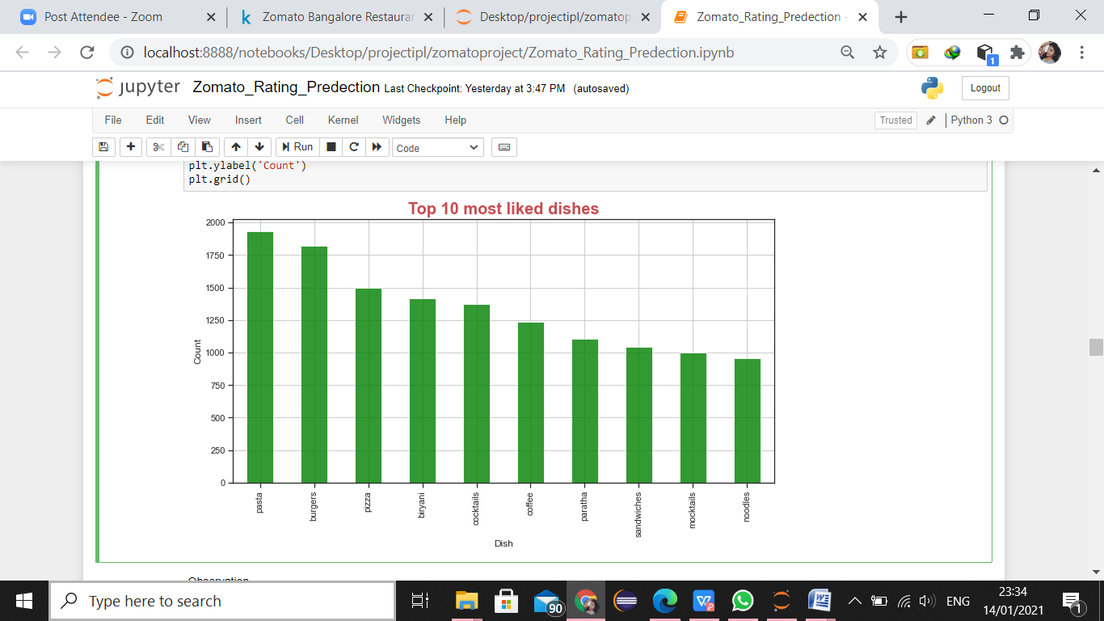
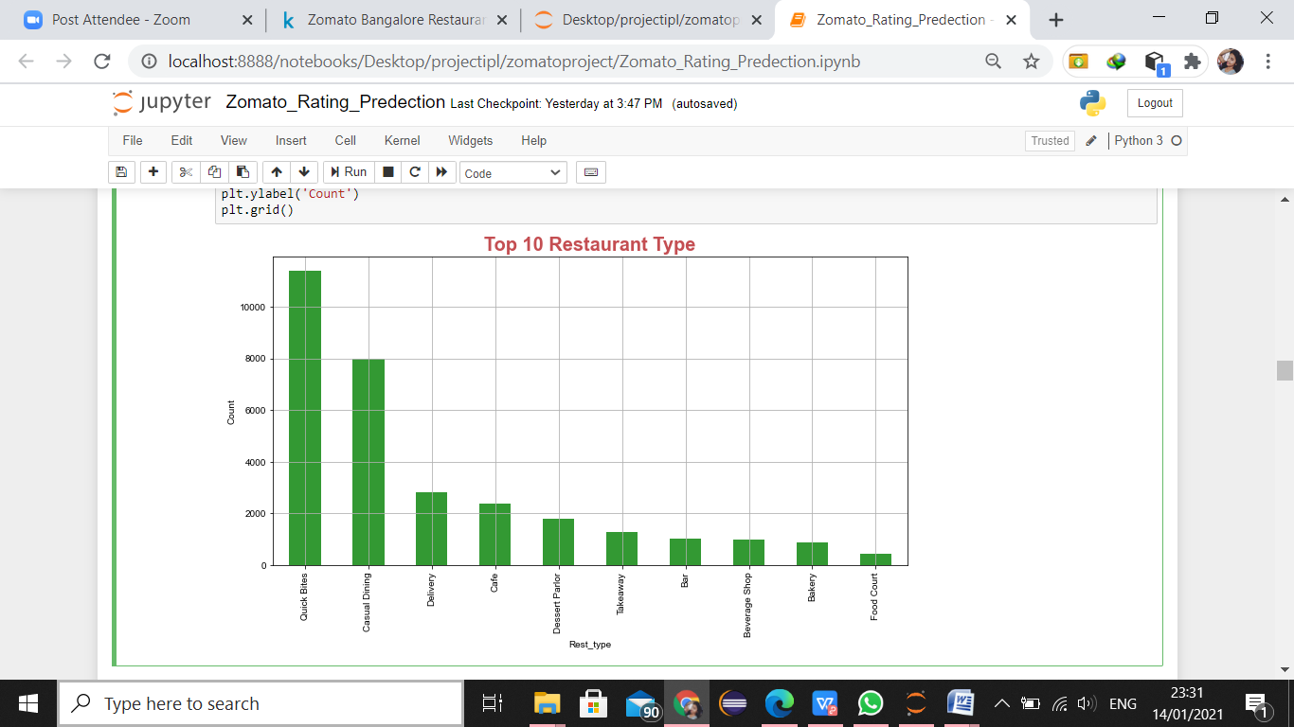
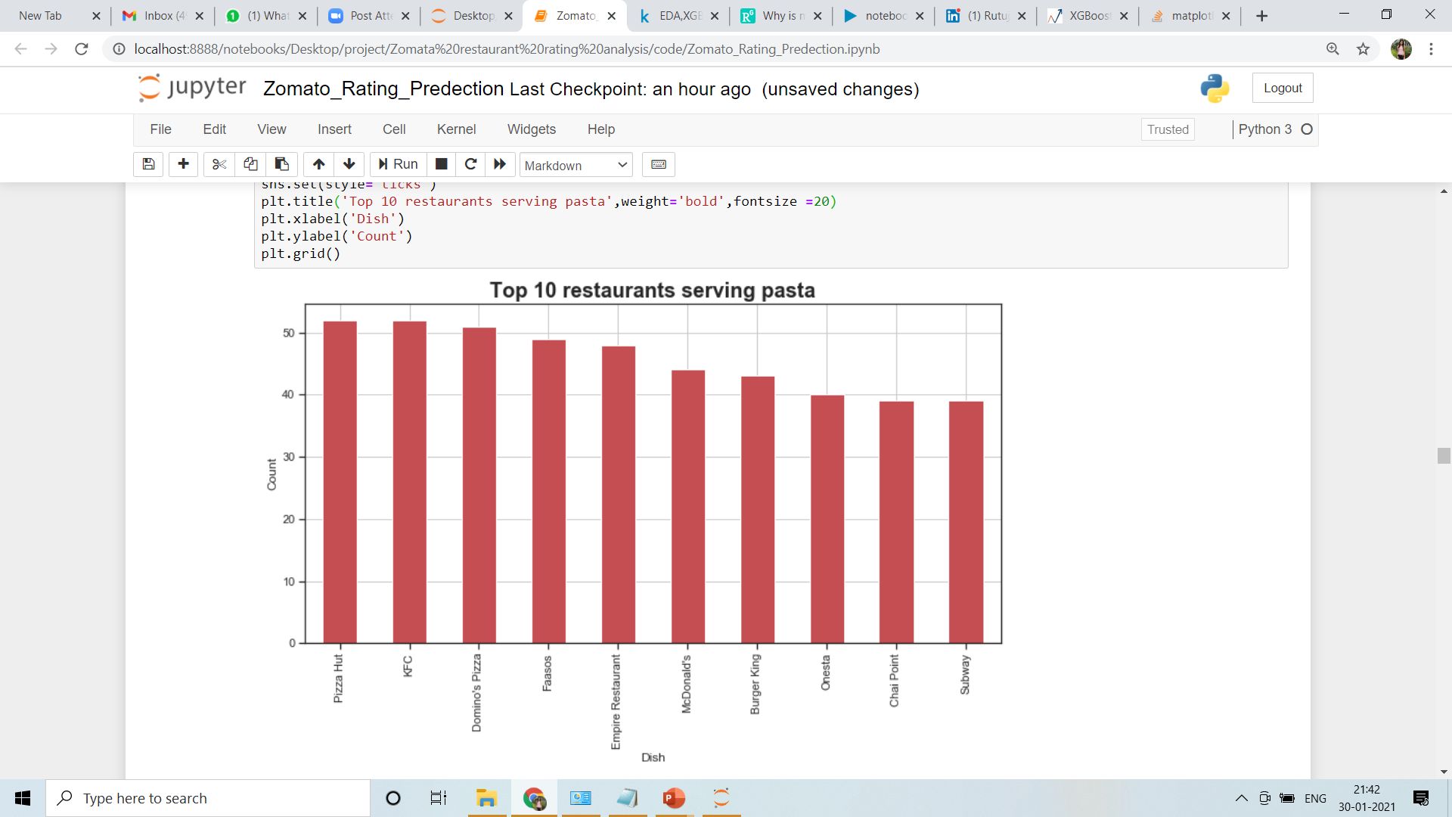
Top 10 liked dishes
Top 10 Restaurant Type
Top 10 restaurants serving Pasta

Slide 12
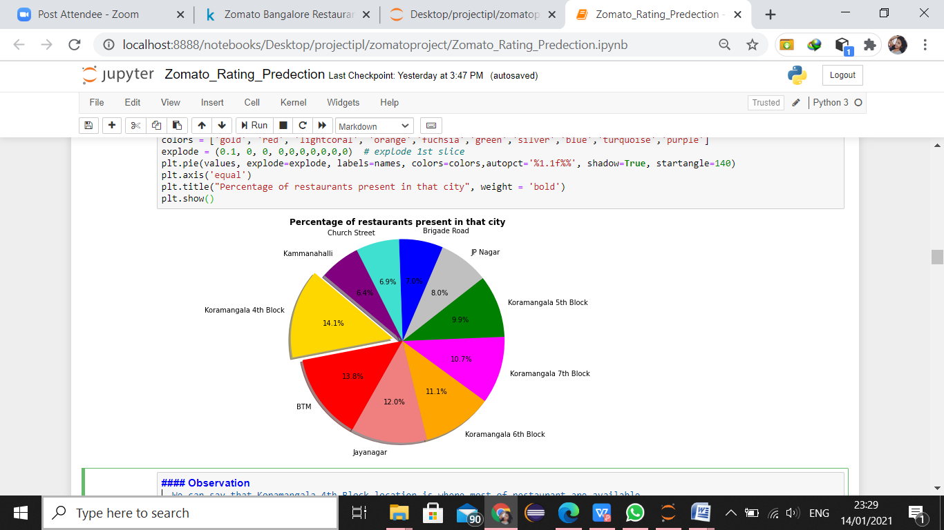
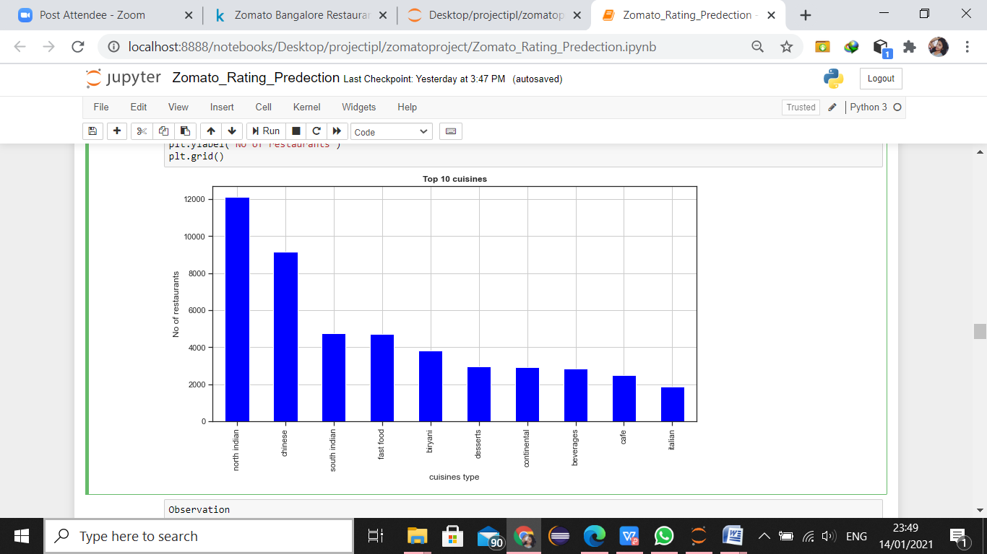
Percentage of Restaurants
Top 10 Cuisines

Slide 13
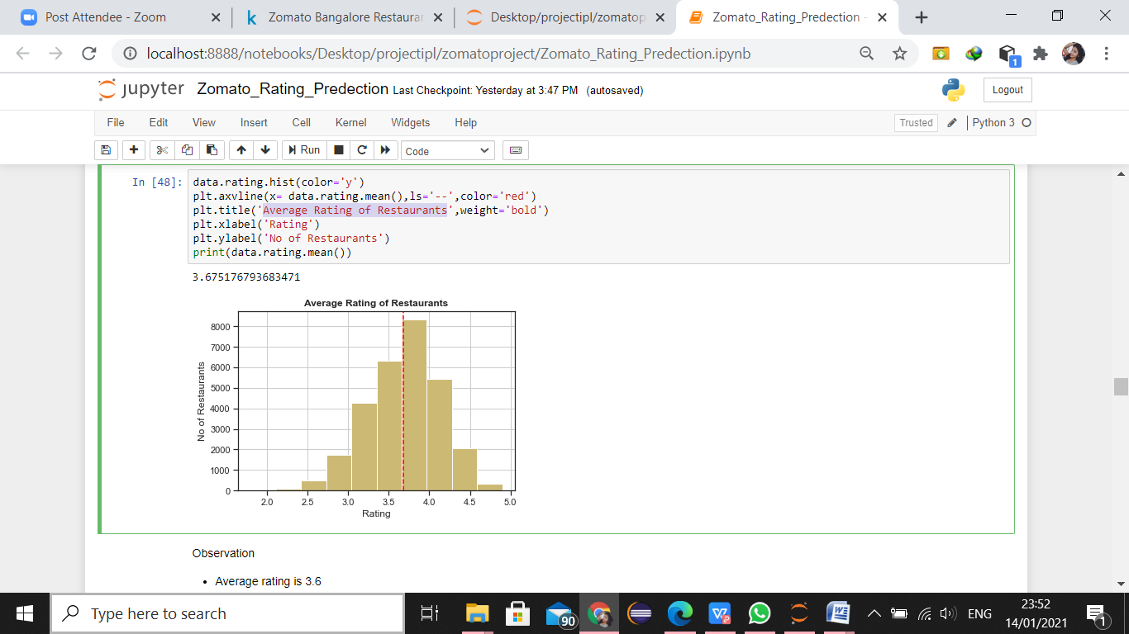
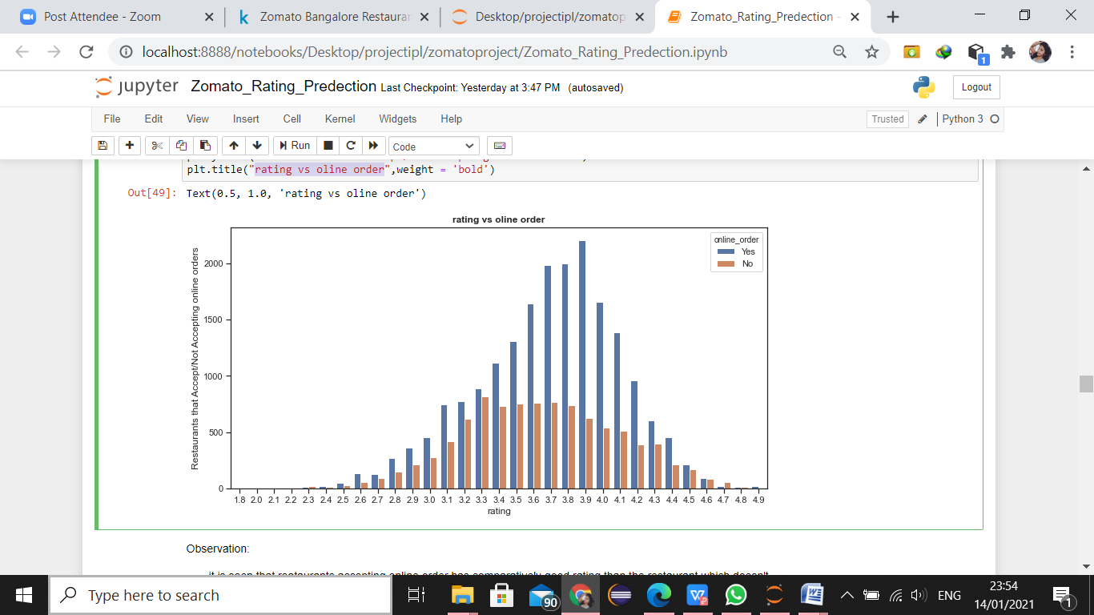
Rating Vs Online Order
Average Rating

Slide 14
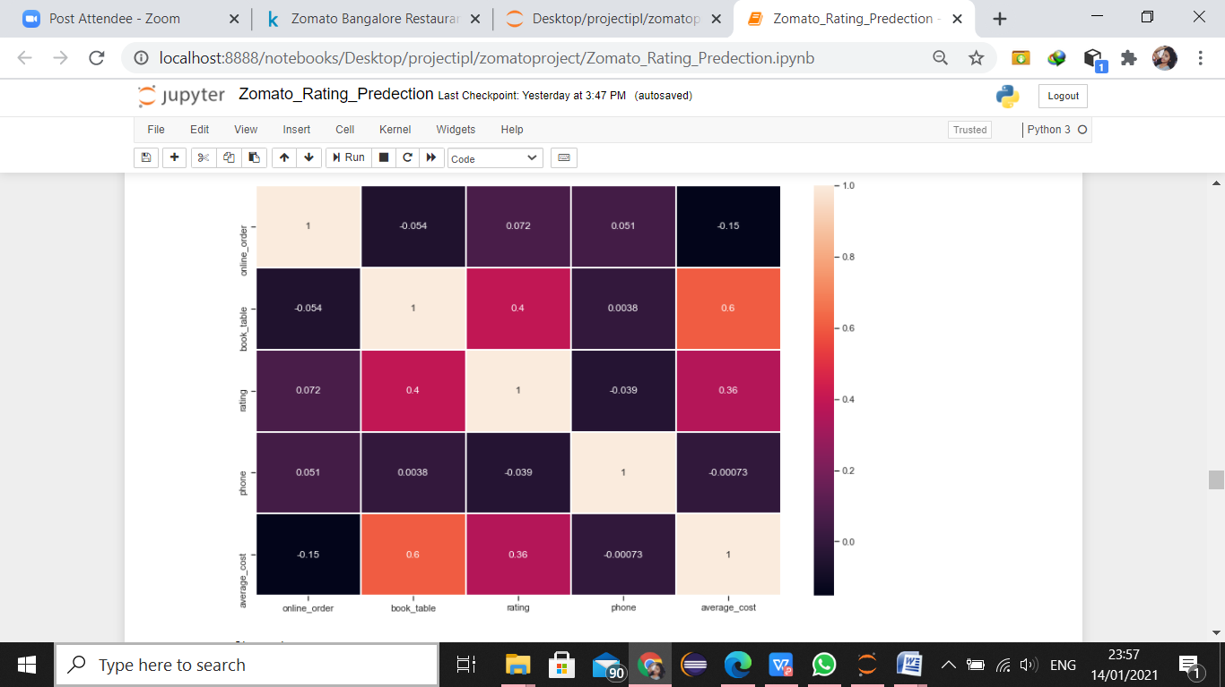
Heatmap
So from the heatmap it is seen that book table and online order impacts more on the target variable.

Slide 15
Model and Algorithms
Algorithms :
Linear Regression
Without tuning: r2score = 0.32
With tuning: r2score = 0.32
Decision tree Regressor
Without tuning: r2score = 0.72
With tuning: r2score = 0.76

Slide 16
Random forest Regressor
Without tuning: r2score = 0.79
With tuning: r2score = 0.83
XGBoost Regressor
Without tuning: r2score = 0.56
With tuning: r2score = 0.77

Slide 17
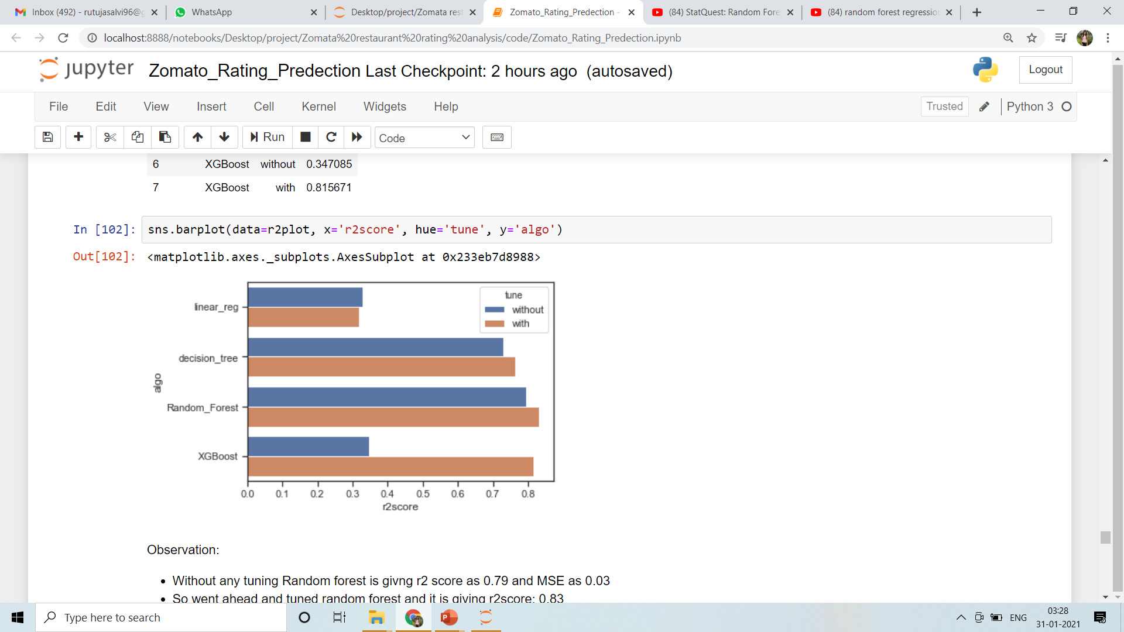
Results

Slide 18
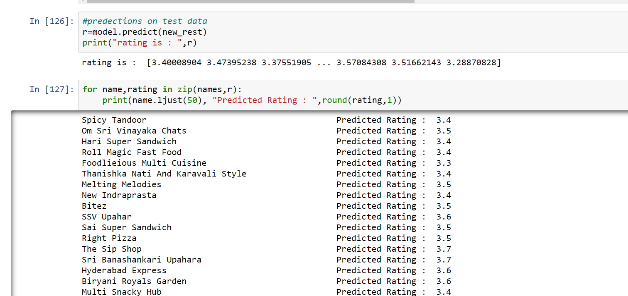
Predictions on new restaurants

Slide 19
Conclusion
This system predicts the ratings of the new restaurants in Bangalore city.
One hot encoding is performed on 5 features and tried different models.
Among those models Random forest Regressor performed best so it is selected as the final model.

Slide 20
Future Scope
Neural network can used be to check if it performs better than Random Forest
User interface can be made which takes inputs for a new restaurants

Slide 21

Thank You

