Slide 1
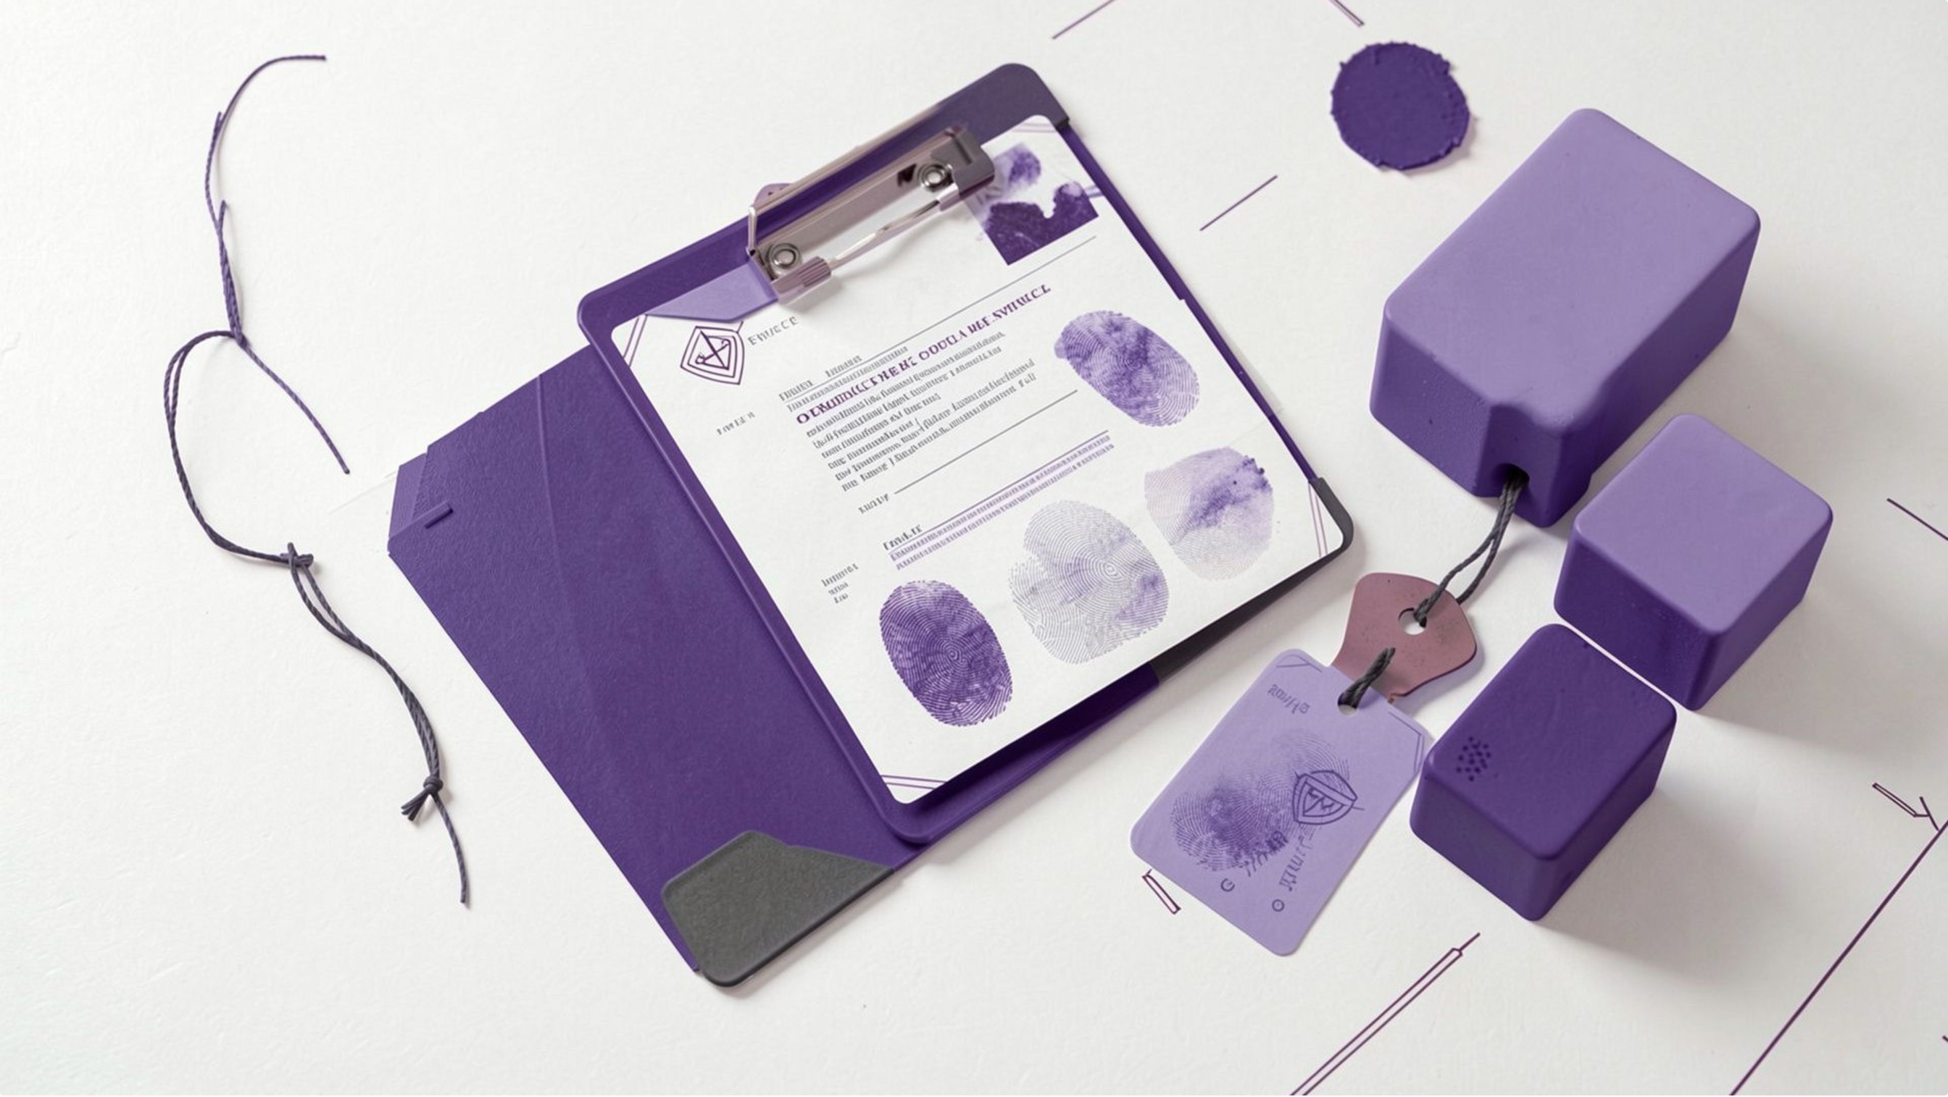
UNIVERSITY PROJECT · CYBERSECURITY & FORENSICS
Blockchain-Based Digital Evidence Chain of Custody System Using Python
Project overview and technical demonstration
Yogita Vohra (72413455)
Avneet Kaur (72313560)
BTech Computer Science Engineering

Slide 2
THE CHALLENGE
Digital evidence needs a record that is hard to rewrite silently
A file can change without leaving a physical trace. The record around it must make that change visible.
The weak record
The required proof
  Digital files can be changed without a physical trace.
  Paper or spreadsheet custody logs can be edited after the fact.
  Investigators need to show both file integrity and handling history.
  Later changes become visible through SHA-256 fingerprints and a hash-linked custody ledger.

Slide 3
THE SYSTEM LOGIC
The system connects evidence registration to verifiable history
Every action adds context to the same evidence record.
Register
Record
Verify
Report
Assign an EV-xxxx identifier and calculate the file’s SHA-256 hash.
Append custody events as linked blockchain blocks.
Re-hash the stored file and validate the ledger.
Generate a PDF summary from database records.
Outcome. A working local prototype that makes file changes and broken history easier to detect.
3

Slide 4





Python and Django carry the prototype end to end
A compact local stack keeps the technical path visible and testable.
Python 3.13
Django 5.2
SQLite
Core language and hashlib support.
Routing, forms, ORM, authentication, templates and tests.
Local database for cases, evidence, custody events, blocks and verification records.
SHA-256 + canonical JSON
ReportLab, HTML/CSS/JavaScript, Bootstrap
Deterministic fingerprints for files and block data.
PDF output, server-rendered UI and offline-friendly interface styling.

Slide 5
TECHNICAL ARCHITECTURE
The architecture is a layered Django application with local storage
Browser UI
Django views + services
Evidence storage + SQLite
Blockchain + verification
Login, dashboard, forms, verification and reports.
Validate inputs, enforce custody rules and coordinate transactions.
Keep the file private while metadata, hashes and events live in the database.
Recalculate hashes, check links and compare the file with its original fingerprint.
Scope boundary. No public network, distributed nodes or consensus layer is implemented.
5

Slide 6
REGISTRATION FLOW
One registration creates both a file fingerprint and a first custody block
Log in and select a case
1
Upload evidence; hash the file in chunks
2
Store a private copy under a random name; re-hash the saved bytes
3
Create the evidence record and first REGISTERED event
4
Append a block linked to the previous block
5
Re-hash and re-calculate the chain before results or reports
6

Slide 7
INTEGRITY MODEL
Two hashes answer two different integrity questions
FILE INTEGRITY
LEDGER INTEGRITY
Evidence hash
Block hash
SHA-256(File Content)
SHA-256(Serialized Block Data)
Is this file byte-for-byte the same as at registration?
Does this block still match its stored contents?
Each block stores the previous block’s hash. Changing an earlier block can break the next link.
SHA-256 output: 256 bits, commonly shown as 64 hexadecimal characters. A match supports integrity since registration; it does not prove origin or real-world authenticity.
7

Slide 8

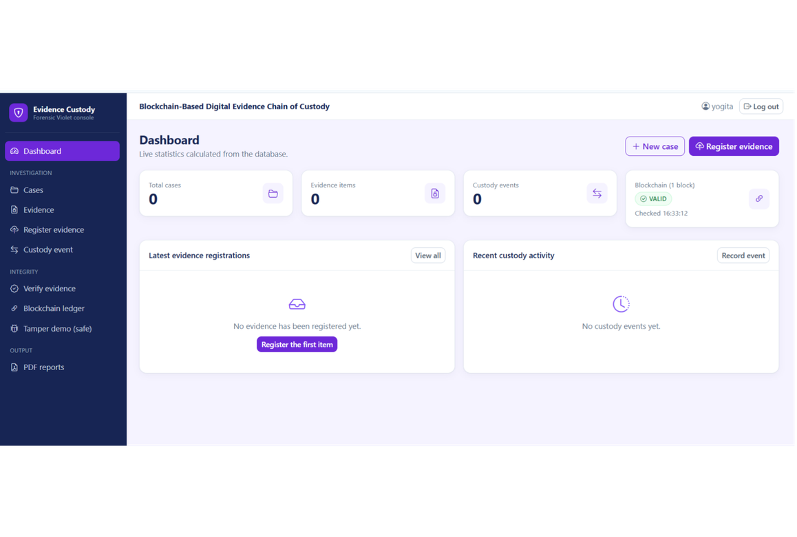
SYSTEM INTERFACE
The dashboard gives investigators one place to see the current state
Cases, evidence items, custody events and blockchain status appear together, with direct actions to create a case or register evidence.
Visible state
Actual dashboard view
Cases · evidence · custody · blockchain status
8

Slide 9
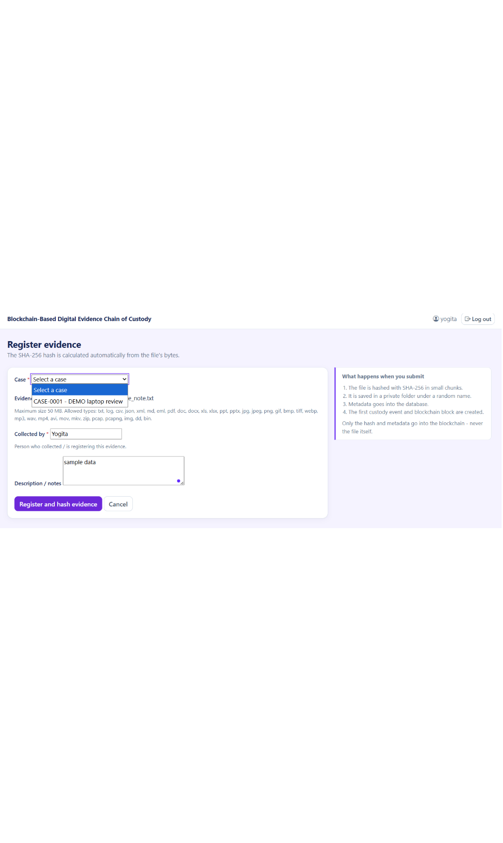



Registration captures the file, handler and purpose before the event is written
Case + file: Selected together before the record is created.
Handler + notes: The collector, handler and purpose become part of the record.
Event explanation: The interface explains hashing, private storage and the new linked block.

Slide 10
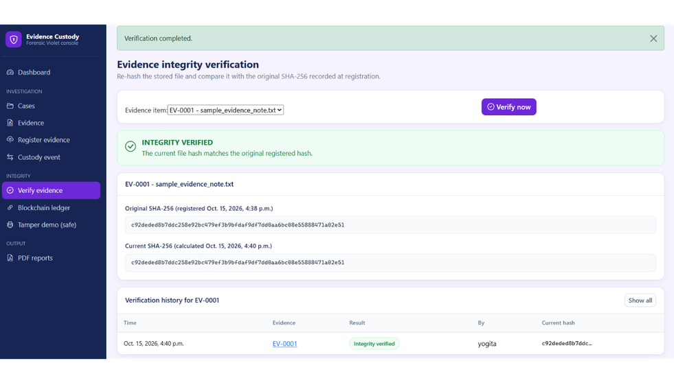
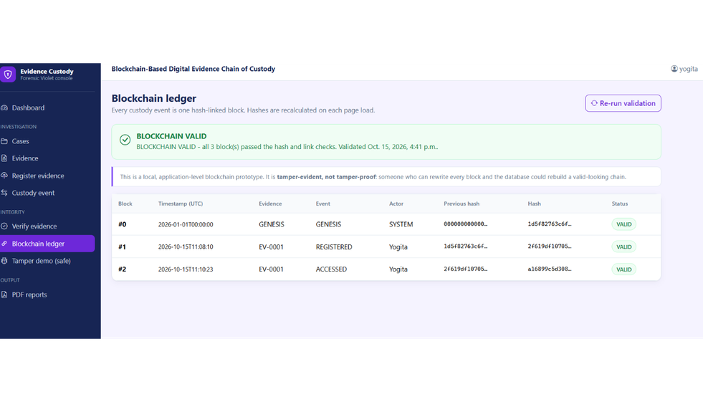
VERIFICATION
Verification separates file integrity from ledger integrity
File verification
Blockchain validation
Current SHA-256 equals the stored original hash.
Stored block hashes and previous-hash links remain consistent.
Read the label carefully. The local chain is tamper-evident, not tamper-proof.

Slide 11
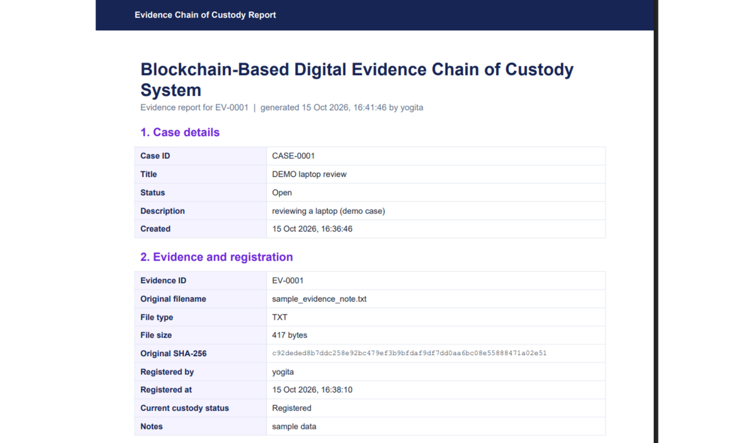
REPORTS AND LIMITS
Reports, Testing, and Project Limitations
What the report contains
Case details, evidence metadata, original filename,
type and size, original SHA-256, handler and time,
custody status, and notes.
Checks implemented
  File SHA-256 comparison for file integrity
  Hash-linked block verification for ledger integrity
  Report generation from recorded case and evidence data
Test status not independently confirmed here.
Generated report preview: case details, evidence metadata,
SHA-256, handler and time, custody status, notes.
Limitations: local prototype with a custom hash-linked chain on local, single-node storage.
Not automatically equivalent to a distributed production blockchain.
Production would need distributed consensus and networking, stronger access control, audit hardening, and operational security.
11

Slide 12


CONCLUSION
Conclusion and Future Scope
The project records digital evidence and custody events and uses SHA-256 hashing
and blockchain-style linking to make changes detectable.
Tracking and verification are supported through the dashboard and reports.
Future work
  Distributed multi-node deployment and consensus
  Stronger authentication and role-based access control
  Tamper-evident external audit and backup integration
Thank You

