Slide 1
POS Training Module

Slide 2
Concepts of Insurance
Purpose and need of Insurance
Concept of Risk, Peril, and Hazard
Section 1
Introduction To Insurance
©Max Life Insurance

Slide 3

Concept of Insurance: Basis of Insurance
Introduction to Insurance
1
Life in this world is full of uncertain events
These events are unpredictable, else we can prepare for it.
Uncertain events make us anxious and afraid
Because of anticipation of economic loss and grief
A community can come to the aid of individuals who are affected by such events, by having a system of sharing and mutual support. This forms the basis of Insurance.
©Max Life Insurance

Slide 4
Concept of Insurance: Rationale
Introduction to Insurance
1
When an asset loses its economic value (by loss or destruction) due to a certain event, the owner of the asset suffers an economic loss.
However if a common fund or pool is created, which is made up of small contributions from many such owners of similar assets, this amount could be used to compensate the loss suffered by the unfortunate few.
In simple words, the chance of suffering a certain economic loss and its consequence could be transferred from one individual to many through the mechanism of insurance.
Insurance may be considered as a process by which the losses of a few, who are unfortunate to suffer such losses, are shared amongst those exposed to similar uncertain events / situations.
©Max Life Insurance

Slide 5
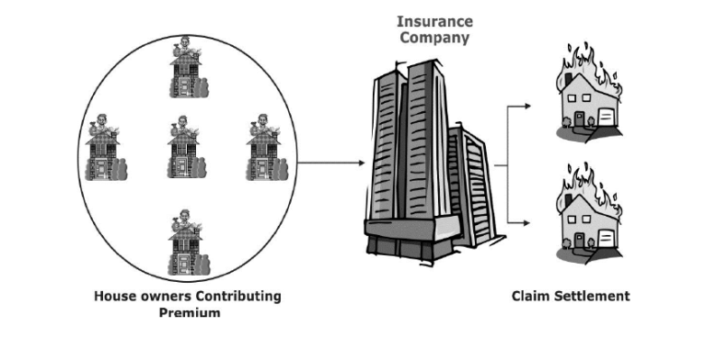
Concept of Insurance: Process
Introduction to Insurance
1
Insurance
Process where losses of a few are shared by others exposed to similar uncertain events/situations
Example : Out of 400 houses, each valued at Rs. 20,000, on an average 4 houses get burnt every year resulting in a combined loss of Rs. 80,000. The annual contribution of each house owner to make good this loss would be 80000/400= Rs.200
©Max Life Insurance

Slide 6
Purpose and Need of Insurance
Introduction to Insurance
2
Primary Function
Provide protection
Secondary Function
Collective bearing of risk
Small capital to cover larger risk
Means of saving & investments
Reduction in tension and fear
The need for life insurance is based on the concept of Human Life Value.
Human Life is an asset and holds value because of its earning potential.
Human Life Value is the value of expected net future earnings.
Life insurance provides protection against those risk events that can destroy or diminish the value of human life as an asset
©Max Life Insurance

Slide 7
Concept of Risk, Peril, and Hazard
Introduction to Insurance
3
Primary Function
Provide protection
Secondary Function
Collective bearing of risk
Small capital to cover larger risk
Means of saving & investments
Reduction in tension and fear
The need for life insurance is based on the concept of Human Life Value.
Human Life is an asset and holds value because of its earning potential.
Human Life Value is the value of expected net future earnings.
Life insurance provides protection against those risk events that can destroy or diminish the value of human life as an asset
©Max Life Insurance

Slide 8
Insurers
Agents
Intermediaries
Role of POS Persons
IRDAI
Section 2
Indian Insurance Market
©Max Life Insurance

Slide 9
Insurers: Overview of the Life Insurance Industry
Indian Insurance Market
1
Insurance companies in India are either termed as:
Life Insurance companies
Non Life Insurance companies
(anything other than life)
24 life insurance companies
Life Insurance Corporation (LIC) of India (Public Sector)
23 Private life insurance companies
©Max Life Insurance

Slide 10
Insurers: Role of Insurers
Indian Insurance Market
1
Pooled funds are collected and held for the benefit of the policyholders, it provides numerous direct and indirect benefits to the individual, his family, to industry and to the community and the nation as a whole.
Insurance removes the fear, worry and anxiety associated with one’s future and encourages efficient use of capital in business enterprises and promotes efficient use of existing resources
Insurers play an important role in social security schemes sponsored by the Government. E.g. Rural schemes for rural families
©Max Life Insurance

Slide 11
Agents: Role of agents and the process of becoming an agent
Indian Insurance Market
2
"Insurance Agent" means an individual appointed by an insurer for the purpose of soliciting or procuring insurance business including business relating to the continuance, renewal or revival of policies of insurance.
Qualifications of the applicant
Pass in 12th Standard (Resident of a place where population is 5000 or more as per the last census)
Practical Training
50 hours training from an IRDAI approved institution, spread over 2-3 weeks
Examination
Pre Recruitment exam conducted by III Mumbai
Fees Payable
RS.250 or as amended from time to time
Pass in 10th Standard (other places)
©Max Life Insurance

Slide 12
Intermediaries: Role of other intermediaries
Indian Insurance Market
3
Brokers
Individuals or corporates, who work independently of insurance companies, represent the people who want insurance and connect them to insurance companies
Corporate Agents
Corporate entities who represent an insurance company and sell its policies. Usually they are engaged in a particular business and sell insurance policies to their existing customers
Insurance Web Aggregators
Through their web site and/or telemarketing, they can solicit insurance business through distance marketing with the prospect and generate leads of interested prospects for insurers
Insurance Marketing Firms
Sell insurance products of two Life, two General and two Health Insurance companies at any point of time, under intimation to the Authority by engaging Insurance Sales Persons (ISP)
©Max Life Insurance

Slide 13
POS persons: Key guidelines governing the recruitment, and conduct of ‘Point of Sales Persons’
Indian Insurance Market
4
"Point of Sales Person" means an individual appointed by an insurer or intermediary, who possesses the minimum qualifications and has undergone training and is allowed to sell the "Point of Sales" products.
Any individual of at-least 18 years of Age
POS needs to be Class X pass
Identified by his Aadhaar Card or PAN Card
Who can be a POS Person?
POSP can be recruited by an Insurer or Intermediary
POSP is authorized to sell only POS – Life Insurance products.
POSP can only be employed by 1 insurer / intermediary
POSP can sell Life Insurance products of all insurers whose products the intermediary is allowed to sell
Who can appoint a POS?
POSP are allowed to sell simple products, where each and every benefits of the products are:
Simple to understand
Stated upfront clearly
Fixed / pre-defined
What kind of Products can POS Sell?
©Max Life Insurance

Slide 14
IRDAI: Role, history of IRDAI
Indian Insurance Market
5
Role of IRDAI
It regulates all insurance business and players in the insurance market & develops them by focusing on :
Protection of interest of consumers
Financial soundness of insurance industry
Ways to help a healthy growth of insurance market
History of IRDAI
Malhotra Committee Report,1994
Explore and recommend changes for development of the industry.
IRDA Act,1999
Passing of the Act led to the formation of Insurance Regulatory and Development Authority of India (IRDAI) in April 2000.
IRDA has been subsequently renamed as IRDAI in 2014.
In 1997 the Insurance Regulatory Authority (IRA) was established and Industry was opened for competition
©Max Life Insurance

Slide 15
Offer (Proposal and Acceptance)
Consideration (Premium)
Insurable Interest
Sales Literature
Proposal Form Cum KFD
Renewal Notice
Utmost good faith
Premium Payment Options
Sec 64-VB of Insurance Act
Policy Terms and Conditions
Section 3
Principles And Practice Of Insurance
©Max Life Insurance

Slide 16
Offer (Proposal) and Acceptance
Principles and Practice of Insurance
1
When willingness to do or to abstain from doing anything is expressed for assent/approval , an offer or proposal is said to be made
Usually, the offer is made by the proposer, and acceptance made by the insurer.
When a person to whom the offer is made signifies his assent thereto, this is deemed to be an acceptance.
The acceptance needs to be communicated to the proposer which results in the formation of a contract.
Proposer accepts the terms of the insurance plan and pays the deposit amount
The policy bond becomes the evidence of the contract.
On acceptance of the proposal, deposit amount gets converted to the first premium
The proposal becomes a Policy (Promise)
If any condition is put, it becomes a counter offer.
©Max Life Insurance

Slide 17
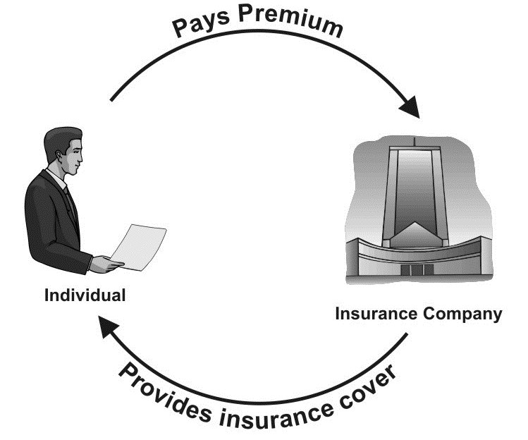
Consideration (Premium)
Principles and Practice of Insurance
2
Consideration means that the contract must contain some mutual benefit for the parties.
The premium is the consideration from the insured, and the promise to indemnify, is the consideration from the insurers.
©Max Life Insurance

Slide 18
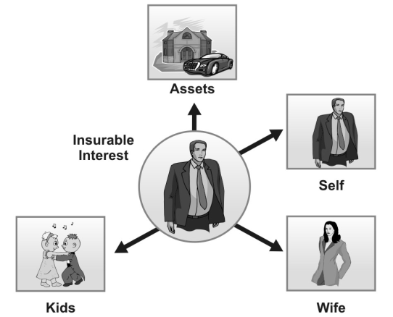
Insurable Interest: Concept
Principles and Practice of Insurance
3
The interest that the insured has in his house or his money or assets is termed as insurable interest.
The presence of insurable interest makes an insurance contract valid and enforceable under the law.
The existence of “insurable interest” is an essential ingredient of every insurance contract.
©Max Life Insurance

Slide 19
Insurable Interest: Time When Insurable Interest should be present
Principles and Practice of Insurance
3
Insurable interest should be present at the time of taking the policy in life insurance.
In general insurance, insurable interest should be present both at the time of taking the policy and at the time of claim, with some exceptions like marine policies.
Insurance differs from a gambling or wager agreement as unlike a card game, where one could win or lose, a fire can have only one consequence , i.e., loss
The owner takes insurance to ensure that the loss suffered is compensated for in some way. It is only when the insured has financial/pecuniary an interest in the property that he has the legal right to insure.
©Max Life Insurance

Slide 20
Sales Literature
Principles and Practice of Insurance
4
Brochures
Serves the purpose of introducing a product to prospective buyers
Single Pagers
Provides a brief detail about the features and benefits of the product
Illustration(IFTIS)
How a life insurance policy will perform at a selected interest rate, with an assumed number of predetermined premium payments and a "current" and "guaranteed" cost of insurance and expenses.
Posters
Piece of printed paper designed to be attached to a wall advertising a product or service
©Max Life Insurance

Slide 21
Proposal Form cum KFD
Principles and Practice of Insurance
5
The application document used for making the proposal is commonly known as the ‘proposal form’. It has to be in writing.
Proposal Form Cum Key Features Document
KFD used by insurance company should state each of following under each of its plans of insurance
Terms and Conditions
Scope of Benefits – Guaranteed and Non Guaranteed
Entitlements
Exceptions
Whether plan is participating or non participating
It is a formal legal document used by insurance companies that provides details about the product
©Max Life Insurance

Slide 22
Renewal Notice
Principles and Practice of Insurance
6
No legal obligation on the part of insurers to advise the insured that his premium is due
A note advising the insured for intimating any material alterations in the risk is included as a practice
Statutory provision that no risk can be assumed unless the premium is paid in advance is also included.
Due to courtesy and healthy business practice, insurers issue a renewal notice
Its issued in advance of the date of expiry, inviting renewal of the policy
Includes all relevant particulars such as sum insured, the annual premium, etc.
©Max Life Insurance

Slide 23
Utmost Good Faith: Concept
Principles and Practice of Insurance
7
It means that every party to the contract must disclose all material facts relating to the subject matter of insurance
If utmost good faith is not observed by either party, the contract may be avoided by the other party.
Material Fact
It has been defined as a fact that would affect the judgment of an insurance underwriter in deciding whether to accept the risk and if so the rate of premium and the terms and conditions
©Max Life Insurance

Slide 24
Utmost Good Faith: Breach of utmost good faith
Principles and Practice of Insurance
7
Non-Disclosure
When the insured is silent in general about material facts or evades answers to queries
Fraud
Act intended to deceive and induce the insurer to issue a policy
Misrepresentation
Incorrect statement made during negotiation of a contract of insurance (can be innocent or fraudulent)
©Max Life Insurance

Slide 25
Premium payment options
Principles and Practice of Insurance
8
Cash
Postal Money Order
Credit/Debit Card
Cheque/Demand Draft/Pay Order/Banker Cheque
Internet/E-Transfer
Direct credits via standing instruction
Any other method or payment as may be approved by the Authority from time to time
Bank guarantee
©Max Life Insurance

Slide 26
Sec 64 -VB of Insurance Act,1938
Principles and Practice of Insurance
9
No insurer shall assume any risk unless and until the premium is received in advance or is guaranteed to be paid or a deposit is made in advance in the prescribed manner
Where an insurance agent collects a premium, he shall deposit within 24 hours with the insurer or dispatch by post to the insurer the premium without deduction of his commission
Risk may be assumed on the date on which the money order is booked or the cheque is posted
As per Sec 64 -VB of the Insurance Act, 1938 states that premium is to be paid in advance, before the start of the insurance cover.
©Max Life Insurance

Slide 27
Policy Conditions
Principles and Practice of Insurance
10
Grace period
An additional period of time to pay the premium after it has become due.
Reinstatement
Put back into force a policy that has either been terminated because of non-payment of premiums or has been continued under one of the non-forfeiture provisions.
Policy loan
The right to borrow money from the insurer by using the cash value of the policy as a security for the loan
Nomination
The life assured proposes the name of the person(s) to which the sum assured should be paid by the insurance company after their death
Assignment
Act of transferring the rights right, title and interest in the policy (as property) from one person to another.
Alteration
Changes which do not impact the terms and conditions of the policy like change in mode of payment, change of address etc.
©Max Life Insurance

Slide 28
POS – Life Insurance Guidelines
POS – Product Guideline
Section 4
Point of Sale
Life Insurance Products
©Max Life Insurance

Slide 29
‘Point of Sale’ Life Insurance Guidelines
Point of Sale: Life Insurance Products
1
Any individual of at-least 18 years of Age
POS needs to be Class X pass
Identified by his Aadhaar Card or PAN Card
Who can be a POS Person?
POSP can be recruited by an Insurer or Intermediary
POSP is authorized to sell only POS – Life Insurance products.
POSP can only be employed by 1 insurer / intermediary
Who can appoint a POS?
Training: Insurer will conduct an in-house training of 15 hours. Can be Online.
Examination: Insurer will conduct an examination after completion of the training.
Certification: Insurer will issue a certificate to the candidate passed in the examination
Contract: Insurer will enter into a written agreement with the POS person
How will the POS be recruited?
©Max Life Insurance

Slide 30
‘Point of Sale’ Product Guidelines
Point of Sale: Life Insurance Products
2
POSP are allowed to sell simple products, where each and every benefits of the products are:
Simple to understand
Stated upfront clearly
Fixed / pre-defined
Salient features of ‘Point of Sales’ Products
The turnaround time for issuance of policy / acceptance of Risk (or otherwise) and communication of the same should be done within two working days (Excluding holidays)
If the Proposal is not accepted, the refund of payment should be done to the Proposer / Life Assured within 7 days from the date of decision.
Timelines for issuance / rejection of proposal
©Max Life Insurance

Slide 31
‘Point of Sale’ Product Guidelines: Product features
Point of Sale: Life Insurance Products
2
Max Sum Assured 25 lakhs
Min Policy Term 5 years
Non Medical Underwriting
Pure Term
Max Sum Assured 25 lakhs
Min Policy Term 5 years
Non Medical Underwriting
Term with
Return of Premium
Non-PAR Endowment
Max Sum Assured 10 lakhs
Min Policy Term 5 years
Non Medical Underwriting
Immediate Annuity
Single Premium only
Max Premium : no limit
©Max Life Insurance

Slide 32
Anti Money Laundering
Know Your Customer
Do’s and Don’ts for POS Persons
Grievance Redressal Mechanism
Section 5
Other Key Regulatory Guidelines
©Max Life Insurance

Slide 33
Anti Money Laundering
Other Key Regulatory Guidelines
1
Definition
Money Laundering is moving illegally acquired cash through financial systems so that it appears to be legally acquired.
The Prevention of Money Laundering Act (PMLA), 2002 came into effect from 2005 to control money laundering activities and to provide for confiscation of property derived from money-laundering.
Each insurer is required to have an AML policy and accordingly file a copy with IRDAI.
Implication for Insurers
Know Your Customer (KYC) Guidelines
Due Diligence based on the customer segment
Training of Employees and Distributors
Prompt reporting to authorities as required by law and regulations
Key Elements of Max Life’s AML Program
©Max Life Insurance

Slide 34
Know Your Customer
Other Key Regulatory Guidelines
2
Verification of the identity of the client /payee /legal person /beneficial owner - Checks to ensure that the Company determines:
The true identity of the customers
The contracts are not anonymous or have fictitious names
Definition
By Collection of mandated KYC documents viz. Address proof, Identity Proof, Photograph, Income documents etc.through physical and electronic mode (E-KYC-Unique Identification Authority of India (UIDAI) E-KYC services)
KYC activity is performed at various stages of policy cycle including;
On Boarding
Claims Payout, and
Inconsistent top up remittances
Key Elements of Max Life’s AML Program
©Max Life Insurance

Slide 35
Do’s for Point of Sales Persons
Other Key Regulatory Guidelines
3
Identify himself and the insurer of whom he is a 'Point of Sales Person'
Disseminate the requisite information in respect of insurance products offered for sale by his insurer and take into account the needs of the prospect while recommending a specific insurance plan
Where the 'Point of Sales Person' represents more than one insurer offering same line of products, he should dispassionately advice the policyholder on the products of all Insurers whom he is representing and the product best suited to the specific needs of the prospect
Disclose the scales of commission in respect of the insurance product offered for sale, if asked by the prospect
Indicate the premium to be charged by the insurer for the insurance product offered for sale;
Explain to the prospect the nature of information required in the proposal form by the insurer, and also the importance of disclosure of material information in the purchase of an insurance contract;
Bring to the notice of the insurer every fact about the prospect relevant to insurance underwriting
Obtain the requisite documents at the time of filing the proposal form with the insurer; and other documents subsequently asked for by the insurer for completion of the proposal
Advise every prospect to effect nomination under the policy
Inform promptly the prospect about the acceptance or rejection of the proposal by the insurer
Render necessary assistance and advice to every policyholder introduced through him/her on all policy servicing matters including assignment of policy, change of address or exercise of options under the policy or any other policy service, wherever necessary;
Render necessary assistance to the policyholders or claimants or beneficiaries in complying with the requirements for settlement of claims by the insurer;
©Max Life Insurance

Slide 36
Don’ts for Point of Sales Persons
Other Key Regulatory Guidelines
3
Solicit or procure insurance business without being appointed to act as such by the insurer
Induce the prospect to omit any material information in the proposal form
Induce the prospect to submit wrong information in the proposal form or documents submitted to the insurer for acceptance of the proposal
Resort to multilevel marketing for soliciting and procuring insurance policies and/or induct any prospect/policyholder into a multilevel level marketing scheme.
Offer different rates, advantages, terms and conditions other than those offered by his insurer;
Demand or receive a share of proceeds from the beneficiary under an insurance contract;
Force a policyholder to terminate the existing policy and to effect a new policy from him within three years from the date of such termination of the earlier policy;
©Max Life Insurance

Slide 37
Grievance Redressal Mechanism
Other Key Regulatory Guidelines
4
Following avenues are available with the customers to resolve their grievances:
IRDAI’s Integrated Grievance Management System
IRDAI has launched an Integrated Grievance Management System (IGMS) which acts as a central repository of insurance grievance data and as a tool for monitoring grievance redress in the industry.
Policyholders can log their complaints on this system, which are then forwarded to the respective insurance companies. IGMS tracks complaints and the time taken for their redressal.
“Consumer disputes redressal agencies” are set up under “The Consumer Protection Act, 1986”.
“Consumer disputes redressal agencies” are established in each district and state and at national level.
There is no fee for filing a complaint or filing an appeal whether before the State Commission or National Commission.
The complaint can be filed by the complainant himself or by his authorised agent. It can be filed personally or can even be sent by post.
Consumer disputes redressal agencies
The Insurance Ombudsman was created by Government of India for individual policyholders to have their complaints settled out of the courts system in a cost-effective, efficient and impartial way. There are 12 Insurance Ombudsman in different locations and the customers can approach the one having jurisdiction over the location of the insurance company office that they have a complaint against.
Customers can approach the Ombudsman with complaint if:
They have first approached the insurance company with the complaint and
Either not resolved it or not resolved it to the customer's satisfaction or
Not responded to it at all for 30 days
The complaint pertains to any policy that the customer has taken as an individual and the value of the claim including expenses claimed is not above Rs 20 lakh
Insurance Ombudsman
©Max Life Insurance

Slide 38
Thank you

Slide 39
Disclaimer
This document is strictly for internal circulation and / or training purposes. Any unauthorized use of the same including as customer communication and/or in the solicitation process is prohibited. Max Life Insurance Company Limited is not liable for any loss incurred by anyone for any action(s) taken basis the content of this document.

