Slide 1
Workflow driven analysis for VOEIS data management
Montana State University
VOEIS team

Slide 2
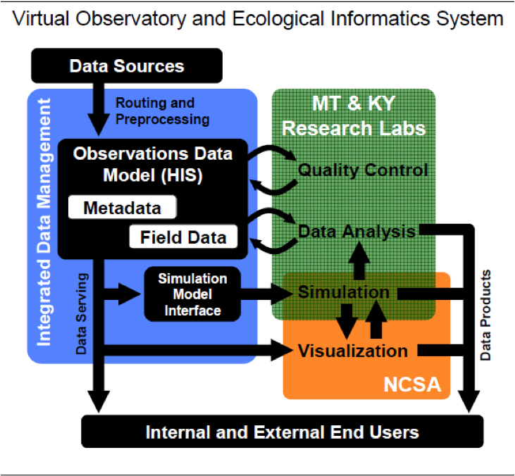
VOEIS
VOEIS provides cyber-infrastructure (CI) for data management:
Collection
Quality Control
Analysis
Modeling/Simulation
Visualization
Publication

Slide 3
VOEIS Use Cases
Administrative Activities
Managing users
Configuring System
Defining Roles/Permissions
Creating Projects
Creating Sites, Sensors
Associating Sites, Sensors with projects
Retrieving Field Data
Streaming Sensors
Configuring live streaming
Downloading files from loggers
Uploading new programs
Verifying program/data parameters
Logging activities
Observed Data
Capturing metadata
Taking data measurements
Logging activities
Samples (for lab processing)
Capturing metadata
Taking samples
Logging activities
Checking in Data to VOEIS
Uploading data
Associating data and metadata
Data Management Processes
Validating uploaded data
Approving new metadata
Validating logger programs
Data Processes
Search, browse, download data
Quality Control/Analysis Processes
Update values, tag with metadata
Simulation/Modeling Processes
Bulk Export/Import
Interactive (via API) Retrieve/Update
Visualization Processes
Bulk Export
Connect to live Simulations (Models)
Publishing for public access
Adding publishing destinations
Marking data as publishable
Curating ontological annotations

Slide 4
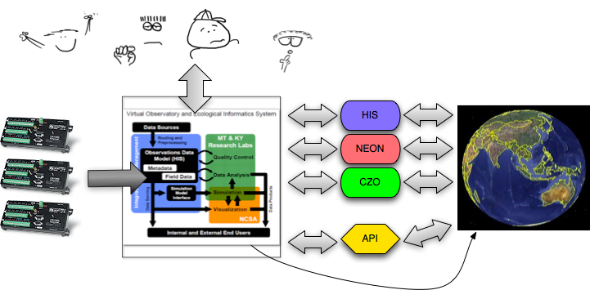
VOEIS Data HUB
Public Access
Interactive
Data Management
Data Publishing
Notes:
Create an end-to-end CI system for Data Management
Support multiple types of data: streaming, observed (organism and ecology), and lab chemistry
Make data accessible to collaborators and when appropriate publicly available to other researchers (e.g. via CUAHSI HydroServer)

Slide 5
VOEIS Plan
Streaming Data
Field Collected Data
Lab Processed Data
RESTful Data Access API
(XML, JSON, …)
Integrated Data Management
Quality Control
Data Analysis
Simulation
Yogo Toolkit
Matlab Tools
Hydro Desktop
Projects
HydroSeek
WEB Services - WaterML
HydroObjects
Local RDBMS
(Like ODM)
Models
Data
People
HydroExcel
GIS Tools
Access Control
Simulation Model Interface
Legacy Data
HydroLink (OpenMI)
Visualization
External Data Mapper
Tools with similar capabilities as existing tools
Information Discovery
Private Hydro Server
Public Hydro Server
NCSA
Internal Users
HIS Central Catalog &
Ontology
External Users

Slide 6
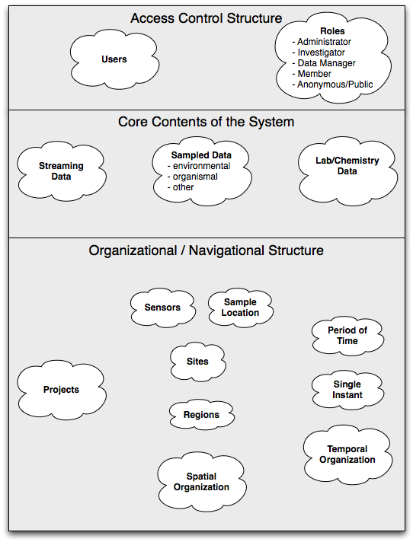
VOEIS Data Model
There are three major components in VOEIS:
Access Controls
Managed Data
Three basic types, plus support for creating new types on the fly
Organizational Structure
Temporal
Spatial
Project

Slide 7
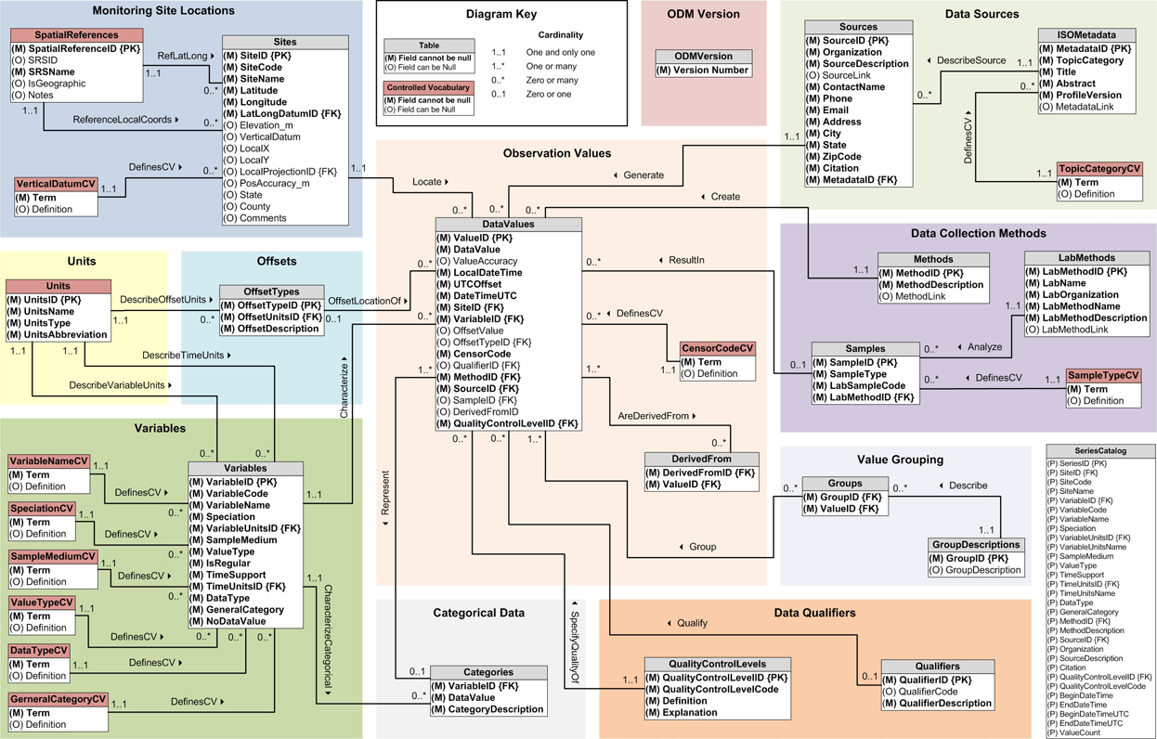
VOEIS: External Data Mapping
CUAHSI ODM 1.1
?
?
Data can be mapped for automatic and periodic
import, export or synchronization.

Slide 8
Requirements Gathering
Initial investigation is based on:
Discussions and contextual interviews with project and tool champions
Don Schenck, Matt Williamson, Geoff Poole, Lucy Marshall, Brian McGlynn, …
Analysis of biological station schemas and workflows
Analysis of field operation workflows
Feedback from VOEIS prototype users
Analysis of CUAHSI HIS ODM

Slide 9
User Interface Mockups
Mockups to show user interfaces for feedback
These show where different “entry points” of functionality appear

Slide 10
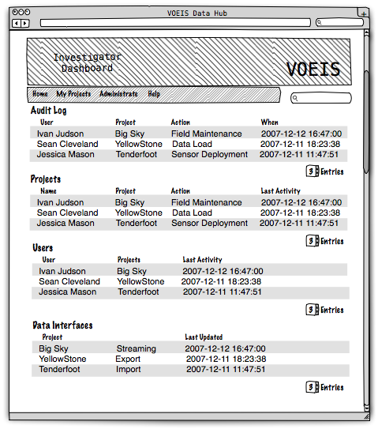
Investigator Dashboard Mockup
First place an investigator lands, unless they specify a default project
Provides an instant view of activity on their projects

Slide 11
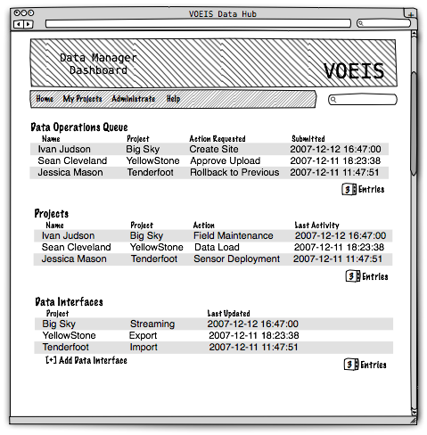
Data Manager Dashboard Mockup
Provides a quick view of all information necessary for a data manager
In particular, users that have submitted data operations are presented as a queue of work for the data manager

Slide 12
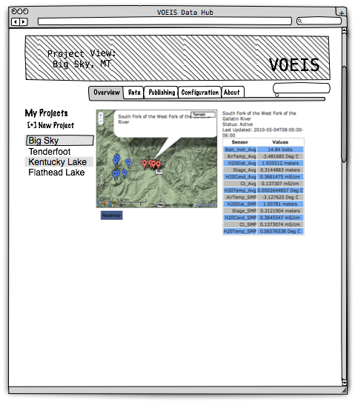
Project Overview Mockup
Project information is provided through a richer tabbed interface
Each tab provides different information (and the ability to configure some aspect of the project)

Slide 13
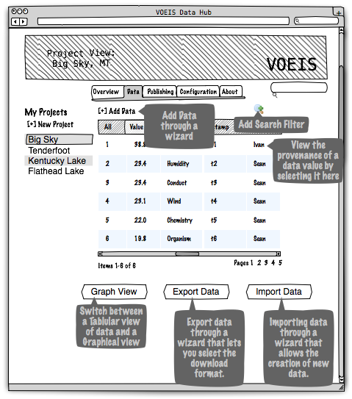
Project Data View Mockup
The data view is the primary project view, providing the place to search, browse, download, upload, and interact with all data in the project.

Slide 14
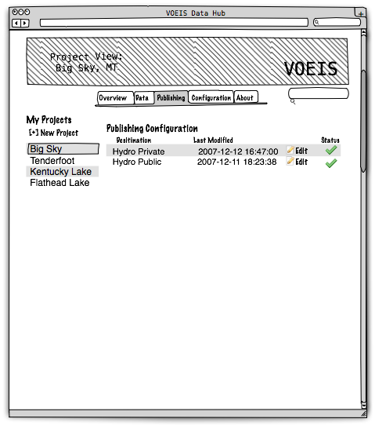
Project Publishing View Mockup
VOEIS must include the ability to import and export data to and from other locations (e.g. usgs and HydroServer)
This view allows project members to view the status of those external connections

Slide 15
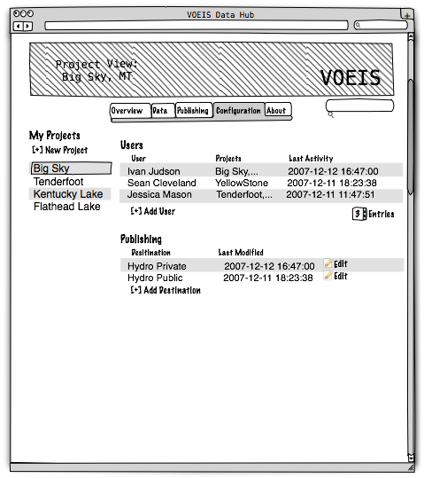
Project Configuration Mockup
A project settings page allows project administrators to configure all aspects of the project from a single location

Slide 16
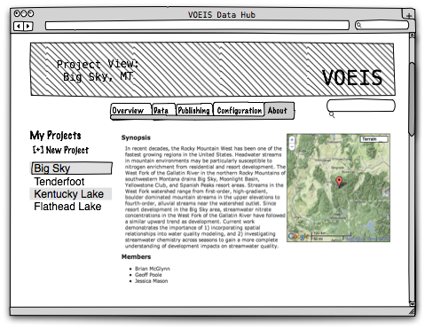
Project About Mockup
The about tab is the place to see meta-information about the project.

Slide 17
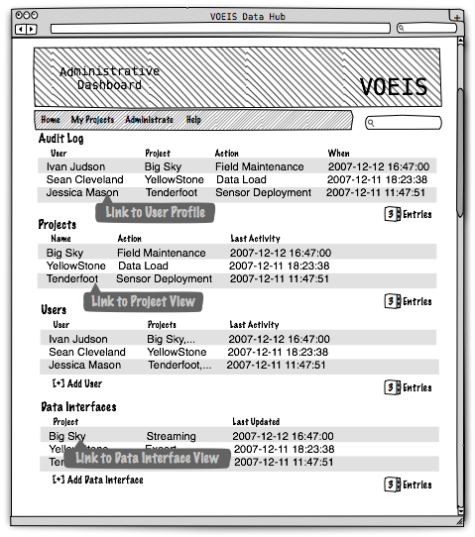
Administrative View Mockup
The VOEIS System requires administrative operations, those operations are exposed through the Administrative dashboard.

Slide 18
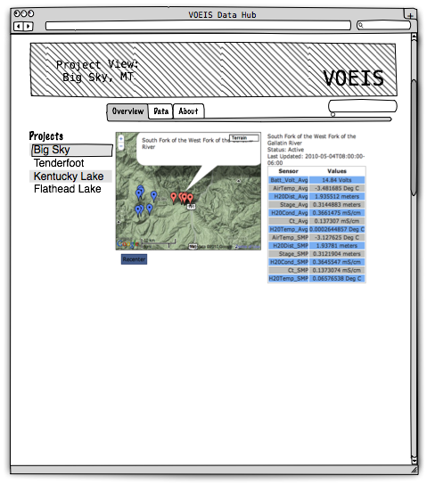
Public/Anonymous View Mockup
For projects that publish data for anonymous access to the web, this view shows what public/anonymous users might see about the project.

Slide 19
Illustrative Use Cases
VOEIS use cases come in two types:
Administrative
User management, project management, access control
Data management
General
Browsing, searching, Quality Control, Modeling, metadata creation, etc.
Streaming Data
Configuration of automated data imports
Field Observed/Sampled Data
Lab Processed Data

Slide 20
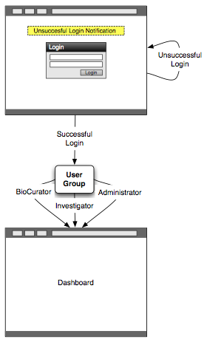
Administrative VOEIS Workflow: User Logging In
Feature: user login in
In order to use the application
As a user that has been added to the system
I want to log in.
Scenario: investigator log in
Given my user is in the system
And is a member of the investigator group
When I log in
Then I should be sent to the investigator dashboard.
Scenario: data manager log in
Given my user is in the system
And is a member of the data manager group
When I log in
Then I should be sent to the data manager dashboard.
Scenario: user log in
Given my user is in the system
When I log in
Then I should be sent to the user dashboard.

Slide 21
Administrative VOEIS Workflow: User Logging In
Scenario: existing user with failed login
Given my user is in the system
When I fail to log in
Then I should be redirected back to the login page
And a notification message should be displayed
Scenario: anonymous log in
Given my user is not in the system
When I log in
Then I should be redirected back to the public data access page
And a notification message should be displayed
Scenario: administrator log in
Given my user is in the system
And is a member of the administrator group
When I log in
Then I should be sent to the administrator dashboard.

Slide 22
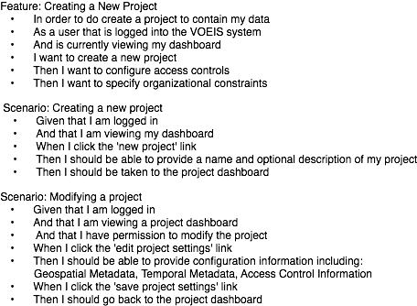
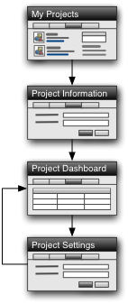
Administrative VOEIS Use Case: Creating a New Project

Slide 23
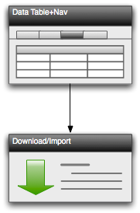
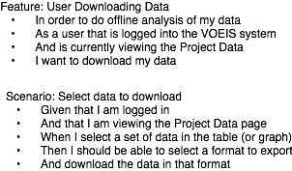
General Data Use Case: Export/Download

Slide 24
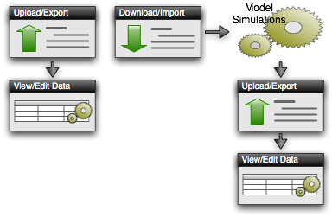
General Data Use Case: Modeling

Slide 25
General Data Use Case: Modeling
Feature: User Uploads Historical Data
In order to add data to an existing project
At an existing site
As a User
I want my data formatted with the correct default meta-data
Feature: User Downloading Data (see previous slide)
Feature: User Uploads Derived Model Data
In order to add new model derived data to an existing project
As a user that is logged in to the VOEIS system
And has currently selected a project
I want to add new model derived data in an accepted format
Scenario: Add Derived Data
Given I am logged in
And that I am viewing the Project
Then I should be able to upload the new data and link it to existing data

Slide 26
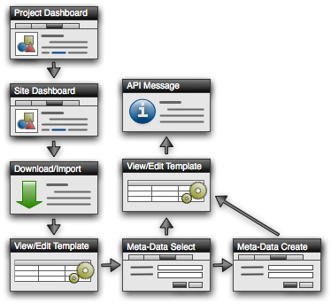
Configuring Automatic Data Import
Feature: Create Streaming Data Site
In order to create a streaming data site
As a user that is logged in to the VOEIS system
And has currently selected a Project site
I want to add a Streaming Data site
Scenario: Setup Streaming Data Site by uploading raw data-logger file
Given I am logged in
And the site selected exists
Then I should be able to select a logger file type
And upload the raw data-logger file
Then I should then be able to select what the values measured are, what the timestamps are and what the units are
And I should be able to select the Meta-Data that should be automatically added with each value
Then I should be given and address with api-key access that will tell the VOEIS data importer where to import the streaming data to

Slide 27
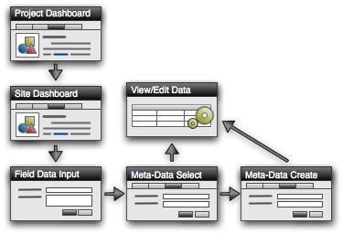
Use Case: Retrieving Field Data
Feature: User Adds Field Observation
In order to add a field observation
As a user that is logged in to the VOEIS system
And has currently selected a Project site
I want to add field observation data
Scenario: Add New Field Observation Information
Given I am logged in
And I have selected a site
Then I should be add a field observation
And I should be able to select the Meta-Data that should be associated with this observation

