Slide 1
MiniSAT (VSIDS, luby restart)
LRB
Glucose (LBD Clause Management)
CDCL(T)
MCSAT
Interval Arithmetic
Cooperation of CDCL and LS
Cooperation of CDCL(T) and LS
Cooperation of MCSAT and LS (Potential)
Cooperation of Interval Propagation and LS (Potential)
GSat
WalkSAT
LS_CCAnr
LS_ILA
LS_MLA
LS_NRA

Slide 2
MiniSAT (VSIDS, luby restart)
LRB
Glucose (LBD Clause Management)
CDCL(T)
MCSAT
Interval Arithmetic
Cooperation of CDCL and LS
Cooperation of CDCL(T) and LS
Cooperation of MCSAT and LS (Potential)
Cooperation of Interval Propagation and LS (Potential)
GSat
WalkSAT
LS_CCAnr
LS_LIA
LS_MLR
LS_NRA

Slide 3
MiniSAT (VSIDS, luby restart)
LRB
Glucose (LBD Clause Management)
Cooperation of CDCL and LS
GSat
WalkSAT
LS_CCAnr

Slide 4
LS Solver
CDCL Solver
Theory Solver

Slide 5
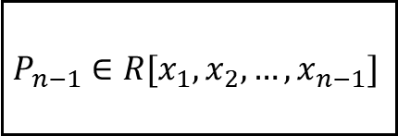
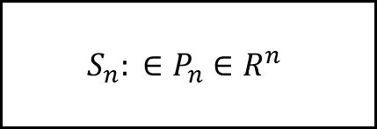
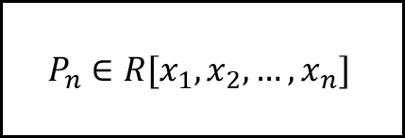
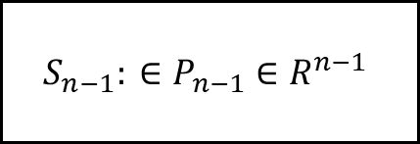
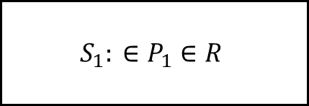
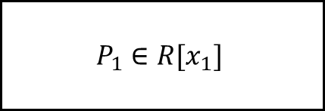
$$P_{n}∈R[x_{1},x_{2},…, x_{n}]$$
$$S_{n}: ∈P_{n}∈R^{n}$$
投影(Project)
提升(Lift)
$$P_{n−1}∈R[x_{1},x_{2},…, x_{n−1}]$$
$$S_{n−1}: ∈P_{n−1}∈R^{n−1}$$
投影(Project)
提升(Lift)
…
…
$$P_{1}∈R[x_{1}]$$
实根隔离
$$S_{1}: ∈P_{1}∈R$$

Slide 6


理论求解器
全部变量赋值
分支决策
SAT
一致
一致
冲突
检查理论一致
添加理论子句
单元传播
冲突分析
冲突
$$bl>0$$
回退
UNSAT
$$bl<0$$
CDCL框架

Slide 7
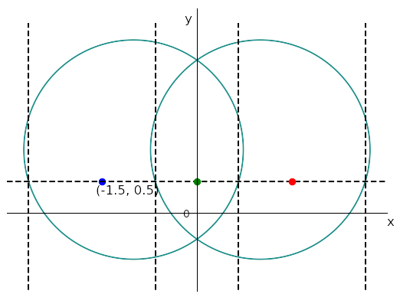
+1
+1
-1
-1
-1
0
1
0
-1
score
-2.658
-0.658
0.658
2.658
value

