Slide 1
Single Block
Multiple Blocks
Program_idx: 0
Program_idx: 1
X_ptr
block0
block1
0
1
2
3
0
1
2
3
X_ptr
offset = range(0, N0)
offset = program_idx * B0 + range(0, B0)

Slide 2
Offset = N0 * offset_j[:, None] + offset_i[None, :]
N1
2
3
0
1
2
3
* N0 (4)
2
10
11
4
5
6
7
N0
Program_idx(0)
3
14
15
8
9
10
11
B0
Offset_i = idx0 * B0 + range(0, B0)
= [2, 3]
12
13
14
15
B1
Program_idx(1)
Offset_j = idx1 * B1 + range(0, B1)
= [2, 3]

Slide 3
Safe Softmax
0,0
0,1
m0
0,0
0,1
tl.max
1,0
1,1
m1
1,0
1,1
1. Minus maximum
4. Div
Softmax = Exp[i, j] / sum(exp[i])
ele[i, j] -= max[i]
0,0
0,1
0,0
0,1
s0
2. Exp
3. Sum
1,0
1,1
1,0
1,1
s1

Slide 4
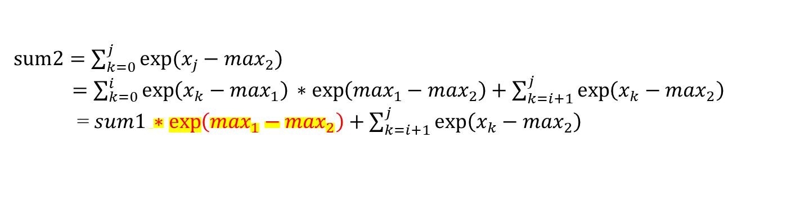
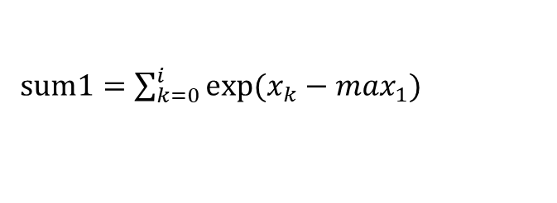
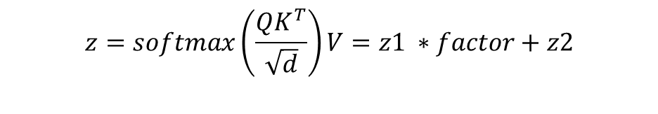
Online Softmax
0
1
2
3
4
5
6
7
8
9
10
11
12
13
14
15
Collect maximum and sum of exp
$sum1=\sum_{k=0}^{i}{exp⁡(x_{k}−\max_{1})}$
$sum2=\sum_{k=0}^{j}{exp⁡(x_{j}−\max_{2})}$
$=\sum_{k=0}^{i}{\exp\left(x_{k}−\max_{1}\right)∗exp\left(\max_{1}−\max_{2}\right)+\sum_{k=i+1}^{j}{\exp\left(x_{k}−\max_{2}\right) }}$
= $sum1∗exp\left(\max_{1}−\max_{2}\right)+\sum_{k=i+1}^{j}{\exp\left(x_{k}−\max_{2}\right) }$
$$z=softmax\left(\frac{QK^{T}}{\sqrt{d}}\right)V=z1 ∗factor+z2$$

