Slide 1

Mail Administration Program

Slide 2

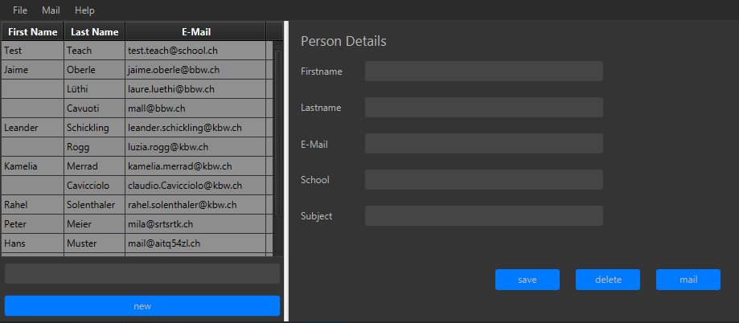

Slide 3
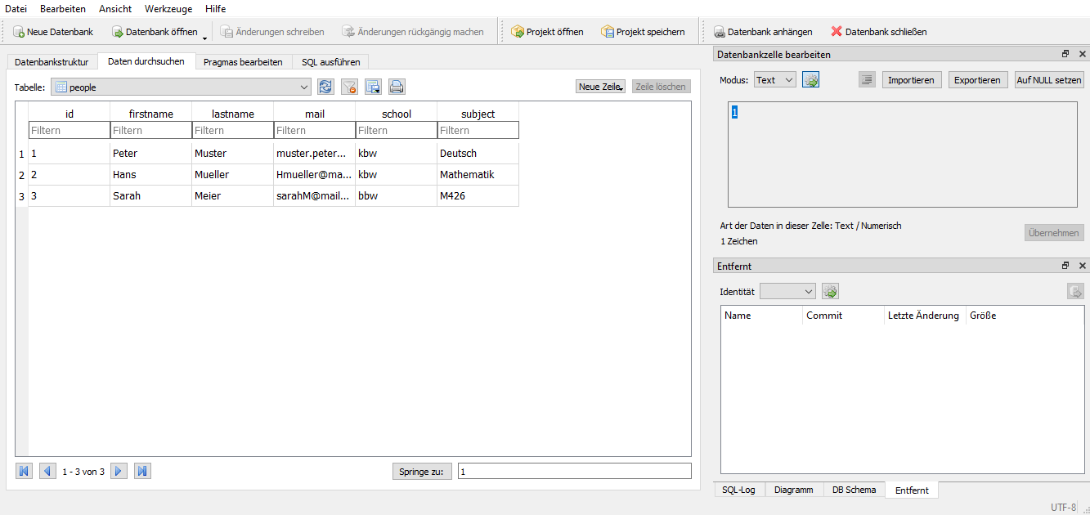

Slide 4
Mail Administration Program

