Slide 1

Descriptive Analysis of NASDAQ Stock Exchange Closing Prices Using Big Data Technologies
CSGY-6513 Big Data
Section D
Fall 2023
Anubhav Ghildiyal (ag8766)
Noel Nebu Panicker (nnp5666)
Yogya Sharma (ys5250)

Slide 2
Project Statement
Leverage big data and advanced analytics to predict Nasdaq stock closing price movements in the final ten minutes of trading, providing valuable insights for traders.
Objective
Conduct a comprehensive analysis of stocks by integrating continuous order book data and auction book data. Utilize big data tools for processing extensive stock market data, with the goal of optimizing market efficiency and supporting advanced investment strategies.

Slide 3
Data Source
Optiver Trading at the close, available on Kaggle. The dataset includes over 5 million records and is 646.7 MB in size.
Technologies/Tools Used
Python: For model development. Programming and data manipulation.
Hadoop: For storing data.
Apache Spark: For real-time processing and analysis of the dataset.
JupyterHub: For allowing multiple users to access and interact with Python-based analytics
Apache Hive: For storing persistent DB

Slide 4
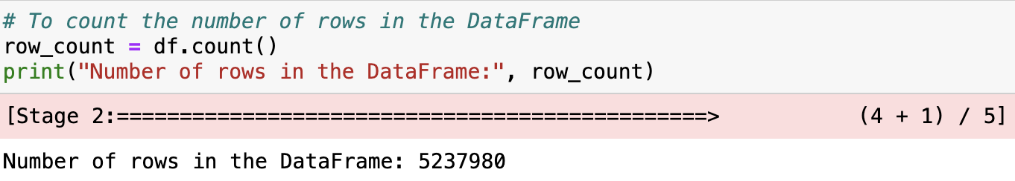
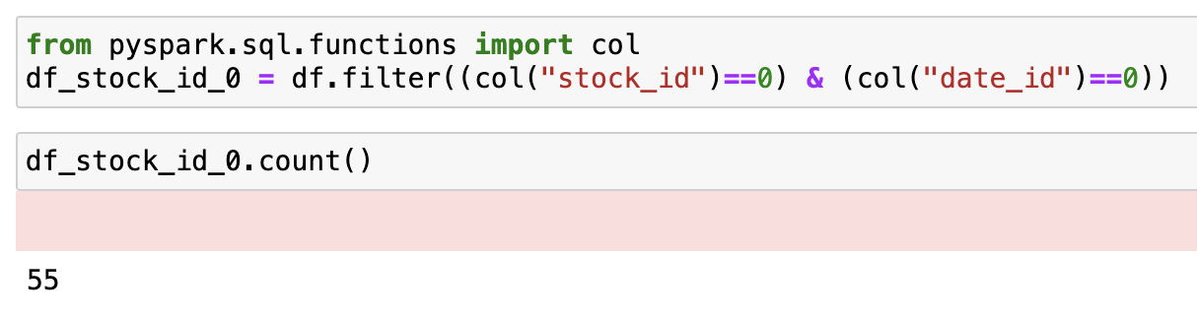
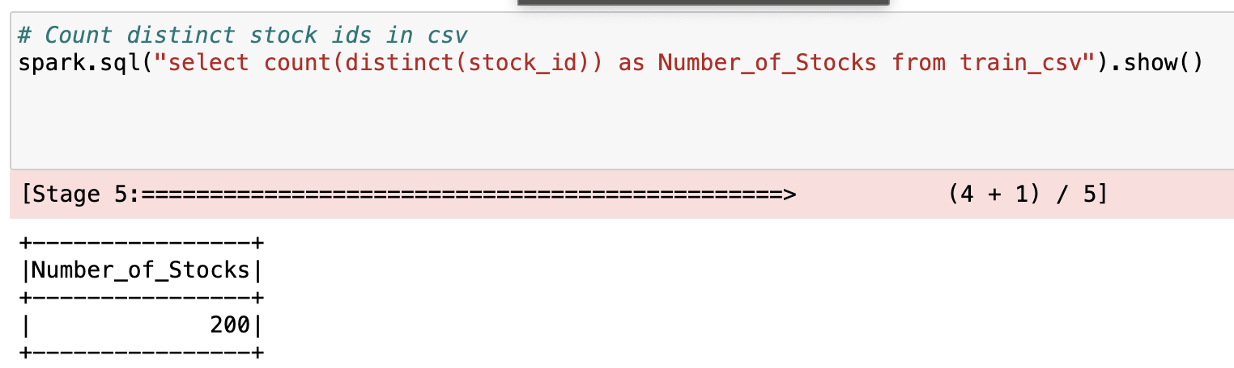
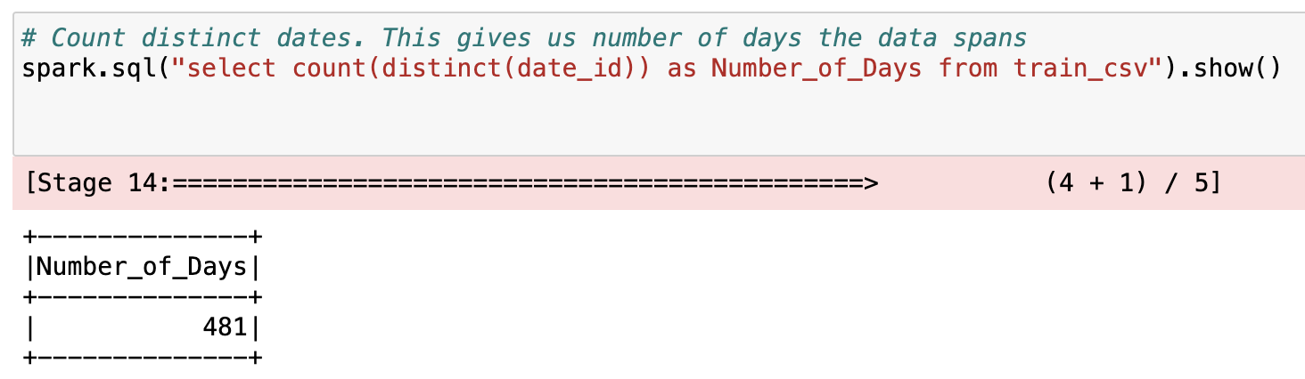
Dataset Description
We have 5 million plus rows. This data has information about 200 stocks, for 481 days and for each day we have 55 data points.
So, this is a time series data!

Slide 5
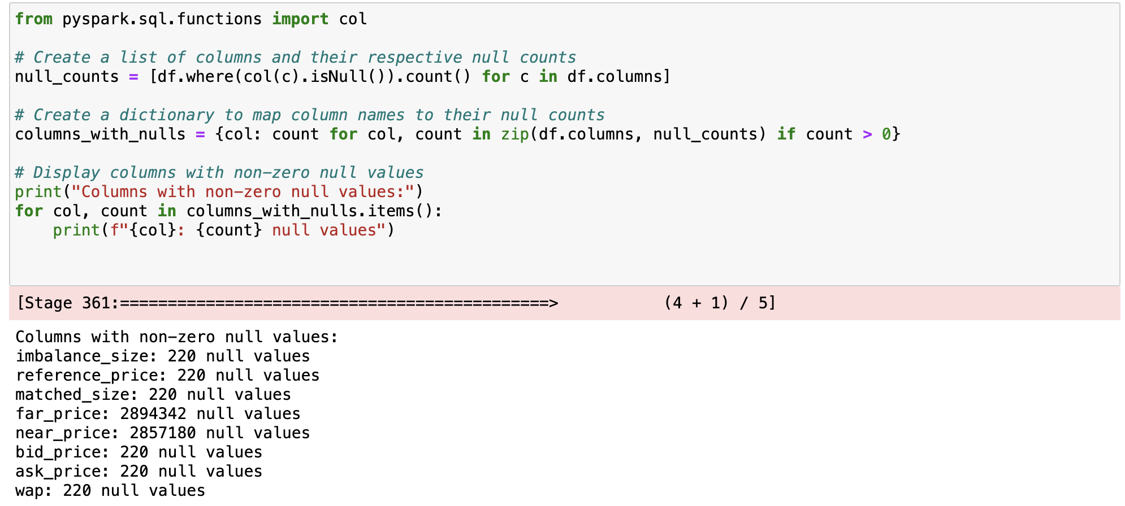
Data Exploration and Cleaning
The null values in columns except near and far price, were filled using backward fill.
For far and near price columns before the 300s mark, the null values were set to zero.
After this step, we normalized the data.

Slide 6
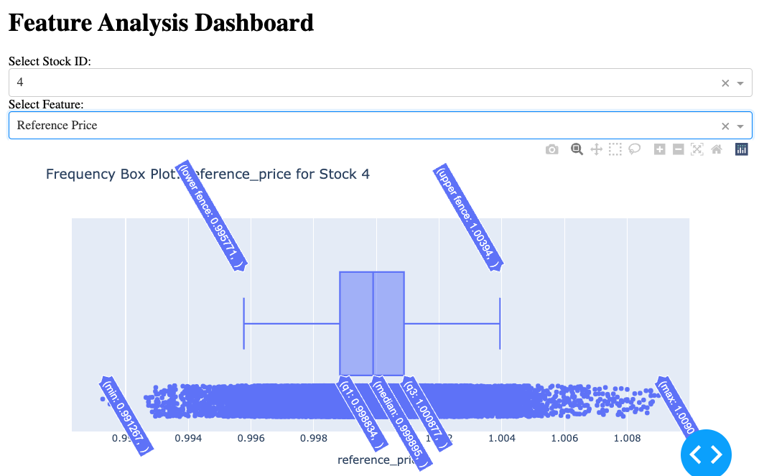
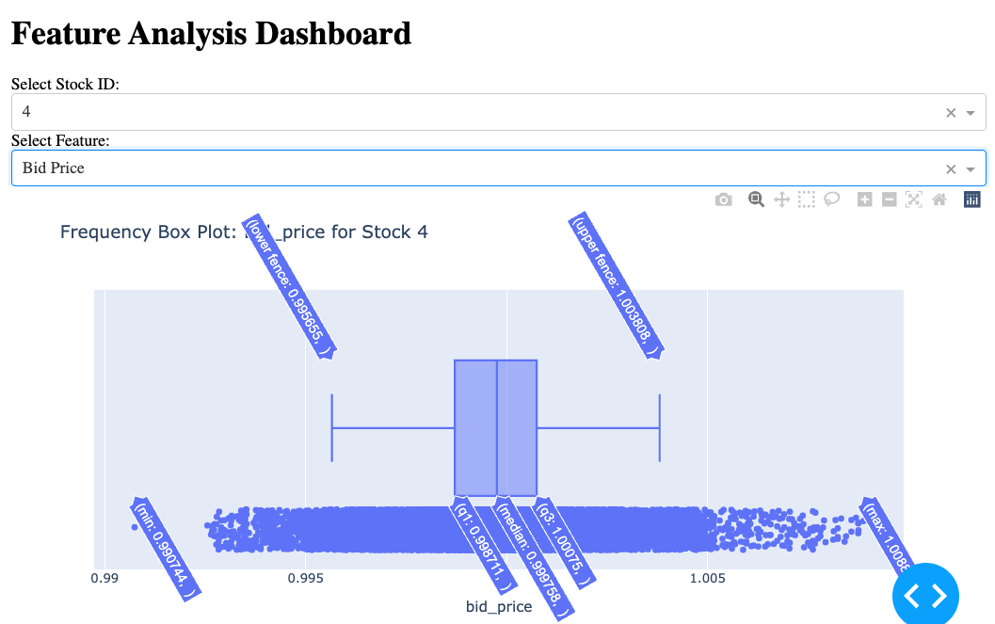
Frequency Plots

Slide 7
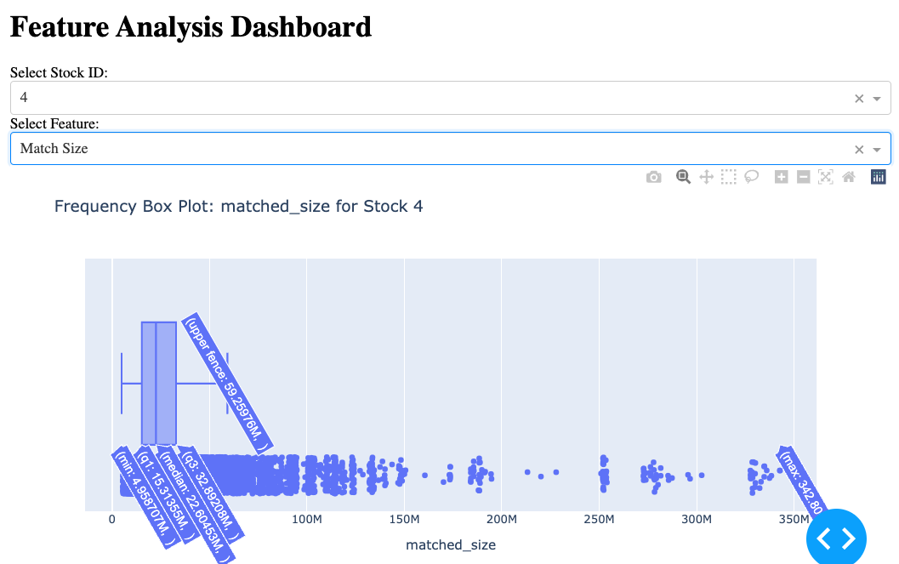
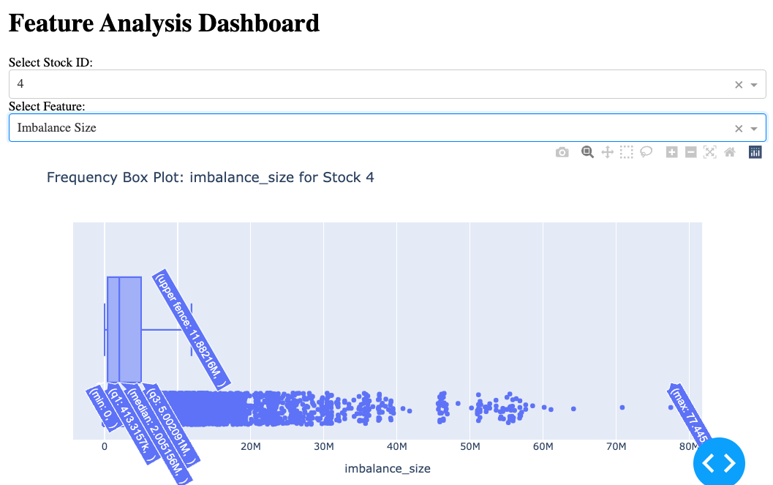
Frequency Plots
Notes:
Test speaker notest merer

Slide 8
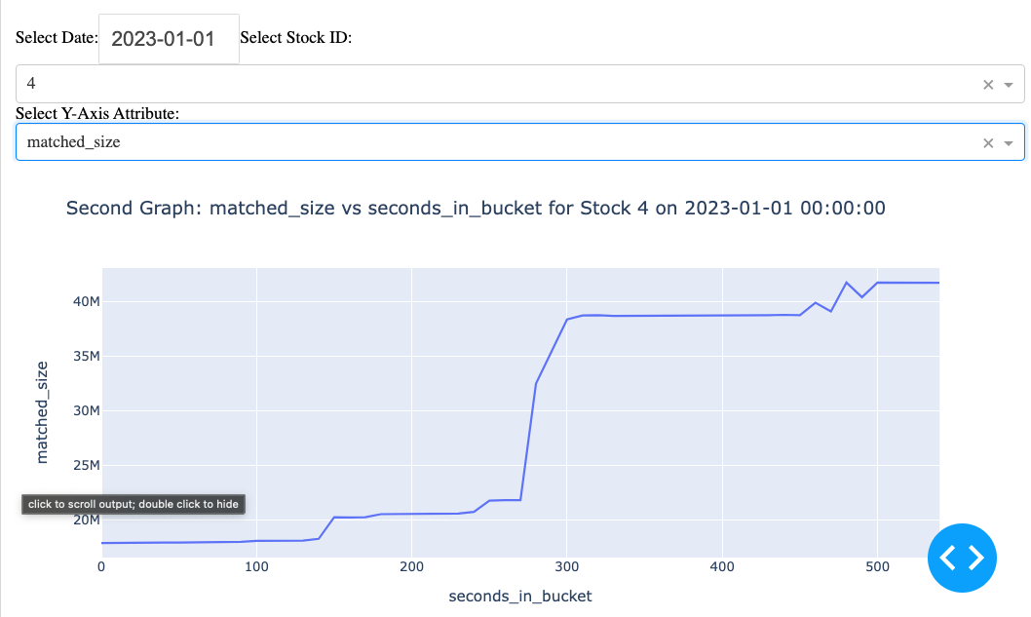
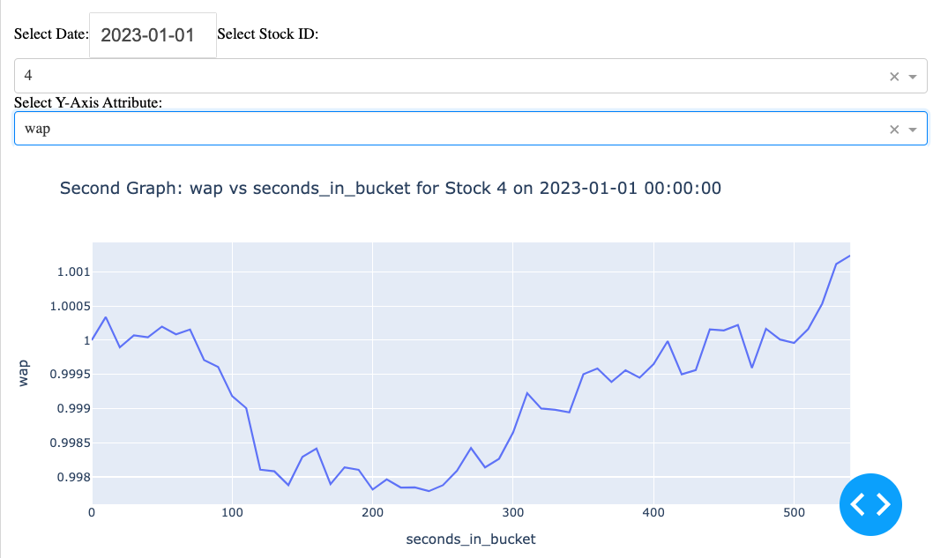
Single Stock Analysis
Visualization of the movement of a single attribute on a given day.

Slide 9
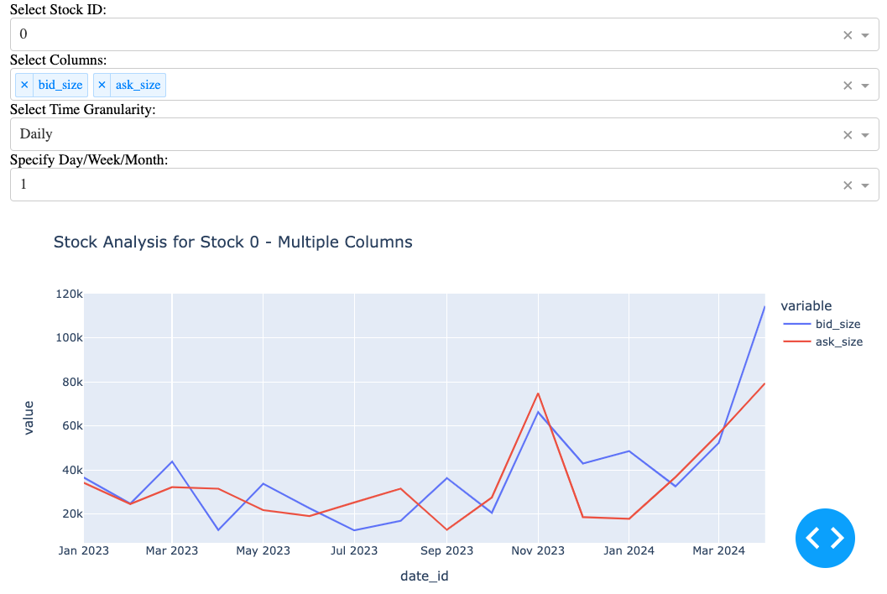
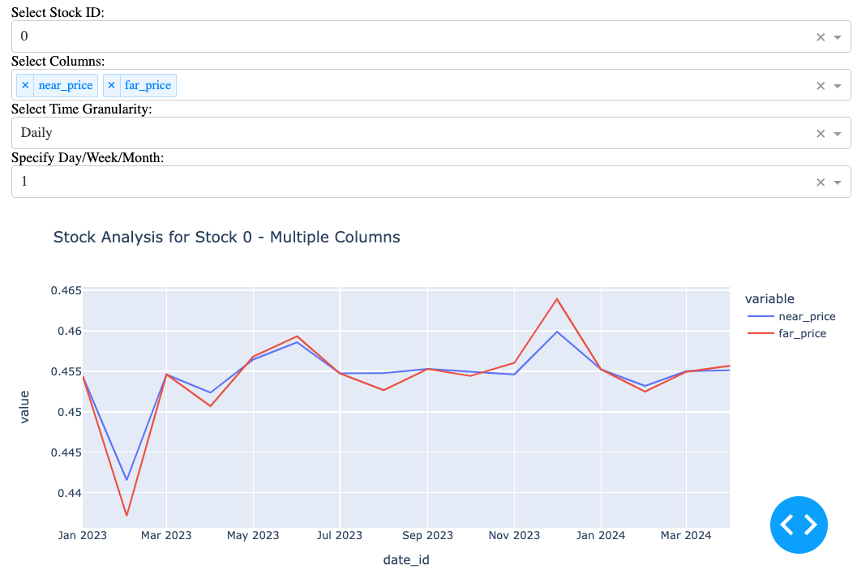
Single Stock Analysis
Visualization of the relationship between a pair of attributes.

Slide 10
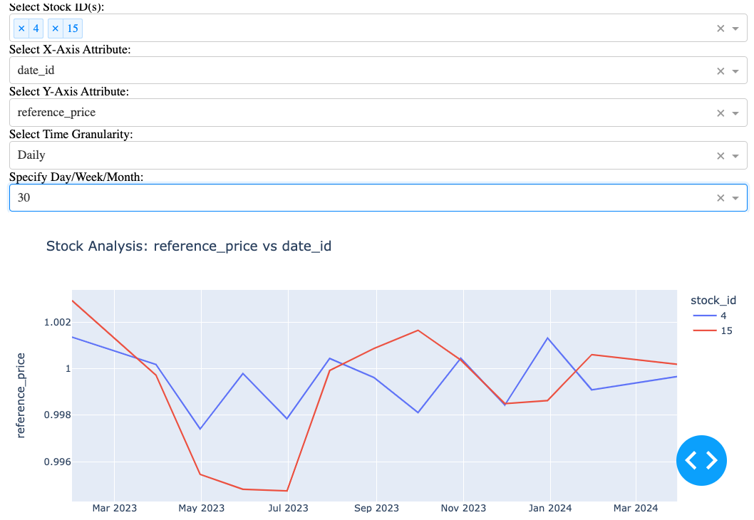
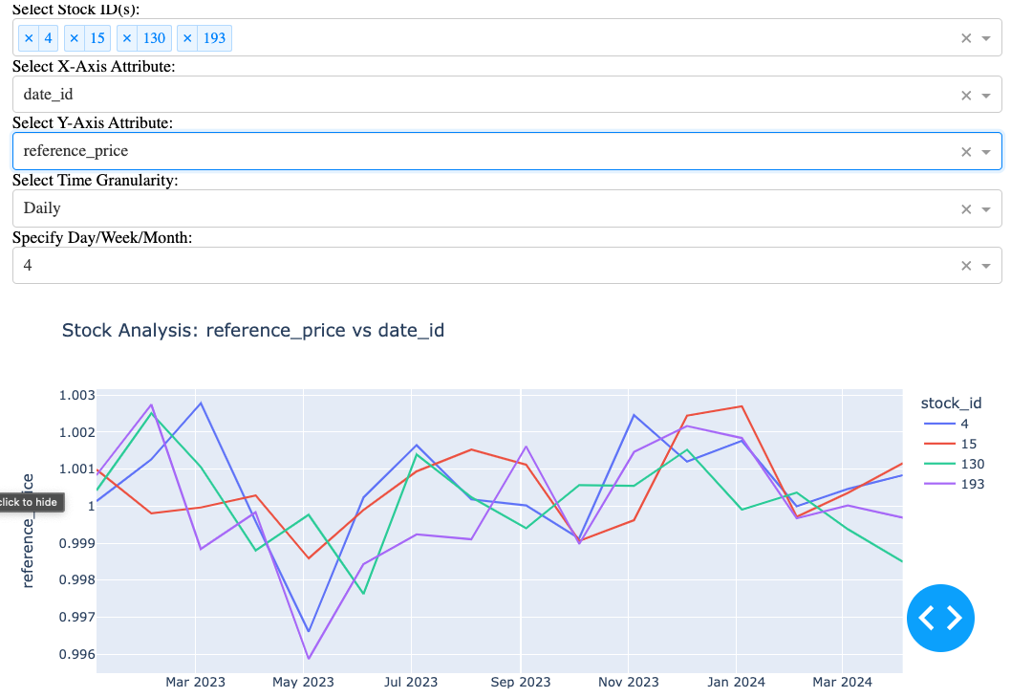
Multi-Stock Analysis
Visualization of the movement of a single attribute on a given day for multiple stocks, to check for temporal patterns for identifying events on the basis of anomalies.

Slide 11
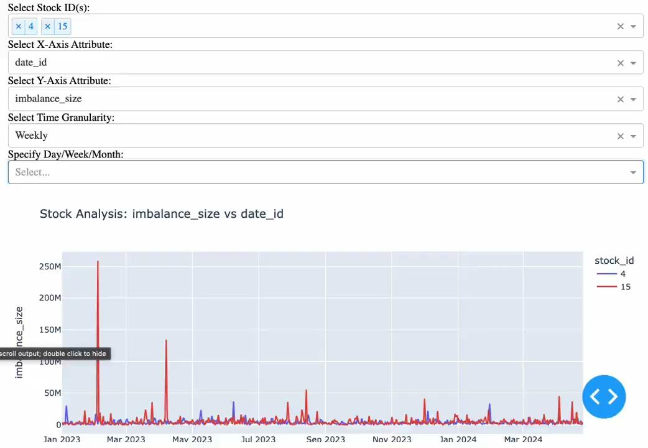

Slide 12
Conclusion
Lessons learned
Analyzed Nasdaq closing prices, shedding light on market behavior during auctions.
Unveiled temporal patterns in stock data, enhancing predictive insights.
Leveraged PySpark for scalable, distributed computing in dynamic stock markets.
Data Preprocessing: Crucial for big data analytics accuracy.
Feature Engineering: Impactful in enhancing model predictions.
Big Data Technologies: Proficiency in Hadoop, Spark for handling large datasets.
Team Collaboration & Communication: Essential in multifaceted big data projects.
Real-Time Data Processing: Complexities and learning in streaming data analysis.
Continuous Adaptation: Necessity in the ever-evolving big data landscape.

Slide 13
Future Scope

Slide 14
Thank you!

