Slide 1
CAPSTONE PROJECT
Breast Cancer Diagnosis Classifier
An end-to-end ML pipeline: data → cleaning → EDA → modeling → evaluation → deployment
Data Science / ML Internship • Week 12 Wrap-Up

Slide 2
What We'll Cover
01
Problem & why this dataset
02
Data & cleaning
What we're predicting, and why it's a good capstone fit
A quick look at the raw data and what checks were run
03
Exploratory analysis
04
Modeling & evaluation
What the data actually shows before modeling
Three models compared, and how the winner was picked
05
Deployment demo
06
Reflection & next steps
The trained model running as a live web app
What I'd improve, and what I'm taking away from this internship
Capstone Project — Breast Cancer Diagnosis Classifier
2

Slide 3
Problem Statement
Predict whether a breast mass is malignant or benign, from 30 numeric measurements taken from a digitized image of the mass's cell nuclei (radius, texture, concavity, symmetry, etc.).
Why this problem
Real, well-documented dataset — supports genuine EDA, not just a demo
Small enough to build fully in the time available
Precision vs. recall trade-offs are concrete and meaningful here
Naturally supports a deployable prediction demo
A binary classification problem — the Breast Cancer Wisconsin (Diagnostic) dataset, 569 samples × 30 features.
Capstone Project — Breast Cancer Diagnosis Classifier
3

Slide 4
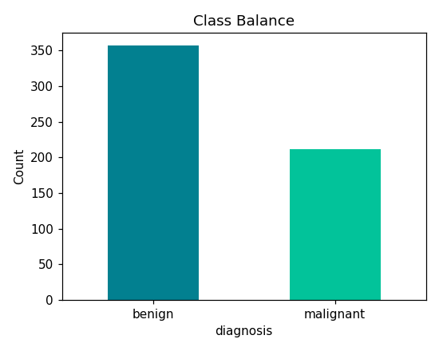
Data & Cleaning Check
569
30
samples
numeric features
0
0
missing values
duplicate rows
Class balance: 357 benign vs. 212 malignant (mild imbalance)
Data was already clean — the checks still had to be run, not assumed.
Capstone Project — Breast Cancer Diagnosis Classifier
4

Slide 5
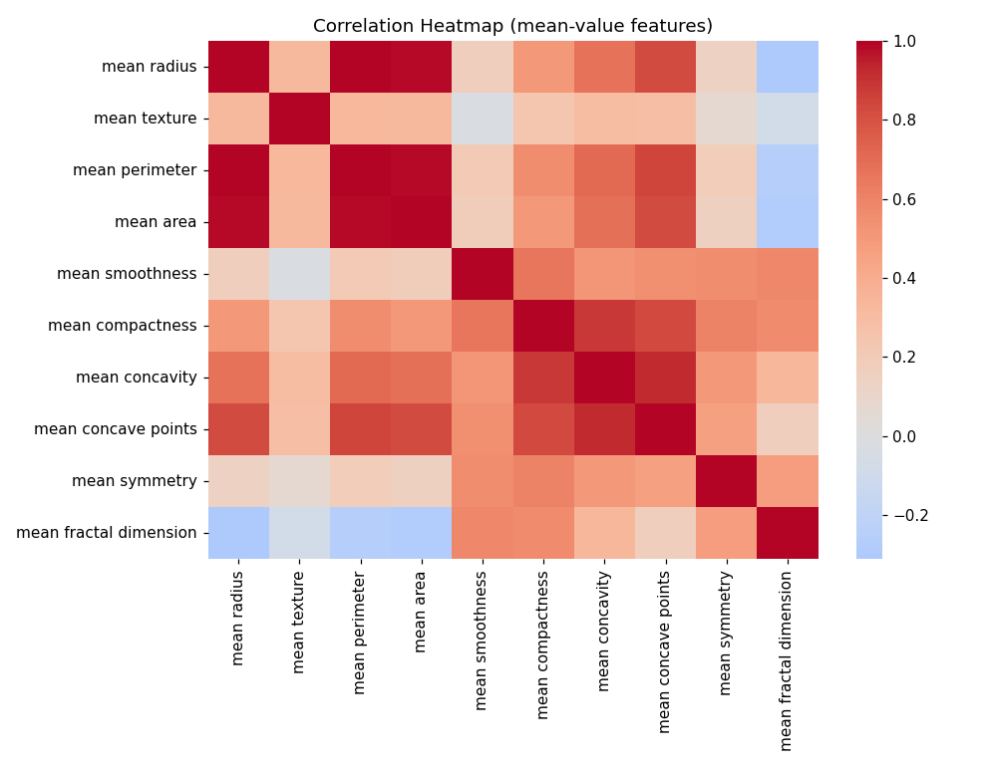
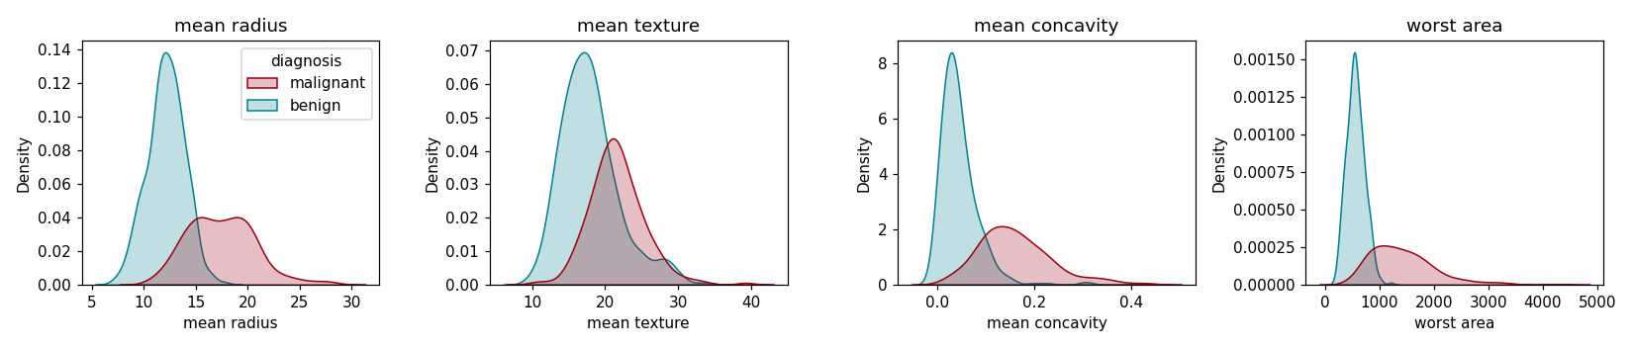
Exploratory Data Analysis
Key takeaway: malignant cases skew toward higher radius, texture, concavity, and area — confirming the features carry real predictive signal before any model is built. Size-related features are also highly correlated with each other, which matters for interpreting coefficients later.
Capstone Project — Breast Cancer Diagnosis Classifier
5

Slide 6
Modeling Approach
Three model families were trained on an identical, stratified 80/20 train/test split, so comparisons are fair.
1
2
3
Logistic Regression
Random Forest
Neural Network (MLP)
A simple, interpretable linear baseline
An ensemble of decision trees
A small feedforward network, 2 hidden layers
Capstone Project — Breast Cancer Diagnosis Classifier
6

Slide 7
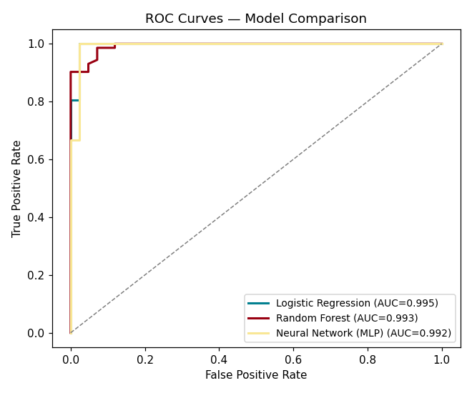
Evaluation: Beyond Accuracy
In a medical-style problem, missing a malignant case is far costlier than a false alarm — so precision, recall, F1, and ROC-AUC all matter, not just accuracy.
Model | Acc. | F1 | AUC
Logistic Regression | 0.983 | 0.986 | 0.995
Random Forest | 0.956 | 0.966 | 0.993
Neural Net (MLP) | 0.956 | 0.965 | 0.992
Winner: Logistic Regression
Best F1 and best ROC-AUC — and it's the simplest, most interpretable model of the three. The simplest model won; complexity wasn't needed here.
Capstone Project — Breast Cancer Diagnosis Classifier
7

Slide 8
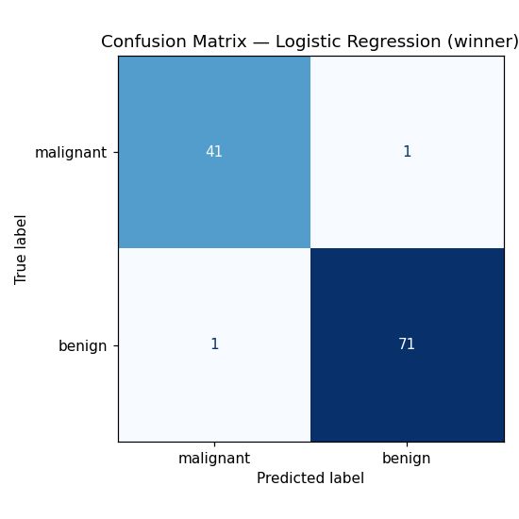
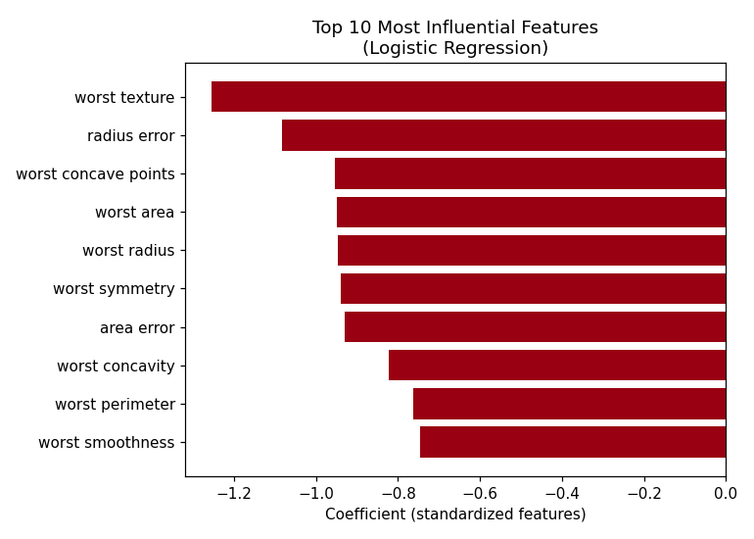
The Winning Model, In Detail
Capstone Project — Breast Cancer Diagnosis Classifier
8

Slide 9
Deployment: From Notebook to Demo App
The full model uses 30 features — impractical for a demo form. A simplified model using the top 8 most influential features was trained separately for the deployed app, documenting a real usability-vs-signal trade-off.
Full model (30 features)
Live demo — Flask app
Accuracy: 0.983 F1: 0.986
User fills in 8 measurements via a web form
App loads the pickled model + scaler and returns a prediction with confidence
Tested end-to-end over real HTTP requests: 7/7 correct on sample cases
Clear on-screen disclaimer: demo only, not a diagnostic tool
Demo model (8 features)
Accuracy: 0.965 F1: 0.973
Capstone Project — Breast Cancer Diagnosis Classifier
9

Slide 10
What I'd Improve With More Time
1
Get mentor/domain input on which features are clinically meaningful to simplify to — not just statistically convenient
2
Handle class imbalance more deliberately; report malignant-class recall as the headline metric
3
Add a calibration check — predicted probabilities should mean what they say
4
Harden the app: input validation, production WSGI server before any real exposure
5
Add an explicit PCA / feature-engineering comparison, not just raw-feature model comparisons
Capstone Project — Breast Cancer Diagnosis Classifier
10

Slide 11
Reflection: 12 Weeks In
3 biggest things learned
Areas to keep improving
End-to-end pipelines matter more than any single model — cleaning, evaluation choice, and deployment shape the outcome as much as the algorithm.
The simplest model that works is often the right one — Logistic Regression beat a Random Forest and a neural net here.
A model isn't done when it's accurate — it's done when someone else can actually run it and get a result.
Going deeper on evaluation rigor for imbalanced/high-stakes problems (calibration, cost-sensitive metrics), not just headline accuracy.
Getting more comfortable owning deployment concerns (validation, robustness) rather than treating deployment as an afterthought.

Slide 12
Thank you
Questions & discussion

