Slide 1

LANDMARK UNIVERSITY, OMU-ARAN
DEPARTMENT OF COMPUTER SCIENCE
Affective Intelligent Dialogue Agent
for Preliminary Mental Health Intervention
EMEKA, YOHANAN KAMSI
Supervisor: Dr. DOLA OLAWOYE
Notes:
Introduce yourself: name, project title, what AIDA stands for. This is a second defense so the committee has seen the work. Briefly say: we have a working system evaluated on a 58-case test set.

Slide 2
OUTLINE
01
Introduction and Problem Statement
05
Emotion Classification
02
Aim & Objectives
06
Trend analysis and Strategy Selection
03
Literature Review
07
Evaluation Results
04
Methodology: AEIF Framework
08
Conclusion & Future Work
Notes:
Walk through the outline quickly. Tell them we have a working prototype and will show real evaluation data.

Slide 3
INTRODUCTION
1 in 4
Mental health disorders affect 1 in 8 people globally (WHO, 2022); in Nigeria, fewer than 10% of those affected access care.
AI-powered chatbots (e.g. Woebot, Wysa, Tess) have shown efficacy in reducing depression and anxiety symptoms through CBT-aligned conversation
Existing chatbots detect current emotion but lack trajectory awareness they cannot distinguish between transient distress and escalating crisis
AIDA addresses this gap through the Adaptive Emotion-Aware Intervention Framework (AEIF), a 6-layer pipeline that integrates emotion detection, trend analysis, and strategy selection.
Nigerians affected by a mental
health condition (WHO)
< 300
Psychiatrists for 200M+ population
> 90%
Mental health treatment gap
in sub-Saharan Africa
Notes:
Nigeria has one of the worst mental health workforce gaps in the world. Chatbots exist but they treat each message as if the conversation just started. That's the gap we address

Slide 4
STATEMENT OF PROBLEM
• Calculations done by the Association of Psychiatrists in Nigeria (APN) has revealed that Nigeria has a psychiatrist-to-population ratio of approximately 1:1 million, leaving millions without access to mental health support
• Existing mental health chatbots detect a user’s current emotional state, but do not model emotional trajectory over time.
• Without trend awareness, chatbots can’t differentiate between a user who is persistently distressed and a user who is improving.
• Nigerian Pidgin English is entirely absent from emotion classification datasets.
• Strategy selection in existing systems is not driven by trajectory data, limiting response quality in multi-turn conversations
Notes:
Nigeria has one of the worst mental health workforce gaps in the world. Chatbots exist but they treat each message as if the conversation just started. That's the gap we address

Slide 5
AIM & OBJECTIVES
AIM
To design, implement and evaluate the Adaptive Intelligent Dialogue Agent using the Adaptive Emotion-Aware Intervention Framework
01
Design the 6-layer AEIF framework, integrating emotion classification, trend analysis, and strategy selection.
02
Build an emotional trend analyser that derives 7 trajectory types from session history
03
Evaluate the system using automated metrics: emotion detection accuracy, trend accuracy, and crisis detection accuracy
Notes:
Five concrete objectives. The most important is the controlled comparison — we built a parallel baseline pipeline with no trajectory or strategy, and ran both on the same inputs.

Slide 6
LITERATURE REVIEW
Woebot (Fitzpatrick et al., 2017) — RCT showing significant depression reduction using CBT-based chatbot, but no emotion trajectory tracking
Wysa (Inkster et al., 2018) — Empathy-driven conversational agent with demonstrated real-world impact, but limited to single-turn emotion detection
Emotional Support Conversation framework (Liu et al., 2021) — Proposed multi-strategy approach for ESC, but no trajectory-to-strategy mapping
GoEmotions dataset (Demszky et al., 2020) — 27 fine-grained emotion categories, basis for AEIF's 6-cluster taxonomy
Key gap: No existing system integrates emotion trajectory analysis directly into strategy selection for mental health chatbots

Slide 8
METHODOLOGY: AEIF FRAMEWORK
Adaptive Emotion-Aware Intervention Framework — 6-Layer Pipeline
1
2
3
4
5
6
Safety Detection
Emotion Classification
Memory (Session Store)
Trend Analysis
Strategy Selection
Response Generation
If crisis is detected in input → immediate helpline response,
j-hartmann/distilroberta → 6 clusters: POSITIVE, SADNESS, ANXIETY, ANGER, NEUTRAL, AMBIGUOUS
In-memory conversation history (20-turn cap)
Stores role, text, emotion, confidence, strategy per turn
Weighted severity scoring over last 10 turns → 7 trajectory types
12-condition lookup: trend + emotion → one of 9 CBT-aligned strategies
Groq API → LLaMA-3.3-70b-versatile with strategy-specific system prompt
Baseline mode: same model, no trend/strategy in prompt
▶
▶
▶
▶
▶
← User Message
Response →
Notes:
The pipeline processes every message left to right. Layer 1 (safety) is unconditional — if crisis detected, no other layer runs. Layers 4 and 5 are what distinguish AEIF from the baseline.

Slide 9
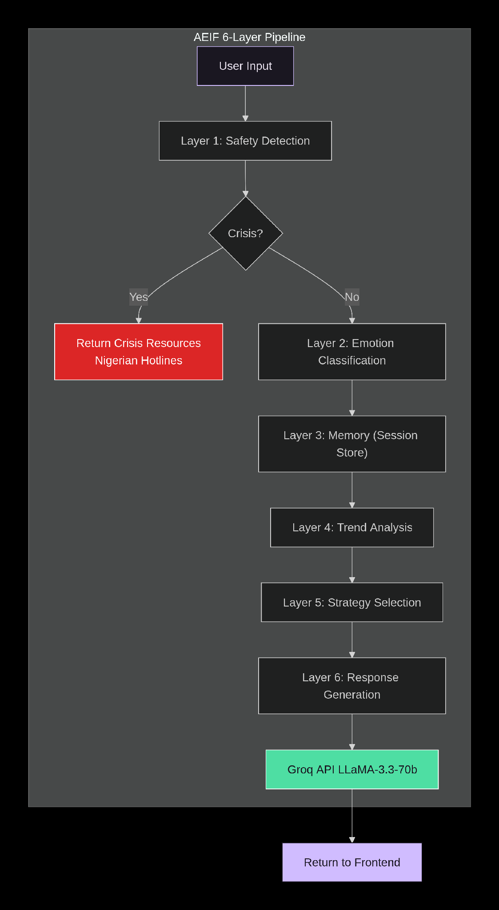
Notes:
The pipeline processes every message left to right. Layer 1 (safety) is unconditional — if crisis detected, no other layer runs. Layers 4 and 5 are what distinguish AEIF from the baseline.

Slide 10
METHODOLOGY: EMOTION CLASSIFICATION
Example Classifications
AEIF defines 6 mutually exclusive emotion clusters mapped from HuggingFace and GoEmotions labels:
POSITIVE (0.0) — joy, love, gratitude, optimism, relief
NEUTRAL (0.3) — neutral statements, factual content
AMBIGUOUS (0.4) — confusion, surprise, contradictory expressions
ANXIETY (0.6) — fear, nervousness, worry, dread
ANGER (0.7) — anger, annoyance, disgust, frustration
SADNESS (0.8) — sadness, grief, disappointment, hopelessness
CRISIS (1.0) — detected by safety layer before emotion classification
"I feel so worthless and tired"
→ SADNESS (98%)
"I got the job but I'm terrified"
→ AMBIGUOUS (pre-check)
"E be like say nobody dey for me"
→ SADNESS (Pidgin fallback)
"I think I finally passed!"
Ambiguity Pre-check:
→ POSITIVE (91%)
If message has contrastive conjunction (but, though) AND both positive + negative keywords → AMBIGUOUS
"I can't stop worrying about it"
→ ANXIETY (83%)
Notes:
Two-path architecture. The ambiguity pre-check is key — it catches messages like 'I got the job but I'm terrified' before the transformer misclassifies them. Nigerian Pidgin terms are hard-coded into the keyword lists.

Slide 11
TREND ANALYSIS & STRATEGY SELECTION
7 Trend Types
Severity Scoring
PERSISTENT_DISTRESS
POSITIVE
0.0
Mean severity > 0.55
NEUTRAL
0.3
ESCALATING_DISTRESS
AMBIGUOUS
0.4
Strictly increasing severity scores
ANXIETY
0.6
ELEVATED_ANGER
ANGER
0.7
2+ consecutive ANGER turns
SADNESS
0.8
IMPROVING
CRISIS
1.0
Strictly decreasing + started negative
STABLE_POSITIVE
Mean ≤ 0.2, recent POSITIVE turn
Trend Analysis is calculated using the weighted arithmetic mean of severity scores over sliding window (max 10 entries)
Minimum 3 turns required before trend is derived
FLUCTUATING
One or more direction reversals
INSUFFICIENT_DATA
Fewer than 3 turns
Notes:
The severity scores are the core of the trend analyser. We take an unweighted arithmetic mean of the last 10 turns. The strategy lookup table has 12 conditions — 6 for when a trend is established, and 6 first-turn defaults based on the current emotion.

Slide 12
TREND ANALYSIS & STRATEGY SELECTION
Strategy Mapping
The System prompt contains the AEIF persona declaration,
the current emotion cluster, the emotional trend, the selected strategy label, the full strategy
instruction corresponding to that label, the last ten turns of conversation history formatted
with role and emotion labels, and six hard rules constraining the LLMs output: (maximum
four sentences, exactly one open question, no clinical vocabulary, no diagnosis or
prescription, no clinical advice, tone specification).
PERSISTENT_DISTRESS → VALIDATION AND REFLECTION
ESCALATING_DISTRESS → GROUNDING
IMPROVING → ENCOURAGEMENT
STABLE_POSITIVE → POSITIVE REINFORCEMENT
FLUCTUATING → EXPLORATORY INQUIRY
ELEVATING ANGER → CALM REFLECTION
Notes:
The severity scores are the core of the trend analyser. We take an unweighted arithmetic mean of the last 10 turns. The strategy lookup table has 12 conditions — 6 for when a trend is established, and 6 first-turn defaults based on the current emotion.

Slide 13
EVALUATION RESULTS
Automated testing on 58-case annotated test set
77.1%
100%
100%
31/31
Emotion
Accuracy
Crisis
Detection
Trend
Accuracy
Unit Tests
Passing
on 58 cases incl. Pidgin
& ambiguous inputs
10/10 cases — non-negotiable
safety threshold
7/7 scripted multi-turn
sequences
Crisis, emotion, trend,
strategy, pipeline
Emotion Classification — By Cluster
Context on 77.1%
Cluster
Prec.
Recall
F1
On a plain English test set (no Pidgin, no ambiguous inputs), the system scored 100%.
The 77.1% reflects genuine challenge: 8 ambiguous cases, 6 Pidgin cases, 4 context-contradicting cases.
Most difficult: AMBIGUOUS cluster (F1 = 0.61).
ANGER
0.80
1.00
0.89
POSITIVE
1.00
0.89
0.94
SADNESS
1.00
0.80
0.89
ANXIETY
0.8
0.80
0.8
NEUTRAL
0.5
0.90
0.64
AMBIGUOUS
1.00
0.40
0.57
CRISIS
1.00
1.00
1.00
Notes:
77.1% sounds modest but the test set was deliberately hard. Crisis detection is 100% which is non-negotiable for a mental health system. AMBIGUOUS is the hardest cluster — emotionally contradictory language is genuinely hard to classify.

Slide 14
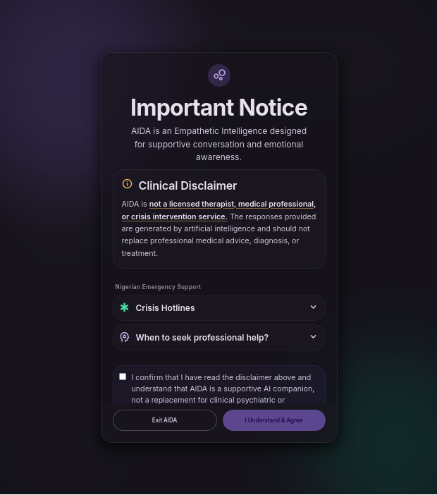
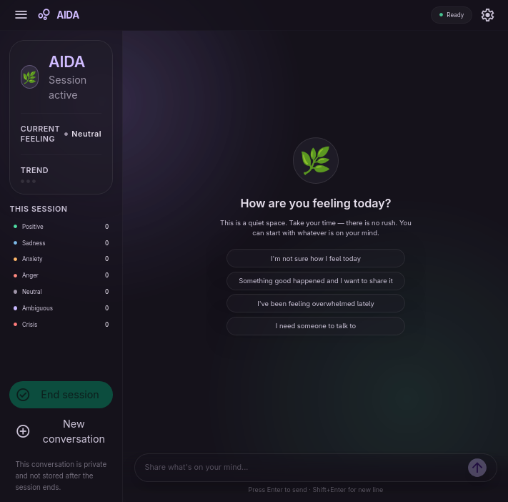

Slide 15
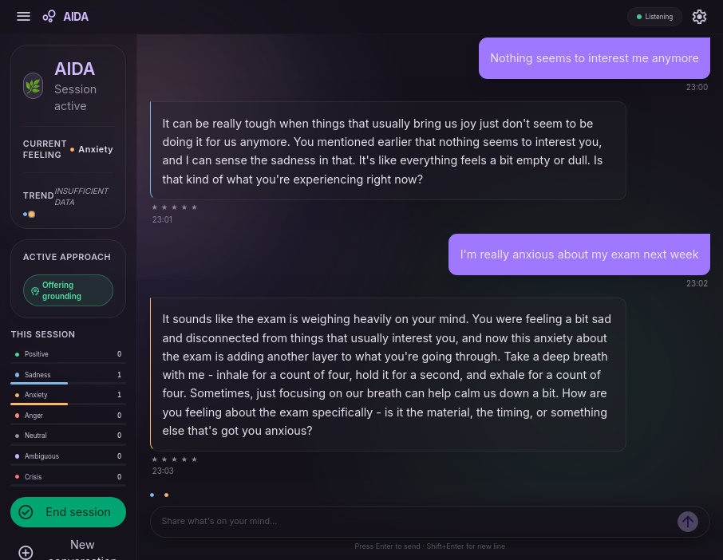

Slide 16
Baseline Response | AEIF Response
Input: "Nothing seems to interest me anymore" | "It can be really tough to feel like you've lost your spark... What's one thing you used to enjoy that you haven't tried in a while?" | "It can be really discouraging when things that used to bring you joy no longer do... What's one thing that you used to enjoy doing that you haven't done in a while?"
Input: "I'm really anxious about my exam next week" | "It's completely normal to feel anxious... Would you like to talk a bit more about what's been going through your mind?" | "Let's take a deep breath together... why don't you notice the things around you? What's the first thing you notice when you look around you?"
Input: "I got the job but I'm terrified I'll mess it up" | "It's completely normal to feel that way... What are some things that make you feel most uncertain about your new role?" | "I hear both excitement about getting the job and fear about messing it up. That's a lot to hold at once. Can you tell me more about which feeling is stronger right now?"

Slide 17
Why AEIF wins: Detected PERSISTENT_DISTRESS trend across session → escalated from VALIDATION to VALIDATION_AND_REFLECTION → deeper validation without platitudes. Baseline stays on generic STANDARD script.
Why AEIF wins: Detected ANXIETY cluster → selected GROUNDING strategy → offers an actionable calming technique. Baseline just talks about the anxiety without offering anything to do about it.
Why AEIF wins: The "but" + positive + negative pattern triggered the ambiguity pre-check → selected CLARIFICATION_REQUEST instead of giving generic career advice like Baseline.

Slide 18
CONCLUSION & FUTURE WORK
✓
AEIF achieves 77.1% emotion accuracy, 100% crisis detection, 100% trend accuracy on a challenging, culturally diverse 58-case test set.
✓
Strategy-aware response generation produces qualitatively superior empathetic alignment versus an unguided baseline — demonstrated across 3 scripted scenarios.
✓
The controlled AEIF vs. baseline comparison provides direct evidence that trajectory-aware design meaningfully differentiates conversational AI responses.
Notes:
Three key conclusions. The most important: trajectory-aware strategy selection is not just a technical elaboration — it produces qualitatively different and better responses. Future work: a real user study with Nigerian participants would make this even stronger.

Slide 19
CONCLUSION & FUTURE WORK
Future Work
→ LLM-based secondary crisis detection layer for novel expressions
→ Formal user study with Nigerian young-adult participants to validate real-world efficacy
→ Fine-tuning a BERT model to classify nigerian pidgin.
Notes:
Three key conclusions. The most important: trajectory-aware strategy selection is not just a technical elaboration — it produces qualitatively different and better responses. Future work: a real user study with Nigerian participants would make this even stronger.

Slide 20
THANK YOU
Questions
Notes:
Open the floor to questions. Key topics they might ask about: why 77% and not higher, what about clinical validation, how does the trend analyser handle very short conversations.

