Slide 1
AMD AI DevMaster Radeon GPU Hackathon 2026-07 · TRACK 2: AGENTIC AI
SOC Triage Agent (Private)
A locally-deployed AI agent that triages security alerts entirely on-device — powered by AMD Radeon GPU inference.
Team / Author: Yohanes Lengkong
github.com/yohanesfc/Track2-yohanesfc-soc-triage-agent

Slide 2
The problem
Security teams are overwhelmed by alerts from multiple tools — and the data is too sensitive to hand to a third-party cloud AI.
!
?
✗
Alert flood
Slow, inconsistent triage
Data can't leave the network
Wazuh, Suricata, and Greenbone each generate a constant, high-volume stream of alerts.
Manually mapping an alert to the right ATT&CK technique and CVE takes time and varies by analyst.
Security telemetry is sensitive — it shouldn't be sent to an external cloud LLM for analysis.

Slide 3
Agent architecture
Security tools
Knowledge base
Wazuh · Suricata · Greenbone
MITRE ATT&CK · CVE (RAG)
Agent orchestrator
Planning · tool calls · memory · permissions
Local LLM on Radeon GPU
vLLM · gfx1100 · ROCm 7.2.1
Analyst interface
Chat + incident recommendation
Alert data never leaves this loop — all inference is local.

Slide 4
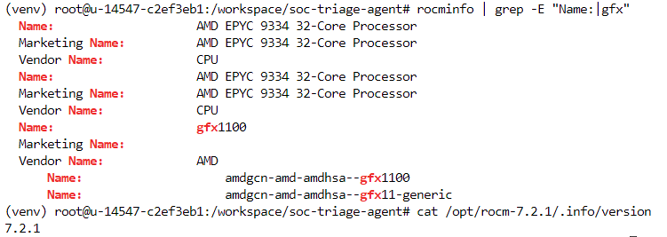

Slide 5
Core capabilities — 5 of 5 implemented
✓
Local knowledge retrieval (RAG)
Keyword-scored retrieval over a local MITRE ATT&CK / CVE corpus — zero external dependencies.
✓
Tool invocation
Agent calls Wazuh, Suricata, and Greenbone connectors as needed to enrich an alert.
✓
Multi-step task planning
Retrieve context → decide on tool calls → re-prompt with results → final recommendation.
✓
Multi-turn memory
Bounded conversation buffer lets an analyst ask follow-up questions with context retained.
✓
Permission control & privacy
Role-based field redaction applied before any alert data reaches the LLM.

Slide 6
Model & local deployment
Qwen3-8B
vLLM
gfx1100
ROCm 7.2.1
Instruct — base model
OpenAI-compatible serving
AMD Radeon RDNA3 GPU
Compute platform
Deployment
Deploy type: vLLM Model API on Radeon Cloud
Serve command: vllm serve <model> --host 0.0.0.0 --port 8000
Development strategy: agent logic built and fully tested against a mock LLM client first, then wired to the live Radeon-served model
**Why Qwen3-8B, not a cloud API:** AMD's Token Factory (the free, cloud-hosted Model API) requires a mainland China phone number for account verification, which wasn't available to us. Rather than depend on a cloud API we couldn't even register for, this reinforced the case for genuine local deployment — Qwen3-8B was downloadable via ModelScope (reachable from the sandbox network, unlike huggingface.co) with no account gating at all, letting the entire inference pipeline run privately, on the Radeon GPU itself, exactly as Track 2 asks for.

Slide 7
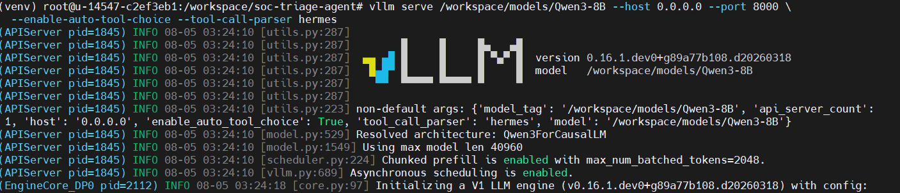
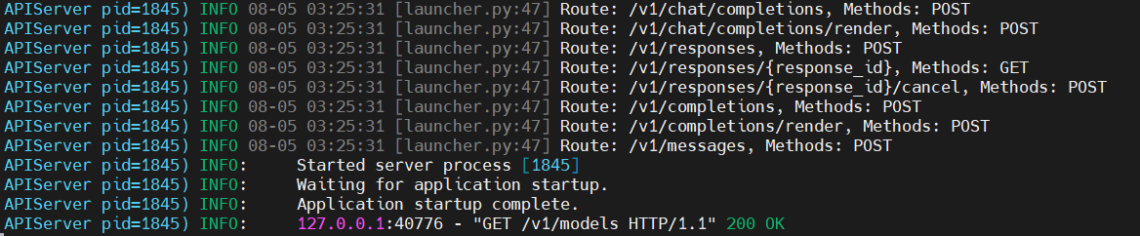

Slide 8
Demo scenario
A correlated SSH brute-force incident, triaged end to end
1
2
3
4
Alert received
Context retrieved
Tool called
Recommendation
Wazuh + Suricata both flag repeated SSH failures from the same source IP.
Agent's RAG layer surfaces MITRE T1110 — Brute Force.
Greenbone lookup finds a matching OpenSSH CVE (regreSSHion) on the target host.
Block source IP, check for successful logins, escalate if host is externally facing.

Slide 9
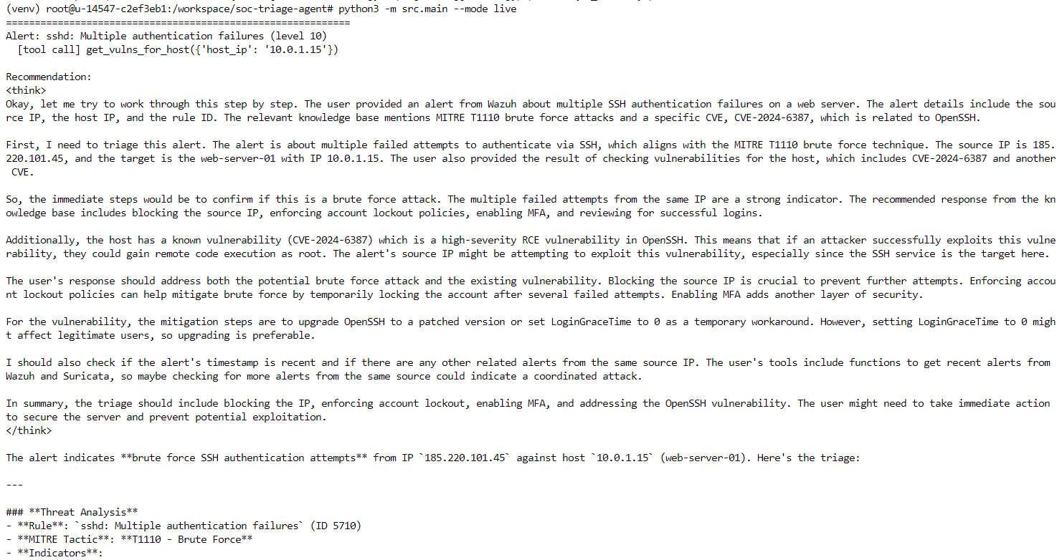

Slide 10
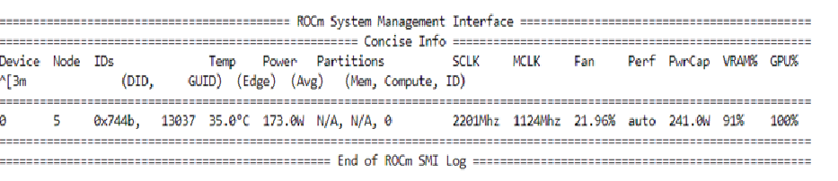
Radeon GPU optimization
1
Serving approach
vLLM's PagedAttention and continuous batching run natively on ROCm, so the model is served directly on the Radeon GPU (gfx1100) without a translation layer.
2
Verified GPU execution
rocm-smi confirms GPU utilization rises during inference requests — demonstrated live in the demo video, not simulated.
Benchmarking
Throughput and latency benchmarks (tokens/sec, time-to-first-token) measured directly on the Radeon Cloud instance are included in the Project Specification Document alongside this deck.

Slide 11
Private, local, on Radeon.
5 of 5 core capabilities implemented and verified end to end.
github.com/yohanesfc/Track2-yohanesfc-soc-triage-agent

