Slide 1
Chapter 6
Chemical Reactions: An Introduction
Copyright ©2019 Cengage Learning. All Rights Reserved. May not be scanned, copied or duplicated, or posted to a publicly accessible website, in whole or in part.

Slide 2
What are the clues that a chemical change has taken place?
Chemical reactions often give visual signals
However, reactions are not always visible

Slide 3
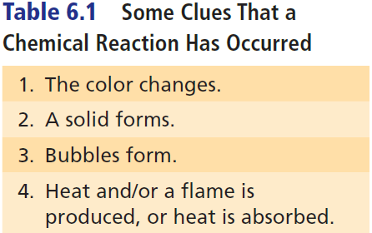
Some Clues That a Chemical Reaction Has Occurred

Slide 4
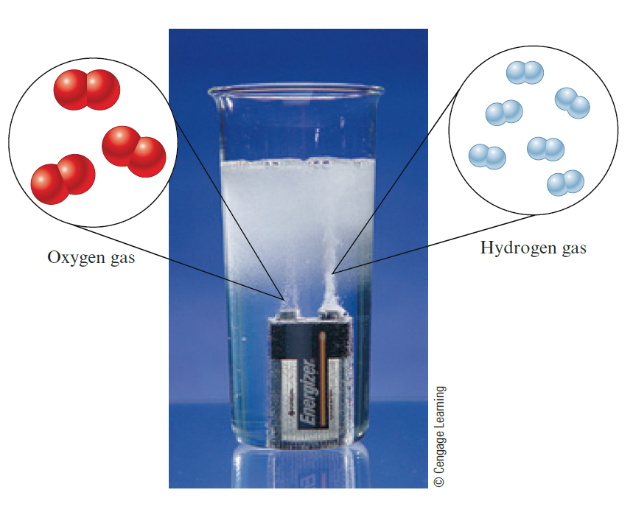
Exercise, 1
Identify a clue that indicates a reaction has occurred in the given image
a) The color changes
b) A solid forms
c) Bubbles are present
d) A flame is produced
Notes:
The answer is c. The formation of bubbles, a gas, is a sign that a chemical reaction has taken place.

Slide 5
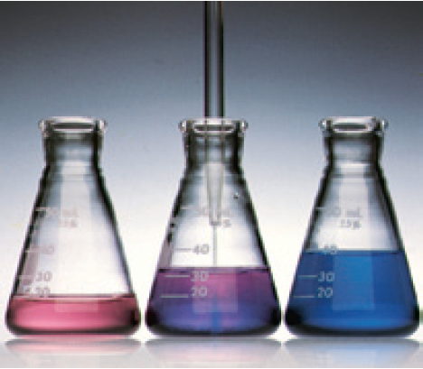
Exercise, 2
Identify a clue that indicates a reaction has occurred in the statement and in the given image
“Colorless hydrochloric acid is added to a red solution of cobalt(II) nitrate, turning the solution blue”
a) The color changes
b) A solid forms
c) Bubbles are present
d) A flame is produced
Notes:
The answer is a. The solution turning blue is a sign that a chemical reaction has taken place.

Slide 6
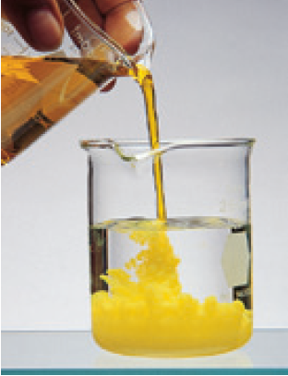
Exercise, 3
Identify a clue that indicates a reaction has occurred in the statement and in the given image
“A solid forms when a solution of sodium dichromate is added to a solution of lead nitrate”
a) A gas forms
b) A solid forms
c) Bubbles are present
d) A flame is produced
Notes:
The answer is b. The formation of a yellow solid is a sign that a chemical reaction has taken place.

Slide 7
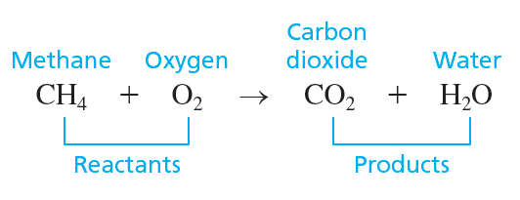
Chemical Reactions
Chemical reactions involve changing the ways in which the atoms in compounds are grouped
A chemical equation represents a chemical reaction
Reactants are shown to the left of the arrow
Products are shown to the right of the arrow

Slide 8
Chemical Reactions (continued)
In a chemical reaction, atoms are neither created nor destroyed
All atoms present in the reactants must be accounted for among the products
There must be same number of each type of atom on both sides of the arrow

Slide 9
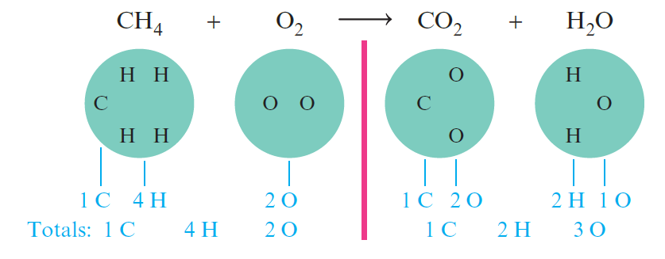
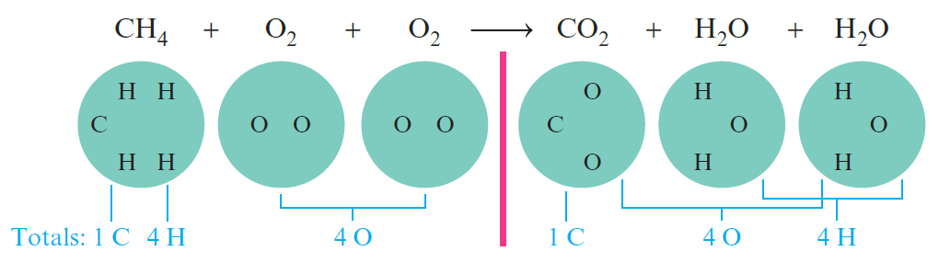
Balancing a Chemical Equation
Unbalanced equation
Balancing the equation
The balanced equation CH₄ + 2O₂ → CO₂ + 2H₂O

Slide 10
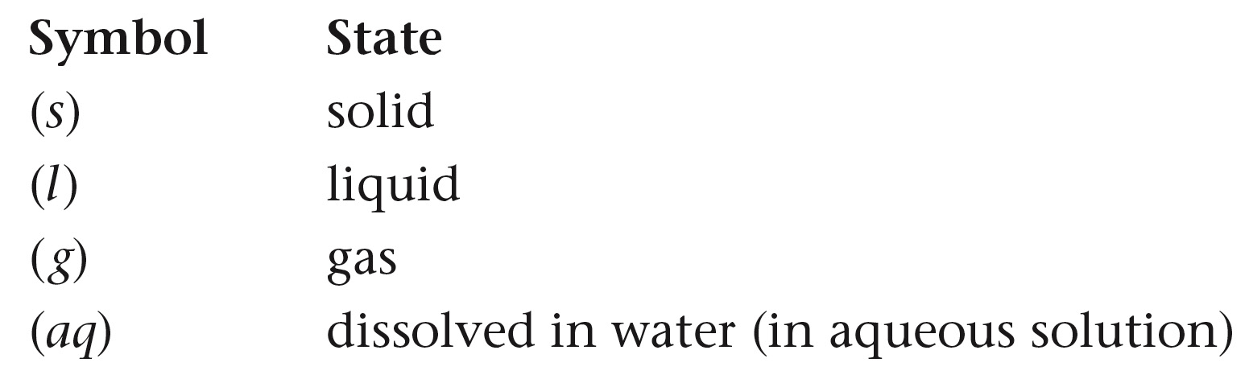
Physical States
Physical states of compounds are often given in a chemical equation

Slide 11
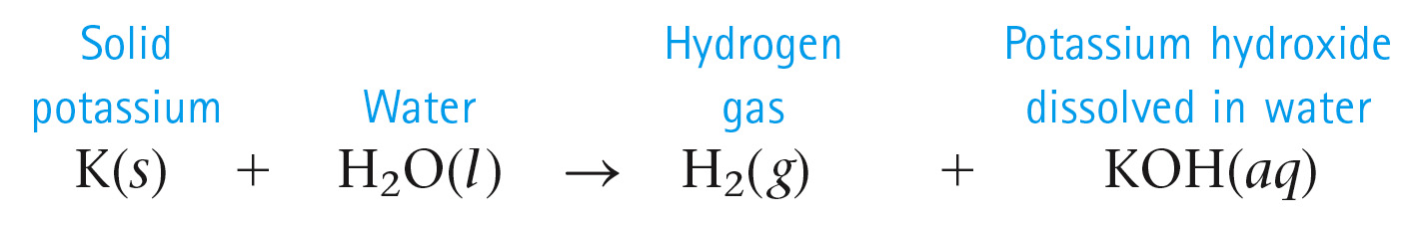
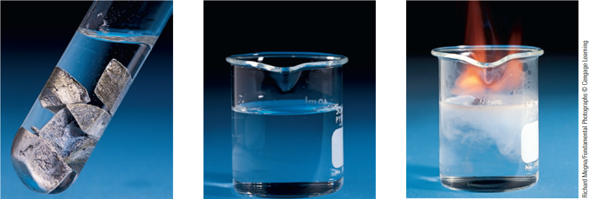
Example

Slide 12
Exercise, 4
When blue light shines on a mixture of hydrogen gas and chlorine gas, the elements react explosively to form gaseous hydrochloric acid. What is the unbalanced equation for this process?
a) H₂(g) + CH₄(g) → HCl(g)
b) HCl(g) → H(g) + Cl(g)
c) H(g) + Cl(g) → HCl(g)
d) H₂(g) + Cl₂(g) → HCl(g)
Notes:
The answer is d. Notice that the reactants hydrogen and chlorine are both diatomic gases. We have only one product that is hydrochloric acid.

Slide 13
Writing a Balanced Equation for a Chemical Reaction
The principle that lies at the heart of the balancing process is that atoms are conserved in a chemical reaction
Atoms are neither created nor destroyed
The same number of each type of atom is found among the reactants and among the products

Slide 14
Writing a Balanced Equation for a Chemical Reaction (continued)
Chemists determine the identity of the reactants and products of a reaction by experimental observation
The identities or formulas of the compounds must never be changed when balancing a chemical equation

Slide 15
How to Write and Balance Equations
Read the description of the chemical reaction. Identify the reactants, the products, and their states. Write the appropriate formulas.
Hydrogen gas or H₂ and oxygen gas or O₂ combine to form liquid water or H₂O
Write the unbalanced equation that summarizes the information from the previous step
H₂(g) + O₂(g) → H₂O(l)

Slide 16
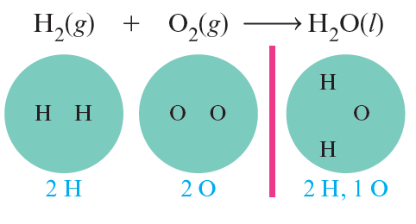
How to Write and Balance Equations (continued 1)
Balance the equation by inspection, starting with the most complicated molecule
We can see that the equation is unbalanced by counting the atoms on both sides of the arrow

Slide 17
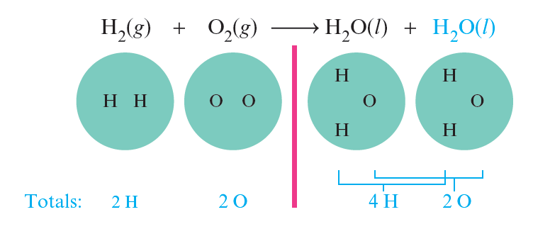
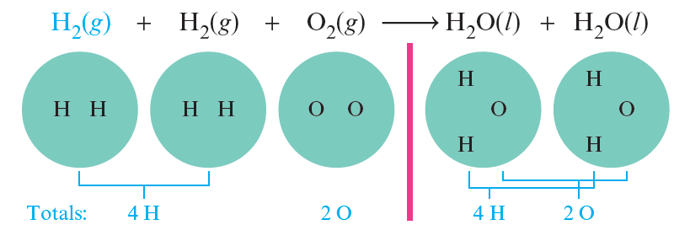
How to Write and Balance Equations (continued 2)
Balance the equation by inspection, starting with the most complicated molecule
We must balance the equation by adding more molecules of reactants and/or products

Slide 18
How to Write and Balance Equations (continued 3)
Check to see that the coefficients used give the same number of each type of atom on both sides of the arrow. Also, check to see that the coefficients used are the smallest integers that give the balanced equation.
The balanced equation is:
2H₂(g) + O₂(g) → 2H₂O(l)
or could be:
4H₂(g) + 2O₂(g) → 4H₂O(l)
preferred

Slide 19
Exercise, 5
Balance the following equation in standard form or lowest multiple integers, and determine the sum of the coefficients
FeO(s) + O₂(g) → Fe₂O₃(s)
a) 3
b) 4
c) 7
d) 14
Notes:
The answer is c. The balanced equation is:
4FeO(s) + O₂(g) → 2Fe₂O₃(s). The sum of the coefficients is therefore 4 + 1 + 2 = 7.

Slide 20
Exercise, 6
Which of the following equations correctly balance the chemical equation given below? There may be more than one correct balanced equation. If a balanced equation is incorrect, explain what is incorrect about it.
CaO + C → CaC₂ + CO₂
I. CaO₂ + 3C → CaC₂ + CO₂
II. 2CaO + 5C → 2CaC₂ + CO₂
III. CaO + (2.5)C → CaC₂ + (0.5)CO₂
IV. 4CaO + 10C → 4CaC₂ + 2CO₂
Notes:
II, III, and IV are correct. I is not correct because you cannot use subscripts to balance a chemical equation.

Slide 21
Exercise, 7
Of the three that are correct, which one is preferred most (the most accepted convention)? Why?
CaO + C → CaC₂ + CO₂
I. CaO₂ + 3C → CaC₂ + CO₂
II. 2CaO + 5C → 2CaC₂ + CO₂
III. CaO + (2.5)C → CaC₂ + (0.5)CO₂
IV. 4CaO + 10C → 4CaC₂ + 2CO₂
Notes:
II is preferred most (most accepted convention) because it is the balanced equation with the smallest integers (whole numbers).

Slide 22
Concept Check
In the context of balancing a chemical equation, which of the following statements is false?
a) Subscripts in the reactants must be conserved in the products
b) Coefficients are used to balance the atoms on both sides
c) When one coefficient is doubled, the rest of the coefficients in the balanced equation must also be doubled
d) Phases are often shown for each compound but are not critical to balancing an equation
Notes:
The answer is a. Subscripts in the reactants do not have to be conserved in the products to balance the equation. Coefficients are used to balance the atoms on both sides. For example:
2H₂(g) + O₂(g) → 2H₂O(g).
Balancing using subscripts will change the compounds.

Slide 23
Notice
The number of atoms of each type of element must be the same on both sides of a balanced equation
Subscripts must not be changed to balance an equation
A balanced equation tells us the ratio of the number of molecules that react and are produced in a chemical reaction
Coefficients can be fractions, although they are usually the lowest integer multiples

