Slide 1
Chapter 9
Chemical Quantities
Copyright ©2019 Cengage Learning. All Rights Reserved. May not be scanned, copied or duplicated, or posted to a publicly accessible website, in whole or in part.

Slide 2
Understanding the Molecular and Mass Information in a Balanced Equation
Balanced chemical equation gives the amount of reactant and product molecules that participate in a chemical reaction
Coefficients in a balanced equation give the relative numbers of molecules

Slide 3
Understanding the Molecular and Mass Information in a Balanced Equation (continued)
C₂H₅OH + 3O₂ → 2CO₂ + 3H₂O
Equation is balanced
All atoms present in the reactants are accounted for in the products
1 molecule of ethanol reacts with 3 molecules of oxygen to produce 2 molecules of carbon dioxide and 3 molecules of water
1 mole of ethanol reacts with 3 moles of oxygen to produce 2 moles of carbon dioxide and 3 moles of water

Slide 4
Concept Check, 1
The following reaction represents one of the key steps in the production of pure copper from copper ores:
Cu₂S(s) + Cu₂O(s) → Cu(s) + SO₂(g) (unbalanced)

Slide 5
Concept Check, 1 (continued)
After balancing the reaction, determine how many dozens of copper atoms can be produced from a dozen molecules of the sulfide and two dozen molecules of the oxide of copper(I). Also, how many moles of copper can be produced from one mole of the sulfide and two moles of the oxide?
a) 1 dozen and 1 mole
b) 2 dozens and 2 moles
c) 3 dozens and 3 moles
d) 6 dozens and 6 moles
Notes:
The correct answer is d. The balanced equation is: Cu₂S(s) + 2Cu₂O(s) → 6Cu(s) + SO₂(g)

Slide 6
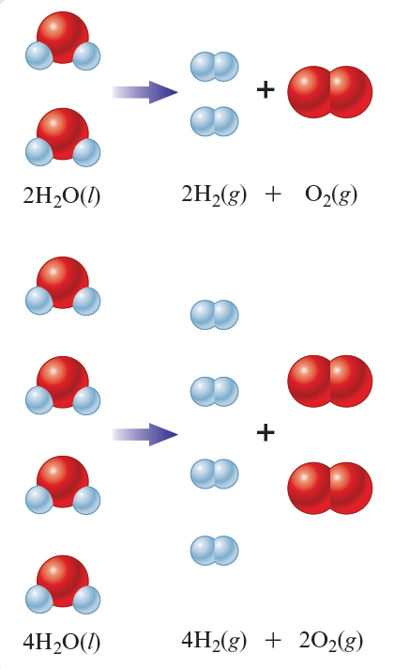
Relationship between Moles of Reactants and Moles of Products
Balanced equations can predict the moles of products that a given number of moles of reactants will yield
2 moles of H₂O yields 2 moles of H₂ and 1 mole of O₂
4 mol H₂O yields 4 mol H₂ and 2 mol O₂

Slide 7
Mole Ratio
Allows us to convert from moles of one substance in a balanced equation to moles of a second substance in the equation

Slide 8
Example, 1
Consider the following balanced equation:
Na₂SiF₆(s) + 4Na(s) → Si(s) + 6NaF(s)
How many moles of NaF will be produced if 3.50 moles of Na is reacted with excess Na₂SiF₆?
Where Are We Going?
We want to determine the number of moles of NaF produced when 3.50 moles of Na reacts with excess Na₂SiF₆
What Do We Know?
Balanced equation
We start with 3.50 mol Na

Slide 9
Example, 1 (continued)
Consider the following balanced equation:
Na₂SiF₆(s) + 4Na(s) → Si(s) + 6NaF(s)
How many moles of NaF will be produced if 3.50 moles of Na is reacted with excess Na₂SiF₆?
How Do We Get There?

Slide 10
Exercise, 1
Propane, C₃H₈, is a common fuel used for heating in rural areas. Predict the number of moles of CO₂ formed when 3.74 moles of propane is burned in excess oxygen.
C₃H₈ + 5O₂ → 3CO₂ + 4H₂O
a) 11.2 moles
b) 7.48 moles
c) 3.74 moles
d) 1.25 moles
Notes:
The correct answer is a.
(3.74 mol C₃H₈) × (3 mol CO₂/1 mol C₃H₈) = 11.2 mol CO₂

Slide 11
Steps for Calculating the Masses of Reactants and Products in Chemical Reactions
Balance the equation for the reaction
Convert the masses of reactants or products to moles
Use the balanced equation to set up the appropriate mole ratio(s)
Use the mole ratio(s) to calculate the number of moles of the desired reactant or product
Convert from moles back to masses

Slide 12
Stoichiometry
Process of using a balanced chemical equation to calculate the relative masses of reactants and products involved in a reaction

Slide 13
Example, 2
For the following unbalanced equation:
Cr(s) + O₂(g) → Cr₂O₃(s)
How many grams of chromium(III) oxide can be produced from 15.0 g of solid chromium and excess oxygen?
Where Are We Going?
We want to determine the mass of Cr₂O₃ produced by the reaction of 15.0 g Cr with excess O₂

Slide 14
Example, 2 (continued 1)
For the following unbalanced equation:
Cr(s) + O₂(g) → Cr₂O₃(s)
How many grams of chromium(III) oxide can be produced from 15.0 g of solid chromium and excess oxygen?
What Do We Know?
Unbalanced equation
We start with 15.0 g Cr
We know from the periodic table that the atomic masses of chromium and oxygen are 52.00 g/mol and 16.00 g/mol, respectively

Slide 15
Example, 2 (continued 2)
For the following unbalanced equation:
Cr(s) + O₂(g) → Cr₂O₃(s)
How many grams of chromium(III) oxide can be produced from 15.0 g of solid chromium and excess oxygen?
What Do We Need To Know?
We need to know the balanced equation
4Cr(s) + 3O₂(g) → 2Cr₂O₃(s)
We need the molar mass of Cr₂O₃
152.00 g/mol

Slide 16
Example, 2 (continued 3)
How Do We Get There?
4Cr(s) + 3O₂(g) → 2Cr₂O₃(s)
Convert the mass of Cr to moles of Cr
Using the mole ratio from the balanced equation, determine the moles of Cr₂O₃ produced

Slide 17
Example, 2 (continued 4)
How Do We Get There?
4Cr(s) + 3O₂(g) → 2Cr₂O₃(s)
Convert moles of Cr₂O₃ to grams of Cr₂O₃
Conversion string

Slide 18
Exercise, 2
Tin(II) fluoride is added to some dental products to help prevent cavities. Tin(II) fluoride is prepared according to the following equation:
Sn(s) + 2HF(aq) → SnF₂(aq) + H₂(g)
How many grams of tin(II) fluoride can be produced from 55.0 g of hydrogen fluoride if there is plenty of tin available to react?
a) 431 g
b) 215 g
c) 72.6 g
d) 1.37 g
Notes:
The correct answer is b.
(55.0 g HF) × (1 mol HF/20.008 g HF) × (1 mol SnF₂/2 mol HF) × (156.71 g SnF₂/1 mol SnF₂) = 215 g SnF₂

Slide 19
Exercise, 3
Consider the following reaction:
PCl₃ + 3H₂O → H₃PO₃ + 3HCl
What mass of H₂O is needed to completely react with 20.0 g of PCl₃?
7.87 g
0.875 g
5.24 g
2.62 g
Notes:
The correct answer is a.
(20.0 g PCl₃) × (1 mol PCl₃/137.32 g PCl₃) × (3 mol H₂O/1 mol PCl₃) × (18.016 g H₂O/1 mol H₂O) = 7.87 g H₂O

Slide 20
Exercise, 4
Consider the following reaction where X represents an unknown element:
6X(s) + 2B₂O₃(s) → B₄X₃(s) + 3XO₂(g)
If 175 g of X reacts with diboron trioxide to produce 2.43 moles of B₄X₃, what element does X represent?
a) Ge
b) Mg
c) Si
d) C
Notes:
The correct answer is d. X is carbon.
(2.43 mol B₄X₃) × (6 mol X / 1 mol B₄X₃) = 14.6 mol X
Molar Mass = # grams / # moles = 175 g X / 14.6 mol X = 12.0 g/mol

Slide 21
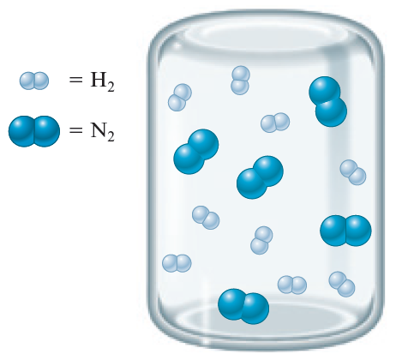
Stoichiometric Mixture
Contains the relative amounts of reactants that match the numbers in a balanced equation
N₂(g) + 3H₂(g) → 2NH₃(g)

Slide 22
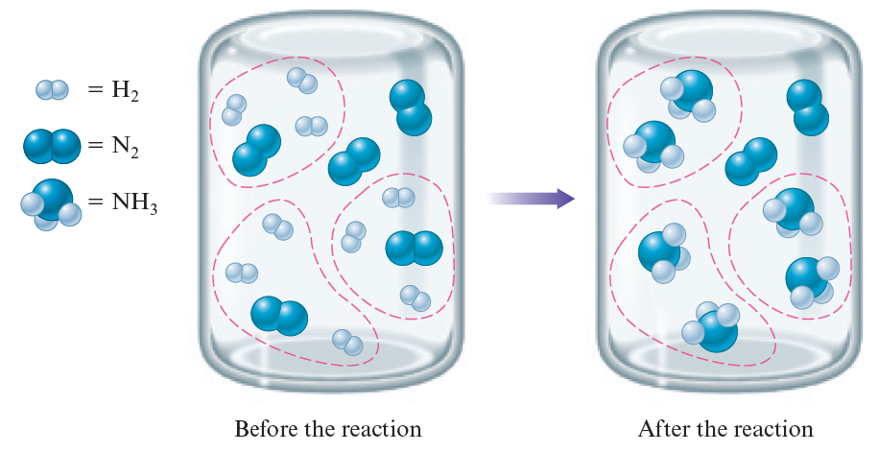
Limiting Reactant Mixture
N₂(g) + 3H₂(g) → 2NH₃(g)

Slide 23
Limiting Reactant Mixture (continued)
N₂(g) + 3H₂(g) → 2NH₃(g)
Limiting reactant or reagent is the reactant that runs out first and thus limits the amounts of products that can form
H₂ is the limiting reactant for the reaction shown above

Slide 24
Limiting Reactants
Determine which reactant is limiting to calculate the amounts of products that will be formed
Methane and water will react to form products according to the following equation:
CH₄ + H₂O → 3H₂ + CO

Slide 25
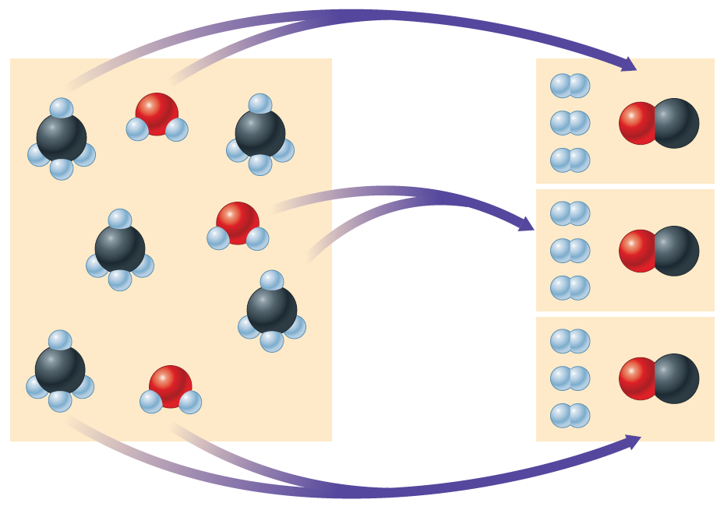
Limiting Reactants (continued 1)
H₂O molecules are used up first, leaving two unreacted CH₄ molecules

Slide 26
Limiting Reactants (continued 2)
Amount of products that can form is limited by the water
Water is the limiting reactant
Methane is in excess

Slide 27
Steps for Solving Stoichiometry Problems Involving Limiting Reactants by Solving for Limiting Reactant First (Approach A)
Write and balance the equation for the reaction
Convert known masses of reactants to moles
Using the numbers of moles of reactants and the appropriate mole ratios, determine which reactant is limiting
Using the amount of the limiting reactant and the appropriate mole ratio, compute the number of moles of the desired product
Convert from moles of product to grams of product, using the molar mass, if this is required by the problem

Slide 28
Example, 3, Approach A
You know that chemical A reacts with chemical B
You react 10.0 g of A with 10.0 g of B
What information do you need to know in order to determine the amount of product that will be produced?

Slide 29
Let’s Think About It (Approach A)
Where Are We Going?
To determine the mass of product that will be produced when you react 10.0 g of A with 10.0 g of B
What Do We Need To Know?
Mole ratio between the reactants and the products
In other words, we need to know the balanced equation
Molar masses of A, B, and the product they form

Slide 30
Example, 3, Approach A (continued 1)
You react 10.0 g of A with 10.0 g of B. Given that the molar mass of A is 10.0 g/mol, B is 20.0 g/mol, and C is 25.0 g/mol, what will be the mass of the product produced?
They react according to the equation:
A + 3B → 2C

Slide 31
Example, 3, Approach A (continued 2)
You react 10.0 g of A with 10.0 g of B. Given that the molar mass of A is 10.0 g/mol, B is 20.0 g/mol, and C is 25.0 g/mol, what will be the mass of the product produced?
They react according to the equation:
A + 3B → 2C
How Do We Get There?
Convert known masses of reactants to moles

Slide 32
Example, 3, Approach A (continued 3)
You react 10.0 g of A with 10.0 g of B. Given that the molar mass of A is 10.0 g/mol, B is 20.0 g/mol, and C is 25.0 g/mol, what will be the mass of the product produced?
They react according to the equation:
A + 3B → 2C
How Do We Get There?
Determine which reactant is limiting
Only 0.500 mol B is available, so B is the limiting reactant

Slide 33
Example, 3, Approach A (continued 4)
You react 10.0 g of A with 10.0 g of B. Given that the molar mass of A is 10.0 g/mol, B is 20.0 g/mol, and C is 25.0 g/mol, what will be the mass of the product produced?
They react according to the equation:
A + 3B → 2C
How Do We Get There?
Compute the number of moles of C produced

Slide 34
Example, 3, Approach A (continued 5)
You react 10.0 g of A with 10.0 g of B. Given that the molar mass of A is 10.0 g/mol, B is 20.0 g/mol, and C is 25.0 g/mol, what mass of product will be produced?
They react according to the equation:
A + 3B → 2C
How Do We Get There?
Convert from moles of C to grams of C using the molar mass

Slide 35
Notice
We cannot simply add the total moles of all the reactants to decide which reactant mixture makes the most product
We must always think about how much product can be formed by using what we are given and the ratio in the balanced equation

Slide 36
Steps for Solving Stoichiometry Problems Involving Limiting Reactants by Determining the Number of Moles of Product First, Approach B
Write and balance the equation for the reaction
Convert known masses of reactants to moles
Using the appropriate mole ratios, compute the numbers of moles of product formed if each reactant were consumed
Choose the least number of moles of product formed
Convert from moles of product to grams of product, using the molar mass, if this is required by the problem

Slide 37
Example, 3, Approach B
You know that chemical A reacts with chemical B
You react 10.0 g of A with 10.0 g of B
What information do you need to know in order to determine the amount of product that will be produced?

Slide 38
Let’s Think About It (Approach B)
Where Are We Going?
To determine the mass of product that will be produced when you react 10.0 g of A with 10.0 g of B
What Do We Need To Know?
Mole ratio between the reactants and the products
In other words, we need to know the reaction’s balanced equation
Molar masses of A, B, and the product they form

Slide 39
Example, 3, Approach B (continued 1)
You react 10.0 g of A with 10.0 g of B. Given that the molar mass of A is 10.0 g/mol, B is 20.0 g/mol, and C is 25.0 g/mol, what will be the mass of the product produced?
They react according to the equation:
A + 3B → 2C

Slide 40
Example, 3, Approach B (continued 2)
You react 10.0 g of A with 10.0 g of B. Given that the molar mass of A is 10.0 g/mol, B is 20.0 g/mol, and C is 25.0 g/mol, what will be the mass of the product produced?
They react according to the equation:
A + 3B → 2C
How Do We Get There?
Convert known masses of reactants to moles

Slide 41
Example, 3, Approach B (continued 3)
You react 10.0 g of A with 10.0 g of B. Given that the molar mass of A is 10.0 g/mol, B is 20.0 g/mol, and C is 25.0 g/mol, what will be the mass of the product produced?
They react according to the equation:
A + 3B → 2C
How Do We Get There?
Compute the number of moles of product formed from each reactant

Slide 42
Example, 3, Approach B (continued 4)
You react 10.0 g of A with 10.0 g of B. Given that the molar mass of A is 10.0 g/mol, B is 20.0 g/mol, and C is 25.0 g/mol, what will be the mass of the product produced?
They react according to the equation:
A + 3B → 2C
How Do We Get There?
Choose the least number of moles of product formed

Slide 43
Example, 3, Approach B (continued 5)
You react 10.0 g of A with 10.0 g of B. Given that the molar mass of A is 10.0 g/mol, B is 20.0 g/mol, and C is 25.0 g/mol, what will be the mass of the product produced?
They react according to the equation:
A + 3B → 2C
How DO We Get There?
Convert from moles of C to grams of C using the molar mass

Slide 44
Concept Check, 2
Which of the following reaction mixtures would produce the greatest amount of product, assuming all went to completion? Each involves the reaction symbolized by the equation:
2H₂ + O₂ → 2H₂O
a) 2 moles of H₂ and 2 moles of O₂
2 moles of H₂ and 3 moles of O₂
2 moles of H₂ and 1 mole of O₂
d) 3 moles of H₂ and 1 mole of O₂
e) Each produce the same amount of product
Notes:
The correct answer is e. All of these reaction mixtures would produce two moles of water.

Slide 45
Concept Check, 3
Consider the equation: A + 3B → 4C. If 3.0 moles of A is reacted with 6.0 moles of B, which of the following is true after the reaction is complete?
a) A is the leftover reactant because you only need 2 moles of A and have 3 moles
b) A is the leftover reactant because for every 1 mole of A, 4 moles of C are produced
c) B is the leftover reactant because you have more moles of B than A
d) B is the leftover reactant because 3 moles of B react with every 1 mole of A
Notes:
The correct answer is a.
(6.0 mol B) × (1 mol A/3 mol B) = 2.0 mol A needed

Slide 46
Exercise, 5
How many grams of NH₃ can be produced from the mixture of 3.00 g each of nitrogen and hydrogen by the Haber process?
N₂ + 3H₂ → 2NH₃
a) 2.00 g
b) 3.00 g
c) 3.65 g
d) 1.82 g
Notes:
The correct answer is c. Nitrogen is the limiting reactant.
(0.107 mol N₂) × (2 mol NH₃/1 mol N₂) × (17.034 g NH₃/1 mol NH₃) = 3.65 g NH₃

Slide 47
Percent Yield
Important indicator of the efficiency of a particular laboratory or industrial reaction
Comparison of the actual yield of a product to its theoretical yield

Slide 48
Percent Yield (continued 1)
Theoretical Yield
The maximum amount of a given product that can be formed when the limiting reactant is completely consumed
The amount of product actually obtained
Actual yield, or the amount actually produced, of a reaction is usually less than the maximum expected, or theoretical yield

Slide 49
Percent Yield (continued 2)
Actual amount of a given product as a percentage of the theoretical yield is given by

Slide 50
Example, 3, Recall
You react 10.0 g of A with 10.0 g of B. Given that the molar mass of A is 10.0 g/mol, B is 20.0 g/mol, and C is 25.0 g/mol, what will be the mass of the product produced?
They react according to the equation:
A + 3B → 2C
We determined that 8.33 g C should be produced. 7.23 g of C is what was actually made in the lab. What is the percent yield of the reaction?
What Do We Know?
We know the actual and theoretical yields

Slide 51
Example, 3, Recall (continued)
You react 10.0 g of A with 10.0 g of B. Given that the molar mass of A is 10.0 g/mol, B is 20.0 g/mol, and C is 25.0 g/mol, what will be the mass of the product produced?
They react according to the equation:
A + 3B → 2C
We determined that 8.33 g C should be produced. 7.23 g of C is what was actually made in the lab. What is the percent yield of the reaction?
How Do We Get There?

Slide 52
Exercise, 6
Consider the reaction 2S + 3O₂ → 2SO₃
Find the percent yield of product if 1.50 g of SO₃ is produced from 1.00 g of O₂ and excess sulfur
a) 40.0%
b) 80.0%
c) 89.8%
d) 92.4%
Notes:
The correct answer is c. First, we find the maximum yield (theoretical yield) of product
(1.00 g O₂)(1 mol O₂ / 32.00 g O₂)(2 mol SO₃ / 3 mol O₂)(80.06 g SO₃ / 1 mol SO₃) = 1.67 g (theoretical yield)
We then divide the actual yield by the theoretical yield
Percent yield = (1.50 g/1.67 g) × 100 = 89.8%

Slide 53
Exercise, 7
Consider the following reaction:
P₄(s) + 6F₂(g) → 4PF₃(g)
What mass of P₄ is needed to produce 85.0 g of PF₃ if the reaction has a 64.9% yield?
a) 29.9 g
b) 46.1 g
c) 184 g
d) 738 g
Notes:
The correct answer is b.
64.9% = (85.0 g PF₃ / x)(100); x = 130.97 g PF₃
(130.97 g PF₃)(1 mol PF₃ / 87.97 g PF₃)(1 mol P₄ / 4 mol PF₃)(123.88 g P₄ / 1 mol P₄) = 46.1 g of P₄

