Slide 1
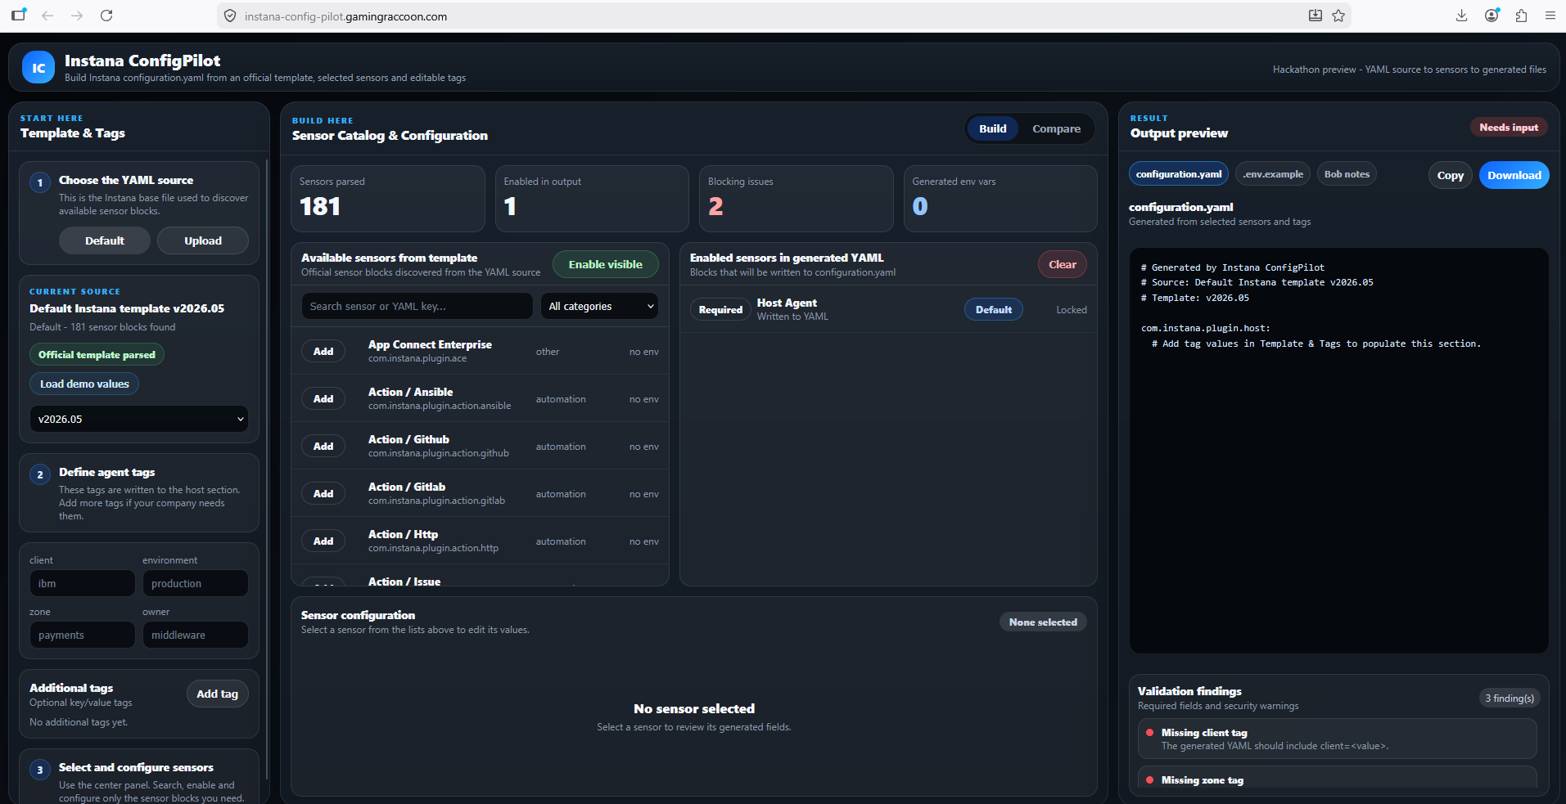
IBM Bob Hackathon
Instana
Config
Pilot
Generate, validate, compare, and export IBM Instana configuration YAML from a guided browser workflow.
Frontend-first delivery built with IBM Bob
Browser-based workflow: template -> sensors -> validation -> export

Slide 2
Manual Instana YAML editing is fragile
Large configuration files create operational risk before changes ever reach a real environment.
01
02
03
Syntax and indentation errors
Incomplete sensor fields
Hard-to-review changes
A single spacing mistake can break an otherwise valid sensor configuration.
Different servers and environments need different sensors, credentials, tags, and tuning values.
Teams need to understand exactly what changed before applying configuration.
Instana Config Pilot | IBM Bob Hackathon
02

Slide 3
A guided workflow from template to usable YAML
Instana Config Pilot turns configuration work into a repeatable browser flow.
Load template
Detect sensors
Configure fields
Validate risks
Export files
Detects com.instana.plugin.* blocks from Instana-style YAML
Generates .env.example placeholders for credentials
Builds a dynamic sensor catalog with known and unknown sensors
Flags missing required values and hardcoded-secret risks
Generates configuration.yaml without hand-editing indentation
Compares generated YAML against another file before review
Instana Config Pilot | IBM Bob Hackathon
03

Slide 4
The demo starts with a real Instana-style template
The frontend loads the template, discovers sensor blocks, and exposes the workflow in one screen.
Instana Config Pilot | IBM Bob Hackathon
04

Slide 5
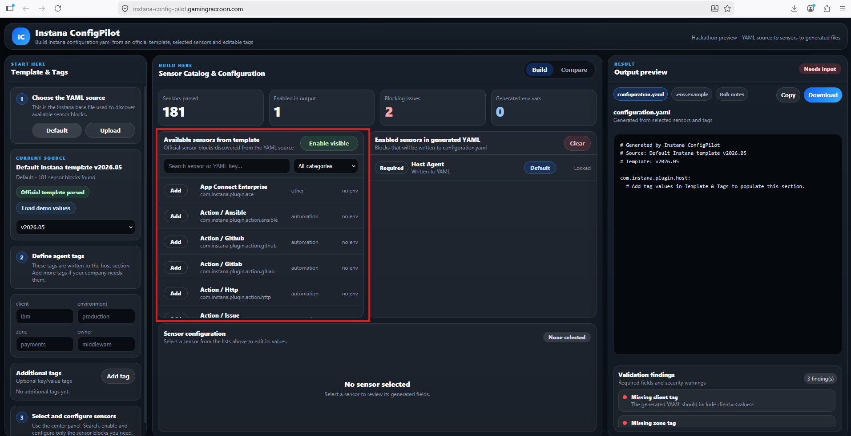
Sensor catalog: searchable, filterable, configurable
Known sensors get curated fields; unknown plugin blocks are still preserved through dynamic metadata.
What the user gets
Search and category filters
One-click sensor enablement
Required-field guidance
IBM MQ demo values for fast walkthrough
Instana Config Pilot | IBM Bob Hackathon
05

Slide 6
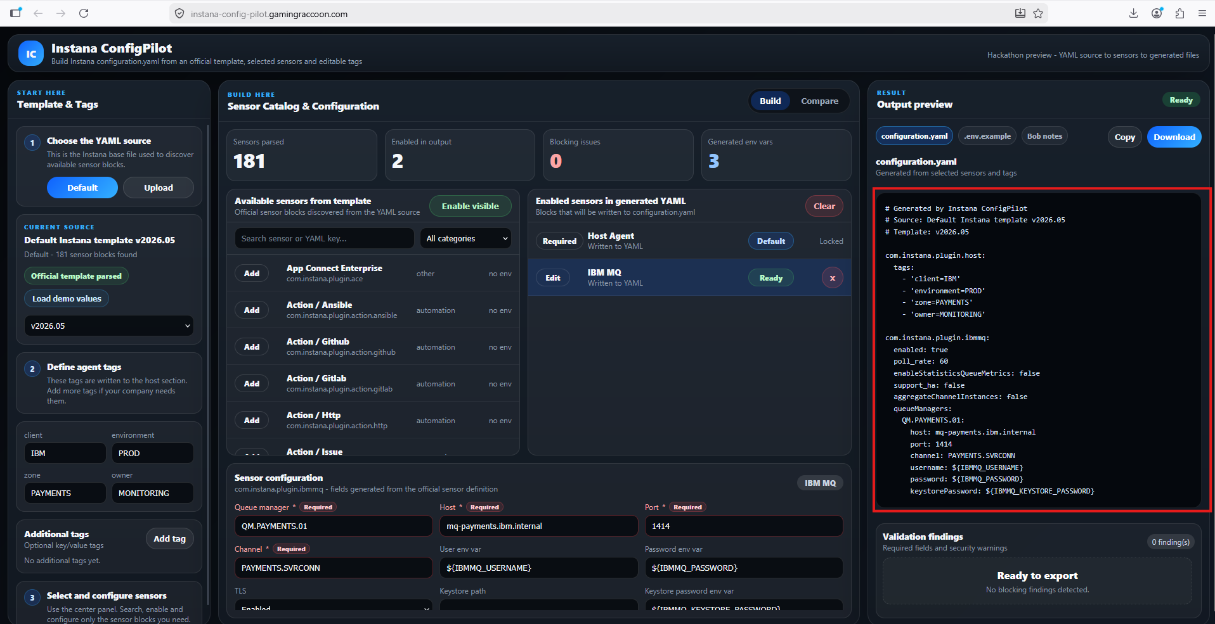
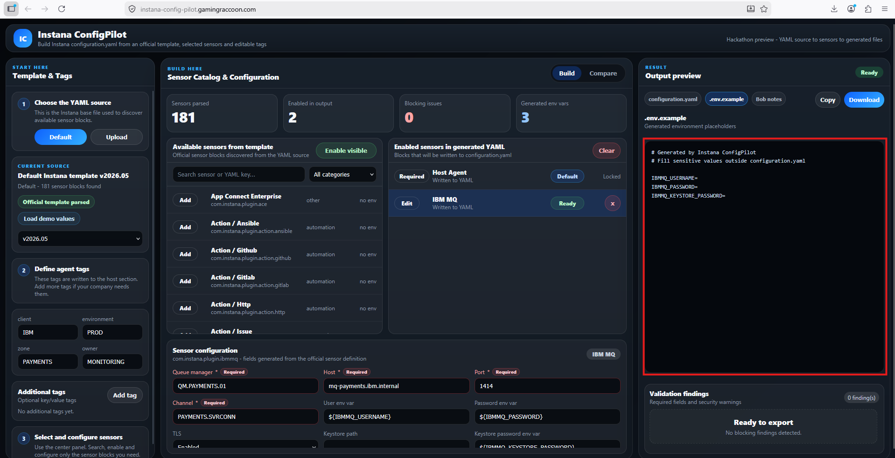
Generated outputs separate configuration from secrets
configuration.yaml carries structure; .env.example carries placeholders for sensitive values.
configuration.yaml
.env.example
Instana Config Pilot | IBM Bob Hackathon
06

Slide 7
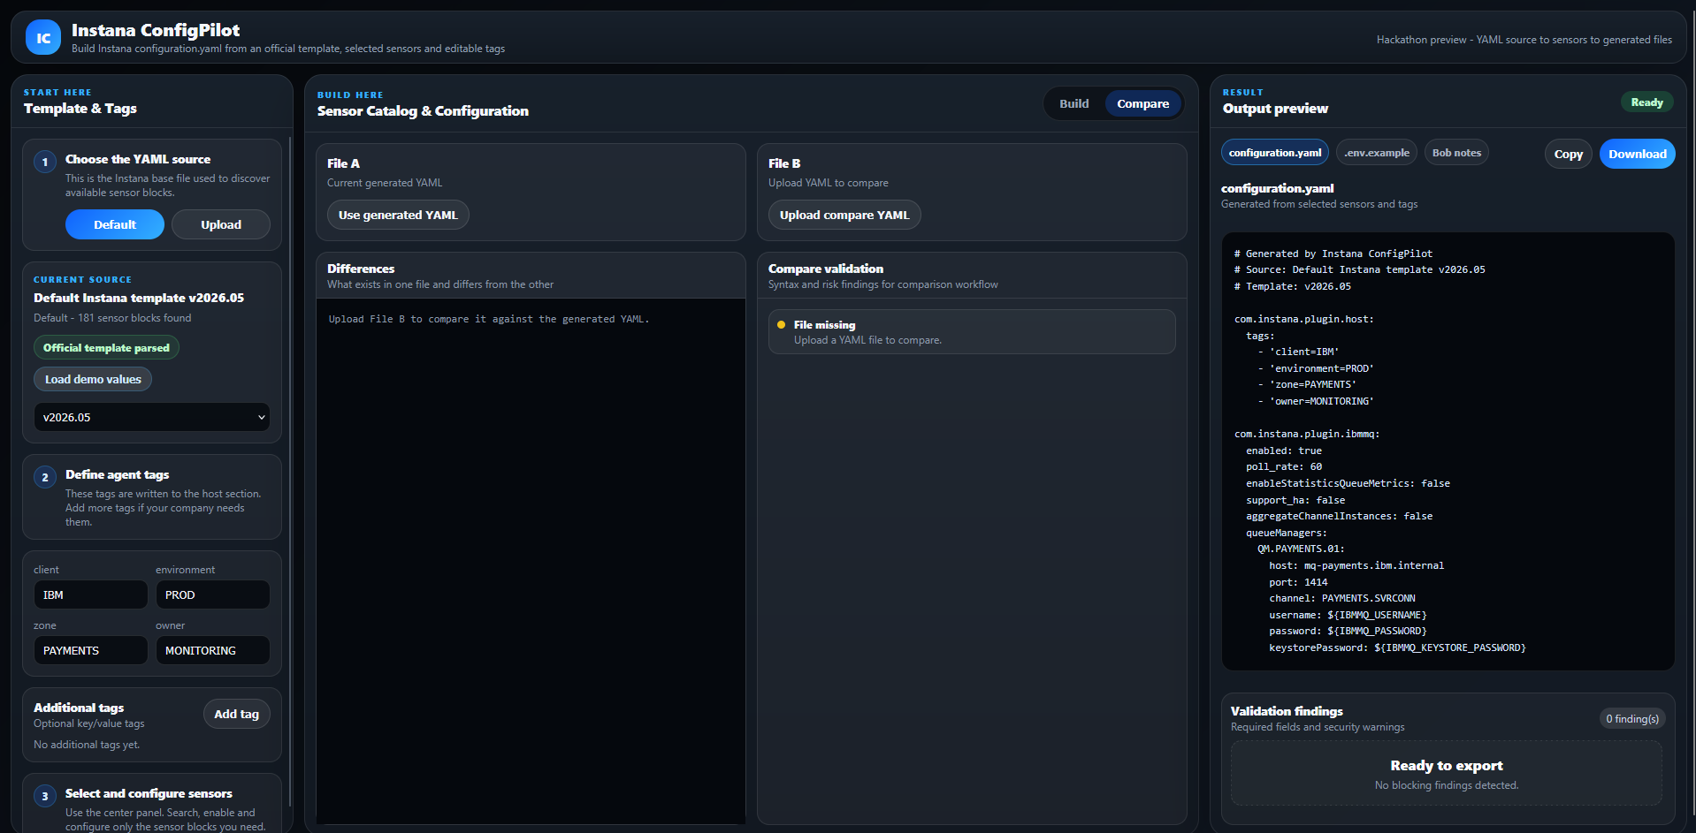
Compare mode makes configuration review visible
Before applying changes, teams can compare generated YAML against another candidate file.
Review before apply
Visual line-by-line diff
Candidate YAML validation
Clear A/B comparison for operators
Instana Config Pilot | IBM Bob Hackathon
07

Slide 8
IBM Bob was the development partner
Bob helped move from idea to architecture, implementation, refactor, and final documentation.
Bob IDE usage
Hackathon pivot
Architecture exploration and planning
The original plan included web + API + MCP. When BobCoins became a practical constraint, the team pivoted to a frontend-first MVP that preserved the core product value.
Frontend implementation and TypeScript refactor
Documentation, runbook, and submission prep
Task evidence exported to bob_sessions/
A working demo beat a broader unfinished architecture.
Instana Config Pilot | IBM Bob Hackathon
08

Slide 9
Final architecture: browser-first and static deployable
The functional delivery removes API dependency and keeps the Instana workflow local to the frontend.
Delivery scope
React + TypeScript + Vite
Static frontend served by Nginx
Client-side engines
Backend remains as reference/prototype code
sensorDetector -> sensorCatalog -> validator -> yamlGenerator -> envGenerator -> diffEngine
No production secrets or client data required
Future MCP/API path remains possible after MVP
Instana Config Pilot | IBM Bob Hackathon
09

Slide 10
Impact: safer configuration, faster review
A focused proof of concept for teams that manage Instana agent configuration.
What changes
Next steps
Less manual YAML editing
Add unit tests for frontend engines
More consistent operational tags
Improve nested YAML rendering for more sensors
Secrets pushed toward environment variables
Add frontend-only ZIP bundle export
Diffs visible before config reaches a server
Revisit API/MCP integration after MVP
Instana Config Pilot | IBM Bob Hackathon
10

